Slide 1
Algorithms
Lecture 35

Slide 2
Randomized algorithms

Slide 3
Randomized algorithms
Randomization can help in many settings
  Simpler algorithms
  More efficient algorithms
  Sometimes the only poly-time algorithms we know use randomization
  In some cases, solving a problem is only possible using randomization
However, it still does not (seem to) allow us to solve NP-complete problems in poly-time

Slide 4
Randomization
(At least) two ways to study randomization in the context of algorithms
  Analyze the performance of an algorithm on randomly generated input
    I.e., average-case (vs. worst-case) analysis
    Drawback: in many cases we don’t know the distribution inputs come from
  Analyze the performance of a randomized algorithm for all inputs

Slide 5
Randomization
Two ways to analyze the performance of a randomized algorithm
  Algorithm might only output a correct answer with some probability
    Interested in upper bounding the probability of getting the wrong answer
  Algorithm may always get the right answer, but have variable running time
    Interested in understanding the expected running time
    Interested in understanding the probability that the algorithm exceeds some running time

Slide 6
Randomization
Should you be concerned about an algorithm with a small probability of error?
Randomized algorithms are now standard

Slide 7
Are randomized algorithms possible?
Computers are inherently deterministic
Nevertheless, we can imagine algorithms that execute a fixed set of instructions while having the ability to “toss coins” (i.e., access a sequence of uniform bits)
  Note: random ≠ uniform, however very often these are used interchangeably

Slide 8
Random-number generation
Two steps:
  Continually collect a “pool” of high-entropy (i.e., “unpredictable”) data
  When random bits are requested, process the high-entropy data to generate a sequence of uniform, independent bits

Slide 9
Step 1
Collect a “pool” of high-entropy data
Must ultimately come from some physical process (since computation is deterministic)
  External inputs
    Keystroke/mouse movements
    Delays between network events
    Hard-disk access times
    Other external sources
  Hardware random-number generation (e.g., Intel)
  Quantum effects

Slide 10
Step 2: Smoothing
Need to eliminate both bias and dependencies
Ex: von Neumann approach for eliminating bias:
  Collect two bits per output bit
    01 -> 0
    10 -> 1
    00, 11 -> skip
  Note that this assumes independence (as well as constant bias)

Slide 11
Pseudorandomness
A small number of uniform bits can be used to generate a huge number of bits that are indistinguishable from uniform
  Take CMSC 456 to learn more!

Slide 12
Random-number generation
We will just assume algorithms have access to as many uniform, independent bits as needed

Slide 13
Probabilistic analysis
Part of the goal is for you to understand basic techniques of probabilistic analysis
  Will do proofs in detail
  Sometimes the proofs are more interesting than the application
You are responsible for understanding how to use these techniques
  I will try to highlight them as we encounter them
  I assume you have seen many of them before

Slide 14
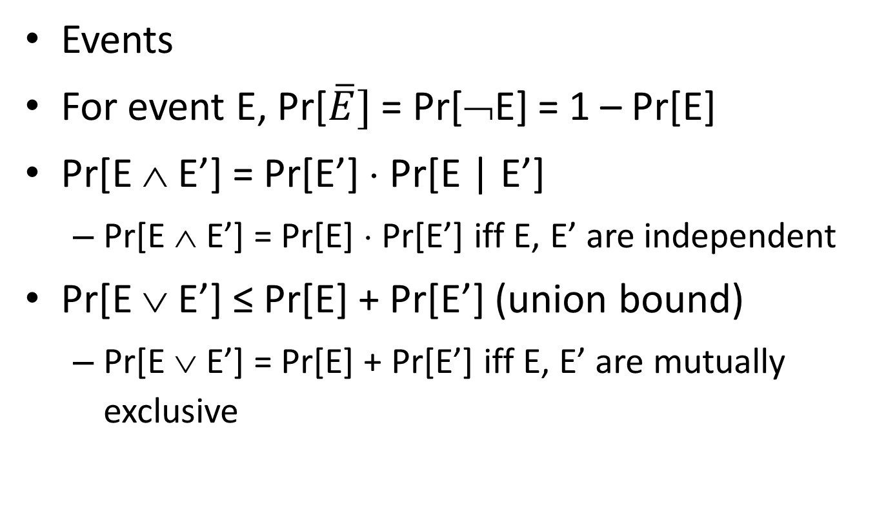
Basic probability facts
Events
For event E, Pr[$\overline{E}]$ = Pr[¬E] = 1 – Pr[E]
Pr[E ∧ E’] = Pr[E’] ⋅ Pr[E | E’]
  Pr[E ∧ E’] = Pr[E] ⋅ Pr[E’] iff E, E’ are independent
Pr[E ∨ E’] ≤ Pr[E] + Pr[E’] (union bound)
  Pr[E ∨ E’] = Pr[E] + Pr[E’] iff E, E’ are mutually exclusive

Slide 15
Basic probability facts
(Integer-valued) random variables
Exp[N] = Σ_{i} i ⋅ Pr[N=i]
Exp[N₁ + N₂] = Exp[N₁] + Exp[N₂] (linearity of expectation)

Slide 16
Contention resolution

Slide 17
Contention resolution
Imagine n identical machines trying to access some resource
  In each time step (round), each machine can attempt to access the resource or not
  A machine succeeds in some round iff it is the only one to attempt access in that round
Goal is for all machines to eventually access the resource
No deterministic algorithm is possible here!

Slide 18
Contention resolution
Say in each round, each machine tries to access the resource with probability p
Let A_{i,j} be the event that machine i attempts to access the resource in round j
  So Pr[A_{i,j}] = p for all i, j
  Pr[¬A_{i,j}] = 1 – p
  All {A_{i,j}}_{i, j} are independent

Slide 19
Contention resolution
Let Unique_{i,j} be the event that only machine i attempts to access the resource in round j
What is the probability that machine i succeeds in round j?
  Pr[Unique_{i,j}] = Pr[A_{i,j} ∧ (∧_{i’≠i} ¬A_{i’,j})]
  = Pr[A_{i,j}] ⋅ Π_{i’≠i} Pr[¬A_{i’,j}]
  = p ⋅ (1 – p)^{n-1}
  (using independence)

Slide 20
Contention resolution
For fixed n, we can take the derivative of this expression with respect to p to find the optimal value of p
p = 1/n
Pr[Unique_{i,j}] = 1/n ⋅ (1 – 1/n)^{n-1} ≈ 1/ne
Note: 1/2e ≤ (1 – 1/n)^{n} ≤ 1/e for n ≥ 2

Slide 21
Contention resolution
What is the expected number of machines N that attempt to access the resource in a given round?
Let N_{i} be the indicator random variable that
is 1 iff machine i attempts to access the resource in that round
  Note N = Σ_{i} N_{i}, and Exp[N_{i}] = p
Exp[N] = Exp[Σ_{i} N_{i}] = Σ_{i} Exp[N_{i}] = Σ_{i} p = np (linearity of expectation)
  When p = 1/n, then Exp[N] = 1

Slide 22
Contention resolution
What is the probability that some machine succeeds in round j?
  Pr[∨_{i} Unique_{i,j}] = Σ_{i} Pr[Unique_{i,j}]
  = n ⋅ p ⋅ (1 – p)^{n-1} ≈ 1/e
  (since {Unique_{i,j}}_{i=1, …, n} are mutually exclusive, but not independent)

