Slide 1
Algorithms
Lecture 36

Slide 2
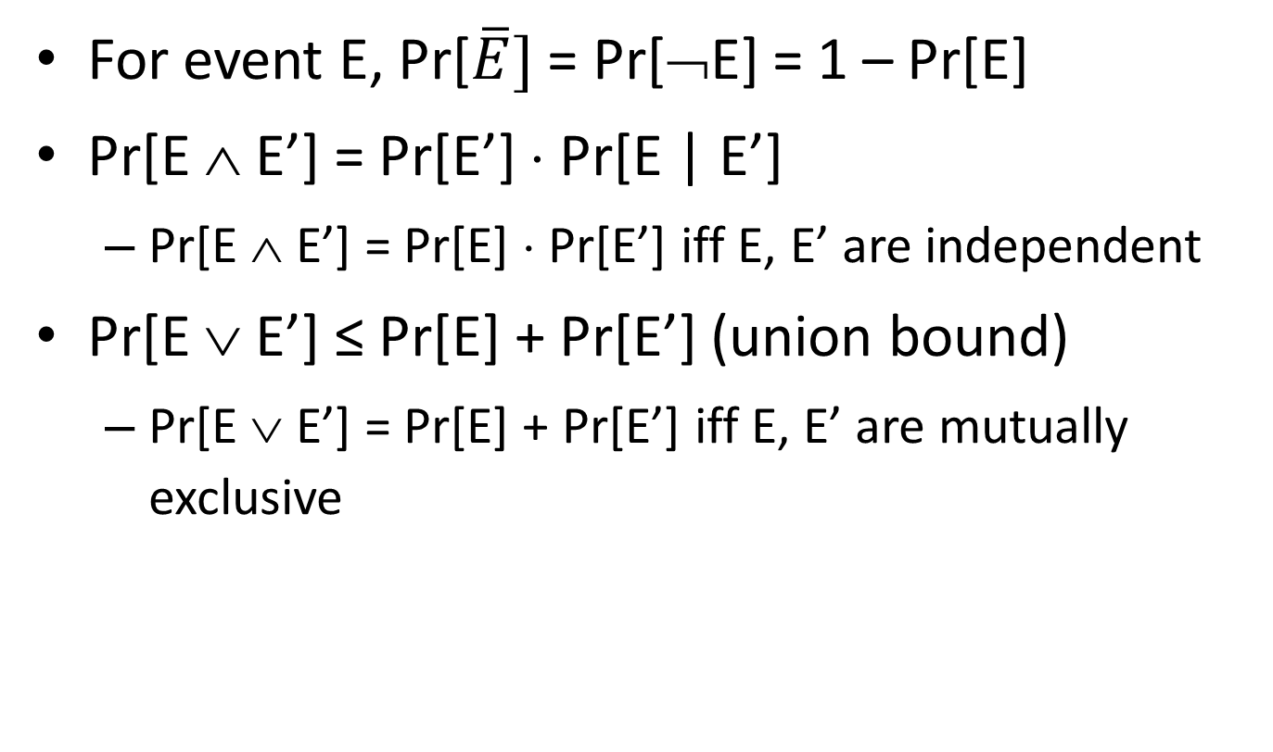
Basic probability facts
For event E, Pr[$\overline{E}]$ = Pr[¬E] = 1 – Pr[E]
Pr[E ∧ E’] = Pr[E’] ⋅ Pr[E | E’]
  Pr[E ∧ E’] = Pr[E] ⋅ Pr[E’] iff E, E’ are independent
Pr[E ∨ E’] ≤ Pr[E] + Pr[E’] (union bound)
  Pr[E ∨ E’] = Pr[E] + Pr[E’] iff E, E’ are mutually exclusive

Slide 3
Basic probability facts
For an integer-valued random variable N, Exp[N] = Σ_{i} i ⋅ Pr[N=i] (by definition)
For random variables N₁, N₂:
Exp[N₁ + N₂] = Exp[N₁] + Exp[N₂]
(linearity of expectation)

Slide 4
Contention resolution

Slide 5
Contention resolution
Suppose n identical machines are trying to access some resource
  In each time step (round), each machine can attempt to access the resource or not
  A machine succeeds in some round iff it is the only one to attempt access in that round
Goal is for all machines to eventually access the resource
No deterministic algorithm is possible here!

Slide 6
Contention resolution
Assume that in each round, each machine tries to access the resource with probability p
Let A_{i,j} be the event that machine i attempts to access the resource in round j
  So Pr[A_{i,j}] = p for all i, j
  Pr[¬A_{i,j}] = 1 – p
  All {A_{i,j}}_{i, j} are independent

Slide 7
Contention resolution
Let Unique_{i,j} be the event that only machine i attempts to access the resource in round j (so machine i succeeds)
What is the probability that machine i succeeds in round j?
  Pr[Unique_{i,j}] = Pr[A_{i,j} ∧ (∧_{i’≠i} ¬A_{i’,j})]
  = Pr[A_{i,j}] ⋅ Π_{i’≠i} Pr[¬A_{i’,j}]
  = p ⋅ (1 – p)^{n-1}
  (using independence)

Slide 8
Contention resolution
For fixed n, we can take the derivative of this expression with respect to p to find the optimal value of p
p = 1/n
Pr[Unique_{i,j}] = 1/n ⋅ (1 – 1/n)^{n-1} ≈ 1/ne
Note: 1/2e ≤ (1 – 1/n)^{n} ≤ 1/e for n ≥ 2

Slide 9
Contention resolution
What is the expected number of machines N that attempt to access the resource in a given round?
Let N_{i} be the indicator random variable that
is 1 iff machine i attempts to access the resource in that round
  Note N = Σ_{i} N_{i}, and Exp[N_{i}] = p
Exp[N] = Exp[Σ_{i} N_{i}] = Σ_{i} Exp[N_{i}] = Σ_{i} p = np (linearity of expectation)
  When p = 1/n, then Exp[N] = 1

Slide 10
Contention resolution
What is the probability that some machine succeeds in round j?
  Pr[∨_{i} Unique_{i,j}] = Σ_{i} Pr[Unique_{i,j}]
  = n ⋅ p ⋅ (1 – p)^{n-1} ≈ 1/e
  ({Unique_{i,j}}_{i=1, …, n} are mutually exclusive, but not independent)

Slide 11
Contention resolution
What is the probability that machine i succeeds by round T?
  Pr[Succ_{i,T}] = Pr[∨^{T}_{j=1} Unique_{i,j}]
  = 1 – Pr[∧_{j} ¬Unique_{i,j}]
  = 1 – Π_{j} Pr[¬Unique_{i,j}]
  = 1 – Π_{j} (1 – Pr[Unique_{i,j}])
  = 1 – (1 – Pr[Unique_{i,j}])^{T}
  ({Unique_{i,j}}_{j=1, …} are independent, but not mutually exclusive)

Slide 12
Contention resolution
What is the probability that machine i does not succeed by round T?
  Pr[Fail_{i,T}] = Π_{j} Pr[¬Unique_{i,j}]
  = (1 – Pr[Unique_{i,1}])^{T} ≤ (1 – 1/en)^{T}
Taking T = enρ, we get
(1 – 1/en)^{T} = ((1 – 1/en)^{en})^{ρ} ≤ 1/e^{ρ}

Slide 13
Contention resolution
What is the probability that there is some machine that does not succeed by round
T = enρ?
  Pr[∨_{i} Fail_{i,T}] ≤ Σ_{i} Pr[Fail_{i,T}] = n ⋅ Pr[Fail_{i,T}] ≤ n/e^{ρ}
  (union bound)
I.e., except with probability n/e^{ρ}, all machines succeed by round T

Slide 14
Contention resolution
What is the expected number of rounds R until machine i succeeds?
Let q denote the probability that the machine succeeds in any particular round
Exp[R] = Σ_{r=1} r ⋅ Pr[R = r]
= Σ_{r=1} r ⋅ (1 – q)^{r-1} ⋅ q
⇒ Exp[R] = 1/q

Slide 15
Derivation
Exp[R] = Σ_{r=1} r ⋅ (1 – q)^{r-1} ⋅ q
Exp[R] – (1 – q) ⋅ Exp[R]
= Σ_{r=1} r ⋅ (1 – q)^{r-1} ⋅ q – Σ_{r=1} r ⋅ (1 – q)^{r} ⋅ q
= q ⋅ (Σ_{r=1} r⋅(1–q)^{r-1} – Σ_{r=1} (r+1)⋅(1–q)^{r} + Σ_{r=1} (1–q)^{r})
= q ⋅ (Σ_{r=1} r⋅(1–q)^{r-1} – Σ_{r=2} r ⋅ (1–q)^{r-1} + Σ_{r=2} (1–q)^{r-1})
= q ⋅ Σ_{r=1} (1 – q)^{r-1} = 1
⇒ Exp[R] = 1/q

Slide 16
COVID vaccines/testing

Slide 17
Bayes’s law
Pr[A | B] = Pr[A ∧ B]/Pr[B]
= Pr[B | A] Pr[A]/Pr[B]
Pr[B] = Pr[B | A] Pr[A] + Pr[B | ¬A] Pr[¬A]

Slide 18
Bayes’s law
Vaccine studies show that
Pr[no vaccine administered | sick] = 0.9
  What we care about is
  Pr[sick | vaccine administered]
We can use Bayes’s law to compute this!

Slide 19
Bayes’s law
Pr[sick | vaccine]
= Pr[vaccine | sick] Pr[sick]/Pr[vaccine]
= 0.1 Pr[sick] / 0.5 = 0.2 ⋅ Pr[sick]
Pr[sick | no vaccine]
= Pr[no vaccine | sick] Pr[sick]/Pr[no vaccine]
= 0.9 Pr[sick] / 0.5 = 1.8 ⋅ Pr[sick]
Pr[sick | vaccine] / Pr[sick | no vaccine] = 0.11
  I.e., vaccine is 89% effective

Slide 20
COVID testing
Assume we have N students, each (independently) positive with probability p
Want to find all positive cases
Clearly, we can do it using N tests
  Can we do better?

Slide 21
Remark
This is a well-studied problem, under the name “combinatorial group testing”
Real-life constraints sometimes mean that theoretical solutions don’t apply
A recent paper (April, 2020) gave a simple improvement to a widely used technique

Slide 22
Pooling
Introduced in 1943
Randomly assign students to groups of size s
  Assume for simplicity that s divides N
[Round 1:] For each group, combine samples of all students and administer one test
  If negative, everyone in the group is negative
  [Round 2:] If positive, test everyone in the group individually

Slide 23
Pooling
What is the expected number of tests?
N/s tests administered in round 1
Let T_{i} be the indicator random variable that is 1 iff student i is tested in round 2
Two cases:
  If student i is positive, they are definitely tested
    Exp[T_{i}] = 1
  If student i is negative, they are tested iff they are put in a group with someone who is positive
    Exp[T_{i}] = 1 – (1 – p)^{s-1}

Slide 24
Pooling
Overall, Exp[T_{i}] = p ⋅ 1 + (1 – p) ⋅ (1 – (1 – p)^{s-1})
So the expected number of tests is
N/s + N ⋅ [p + (1 – p) ⋅ (1 – (1 – p)^{s-1})]
If we know p, we can use calculus to find s minimizing the expected number of tests

Slide 25
Double pooling (2020)
Randomly partition students into groups of size s, twice
[Round 1:] For each group, combine samples of all students and administer one test
  [Round 2:] Test any student only if both of the groups he/she were in tested positive

Slide 26
Double pooling
What is the expected number of tests?
2N/s tests administered in round 1
Let T_{i} be an indicator random variable that is 1 iff student i is tested in round 2
Two cases:
  If student i is positive, they are definitely tested
    Exp[T_{i}] = 1
  If student i is negative, they are tested iff they are put twice in a group with someone who is positive
    Exp[T_{i}] = (1 – (1 – p)^{s-1})²

Slide 27
Double pooling
Overall, Exp[T_{i}] = p ⋅ 1 + (1 – p) ⋅ (1 – (1 – p)^{s-1})²
So the expected number of tests is
2N/s + N ⋅ [p + (1 – p) ⋅ (1 – (1 – p)^{s-1})²]
If we know p, we can use calculus to solve for the optimal s

Slide 28
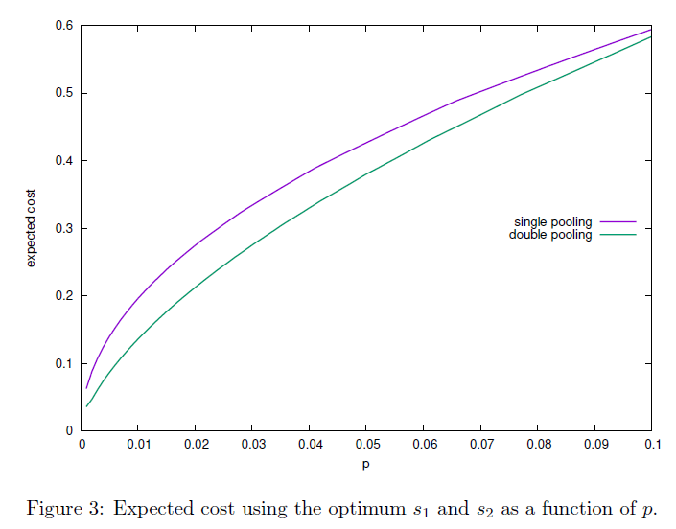
From: Broder and Kumar, “A Note on Double Pooling Tests”

