Slide 1
Algorithms
Lecture 38

Slide 2
Minimum cut

Slide 3
Minimum cut
Recall that a cut in a graph is a partition of its vertices into two non-empty subsets A, B
The size of a cut is the number of edges from vertices in A to vertices in B
  I.e., the number of edges crossing the cut
Min-cut problem: Given a graph G, find a minimum cut

Slide 4
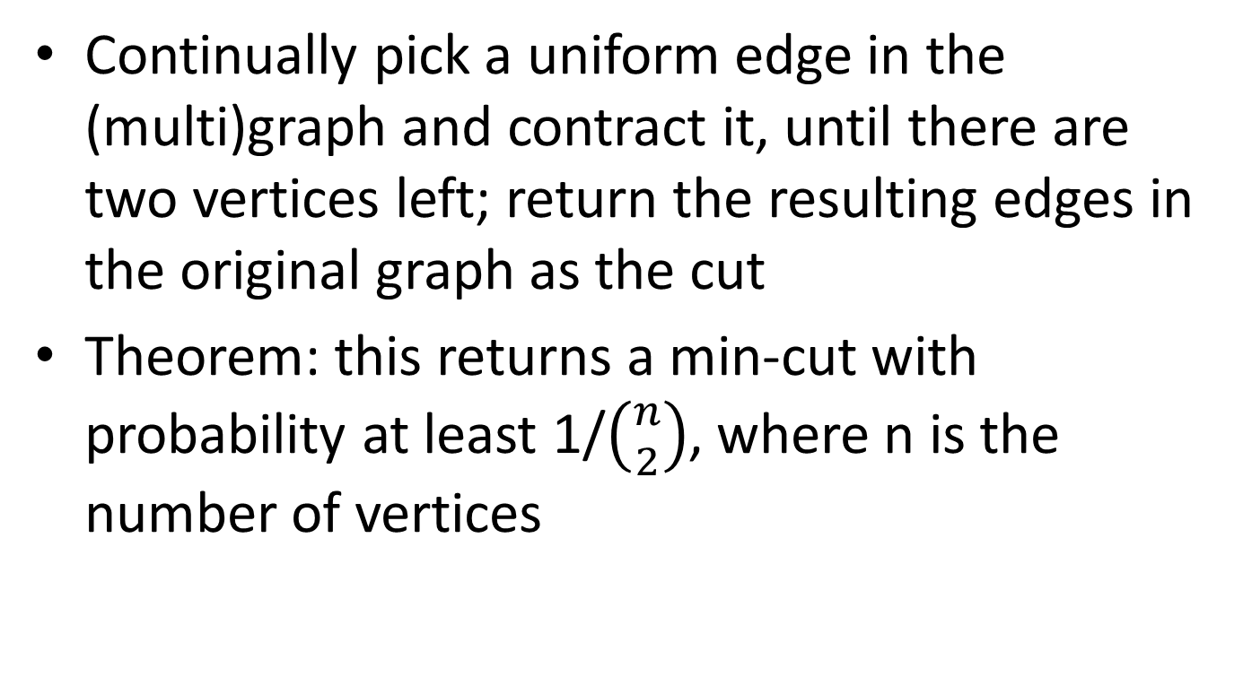
Finding a min-cut
Continually pick a uniform edge in the (multi)graph and contract it, until there are two vertices left; return the resulting edges in the original graph as the cut
Theorem: this returns a min-cut with probability at least 1/$\left({n \atop 2}\right)$, where n is the number of vertices

Slide 5
Finding a min-cut
The probability that the algorithm finds a min-cut is inverse polynomial, but not very large
Run the algorithm T times, and take the smallest cut returned!
If any of the executions finds a min-cut, then this algorithm finds a min-cut
  What is the overall probability that the algorithm finds a min-cut?

Slide 6
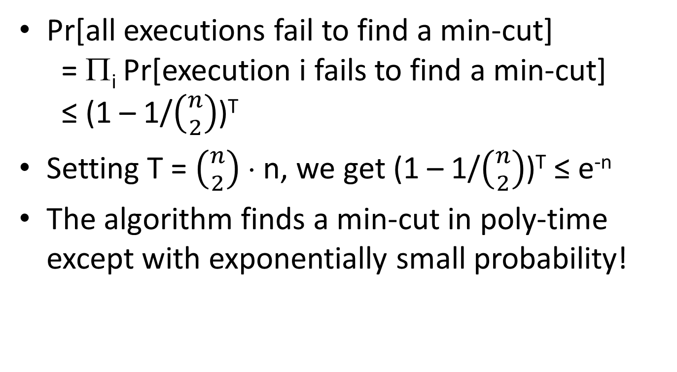
Finding a min-cut
Pr[all executions fail to find a min-cut]
= Π_{i} Pr[execution i fails to find a min-cut]
≤ (1 – 1/$\left({n \atop 2}\right)$)^{T}
Setting T = $\left({n \atop 2}\right)$ ⋅ n, we get (1 – 1/$\left({n \atop 2}\right)$)^{T} ≤ e^{-n}
The algorithm finds a min-cut in poly-time except with exponentially small probability!

Slide 7
Max-3SAT

Slide 8
Max-3SAT
Given a 3-SAT formula ϕ with k clauses, want to satisfy as many clauses as possible
  This makes sense whether ϕ is satisfiable or not
For an arbitrary formula ϕ, can we bound how many clauses can potentially be satisfied?
Use the probabilistic method!

Slide 9
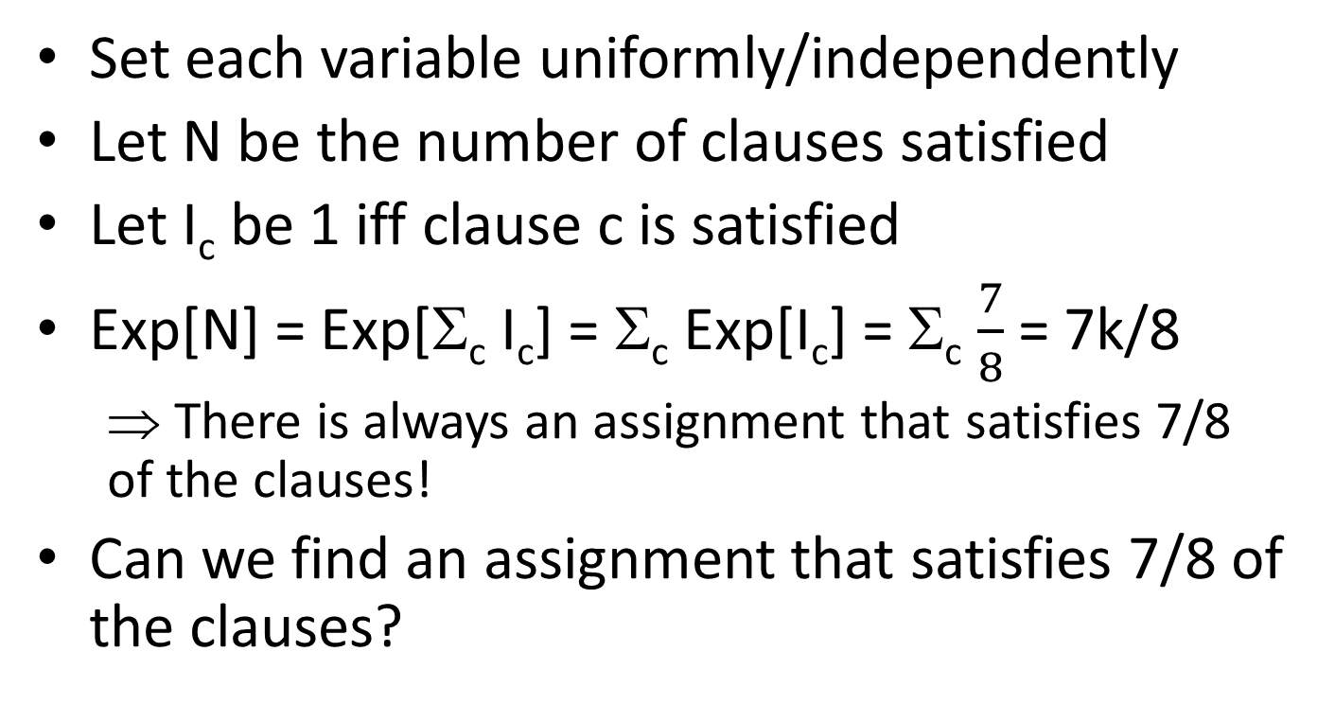
Max-3SAT
Set each variable uniformly/independently
Let N be the number of clauses satisfied
Let I_{c} be 1 iff clause c is satisfied
Exp[N] = Exp[Σ_{c} I_{c}] = Σ_{c} Exp[I_{c}] = Σ_{c} $\frac{7}{8}$ = 7k/8
  ⇒ There is always an assignment that satisfies 7/8 of the clauses!
Can we find an assignment that satisfies 7/8 of the clauses?

Slide 10
Max-3SAT
Setting variables at random satisfies 7/8 of the clauses in expectation
What if we want to satisfy at least 7/8 of the clauses with high probability?
  (Note: our analysis is different from the book)

Slide 11
Markov’s inequality
Markov’s inequality: If X is a nonnegative, integer r.v. and t > 0, then Pr[X ≥ t] ≤ Exp[X]/t
Proof:
Exp[X] = Σ_{i<t} i ⋅ Pr[X = i] + Σ_{i≥t} i ⋅ Pr[X = i]
≥ t ⋅ Σ_{i≥t} Pr[X = i]
= t ⋅ Pr[X ≥ t]

Slide 12
Max-3SAT
Apply Markov’s inequality to the number N’ of clauses that are not satisfied
Exp[N’ + N] = Exp[k] = k
  Exp[N’] = k/8
Pr[N’ > k/8] = Pr[N’ ≥ (k+1)/8] ≤ k/(k+1)
Pr[N ≥ 7k/8] = 1 – Pr[N’ > k/8] ≥ 1/(k+1)
Can now compute the expected number of iterations of the algorithm needed, or how many times it is necessary to run the algorithm so it succeeds except with arbitrarily small probability

Slide 13
Coupon-collector problem

Slide 14
Problem setup
There are n types of items
Items arrive one-by-one; the items’ types are uniformly distributed and independent
How many items N do you expect to need to see before getting one of each type of item?

Slide 15
Analysis
Let N_{i} be the number of items you need to see after collecting i-1 types, until you get an item of the ith type
Exp[N_{i}] = ?
  The probability that the next item will be a new type is (n-i+1)/n
  So the expected number of items needed until getting a new type is n/(n-i+1)
Exp[N] = Exp[Σ_{i} N_{i}] = Σ_{i} Exp[N_{i}] = n ⋅ Σ_{i} 1/(n-i+1)
≈ n log n

Slide 16
Application
Recall the contention-resolution problem…
In any round, the probability that some machine succeeds is ≈ 1/e
  By symmetry, if some machine succeeds it is equally likely to be any one of the machines
How many successes do we need in expectation before every machine succeeds?
  This is just the coupon-collector problem!
How many rounds do we need in expectation before every machine succeeds?

