Slide 1
Cryptography
Lecture 15

Slide 2
Summary and review
We have finished our treatment of private-key schemes!
(Though it will come up again later)
Private-key crypto is used extensively in practice
Arguably more than public-key crypto

Slide 3
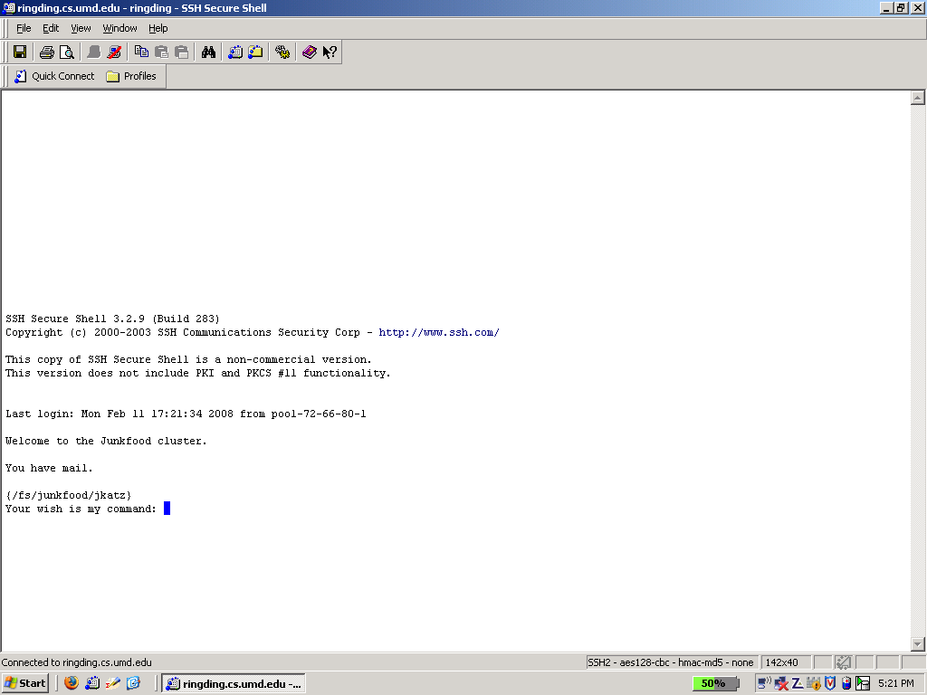

Slide 4
So far…
We have seen how to construct schemes based on various lower-level primitives
Stream ciphers/PRGs
Block ciphers/PRFs
Hash functions
How do we construct these primitives?

Slide 5
Two approaches
Construct from even lower-level assumptions
Can prove secure (given lower-level assumption)
Typically inefficient
Build directly
Much more efficient!
Need to assume security, but
We have formal definitions to aim for
We can concentrate our analysis on these primitives
We can develop/analyze various design principles

Slide 6
Stream ciphers/PRGs

Slide 7
Terminology
Init algorithm
Takes as input a key + initialization vector (IV)
Outputs initial state
GetBits algorithm
Takes as input the current state
Outputs next bit/byte/chunk and updated state
Allows generation of as many bits as needed

Slide 8
Security requirements
If there is no IV, then (for a uniform key) the output of GetBits should be indistinguishable from a uniform, independent stream of bits
If there is an IV, then (for a uniform key) the outputs of GetBits on multiple, uniform IVs should be indistinguishable from multiple uniform, independent streams of bits
Even if the attacker is given the IVs

Slide 9
LFSRs
Degree n ⇒ n registers
State: bits s_{n-1}, …, s₀ (contents of the registers)
Feedback coefficients c_{n-1}, …, c₀ (view as part of state; do not change)
State updated and output generated in each “clock tick”

Slide 10
Example
Assume initial content of registers is 0100
First 4 state transitions: 0100 → 1010 → 0101 → 0010 → …
First 3 output bits: 0 0 1 …

Slide 11
LFSRs as stream ciphers
Key + IV used to initialize the state of the LFSR (possibly including feedback coefficients)
One bit of output per clock tick
State updated

Slide 12
LFSRs
State (and output) “cycles” if state ever repeated
Maximal-length LFSR cycles through all 2^{n} - 1 nonzero states
Known how to set feedback coefficients so as to achieve maximal length

Slide 13
LFSRs
Maximal-length LFSRs have good statistical properties…
…but they are not cryptographically secure!

Slide 14
Security?
Are LFSRs secure?
Might hope for 2n-bit security
n-bit state + n bits to specify feedback
Slightly less if we insist on maximal-length LFSR

Slide 15
LFSRs
If feedback coefficients known, the first n output bits directly reveal the initial state!
Even if feedback coefficients are unknown, can use linear algebra to learn everything from 2n consecutive output bits
Moral: linearity is bad for cryptography (because linear algebra is so powerful)

Slide 16
Nonlinear FSRs
Add nonlinearity to prevent attacks
Nonlinear feedback
Output is a nonlinear function of the state
Multiple (coupled) LFSRs
…or any combination of the above
Still want to preserve statistical properties of the output, and long cycle length

Slide 17
Trivium
Designed by De Cannière and Preneel in 2006 as part of eSTREAM competition
Intended to be simple and efficient (especially in hardware)
Essentially no attacks better than brute-force search are known

Slide 18
Trivium

Slide 19
Trivium
Three FSRs of degree 93, 84, and 111
Initialization:
80-bit key in left-most registers of first FSR
80-bit IV in left-most registers of second FSR
Remaining registers set to 0, except for three right-most registers of third FSR
Run for 4 x 288 clock ticks

