Slide 1
Cryptography
Lecture 16

Slide 2
RC4
Designed in 1987
Designed to have good performance in software, rather than hardware
No longer considered secure, but still interesting to study
Simple description; not LFSR-based
Still encountered in practice
Interesting attacks

Slide 3
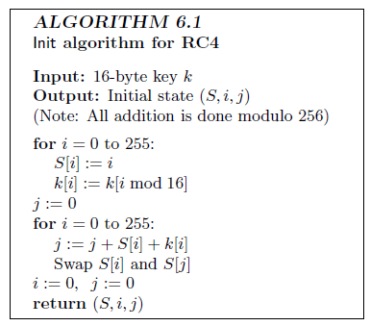
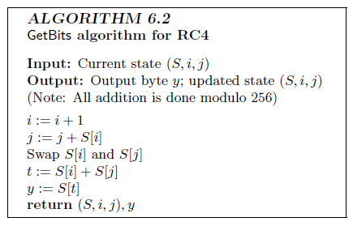
RC4

Slide 4
RC4
Not designed to take an IV, but often used with an IV anyway
E.g., prepend IV to the key

Slide 5
Attack 1: bias in 2nd output byte
Let S_{t} denote permutation after t steps
Treat S₀ as uniform for simplicity
Say X = S₀[1] ≠ 2 and S₀[2] = 0
Occurs with probability ~1/256
Then:
After 1 step, S₁[X]=X, i=1, j=X
After 2 steps, j=X, output S₂[X]=0
Otherwise, S₂[X] is uniform
Overall probability of 2nd byte 0 is about 2/256

Slide 6
Attack 2
If first t bytes of key are known, can learn (t+1)st byte of key from the output
Assume t=3, and initial 3 bytes of the key are (3, 255, X) for simplicity
Occurs with probability 1/256²
Observation: After first 4 steps of Init:
S[0]=3, S[1]=0, S[3] = X+6+K[3] mod 256

Slide 7
Attack 2, continued
Look at remaining 252 iterations of Init:
i will never affect S[0], S[1], S[3]
Treating j as random, the probability that j never affects those entries is (253/256)²⁵² > 0.05
This can be experimentally verified
…in which case the first byte output will be X+6+K[3]
So we get an estimate for K[3] that is 5% accurate
Random guessing is 0.4% accurate

Slide 8
Detour: attacks on WEP

Slide 9
Wired equivalent privacy (WEP)
Part of original 802.11 standard, 1997
Still found in use today
Considered a canonical example of poor security design

Slide 10
Encryption in WEP
Client and access point share a key k
By default (but not necessarily) a 40-bit key
Use unsynchronized stream-cipher mode:
IV, RC4(IV, k) ⊕ (m, c(m)), where IV is a 24-bit IV and c is a 4-byte, linear (noncryptographic) checksum
Claimed to give 64-bit security since |IV|+|k|=64

Slide 11
Authentication in WEP
Access point sends a random challenge; client sends back an encryption of the challenge
Is this secure?
What is the right primitive to use here?

Slide 12
IV re-use
If IV is re-used (with the same key), same keystream is re-generated
How often until we expect IV re-use to occur?
Note: chosen-plaintext attacks are particularly easy in this context, making IV re-use worse

Slide 13
Checksum
Intended to provide integrity
But only detects random errors, not malicious attacks
Unkeyed!
Checksum is linear (i.e., c(x) ⊕ c(y) = c(x ⊕ y))
Attacks can effect known shifts of (known or unknown) plaintext

Slide 14
“Padding-oracle attack”
Say t>3 bytes of RC4 output are known for some IV (e.g., due to known headers)
Take arbitrary message M of length t-3, append first 3 bytes of c(M), and XOR with known output
Enumerate over final byte of ciphertext;
⇒ when decryption succeeds, learn the (t+1)st byte of RC4 output

Slide 15
Attacking RC4 in WEP
Note that first 3 bytes of effective key are known (since they are the IV)!
Apply attack discussed previously

Slide 16
Block ciphers

Slide 17
Recall…
Want keyed permutation F: {0,1}^{n} x {0,1}^{l} → {0,1}^{l}
n = key length, l = block length
Want F_{k} (for uniform, unknown key k) to be indistinguishable from a uniform permutation over {0,1}^{l}

Slide 18
Attack models
A block cipher is not an encryption scheme!!
Nevertheless, some of the terminology used in the same (for historical reasons)
“known-plaintext attack”: attacker given {(x, F_{k}(x)} for random x (outside control of the attacker)
“chosen-plaintext attack”: attacker can query F_{k}(.)
This is the default model we have been using
“chosen-ciphertext attack”: attacker can query F_{k}(.) and F_{k}⁻¹(.)

Slide 19
Concrete security
(As in the case of stream ciphers) we are interested in concrete security for a given key length n
Best attack should take time ≈ 2^{n}
If there is an attack taking time 2^{n/2} then the cipher is considered insecure

Slide 20
Designing block ciphers
Want F_{k} (for uniform, unknown key k) to be indistinguishable from a uniform permutation over {0,1}^{l}
If x and x’ differ in one bit, what should be the relation between F_{k}(x) and F_{k}(x’)?
How many bits should change (on average)?
Which bits should change?
How to achieve this?

Slide 21
Confusion/diffusion
“Confusion”
Small change in input should result in local, “random” change in output
“Diffusion”
Local change in output should be propagated to entire output

Slide 22
Design paradigms
Two design paradigms
Substitution-permutation networks (SPNs)
Feistel networks

Slide 23
SPNs
Build “random-looking” permutation on large input from random permutations on small inputs
E.g., assume 8-byte block length F_{k}(x) = f_{k1}(x₁) f_{k2}(x₂) … f_{k8}(x₈), where each f is a random permutation
How long is k?

Slide 24
SPN
. . .
f_{k1}
f_{k2}
Is this a pseudorandom function?

