Slide 1
Cryptography
Lecture 18

Slide 2
Key-recovery attack, 1-round SPN
Consider first the case where there is no final key-mixing step
Possible to get the key immediately!
What about a full 1-round SPN?
Attack 1: for each possible 1st-round key, get corresponding 2nd-round key
Continue process of elimination
Complexity ≈2^{l} for key of length 2l

Slide 3
Key-recovery attack, 1-round SPN
Better attack: work S-box-by-S-box
Assume 8-bit S-box
For each 8 bits of 1st-round key, get corresponding 8 bits of 2nd-round key
Continue process of elimination
Complexity?

Slide 4
Feistel networks

Slide 5
Feistel networks
Build (invertible) permutation from non-invertible components
One round:
Keyed round function f: {0,1}^{n} x {0,1}^{l/2} →{0,1}^{l/2}
F_{k1}(L0, R0) → (L1, R1) where L1 = R0; R1 = L0 ⊕ f_{k1}(R0)
Always invertible!

Slide 6
Security?
Security of 1-round Feistel?
Security of 2-round Feistel (with independent keys)
Security of 3/4-round Feistel?

Slide 7
Data Encryption Standard (DES)
Standardized in 1977
56-bit keys, 64-bit block length
16-round Feistel network
Same round function in all rounds (but different sub-keys)
Basically an SPN design!

Slide 8
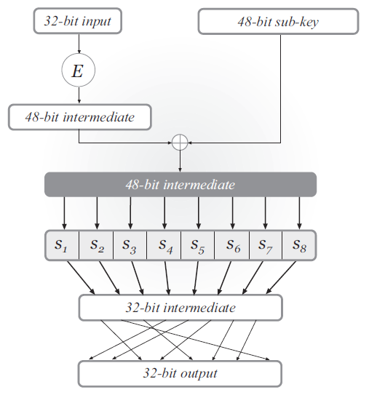
DES mangler function

Slide 9
DES mangler function
S-boxes
Each S-box is 4-to-1
Changing 1 bit of input changes at least 2 bits of output
Mixing permutation
The 4 bits of output from any S-box affect the input to 6 S-boxes in the next round

Slide 10
Key schedule
56-bit master key, 48-bit subkey in each round
Each subkey takes 24 bits from the left half of the master key, and 24 bits from the right half of the master key

Slide 11
Avalanche effect
Consider 1-bit difference in left half of input
After 1 round, 1-bit difference in right half
S-boxes cause a 2-bit difference, implying a 3-bit difference overall after 2 rounds
Mixing permutation spreads differences into different S-boxes
…

Slide 12
Security of DES
DES is extremely well-designed
Except for some attacks that require large amounts of plaintext, no attacks better than brute-force are known
But … parameters are too small!
I.e., brute-force search is feasible

Slide 13
56-bit key length
A concern as soon as DES was released
Brute-force search over 2⁵⁶ keys is possible
1997: 1000s of computers, 96 days
1998: distributed.net, 41 days
1999: Deep Crack ($250,000), 56 hours
Today: 48 FPGAs, ~1 day

Slide 14
64-bit block length
Birthday collisions relatively likely
E.g., encrypt 2³⁰ (≈ 1 billion) records using CTR mode; chances of a collision are ≈ 2⁶⁰/2⁶⁴ = 1/16

Slide 15
Increasing key length?
DES has key that is too short
How to fix?
Design new cipher
Tweak DES so that it takes a larger key
Build new cipher using DES as a black box

Slide 16
Double encryption
Let F: {0,1}^{n} x {0,1}^{l} → {0,1}^{l}
(i.e., n=56, l=64 for DES)
Define F² : {0,1}^{2n} x {0,1}^{l} → {0,1}^{l} as follows: F²_{k1, k2}(x) = F_{k1}(F_{k2}(x)) (still invertible)
If best attack on F takes time 2^{n}, is it reasonable to assume that the best attack on F² takes time 2^{2n}?

Slide 17
Meet-in-the-middle attack
No! There is an attack taking 2^{n} time…
(And 2^{n} memory)
The attack applies any time a block cipher can be “factored” into 2 independent components

Slide 18
Triple encryption
Define F³ : {0,1}^{3n} x {0,1}^{l} → {0,1}^{l} as follows: F³_{k1, k2, k3}(x) = F_{k1}(F_{k2}(F_{k3}(x)))
What is the best attack now?

Slide 19
Two-key triple encryption
Define F³ : {0,1}^{2n} x {0,1}^{l} → {0,1}^{l} as follows: F³_{k1, k2}(x) = F_{k1}(F_{k2}(F_{k1}(x)))
Best attacks take time 2^{2n} – optimal given the key length!
This approach is taken by triple-DES

