Slide 1

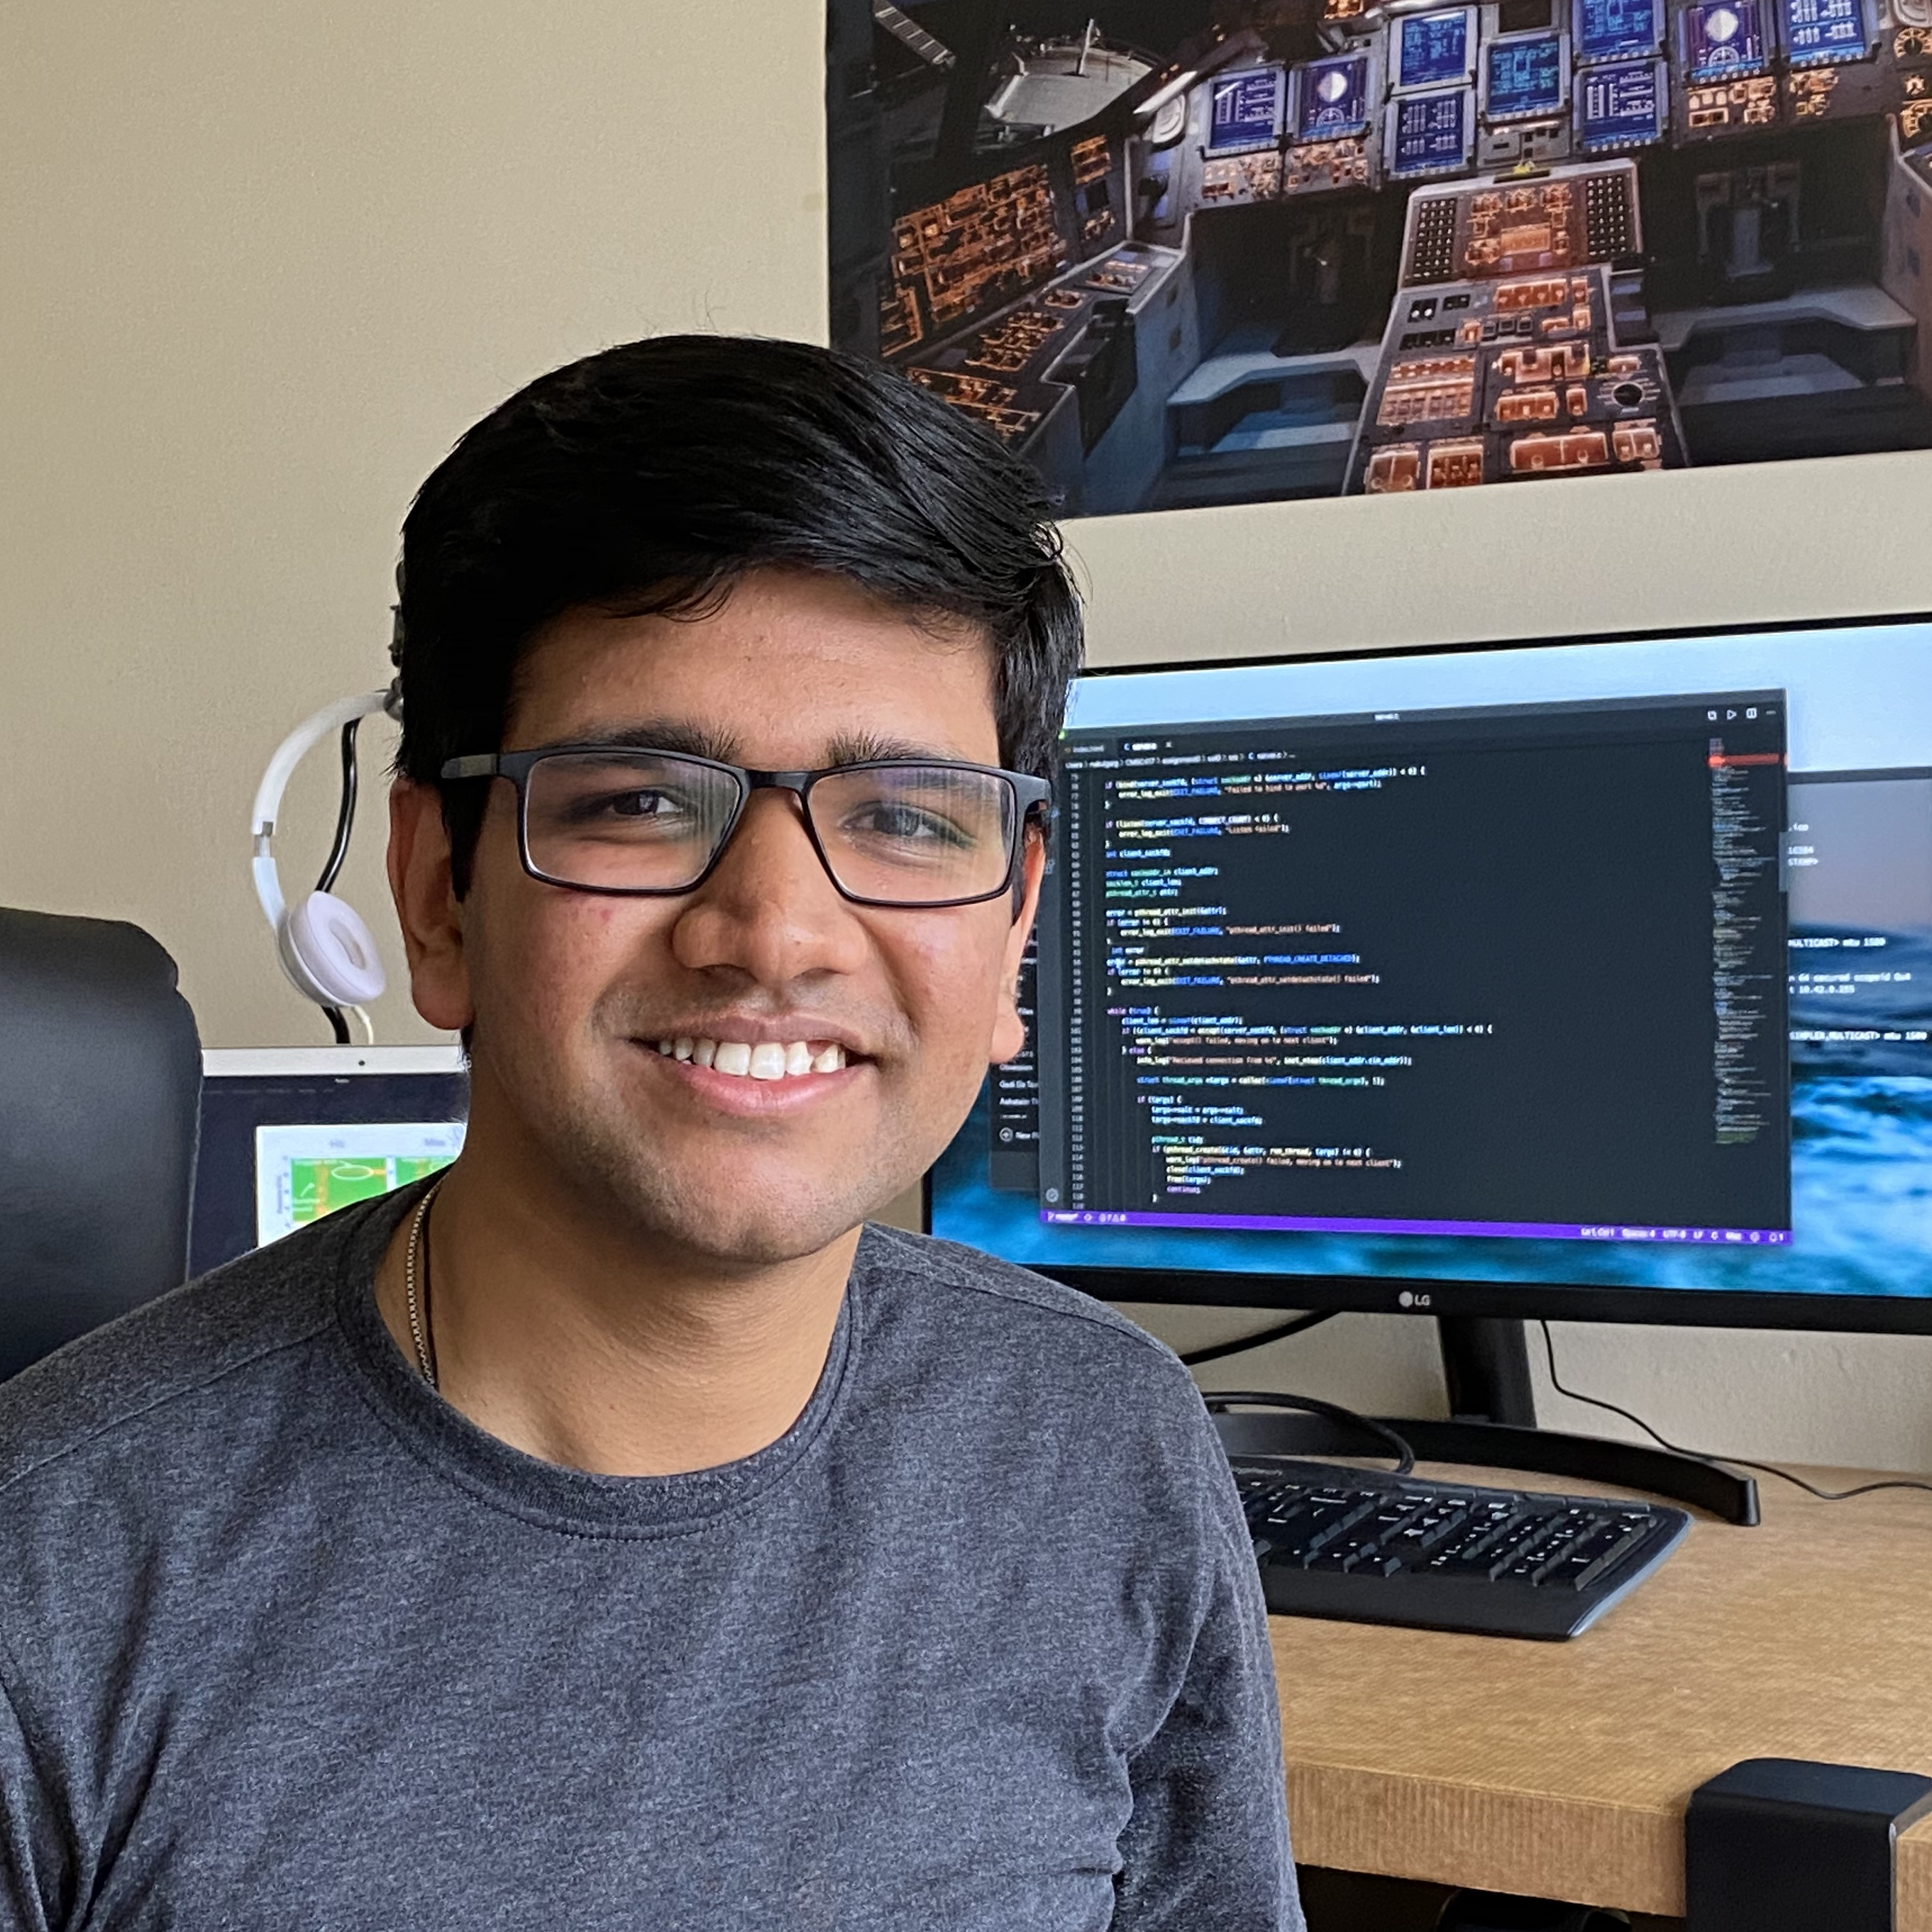


SPiDR: Ultra-low-power Acoustic Spatial Sensing
for Micro-robot Navigation
Yang Bai*
Nakul Garg*
Nirupam Roy
yangbai8@umd.edu
nakul22@umd.edu
niruroy@umd.edu
(*Equal contribution)
MobiSys 2022
Notes:
Hi everyone, I am Yang Bai. Today I am going to present our paper called “SPiDR: ultra-low-power acoustic spatial sensing for micro-robot navigation”. This is a joint work with my colleague Nakul Garg and my advisor Nirupam Roy. We are from the University of Maryland, College Park.

Slide 2
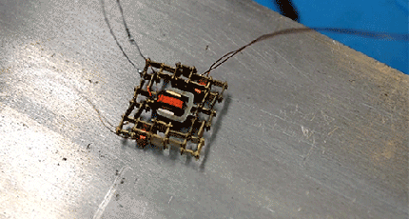
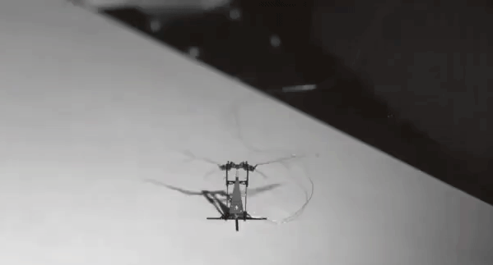
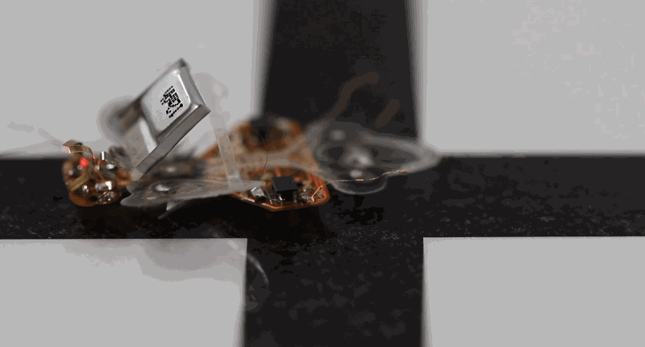
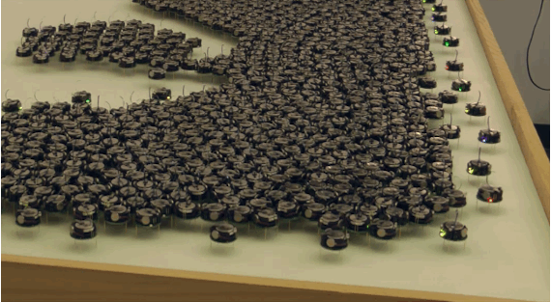
Tiny robots are emerging…
…with many applications
Notes:
Autonomous tiny robots become more and more promising in the last several years. These tiny robots have many capabilities. They not only can walk, they can also fly as insects, navigate through apertures, take turns and so on. These small robotic systems, when paired with autonomous navigation, can create new possibilities in a wide range of applications. (click)
Autonomous robots are promising.

Slide 3
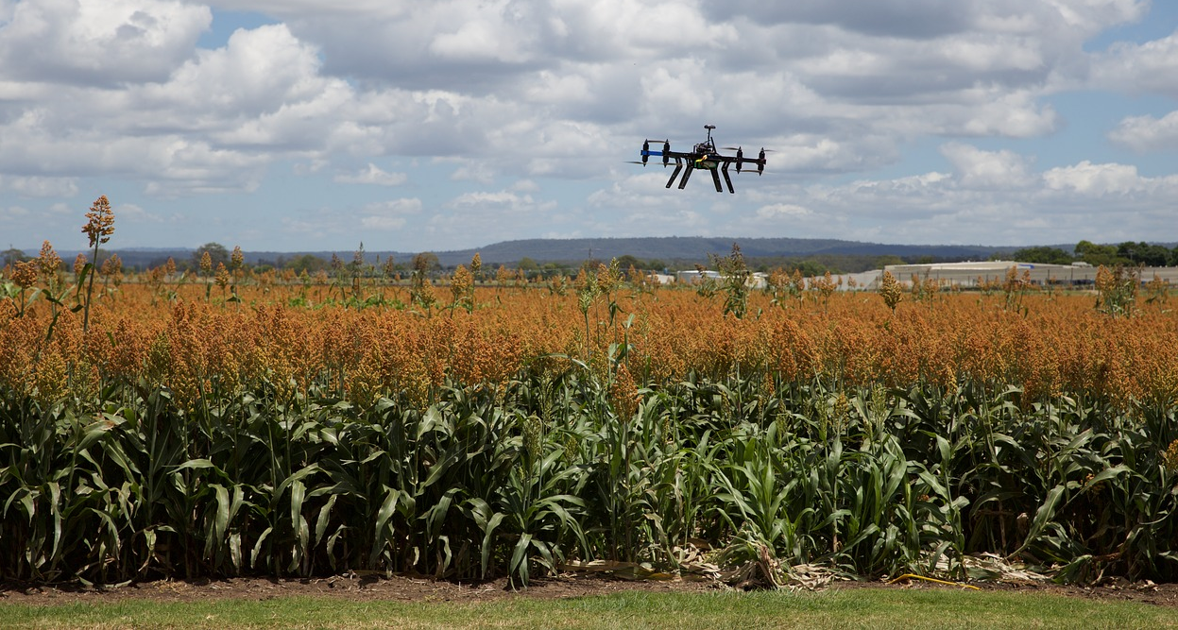
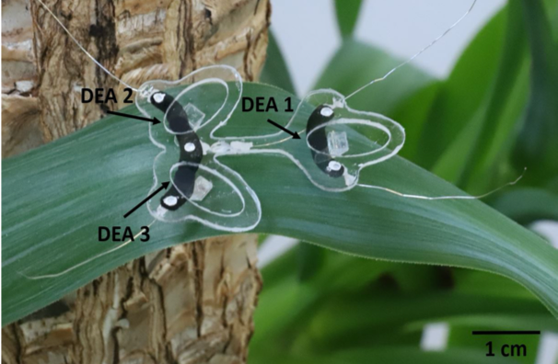
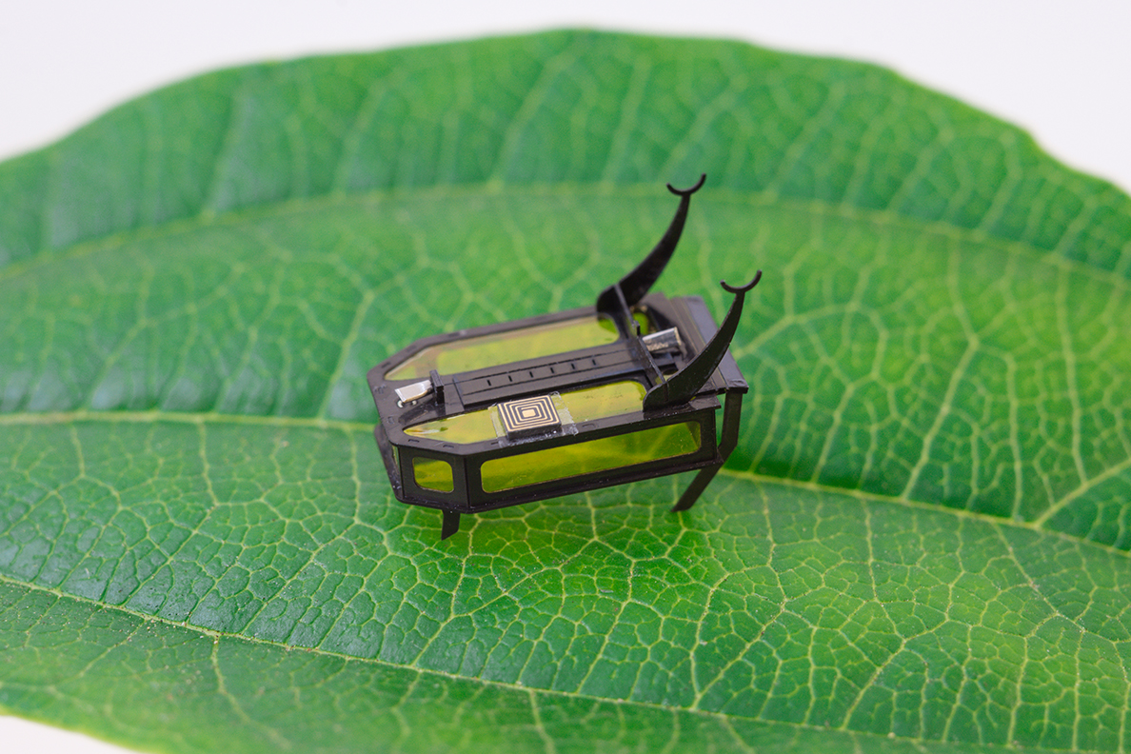

Precision farming
Notes:
It can revolutionize the way we do farming.

Slide 4
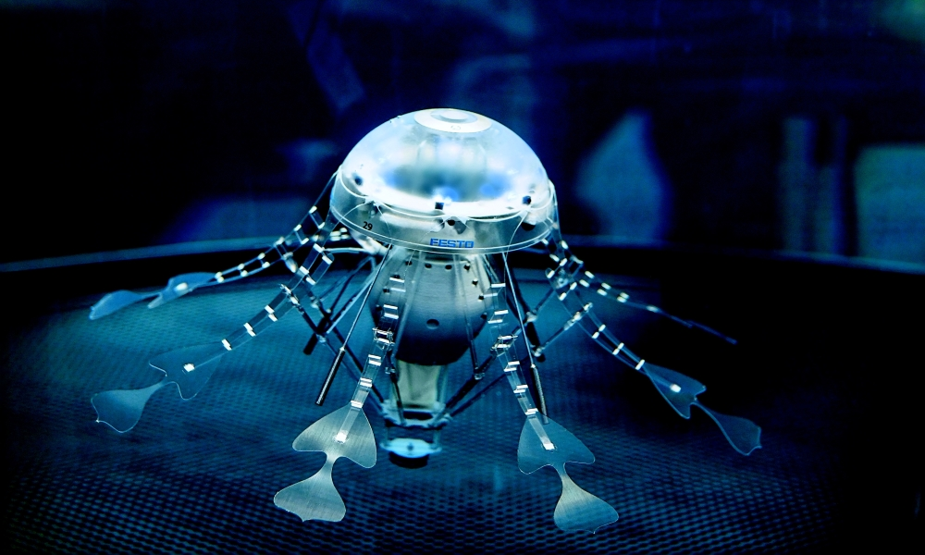
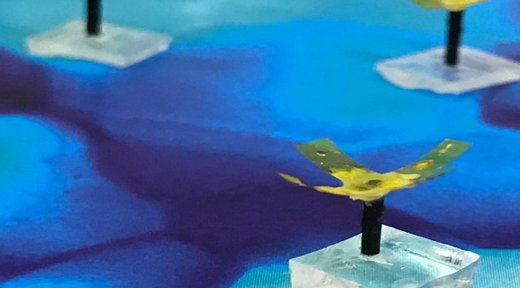
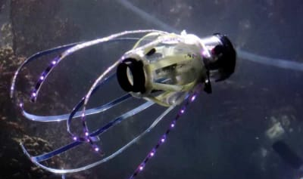
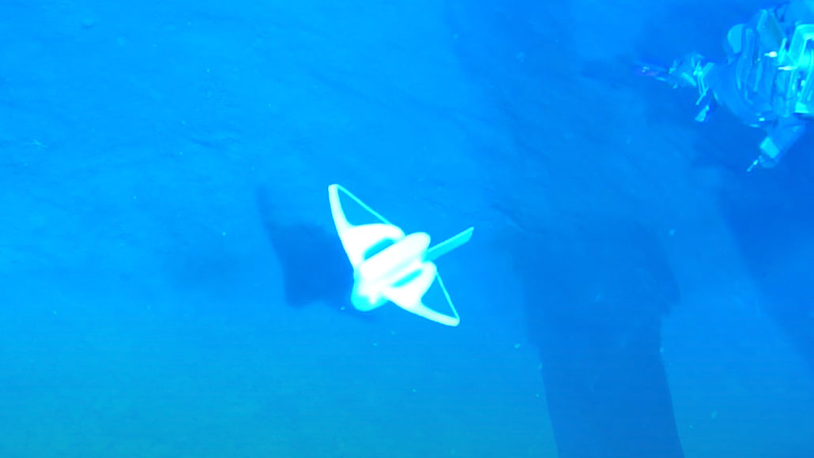
Autonomous exploration
Notes:
Even it can be used in autonomous exploration in the deep sea, where human cannot go.

Slide 5
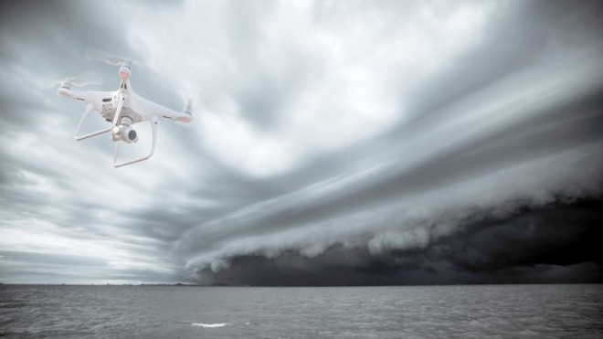

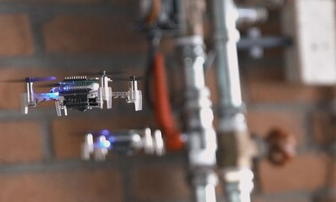
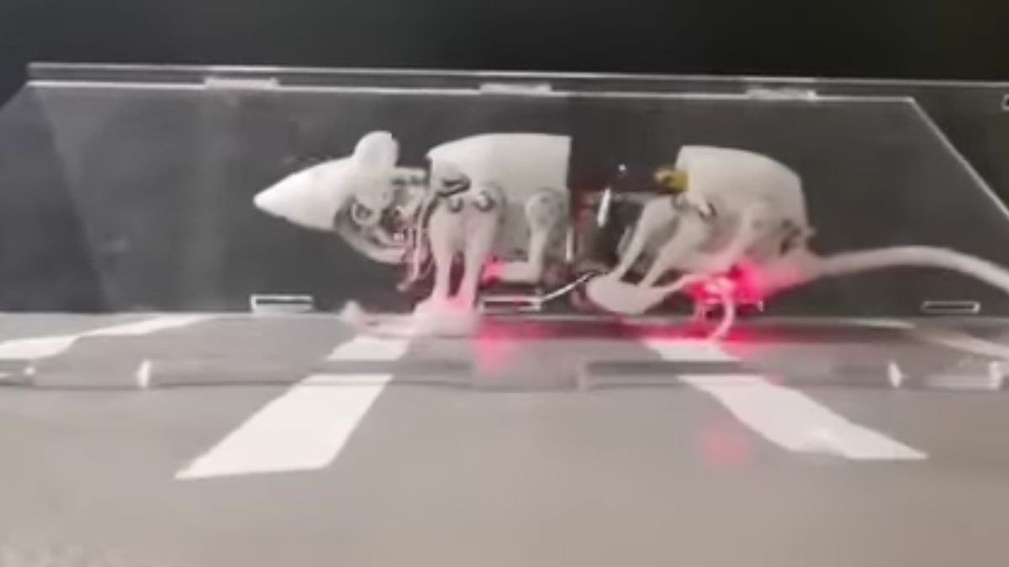
Disaster management and rescue…
…and many more are possible
Notes:
These robots can be the first responders in the disasters and help with rescue. Many more applications are possible when these tiny robots can be fully operated.

Slide 6
Navigation
Communication
Locomotion
Notes:
To apply tiny robots in real world scenarios, we still have to solve many problems, locomotion, communication, navigation.

Slide 7
One of the key challenge is… the sensor for navigation
Notes:
One of the key challenge is the sensor for navigation.

Slide 8
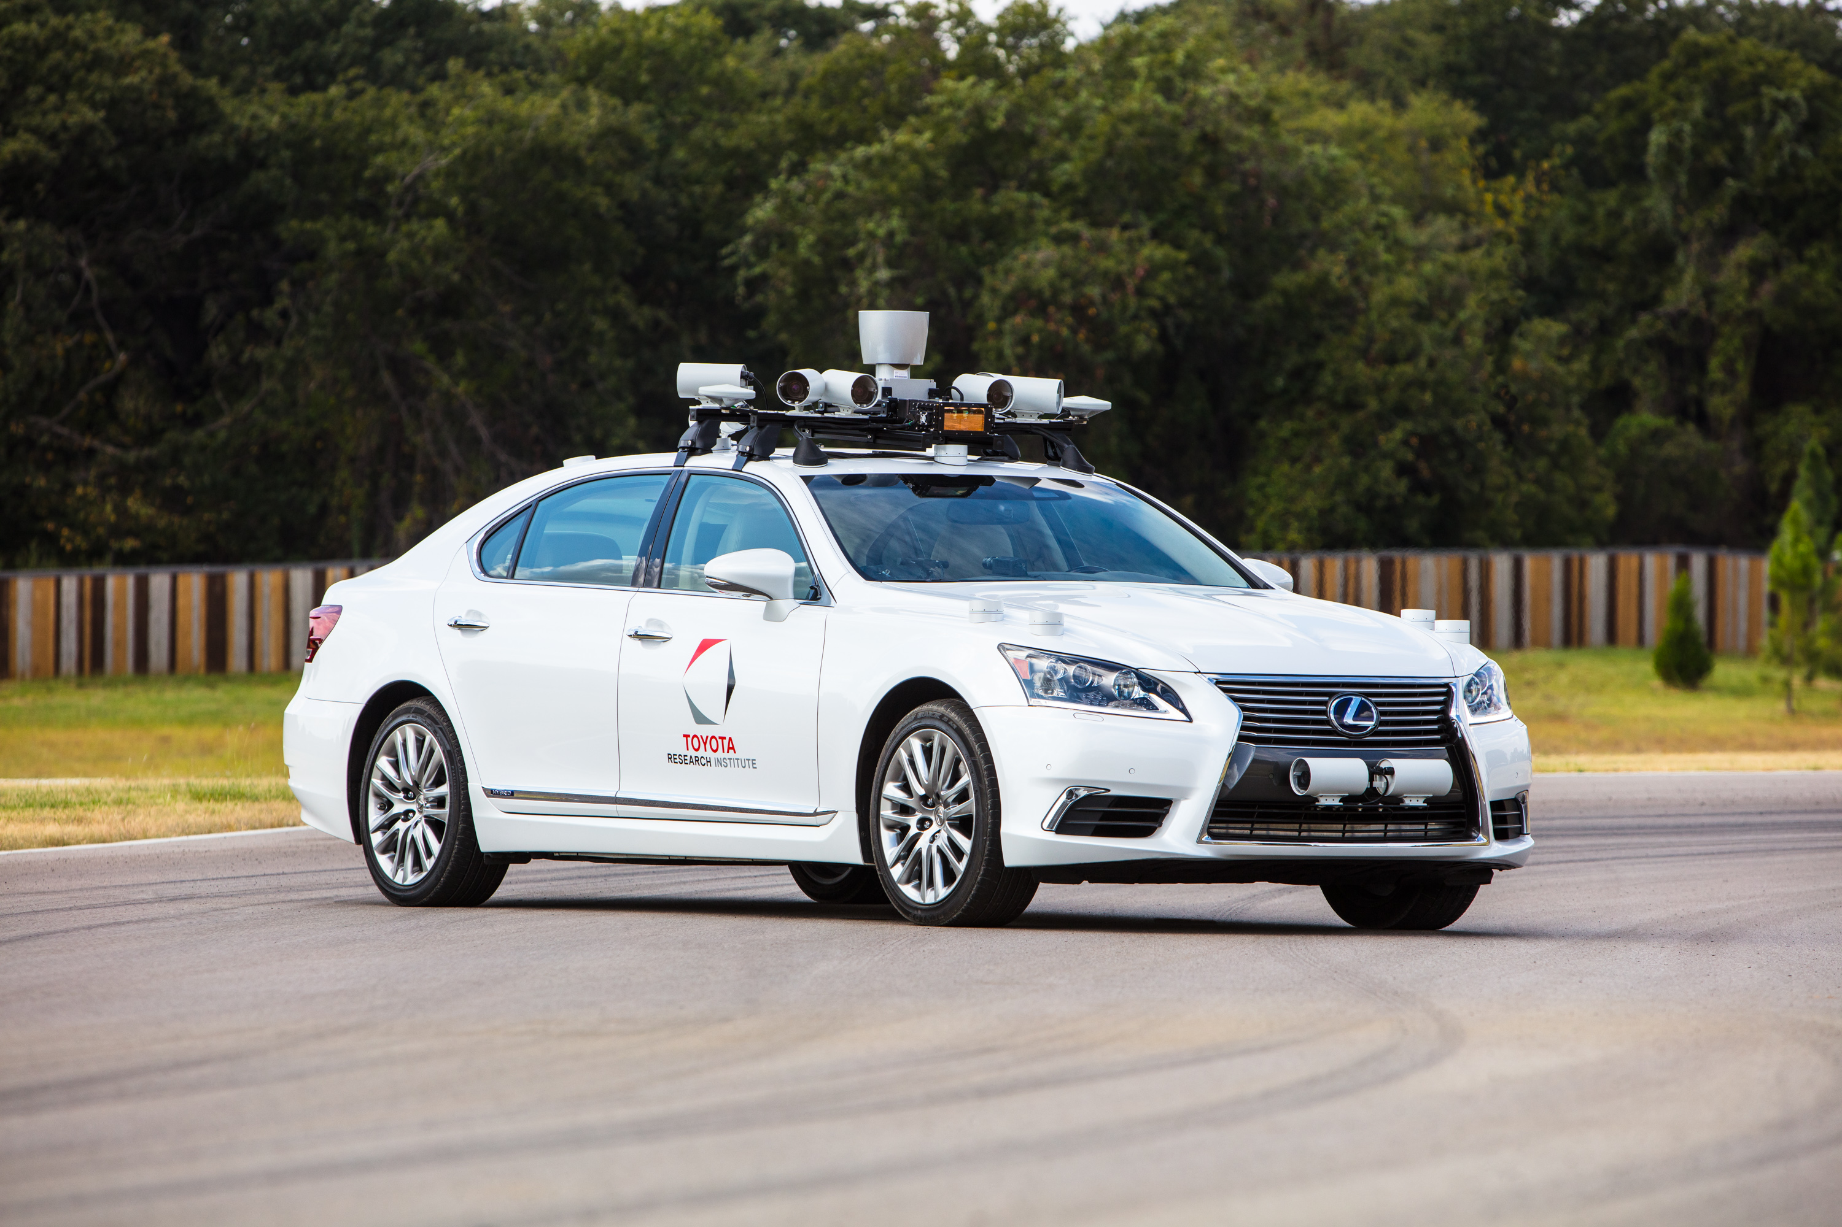
Existing techniques are not applicable.
Notes:
Interestingly, we have almost solved this navigation problem in autonomous cars with existing techniques. Now they already can navigate in a busy road. (click) Unfortunately, these techniques cannot be applied on the tiny robots we are talking about, because they are too power hungry.

Slide 9
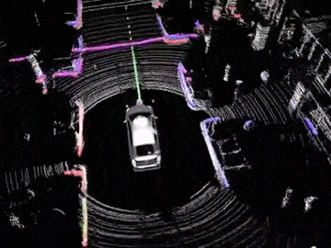
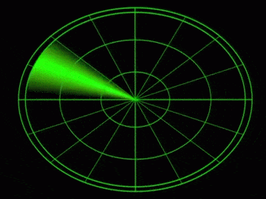
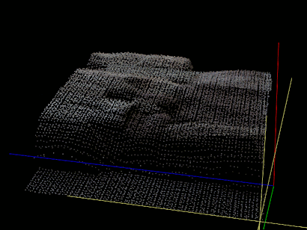
These techniques are power hungry!
Lidar
Radar
Depth camera
Notes:
Lidar, the most prominent solution, consumes tens watts of power to create the 3D map of the region. Radar requires watt-level power because it needs an array of power hungry transducers for beamforming. That sets a fundamental limit on the smallest size. Depth camera also consumes watts of power.

Slide 10

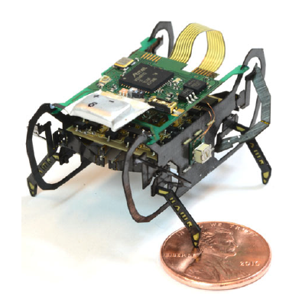
VS
60A h battery
25mA h battery
Notes:
While automatic driving cars can build a huge power supply on board. But in our case, we are targeting small robotic systems with only 25mA h battery available.
Add the robot figure

Slide 11
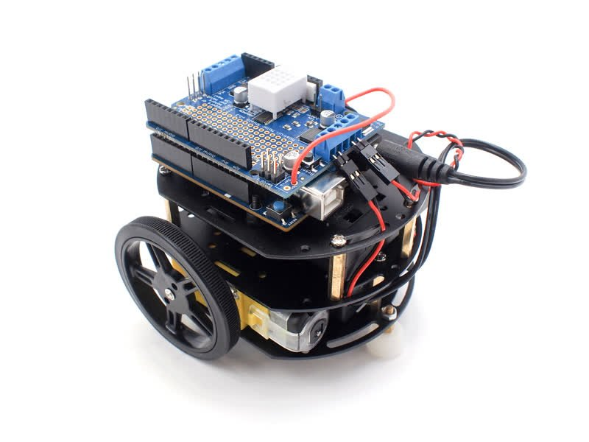
Power consumption breakdown of tiny robot
[40mW]
[45mW]
RF transmitter
Atmega MCU
Actuators
[200mW]
Total power consumption of the tiny robot: [307-395mW]
Notes:
Let's first take a look at the power consumption break down of a typical tiny robot.
The total power consumption of the tiny robot is 300-400mW.
The most power-hungry part is the actuators, they consume 60% of the power. (click)
The energy source, computational power, size, and the manufacturing cost of tiny robots are constraint.
Tiny robots only have power budget of 10-30mW for sensing and computation.

Slide 12
Power consumption breakdown of tiny robot
[40mW]
[45mW]
RF transmitter
Atmega MCU
Actuators
[200mW]
Tiny robots only have power budget of 10-30mW for sensing and computation.
Total power consumption of the tiny robot: [307-395mW]
Notes:
Within the remain power, tiny robots only have power budget of 10-30mW for sensing and its computation. If we go over the existing navigation solutions for robots, we find the power consumptions are too high for tiny robots. Another factor is the space, none of them can be applied on tiny robots in this size.

Slide 13
Can we enable ultra-low-power navigation for tiny robots and fit in the size of only a few inches?
Notes:
In this project, we challenge ourself with the question: can we enable navigation for these super low power tiny robots and fit in the size of only a few inches.

Slide 14
Our system consumes only 10mW of power with one pair of speaker/microphone!
Notes:
The answer is yes. Our system only consumes 10mW of power with one pair of speaker and microphone.
Before I tell you the intuition, let me explain where lies the core technical challenge.

Slide 15
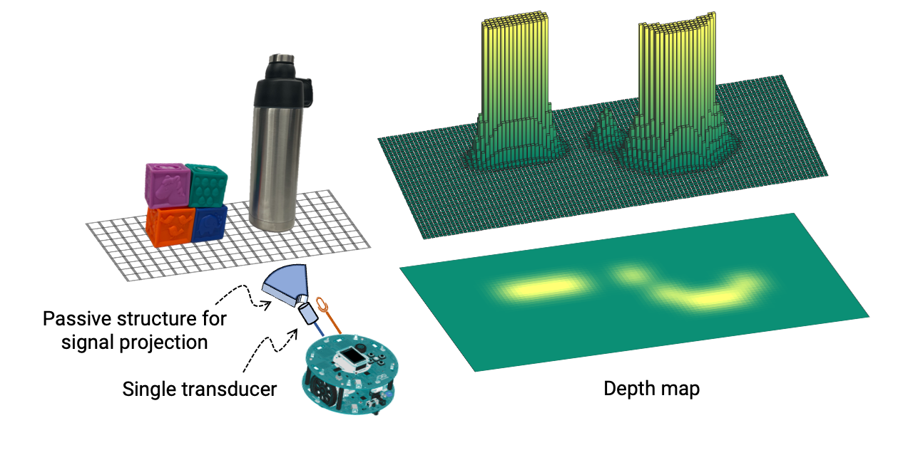
Cross sectional depth map
Notes:
These navigation sensor basically tries to produce a cross sectional depth map of the scene, so that it can identify the location of nearby objects.

Slide 16







Traditional navigation sensors
Object
$$φ$$
$$φ$$
$$φ$$
$$φ$$
$$TX$$
$$φ$$
$$φ$$
Transducers
Object
Notes:
Let us rethink about the navigation problem. Basically what navigation sensors do is to search which direction we are getting the reflected signal.
Existing sensors scan the scene one angle at a time.

Slide 17
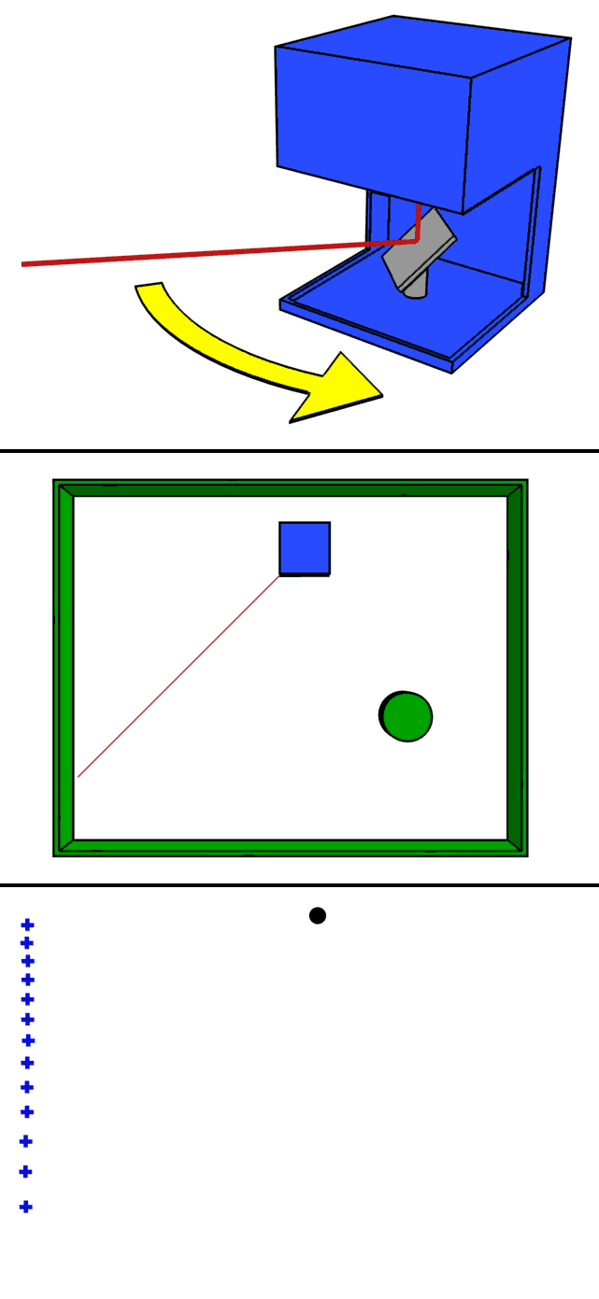
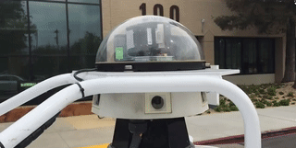
Scanning is power consuming: mechanical rotation
Notes:
There are two kinds of scanning, one is mechanical scanning. Power consumption of mechanical scanning is high, since it requires a motor to keep rotating the transducers.

Slide 18
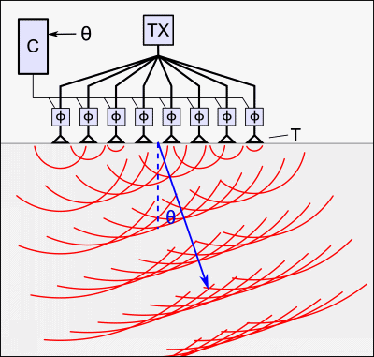
Scanning is power consuming: beamforming
Notes:
Another kind of scanning is beamforming. While beamforming does not require a motor, a fine angular resolution of the beam requires a large number of transducers to transmit the signal simultaneously. This architecture needs parallel transmit/receive hardware chains and processing, leading to higher computational complexity and power budget.

Slide 19
Scanning fundamentally add a power barrier
I need a low-power, small-size, and a light-weight navigation solution!
We develop SPiDR, a navigation solution for ultra-low-power tiny robots!
Notes:
Scanning fundamentally add a power barrier. Our approach to meet this low-power, small size, and light weight requirements in certain low-power platform is to break away from scanning based navigation. Next I will introduce the core intuition of our approach, called coded signal projection.

Slide 20

Our project: coded signal projection
Object
Microphone
Ultrasound speaker
Object
Notes:
We envision a concept called coded signal projection. Let’s first review what is the signal propagation process in real world. (click)When the signal is transmitted, it propagates to an omni direction. If there are two objects in the scene, we cannot differentiate the reflected signals from them. This is the reason why previous approach scan one direction at a time so that they can identify which direction the reflection is coming from.
Coded signal projection
Show beamforming. Breaking away from scanning based imaging, we are showing coded signal projection. We want to know which direction we are getting. Instead of sensing to direction, spatially coded signal.unwraval. Convert to a depth map. While idea is easy

Slide 21
Our project: coded signal projection
Object
Microphone
Ultrasound speaker
Object
Notes:
Here we plan to transmit direction coded signals. The transmit signals have different patterns in each direction. In this case, the reflected signals will also have the pattern of direction.
Coded signal projection
Show beamforming. Breaking away from scanning based imaging, we are showing coded signal projection. We want to know which direction we are getting. Instead of sensing to direction, spatially coded signal.unwraval. Convert to a depth map. While idea is easy

Slide 22
Our project: coded signal projection
y_{rcv}
=
⍺₁
⍺₂
Object
✶
➕
✶
Microphone
Ultrasound speaker
Object
Notes:
Now if we successfully unravel these reflections, we will be able to find out which direction the reflections are coming from, and how far the objects are. These are the information we need to create a depth map of the scene. While the idea is clean in theory, there are several practical challenges we need to solve in practice.
Coded signal projection
Show beamforming. Breaking away from scanning based imaging, we are showing coded signal projection. We want to know which direction we are getting. Instead of sensing to direction, spatially coded signal.unwraval. Convert to a depth map. While idea is easy

Slide 23







How to project direction coded signal?
Object plane
>
Pixel-1
$$φ_{1}$$
Pixel-2
>
…
$$φ_{2}$$
…
$$φ_{3}$$
>
$$TX$$
$$φ_{4}$$
>
$$φ_{5}$$
Pixel-m
$$φ_{6}$$
Sensor array is still power hungry.
Notes:
One idea is sensor array, for each transmitter, we have a specific phase delay, so that we can project direction coded signal. (click) But the problem is an array is still power hungry since it utilizes an array of transducers, similar to the beamforming approach.
Controlled multipath
Mimo, gogin to power hungry.

Slide 24

Acoustic micro-structure for code projection
Acoustic structure (model internal view)
Notes:
We design a 3D printed acoustic structure, called stencil, that can help us emulate multiple sound sources. This is the internal view of stencil. It has many paths inside with different lengths.
Controlled multipath
Mimo, gogin to power hungry.

Slide 25
Acoustic micro-structure for code projection
Path-1, length d1
Gain 𝑔₁
Path-n, length dn
Gain 𝑔_{n}
Acoustic structure (model internal view)
Notes:
These tubes will delay the signal with different phase values when coming out. In this way, we emulate the speaker array with only one speaker. No scanning or multiple speakers is needed.
Controlled multipath
Mimo, gogin to power hungry.

Slide 26
Acoustic micro-structure for code projection
Object plane
Path-1, length d1
Gain 𝑔₁
>
Pixel-1
Pixel-2
>
…
…
>
>
Pixel-m
Path-n, length dn
Gain 𝑔_{n}
Acoustic structure (model internal view)
Notes:
After signal propagate through different paths, a controlled multipath is formed in the scene. With the multipath, the received signals at each pixels in the object plane are unique. More importantly, since the structure of stencil is stable, the multipath is also static. We only need to calibrate the received signal once.

Slide 27
Acoustic micro-structure for code projection
3D model of the acoustic structure
Internal structure for the signal paths
Object plane
Path-1, length d1
Gain 𝑔₁
>
Pixel-1
Pixel-2
>
…
…
>
>
Pixel-m
Path-n, length dn
Gain 𝑔_{n}
Acoustic structure (model internal view)
Notes:
On the top, we give an example of the 3D model of the stencil. Of course we need a complex internal structure to induce enough diversity at each location in the scene.
We achieve this with helical structures to induce enough diversity.

Slide 28
Acoustic micro-structure for code projection
3D model of the acoustic structure
Internal structure for the signal paths
Object plane
Path-1, length d1
Gain 𝑔₁
>
Pixel-1
Pixel-2
>
…
…
>
>
Pixel-m
Acoustic structure embeds codes into the signal.
It consumes zero power!
Path-n, length dn
Gain 𝑔_{n}
Acoustic structure (model internal view)
Notes:
And interestingly, it does not consume any power, it is just a 3D printed metamaterial. But it can achieve similar diversity like a 10 element array.

Slide 29
Core idea: controlled multipath in space
Without stencil
With stencil
Notes:
The core theory that we have developed behind this stencil is the sound interaction with the microstructure with desired code, relying on our idea of controlled multipath. Just to give an overview, on the left hand side, the signals in all directions are almost the same. But after we add the stencil, the energy is diversified to all the directions.
How we project direction code: stencil. Add two animations of comsol, with and without stencil.

Slide 30
Core idea: controlled multipath in space
Without stencil
With stencil
Notes:
These are the amplitudes of the cross section of the image plane without and with stencil. We can see that in each angle, the patterns of signal amplitudes are not the same.
the internal micro-structure of the stencil diversifies the signal amplitude, forming the direction code as we need.

Slide 31
Scene reconstruction
Time-domain received signal
M
1
Notes:
This is the process we reconstruct the scene. Since we only use one microphone as receiver, the time-domain received signal is a vector. The received signal is the combination of all the reflected signals in the scene. Therefore, the received signal can be unraveled as multiplying a H matrix with a vector x.

Slide 32
Scene reconstruction
Time-domain received signal
One-time calibrated received signals for different locations
Scene
1
0
…
1
N
…
M
M
0
1
1
N
Notes:
Each column in H matrix is the received signal when there is an object at the location. The x vector represents the scene, that is if there is an object at each of the locations.

Slide 33
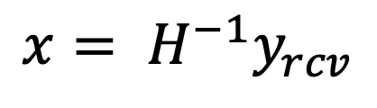
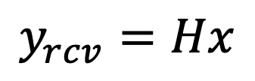
Scene reconstruction
Time-domain received signal
One-time calibrated received signals for different locations
Scene
Known
1
$$y_{rcv}=Hx$$
0
…
1
N
…
$$x= H^{−1}y_{rcv}$$
M
M
0
1
Scene of the tiny robot
1
N
Notes:
After getting the received signal y and the H matrix from calibration, we can get the scene x as H-1y. We used compressed sensing algorithm least absolute deviations to solve this equation.
However, at this stage, the it is still power hungry due to the matrix inversion process.
Now the scene reconstruction has boiled down to solving this equation, where y is the received signal, and H is the matrix of calibrated received signal. As you can see, if H matrix is bigger, it is more computationally heavy, depending on how big the scene we want to reconstruct and how fine the resolution is.

Slide 34




Challenge: Low-power scene reconstruction
$$y_{rev}=Hx$$
$$y_{rev}= H_{meta}x_{meta}$$
$$y_{rev}= H_{fine}x$$
Notes:
This inverse problem can be computationally heavy, it is proportional to the number of columns we consider in the H matrix. We attempt to reduce the power consumption as well. And the key intuition here is we do not need to invert the entire H matrix at a time. Rather, we can iteratively reconstruct the scene. First we try to get a coarse-grained reconstruction of the image, by sparsely sampling some of the elements of H. Once we highlighted certain region of interest, we apply a smaller but denser channel matrix to increase the resolution.
Instead of including all the pixels in H matrix, we define meta-pixels that can cover a cluster of pixels based on correlation channels. This approximate scene xmeta lacks usable resolution for perception, but provided the possible locations of the objects. After that, we select a smaller region to further reconstruct the scene to improve resolution, with a smaller subset of the columns of H. In this way, the column number in H is exponentially reduced, saving more power for scene reconstruction.

Slide 35
Challenge: Low-power scene reconstruction
Notes:
This is the consumed energy with numbers of columns in H. The more columns, the higher the power consumption.

Slide 36
Challenge: Low-power scene reconstruction
Notes:
How can we find the level of sub resolution used for the first reconstruction of the scene? We find that the correlation of locations within 3cm is larger than 0.5. Therefore one column in the coarse grained H represents a 3cm square.

Slide 37
Some practical improvements to further improve the imaging performance.
Notes:
Until here we can reconstruct our scene using low power. We introduce some practical improvements to further improve the imaging performance.

Slide 38
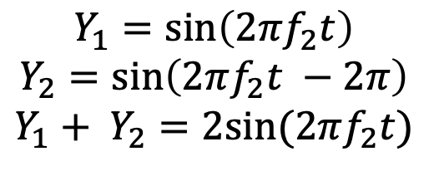
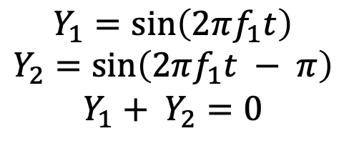
Practical improvements: frequency stacking
Y1
Y1
Y2
Y2
$$Y_{1}=\sin\left(2πf_{1}t\right)$$
$$Y_{2}=\sin\left(2πf_{1}t − π\right)$$
$$Y_{1}+ Y_{2}=0$$
$$Y_{1}=\sin\left(2πf_{2}t\right)$$
$$Y_{2}=\sin\left(2πf_{2}t −2π\right)$$
$$Y_{1}+ Y_{2}=2sin⁡(2πf_{2}t)$$
Notes:
One way to improve this image is to take the snapshot of the same scene with different channel matrices. Which seems impossible with only one acoustic structure. But it is possible if we transmit different frequencies, and we use this as an intuition to improve our image accuracy. The core observation here, the same internal structure when passed by different frequencies, they can have different phase and amplitude at the same location. We can see that with frequency f1, the signal strength is zero after two paths encountered together. (click) But for frequency f2, the strength is enlarged.

Slide 39






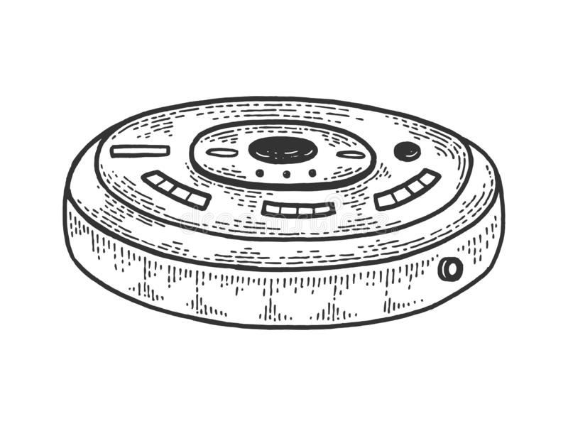
Practical improvements: motion stacking
Maps constructed during motion
After motion stacking
Notes:
So far in our processing, we did not consider the movement of the robot that provides an opportunity for further improving the quality of the generated map. Robots require continuous mapping of the scene during navigation. Therefore, it provides multiple snapshots where certain parts of the scene are in common. It is possible to reorient the snapshots and superimpose them to generate a robust and high-resolution reconstruction of the scene. The concept of superimposition or stacking maps is a popular approach in robot navigation. We use the knowledge about the robot’s movement to compensate for the translational changes between consecutive maps before superimposition.
animation

Slide 40
Evaluation
Notes:
Until here we can reconstruct our scene using low power. We introduce some practical improvements to further improve the imaging performance.

Slide 41
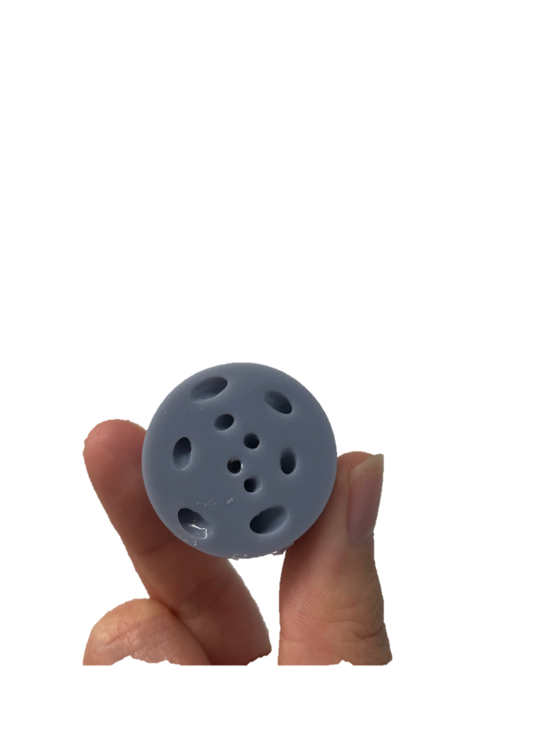
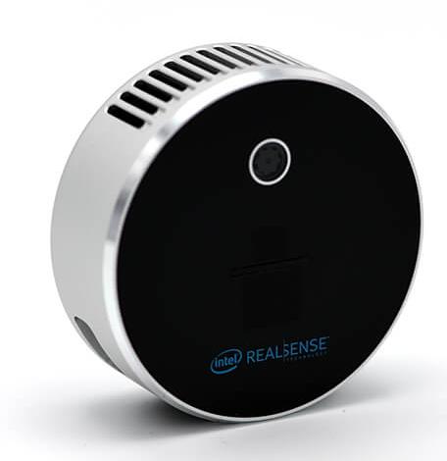
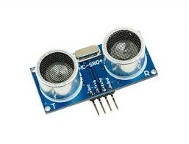
Evaluation
Lidar
Distance sensor with servo motor
SPiDR prototype
Notes:
We evaluate the power consumptions and accuracy of Lidar, distance sensor with servo motor, and SPiDR.
Picture for lidar
Picture for distance sensor with steering motor
Picture for SPiDR

Slide 42
Evaluation results
Bad
Good
Notes:
In this picture, we show the accuracy and energy tradeoff for lidar and distance sensor with servo motor compare to our design. The x dimension is the accuracy (click), and the y dimension is the energy consumption (click).

Slide 43
Evaluation results
LiDAR
Bad
Bad
Good
Good
SPiDR
Notes:
We can see that the accuracy of SPiDR is comparable with Lidar, but with 400 times less power consumption.

Slide 44
Evaluation results
LiDAR
Distance sensor with servo motor
Bad
Bad
Good
Good
SPiDR
Notes:
Also the accuracy of SPiDR is much higher than distance sensor with around 300 times of less power.

Slide 45
Evaluation results
Notes:
We also evaluated the performance under varying proximity. This result shows that we can successfully detect the open space between two blocks.

Slide 46
Evaluation results
Notes:
Here we evaluate if we can have an accurate estimate of the depth of the obstacle. We find that the system is also sensitive to the depth change.

Slide 47
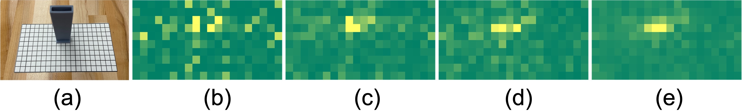
Evaluation results
Ground truth
Raw output
Only motion stacked
Only frequency stacked
Both
Notes:
This result shows how frequency stacking and motion stacking improves the imaging performance. The raw output is blurred, but after motion stacking and frequency stacking, the scene is very clear.

Slide 48
Evaluation results
Notes:
These are several real-world scenes we constructed. As you can see, the detected scenes match with the ground truth.

Slide 49
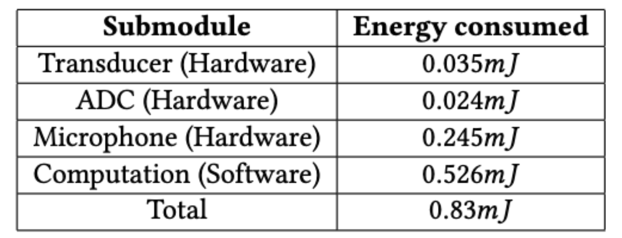
Evaluation results
Notes:
We break down the power consumption into submodules. The total energy consumption is 0.83mJ for constructing one image. The power consumption is 10mW. (click) This is the power consumption variation during the imaging process. We can see that the power consumption of microphone is as high as 30mW, so we only power up the microphone during sampling, which further reduces the power consumption.

Slide 50
Takeaway
SPiDR, is a practical system for ultra-low-power acoustic scene reconstruction using passive micro-structures..
Notes:
As a summary, we introduce the usage of acoustic microstructure for miniaturized spatial sensing.
That is all we have for our presentation today.
As a summary, we introduce the usage of acoustic microstructure for miniaturized spatial sensing.
We believe that owlet will open up many applications, including on-body sensing and insect-scale navigation. Thank you for listening in.

Slide 51
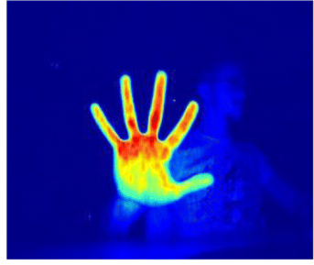
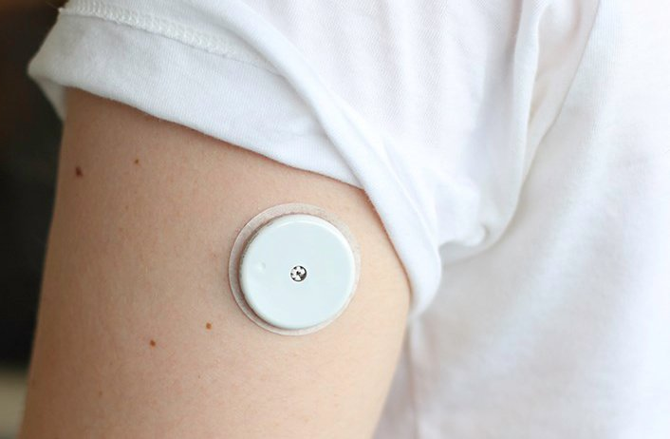
Low-power sensing using acoustic structure
Hand gesture recognition
On-body sensing
Notes:
We believe that microstructures will bring low power to many applications, such as hand gesture recognition and on body sensing. With ultra low power, these applications can be paired with wireless charging to be battery free.

Slide 52
SPiDR: Ultra-low-power Acoustic Spatial Sensing
for Micro-robot Navigation
For more information, read our MobiSys 2022 paper and visit our group website: http://icosmos.cs.umd.edu/
Yang Bai*
Nakul Garg*
Nirupam Roy
yangbai8@umd.edu
nakul22@umd.edu
niruroy@umd.edu
(*Equal contribution)
Notes:
Thank you. Please feel free to raise questions.

