Slide 1
Operational models for acting and planning: current status and future prospects
Sunandita Patra patras@umd.edu​ PostDoctoral Researcher University of Maryland, College Park, USA Invited Talk: JPL AIG May 5, 2021
 | ​

Slide 2
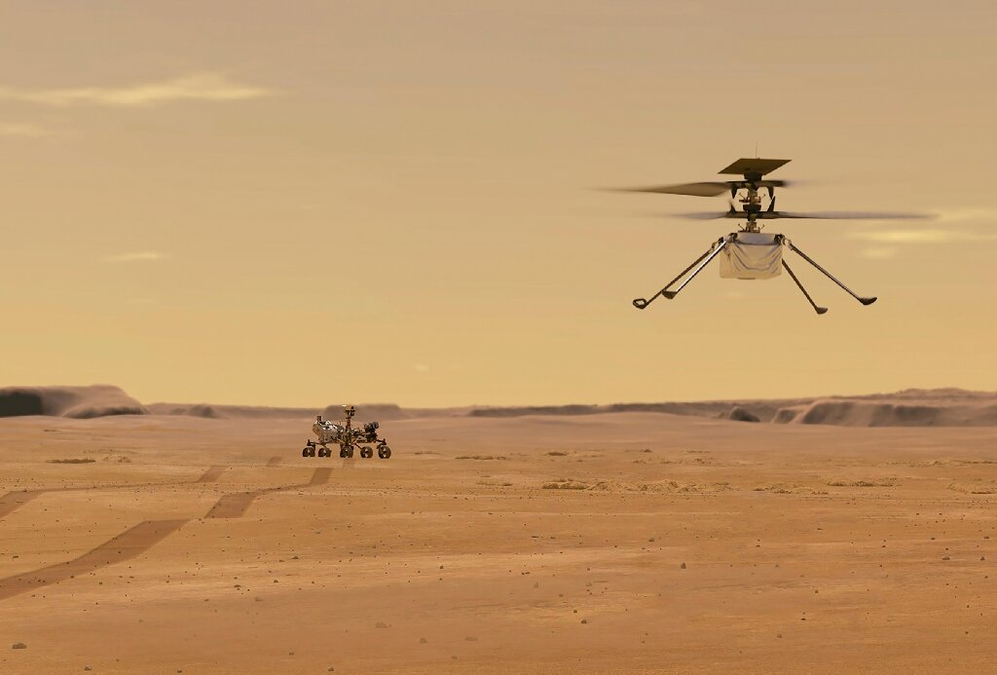
Why integrate Acting and Planning?
Actors
Notes:
As an example, consider exploration tasks in an environment with dynamic events, concurrent tasks, sensing some information from the environment, planning and learning.
On one hand, the actor can’t start acting without a plan. But, on the other hand, you can’t take a plan and execute it all the way through because a lot of things could go wrong. So, the actor needs to continually plan while it is acting. This is just one example, there are many such scenarios where the integration is important.

Slide 3
Proposed Architecture of an Actor
Actor
Planner
Learning Component
Tasks/goals
Task and Action Models
Acting Engine
State
Focus of this talk: Descriptive or operational?
Actions
Events
Execution Platform
Actuation
Sensing
Environment

Slide 4
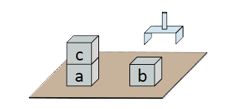
Planning
Prediction + search
Descriptive action models: Say ``what” actions do
Has a set of preconditions and effects
Efficiently predict next state(s)
Search large state spaces quickly
Example: Simple blocks-world domain
Range(x) = {a, b, c}
Action: Pickup(x)
Pre: loc(x) = table, top(x) = nil,
holding = nil
Eff: loc(x) ← hand, holding ← x
Action: Putdown(x)
Pre: holding = x
Eff: loc(x) ← table, holding ← nil

Slide 5
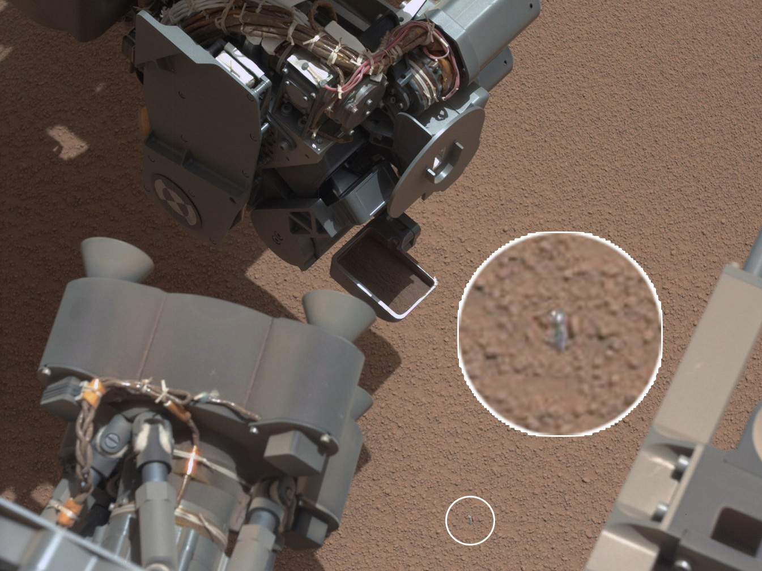
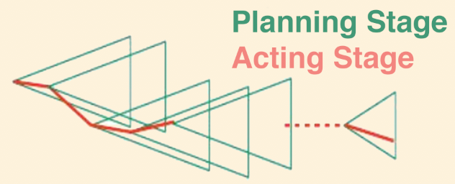
Acting
pickup(object)
Performing tasks and actions in the real world
Knowing ``what” not enough
Execution platform needs to know ``how”
May involve closed loop online decision making
Planner
How?
Operational Models
How to perform the task?
Acting Engine

Slide 6
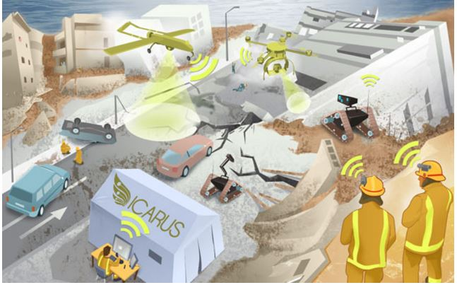
Operational Models
Tell us how to perform the task
Task: An activity for the actor to perform
For each task, one or more refinement methods
Possible ways to accomplish the task
Commands: Actions sent to the execution platform
Can have nondeterministic outcomes
Example: Some natural disaster has happened
Task: rescue(p)
rescue-method1(p, r)
task: rescue(p)
pre: status(r) = Free and loc(p) = Unknown
body: for l in LOCATIONS:
move(r, l)
sense(l)
if loc(p) = l:
help(r, p)
return
output(“cannot find” p)
rescue-method2(p,l)
task: rescue(p)
pre: loc(p) = l and l ≠ Unknown
body: r ← free robot nearest to p
if r != NONE:
move(r, l)
help(r, p)
else fail
Notes:
method-name1(arg₁, …, arg_{k})
task: task-identifier
pre: test
body: computer program to generate
commands and tasks

Slide 7
Example: Descriptive Vs Operational
Descriptive model
task: rescue(p)
pre: status(r) = Free and loc(p) = Unknown
effects: status( r) = Free loc(p) = base status(p) = saved
Descriptive Models
What the actions do?
Planner
Operational model
task: rescue(p)
pre: status(r) = Free and loc(p) = Unknown
body: for l in LOCATIONS:
move(r, l)
sense(l)
if loc(p) = l:
help(r, p)
return
output(“cannot find” p)
Operational Models
How to perform the task?
Acting engine

Slide 8
Integration of Actor and Planner
Standard procedure to integrate acting and planning
Plan using descriptive
Act using operational
Replan online when necessary
Descriptive Models
What the actions do?
Planner
Operational Models
How to perform the task?
Acting engine
Notes:
If descriptive models are not predicting what operational models actually do, then plan verification becomes impossible.
It is more difficult to maintain consistency when there are dynamic events happening

Slide 9
Integration of Actor and Planner
Issues with this style of integration:
Consistency between two different models
Plan verification
Plan management
Descriptive Models
What the actions do?
Planner
Consistent?
Proposed Solution
One single representation for both actor and planner
Must be operational
Descriptive models too abstract
New planning algorithms to reason with operational models
Operational Models
How to perform the task?
Acting engine
Notes:
If descriptive models are not predicting what operational models actually do, then plan verification becomes impossible.
It is more difficult to maintain consistency when there are dynamic events happening

Slide 10
Use Descriptive or Operational models?
How to choose one model over the other? Issues to Consider:
Overhead for maintaining model consistency
Nondeterminism
Dynamic events
Multiple agents
Integration with learning
…

Slide 11
Model Consistency
Descriptive model
task: rescue(p)
pre: status(r) = Free and loc(p) = Unknown
effects: status( r) = Free loc(p) = base status(p) = saved
Consistency between the actor’s and planner’s models
Do the descriptive models correctly predict what the operational models do?
final loc( r) or loc( p)?
outcome of sense(l) ?
Every change in operational model => accurately reflect in the descriptive model
Need constant human supervision to avoid inconsistent plans
Plan verification and management becomes difficult
Operational model
task: rescue(p)
pre: status(r) = Free and loc(p) = Unknown
body: for l in LOCATIONS:
move(r, l)
sense(l)
if loc(p) = l:
help(r, p)
return
output(“cannot find” p)

Slide 12
Nondeterminism
Descriptive model
task: rescue(p)
pre: status(r) = Free and loc(p) = Unknown
effects: status( r) = Free / busy? loc(p) = base / outdoors? status(p) = saved / not saved?
Actions/tasks may have nondeterministic outcomes
Need explicit list of outcomes in descriptive models
Planner reason over the outcomes
Cyclic/acyclic solutions?
Operational models: outcomes are simulated
Operational model
task: rescue(p)
pre: status(r) = Free and loc(p) = Unknown
body: for l in LOCATIONS:
move(r, l)
sense(l)
if loc(p) = l:
help(r, p)
return
output(“cannot find” p)

Slide 13
Dynamic Events
Descriptive model
task: rescue(p)
pre: status(r) = Free and loc(p) = Unknown
effects: status( r) = Free / busy / dead? loc(p) = base / outdoors / unknown? status(p) = saved / not saved / unknown?
Descriptive models:
A single event may affect all action models (e.g., another natural disaster happens)
Explosion in the number of outcomes
Operational models:
Add one new event to recover from the new disaster, recover()
Leave other action models unchanged
Operational model
task: rescue(p)
pre: status(r) = Free and loc(p) = Unknown
body: for l in LOCATIONS:
move(r, l)
sense(l)
if loc(p) = l:
help(r, p)
return
output(“cannot find” p)

Slide 14
Multiple Agents
Descriptive model
task: rescue(p)
pre: status(r) = Free and loc(p) = Unknown
effects: status( r) = Free / busy / dead? loc(p) = base / outdoors / unknown? status(p) = saved / not saved / unknown?
Cooperative setup
Do the agents share resources?
Do they communicate?
Operational model
task: rescue(p)
pre: status(r) = Free and loc(p) = Unknown
body: for l in LOCATIONS:
move(r, l)
sense(l)
send message to another robot r2
if loc(p) = l:
help(r, p)
return
output(“cannot find” p)

Slide 15
Integration with Learning
Descriptive model
task: rescue(p)
pre: status(r) = Free and loc(p) = Unknown
effects: status( r) = Free / busy / dead? loc(p) = base / outdoors / unknown? status(p) = saved / not saved / unknown?
Descriptive model
Work has been done on representation learning
Operational Models
Learn to choose methods
Learning a heuristic function
Operational model
task: rescue(p)
pre: status(r) = Free and loc(p) = Unknown
body: for l in LOCATIONS:
move(r, l)
sense(l)
send message to another robot r2
if loc(p) = l:
help(r, p)
return
output(“cannot find” p)

Slide 16
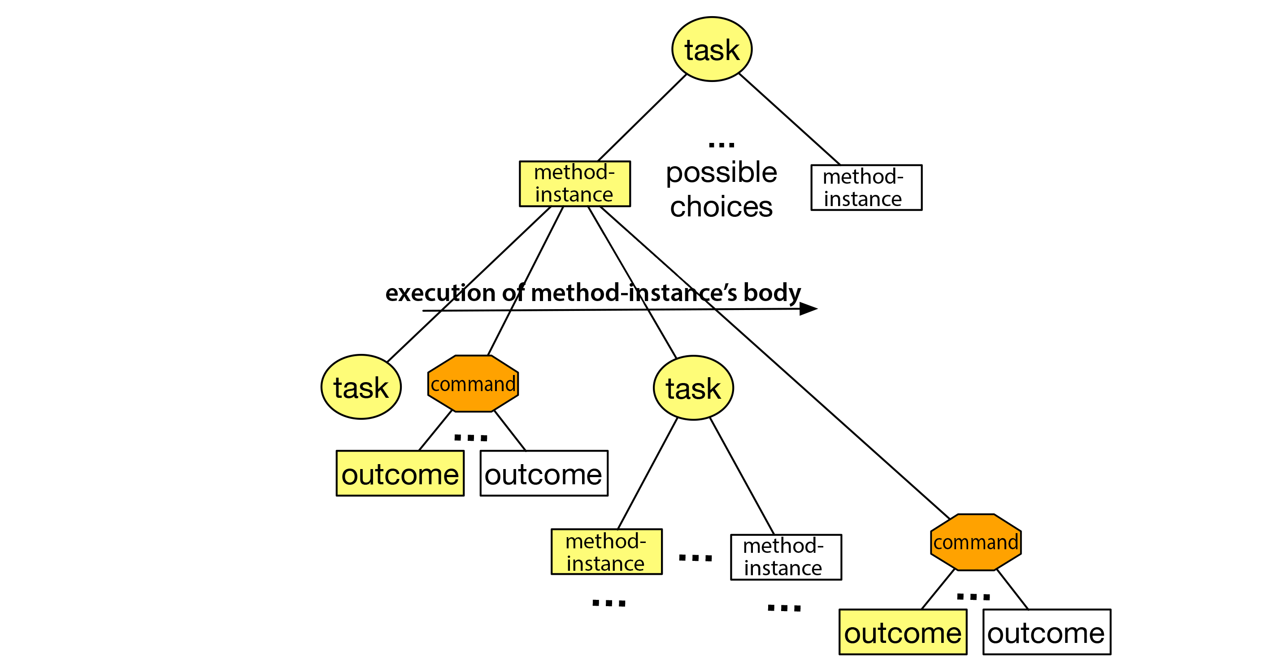
Planning with Operational Models
Main Challenge: backtracking in program code
Solution:
Do several Monte Carlo Rollouts
Choose the method with the highest expected utility
m1
m2
Execution of m2’s body

Slide 17
Tradeoffs (open to discussion)
Comparison Metric | Descriptive Models | Operational Models
Closed world problems | ✅ | ⛔️
Plan computation efficiency | ✅ (many years of research) | ⚠️ (fairly recent)
Consistency between actor and planner | ⛔️ | ✅
Nondeterminism | ⚠️ | ✅
Plan Monitoring | ⛔️ | ⚠️
Dynamic Events | ⛔️ | ✅
Dead Ends | ⛔️ | ✅
Multiple Agents | ? | ?
Learning | ⚠️ | ⚠️
Simulator | Use if simulator not available | Use if simulator is available
Cost of building models | Feasible with an initial model learning curve (e.g., learning PDDL, HTN) | Need more data to make a good estimate
Notes:
Overhead: simulator

Slide 18
Summary
Actor
Planner
Learning component
Tasks/goals
Task and action models
Acting engine
State
Focus of this talk: Descriptive or operational?
Actions
Events
Execution Platform
Actuation
Sensing
Environment
Notes:
Title?

Slide 19
Conclusions
Descriptive models: says *what* actions do
Operational models: says *how* to do actions
How to choose?
Study the properties of environment: dynamic events, dead ends, nondeterminism
Complexity of the actor: concurrent tasks, closed-loop execution
Simulator available?

Slide 20
Thank you
Important Links:
1. Deliberative Acting, Online Planning and Learning with Hierarchical Operational Models. Sunandita Patra, James Mason, Malik Ghallab, Dana Nau, Paolo Traverso. AIJ. 2021
Link: https://arxiv.org/abs/2010.01909
2. Integrating Acting, Planning and Learning in Hierarchical Operational Models. Sunandita Patra, James Mason, Amit Kumar, Malik Ghallab, Paolo Traverso, Dana Nau. ICAPS. 2020.
Link: https://icaps20.icaps-conference.org/paper55.html
Talk: https://www.youtube.com/watch?v=q82ZLTdMef8
Poster: https://icaps20.icaps-conference.org/posters/poster55.pdf
3. My PhD Thesis (2020): https://www.cs.umd.edu/~patras/PhD_Thesis_Sunandita_Patra.pdf
Code repositories:
1. RAE (actor) and UPOM (planner) : https://bitbucket.org/sunandita/upom/src/master/
2. RAE (actor) and RAEPlan (planner) : https://bitbucket.org/sunandita/raeplan/src/master/
For any doubts or discussions, please reach out to me at patras@umd.edu ☺
Notes:
Thank you, everyone for listening to my presentation.

