Slide 1
Algorithms for Dynamic NFV Workload
Seffi Naor
Computer Science Dept.
Technion
Based on joint papers with Rami Cohen, Yaron Fairstain, Liane Lewin-Eytan, Danny Raz
[Infocom 2015, WAOA 2018]

Slide 2
Network Functions Virtualization (NFV)
New way of designing, deploying, managing networking services.
Decouples network functions from proprietary hardware appliances so they can run in software; e.g., network address translation (NAT), firewalling, intrusion detection, domain name service (DNS), parental control, caching, etc.
Functions can be located in, e.g.,:
servers at gateways, cloud (rental), private clouds (buying servers), edge compute (mobile edge computing)

Slide 3
Network Functions Virtualization (NFV)
Challenging network design problems: how to support a fully virtualized infrastructure – including virtual servers, storage, other networks, etc. ?
Leading to novel algorithmic location problems:
where?
how many locations?
which functions should be co-located?
taking into account:
cost and capacity of infrastructure
service chaining
Ample work on facilty location
yet focus has mostly been on a “single” function
multi-commodity facility location [Ravi & Sinha, 2004]

Slide 4
Placement of Network Functions
Distributed Network
Functions (and services) are implemented at various locations in the network
Traffic is sent to these servers using the control mechanism of SDN
SDN
Controller
Where to place services
One place (globally)?
In each location?
As needed = depending on demand?
PCE LTE TE
PDN-GW S-GW
SGSN/GGSN
SIP NAT RSVP
EPC
DPI

Slide 5
Model: Problem Definition
Input
Network endowed with a distance metric d(·)
Set of possible service locations
Servers have bounded size
For each network function:
capacity - number of clients it can serve
size on server
setup cost
Set of given flows (clients); for each flow:
there is a predefined route in the network
requests a set of network functions
demand requirement for each function

Slide 6
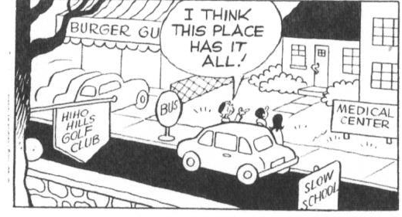
Model: Problem Definition
Output
placement of network functions on servers
rerouting of flow to network locations such that:
demand of each flow is fully served by the functions it requested
servers:
size constraints are not exceeded by the functions placed at a server
capacity constraints of each (copy of) function are met

Slide 7
Model: Problem Definition
Objective function
each flow is rerouted through servers containing the functions it requests
cost = sum of distances from the flow path to the servers
functions are placed at the servers
cost = sum of setup costs of the functions
setup cost is paid for each copy of a function
total cost = sum of distance costs + sum of setup costs

Slide 8
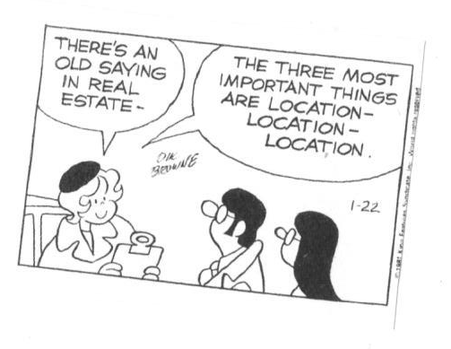
Facility Location Problems
Problem:
network endowed with a distance metric
set of clients
facilities: each has a setup cost and capacity
Goal:
open a set of facilities in the network
match clients to facilities while satisfying capacity constraints
minimize sum of distance costs and setup costs
History:
classic problem, studied extensively since the 1960s
NP-hard problem, constant-factor approximations
In our terminology: single function!

Slide 9
Generalized Assignment Problem
Jobs are assigned to machines:
for each job:
setup cost – machine dependent
size – machine dependent
for each machine:
upper bound on total size of jobs assigned to it
goal: minimize sum of setup costs, while satisfying size constraints
In our terminology:
multiple functions: job = function
infinite capacity - single copy of each function suffices
network distances = 0

Slide 10
NFV Location Problem
Model captures important aspects of NFV placement
A bi-criteria (O(1), O(1)) approximation algorithm for the general NFV location problem
LP formulation of the problem
rounding a fractional solution
bi-criteria approximate solution:
size constraints are violated by a constant
Experimental results:
significant improvement over greedy algorithm over many different scenarios
Good performance in terms of obeying capacity constraints

Slide 11
Dynamic NFV Placement (1)
from a “one shot” solution to an evolving solution
setting: heterogeneous networks
clients (flows) undergo changes, moving over time: e.g., satellites, mobile users
highly dynamic in nature, therefore taking it into account is essential for efficient deployment

Slide 12
Dynamic NFV Placement (2)
dynamic setting is captured by a metric evolving over time
allows us to model movement of flows over time
goal:
computing a stable solution
minimizing changes to the configuration, i.e., assignment changes
demands and metric evolution are given ahead of time:
prediction in HTS and vRAN systems is very useful
competitive factors are not meaningful in the dynamic setting

Slide 13
Dynamic Facility Location
defined over a time horizon
different metric at each time step
change cost paid for assignment changes between consecutive time steps
[Eisenstat, Mathieu, Schabanel, ICALP 2014]

Slide 14
Model: Problem Definition
Input
Time horizon T
Metric changes at each time step:
Servers remain at fixed locations
Clients are dynamically changing location
Cost g for client assignment changes between time steps
Set of possible service locations
Servers have bounded size
Set of given flows (clients); for each flow:
there is a predefined route in the network for each time step
requests a set of network functions
demand requirement for each function

Slide 15
Model: Problem Definition
Output
placement of network functions on servers
rerouting of flow to network locations such that:
demand of each flow is fully served by the functions it requested at each time step
servers:
size constraints are not exceeded by the functions placed at a server
capacity constraints of each (copy of) function are met

Slide 16
Model: Problem Definition
Objective function
each flow is rerouted through servers containing the functions it requests
connection cost = sum of distances from the flow path to the servers
change cost = number of assignment changes times the change cost
functions are placed at the servers
cost = sum of setup costs of the functions
setup cost is paid for each copy of a function
total cost = sum of distance costs + sum of setup costs
+ sum of change costs

Slide 17
Dynamic NFV
Interval selection:
Independently, for each client and function
breaks time horizon into intervals with fixed fractional assignment
at most doubles fractional solution
guarantees fractional change of at least $\frac{1}{2}$ over each interval
$$c_{1}$$
$$c_{2}$$
$$c_{3}$$
$$c_{4}$$
$$I_{9}$$
$$I_{6}$$ | $$I_{7}$$ |  |  | $$I_{8}$$
$$I_{3}$$ |  | $$I_{4}$$ | $$I_{5}$$
$$I_{1}$$ |  |  | $$I_{2}$$

Slide 18
Interval Graph List Coloring
Input
interval graph
a set of colors
for each interval – a subset of colors it can be legally colored with
Output
a legal coloring of the intervals such that intersecting intervals are colored differently

Slide 19
Interval Graph List Coloring
List coloring is NP-hard even on interval graphs (unlike coloring)
Goal: minimizing the number of “extra” copies of any color
we show an integrality gap of $Ω\left(\frac{\log{k}}{\log{\log{k}}}\right)$ where $k$ is the size of the largest clique in the interval graph
we show how to color the intervals with at most $O\left(\log{min⁡\{k,T\}}\right)$ copies of each color, given that a feasible fractional coloring exists

Slide 20
IGLC - $\log{k}$ Approximation
Consider a bipartite graph $G=\left(P∪C,E\right)$
$P$ – intervals at a specific point
$C$ – colors
$E$ - edges between intervals to colors they can be colored with
In any feasible fractional coloring each subset $S⊆P$ of intervals is colored with at least $\left|S\right|$ colors
Each subset $S⊆P$ can be colored with at least $\left|S\right|$ colors
$P$ can be fully matched to colors (Hall’s theorem)

Slide 21
Dynamic NFV
Define an instance of IGLC:
each ball with capacity $μ$ → $μ$ colors
each interval can be colored with colors belonging to its representative balls

Slide 22
Dynamic NFV - Analysis
Setup part
placing a function for each ball using GAP rounding
factor of 2 to the size violation
Overall
demand of each client is fully satisfied
constant factor approximation of the cost
constant factor violation of size constraints
logarithmic factor violation of capacity constraints

Slide 23
Thank you

