Slide 1
New Results of Quantum-proof Randomness Extractors
Xiaodi Wu (MIT)
1st Trustworthy Quantum Information Workshop
Ann Arbor, USA
based on work w/ Kai-Min Chung and Xin Li, arXiv: 1411.2315 and
work w/Kai-Min Chung, in preparation
Notes:
A new way of extracting pure randomness from physics systems
Talk Outline: 25 mins~ 30 mins
1. Refresh the definition; add a few pointers to the motivations, refer to the previous talks.
2. Proposal two main question + solution:
Qa) extractor constructions: result-wise go beyond Trevisan, and …..; technique-wise, construct quantum condensers (go beyond KM).
Sa) construct the first extractor (new construction even in the classical setting), i) optimal for the inverse-polynomial rate sources, (most commonly appeared) ii) strict improvement over existing constructions for all parameters region
iii) improve its application (DI, Privacy Amplification, Bounded Storage Crypto)
Ta) i) a new construction of condenser: inverse-polynomial rate to constant rate
ii) const-rate optimal extractors (David Zuckerman)
Q b) what is the right side information model for the

Slide 2



Randomness Extractor: Seeded
[SV84,Vaz85,VV85,CG85,Vaz87,CW89,Zuc90,Zuc91,…]
A deterministic function converts indep. weak random sources with entropy to almost-uniform randomness
source
seed
X
U_{d}
$$Ext$$
$≈$uniform output
Z

Slide 3



Randomness Extractor: Multi-source
[CG85, BIK04, Raz, Rao, Bourgain, Li ……]
A deterministic function converts indep. weak random sources with entropy to almost-uniform randomness
weak random source
$$…$$
weak random source
X₁
X_{t}
$$Ext$$
$≈$uniform output
Z

Slide 4
Applications beyond randomness
Classical TCS
  Cryptography, Derandomization [Sis88, NZ93,…], Distributed algorithms [WZ95], Data structures [Ta02], Hardness of Approximation [Zuc93,…]
Quantum Information
  Privacy amplification (QKD) [BB84, BBR…], device-independent crypto [VV12, MS14, CSW14, B+, …]
  Bounded-storage model [DFSS08,…]

Slide 5
This talk:
Q. Seeded Extractors with Optimal Parameters:
(Chung, W, in preparation)
* a new construction optimal w/ inverse poly rate source
* new techniques for quantum-proof condensers
Q. Side Info Model for Multi-source Extraction:
(Chung, Li, W, arXiv: 1411.2315)
* a proposal naturally unifying and extending existing models
* q. multi-source extractors w/ matching paras to classical

Slide 6
Q. Seeded Extractors with Optimal Parameters:
(Chung, W, in preparation)
* a new construction optimal w/ inverse poly rate source
* new techniques for quantum-proof condensers

Slide 7
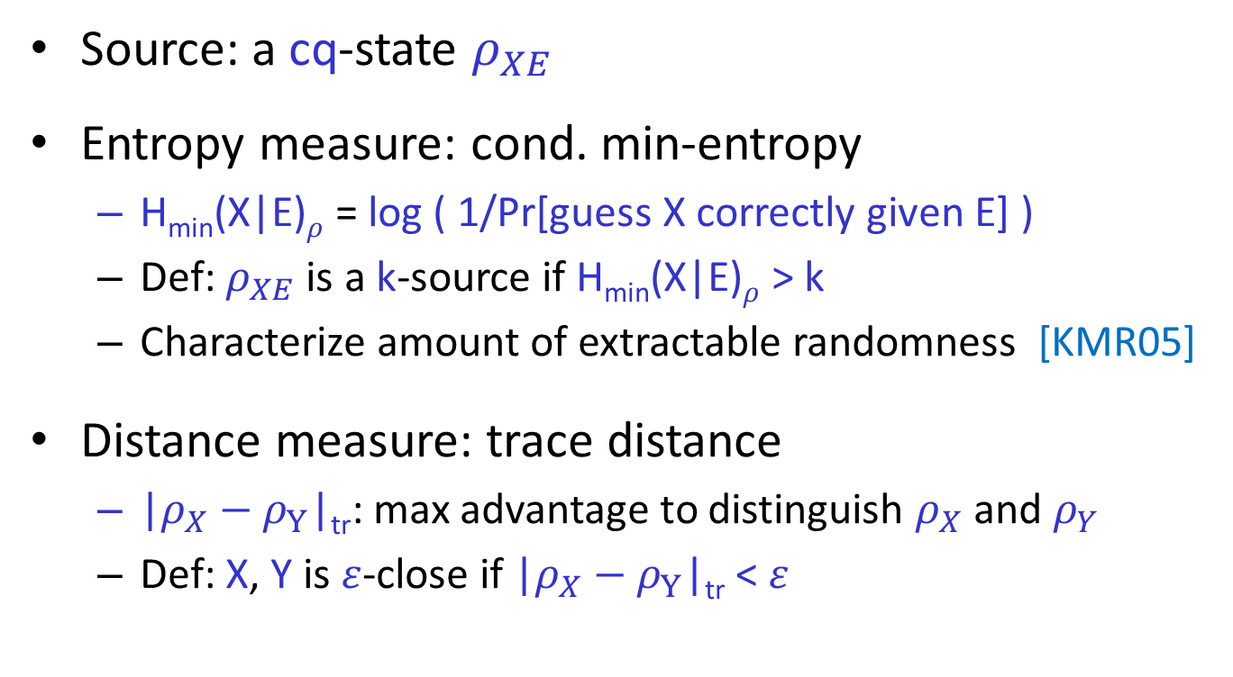
Quantum Side Info: seeded extraction
Source: a cq-state $ρ_{XE}$
Entropy measure: cond. min-entropy
  H_{min}(X|E)$ρ$ = log ( 1/Pr[guess X correctly given E] )
  Def: $ρ_{XE}$ is a k-source if H_{min}(X|E)$ρ$ > k
  Characterize amount of extractable randomness [KMR05]
Distance measure: trace distance
  |$ρ_{X}−ρ_{Y}$|_{tr}: max advantage to distinguish $ρ_{X}$ and $ρ_{Y}$
  Def: X, Y is $ε$-close if |$ρ_{X}−ρ_{Y}$|_{tr} < $ε$

Slide 8


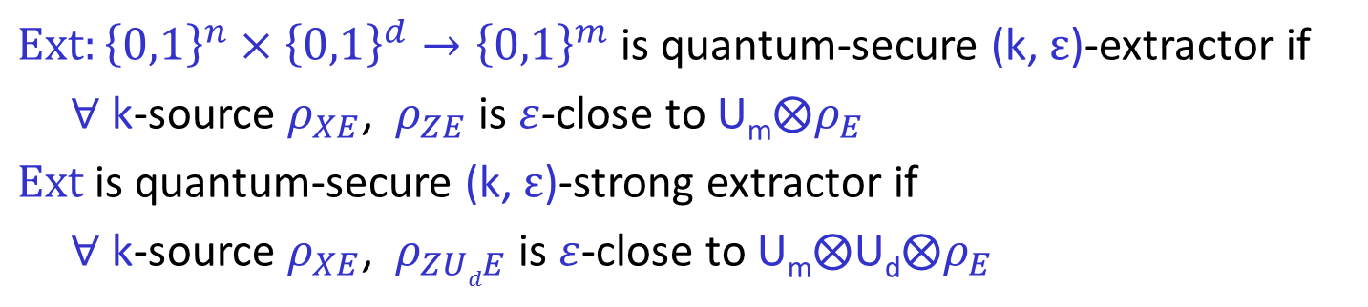
Seeded Extractors against Side Info [R05,KMR05,KT08,DV10,T11,DPVR11]
$Ext:{\left\{0,1\right\}}^{n}×{\left\{0,1\right\}}^{d}→{\left\{0,1\right\}}^{m}$ is quantum-secure (k, $ε$)-extractor if
$∀$ k-source $ρ_{XE}$, $ρ_{ZE}$ is $ε$-close to U_{m}$⨂ρ_{E}$
$Ext$ is quantum-secure (k, $ε$)-strong extractor if
$∀$ k-source $ρ_{XE}$, $ρ_{ZUdE}$ is $ε$-close to U_{m}$⨂\text{U}\text{d}⨂ρ_{E}$
classical-secure
marginal-secure
for no side-info
for classical side-info
classical-secure
marginal-secure
Seeded Randomness Extractor
source
seed
X
U_{d}
adversary
$$Ext$$
$$E$$
$≈$uniform output
Z

Slide 9
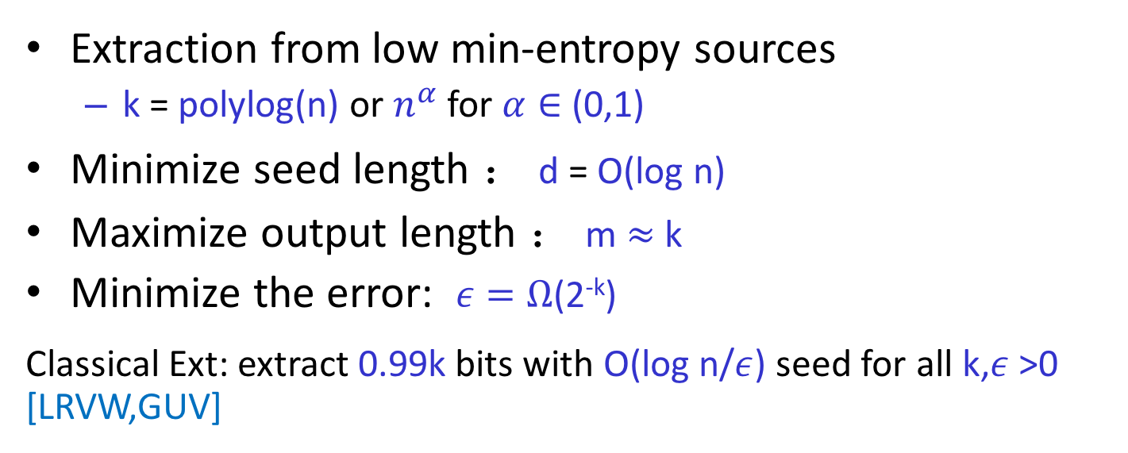
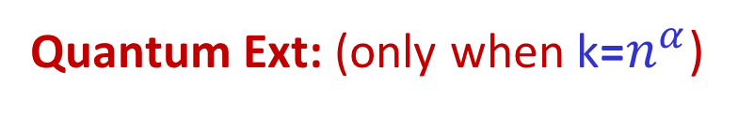
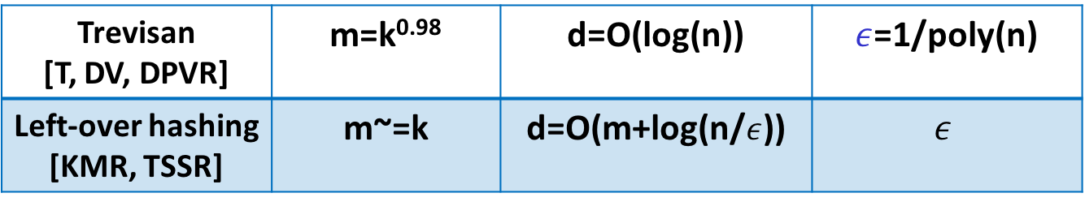
What do we want?
Extraction from low min-entropy sources
  k = polylog(n) or $n^{α}$ for $α∈$ (0,1)
Minimize seed length ： d = O(log n)
  Maximize output length ： m $≈$ k
Minimize the error: $ε=Ω$(2^{-k})
Classical Ext: extract 0.99k bits with O(log n/$ε$) seed for all k,$ε$ >0 [LRVW,GUV]
Quantum Ext: (only when k=$n^{α}$)
Trevisan [T, DV, DPVR] | m=k^{0.98} | d=O(log(n)) | $ε$=1/poly(n)
Left-over hashing [KMR, TSSR] | m~=k | d=O(m+log(n/$ε$)) | $$ε$$
Notes:
List the draw back of each extractors: at least Trevisan, pairwise hashing, need to add the error term??
Here then points out the goal of construction!

Slide 10

What GUV requires?
Our Contribution:
GUV:
Q. Extractor:
(new even classically)
Very Good Condenser
Partial Progress: Cond. Inv. poly
Block Extraction & Composition
Extends to quantum setting
Main Thm: quantum-secure extractor Ext : {0,1}^{n} x {0,1}^{d} ->
{0,1}^{m}, s.t., for any (n,k) source, k=nª, w/ seed length
O(log(n/$ε$)), output length m=0.99k , $ε$=$Ω$(2^{-k^0.99}). Optimal!
Remark: inverse-poly rate sources are good for most applications!

Slide 11
Our strategy
Refer to Chung’s talk for technique limitations
Resort to extractor paradigm [NZ,SZ, Zuc] before Trevisian, based on block-sampling & block-extraction.
Our Observation:
  A) this paradigm extends to the quantum setting
  B) A new condenser/extractor in this paradigm
(n,k) source
Sampling a subset:
Hope: min-entropy
rate remains
Non-trivial to prove classically (e.g, Zuc97, Vad03).
The quantum version by Koenig & Renner 11
However, this does not condense!
Block-Sampling!
Notes:
Change the order; first list the result; and then list the observation
Main observation is that this paradigm extends to quantum; and what is more, we construct a new one that even new classically, and that one extends to the quantum case as well.

Slide 12



Block Sampling & Extraction [NZ,SZ,Zuc]
(n,k) source
Observation:
well, it does not need to be able to sample & extract at the same time!
When fails to sample, it condenses!
A win-win argument!
Block-Sampling (one by one) :
Structure Entropy
while keeping the rate
Block-Extraction (one by one):
Exp. increase Seed length
Competing Parameters: 1) able to sample
2) able to extract
=> optimal paras for const entropy-rate sources [Zuc]
Our Contribution: this construction is also quantum-proof.
Notes:
Why need two steps: because sampling cannot improve the entropy rate.

Slide 13
Condenser: 1/poly rate -> const rate (Win-Win argument)
(n,k)
Sampling ( if success -> extraction, otherwise condensing)
E₁
Sample again on a shorter input
E₂
……
E₃
const Rounds
(C0, E1,E2,…) -> const rate source
……
C₀ length k
Quantum: 1) sampling [KR] 2) remaining analysis & comp.
Notes:
Either you can continue sampling, or the part already sampled has large entropy ( a condenser, or increase the entropy rate).
We don’t know what happens.

Slide 14
Summary:
Win-Win Condenser
Zuckerman’s Extractor
Main Thm: quantum-secure extractor Ext : {0,1}^{n} x {0,1}^{d} ->
{0,1}^{m}, s.t., for any (n,k) source, k=nª, w/ seed length
O(log(n/$ε$)), output length m=0.99k , $ε$=$Ω$(2^{-k^0.99}). Optimal!
Notes:
Need a recursive use of condenser and zuckerman’s extractors.
Hiding technical details. (for such recursive use)
Improve output length afterwards.

Slide 15
Q. Side Info Model for Multi-source Extraction:
(Chung, Li, W, arXiv: 1411.2315)
* a proposal naturally unifying and extending existing models
* q. multi-source extractors w/ matching paras to classical

Slide 16



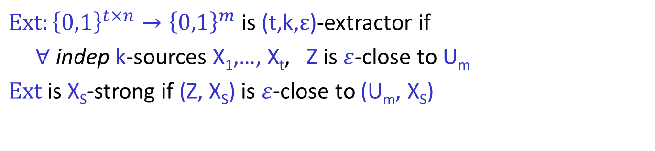
Multi-source Extractors [BIW04]
$Ext:{\left\{0,1\right\}}^{t×n}→{\left\{0,1\right\}}^{m}$ is (t,k,$ε$)-extractor if
$∀$ indep k-sources X₁,…, X_{t}, Z is $ε$-close to U_{m}
$Ext$is X_{S}-strong if (Z, X_{S}) is $ε$-close to (U_{m}, X_{S})
Multi-source Extractor
source
$$…$$
source
X₁
X_{t}
$$Ext$$
$≈$uniform output
Z

Slide 17
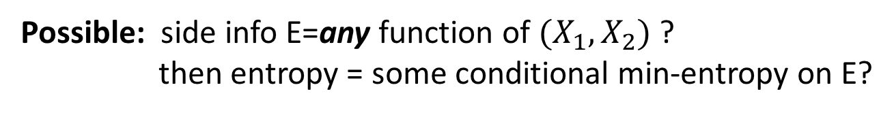
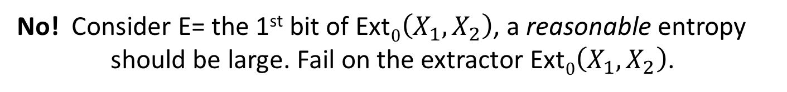
Side Info. of multiple sources?
Want: a general definition of entropy &
sufficient entropy => extractability.
Possible: side info E=any function of $(X_{1},X_{2})$ ?
then entropy = some conditional min-entropy on E?
No! Consider E= the 1st bit of Ext$0\left(X_{1},X_{2}\right)$, a reasonable entropy
should be large. Fail on the extractor Ext$0\left(X_{1},X_{2}\right)$.
Restriction on E
is necessary!
adversary
$$E$$
Notes:
On this slides, give the obstacle, the example, side information (F(x)), and then the general principle

Slide 18




Simple Models
Independent Adversary (IA): each source leaks own side information
However, IA fails to consider the entanglement /correlation.
Bounded Storage Adv (BS): allow entangle; one-round leaking [KK12]
May break independence; non-trivial even for classical side info
Two-source Extractor
source
source
X₁
X₂
E₁
E₂
adversary
adversary
A₁
A₂
$$Ext$$
$$E_{1}$$
$$E_{2}$$
$≈$uniform output
Z
20

Slide 19
Kasher & Kempe 12
The [DEOR04] extractor works with comparable parameters in both IA & BS models, although side info breaks independence.
Remarks on the model:
1. Could refer to a practical scenario of generating side-info: when parties are far apart from each other & leaking procedure is short!
2. Unclear about extension to multiple rounds. Could fall into the previous counter-example .
ISSUEs:
No unified model & No unified entropy measure
Technique-wise very specific to the [DEOR04] extractor
Our Contribution:
A Unified & Generalized Model: General Entangled (GE) model
Take the one-round leaking model [KK12] + right entropy measure
Prove most existing two-/multi-source extractors are GE-secure
e.g., Raz, Bourgain, Li, BRSW, Rao, ….

Slide 20
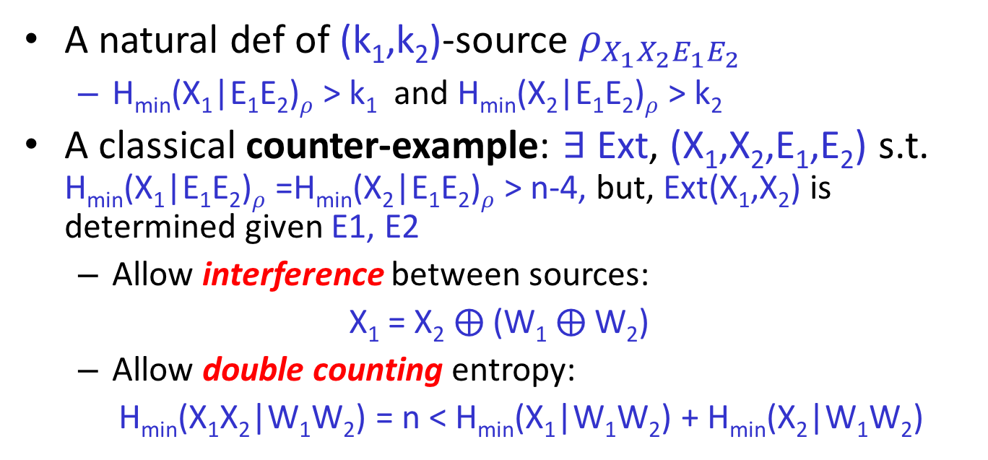
Entropy measure: problematic [KK12]
A natural def of (k₁,k₂)-source $ρ_{X_{1}X_{2}E_{1}E_{2}}$
  H_{min}(X₁|E₁E₂)$ρ$ > k₁ and H_{min}(X₂|E₁E₂)$ρ$ > k₂
  A classical counter-example: $∃$ Ext, (X₁,X₂,E₁,E₂) s.t. H_{min}(X₁|E₁E₂)$ρ$ =H_{min}(X₂|E₁E₂)$ρ$ > n-4, but, Ext(X₁,X₂) is determined given E1, E2
  Allow interference between sources:
  X₁ = X₂ $⨁$(W₁ $⨁$W₂)
  Allow double counting entropy:
  H_{min}(X₁X₂|W₁W₂) = n < H_{min}(X₁|W₁W₂) + H_{min}(X₂|W₁W₂)
Notes:
Shrink it!!!

Slide 21


Contribution I: General Entangled (GE) Model
Allow general entanglement; new way to measure entropy, avoid interference
Measure entropy of X_{i} right after receiving E_{i}
  k_{i} = H_{min}(X_{i}|E_{i}A_{-i})$ρ$
No interference: entropy of X_{-i} don’t go to X_{i}
$$…$$
X₁
X₂
X_{t}
E₁
A₂
E₂
E_{t}
A₁
A_{t}
adversary
A₁
A_{t}
Notes:
Speak of the side information generation procedure again!
Mention that X1,…,Xt are initially independent
Say that no structural restriction, only change the way to measure entropy
Justify the one-round generative model:
One round is necessary: interaction impose interference, and allow Adv to learn Ext(X)
If side info come from generation of sources, and sources gen. around the same time, then one-round is reasonable
Independence is very crucial, it’s hard to go beyond, which we do!

Slide 22
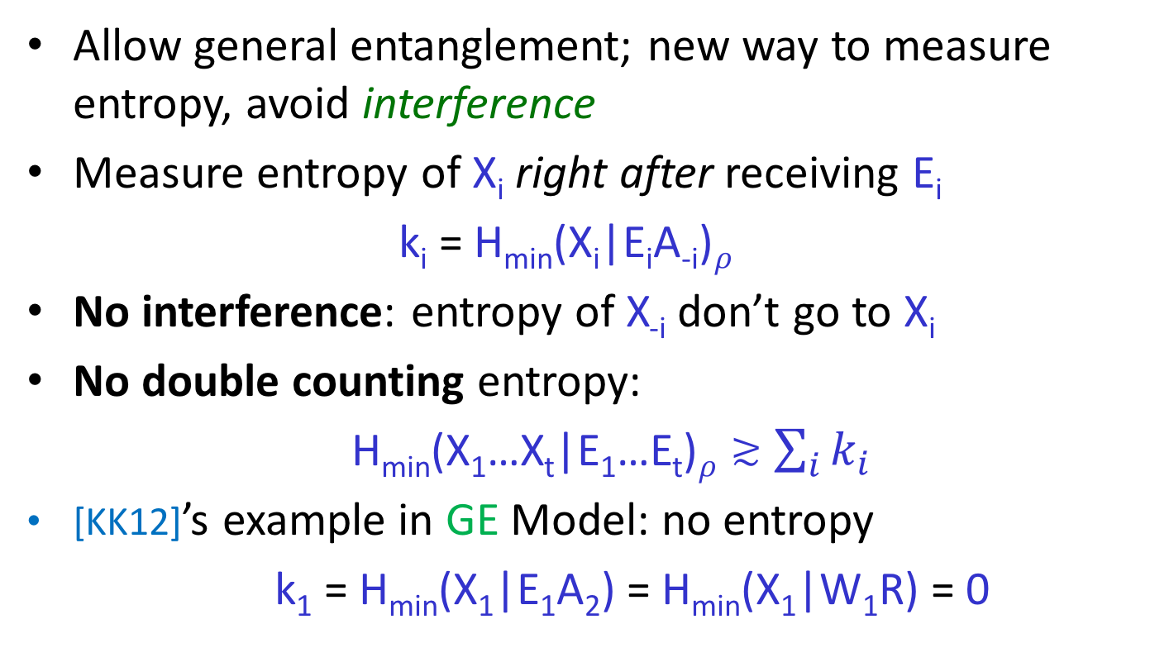
General Entangled (GE) Model
Allow general entanglement; new way to measure entropy, avoid interference
Measure entropy of X_{i} right after receiving E_{i}
  k_{i} = H_{min}(X_{i}|E_{i}A_{-i})$ρ$
No interference: entropy of X_{-i} don’t go to X_{i}
No double counting entropy:
H_{min}(X₁…X_{t}|E₁…E_{t})$ρ≳$ $\sum_{i}{k_{i}}$
[KK12]’s example in GE Model: no entropy
k₁ = H_{min}(X₁|E₁A₂) = H_{min}(X₁|W₁R) = 0
Notes:
So fail of extraction is valid

Slide 23
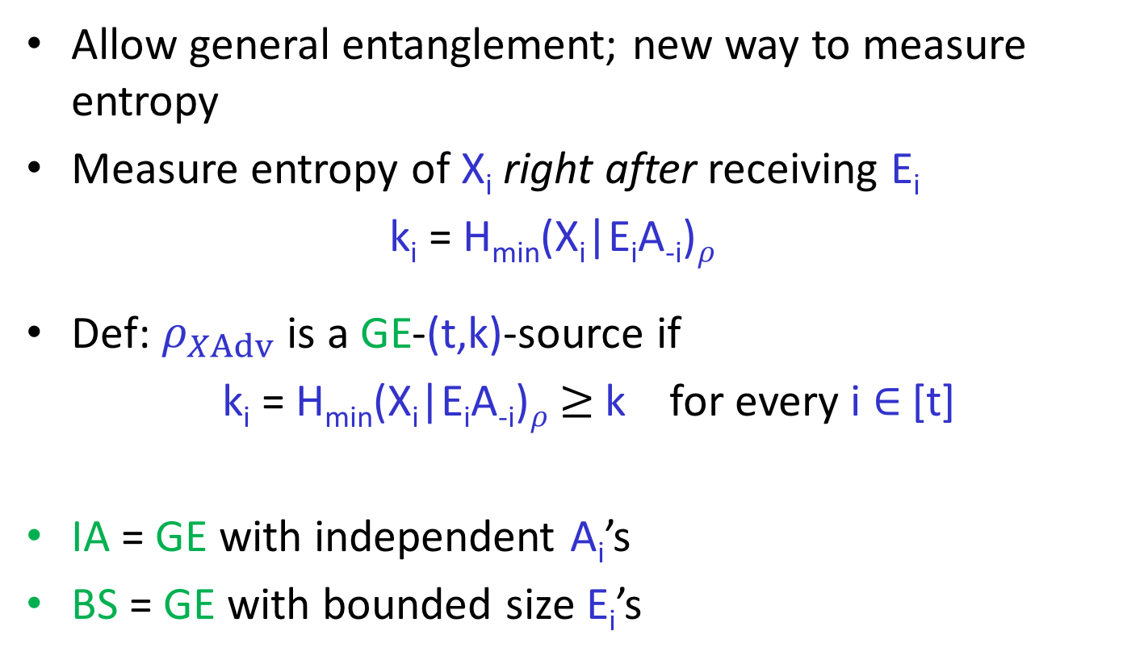
General Entangled (GE) Model
Allow general entanglement; new way to measure entropy
Measure entropy of X_{i} right after receiving E_{i}
  k_{i} = H_{min}(X_{i}|E_{i}A_{-i})$ρ$
Def: $ρ_{XAdv}$ is a GE-(t,k)-source if
k_{i} = H_{min}(X_{i}|E_{i}A_{-i})$ρ$ $≥$ k for every i $∈$ [t]
IA = GE with independent A_{i}’s
BS = GE with bounded size E_{i}’s
Notes:
Mention introduce notation, X for all X_i, Adv for the side info

Slide 24

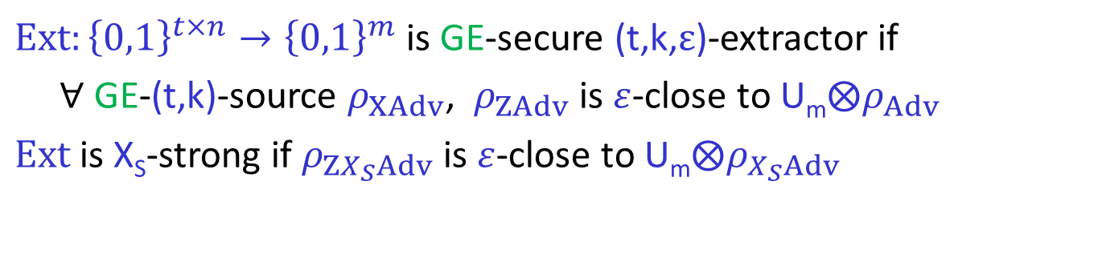
GE-secure Multi-source Extractors
$Ext:{\left\{0,1\right\}}^{t×n}→{\left\{0,1\right\}}^{m}$ is GE-secure (t,k,$ε$)-extractor if
$∀$ GE-(t,k)-source $ρ_{XAdv}$, $ρ_{ZAdv}$ is $ε$-close to U_{m}$⨂ρ_{Adv}$
$Ext$is X_{S}-strong if $ρ_{ZX_{S}Adv}$ is $ε$-close to U_{m}$⨂ρ_{X_{S}Adv}$
Multi-source Extractor
source
$$…$$
source
X₁
X_{t}
adversary
$$Ext$$
$$Adv$$
$≈$uniform output
Z

Slide 25
Contribution II: GE-secure extractors
Existing Two-source Extractors (e.g., Raz, Bourgain, existential ones) are GE-secure.
Any Multi-source Extractors (e.g., Li, BRSW, Rao) can be upgraded to be GE-secure.
Both w/ matching parameters.
GE- Strong OA Security Equivalence!
Omitted!
Obtain Strong OA Security: XOR, +1 source, block-source
Notes:
Claim unclear how to cond., pause for ppl to think

Slide 26

One-sided Adversary (OA) Model
Only get side info from a single source
  at adversary’s choice (without seeing the sources)
Weaker than IA & GE
OA-sources & OA-secure extractors defined similarly
$$…$$
$$…$$
X₁
X_{i}
X_{t}
A_{i}
E_{i}
adversary
Notes:
Say anything more?

Slide 27

Strong OA-GE Security Equivalence
Thm: For any S $⊂$ [t] with |S|=t-1,
if Ext is X_{S}-strong OA-secure (t,k,$ε$)-extractor,
$⟹$ Ext is X_{S}-strong GE-secure (t,k,$ε$)-extractor.
IA
classical
side-info
M
OA
GE
no side-info
BS
strong ext.
Notes:
Say slowly, main observation is that for strong extractors, OA and GE security are equivalent!!
Perhaps surprise, powerful consequence
Very simple to proof!!!

Slide 28


Strong OA-GE Security Equivalence
Thm: Let S $=$ [t-1],
if Ext is X_{S}-strong OA-secure (t,k,$ε$)-extractor,
$⟹$ Ext is X_{S}-strong GE-secure (t,k,$ε$)-extractor.
S
$$…$$
X₁
X₂
X_{t}
E₁
A₂
E₂
E_{t}
A₁
A_{t}
adversary
Leaking on X_{S}
Apply Ext
A₂
A₁
Notes:
Intuitioin

Slide 29
Proof: simulation b/c
Leaking on X_{S}
COMMUTE
(strong)
Apply OA Ext
Leaking on X_{t}, Leaking on X_{S}, Apply Ext
=
Leaking on X_{t}, Apply Ext , Leaking on X_{S}
Apply OA security
w/ sufficient entropy

Slide 30
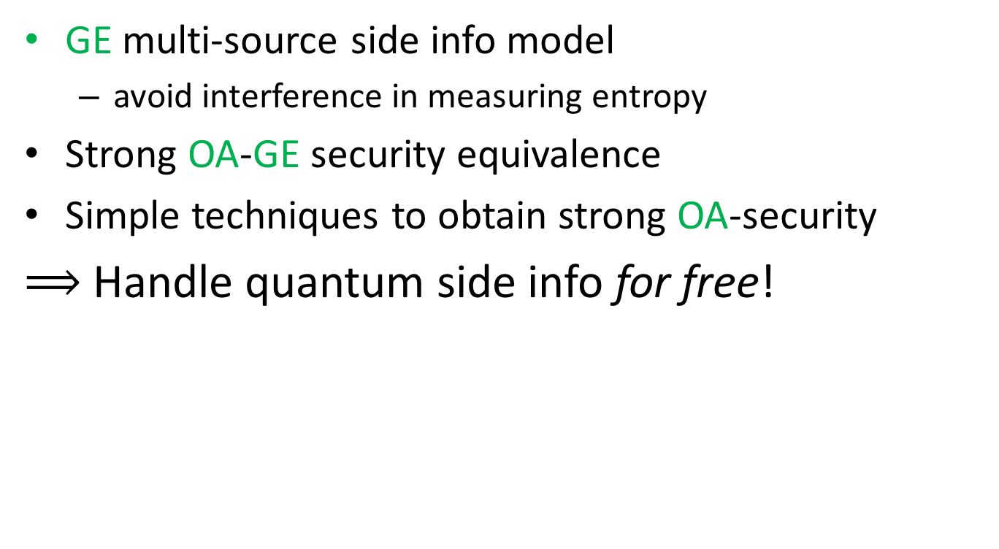
Summary
GE multi-source side info model
  avoid interference in measuring entropy
Strong OA-GE security equivalence
Simple techniques to obtain strong OA-security
$⟹$ Handle quantum side info for free!
IA
M
OA
GE
BS
strong ext.

Slide 31
Conclusions:
Q. Seeded Extractor optimal w/ inv. poly rate sources
Q. Multi-source: side info model & extractors
Open Questions:
Better Q. Extractor/Condenser? Optimal Parameters for any source?
Alternative/General Side Info Model allowing extraction?

Slide 32
Thanks!
Questions?

Slide 33
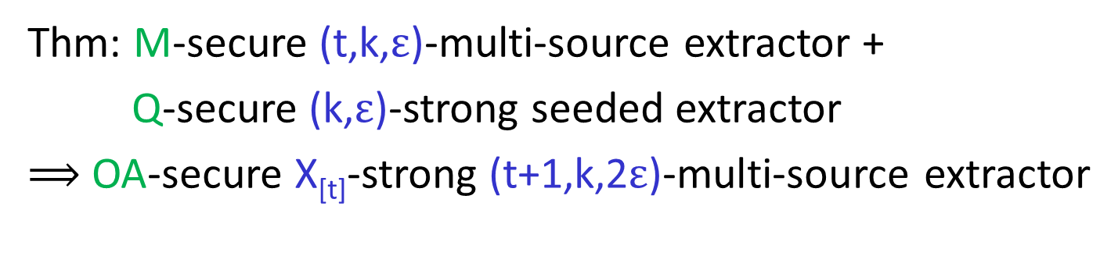



Obtain Strong OA-security (I):
+1 source
Thm: M-secure (t,k,$ε$)-multi-source extractor +
Q-secure (k,$ε$)-strong seeded extractor
$⟹$ OA-secure X_{[t]}-strong (t+1,k,2$ε$)-multi-source extractor
$$…$$
X₁
X_{t}
X_{t+1}
$$MExt$$
$$QExt$$
Y
Z
LIFT: marginal uniform + seeded quantum extractor
-> quantum-proof uniform
Notes:
Add MExt, marginal security, can lift its security by using a quantum-proof seeded extractor, with an independent seed.

Slide 34
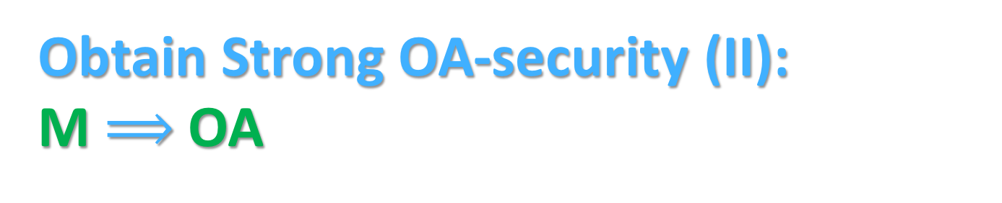
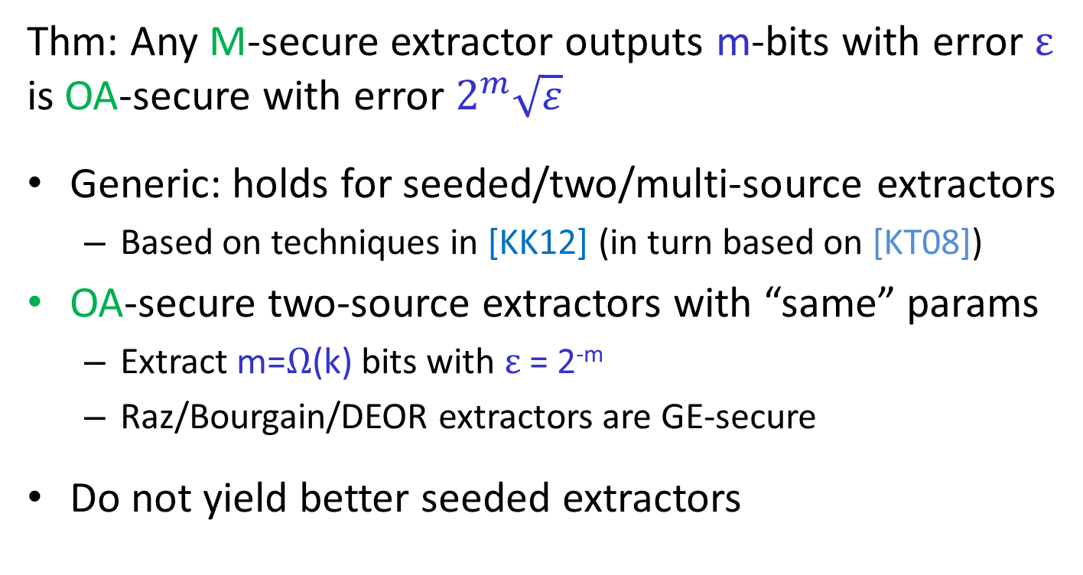
Obtain Strong OA-security (II):
M $⟹$ OA
Thm: Any M-secure extractor outputs m-bits with error $ε$ is OA-secure with error $2^{m}\sqrt{ε}$
Generic: holds for seeded/two/multi-source extractors
  Based on techniques in [KK12] (in turn based on [KT08])
OA-secure two-source extractors with “same” params
  Extract m=$Ω$(k) bits with $ε$ = 2^{-m}
  Raz/Bourgain/DEOR extractors are GE-secure
Do not yield better seeded extractors
Notes:
What points xiaodi wanna make?

Slide 35
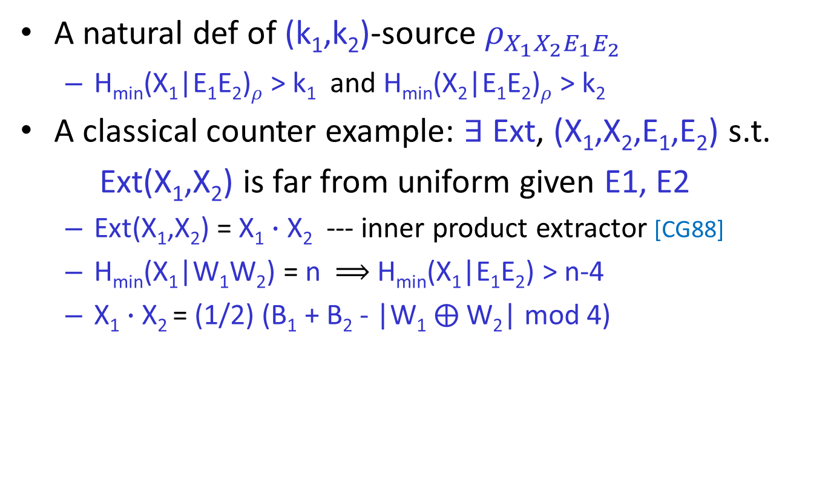
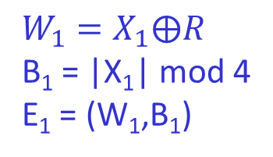
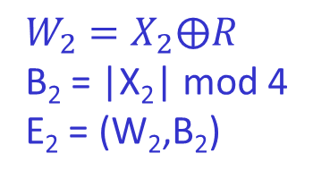
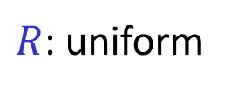

Entropy measure: problematic [KK12]
A natural def of (k₁,k₂)-source $ρ_{X_{1}X_{2}E_{1}E_{2}}$
  H_{min}(X₁|E₁E₂)$ρ$ > k₁ and H_{min}(X₂|E₁E₂)$ρ$ > k₂
A classical counter example: $∃$ Ext, (X₁,X₂,E₁,E₂) s.t.
  Ext(X₁,X₂) is far from uniform given E1, E2
  Ext(X₁,X₂) = X₁ $∙$ X₂ --- inner product extractor [CG88]
  H_{min}(X₁|W₁W₂) = n $⟹$ H_{min}(X₁|E₁E₂) > n-4
  X₁ $∙$ X₂ = (1/2) (B₁ + B₂ - |W₁ $⨁$W₂| mod 4)
X₁
X₂
adversary
$R$: uniform
$$W_{1}=X_{1}⨁R$$
B₁ = |X₁| mod 4
E₁ = (W₁,B₁)
$$W_{2}=X_{2}⨁R$$
B₂ = |X₂| mod 4
E₂ = (W₂,B₂)
$|X|$: Hamming weight
Notes:
Shrink it!!!

