Slide 1
Ripple: Communicating through
Physical Vibrations
Nirupam Roy, Mahanth Gowda, Romit Roy Choudhury
University of Illinois at Urbana-Champaign
Notes:
(This presentation was prepared with the PowerPoint for Mac 2011 – Version: 14.4.9)

Slide 2
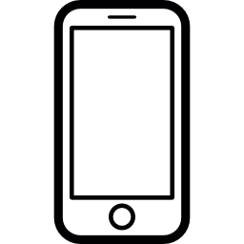
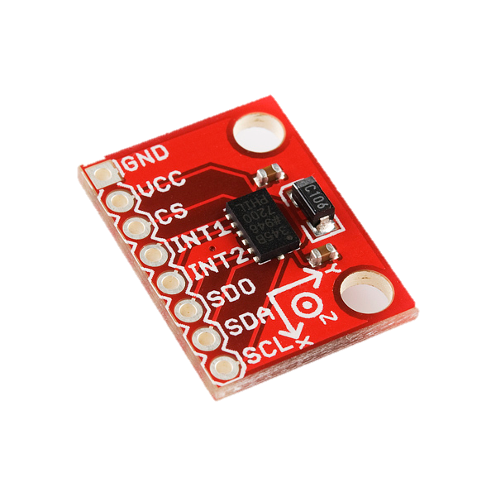
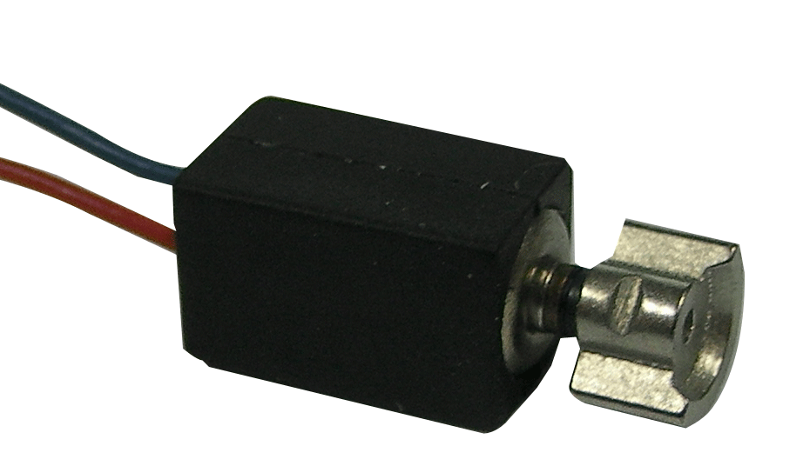
Accelerometer
Vibration Motor

Slide 3
Accelerometer
Vibration Motor

Slide 4
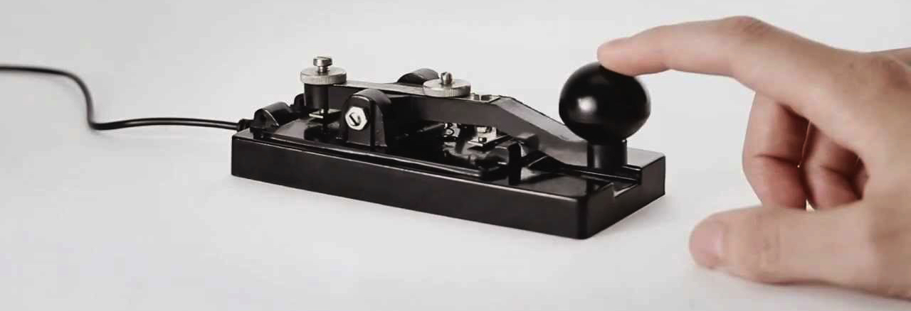
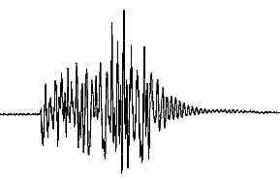
Morse Code Key
On
On
On
Off
Modulated vibration
Accelerometer
Vibration Motor

Slide 5
Radio-Frequency
Optical
Vibratory Communication through Solids
Acoustic
Magnetic

Slide 6
Radio-Frequency
Optical
Vibratory Communication through Solids
Why do we care?
Acoustic
Magnetic

Slide 7
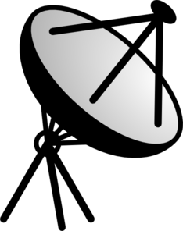
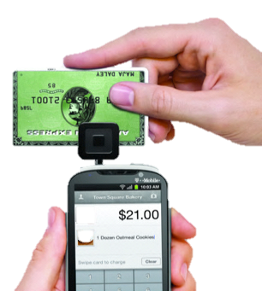

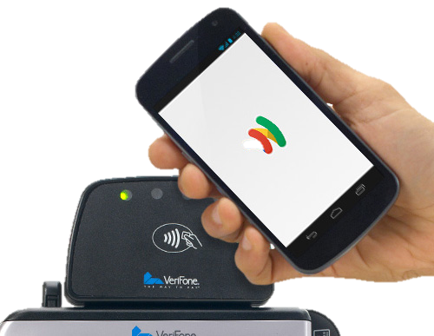
Applications: Mobile Money Transfer

Slide 8
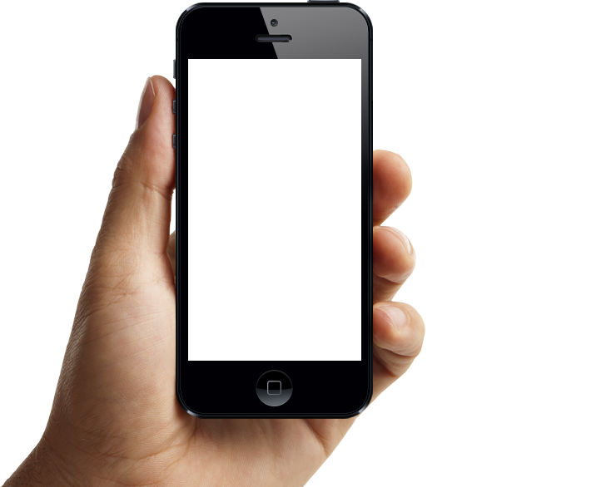
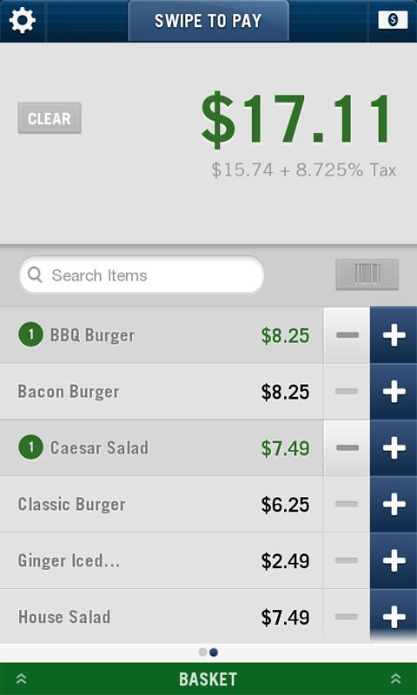
Applications: Mobile Money Transfer
SEND
RECEIVE

Slide 9
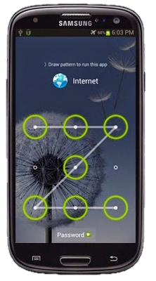
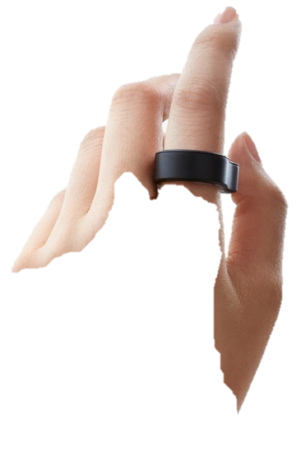
Applications: Authentication with Ring
Enter Passcode

Slide 10
Applications: Authentication with Ring
Vibratory
Passcode Detected

Slide 11
Applications: Authentication with Ring

Slide 12
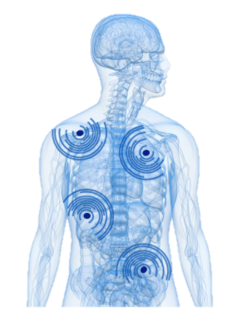

Applications: Body-Area Network

Slide 13

Again, we don’t know the killer-app.

Slide 14
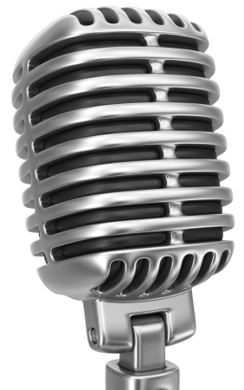
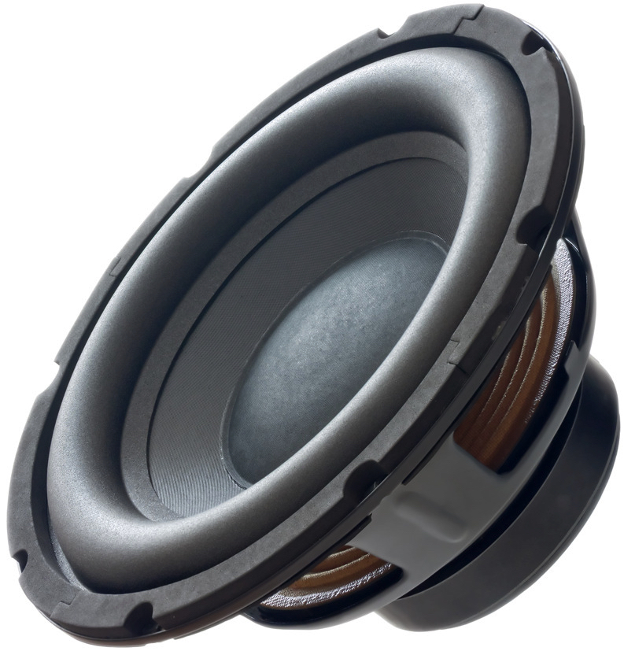
Application
6 bps 80 bps 200 bps 400 bps +secured
Vibratory Radio
Morse-code
Single-Carrier
Multi-Carrier
Multi-dimension
Phy-Security
Hardware

Slide 15
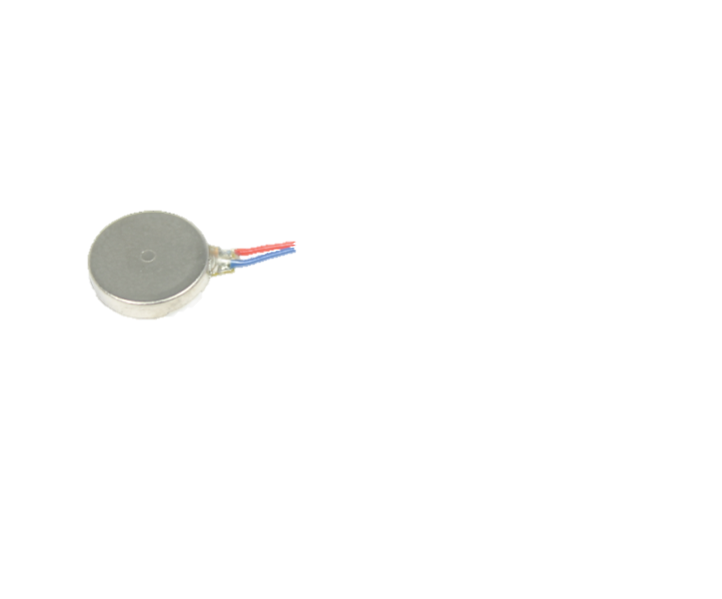
Morse-code
Single-Carrier
Multi-Carrier
Multi-dimension
Phy-Security
Vibration Motor
Accelerometer
C1
C2
N
S

Slide 16

Morse-code
Single-Carrier
Multi-Carrier
Multi-dimension
Phy-Security
0
30
60
90
120 ms
Regulated
Input
Vibration
Braking

Slide 17
Morse-code
Single-Carrier
Multi-Carrier
Multi-dimension
Phy-Security
0
30
60
90
120 ms

Slide 18
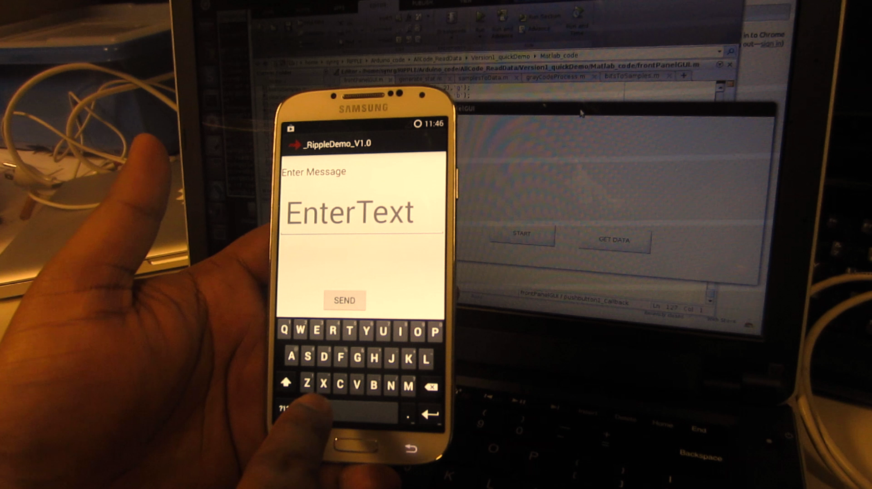
Morse-code
Single-Carrier
Multi-Carrier
Multi-dimension
Phy-Security

Slide 19
Morse-code
Single-Carrier
Multi-Carrier
Multi-dimension
Phy-Security
Single-Carrier
Multi-Carrier

Slide 20
Morse-code
Single-Carrier
Multi-Carrier
Multi-dimension
Phy-Security
0
30
60
90
120 ms
100 Hz
200 Hz
300 Hz

Slide 21
Morse-code
Single-Carrier
Multi-Carrier
Multi-dimension
Phy-Security
+
…
+
N
S

Slide 22
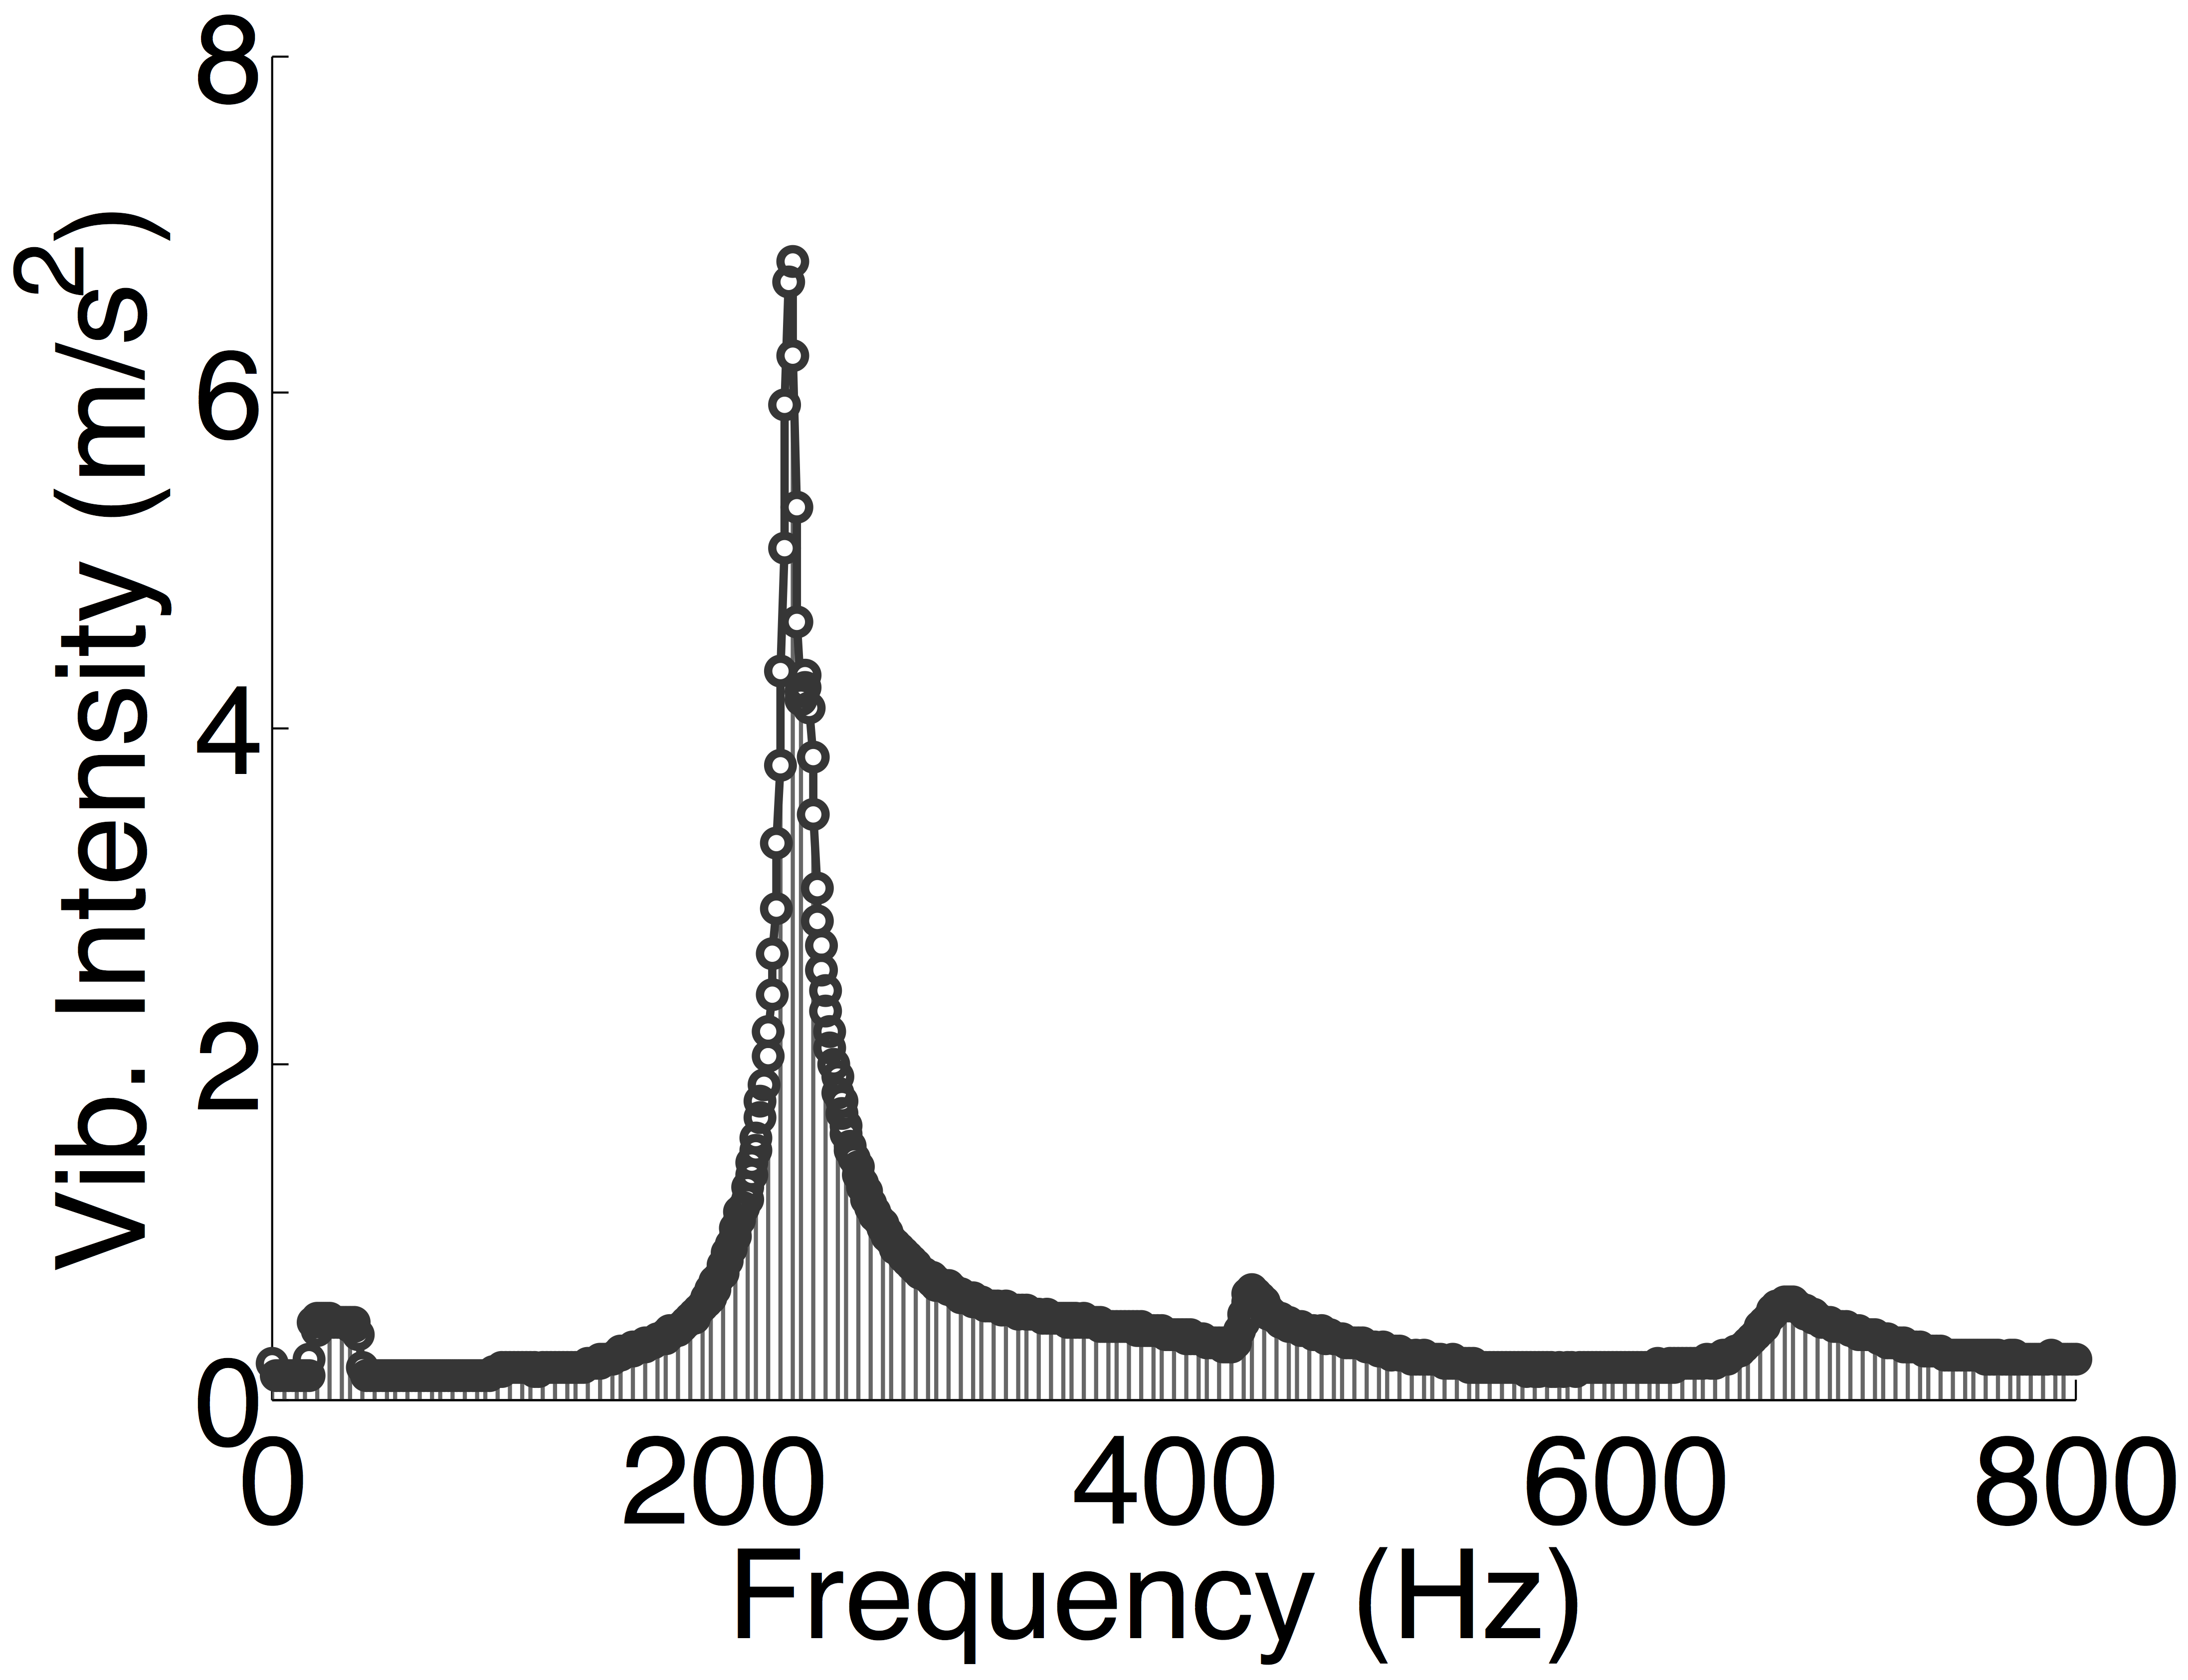
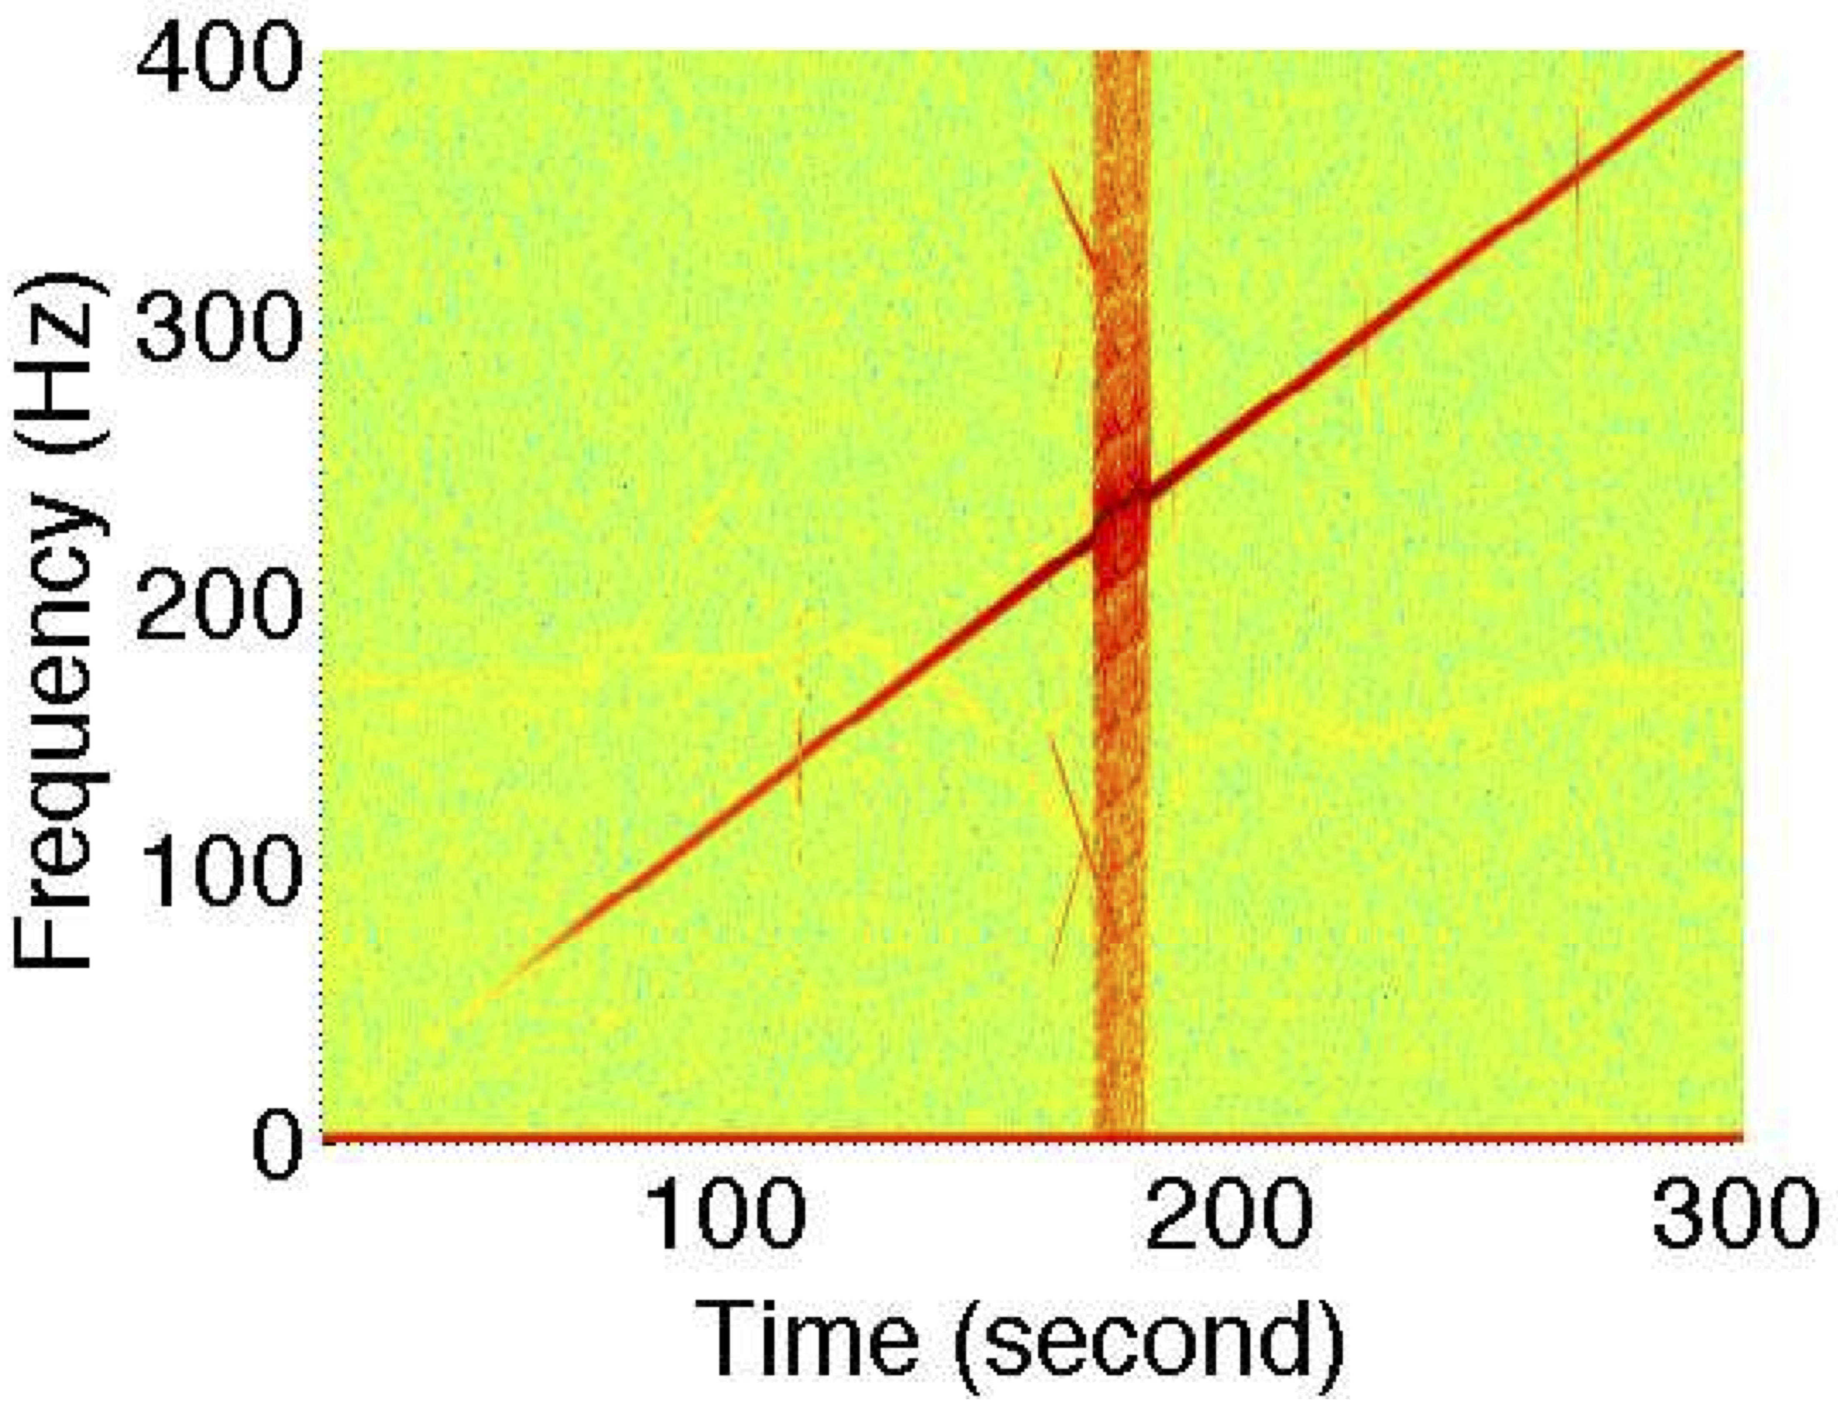
Morse-code
Single-Carrier
Multi-Carrier
Multi-dimension
Phy-Security

Slide 23
Morse-code
Single-Carrier
Multi-Carrier
Multi-dimension
Phy-Security

Slide 24
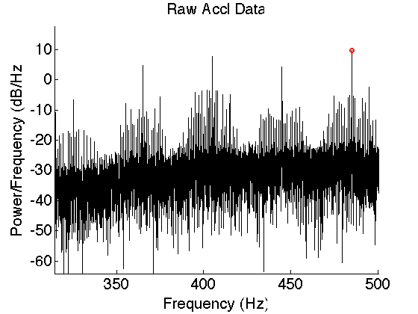
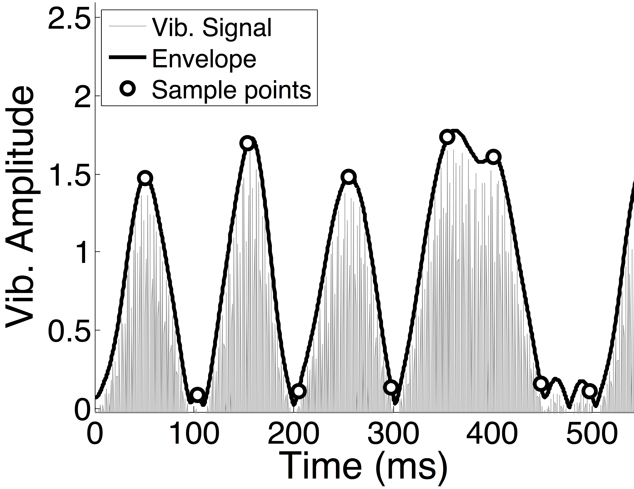
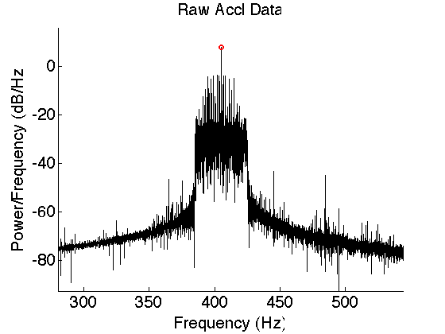
Morse-code
Single-Carrier
Multi-Carrier
Multi-dimension
Phy-Security
Filtering
Envelope
Detection

Slide 25
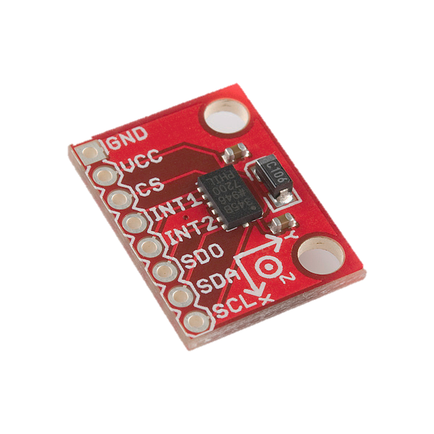
Morse-code
Single-Carrier
Multi-Carrier
Multi-dimension
Phy-Security
Z
Y
X

Slide 26
Morse-code
Single-Carrier
Multi-Carrier
Multi-dimension
Phy-Security
Z
Y
X

Slide 27
Morse-code
Single-Carrier
Multi-Carrier
Multi-dimension
Phy-Security
Z
Y
X

Slide 28
Morse-code
Single-Carrier
Multi-Carrier
Multi-dimension
Phy-Security
Z
Y
Spilled signal
X

Slide 29
Morse-code
Single-Carrier
Multi-Carrier
Multi-dimension
Phy-Security
Z
Y
Phase lag
Spilled signal
X

Slide 30
Morse-code
Single-Carrier
Multi-Carrier
Multi-dimension
Phy-Security
Y signal
2h
Y-Axis
Z-Axis

Slide 31
Morse-code
Single-Carrier
Multi-Carrier
Multi-dimension
Phy-Security
Y signal
2h
Y-Axis
h
Z-Axis
Y spill

Slide 32
Morse-code
Single-Carrier
Multi-Carrier
Multi-dimension
Phy-Security
Y signal
2h
h
Z spill
Y-Axis
Z signal
2h
h
Z-Axis
Y spill

Slide 33
Morse-code
Single-Carrier
Multi-Carrier
Multi-dimension
Phy-Security
Y signal
Scaled Y signal
2h
h
2
=
4h
2h
*
Z spill
Y-Axis
Z signal
2h
h
Z-Axis
Y spill

Slide 34
Morse-code
Single-Carrier
Multi-Carrier
Multi-dimension
Phy-Security
Y signal
Scaled Y signal
2h
h
2
=
4h
2h
*
Z spill
Y-Axis
Z signal
2h
h
Z-Axis
Y spill

Slide 35
Morse-code
Single-Carrier
Multi-Carrier
Multi-dimension
Phy-Security
Y signal
Scaled Y signal
2h
h
2
=
4h
2h
*
Z spill
Y-Axis
Z signal
2h
h
Z-Axis
Y spill

Slide 36
Morse-code
Single-Carrier
Multi-Carrier
Multi-dimension
Phy-Security
Y signal
Scaled Y signal
2h
h
2
=
4h
2h
*
Z spill
Y-Axis
Z signal
2h
h
+
Z-Axis
Y spill

Slide 37
Morse-code
Single-Carrier
Multi-Carrier
Multi-dimension
Phy-Security
Y signal
Scaled Y signal
2h
h
2
=
4h
2h
*
Z spill
Y-Axis
Interference free Y signal
Z signal
=
3h
2h
h
+
Z-Axis
Y spill

Slide 38
Morse-code
Single-Carrier
Multi-Carrier
Multi-dimension
Phy-Security
Z
200 bps
Y
X
200 bps

Slide 39
Morse-code
Single-Carrier
Multi-Carrier
Multi-dimension
Phy-Security
Physical Layer Security

Slide 40

Morse-code
Single-Carrier
Multi-Carrier
Multi-dimension
Phy-Security
N
S
1 0 1
Correlated

Slide 41


Morse-code
Single-Carrier
Multi-Carrier
Multi-dimension
Phy-Security
Vibration sound
Speaker sound

Slide 42
Morse-code
Single-Carrier
Multi-Carrier
Multi-dimension
Phy-Security
Vibration sound
Speaker sound

Slide 43
Morse-code
Single-Carrier
Multi-Carrier
Multi-dimension
Phy-Security
Vibration sound
Speaker sound

Slide 44
Morse-code
Single-Carrier
Multi-Carrier
Multi-dimension
Phy-Security
S6 S5 S4 S3 S2 S1 S0
Audio Sample Buffer
Audio Clock

Slide 45
Morse-code
Single-Carrier
Multi-Carrier
Multi-dimension
Phy-Security
S6 S5 S4 S3 S2 S1 S0
Audio Sample Buffer
Audio Clock

Slide 46
Morse-code
Single-Carrier
Multi-Carrier
Multi-dimension
Phy-Security
Vibration sound
Speaker sound

Slide 47
Morse-code
Single-Carrier
Multi-Carrier
Multi-dimension
Phy-Security
Vibration sound
Speaker sound

Slide 48
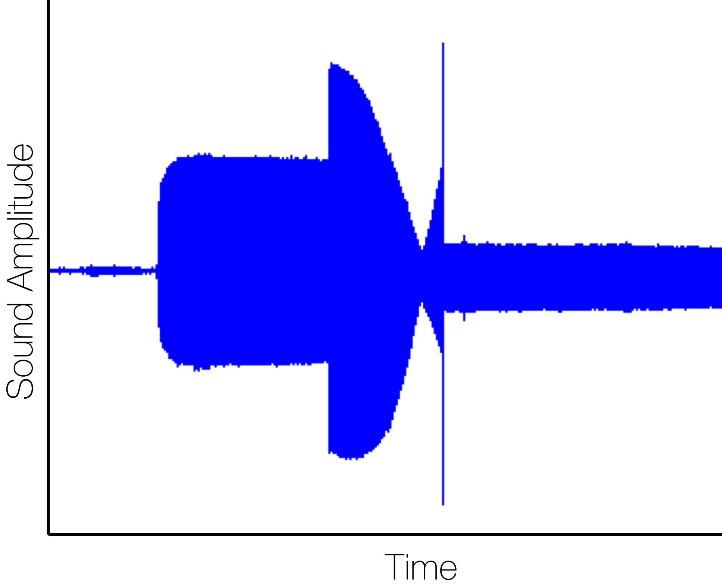
Morse-code
Single-Carrier
Multi-Carrier
Multi-dimension
Phy-Security
Anti-sound start
Frequency switch
Vibration start

Slide 49
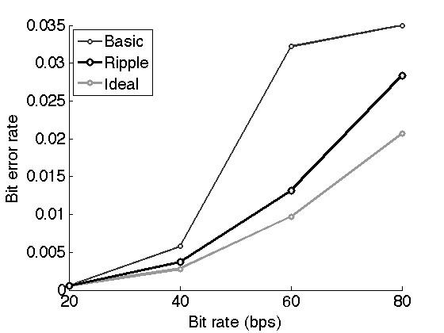
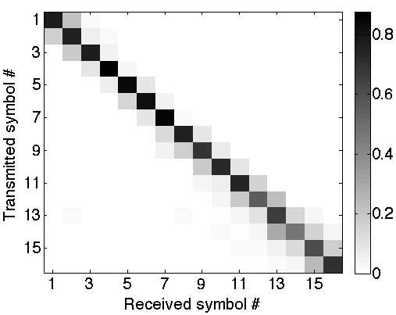
Evaluation
Single-carrier

Slide 50
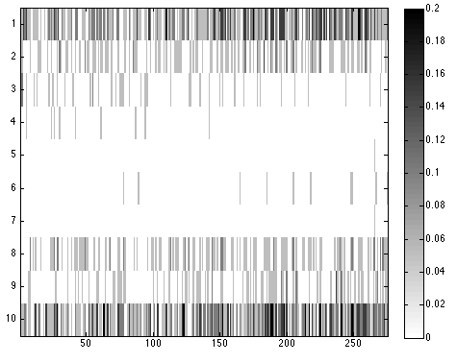
Evaluation
Multi-carrier

Slide 51
Summary
Vibratory Radio
Morse-code
Single-Carrier
Multi-Carrier
Multi-dimension
Phy-Security

Slide 52
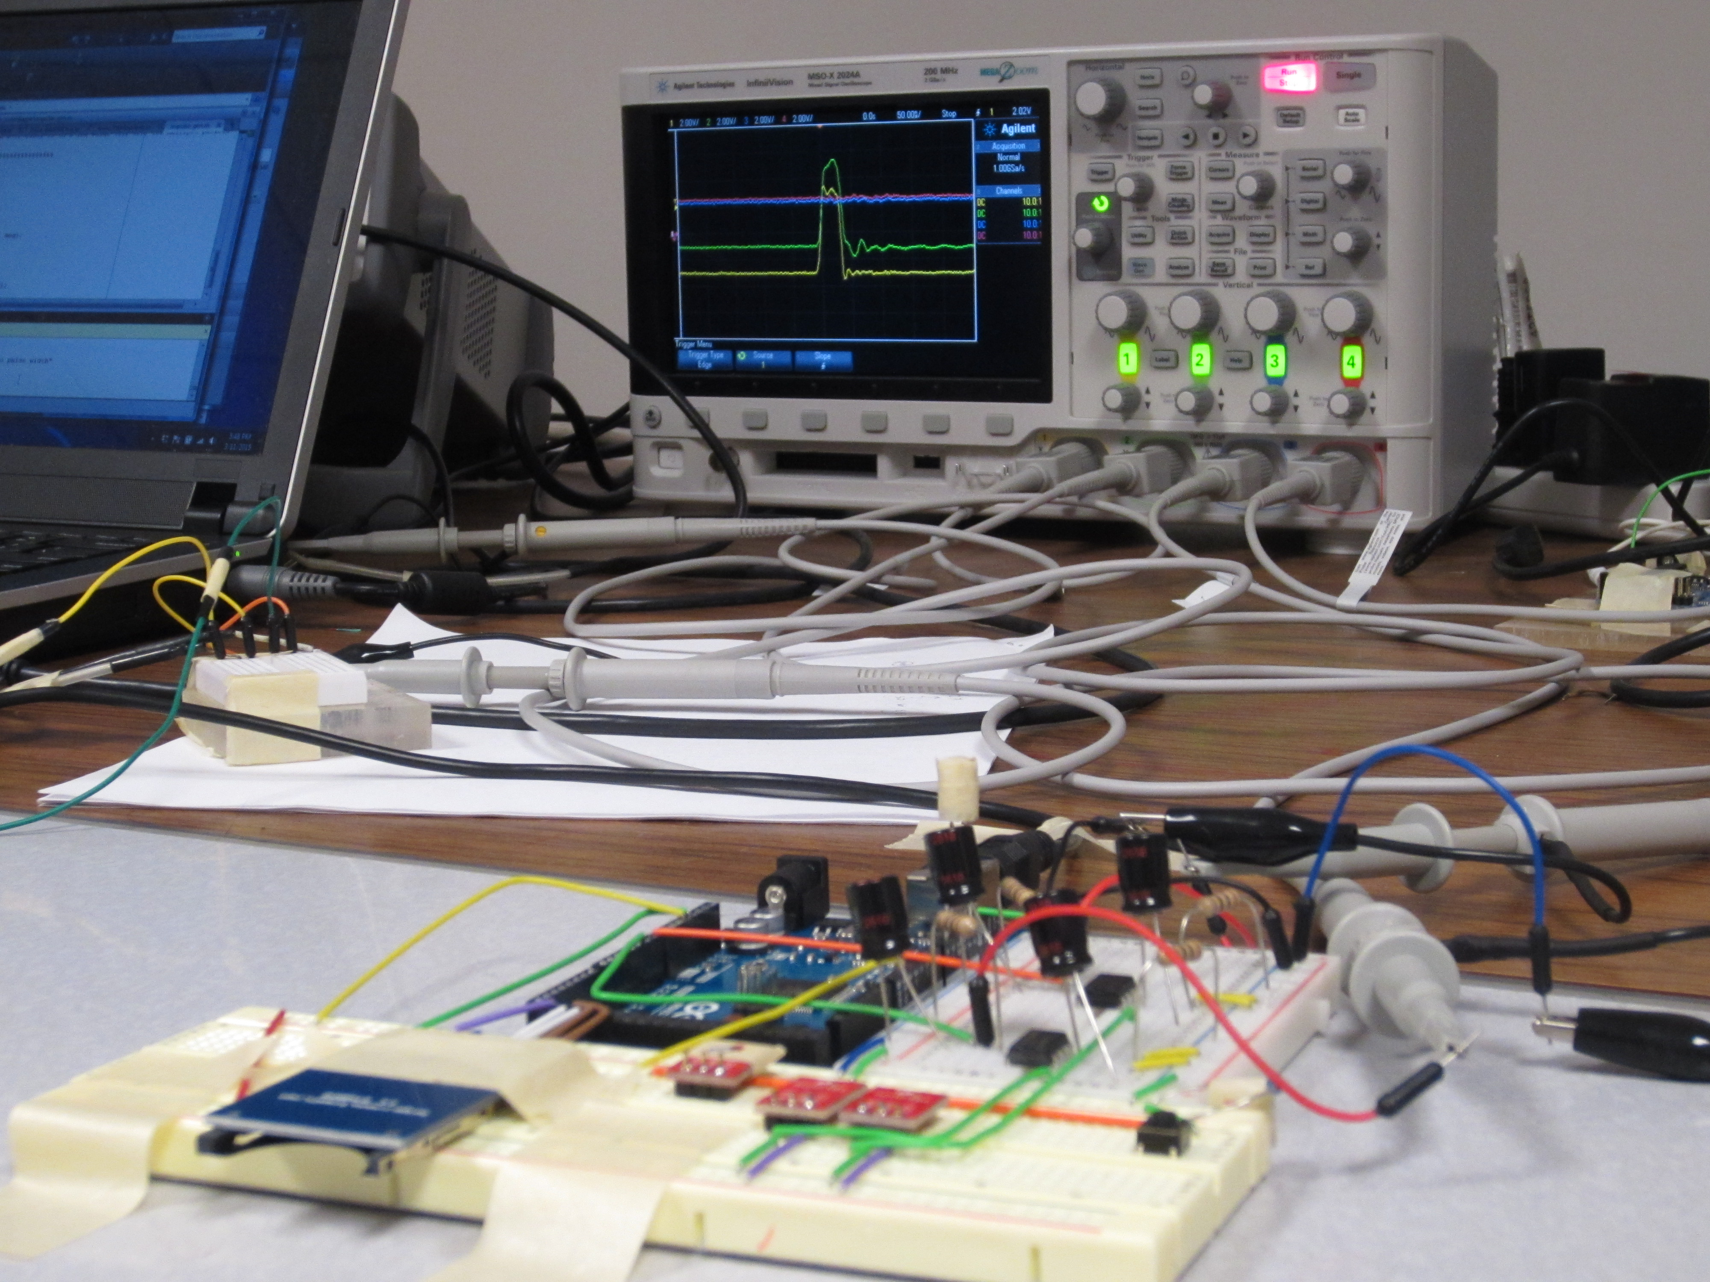
Thank You
(SyNRG Hardware Lab, UIUC)

