Slide 1

Data Integration and Exchange for Scientific Collaboration
Zachary G. Ives
University of Pennsylvania
with Todd Green, Grigoris Karvounarakis,
Nicholas Taylor, Partha Pratim Talukdar, Marie Jacob,
Val Tannen, Fernando Pereira, Sudipto Guha
DILS 2009
July 20, 2009
Funded by NSF IIS-0477972, 0513778, 0629846

Slide 2
A Pressing Need for Data Integration in the Life Sciences
The ultimate goal: assemble all biological data into an integrated picture of living organisms
  If feasible, could revolutionize the sciences & medicine!
Many efforts to compile databases (warehouses) for specific fields, organisms, communities, etc.
    Genomics, proteomics, diseases (incl. epilepsy, diabetes), phylogenomics, …
Perhaps “too successful”: now 100s of DBs with portions of the data we need to tie together!

Slide 3
Basic Data Integration Makes the Wrong Assumptions
Existing data sharing methods (scripts, FTP) are ad hoc, piecemeal, don’t preserve “fixes” made at local sites
What about database-style integration (EII)?
Unlike business or most Web data, science is in flux, with data that is subjective, based on hypotheses / diagnoses / analyses
  What is the right target schema? “clean” version? set of sources?
We need to re-think data integration architectures and solutions in response to this!
queries
Source
Source
Target schema
Consistent data instance
Source
Sources
mappings
(transformations)
cleaning
answers

Slide 4
Common Characteristics of Scientific Databases and Data Sharing
A scientific database site is often not just a source, but a portal for a community:
    Preferred terminologies and schemas
    Differing conventions, hypotheses, curation standards
Sites want to share data by “approximate synchronization”
  Every site wants to import the latest data, then revise, query it
Change is prevalent everywhere:
  Updates to data: curation, annotation, addition, correction, cleaning
  Evolving schemas, due to new kinds of data or new needs
  New sources, new collaborations with other communities
Different data sources have different levels of authority
  Impacts how data should be shared and how it is queried

Slide 5
Collaborative Data Sharing System (CDSS)
[Ives et al. CIDR05;
SIGMOD Rec. 08]
Logical P2P network of autonomous data portals
  Peers have control & updatability of own DB
  Related by compositional mappings and
  trust policies
Dataflow: occasional update exchange
  Record data provenance to assess trust
  Reconcile conflicts according to level of trust
Global services:
  Archived storage
  Distributed data transformation
  Keyword queries
  Querying provenance
  & authority
∆_{B}+/−
Peer B
∆_{C}+/−
Peer C
Peer A
DBMS
∆_{A}+/−
∆_{A}+/−
∆_{A}+/−
Queries,
edits
Archive
∆_{B}+/−
∆_{C}+/−
Notes:
Work in “CDSS” here. Bullet 3, mention “to support collaboration...”

Slide 6
How the CDSS Addresses the Challenges of Scientific Data Sharing
A scientific database site is often not just a source, but a portal for a community:
    Preferred terminologies and schemas
    Differing conventions, hypotheses, curation standards
Sites want to share data by “approximate synchronization”
  Every site wants to import the latest data, then revise, query it
Change is prevalent everywhere:
  Updates to data: curation, annotation, addition, correction, cleaning
  Evolving schemas, due to new kinds of data or new needs
  New sources, new collaborations with other communities
Different data sources have different levels of authority
  Impacts how data should be shared and how it is queried

Slide 7
Supporting Multiple Portals
Suppose we have a site focused on phylogeny (organism names & canonical names)
_{uBio}
U(nam, can)
and we want to import data from another DB, primarily about genes, that also has organism common and canonical names
_{GUS}
G(id,can,nam)

Slide 8
Supporting Multiple Portals / Peers
(combines [Halevy,Ives+03],[Fagin+04])
_{GUS}
G(id,can,nam)
_{uBio}
m
U(nam,can)
Tools exist to automatically find rough schema matches
(Clio, LSD, COMA++, BizTalk Mapper, …) and link entities
We add a schema mapping between the sites, specifying a transformation:
m: U(n,c) :- G(i,c,n)
(Via correspondence tables, can also map between identities)

Slide 9
Adding a Third Portal…
_{GUS}
_{BioSQL}
m₁
G(id,can,nam)
B(id,nam)
_{uBio}
m₂
U(nam,can)
m₃
Sharing data with another peer (uBio) simply requires mapping data to it:
m₁: B(i,n) :- G(i,c,n)
m₂: U(n,c) :- G(i,c,n)
m₃: B(i,n) :- B(i,c), U(n,c)

Slide 10
Suppose BioSQL Changes Schemas
_{GUS}
_{BioSQL}
m₁
G(id,can,nam)
B(id,nam)
_{uBio}
m₂
m₄
_{BioSQL’}
U(nam,can)
m₃
B’(nam)
Schema evolution is simply another schema + mapping:
m₁: B(i,n) :- G(i,c,n)
m₂: U(n,c) :- G(i,c,n)
m₃: B(i,n) :- B(i,c), U(n,c)
m₄: B’(n) ←→ B(i,c)

Slide 11
A Challenge: Diverse Opinions,
Different Curation Standards
A down-side to compositionality: maybe we want data from friends, but not from their friends
Each site should be able to have its own policy about which data it will admit – trust conditions
  Based on site’s evaluation of the “quality” of the mappings and sources used to produce a result – its provenance
Each site can delegate authority to others
  “I import data from Bob, and trust anything Bob does”
By default, “open” model – trust everyone unless otherwise stated

Slide 12
How the CDSS Addresses the Challenges of Scientific Data Sharing
A scientific database site is often not just a source, but a portal
Sites want to share data by “approximate synchronization”
Change is prevalent everywhere
Different data sources have different levels of authority

Slide 13
How a Peer Shares Data in the CDSS
[Taylor & Ives 06], [Green + 07], [Karvounarakis & Ives 08]
Updates from this peer P
Updates
from all peers
(A permanent log using P2P replication
[Taylor & Ives 09 sub])
Publish
∆P_{pub}
⇗
CDSS archive
Publish updates
Updates from all peers
+
Updates
for peer
Import
∆P_{other}
⇘
σ

✗✓
∆P
Translate through mappings with provenance:
update exchange
Apply trust policies
using data + provenance
Reconcile conflicts
−
Apply local curation
Notes:
Delta P’s should be labels not boxes

Slide 14
The Orchestra CDSS and
Update Exchange
[Green, Karvounarakis, Ives, Tannen 07]
m₁: B(i,n) :- G(i,c,n)
m₂: U(n,c) :- G(i,c,n)
m₃: B(i,n) :- B(i,c), U(n,c)
_{GUS}
_{BioSQL}
G^{l}
m₁
B^{l}
G(id,can,
nam)
+
B(id,
nam)
+
+
+
+
-
+
-
+
+
B^{r}
-
m₂
U^{l}
m₃
uBio distrusts data
from GUS along m₂
U(nam,
can)
+
+
-
+
+
-
U^{r}
_{uBio}
Sites make updates offline, that we want to propagate “downstream” (including deleting data)
Approach: Encode edit history in relations describing net effects on data
Local contributions of new data to system (e.g., U^{l})
Local rejections of data imported from elsewhere (e.g., U^{r})
Schema mappings are extended to relate these relations
Annotations called trust conditions specify what data is trusted, by whom

Slide 15
Computing an Instance in Update Exchange
m₁: B(i,n) :- G(i,c,n)
m₂: U(n,c) :- G(i,c,n)
m₃: B(i,n) :- B(i,c), U(n,c)
_{GUS}
_{BioSQL}
G^{l}
m₁
B^{l}
G(id,can,
nam)
+
B(id,
nam)
+
+
+
B^{r}
-
m₂
U^{l}
m₃
U(nam,
can)
+
+
-
To recompute target
U^{r}
_{uBio}
G(i,c,n) :- G^{l}(i,c,n)
B(i,n) :- B^{l}(i,n)
m₁ B(i,n) :- G(i,c,n), ¬ B^{r}(i,n)
m₃ B(i,n) :- B(i,c), U(n,c), ¬ B^{r}(i,n)
U(n,c) :- U^{l}(n,c)
m₂ U(n,c) :- G(i,c,n), ¬ U^{r}(n,c)
Run extended mappings recursively until fixpoint, to compute target
W/o deletions: canonical universal solution [Fagin+04], as with chase

Slide 16
Beyond the Basic Update
Exchange Program
Can generalize to perform incremental propagation given new updates
  Propagate updates downstream [Green+07]
  Propagate updates back to the original “base” data [Karvounarakis & Ives 08]
Can involve a human in the loop – Youtopia [Kot & Koch 09]
But what if not all data is equally useful? What if some sources are more authoritative than others?
  We need a record of how we mapped the data (updates)

Slide 17
Provenance from Mappings
Given our mappings:
(m₁) G(i,c,n) → B(i,n)
(m₂) G(i,c,n) → U(n,c)
(m₃) B(i,c) ∧ U(n,c) → B(i,n)
And the local contributions:
_{GUS}
_{BioSQL}
m₁
G(id,can,nam)
B(id,nam)
m₂
U(nam,can)
m₃
_{uBio}
G^{l}
B^{l}
U^{l}
p
3
:
G
(
3
,
A
,
Z
)
p
1
:
B
(
3
,
A
)
p
2
:
U
(
Z
,
A
)

Slide 18
Provenance from Mappings
Given our mappings:
(m₁) G(i,c,n) → B(i,n)
(m₂) G(i,c,n) → U(n,c)
(m₃) B(i,c) ∧ U(n,c) → B(i,n)
We can record a graph of tuple derivations:
_{GUS}
_{BioSQL}
m₁
G(id,can,nam)
B(id,nam)
m₂
U(nam,can)
m₃
_{uBio}
G^{l}
B^{l}
U^{l}
p
3
:
G
(
3
,
A
,
Z
)
p
1
:
B
(
3
,
A
)
m
p
2
:
U
(
Z
,
A
)
2
G
B
U
(3,A,Z)
m
(3,A)
m
3
(Z,A)
1
(3,Z)
Can be formalized as polynomial expressions in a semiring [Green+07]
Note U(Z,A) true if p₂ is correct, or m₂ is valid and p₃ is correct

Slide 19
From Provenance (and Data), Trust
Each peer’s admin assigns a priority to incoming updates, based on their provenance (and value)
  Examples of trust conditions for peer uBio:
    Distrusts data that comes from GUS along mapping m₂
    Trusts data derived from m₄ with id < 100 with priority 2
    Trusts data directly inserted by BioSQL with priority 1
Orchestra uses priorities to determine a consistent instance for the peer – high priority is preferred
  But how does trust compose, along chains of mappings and when updates are batched into transactions?

Slide 20
Trust across Compositions of Mappings
An update receives the minimum trust along a sequence of paths, the maximum trust along alternate paths
  e.g., uBio trusts GUS but distrusts mapping m₂
G^{l}
B^{l}
p
3
:
G
(
3
,
A
,
Z
)
p
1
:
B
(
3
,
A
)
m
2
G
B
U
(3,A,Z)
m
(3,A)
m
3
(Z,A)
1
(3,Z)

Slide 21
Trust across Transactions [Taylor, Ives 06]
Updates may occur in atomic “transactions”
  Set of updates to be considered atomically
  e.g., insertion of a tree-structured item; replacement of an object
Each peer individually reconciles among the conflicting transactions that it trusts
  We assign a transaction the priority of its highest-priority update
  May have read/write dependencies on prev. transactions (antecedents)
  Chooses transactions in decreasing order of priority
  Effects of all antecedents must be applicable to accept the transaction
  This automatically resolves conflicts for portions of data where a complete ordering can be given statically
The peer gets its own unique instance due to local trust policies

Slide 22
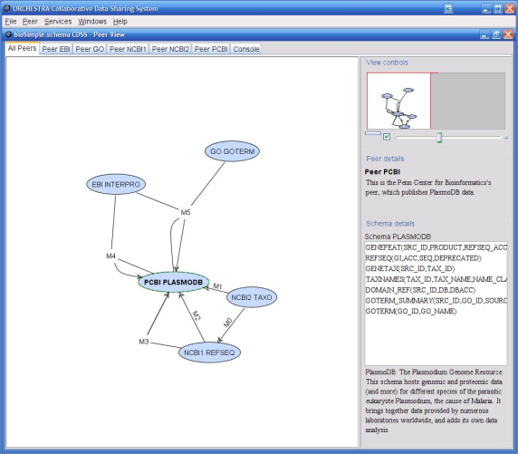
Orchestra Engine
[Green+07, Karvounarakis & Ives 08, Taylor & Ives 09]
Mappings
(Extended) Datalog Program
SQL queries +
recursion, sequence
Fixpoint layer
Data, provenance in
RDBMS tables
Updates to data and provenance in RDBMS tables
Updates from users
RDBMS or
distrib. QP

Slide 23
How the CDSS Addresses the Challenges of Scientific Data Sharing
A scientific database site is often not just a source, but a portal
Sites want to share data by “approximate synchronization”
Change is prevalent everywhere
Different data sources have different levels of authority

Slide 24
Change Is the Only Constant
As noted previously:
  Data changes: updates, annotations, cleaning, curation
  Schema changes: evolution to new concepts
  Set of sources and mappings change

Slide 25
Change Is the Only Constant
As noted previously:
  Data changes: updates, annotations, cleaning, curation
    Handled by update exchange, reconciliation
  Schema changes: evolution to new concepts
    Handled by adding each schema version as a peer, mapping to it
  Set of sources and mappings change
    May have a cascading effect on the contents of all peers!

Slide 26
The Orchestra “Core” Enables Us to Consider Many New Questions
To this point: the basic “core” of Orchestra –
  Data and update transformations via update exchange
  Provenance-based trust and conflict resolution
  Handling of changes to the mappings
Many new questions are motivated by using this core
  How do we assess and exploit sites’ authority?
  How can we harness history and provenance?
  How can we point users to the “right” data?

Slide 27
How the CDSS Addresses the Challenges of Scientific Data Sharing
A scientific database site is often not just a source, but a portal
Sites want to share data by “approximate synchronization”
Change is prevalent everywhere
Different data sources have different levels of authority

Slide 28
Authority Plays a Big Role in Science
Some sites fundamentally have higher quality data, or data that agrees with “our” perspective more
We’d like to be able to determine:
  Whom each peer should trust
  Whom we should use to answer a user’s “global” queries about information – i.e., queries where the user isn’t looking through the lens of a single portal
Our approach: learn authority from user queries, potentially use that to determine trust levels

Slide 29
Querying When We Don’t Have a Preferred Peer: The Q System [Talukdar+ 08]
Users may want to query across peers, finding the relations most relevant to them
Query model: familiar keyword search
  Keywords → ranked integration (join) queries → answers
  Learn the source rankings, based on feedback on answers!

Slide 30
Q: Answering a Keyword Search with the Top Queries
a
b
c
Given a schema graph
  Relations as nodes
  Associations (mappings, refs, etc.) as weighted edges
And a set of keywords
Compute top-scoring trees matching keywords
  Execute Q1 ⋃ Q2 as ranked join queries
a
b
c
a
0
b
0.2
0.1
0
d
f
d
f
d
f
0
0
e
e
e
Query Keywords a, e, f
a
0
b
a
0
b
0.2
c
Q1
0.1
0
Q2
d
f
d
f
0
0
0
0
Rank = 1
Cost = 0.1
Rank = 2
Cost = 0.2
e
e

Slide 31
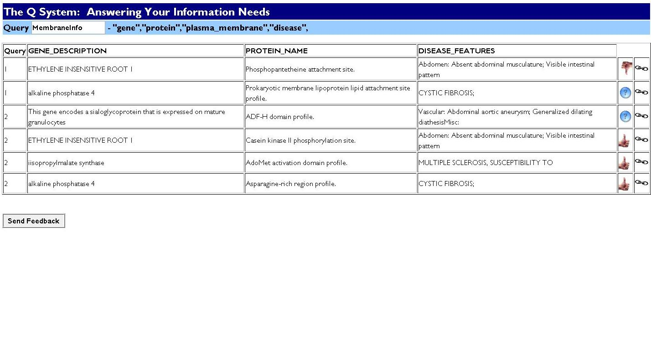
Getting User Feedback
Q1
Q1
Q1,2
Q2
Q2
Q2
System determines “producer” queries using provenance

Slide 32


Learning New Weights
a
b
a
b
c
0
a
0
b
0.05
c
0
0.2
0
Q1
0.1
Q2
0
d
f
d
f
d
f
0
0
0
0
0
Rank = 1
Cost = 0.1
Rank = 2
Cost = 0.2
0
Rank = 2
Cost = 0.1
Rank = 1
Cost = 0.05
e
e
e
Change weights so Q2 is “cheaper” than Q1 – using MIRA algorithm [Crammer+ 06]
a
0
b
0.05
c
0.2
0.1
0
d
f
0
0
e

Slide 33
Does It Work? Evaluation on Bioinformatics Schemas
Can we learn to give the best answers, as determined by experts?
  Series of 25 queries, 28 relations from BioGuide [Cohen-Boulakia+07]
  After feedback on 40-60% queries, Q finds the top query for all remaining queries on its first try!
  For each individual query, a feedback on one item is enough to learn the top query
Can it scale?
  Generated top queries at interactive rates for ~500 relations (the biggest real schemas we could get)
Now: goal is real user studies

Slide 34
Recap: The CDSS Paradigm
Support loose, evolving confederations of sites, which each:
Freely determine their own schemas, curation, and updates
Exchange data they agree about; diverge where they disagree
Have policies about what data is “admitted,” based on authority and trust
Feedback and machine learning – and data-centric interactions with users – are key

Slide 35
A Diverse Body of Related Work
Incomplete and uncertain information [Imielinski & Lipski 84], [Sadri 98], [Dalvi & Suciu 04], [Widom 05], [Antova+ 07]
Integrated data provenance [Cui&Widom01], [Buneman+01], [Bagwat+04], [Widom+05], [Chiticariu & Tan 06], [Green+07]
Mapping updates across schemas:
View update [Dayal & Bernstein 82][Keller 84, 85], Harmony, Boomerang, …
View maintenance [Gupta & Mumick 95], [Blakeley 86, 89], …
Data exchange [Miller et al. 01], [Fagin et al. 04, 05], …
Peer data management [Halevy+ 03, 04], [Kementsietsidis+ 04],
[Bernstein+ 02] [Calvanese+ 04], [Fuxman+ 05]
Search in DBs: [Bhalotia+ 02], [Kacholia+ 05], [Hristidis & Papakonstantinou 02], [Botev&Shanmugasundaram 05]
Authority and rank: [Balmin+ 04][Varadarajan+ 08][Kasneci+ 08]
Learning mashups: [Tuchinda & Knoblock 08]

