Slide 1
MapReduce:
Simplified Data Processing on Large Clusters
This presentation is based on the paper of the same title by
Jeffrey Dean and Sanjay Ghemawat
published by Google, Inc.
These slides were created for CMSC818R
University of Maryland

Slide 2
Outline
Programming Model
  Word Count
  Other Examples
Implementation
  Execution Overview
  Implementation Notes
Refinements
Performance

Slide 3
Programming Model
Problem:
  Given a set of documents,
    D = {d₁,…,d_{i},…,d_{n}}
  Where each d_{i} in D is identified by a key, key_{i}
  Word w_{j}
  How many times does w_{j} appear in D?

Slide 4
Programming Model
We can write the following map and reduce functions:
  For each unique value of key_{i}, do the following:
  map(key_{i}, d_{i})
    Let W_{i} be an empty set
    For each word w_{k} in d_{i}, add tuple (w_{k}, 1) to W_{i}
    Return W_{i}
  Let W_{all} = W₁ U … U W_{i} U...U W_{n}
  reduce(w_{j}, W_{all})
    num_{j} = 0
    For each (w_{k}, 1) in W_{all} where w_{j} = w_{k}, add 1 to num
    For word w_{j}, Return num_{j}

Slide 5

Programming Model
Notice:
In our example
  k1 was a document name, k2 was a word
  v1 was the contents of a document and v2 was a natural number
k1/k2 and v1/v2 are from different domains

Slide 6
Programming Model
Hides messy details of distributed computation from programmer (fault tolerance, scheduling, assignment of machines to tasks, etc.)

Slide 7
Programming Model
Other Example Applications include:
  Distributed Grep (returns lines w. given pattern):
    map emits a line if it matches a pattern
    reduce simply copies intermediate data to output
  Count of URL
    map processes logs of web page and returns tuples of (URL, 1)
    reduce adds together values of the tuple for a given URL and returns (URL, total count)
  Also used for creating large indexes (i.e. for a search engine) as well as large graphs (i.e. a social network)

Slide 8
Implementation
  One of the machines in the cluster is the master, the rest are workers and controlled by the master
Execution overview
  Library in user program splits files into M pieces of 16-64 MB
  Master assigns M maps and R reduce tasks, picking idle workers
  A worker assigned a map task reads its portion of the input and runs the map. The tuples produced by the map are buffered in memory

Slide 9
Implementation
Execution overview
  Periodically, the buffered memory for each worker doing a map is written into one of the R regions by a partitioning function.
    The partitioning function can be based on a key to help the reduce calls later (i.e. hash(key) mod R).
    Note that the R memory locations are in a global file system.
    The memory locations are passed back to the master who then assigns reduce tasks accordingly.
  Reduce worker goes to the memory locations. When it has all intermediate data, it sorts them to aide in the reduce call. Sometimes, it uses an external sort.

Slide 10
Implementation
Execution overview
  The reduce worker iterates over the sorted data and appends the output to a file in its partition (one of the R partitions in the global file system)
  When all tasks complete, the master tells the user program. The output of the map-reduce call is R files that may be combined or passed to another map-reduce call.

Slide 11
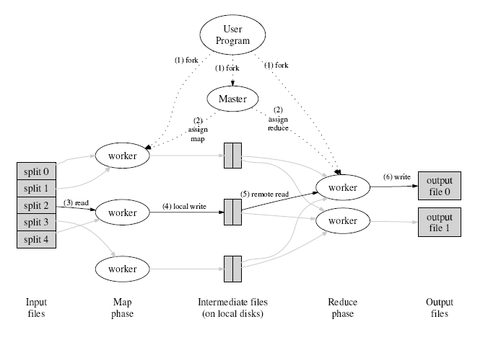
Implementation

Slide 12
Implementation
Data structures maintained
  Locations of R file regions
  Status of each task – idle, in-progress, completed
Fault tolerance
  Master periodically pings workers
  No status – failed, starts a new worker
  And reducer working on data from a failed worker is notified of the new worker
  Master failure – less common (backup or abort task)
  Map-reduce usually deterministic
  “Weaker, but reasonable” semantics for non-deterministic operations

Slide 13
Implementation
Locality
  Conserve bandwidth through Google FS
  Master also takes locations into account when assigning tasks
Task granularity
  Typically M+R > number of machines
  Master schedules O(M+R) operations, requiring O(M*R) memory (small, one byte of data per map/reduce task pair)
Backup tasks
  Often, there are “straggler” machines that take considerably longer to complete a task
  If all done except for stragglers, master assigns backup machines for task, and task is considered complete when either are done.
  Tests show 44% longer w/o backup tasks

Slide 14
Refinements
Partitioning
  Default partition based on a hash of the key typically provides well-balanced loads
  However, may want to support special situations – i.e. wasn’t all URL’s from same host to be in the same file
Ordering guarantees
  Guarantee w/in a given partition that intermediate key value pairs are processed in increasing key order
Combiner function
  Used to speed up reduce later
  i.e. in the word-counting example, may want to combine all (the, 1) entries

Slide 15
Refinements
Skipping bad records
  Bad records often cause map or reduce functions to crash
  Exception handling can ID future bad records and can skip them in the future
  Minimal impact on large data sets
Local Execution
  Used for debugging
Counters
  Default: i.e. number of key/value pairs produced
  Can include user-specified: i.e. all uppercase words in our example
  Master takes care of eliminating duplicates (i.e. due to machine failure) to avoid double-counting

Slide 16
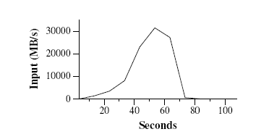
Performance
Grep
  Scan 10^10
  100-byte
  records for a 3
  character pattern
  M=15000
  (64MB ea)
  R=1
  1764 machines
  150 seconds (including about a minute startup overhead)

Slide 17
Performance
Sort
  Sort 10^10 100-byte records
  10-byte sorting key
  <50 lines of code total
  M=15000 (64MB ea)
  R=4000
  Total time (w/backup) = 891 seconds (1057 for TerraSort)
  1283 seconds w/o backup
  933 seconds with 200/1746 machines killed

Slide 18
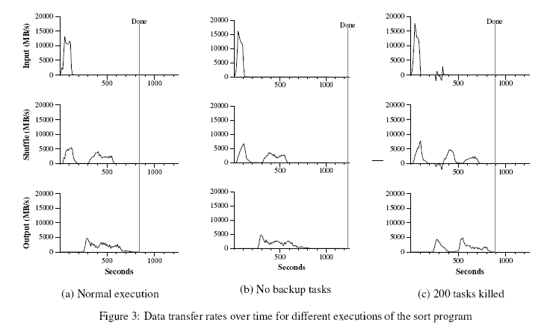
Performance
Sort

Slide 19
Questions

Slide 20
Later
The response to Map-Reduce
MapReduce: A major step backwards
  Blog post by David J. DeWitt and Michael Stonebraker

