Slide 1
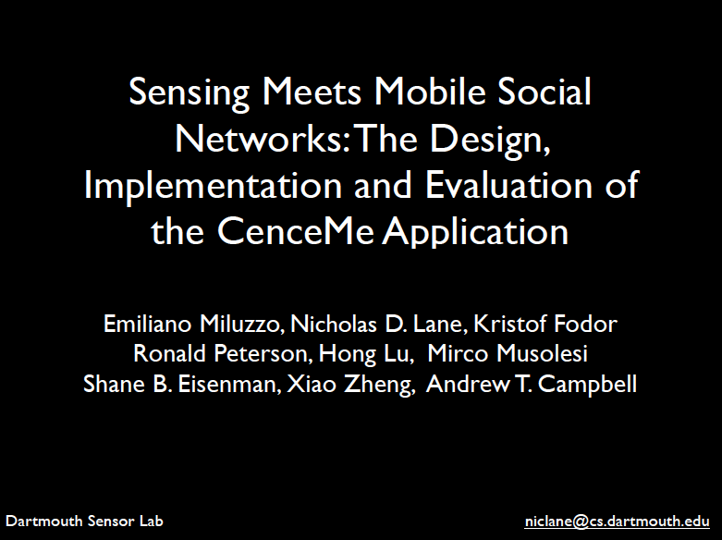
Slides modified and presented by Brandon Wilson

Slide 2
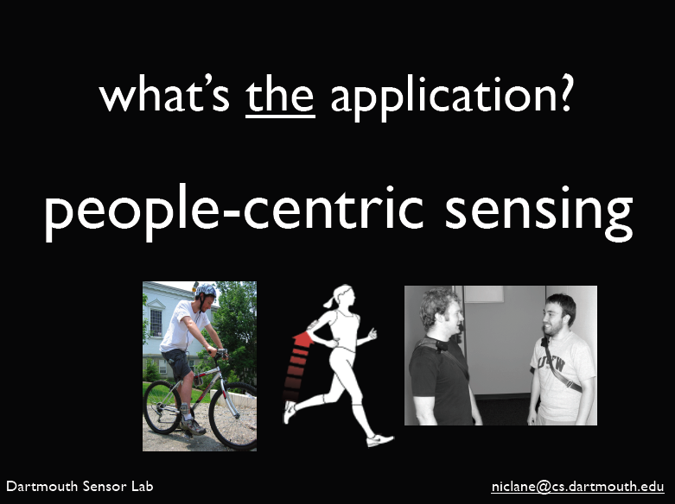

Slide 3
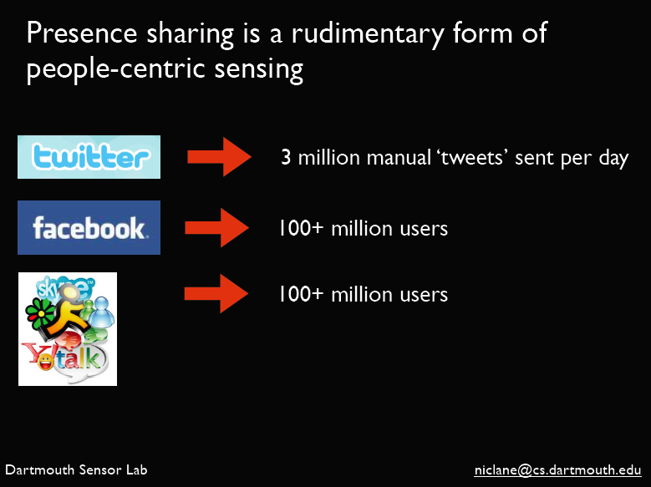

Slide 4

contributions
design, implementation and evaluation of a fully functional
personal mobile sensor system using off-the-shelf sensor-
enabled mobile devices
lightweight, split-level classification paradigm for mobile devices
performance evaluation of the RAM, CPU, and energy
performance of CenceMe software
a user study of the sensor presence sharing system

Slide 5


Slide 6
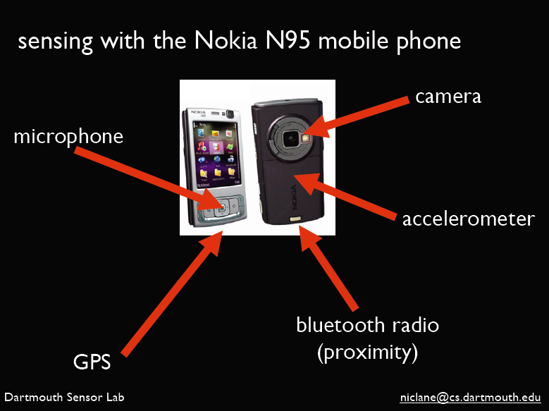

Slide 7
design considerations
hardware and OS limitations (e.g., limited RAM, anytime interruption)
energy consumption
  data upload – combat with duty-cycle strategies
  sensor drain (e.g., GPS) – also can use duty-cycle strategies
API and security limitations

Slide 8
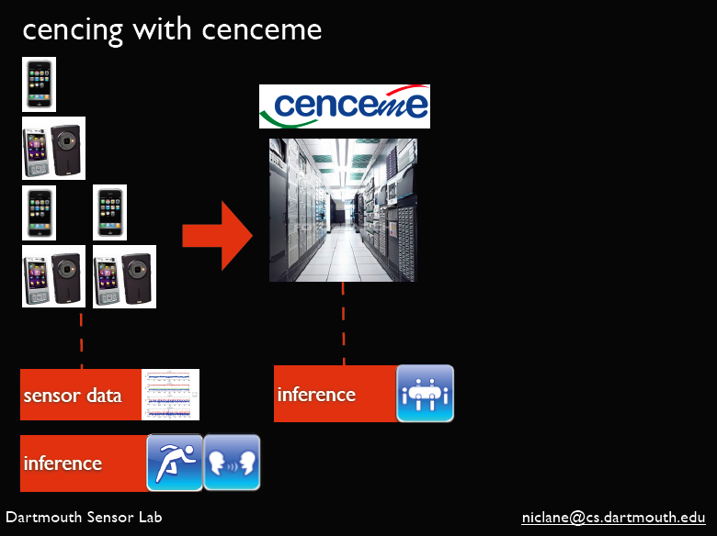
split-level classification

Slide 9
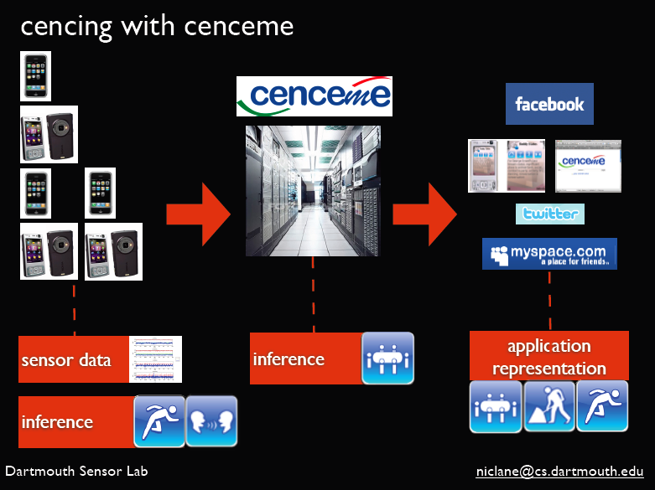

Slide 10
why split-level classification?
scalability - computationally intensive to classify sensor data
from a large number of phones
  phone classification output called primitives (e.g., walking, sitting, running)
  backend classifications uses primitives and produces facts
support for customized tags
resilience to WiFi or cellular dropouts
minimizes sensor data sent back to servers (save bandwidth)
reduces energy consumption

Slide 11
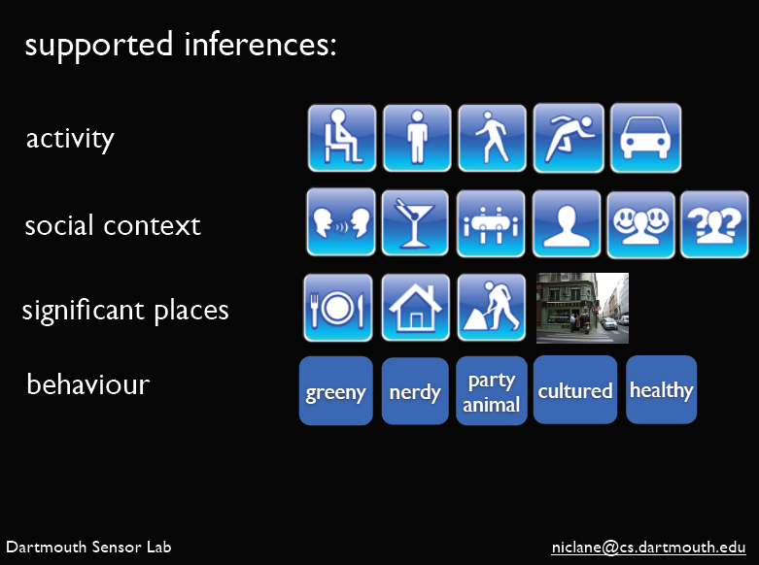

Slide 12
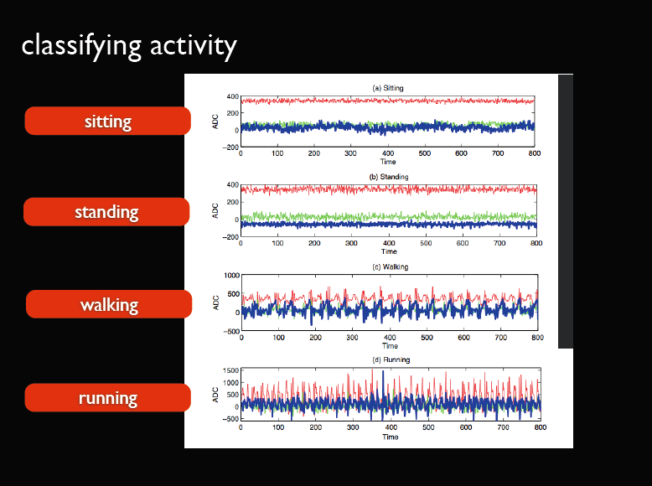

Slide 13
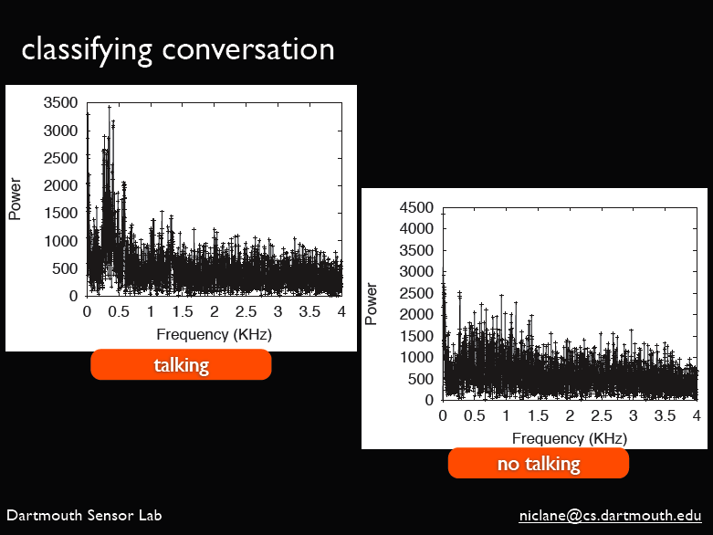

Slide 14
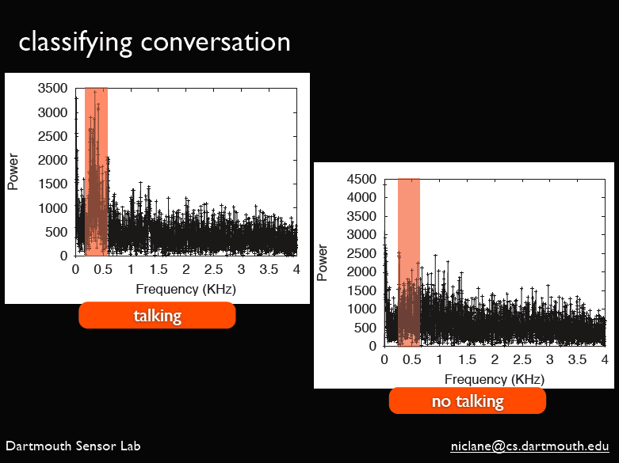

Slide 15
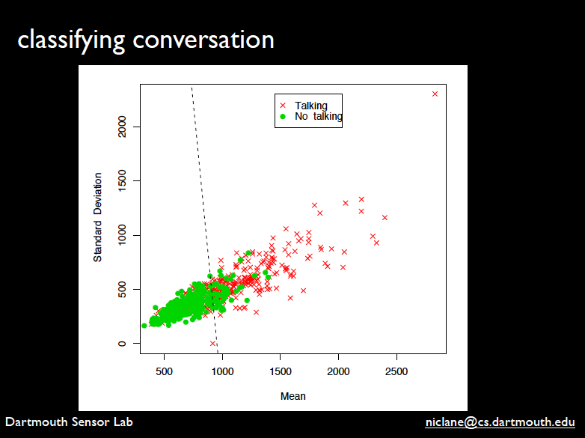
Notes:
Mention sliding window to detect conversations – Using N=5, 2 out of 5 in-conversation is a positive classification, otherwise not in conversation. This is to ensure that more false positives because they are less expensive than false negatives (i.e., seeing someone is not in conversation when they really are when you want to call them can cause unnecessary interruptions)

Slide 16
backend classifiers
conversation classifier
  rolling window of N audio primitives
  conversation state triggered if 2/5 primitives are
  in-conversation
social context
  examines BT MAC addresses for CenceMe buddies,
  combine audio and activity classifier output to determine if
  alone, at a party, or in a meeting
mobility mode detector
  simple, binary detector determines if traveling in vehicle or
  not

Slide 17
backend classifiers (cont’d)
location classifier
  classified based on bindings (e.g., bind GPS coordinates to
  label, short textual description, and type)
  bindings are user-extensible
  bindings are suggested if already established by other
  CenceMe users
am I hot
  nerdy – being alone, large amounts of time in library
  party animal – frequency and duration of party attendance
  cultured – frequency and duration of visits to museums,
  theatres, etc.
  healthy – physical activity frequency
  greeny – users with low environmental impact

Slide 18
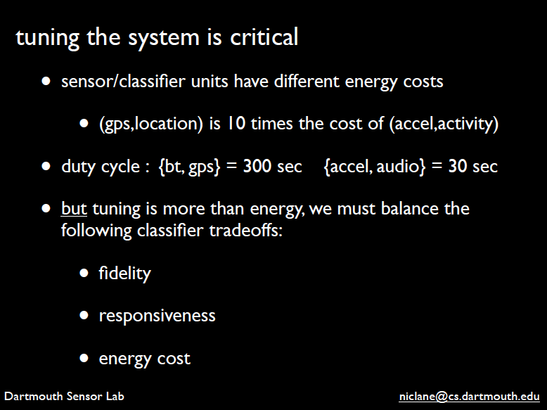

Slide 19
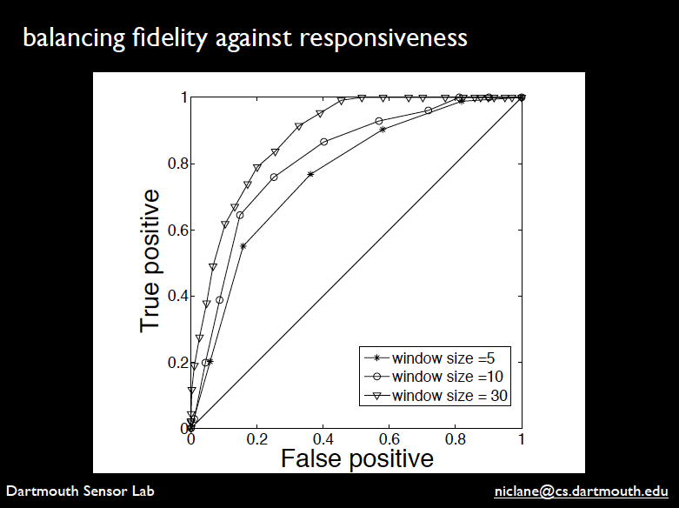

Slide 20


Slide 21
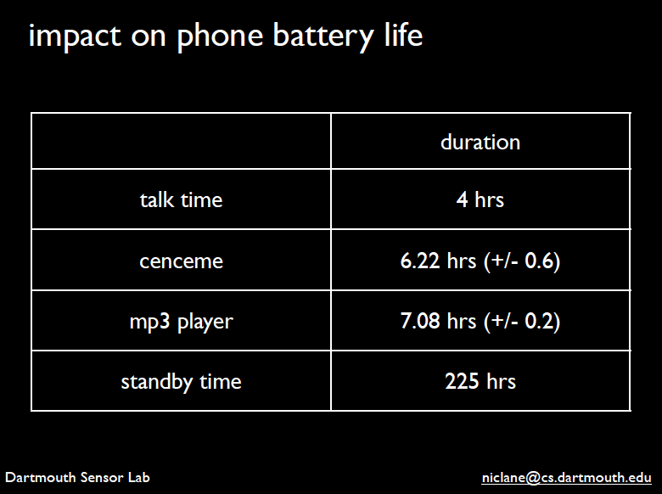

Slide 22

impact on CPU and memory
Initially phone is idle, add modules incrementally and measure
changes to CPU and RAM usage
classification and DFT for audio and accelerometer most
significant impact on CPU
memory footprint for whole CenceMe application < 6MB

Slide 23
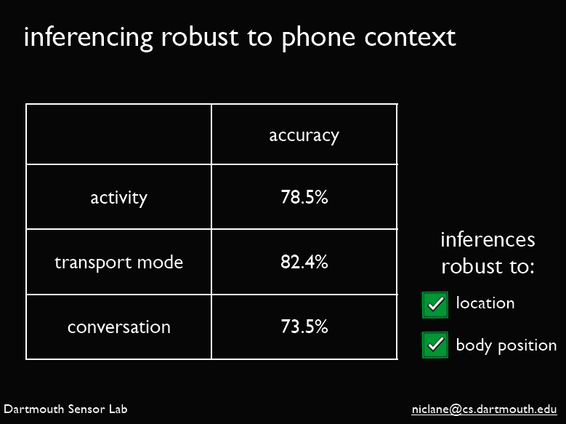
Notes:
Mention conversation classifier confusion matrix uneven by design

Slide 24
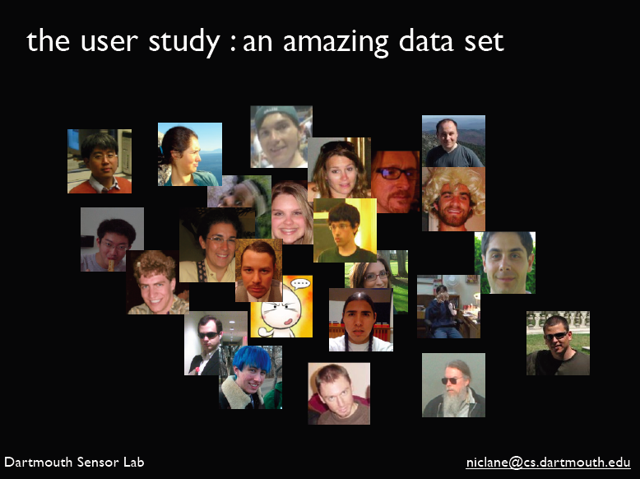

Slide 25
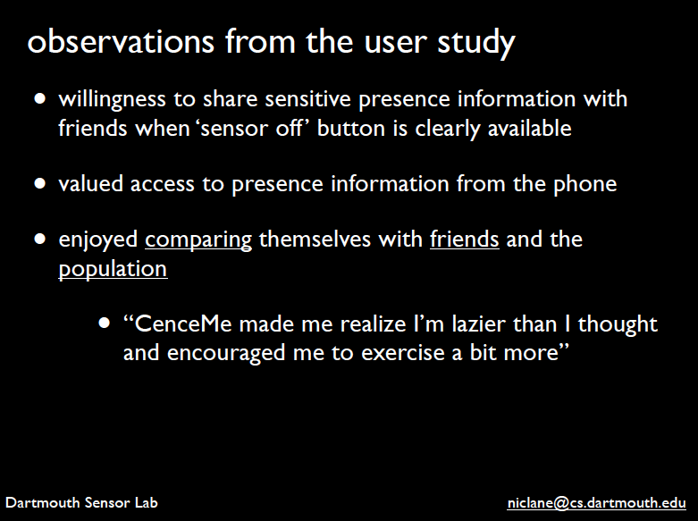

Slide 26
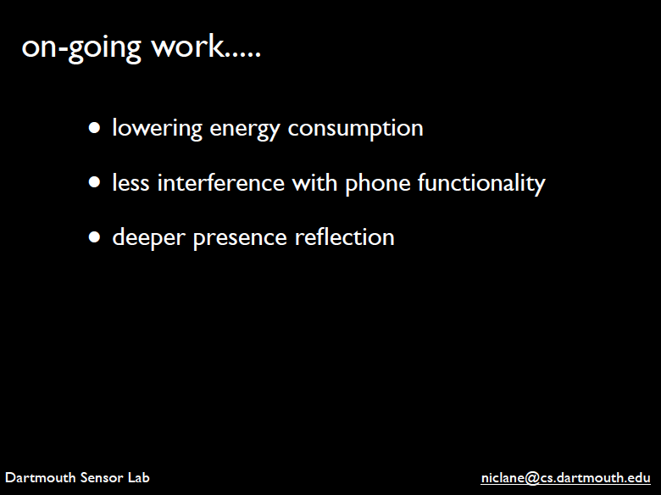

Slide 27
