Slide 1
Pb-lite boundary detection
Kiran Y. D. V.

Slide 2
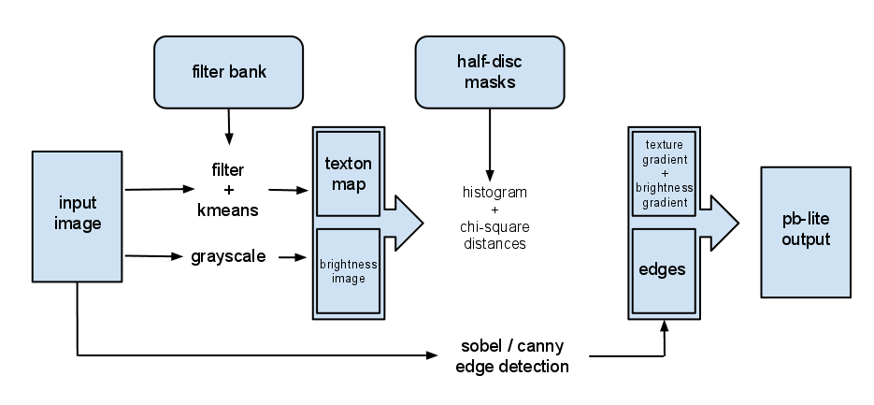
Overview
http://cs.brown.edu/courses/cs143/2011/proj2/

Slide 3
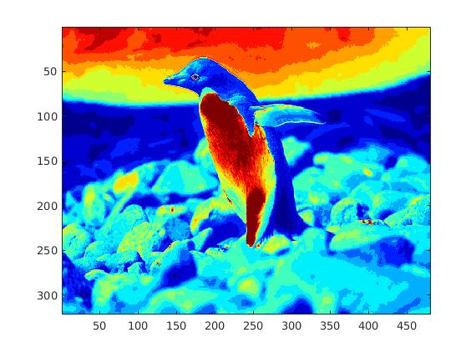
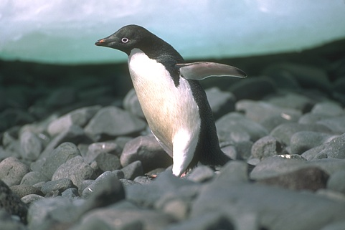
Brightness Gradient
Original Image
Brightness Gradient

Slide 4
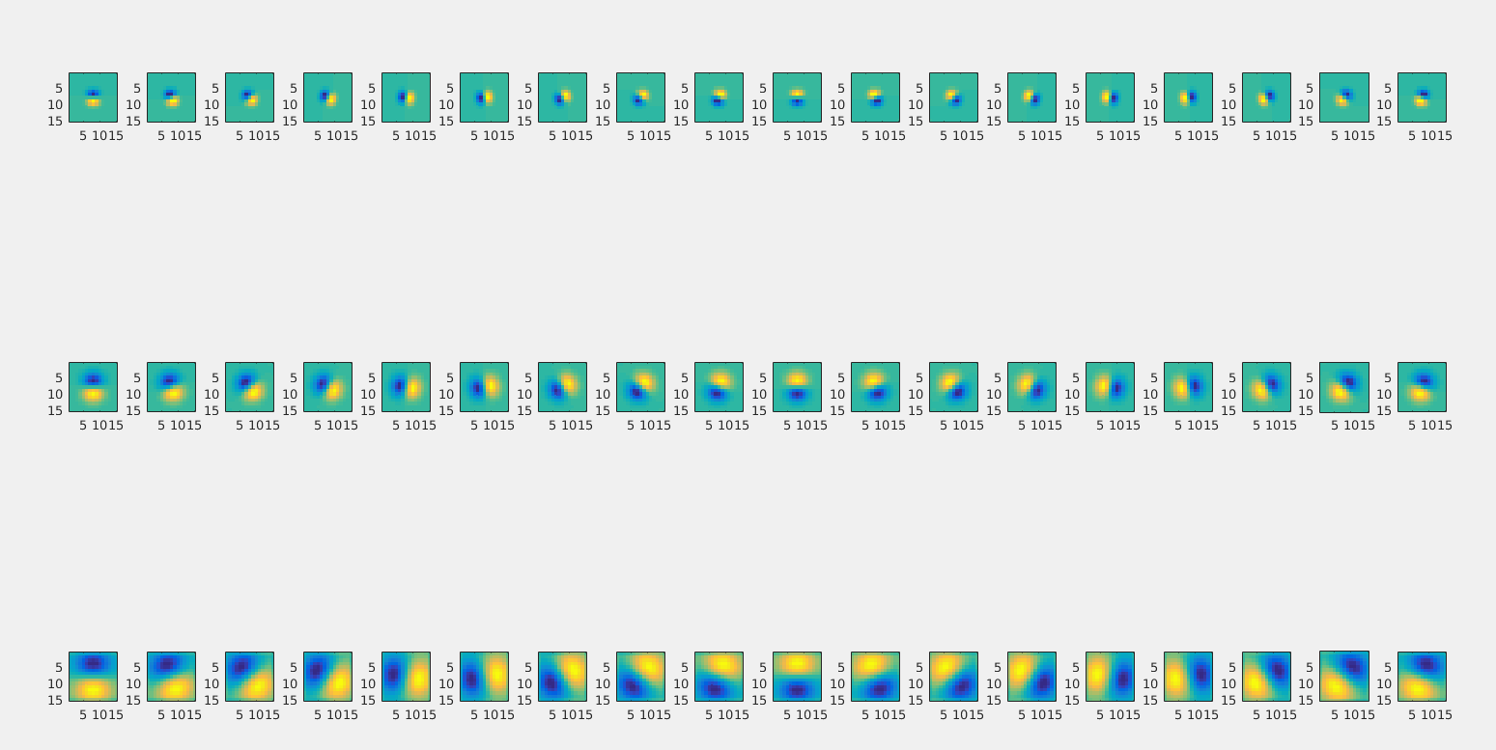
Texture Gradient using Oriented Gaussian Filters
In short these are derivatives of gaussian filter which are steered to different orientations

Slide 5
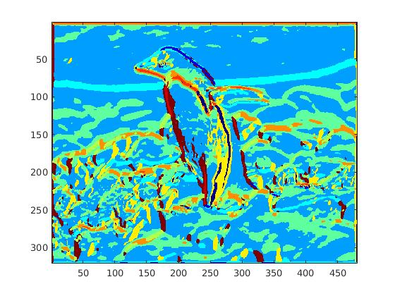
Texton Map
Original Image
Texton Map

Slide 6
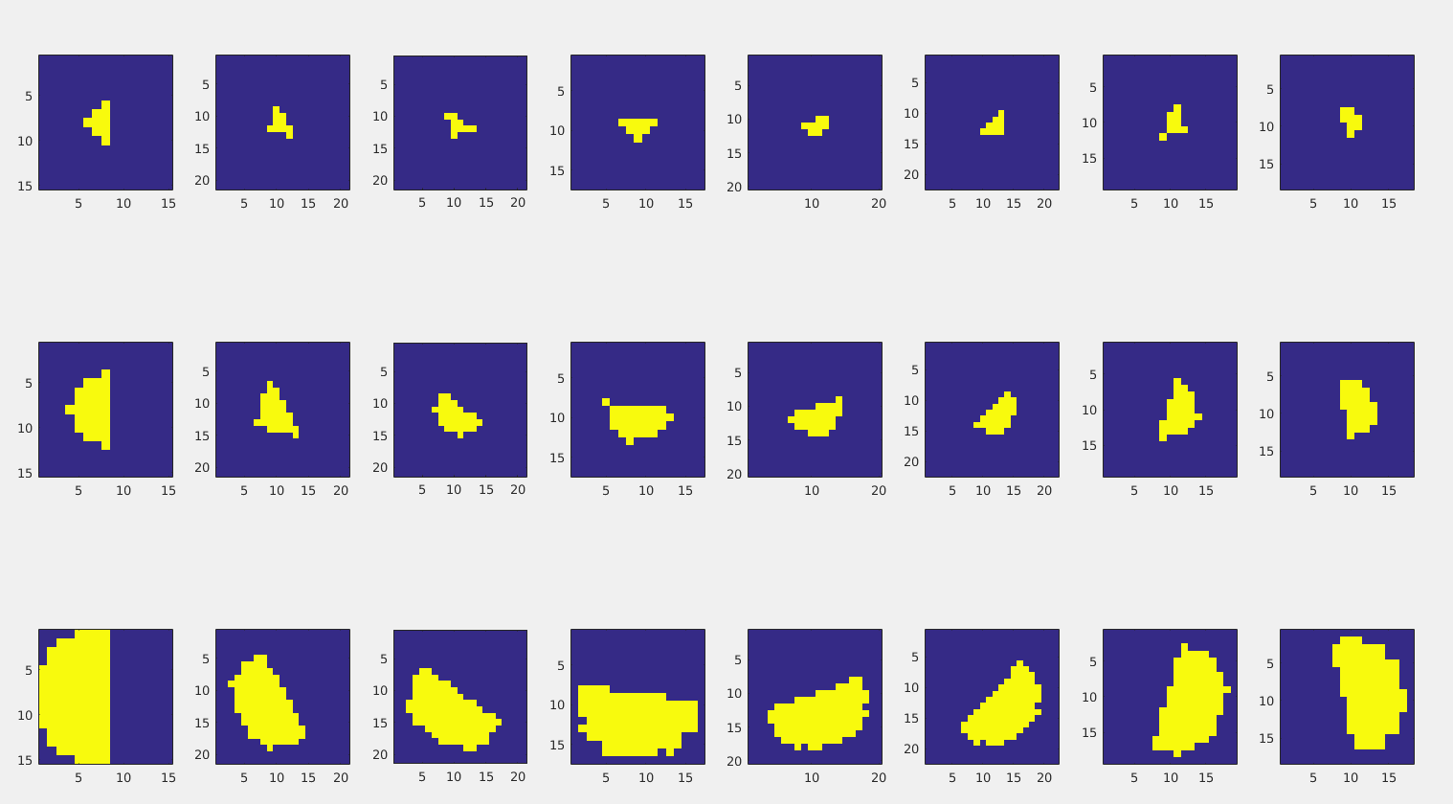
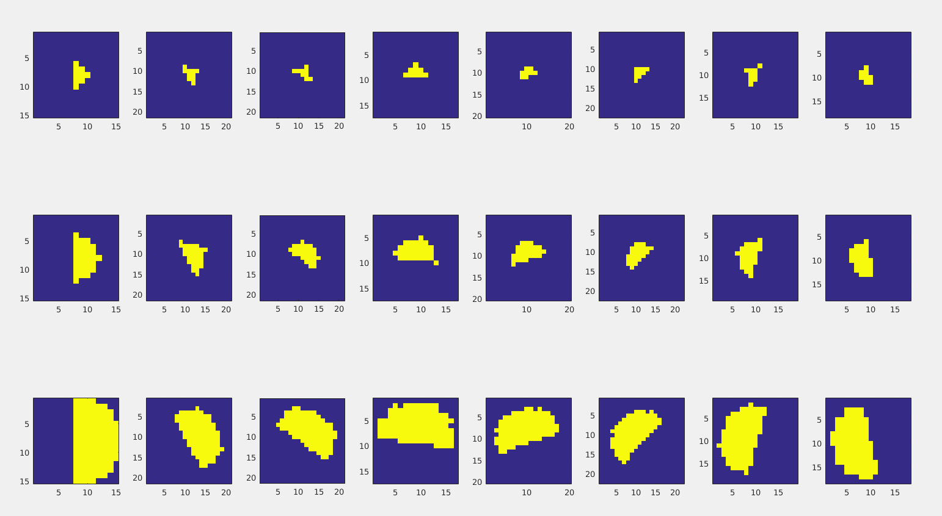
Half Disc Masks to speed up processing
Left - half discs
Left - half discs
Right - half discs

Slide 7
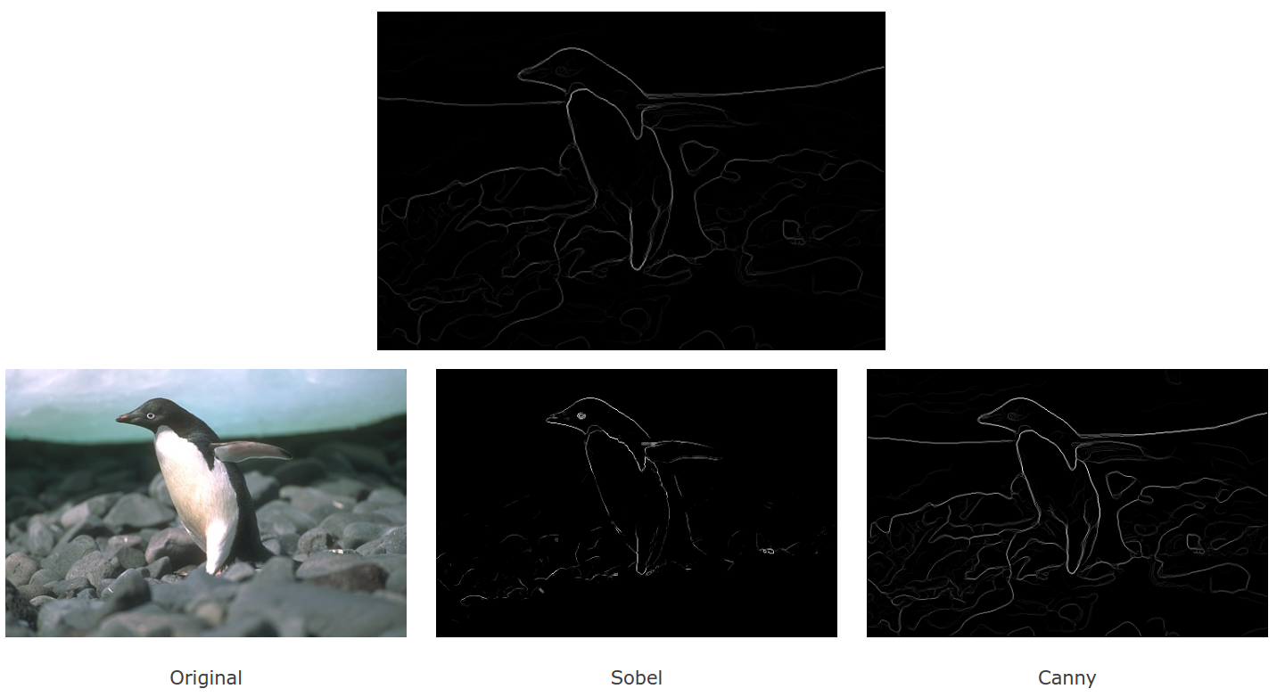
pb-lite
http://cs.brown.edu/courses/cs143/2011/results/proj2/auguray/

