Slide 1
FutureMatch: Combining Human Value Judgments and Machine Learning to Match in Dynamic Environments
John P. Dickerson, Tuomas Sandholm
In AAAI, 2015
Presented by Zuxuan Wu

Slide 2
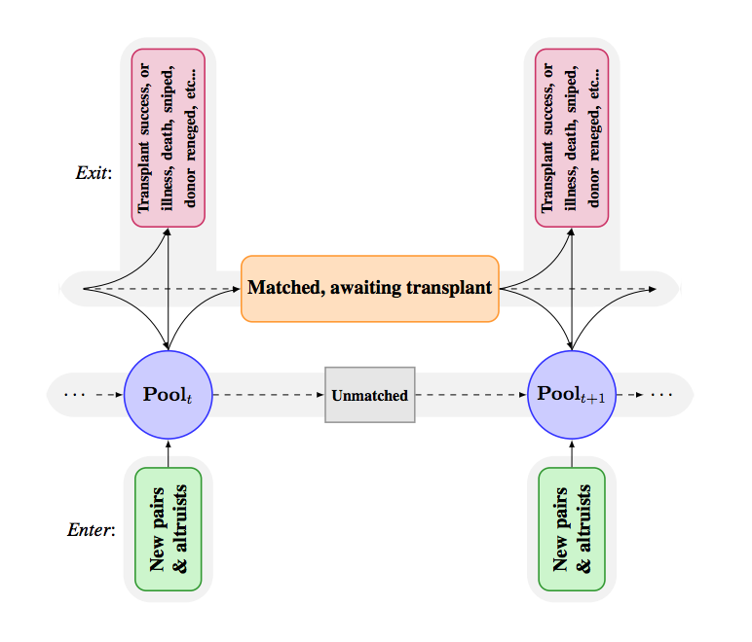
Motivation
Fielded exchanges act myopically, considering only the current pool of pairs.
Kidney exchange is inherently dynamic.
It’s important to consider future when matching.

Slide 3
Contribution
It takes as input a high-level objective decided on by experts.
It automatically learns how to make the objective concrete.
Utilizing historical data to learn the quality of each possible matching
Learn the potentials of elements offline.

Slide 4
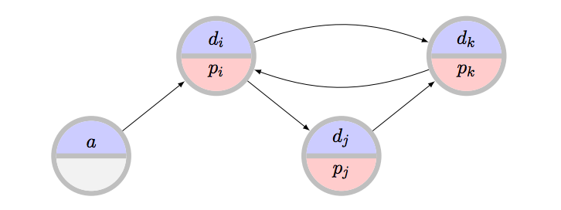

Recap: Kidney Exchange Model
Clearing problem: find a matching M* that maximizes utility function
$$M^{∗}= \underset{M∈ℳ}{argmax}{u(M)}$$

Slide 5
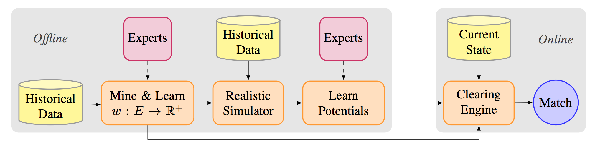
Future Match Framework
1. Overall objective is given by domain expert.
-- e.g., maximize the number of days added
but this is hard how to measure the utility
-- Learning the weights!

Slide 6
Future Match Framework
2. A parameterized (kidney exchange) simulator to mimic distribution.

Slide 7
Future Match Framework
3. Learn the potential to quantify the expected utility to the exchange of that element in the future.

Slide 8
Encoding an Objective Function
Two different models are considered
1）deterministic: post-algorithmic failures are not quantified
2）failure-aware: are quantified
Three matching objectives:
MaxCard: maximize the total number of patients
2) MaxCard-Fair: maximize the total number of patients,
and the “marginalized” patients are weighted more.
3) MaxLife: maximize the total time matched (deterministic) or
transplanted (failure-aware) donor organs.

Slide 9
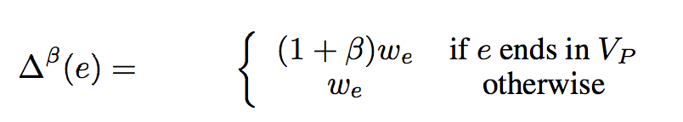

MaxCard and MaxCard-Fair
Encoding an Objective Function
A natural weighted fairness rule:
--adjusts edge weights by some re-weighting function.
the set of preferred vertices
Pediatric or highly sensitized patients

Slide 10
Encoding an Objective Function
MaxLife
Learning to predict graft survival from data.
The Kidney Donor Profile Index (KDPI) score of a deceased donor kidney: the estimated quality of the donor organ being allocated to the average recipient.
In this paper, a unique quality score:
(1) donor attributes
(2) attributes of the specific potential recipient.

Slide 11
Encoding an Objective Function
MaxLife
75,264 living donor transplant during 1987.10 – 2013.6
medical characteristics of the recipient at the time of transplantation
medical characteristics of the donor at the time of transplantation
follow-up data regarding the health of the recipient
follow-up data of the health of the recipient’s new kidney;
Average graft lifetime is about 1912.7 days, or slightly over 5 years.

Slide 12
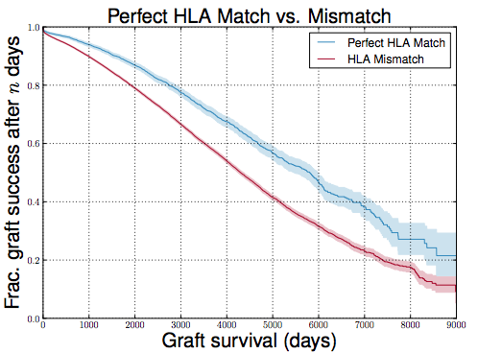
Encoding an Objective Function
MaxLife
Graft survival depends on both the donor and the recipient.
Kaplan-Meier estimator of survival functions

Slide 13
Encoding an Objective Function
MaxLife
Cox proportional hazards analysis for survivability.
Baseline hazard
Features:
recipient age,
difference in donor and recipient’s age,
donor or recipient HLA profile HLA-A/B/DR {0, 1, 2},
donor and recipient blood type compatibility

Slide 14
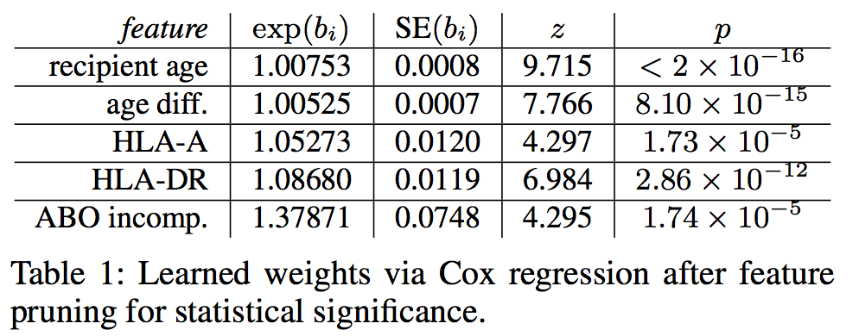
Encoding an Objective Function
MaxLife
Regression results:
HLA-B mismatch did not have a significant effect (p = 0.22).
-- Prior results on cadaveric HLA-B and HLA-DR have significant effect.
Each clearly has a statistically significant effect on graft survival.

Slide 15




Encoding an Objective Function
MaxLife
Survival probability at time t for potential transplant e.
Weighting function:
Higher relative weight to edges with lower risk

Slide 16
Learning Potentials
Goal:
Weight function w defined above quantifies how useful an edge is in the present myopic.
+ potentials define how useful it would be in the future

Slide 17





Learning Potentials
Method:
Select a set of features, and assign usefulness.
pairs
altruists
The weight function w learned is myopic.
Consider the future value:
SMAC is utilized to search the parameter space.

Slide 18
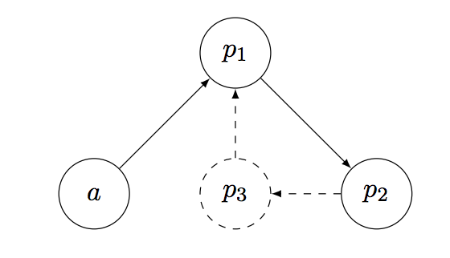


Learning Potentials
Example
<a, p1> and <a, p1, p2>
will have negative utility

Slide 19
Learning Potentials
Example
<a, p1, p2, p3>
will have positive utility

Slide 20
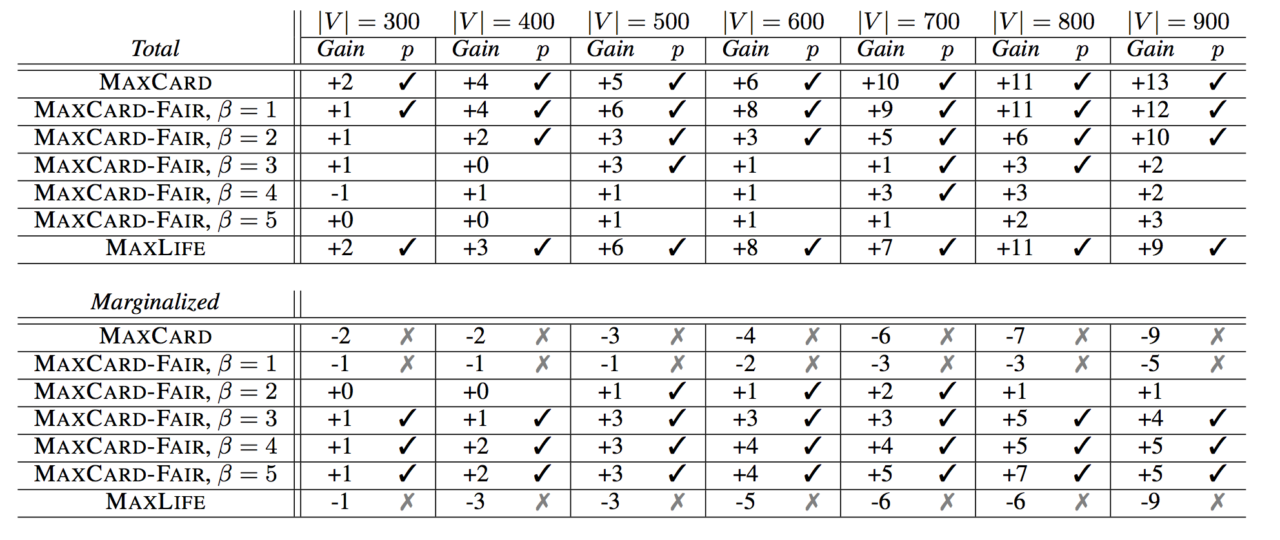
Experiments
Dataset: UNOS, FutureMatch vs myopic matching
Median gains in expected total number of transplants or marginal transplants.

Slide 21
Experiments
Dataset: UNOS
Median gains in expected total number of transplants or marginal transplants.

Slide 22
Experiments
Dataset: UNOS
Median gains in expected total number of transplants or marginal transplants.

