Slide 1
Applied Mechanism Design For Social Good
John P Dickerson
Lecture #18 – 10/27/2016
CMSC828M
Tuesdays & Thursdays
12:30pm – 1:45pm

Slide 2
Midterm
(Please hold your applause.)
The process:
Email me between now and Sunday
I will send you the midterm
Within 24 hours, email me a single PDF
your_user_id_midterm.pdf
with your responses to the 5 questions
I must have midterms by noon on Monday!
The rules:
Work alone & cite your sources
Email me with any clarification questions

Slide 3
Academic Integrity
Common Sense!
(Text unironically stolen from Hal Daumé III)
Any assignment or exam that is handed in must be your own work (unless otherwise stated). However, talking with one another to understand the material better is strongly encouraged. Recognizing the distinction between cheating and cooperation is very important. If you copy someone else's solution, you are cheating. If you let someone else copy your solution, you are cheating (this includes posting solutions online in a public place). If someone dictates a solution to you, you are cheating.
Everything you hand in must be in your own words, and based on your own understanding of the solution. If someone helps you understand the problem during a high-level discussion, you are not cheating. We strongly encourage students to help one another understand the material presented in class, in the book, and general issues relevant to the assignments. When taking an exam, you must work independently. Any collaboration during an exam will be considered cheating. Any student who is caught cheating will be given an F in the course and referred to the University Office of Student Conduct. Please don't take that chance – if you're having trouble understanding the material, please let me know and I will be more than happy to help.

Slide 4
This class:
When do Fair Allocations Exist And How Do We find Them?
Thanks to: Yonatan Aumann (YA), Ariel Procaccia (AP), Shengyu Zhang (SZ)

Slide 5
Cutting a Divisible Cake: Model
Division of a heterogeneous divisible good
The cake is the interval [0,1]
Set of agents N = {1,...,n}
Each agent has a valuation function V_{i} over pieces of cake
Additive: if X∩Y=∅ then V_{i}(X)+V_{i}(Y) = V_{i}(X∪Y)
∀i∈N, V_{i}([0,1]) = 1
Find an allocation A = A₁,...,A_{n}
The cake is a metaphor.

Slide 6
Fairness Definitions
Proportionality: ∀i∈N, V_{i}(A_{i}) ≥ 1/n
Envy-freeness: ∀i,j∈N, V_{i}(A_{i}) ≥ V_{i}(A_{j})
Assuming free disposal the two properties are incomparable
Envy-free but not proportional: ????????????
  Throw away cake!
Proportional but not envy-free:
1/3
1/2
1
1/6
1

Slide 7
Deterministic algorithms
Current research in cake cutting: design truthful, envy free, proportional, and tractable cake cutting algorithms
Requires restricting the valuation functions
Lower bounds for envy-free cake cutting [Procaccia, CACM-2009]
Valuation V_{i} is piecewise uniform if agent i is uniformly interested in a piece of cake
E.g., interested uniformly in [0,0.5] but not (0.5,1.0]
THEOREM
Assuming that the agents have piecewise uniform valuations, then there is a deterministic algorithm that is truthful, proportional, envy-free, and polynomial-time.

Slide 8
Randomized algorithms
A randomized algorithm is universally envy-free (resp., universally proportional) if it always returns an envy-free (resp., proportional) allocation
A randomized algorithm is truthful in expectation if an agent cannot gain in expectation by lying
→ Looking for universal fairness and truthfulness in expectation

Slide 9
A Randomized Cake Cutting Protocol
A partition X₁,...,X_{n} is perfect if for every i, k, V_{i}(X_{k})=1/n
Algorithm:
  Find a perfect partition X₁,...,X_{n}
  Give each player a random piece
Observation [Mossel&Tamuz 2010]: algorithm is truthful in expectation, universally E-F and universally proportional
Proof: if agent i lies it may lead to a partition Y₁,...,Y_{n}, but
Σ_{k} (1/n)V_{i}(Y_{k}) = (1/n) Σ_{k} V_{i}(Y_{k}) = 1/n
It is known that a perfect partition always exists [Alon 1987]
Lemma: if agents have piecewise linear valuations then a perfect partition can be found in polynomial time
???????????

Slide 10
Counting Cuts & Queries
Algorithms for different variants of the problem:
Finite Algorithms
“Moving knife” algorithms
Lower bounds on the number of steps required for divisions
(see [Procaccia CACM-14] for an easy-to-read discussion)
Until very recently it was unknown if there was a bounded (in terms of queries to agents’ valuation functions, and in terms of cuts) and E-F cake cutting algorithm for 4 or more players
[Aziz and Mackenzie STOC-16]: bounded (231 cuts) for 4 players
[Aziz and Mackenzie FOCS-16]: bounded (O(n^n^n^n^n^n) queries) for n players

Slide 11
Cut and Choose
Two agent case!
Alice
Bob
Alice likes the candies
Bob likes the base
Alice cuts in “her” middle
Bob chooses
Proportional
Envy free
Equitable
Proportional ??????
Envy free ??????

Slide 12
Cut And Choose
Three agent case!
Stage 0: Player 1 divides into three equal pieces
  (According to her valuation)
Player 2 trims the largest piece s.t. the remaining is the same as the second largest.
The trimmed part is called Cake 2; the other forms Cake 1

Slide 13
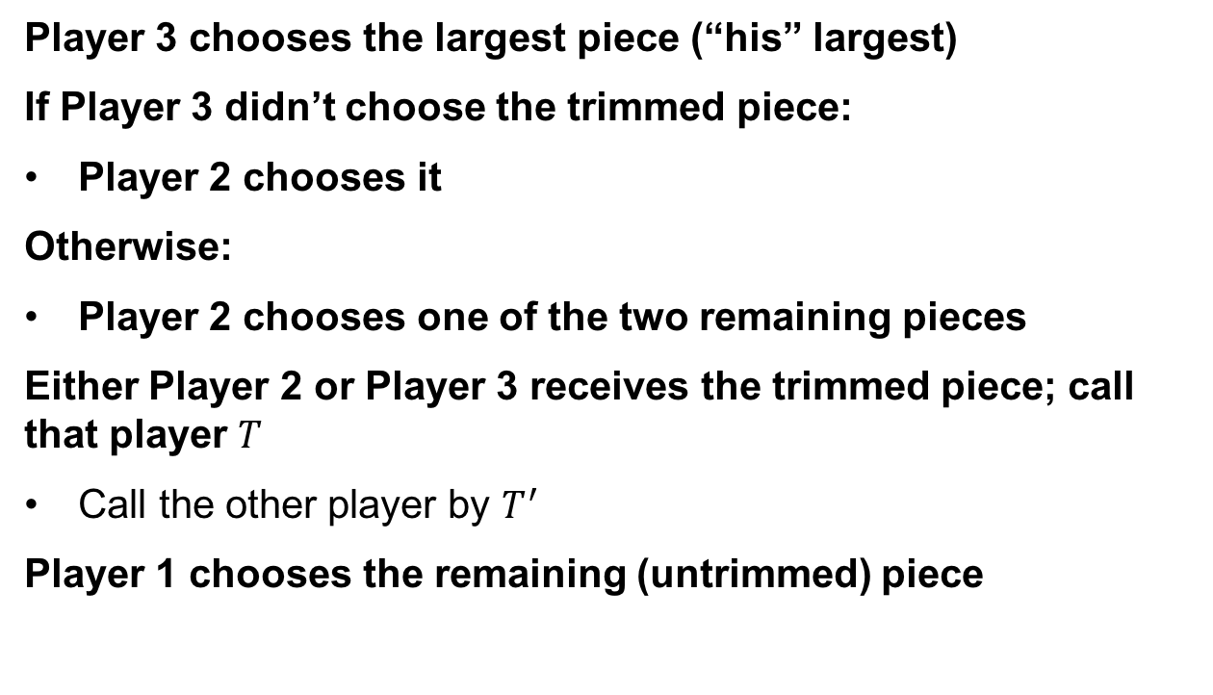
Stage 1: division of Cake 1
Player 3 chooses the largest piece (“his” largest)
If Player 3 didn’t choose the trimmed piece:
Player 2 chooses it
Otherwise:
Player 2 chooses one of the two remaining pieces
Either Player 2 or Player 3 receives the trimmed piece; call that player $T$
Call the other player by $T^{′}$
Player 1 chooses the remaining (untrimmed) piece

Slide 14

Stage 2: division of Cake 2
$T^{′}$ divides Cake 2 into three equal pieces
(According to her valuation)
Players $T$, 1, and $T^{′}$ choose the pieces of Cake 2, in that order.

Slide 15
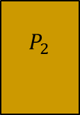




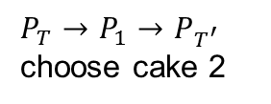
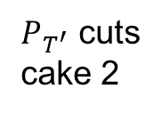


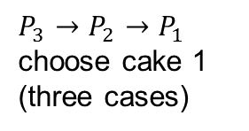
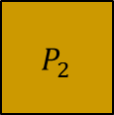
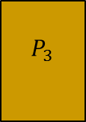

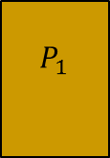

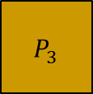
Whole process
$P_{3}→P_{2}→P_{1}$ choose cake 1
(three cases)
$P_{T^{′}}$ cuts
cake 2
$P_{T}→P_{1}→P_{T^{′}}$ choose cake 2
$P_{1}$ cuts
$P_{2}$ trims
Cake 2
$$P_{2}$$
$$P_{2}$$
$$P_{3}$$
$$P_{T}$$
$$P_{T}$$
$$P_{T}$$
$$P_{3}$$
$$P_{1}$$
$$P_{2}$$
$$P_{T^{′}}$$
$$P_{T^{′}}$$
$$P_{1}$$
$$P_{3}$$
$$P_{1}$$
$$P_{T^{′}}$$

Slide 16
Envy-freeness
The division of Cake 1 is envy-free:
Player 3 chooses first so he doesn’t envy others.
Player 2 likes the trimmed piece and another piece equally, both better than the third piece. Player 2 is guaranteed to receive one of these two pieces, thus doesn’t envy others.
Player 1 is indifferent judging the two untrimmed pieces and indeed receives an untrimmed piece.

Slide 17
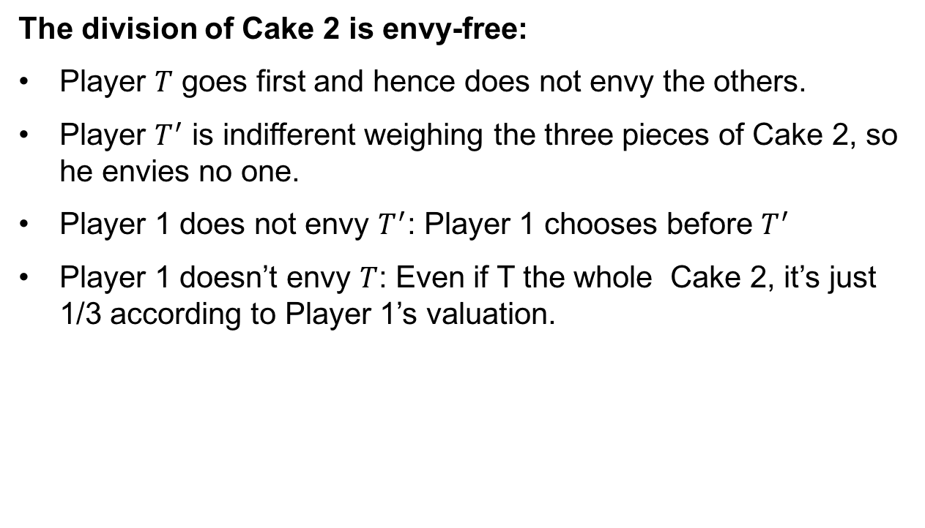
Envy-freeness of Cake 2
The division of Cake 2 is envy-free:
Player $T$ goes first and hence does not envy the others.
Player $T^{′}$ is indifferent weighing the three pieces of Cake 2, so he envies no one.
Player 1 does not envy $T^{′}$: Player 1 chooses before $T^{′}$
Player 1 doesn’t envy $T$: Even if T the whole Cake 2, it’s just 1/3 according to Player 1’s valuation.

Slide 18

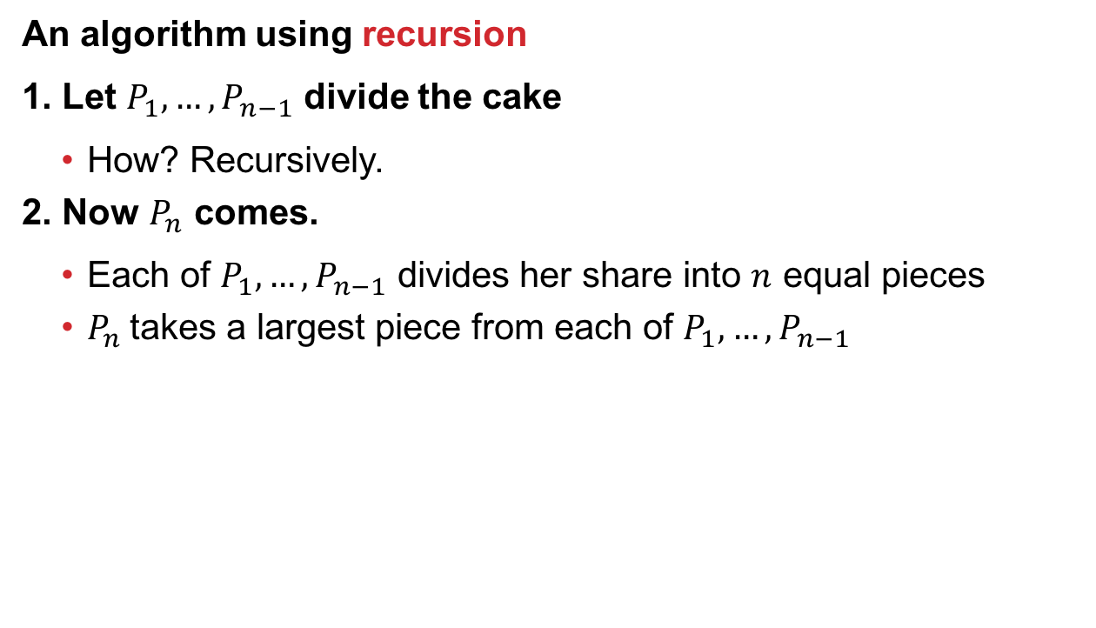
General $n$?
An algorithm using recursion
1. Let $P_{1}, …, P_{n−1}$ divide the cake
  How? Recursively.
2. Now $P_{n}$ comes.
  Each of $P_{1}, …, P_{n−1}$ divides her share into $n$ equal pieces
  $P_{n}$takes a largest piece from each of $P_{1}, …, P_{n−1}$

Slide 19
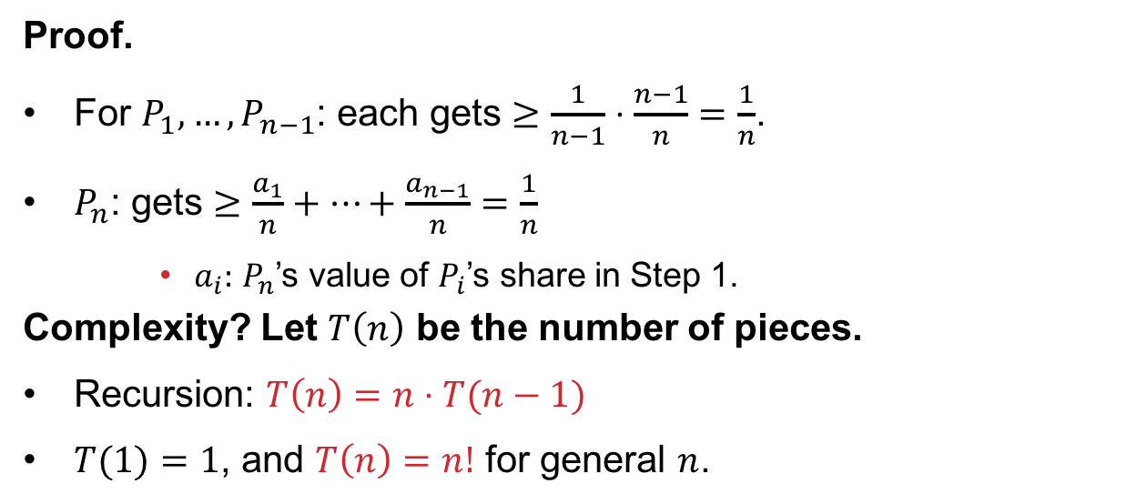
Fairness And Complexity
THEOREM
The protocol is (proportional) fair
Proof.
For $P_{1}, …, P_{n−1}$: each gets $≥\frac{1}{n−1}⋅\frac{n−1}{n}=\frac{1}{n}$.
$P_{n}$: gets $≥\frac{a_{1}}{n}+⋯+\frac{a_{n−1}}{n}=\frac{1}{n}$
    $a_{i}:$ $P_{n}$’s value of $P_{i}$’s share in Step 1.
Complexity? Let $T\left(n\right)$ be the number of pieces.
Recursion: $T\left(n\right)=n⋅T(n−1)$
$T(1)=1$, and $T\left(n\right)=n!$ for general $n$.

Slide 20
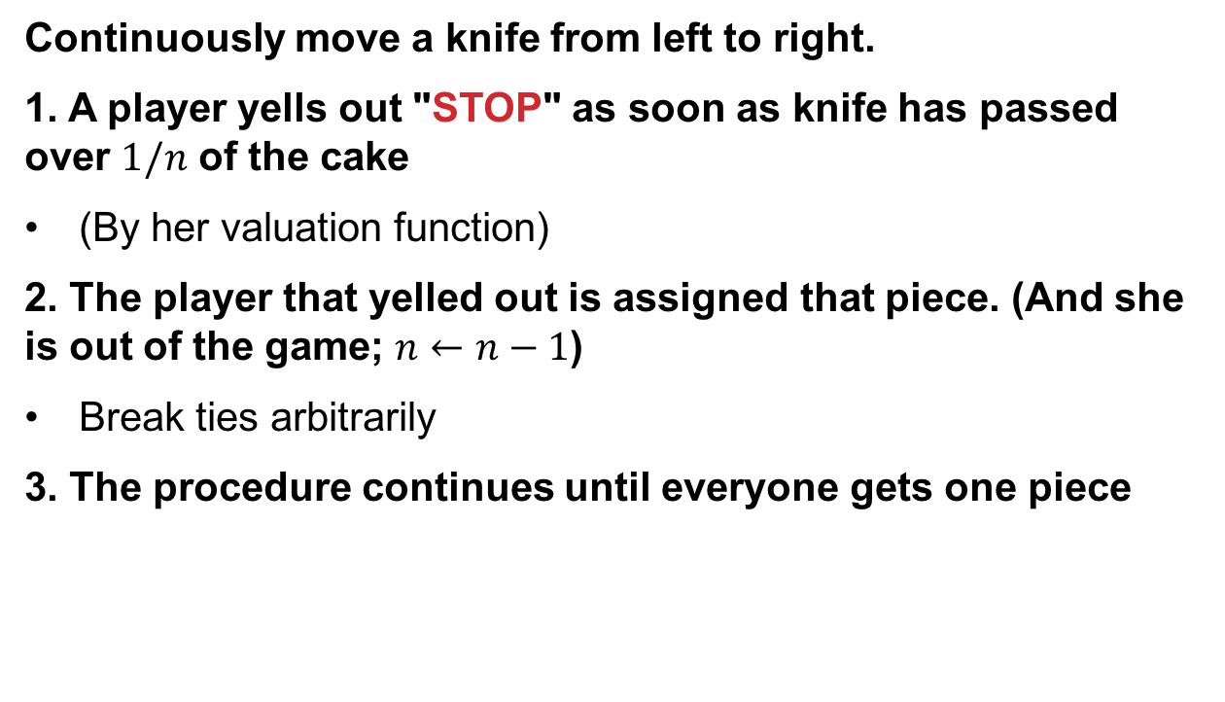
Moving Knife protocols
[Dubins-Spanier 1961]
Continuously move a knife from left to right.
1. A player yells out "STOP" as soon as knife has passed over $1/n$ of the cake
(By her valuation function)
2. The player that yelled out is assigned that piece. (And she is out of the game; $n←n−1$)
Break ties arbitrarily
3. The procedure continues until everyone gets one piece

Slide 21
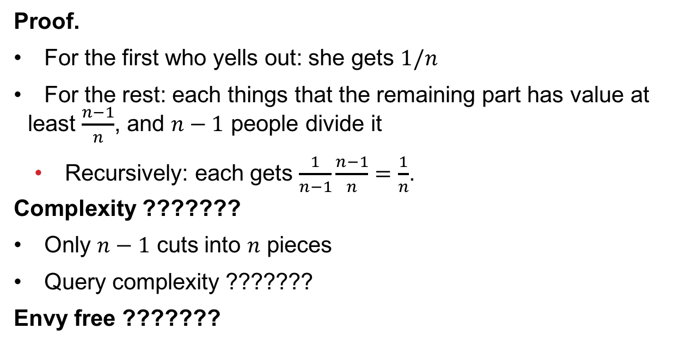
Fairness and complexity
THEOREM
The protocol is (proportional) fair
Proof.
For the first who yells out: she gets $1/n$
For the rest: each things that the remaining part has value at least $\frac{n−1}{n}$, and $n−1$ people divide it
  Recursively: each gets $\frac{1}{n−1}\frac{n−1}{n}=\frac{1}{n}$.
Complexity ???????
Only $n−1$ cuts into $n$ pieces
Query complexity ???????
Envy free ???????

Slide 22
What about Fairness vs social welfare?
Player 1
Player 2
Social welfare maximizing allocation ???????
Players 3,4
E-F allocation ????????
Player 1
Player 1
Player 3
Player 2
Player 2
Player 4
Total: 1.5
Total: 2
Fairness ≠ Maximum Utility

Slide 23
The Price of Fairness In Cake Cutting
Given an instance:
max welfare using any division
PoF =
max welfare using fair division
utilitarian
Price of equitability
Price of envy-freeness
Price of proportionality
egalitarian
(= minimum of players’ utilities)

Slide 24
Price of E-F: Continued Example
Player 1
Player 2
Players 3,4
Envy-free
Utilitarian optimum
Total: 1.5
Total: 2
Utilitarian Price of Envy-Freeness:
4/3

Slide 25
“Price Of” Bounds
[Aumann & Dombb]
Price of … | Proportionality | Envy freeness | Equitability
Utilitarian
Egalitarian | 1 |  | 1

Slide 26
Utilitarian Price of E-F: Lower Bound
Player 1
Player 2
Player 3
Player 3
players
Best possible utilitarian:
Best proportional/envy-free utilitarian:
Utilitarian Price of envy-freeness:

Slide 27
CEEI For Multiple Divisible Items
[Varian 1974]
Endow all players with a budget of $1
Competitive equilibrium is:
(Virtual) prices such that …
… when each player buys their most valuable bundle at those prices ...
... the market clears.
Tough to compute
Envy free allocation
(I can afford any other player’s bundle, but chose my own)

Slide 28
Recall: CEEI for Indivisible items?
Two agents
Capacity: 2
Both agents will
share the same
preference profile:
Market clearing prices
Don’t exist! For any price, for any item, either both agents demand that item or both do not.
Got around this via “A-CEEI,” slightly different budgets for agents, envy free up to 1 good, ~SP in the large …
>
>
>
>
>
>
>
>

Slide 29


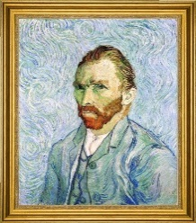





Maximin Share (MMS) Guarantee
Total:
$50
Total:
$30
Total:
$20
$$\$50$$
$$\$30$$
$$\$3$$
$$\$2$$
$$\$5$$
$$\$5$$
$$\$5$$

Slide 30







Maximin Share (MMS) Guarantee
Total:
$50
Total:
$30
Total:
$20
$$\$50$$
$$\$30$$
$$\$3$$
$$\$2$$
$$\$5$$
$$\$5$$
$$\$5$$
Total:
$30
Total:
$30
Total:
$40
$$\$3$$
$$\$2$$
$$\$5$$
$$\$40$$
$$\$10$$
$$\$20$$
$$\$20$$
After Player 1 partitions items into bundles, all other players adversarially choose bundles
What should Player 1 do?

Slide 31

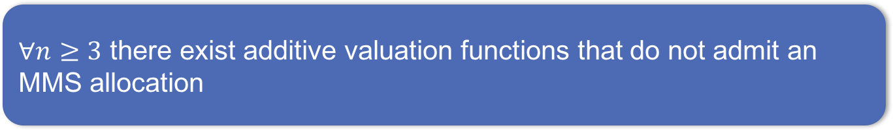
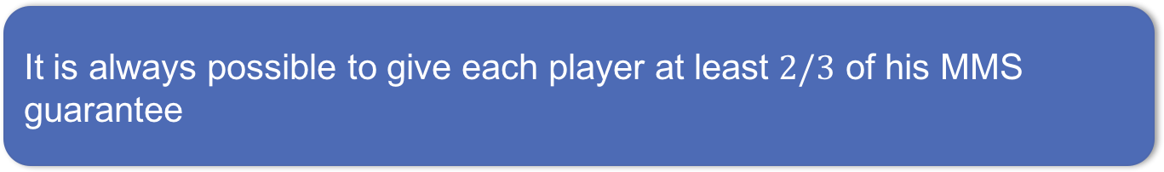
Maximin Share Guarantee
Maximin share (MMS) guarantee [Budish 2011] of player $i$:
$$\max_{X_{1},…,X_{n}}{\min_{j}{v_{i}(X_{j})}}$$
THEOREM
$∀n≥3$ there exist additive valuation functions that do not admit an MMS allocation
[Procaccia & Wang EC-2014]
THEOREM
It is always possible to give each player at least $2/3$ of his MMS guarantee
[Procaccia & Wang EC-2014]

Slide 32








Envy-Freeness up to One Good
Recall: an allocation $A_{1},…,A_{n}$ is envy free up to one good (EF1) if for all $i,j,$
$$v_{i}\left(A_{i}\right)≥v_{i}\left(A_{j}\right)−\max_{g∈A_{j}}{v_{i}(g)}$$
A round-robin allocation is EF1:

Slide 33
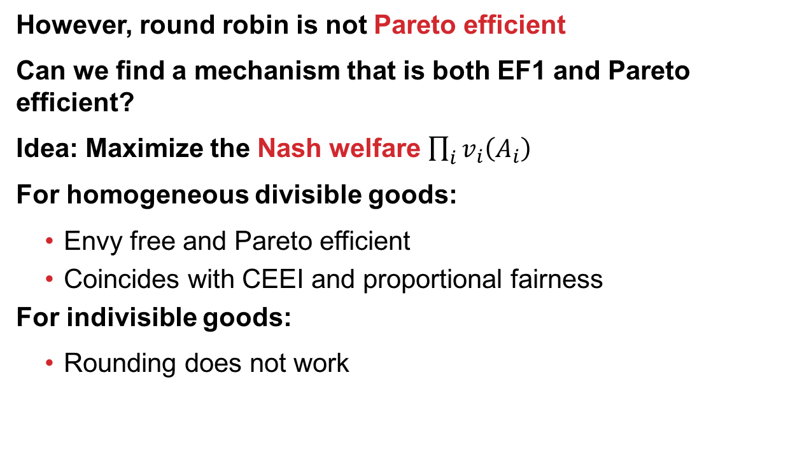
Maximum Nash Welfare
However, round robin is not Pareto efficient
Can we find a mechanism that is both EF1 and Pareto efficient?
Idea: Maximize the Nash welfare $\prod_{i}{v_{i}\left(A_{i}\right)}$
For homogeneous divisible goods:
  Envy free and Pareto efficient
  Coincides with CEEI and proportional fairness
For indivisible goods:
  Rounding does not work
THEOREM
Maximizing Nash welfare satisfies EF1 and Pareto efficiency
[Caragiannis et al. EC-2016]

Slide 34
When do Truly E-F allocations exist?
Can we characterize when an EF allocation of indivisible goods exists (with high probability)?
[A1]: utilities are drawn I.I.D.
[A2]:
each agent equally likely to want g the most
difference between the expected utility of the agent most wanting g and any other agent is at least some constant μ
Uniform distribution satisfies [A1] and [A2]
Goods with intrinsic base values → only [A2]

Slide 35
A small number of goods
THEOREM
Even when the number of goods is larger than the number of agents by a linear fraction, an EF allocation probably won’t exist.
[Dickerson et al. AAAI-14]
Note: if m < n, clearly no EF allocation exists.
How many additional goods beyond m=n are needed?
Formally: under [A1], for small constant δ:
if the probability that EF allocation exists is 1-δ
then m ≥ (1+c(δ))n, with c(δ)>0

Slide 36



A small number of goods
Thought: If two agents want the same good the most, require at least three goods for an envy-free allocation
Count such collisions; are there too many?

Slide 37
A large number of goods
THEOREM
When the number of goods is larger than the number of agents by a logarithmic factor, an EF allocation probably exists.
Formally: under [A2], with n = O(m/ln m):
  An EF allocation exists (w.p.1) as m → ∞
Idea: give each good to the agent who wants it the most
  This produces EF allocations with high probability

Slide 38
A large number of goods
Proof of the theorem uses a natural mechanism that also maximizes social welfare over the space of allocations
Alternate theorem statement:
THEOREM
“When the number of goods is larger than the number of agents by a logarithmic factor, the social welfare-maximizing allocation is EF.”

Slide 39
Experimental validation
Both theorem statements hide constants
  When do these results “kick in”?
We test under two distributions:
  Uniform
    Satisfies [A1] and [A2] and thus both theorems
  Correlated (goods have intrinsic values)
    Satisfies [A2] and thus Theorem 2
Hold n constant, vary m, see when EF allocations exist
  And how long it takes to find them (or prove otherwise)

Slide 41
Number of agents (x-axis) vs. number of items (y-axis) before at least 99% of the instances had an EF allocation, for each of the Uniform and Correlated distributions.
Theorem 2: w.h.p. occurs when n = O(m/ln m) – aligns with results.

Slide 42
Exploring the phase transition
Is the runtime spike an artifact of the model?
Tried two models in the paper:
Feasibility problem (Model #1)
Optimization problem (Model #2)
Motivation: state-of-the-art IP solvers treat feasibility and optimization problems differently
Some evidence that adding objective can help (e.g., the “MIP Nash” paper [Sandholm Gilpin Conitzer 2005])

Slide 44
Next Up:
Leximin Allocations in the real world

