Slide 1
Applied Mechanism Design For Social Good
John P Dickerson
Lecture #2 – 09/01/2016
CMSC828M
Tuesdays & Thursdays
12:30pm – 1:45pm

Slide 2
Administrative Stuff
(Hopefully the last of this sort of thing for a while)

Slide 3
MSc/PHd Qualifier
The majority of students want this to be an MSc/PhD qualifier
I’ve started the process (has to be approved)
Will be an AI qualifier if approved
What this would mean:
“… the courses' written exam(s) which must account for at least 30% of the grade.” – UMD graduate handbook
Implementation:
One take-home midterm; 24 hours to do it
One take-home final; 48 hours to do it
I’ll let you pick when you take exams (within reason; see site)

Slide 4
Also Changed:
Scribing/Presenting
No more explicit participation grade
Students will do one of:
Serving as scribe for two lectures
Presenting for ½ of a lecture
Implementation:
23 “non-intro” lectures, 25 students
People who want to present:
  Look at topics / papers
  Email john@cs.umd.edu by next class
  a list of your top 3 papers to present
I’ll assign scribes randomly afterward

Slide 5
Grade Breakdown | Qualifier Approval
60% course project:
5% project proposal (mid-Oct)
5% project checkup (mid-Nov)
15% in-class presentation (early Dec)
35% course project writeup (mid-Dec)
10% scribing (2x) or presenting (1x)
30% examinations:
Better of 10%/20% or 15%/15% midterm/final
= A+

Slide 6
Reminder:
Academic Integrity
Common Sense!
(Text unironically stolen from Hal Daumé III)
Any assignment or exam that is handed in must be your own work (unless otherwise stated). However, talking with one another to understand the material better is strongly encouraged. Recognizing the distinction between cheating and cooperation is very important. If you copy someone else's solution, you are cheating. If you let someone else copy your solution, you are cheating (this includes posting solutions online in a public place). If someone dictates a solution to you, you are cheating.
Everything you hand in must be in your own words, and based on your own understanding of the solution. If someone helps you understand the problem during a high-level discussion, you are not cheating. We strongly encourage students to help one another understand the material presented in class, in the book, and general issues relevant to the assignments. When taking an exam, you must work independently. Any collaboration during an exam will be considered cheating. Any student who is caught cheating will be given an F in the course and referred to the University Office of Student Conduct. Please don't take that chance – if you're having trouble understanding the material, please let me know and I will be more than happy to help.

Slide 7
Techniques we’ll use
(THIS + Next Two lectures will cover these,
In the context of Mechanism Design)

Slide 8
Combinatorial Optimization
Combinatorial optimization lets us select the “best element” from a set of elements.
Some PTIME problems:
Some forms of matching
2-player zero-sum Nash
Compact LPs
Some PPAD- or NP-hard problems:
More complex forms of matching
Many equilibrium computations
Some > NP-hard problems:
Randomizing over a set of all feasible X, where all feasible X must be enumerated (#P-complete)

Slide 9
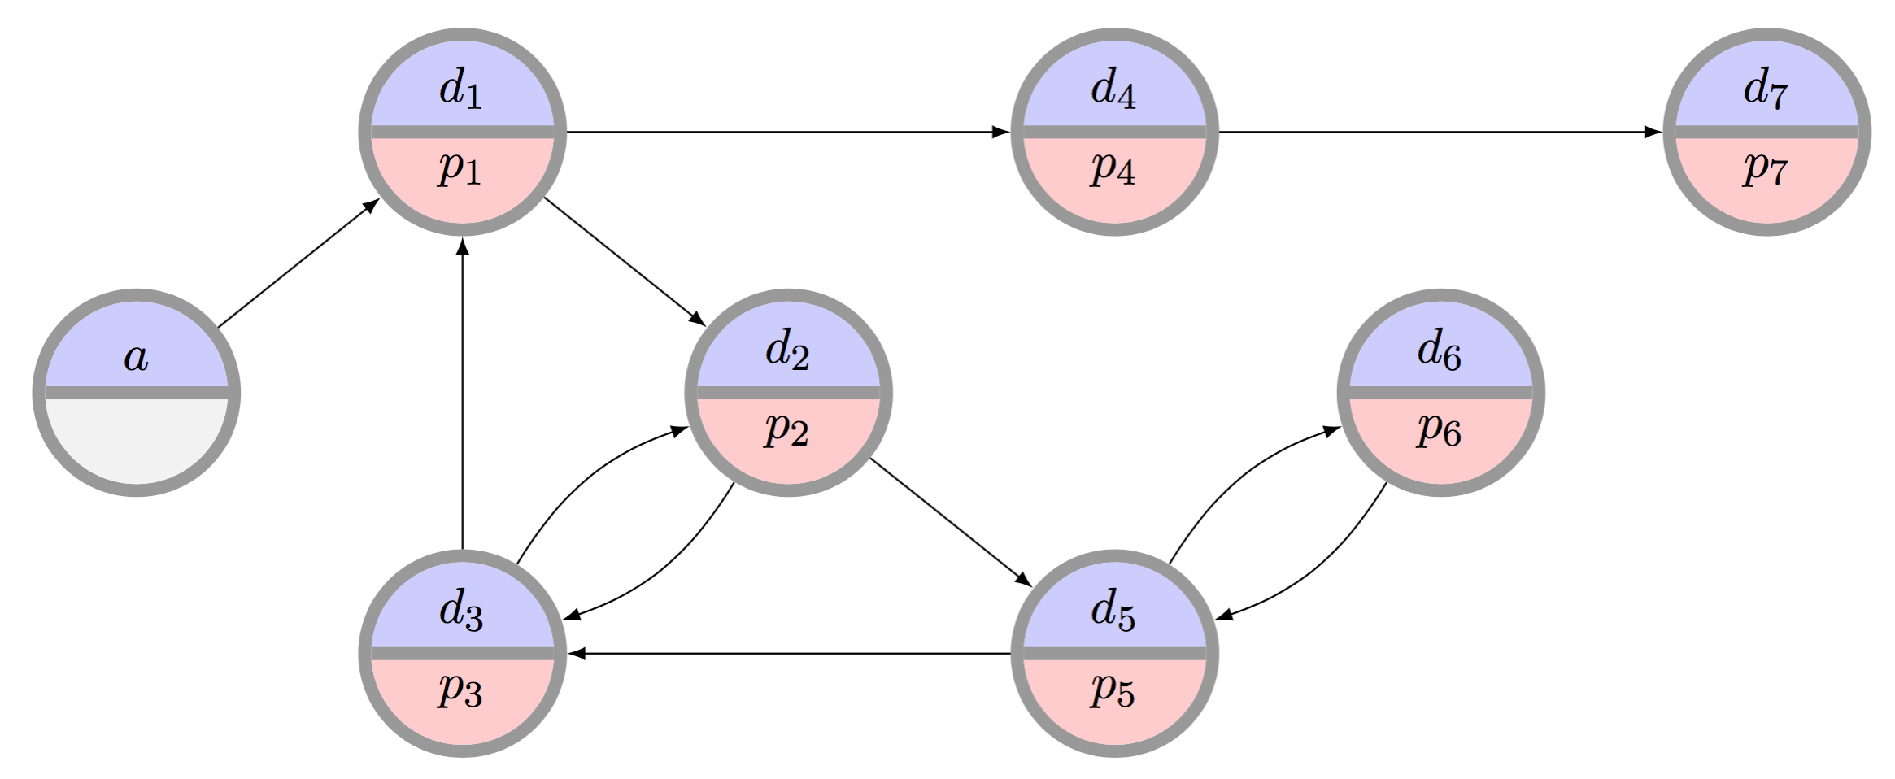
C.O. for Kidney Exchange:
Refresher on Problem

Slide 10
C.O. for Kidney Exchange:
The Edge formulation
[Abraham et al. 2007]
Binary variable x_{ij} for each edge from i to j
Maximize
u(M) = Σ w_{ij} x_{ij}
Subject to
Σ_{j} x_{ij} = Σ_{j} x_{ji} for each vertex i
Σ_{j} x_{ij} ≤ 1 for each vertex i
Σ_{1≤k≤L} x_{i(k)i(k+1)} ≤ L-1 for paths i(1)…i(L+1)
(no path of length L that doesn’t end where it started – cycle cap)
Flow constraint

Slide 11
C.O. For Kidney Exchange:
The Cycle Formulation
[Roth et al. 2004, 2005,
Abraham et al. 2007]
Binary variable x_{c} for each feasible cycle or chain c
Maximize
u(M) = Σ w_{c} x_{c}
Subject to
Σ_{c : i in c} x_{c} ≤ 1 for each vertex i

Slide 12
C.O. For Kidney Exchange: Comparison
Tradeoffs in number of variables, constraints
  IP #1: O(|E|^{L}) constraints vs. O(|V|) for IP #2
  IP #1: O(|V|²) variables vs. O(|V|^{L}) for IP #2
IP #2’s relaxation is weakly tighter than #1’s. Quick intuition in one direction:
  Take a length L+1 cycle. #2’s LP relaxation is 0.
  #1’s LP relaxation is (L+1)/2 – with ½ on each edge
Recent work focuses on balancing tight LP relaxations and model size [Constantino et al. 2013, Glorie et al. 2014, Klimentova et al. 2014, Alvelos et al. 2015, Anderson et al. 2015, Mak-Hau 2015, Manlove&O’Malley 2015, Plaut et al. 2016, …]:
  We will discuss (9/29) new compact formulations, some with tightest relaxations known, all amenable to failure-aware matching

Slide 13
Game Theory & Mechanism Design
We assume participants in our mechanisms are:
Selfish utility maximizers
Rational (typically – sometimes relaxed)
Game theory & M.D. give us the language to describe desirable properties of mechanisms:
Incentive compatibility
Individual rationality
Efficiency

Slide 14

Machine learning
Predicting supply and demand
Computing optimal matching/allocation policies:
MDPs
RL
POMDPs, if you’re feeling brave/masochistic
Aside: recent work looks at fairness and discrimination in machine learning – could be an interesting project.
“… when a search was performed on a name that was “racially associated” with the black community, the results were much more likely to be accompanied by an ad suggesting that the person had a criminal record—regardless of whether or not they did.”

Slide 15
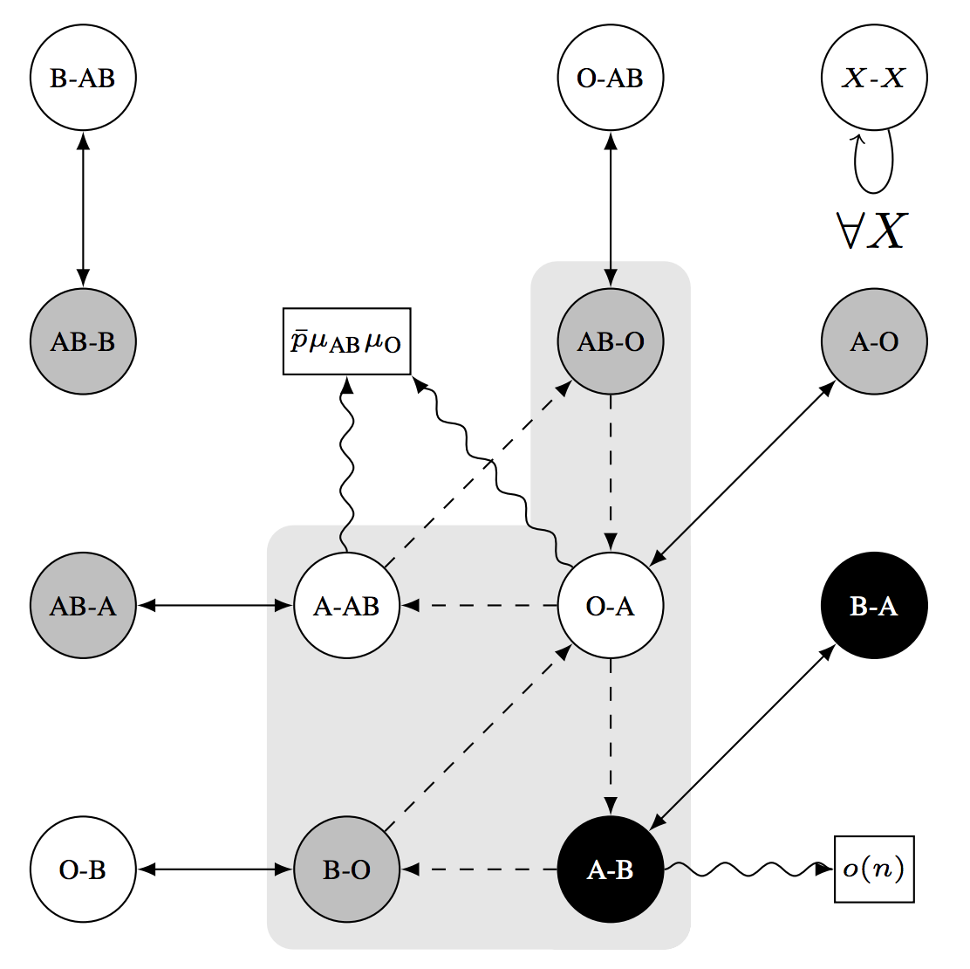
Random Graph Theory
(Might cover a bit in the matching and barter exchange lectures; talk to me.)

Slide 16
Next This class:
Game Theory Primer
Thanks to: AGT book, Blum (AB), Conitzer (VC), Sandholm (TS), Osborne&Rubinstein (OR)

Slide 17
What is game theory?
“… the study of mathematical models of conflict and cooperation between intelligent rational decision-makers.”
“Intelligent rational decision-makers” = agents
Have individual preferences specified by utility functions
Can take different actions (or randomize over them)
Utility of agents usually, but not always, depends on the
actions of other agents
What’s best for me is a function of what’s best for you …
  … which is a function of what’s best for me ...
    ... which is a function of what’s best for you ...
      ... which is …

Slide 18
What is “Utility” …?
“ … utility is a measure of preferences over some set of goods and services.”
Formally:
Let O be the set of outcomes
(e.g., O = {{apple,orange}, {apple}, {orange}, { }})
A utility function u : O → ℜ ranks outcomes, and represents a preference relation p over the set of outcomes O
Example:
u({apple,orange}) = 5
u({apple}) = u({orange}) = 3
u({ }) = 0 → { } p {apple} p {orange} p {apple,orange}

Slide 19
How do we measure “Utility” …?
u({apple,orange}) = 5
5 dollars? 5 clams? 5 days to live?
Standard: 5 “utils” – it doesn’t typically matter
Agent’s behavior under u(o) is typically the same as under u’(o) = a + b*u(o)
u({apple}) = 3 < 5 = u({apple,orange})
Cardinal utility: 3 < 5
  (We’ll see this in security games and auctions)
Ordinal utility: {apple,orange} p {apple}
  Doesn’t encode strength of a preference, just ordering
  (We’ll see more of this in social choice)

Slide 20
Risk attitudes
Which would you prefer?
  A lottery ticket that pays out $10 with probability .5 and $0 otherwise, or
  A lottery ticket that pays out $3 with probability 1
How about:
  A lottery ticket that pays out $100,000,000 with probability .5 and $0 otherwise, or
  A lottery ticket that pays out $30,000,000 with probability 1
Usually, people do not simply go by expected value
VC

Slide 21
Risk Attitudes – Expected Value
An agent is risk-neutral if she only cares about the expected value of the lottery ticket
An agent is risk-averse if she always prefers the expected value of the lottery ticket to the lottery ticket
  Most people are like this
An agent is risk-seeking if she always prefers the lottery ticket to the expected value of the lottery ticket
VC

Slide 22
Decreasing marginal utility
Typically, at some point, having an extra dollar does not make people much happier (decreasing marginal utility)
“Typically”
utility
buy a nicer car (utility = 3)
buy a car (utility = 2)
buy a bike (utility = 1)
$200
$1500
$5000
money
VC

Slide 23
Maximizing expected utility
utility
buy a nicer car (utility = 3)
buy a car (utility = 2)
buy a bike (utility = 1)
$200
$1500
$5000
money
Lottery 1: get $1500 with probability 1 → gives expected utility 2
Lottery 2: get $5000 with probability .4, $200 otherwise
  → expected utility .4*3 + .6*1 = 1.8
E$[Lottery 2] = .4*$5000 + .6*$200 = $2120 > $1500 = E$[Lottery 1]
So: maximizing expected utility is consistent with risk aversion (assuming decreasing marginal utility)
VC

Slide 24
risk attitudes Assuming expected utility max’Ing
utility
money
Green has decreasing marginal utility → risk-averse
Blue has constant marginal utility → risk-neutral
Red has increasing marginal utility → risk-seeking
Grey’s marginal utility is sometimes increasing, sometimes decreasing → neither risk-averse (everywhere) nor risk-seeking (everywhere)
VC

Slide 25
Strategies & Utility
A strategy s_{i} for agent i is a mapping of history/the agent’s knowledge of the world to actions
Pure: “perform action x with probability 1”
Randomized: “do x with prob 0.2 and y with prob 0.8”
A strategy set is the set of strategies available to agent I
Can be infinite (infinite number of actions, randomization)
A strategy profile is an instantiation (s₁, s₂, s₃, …, s_{N})
Abuse of notation: we’ll use s_{-i} to refer to all strategies played other than that by agent i
i = 2, then s_{-i} = (s₁, s₃, ..., s_{N})
Utils awarded after game is played: u_{i} = u_{i}(s_{i}, s_{-i})

Slide 26
Nature
Agents act strategically in the face of what they
believe other agents will do, who act based on …
There may be other sources of non-strategic randomness
Included (when needed) in our models as a unique agent called nature, which acts:
Probabilistically
Without reasoning about what other agents will do
(Sometimes referred to as agent i = 0, often just nature.)

Slide 27
Game representations
Matrix form
(aka normal form
aka strategic form)
Extensive form
(aka tree form)
player 2’s strategy
Left
1, 2
Left,
Left
Left,
Right
Right,
Left
Right,
Right
Up
player 2
Right
3, 4
Up
1, 2
1, 2
3, 4
3, 4
player 1’s
strategy
player 1
Left
5, 6
Down
5, 6
7, 8
5, 6
7, 8
Down
player 2
Right
7, 8
Potential combinatorial explosion
TS

Slide 28
Dominant strategy equilibriA (DSE)
Best response s_{i}*: for all s_{i}’, u_{i}(s_{i}*,s_{-i}) ≥ u_{i}(s_{i}’,s_{-i})
Dominant strategy s_{i}*: s_{i}* is a best response for all s_{-i}
  Does not always exist
  Inferior strategies are called “dominated”
DSE is a strategy profile where each agent has picked its dominant strategy
  Requires no counterspeculation – just enumeration
cooperate
defect
Pareto optimal?
cooperate
3, 3
0, 5
Social welfare
maximizing?
defect
5, 0
1, 1
TS
Notes:
JPD: Pareto optimal = all of them; SW max = (3,3), DSE none of them.

Slide 29
Zero-Sum Games (2-P)
Two-player zero-sum games are a special – purely competitive – case of general games
Everything I win you lose, and vice versa
Example: heads-up poker (with no rake)
A minimax-optimal strategy is a strategy that
maximizes the expected minimum gain
Guarantees the “best minimum” in expectation, no matter which strategy your opponent selects
Theorem [von Neumann ’28] – “Minimax Theorem”:
Every 2-P zero-sum game has a unique value V
Maximin utility: max_{σi} min_{s-i} i(σ_{i}, s_{-i}) (= - min_{σi} max_{s-i} u_{-i}(σ_{i}, s_{-i}))
Minimax utility: min_{σ-i} max_{si} u_{i}(s_{i}, σ_{-i}) (= - max_{σ-i} min_{si} u_{-i}(s_{i}, σ_{-i}))
Theorem: V = max_{σi} min_{s-i} u_{i}(σ_{i}, s_{-i}) = min_{σ-i} max_{si} u_{i}(s_{i}, σ_{-i})
+1, -1
-2, +2
+2, -2
0, 0
Notes:
JPD: Mention we can find minimax-optimal (and thus 2P zero-sum Nash) in PTIME, in two lectures via e.g. LP solving, but not for general games (PPAD-c for Nash even for 2P non-zero-sum).

Slide 30
General-sum games (2-P)
You could still play a minimax strategy in general-sum games
i.e., pretend that the opponent is only trying to hurt you
But this is not rational:
Col
0, 0 | 3, 1
1, 0 | 2, 1
Row
If Col were trying to hurt Row, Col would play Left, so Row should play Down
In reality, Col will play Right (strictly dominant), so Row should play Up
Is there a better generalization of minimax strategies in zero-sum games to general-sum games?
VC

Slide 31
General-Sum Games: Nash Equilibria (2-P)
Nash equilibrium: a pair of strategies that are stable
Stable: neither agent has incentive to deviate from his or her selected strategy on their own
Theorem [Nash 1950]: any general-sum game has at least one Nash equilibrium
Might require mixed strategies (randomization)
Corollary for 2-P zero-sum games: Minimax Theorem!
WLOG pick one of the NE, let V = value to Row
Assumed NE, so neither player can do better (even fully knowing the other player’s mixed strategy!) → minimax-opt
Col
2, 2 | -1, -1
-1, -1 | 2, 2
????????
Row
Notes:
NE: (Left, Up) or (Right, Down) or ((0.5Left, 0.5Right), (0.5Up, 0.5Down))

Slide 32
Example: Chicken
D
S
S
D
D
S
D
0, 0 | -1, 1
1, -1 | -5, -5
????????
????????
S
Thankfully, (D, S) and (S, D) are Nash equilibria
  They are pure-strategy Nash equilibria: nobody randomizes
  They are also strict Nash equilibria: changing your strategy will make you strictly worse off
No other pure-strategy Nash equilibria
VC

Slide 33
Chicken
D
S
D
0, 0 | -1, 1
1, -1 | -5, -5
Is there an NE that uses mixed strategies?
Say, where player 1 uses a mixed strategy?
Note: if a mixed strategy is a best response, then all of the pure strategies that it randomizes over must also be best responses
So we need to make player 1 indifferent between D and S
Player 1’s utility for playing D = -p^{c}_{S}
Player 1’s utility for playing S = p^{c}_{D} - 5p^{c}_{S} = 1 - 6p^{c}_{S}
So we need -p^{c}_{S} = 1 - 6p^{c}_{S} which means p^{c}_{S} = 1/5
Then, player 2 needs to be indifferent as well
Mixed-strategy Nash equilibrium: ((4/5 D, 1/5 S), (4/5 D, 1/5 S))
  People may die! Expected utility -1/5 for each player
S
VC

Slide 34
Criticisms of Nash equilibrium
Not unique in all games (like the example on Slide 31)
Approaches for addressing this problem
  Refinements (=strengthenings) of the equilibrium concept
    Eliminate weakly dominated strategies first (IEDS)
    Choose the Nash equilibrium with highest welfare
    Subgame perfection … [see AGT book on course page]
  Mediation, communication, convention, learning, …
Collusions amongst agents not handled well
“No agent wants to deviate on her own”
Can be disastrous to “partially” play an NE
(More) people may die!
Correlated equilibria – strategies selected by an outsider, but the strategies must be stable (see Chp 2.7 of AGT)
TS, AGT

Slide 35
Correlated equilibrium
Suppose there is a trustworthy mediator who has offered to help out the players in the game
The mediator chooses a profile of pure strategies, perhaps randomly, then tells each player what her strategy is in the profile (but not what the other players’ strategies are)
A correlated equilibrium is a distribution over pure-strategy profiles so that every player wants to follow the recommendation of the mediator (if she assumes that the others do so as well)
Every Nash equilibrium is also a correlated equilibrium
Corresponds to mediator choosing players’ recommendations independently
… but not vice versa
(Note: there are more general definitions of correlated equilibrium, but it can be shown that they do not allow you to do anything more than this definition.)
VC

Slide 36
C.E. for Chicken
D
S
D
0, 0 | -1, 1
1, -1 | -5, -5
20%
40%
S
40%
0%
Why is this a correlated equilibrium?
Suppose the mediator tells Row to Dodge
From Row’s perspective, the conditional probability that Col was told to Dodge is
20% / (20% + 40%) = 1/3
So the expected utility of Dodging is (2/3)*(-1) = -2/3
But the expected utility of Straight is (1/3)*1 + (2/3)*(-5) = -3
So Row wants to follow the recommendation
If Row is told to go Straight, he knows that Col was told to Dodge, so again Row wants to follow the recommendation
Similar for Col

Slide 37
Complexity
Can compute minimax-optimal strategies in PTIME
Can compute 2-P zero-sum NE in PTIME
(We’ll see this as an example during the convex optimization primer lecture next week.)
Can compute correlated equilibria in PTIME
Unknown if we can compute a 2-P general-sum NE in PTIME:
Known: PPAD-complete (weaker than NP-c, and different)
All known algorithms require worst-cast exponential time
Our first “meaty” lectures will cover security games, which try to find Stackelberg equilibria:
Varying complexity, will discuss during those lectures
Notes:
PPAD-c vs NP-c: recall, every game has a Nash Equilibrium! This is unlike NP-c problems like SAT where we’re asking if/if not satisfiable. Different analysis used, weaker than NP-c. Could be that P = PPAD != NP.

Slide 38
Does Nash Model Human Behavior?
Game: pick a number (let’s say, integer) in
{0, 1, 2, 3, …, 98, 99, 100}
Winner: person who picks number that is
closest to 2/3 of the average of all numbers
Example: if the average of all numbers is 54, your best answer would be 36 ( = 54 * 2/3)
What’s the (Nash) equilibrium strategy?
“Level 0” humans: everyone picks randomly? E[v] = 50, choose 50 * 2/3
“Level 1” humans: everyone picks 50 * 2/3, I’ll pick (50 * 2/3) * 2/3
N.E.: fixed point, “Level infinity”, pick 0 or 1 depending on constraints

Slide 39
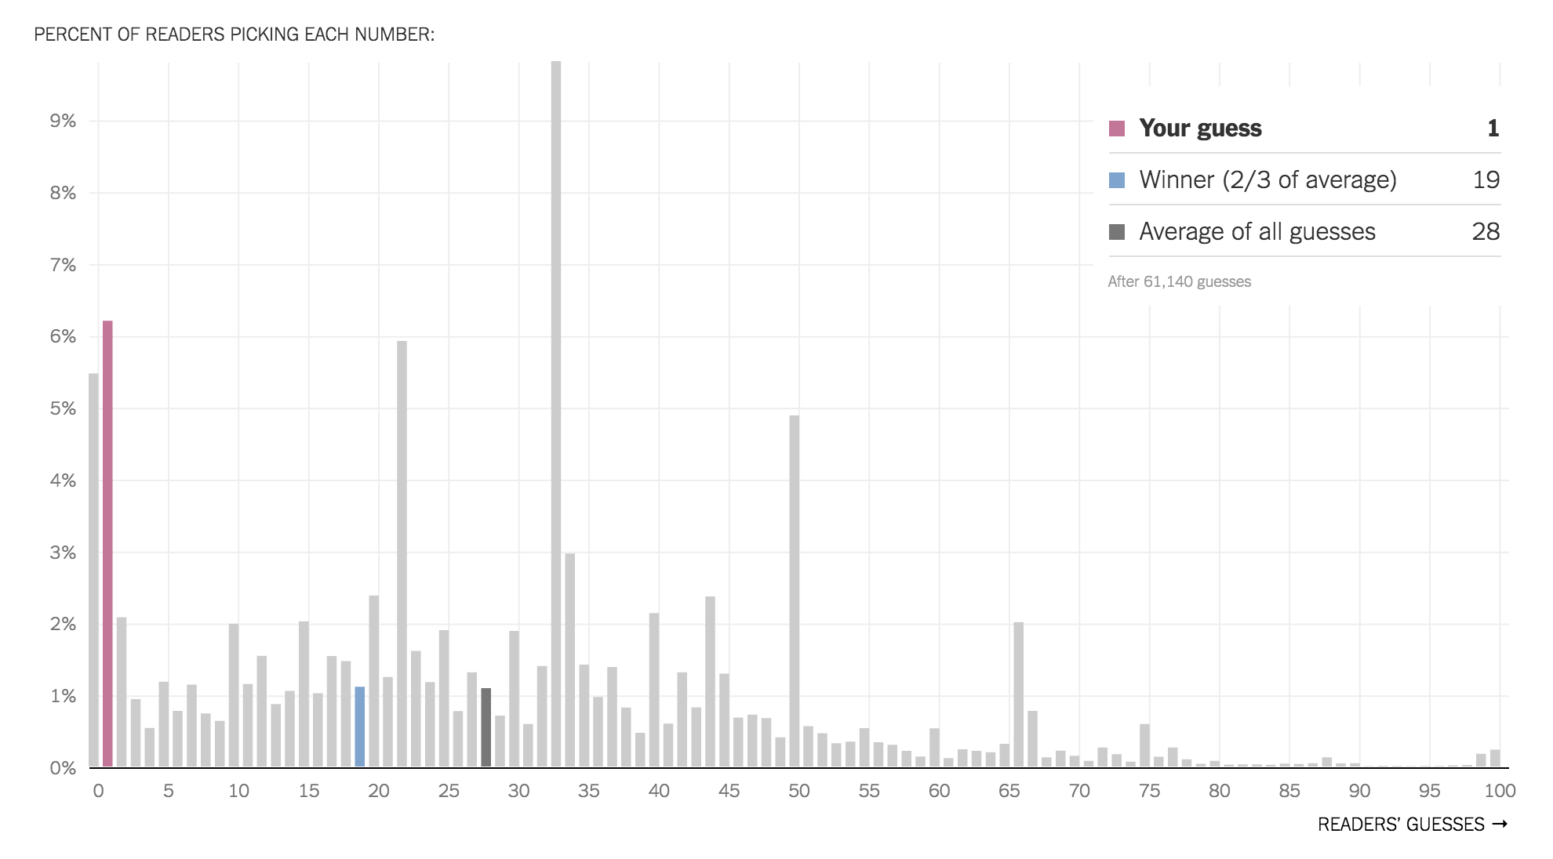
NY Times

Slide 40
Next class:
Mechanism Design Primer
Also: Email me about presenting!

