Slide 1
Maximizing the Spread of Influence through a Social Network
David Kempe, Jon Kleinberg, Éva Tardos
SIGKDD ‘03

Slide 2
Influence and Social Networks
Economics, sociology, political science, etc. all have studied and modeled behaviors arising from information
Online
  Undoubtedly we are influenced by those within our social context

Slide 3
Why study “diffusion” ?
Influence models have been studied for years
  Original mathematical models by Schelling (’70, ’78) & Granovetter ’78
  Viral Marketing Strategies modeled by Domingos & Richardson ’01
Not just about maximizing revenue
  Can study diseases or contagions (medicine, health, etc.)
  The spread of beliefs and/or ideas (sociology, economics, etc.)
On the CS side, need to develop fast and efficient algorithms that seek to maximize the spread of influence

Slide 4
Diffusion Models
Two models
  Linear Threshold
  Independent Cascade
Operation:
  Social Network G represented as a directed graph
  Individual nodes are active (adopter of “innovation”) or inactive
  Monotonicity: Once a node is activated, it can never deactivate
Both work under the following general framework:
  Start with initial set of active nodes A0
  Process runs for t steps and ends when no more activations are possible

Slide 5
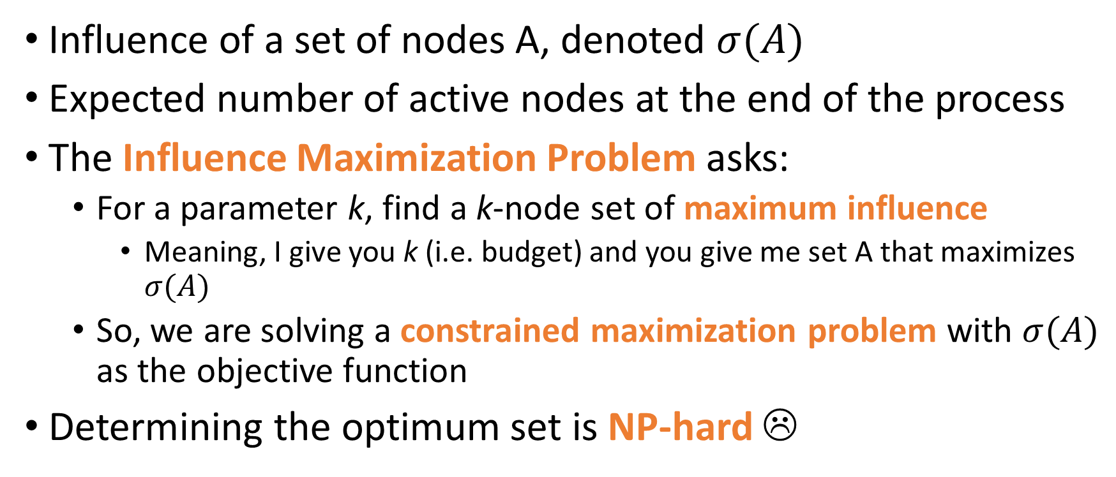
So what’s the problem?
Influence of a set of nodes A, denoted $σ(A)$
Expected number of active nodes at the end of the process
The Influence Maximization Problem asks:
  For a parameter k, find a k-node set of maximum influence
    Meaning, I give you k (i.e. budget) and you give me set A that maximizes $σ(A)$
  So, we are solving a constrained maximization problem with $σ(A)$ as the objective function
Determining the optimum set is NP-hard ☹

Slide 6
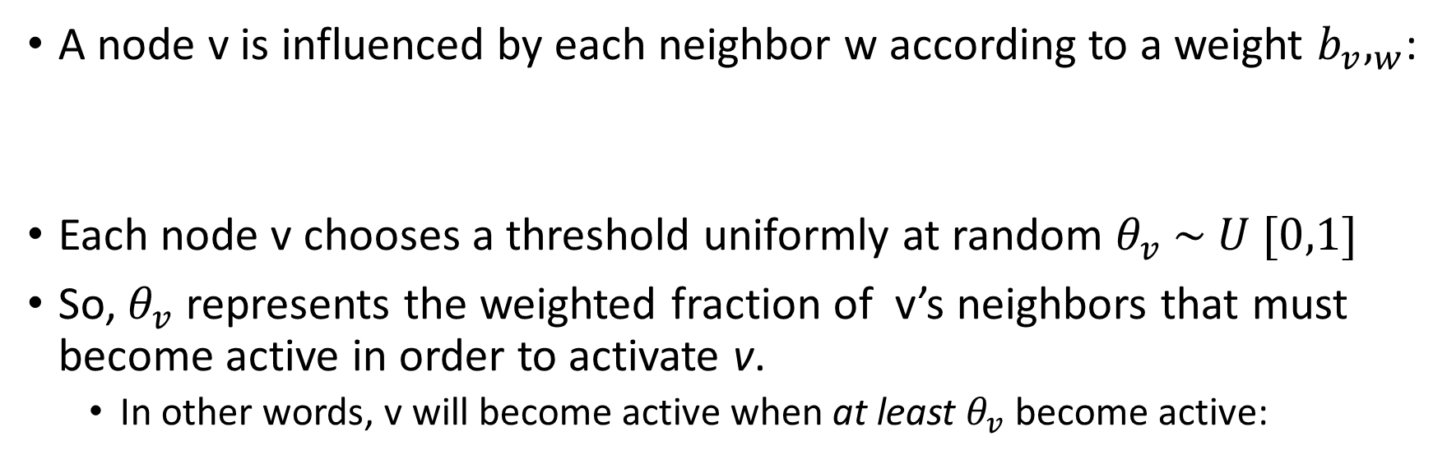
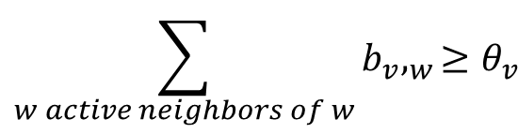
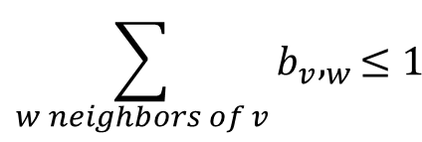
The Linear Threshold Model
A node v is influenced by each neighbor w according to a weight $b_{v},_{w}$:
Each node v chooses a threshold uniformly at random $θ_{v} \sim U [0,1]$
So, $θ_{v}$ represents the weighted fraction of v’s neighbors that must become active in order to activate v.
  In other words, v will become active when at least $θ_{v}$ become active:
$$\sum_{w neighbors of v}{b_{v},_{w}≤1}$$
$$\sum_{w active neighbors of w}{b_{v},_{w}≥θ_{v}}$$

Slide 7
Linear Threshold Model: Example
Rock
0.2
Can’t go any more!
0.3
Inactive Node
Lida
Neal
0.1
Active Node
0.2
0.2
Activation Threshold
0.4
∑ Neighbor’s
Hadi
0.5
Faez
0.2
0.6
Saba

Slide 8
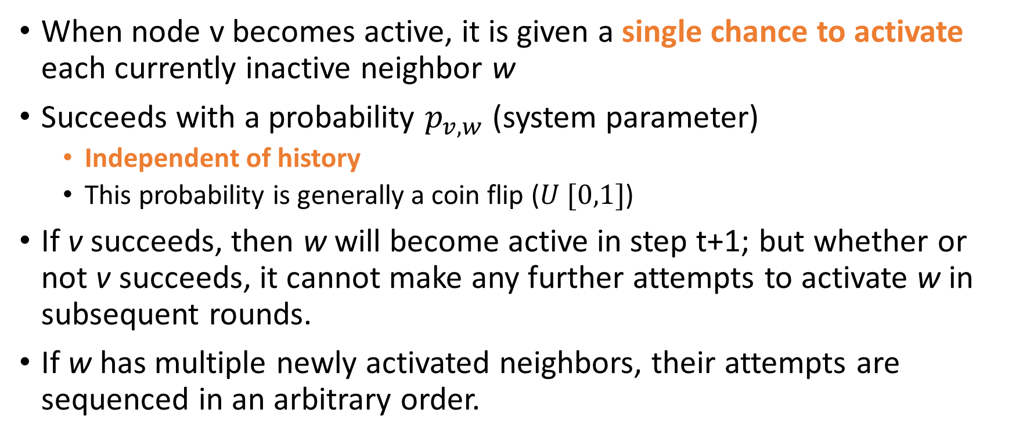
The Independent Cascade Model
When node v becomes active, it is given a single chance to activate each currently inactive neighbor w
Succeeds with a probability $p_{v,w}$ (system parameter)
  Independent of history
  This probability is generally a coin flip ($U [0,1]$)
If v succeeds, then w will become active in step t+1; but whether or not v succeeds, it cannot make any further attempts to activate w in subsequent rounds.
If w has multiple newly activated neighbors, their attempts are sequenced in an arbitrary order.

Slide 9
Independent Cascade Model: Example
Rock
0.2
Can’t go any more!
0.3
Inactive Node
Lida
Neal
Newly Active Node
0.1
0.2
0.2
Perm Active Node
0.4
Successful Roll
Hadi
0.5
Failed Roll
Faez
0.2
0.6
*flip coin*
Saba

Slide 10
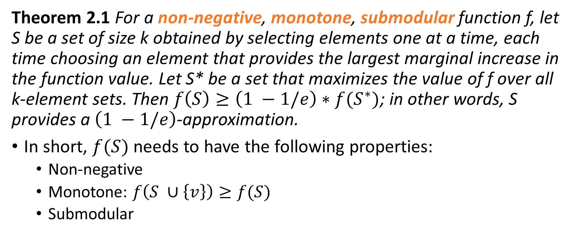
Let’s begin!
Theorem 2.1 For a non-negative, monotone, submodular function f, let S be a set of size k obtained by selecting elements one at a time, each time choosing an element that provides the largest marginal increase in the function value. Let S* be a set that maximizes the value of f over all k-element sets. Then $f\left(S\right)≥\left(1 −1/e\right)∗f(S^{∗})$; in other words, S provides a $\left(1 −1/e\right)$-approximation.
In short, $f(S)$ needs to have the following properties:
  Non-negative
  Monotone: $f\left(S ∪\left\{v\right\}\right)≥f(S)$
  Submodular

Slide 11
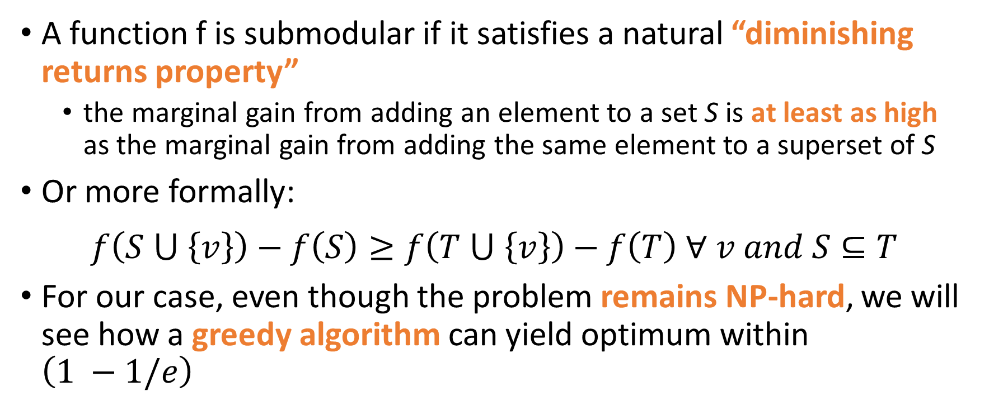
Let’s talk about submodularity
A function f is submodular if it satisfies a natural “diminishing returns property”
  the marginal gain from adding an element to a set S is at least as high as the marginal gain from adding the same element to a superset of S
Or more formally:
$$f\left(S ⋃ \left\{v\right\}\right)−f\left(S\right)≥f\left(T ⋃ \left\{v\right\}\right)−f\left(T\right) ∀ v and S⊆T$$
For our case, even though the problem remains NP-hard, we will see how a greedy algorithm can yield optimum within $\left(1 −1/e\right)$

Slide 12
alt+tab
Refer to: “Tutorial on Submodularity in Machine Learning and Computer Vision” by Stefanie Jagelka and Andreas Krause
More (great) references available at www.submodularity.org
We will look at a short example about placing sensors around a house (and marginal yield)

Slide 13
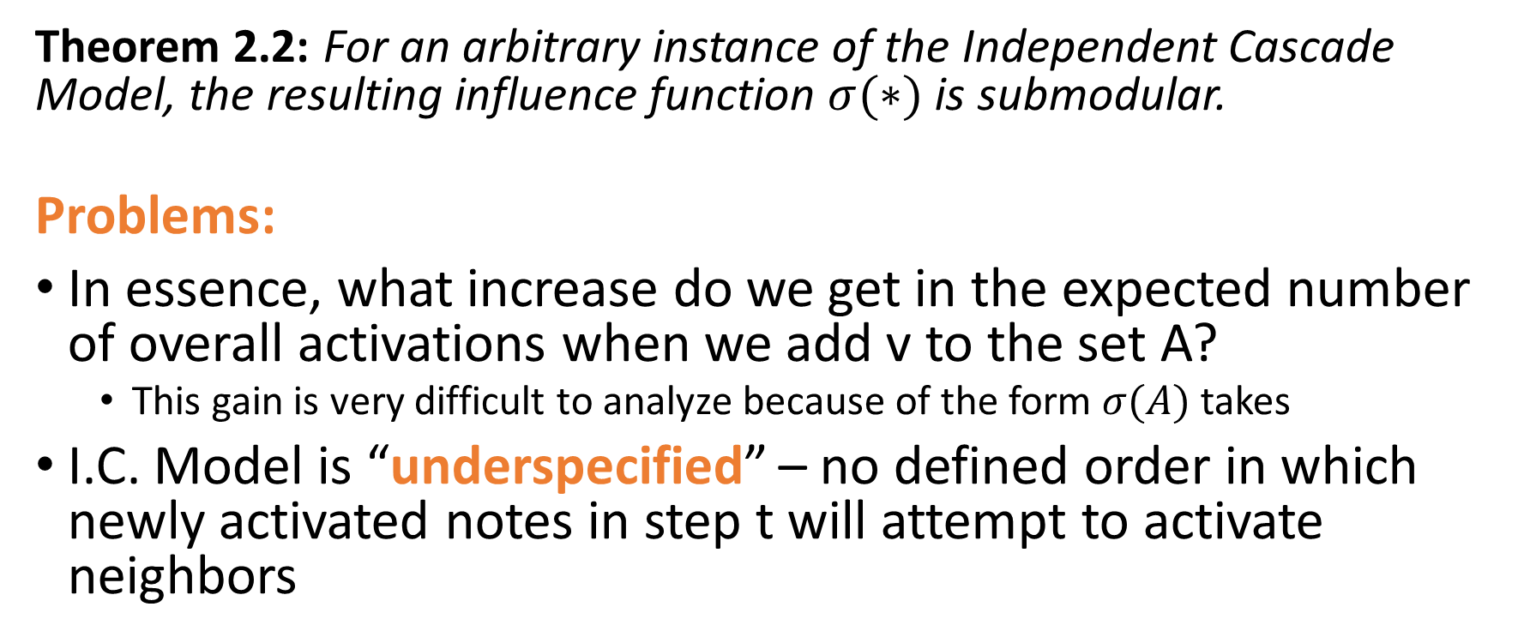
Proving Submodularity for I.C. Model
Theorem 2.2: For an arbitrary instance of the Independent Cascade Model, the resulting influence function $σ(∗)$ is submodular.
Problems:
In essence, what increase do we get in the expected number of overall activations when we add v to the set A?
  This gain is very difficult to analyze because of the form $σ(A)$ takes
I.C. Model is “underspecified” – no defined order in which newly activated notes in step t will attempt to activate neighbors

Slide 14
In the original I.C. model, we “flip a coin” to determine if the path from v to it’s neighbors (w) should be taken
But note that this probability is not dependent on any factor within the model
Idea: Why not just pre-flip all coins from the start and store the outcome to be revealed in the event that v is activated (while w is still inactive)?
View blue arrows as live
View red arrows as blocked
Claim 2.3 Active nodes are reachable via “live-edge”
“Reachability”
0.2
0.3
0.1
0.2
0.2
0.4
0.5
0.2
0.6

Slide 15
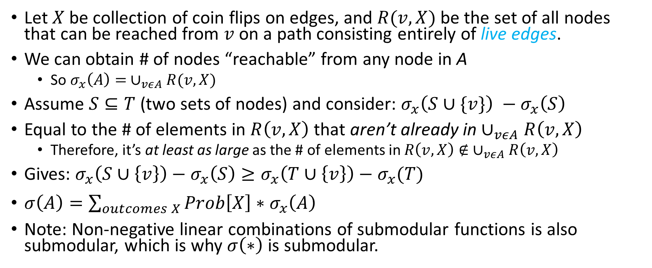
Proving Submodularity for I.C. Model
Let $X$ be collection of coin flips on edges, and $R(v,X)$be the set of all nodes that can be reached from $v$ on a path consisting entirely of live edges.
We can obtain # of nodes “reachable” from any node in A
  So $σ_{x}\left(A\right)= ∪_{vεA}R(v,X)$
Assume $S⊆T$ (two sets of nodes) and consider: $σ_{x}\left(S∪\{v\}\right) −σ_{x}\left(S\right)$
Equal to the # of elements in $R\left(v,X\right)$ that aren’t already in $∪_{vεA}R\left(v,X\right)$
  Therefore, it’s at least as large as the # of elements in $R\left(v,X\right)∉ ∪_{vεA}R\left(v,X\right)$
Gives: $σ_{x}\left(S∪\left\{v\right\}\right)−σ_{x}\left(S\right)≥σ_{x}\left(T∪\left\{v\right\}\right)−σ_{x}(T)$
$σ\left(A\right)=\sum_{outcomes X}{Prob\left[X\right]∗σ_{x}\left(A\right) }$
Note: Non-negative linear combinations of submodular functions is also submodular, which is why $σ\left(∗\right)$ is submodular.

Slide 16
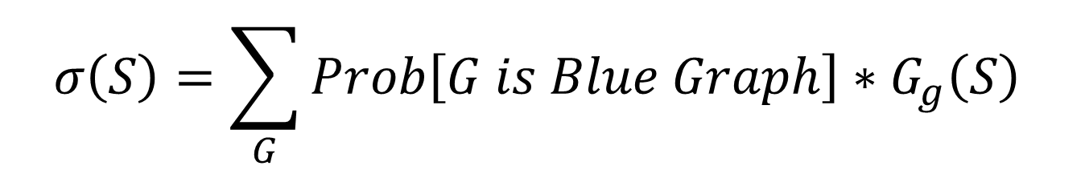
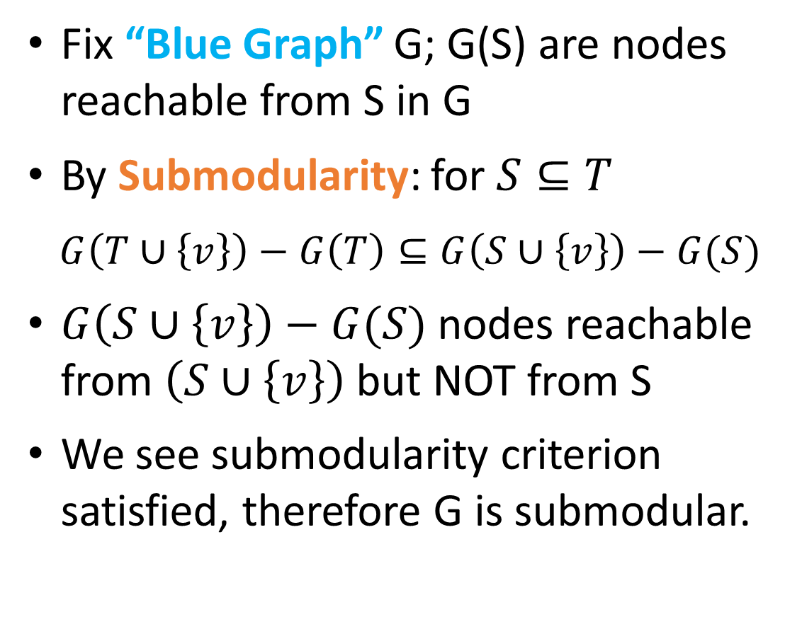
Fix “Blue Graph” G; G(S) are nodes reachable from S in G
By Submodularity: for $S⊆T$
$G\left(T∪\left\{v\right\}\right)−G\left(T\right)⊆G\left(S∪\left\{v\right\}\right)−G(S)$
$G\left(S∪\left\{v\right\}\right)−G(S)$nodes reachable from $\left(S∪\left\{v\right\}\right)$but NOT from S
We see submodularity criterion satisfied, therefore G is submodular.
G(S)
G(T)
G
S
T
$$σ\left(S\right)=\sum_{G}{Prob\left[G is Blue Graph\right]∗G_{g}\left(S\right) }$$

Slide 17
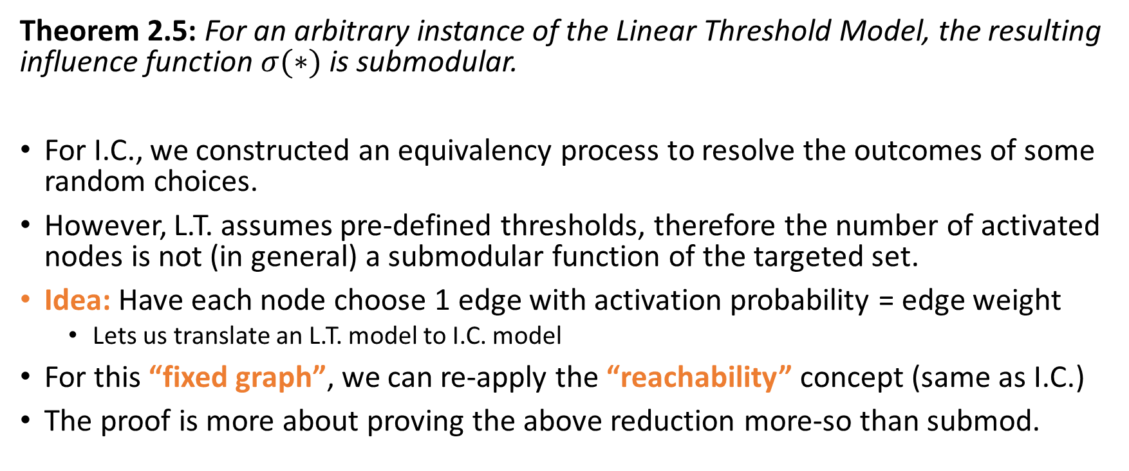
Proving Submodularity for the L.T. Model
Theorem 2.5: For an arbitrary instance of the Linear Threshold Model, the resulting influence function $σ(∗)$is submodular.
For I.C., we constructed an equivalency process to resolve the outcomes of some random choices.
However, L.T. assumes pre-defined thresholds, therefore the number of activated nodes is not (in general) a submodular function of the targeted set.
Idea: Have each node choose 1 edge with activation probability = edge weight
  Lets us translate an L.T. model to I.C. model
For this “fixed graph”, we can re-apply the “reachability” concept (same as I.C.)
The proof is more about proving the above reduction more-so than submod.

Slide 18
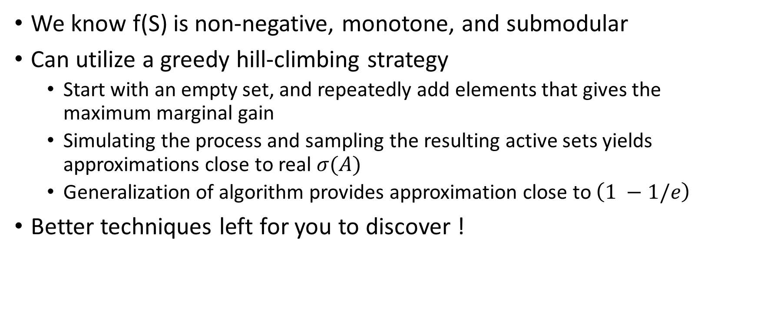
What about f(S) ?
We know f(S) is non-negative, monotone, and submodular
Can utilize a greedy hill-climbing strategy
  Start with an empty set, and repeatedly add elements that gives the maximum marginal gain
  Simulating the process and sampling the resulting active sets yields approximations close to real $σ(A)$
  Generalization of algorithm provides approximation close to $\left(1 −1/e\right)$
Better techniques left for you to discover !

Slide 19
Experiments – The Network Data
Collaboration graph obtained from co-authorships in papers from arXiv’s high-energy physics theory section
  Claim: co-authorship networks capture many “key features”
  Simple settings of the influence parameters
  For each paper with 2 or more authors, edge was placed between them
Resulting graph has 10,748 nodes with edges between ~53,000 pairs of nodes
  Also resulted in numerous parallel edges but kept to simulate stronger social ties

Slide 20
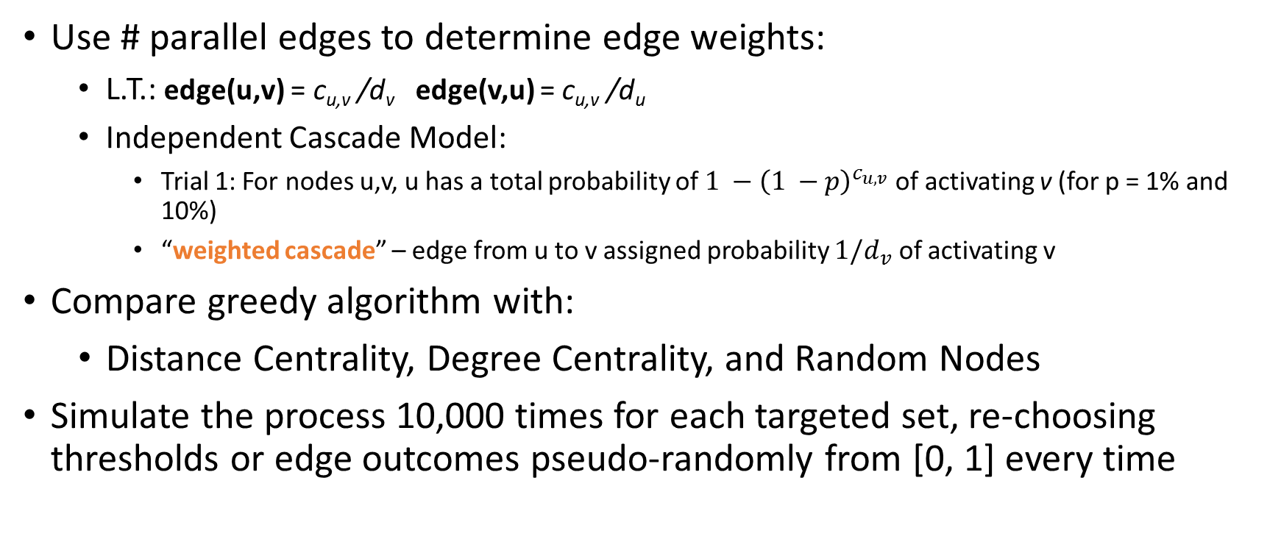
Experiments - Models
Use # parallel edges to determine edge weights:
  L.T.: edge(u,v) = c_{u,v} /d_{v} edge(v,u) = c_{u,v} /d_{u}
  Independent Cascade Model:
    Trial 1: For nodes u,v, u has a total probability of $1 −{\left(1 −p\right)}^{c_{u,v}}$ of activating v (for p = 1% and 10%)
    “weighted cascade” – edge from u to v assigned probability $1/d_{v}$ of activating v
Compare greedy algorithm with:
  Distance Centrality, Degree Centrality, and Random Nodes
Simulate the process 10,000 times for each targeted set, re-choosing thresholds or edge outcomes pseudo-randomly from [0, 1] every time

Slide 21
Results: Models side-by-side
Linear Threshold Model
Independent Cascade Model

Slide 22
Independent Cascade Model (sensitivity)
probability = 1%
probability = 10%

Slide 23
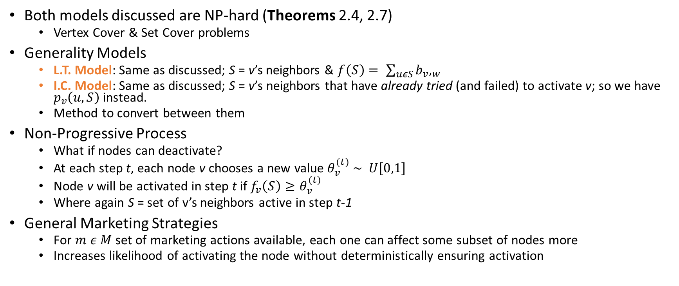
Addendum
Both models discussed are NP-hard (Theorems 2.4, 2.7)
  Vertex Cover & Set Cover problems
Generality Models
  L.T. Model: Same as discussed; S = v’s neighbors & $f\left(S\right)= \sum_{uεS}{b_{v},_{w}}$
  I.C. Model: Same as discussed; S = v’s neighbors that have already tried (and failed) to activate v; so we have $p_{v}\left(u,S\right)$ instead.
  Method to convert between them
Non-Progressive Process
  What if nodes can deactivate?
  At each step t, each node v chooses a new value $θ_{v}^{(t)} \sim U\left[0,1\right]$
  Node v will be activated in step t if $f_{v}\left(S\right)≥θ_{v}^{(t)}$
  Where again S = set of v’s neighbors active in step t-1
General Marketing Strategies
  For $m ε M$ set of marketing actions available, each one can affect some subset of nodes more
  Increases likelihood of activating the node without deterministically ensuring activation

Slide 24
(Some) Releated Works
Mining the Network Value of Customers (Domingos & Richardson)
Efficient Influence Maximization in Social Networks (Chen et. al)
Maximizing Social Influence in Nearly Optimal Time (Borgs et. al)
How to Influence People with Partial Incentives (Demaine, Hajiaghayi et. al)

Slide 25
Thank You!

