Slide 1
School Choice
and the Boston Mechanism
Duncan McElfresh
17 November, 2016

Slide 2


School Choice Problem
Students
I = {i₁ , i₂ , … , i_{n} }
Schools
S = {s₁ , s₂ , … , s_{m} }
College Admission Problem: Both schools and students are strategic agents (two-sided matching)
School Choice Problem: Only student welfare matters (one-sided matching)
Schools do not choose priorities
Similar to resource allocation
Preference (≻_{i}) over schools
Priority over students
Capacity
1 : { a ≻ b ≻ c }
a : { 2, 1, 3 } | ( )
2 : { b ≻ a ≻ c }
b : { 3, 1, 2} | ( )
3 : { a ≻ b ≻ c }
c : { 3, 2, 1} | ( ) ( )
Notes:
First I want to introduce the school choice problem. We have:
Set of students
Set of schools
Each student has a strict preference over the schools
Each school has a strict “priority” ordering over the students
Each school also has a finite capacity -- you can’t have every student attending one school
This is similar to the college admissions problem, where you have students and schools both trying to get the best possible match, however:
In “school choice”, the schools are not agents, instead they’re treated as a limited resource. So it’s a one-sided matching.
And this matters to us because the schools don’t choose their priorities -- the priorities depend on other factors
So why do we care about the school choice problem? Here’s a (very) brief history.

Slide 3
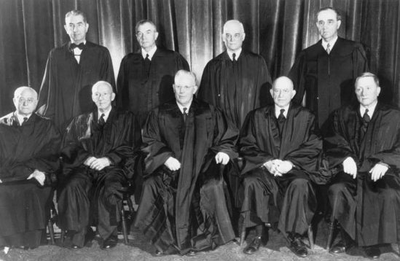

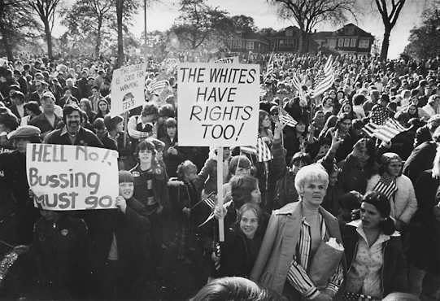
Boston Mechanism
1954: Brown v. Board of Education required desegregation of schools.
1974: In Boston, a court order forced racial integration of public schools via, leading to protests.
1981: Preempting a court order, Cambridge introduced the the controlled choice program to...
Increase diversity
Treat students fairly
Give families a choice
The Boston Mechanism was adopted by many US school districts.
Notes:
The supreme court ordered US schools to desegregate with the Brown v. Board of Ed. ruling in 1954.
… but because they are the supreme court, they can say “this is what you must do”, but they don’t provide any instructions on how to do it... so individual cities and school districts have to figure out how to desegregate on their own.
In 1974 Boston made one attempt at desegregation -- the federal district court in Boston ordered that any school with a majority non-white population had to be “racially balanced”. And the method they chose for “racial balancing” was busing: they would assign students to schools and bus them across the city.
So for very obvious reasons people didn’t like this, and there were protests, there was a wave of white flight out of Boston into the suburbs, and nearly half of boston public school students decided to unenroll.
Meanwhile, Cambridge MA saw this and decided they didn’t want the protests, they didn’t want the bussing. So they preempted a court order by designing their own method for desegregation, which they called “controlled choice”.
Controlled choice set priorities for schools -- students who live nearby get higher priority, students with a sibling at a certain school get a higher priority there, and of course there were racial quotas. But the program also asked families to list their preferences for schools, and they would try to assign every student to their top choice.
So is now called the boston mechanism -- assign as many students as possible to their first choice, accounting for school priorities. Then look at all of the second schools, and assign students as seats are available...
Controlled choice, with some variant of the Boston Mechanism was (and still is) used in many cities to incorporate several types of priorities, including walkable/non-walkable, whether a sibling also attends the school, and diversity (quotas on race/ethnicity).
But… Is it fair?

Slide 4
Boston Mechanism
1954: Brown v. Board of Education required desegregation of schools.
1974: In Boston, a court order forced racial integration of public schools via, leading to protests.
1981: Preempting a court order, Cambridge introduced the the controlled choice program to...
Increase diversity
Treat students fairly
Give families a choice
The Boston Mechanism was adopted by many US school districts.
Boston Mechanism:
Assign as many students as possible to their first choice of school.
Round 1:
Round k:
Only consider each student’s first choice: For each school, assign students to seats based on priority.
…
…
Consider each student’s k^{th} choice: For each school, assign students to seats based on priority.
Notes:
The supreme court ordered US schools to desegregate with the Brown v. Board of Ed. ruling in 1954.
… but because they are the supreme court, they can say “this is what you must do”, but they don’t provide any instructions on how to do it... so individual cities and school districts have to figure out how to desegregate on their own.
In 1974 Boston made one attempt at desegregation -- the federal district court in Boston ordered that any school with a majority non-white population had to be “racially balanced”. And the method they chose for “racial balancing” was busing: they would assign students to schools and bus them across the city.
So for very obvious reasons people didn’t like this, and there were protests, there was a wave of white flight out of Boston into the suburbs, and nearly half of boston public school students decided to unenroll.
Meanwhile, Cambridge MA saw this and decided they didn’t want the protests, they didn’t want the bussing. So they preempted a court order by designing their own method for desegregation, which they called “controlled choice”.
Controlled choice set priorities for schools -- students who live nearby get higher priority, students with a sibling at a certain school get a higher priority there, and of course there were racial quotas. But the program also asked families to list their preferences for schools, and they would try to assign every student to their top choice.
So is now called the boston mechanism -- assign as many students as possible to their first choice, accounting for school priorities. Then look at all of the second schools, and assign students as seats are available...
Controlled choice, with some variant of the Boston Mechanism was (and still is) used in many cities to incorporate several types of priorities, including walkable/non-walkable, whether a sibling also attends the school, and diversity (quotas on race/ethnicity).
But… Is it fair?

Slide 5
Boston Mechanism
What can we say about this mechanism?
Pareto Efficient
Individually Rational (if every student prefers being assigned to being unassigned)
Strategy-proof?...
Boston Mechanism:
Assign as many students as possible to their first choice of school.
Round 1:
Round k:
Only consider each student’s first choice: For each school, assign students to seats based on priority.
…
…
Consider each student’s k^{th} choice: For each school, assign students to seats based on priority. z
Notes:
Pareto efficient -- if you give any student a better assignment, you have to give some student a worse assignment

Slide 6
Boston Mechanism
Some advice for strategic families¹:
“For a better chance of your ‘first choice’ school . . . consider choosing less popular schools.” (BPS School Guide)
“... find a school you like that is undersubscribed and put it as a top choice, OR, find a school that you like that is popular and put it as a first choice and find a school that is less popular for a ‘safe’ second choice.” (West Zone Parent Group)
Boston Mechanism:
Assign as many students as possible to their first choice of school.
Round 1:
Round k:
Only consider each student’s first choice: For each school, assign students to seats based on priority.
…
…
Let’s consider the preference revelation game induced by the Boston Mechanism
Consider each student’s k^{th} choice: For each school, assign students to seats based on priority. z
1: Abdulkadiroglu, Atila. "School choice." The Handbook of Market Design(2013).
Notes:
But students learned how to strategize… How might they strategize? Let’s walk through an example

Slide 7
Boston Game
Students
I = {i₁ , i₂ , … , i_{n} }
Schools
S = {s₁ , s₂ , … , s_{m} }
1 : { a ≻ b ≻ c }
a : { 2, 1, 3 } | ( )
2 : { b ≻ a ≻ c }
b : { 3, 1, 2} | ( )
3 : { a ≻ b ≻ c }
c : { 3, 2, 1} | ( ) ( )
Notes:
First let’s assume all students are strategic -- they will

Slide 8
Boston Game
Round 1:
1,3 propose to a (only 1 is accepted)
2 proposes to b (accepted)
Students
I = {i₁ , i₂ , … , i_{n} }
Schools
S = {s₁ , s₂ , … , s_{m} }
1 : { a ≻ b ≻ c }
1 : { a ≻ b ≻ c }
a : { 2, 1, 3 } | ( )
a : { 2, 1, 3 } | (1)
2 : { b ≻ a ≻ c }
b : { 3, 1, 2} | ( ) ( )
2 : { b ≻ a ≻ c }
b : { 3, 1, 2} | (2)
3 : { a ≻ b ≻ c }
c : { 3, 2, 1} | ( ) ( )
b : { 3, 1, 2} | (2) (3)
3 : { a ≻ b ≻ c }
Notes:
First let’s assume all students are strategic -- they will

Slide 9
Boston Game
Round 1:
1,3 propose to a (only 1 is accepted)
2 proposes to b (accepted)
Round 2:
3 proposes to b (rejected)
Students
I = {i₁ , i₂ , … , i_{n} }
Schools
S = {s₁ , s₂ , … , s_{m} }
1 : { a ≻ b ≻ c }
1 : { a ≻ b ≻ c }
a : { 2, 1, 3 } | ( )
a : { 2, 1, 3 } | (1)
2 : { b ≻ a ≻ c }
b : { 3, 1, 2} | ( ) ( )
2 : { b ≻ a ≻ c }
b : { 3, 1, 2} | (2)
3 : { a ≻ b ≻ c }
c : { 3, 2, 1} | ( ) ( )
Notes:
First let’s assume all students are strategic -- they will

Slide 10
Boston Game
Round 1:
1,3 propose to a (only 1 is accepted)
2 proposes to b (accepted)
Round 2:
3 proposes to b (rejected)
Round 3:
3 proposes to c (accepted)
Students
I = {i₁ , i₂ , … , i_{n} }
Schools
S = {s₁ , s₂ , … , s_{m} }
1 : { a ≻ b ≻ c }
1 : { a ≻ b ≻ c }
a : { 2, 1, 3 } | ( )
a : { 2, 1, 3 } | (1)
b : { 3, 1, 2} | (2)
2 : { b ≻ a ≻ c }
b : { 3, 1, 2} | ( ) ( )
2 : { b ≻ a ≻ c }
b : { 3, 1, 2} | (2) ( )
Is this a stable matching?
Blocking pair: (3,b)
3 can improve assignment by playing { b ≻ … }
3 : { a ≻ b ≻ c }
c : { 3, 2, 1} | (3) ( )
3 : { a ≻ b ≻ c }
Can we generalize?
Notes:
First let’s assume all students are strategic -- they will

Slide 11
Boston Game
Preferences and ≻_{i} and priorities P define an Economy
The set of Nash equilibria of the Boston game is the set of stable matchings under the two-sided matching problem. (Ergin & Sonmez, 2006).
1 : { a ≻ b ≻ c }
a : { 2, 1, 3 } | ( )
Intuition:
If ( i_{i} , s_{j} ) is a blocking pair, student i_{i} can guarantee a seat in school s_{j} by ranking it as her top choice.
Any stable matching 𝜇 can be selected if all students request their assignment under this matching 𝜇(i) as their top choice.
2 : { b ≻ a ≻ c }
b : { 3, 1, 2} | ( )
…
…
i_{n} : { a ≻ b ≻ c }
s_{m} : { 3, 2, 1} | ( ) ( )
What if some students don’t strategize?
Notes:
First let’s assume all students are strategic -- they will

Slide 12



Sincere and Strategic Students
What if some students don’t strategize?
Strategic Students
Sincere Students
I₁^{i}: Sincere students who rank school i as first choice under and all strategic students
I₂^{i}: Sincere students who rank school i as second choice
I_{n}^{i}: Sincere students who rank school i as n^{th} choice
…

Slide 13
Sincere and Strategic Students
Augmented Economy
WIth sincere and strategic students, the Nash equilibria of the Boston game is the set of stable matchings under the augmented economy. (Pathak & Sonmez, 2008).
1 : { a ≻ b ≻ c }
a : { I₁ª , I₂ª, ... , I₃ª, 2, 1, 3 }
I₁^{i}: Sincere students who rank school i as first choice under and all strategic students
I₂^{i}: Sincere students who rank school i as second choice
I_{n}^{i}: Sincere students who rank school i as n^{th} choice
2 : { b ≻ a ≻ c }
b : { I₁^{b} , I₂^{b}, ... , I₃^{b}, 3, 1, 2}
…
…
I_{n} : { a ≻ b ≻ c }
s_{m} : { I₁^{m} , I₂^{m}, ... , I₃^{m}, 3, 2, 1}
…
Original preferences
Augmented priorities
Original priorities
Notes:
First let’s assume all students are strategic -- they will

Slide 14
Sincere and Strategic Students
Augmented Economy
WIth sincere and strategic students, the Nash equilibria of the Boston game is the set of stable matchings under the augmented economy. (Pathak & Sonmez, 2008).
1 : { a ≻ b ≻ c }
a : { I₁ª , I₂ª, ... , I₃ª, 2, 1, 3 }
Intuition:
For every school s, students who rank s higher than other students effectively have higher priority at s.
(Def’n:) Strategic students select the Pareto-dominant Nash equilibrium
2 : { b ≻ a ≻ c }
b : { I₁^{b} , I₂^{b}, ... , I₃^{b}, 3, 1, 2}
…
…
I_{n} : { a ≻ b ≻ c }
s_{m} : { I₁^{m} , I₂^{m}, ... , I₃^{m}, 3, 2, 1}
Sincere students’ assignments are the same under every Nash
If a sincere student I becomes strategic:
  Student I weakly benefits
  All other strategic students weakly suffer
Implications:
Original preferences
Augmented priorities
Original priorities
Notes:
First let’s assume all students are strategic -- they will

Slide 15
Can we do better?
Can we do better?
Deferred Acceptance Mechanism:
Find the student-optimal stable matching
Round 1:
Round k:
Yes! With the student-optimal stable matching (Gale & Shapley)
Boston Game | Student-Optimal Mechanism
Leads to... | Leads to...
Pareto-dominant Nash equilibrium | Student-optimal stable matching
...which is preferred by | ...which is preferred by
All strategic Some sincere | All students
Students propose their 1st choice. Seats are tentatively accepted based on priority and capacity. Unassigned students are rejected.
…
…
Unassigned students propose to their next choice. Full schools accept if proposers have higher priority than current students and reject otherwise.

Slide 16
Deferred Acceptance
Students
I = {i₁ , i₂ , … , i_{n} }
Schools
S = {s₁ , s₂ , … , s_{m} }
Deferred Acceptance Mechanism:
Find the student-optimal stable matching
Round 1:
Round k:
1 : { a ≻ b ≻ c }
a : { 2, 1, 3 } | ( )
Students propose their 1st choice. Seats are tentatively accepted based on priority and capacity. Unassigned students are rejected.
2 : { b ≻ a ≻ c }
b : { 3, 1, 2} | ( )
…
…
3 : { a ≻ b ≻ c }
c : { 3, 2, 1} | ( ) ( )
Unassigned students propose to their next choice. Full schools accept if proposers have higher priority than current students and reject otherwise.
Notes:
First let’s assume all students are strategic -- they will

Slide 17
Deferred Acceptance
Round 1:
1 proposes to a (accepted)
2 proposes to b (accepted)
3 proposes to a (rejected)
Students
I = {i₁ , i₂ , … , i_{n} }
Schools
S = {s₁ , s₂ , … , s_{m} }
1 : { a ≻ b ≻ c }
a : { 2, 1, 3 } | (1)
2 : { b ≻ a ≻ c }
b : { 3, 1, 2} | (2)
3 : { a ≻ b ≻ c }
c : { 3, 2, 1} | ( ) ( )
Notes:
First let’s assume all students are strategic -- they will

Slide 18
Deferred Acceptance
Round 1:
1 proposes to a (accepted)
2 proposes to b (accepted)
3 proposes to a (rejected)
Round 2:
3 proposes to b (accepted)
  2 is rejected
Students
I = {i₁ , i₂ , … , i_{n} }
Schools
S = {s₁ , s₂ , … , s_{m} }
1 : { a ≻ b ≻ c }
a : { 2, 1, 3 } | (1)
2 : { b ≻ a ≻ c }
b : { 3, 1, 2} | (3)
3 : { a ≻ b ≻ c }
c : { 3, 2, 1} | ( ) ( )
Notes:
First let’s assume all students are strategic -- they will

Slide 19
Deferred Acceptance
Round 1:
1 proposes to a (accepted)
2 proposes to b (accepted)
3 proposes to a (rejected)
Round 2:
3 proposes to b (accepted)
  2 is rejected
Round 3:
2 proposes to a (accepted)
  1 is rejected
Students
I = {i₁ , i₂ , … , i_{n} }
Schools
S = {s₁ , s₂ , … , s_{m} }
1 : { a ≻ b ≻ c }
a : { 2, 1, 3 } | (2)
2 : { b ≻ a ≻ c }
b : { 3, 1, 2} | (3)
3 : { a ≻ b ≻ c }
c : { 3, 2, 1} | ( ) ( )
Notes:
First let’s assume all students are strategic -- they will

Slide 20
Deferred Acceptance
Round 1:
1 proposes to a (accepted)
2 proposes to b (accepted)
3 proposes to a (rejected)
Round 2:
3 proposes to b (accepted)
  2 is rejected
Round 3:
2 proposes to a (accepted)
  1 is rejected
Round 3,4:
1 proposes to b (rejected)
1 proposes to c (accepted)
Students
I = {i₁ , i₂ , … , i_{n} }
Schools
S = {s₁ , s₂ , … , s_{m} }
1 : { a ≻ b ≻ c }
a : { 2, 1, 3 } | (2)
2 : { b ≻ a ≻ c }
b : { 3, 1, 2} | (3)
3 : { a ≻ b ≻ c }
c : { 3, 2, 1} | ( ) ( )
c : { 3, 2, 1} | (1) ( )
Notes:
First let’s assume all students are strategic -- they will

Slide 21
Deferred Acceptance
Students
I = {i₁ , i₂ , … , i_{n} }
Schools
S = {s₁ , s₂ , … , s_{m} }
Deferred Acceptance:
Preferred by 2, 3
Boston Mechanism:
Preferred by 1
1 : { a ≻ b ≻ c }
a : { 2, 1, 3 } | (2)
2 : { b ≻ a ≻ c }
b : { 3, 1, 2} | (3)
Deferred acceptance is preferred by most non-strategic students…
But how much does this matter?
3 : { a ≻ b ≻ c }
c : { 3, 2, 1} | ( ) ( )
c : { 3, 2, 1} | (1) ( )
Notes:
First let’s assume all students are strategic -- they will

Slide 22
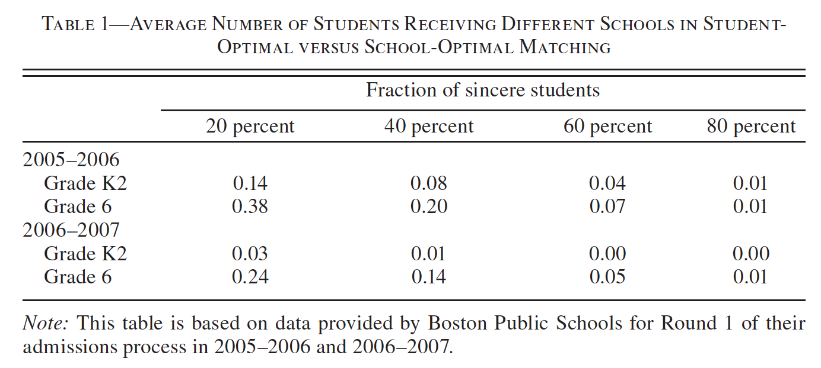
So what?
The core is small…
Notes:
This actually makes sense -- remember that in unbalanced matching problems, there aren’t that many stable matchings! That is what this result is showing us.

Slide 23
So what?
Several reasons to use prefer a strategy-proof mechanism
Strategies can be wrong (inefficient)
Schools want true preference data
Students waste time strategizing
Boston Mechanism doesn’t guarantee a stable matching
But what if students continue to strategize under a strategy-proof mechanism?

Slide 24
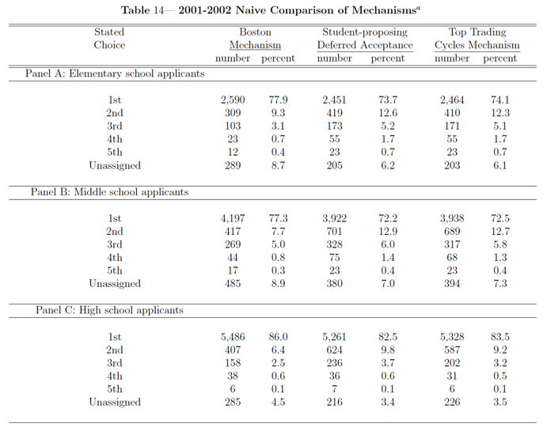
So what?
The transition to strategy-proofness won’t rock the boat.

Slide 25
Thank you!

