Slide 1
Computing Optimal Randomized Resource Allocations for Massive Security Games
C. Kiekintveld et al., AAMAS 2009
(USC)
Presented by Neal Gupta
September 2016

Slide 2
Overview
Motivation and Introduction
Compact Representations of Security Games
ERASER
Alternative LP formulation (ORIGAMI)
ERASER-C (more realistic)
Results

Slide 3
Overview
Motivation and Introduction
Compact Representations of Security Games
ERASER
Alternative LP formulation (ORIGAMI)
ERASER-C (more realistic)
Results

Slide 4
Motivation and introduction
m resources to cover n targets, m < n
Defender can commit to a mixed strategy
Attacker can observe the probabilities for each coverage set
  Surveillance
  Insider threat
Attacker chooses a pure strategy
Equilibrium concept not ex post

Slide 5
Motivation and introduction
Initially assume interchangeable resources (to extend later)
Assume players are risk neutral
One type of follower (attacker)
  Recall that this should be in P
  But, the number of pure strategies now is unreasonably large, with 100 targets and 10 resources ~17 trillion!

Slide 6
Motivation and introduction
Running example: 4 targets, 2 resources
Qualitatively
  Defender values all 4 targets equally (and prefers a covered attack to an uncovered attack).
  Attacker gets twice as much utility for successful attack on target 3. All failed attacks get the same (lower) utility.
1
2
4
3

Slide 7
Motivation and introduction
Running example
Quantitatively
1
2
4
3
Targets 1, 2, 4
 |  | Cov’d | Uncov’d
Defender |  | 4 | 1
Attacker |  | 0 | 1
Target 3
 |  | Cov’d | Uncov’d
Defender |  | 4 | 1
Attacker |  | 0 | 2

Slide 8
Motivation and introduction
Running example
Quantitatively
1
2
4
3
Targets 1, 2, 4
 |  | Cov’d | Uncov’d
Defender |  | 4 | 1
Attacker |  | 0 | 1
Target 3
 |  | Cov’d | Uncov’d
Defender |  | 4 | 1
Attacker |  | 0 | 2

Slide 9
Overview
Motivation and Introduction
Compact Representations of Security Games
ERASER
Alternative LP formulation (ORIGAMI)
ERASER-C (more realistic)
Results

Slide 10
Compact Representations of Security Games—Extensive Form is Too Big!
Defender commits to a mixed strategy (one of uncountably many)
In general, length
Attacker strategy is an efficient algorithm, which given any mixed strategy, Δ computes target

Slide 11
Compact Representations of Security Games
Key insight: the only information needed to represent the defender strategy is the probabilities a target is covered
With one attacker (and in extensions with no interactions between attacks) any feasible assignment of resources that achieves coverage vector C will be a SSE that is (weakly) optimal

Slide 12
Overview
Motivation and Introduction
Compact Representations of Security Games
ERASER
Alternative LP formulation (ORIGAMI)
ERASER-C (more realistic)
Results

Slide 13
ERASER – basic formulation
Exactly one attack occurs

Slide 14
ERASER – basic formulation
Exactly one attack occurs
Feasible use of all resources

Slide 15
ERASER – basic formulation
Exactly one attack occurs
Feasible use of all resources
Constraint only on attacked target – sets d equal to that utility

Slide 16
ERASER – basic formulation
Exactly one attack occurs
Feasible use of all resources
k is an upper bound on attacker’s utility

Slide 17
ERASER – basic formulation
Exactly one attack occurs
Feasible use of all resources
k is an upper bound on attacker’s utility

Slide 18
ERASER – basic formulation
Exactly one attack occurs
Feasible use of all resources
For the attacked target only, the attacker’s utility must be at least k

Slide 19
ERASER – running example
c

Slide 20
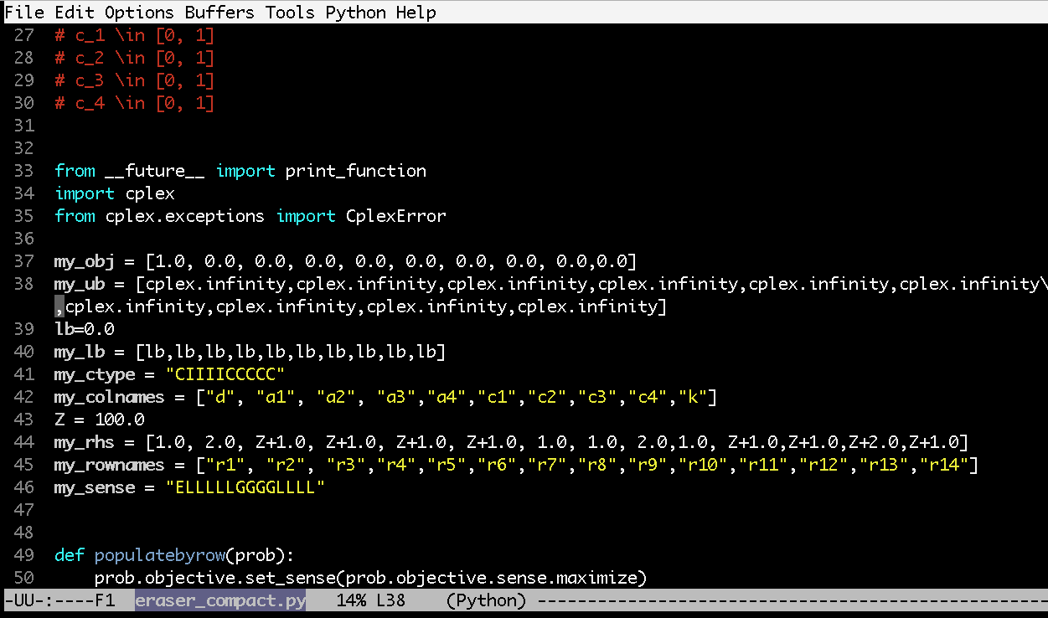
ERASER – running example
Modification of IBM’s CPLEX MILP demo code

Slide 21
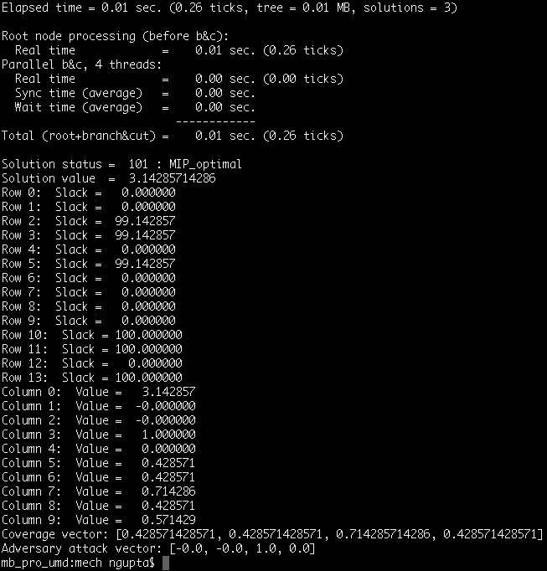
ERASER – running example
Modification of IBM’s CPLEX MILP demo code

Slide 22
ERASER – running example

Slide 23
Overview
Motivation and Introduction
Compact Representations of Security Games
ERASER
Alternative LP formulation (ORIGAMI)
ERASER-C (more realistic)
Results

Slide 24
ORIGAMI
Additional assumption
  Attackers like it when attacks succeed
  Defenders like it when attacks fail
When is this reasonable? Almost always.
  Exception: Honeypots?
  Disputed: Coventry blitz

Slide 25
ORIGAMI
There is no marginal benefit for either player of adding coverage to targets outside the attack set
Because of tiebreak rule, adding targets (without removing them) from attack set benefits defender

Slide 26
ORIGAMI-LP
Indicator variables for attack set

Slide 27
ORIGAMI-LP
Indicator variables for attack set

Slide 28
ORIGAMI-LP
Indicator variables for attack set
Feasible use of all resources

Slide 29
ORIGAMI-LP
Indicator variables for attack set
Feasible use of all resources
k is upper bound on attacker’s utility

Slide 30
ORIGAMI-LP
Indicator variables for attack set
Feasible use of all resources
k is lower bound on attacker’s utility of targets in the attack set

Slide 31
ORIGAMI-LP
Indicator variables for attack set
Feasible use of all resources
Defender only tries to cover targets in the attack set

Slide 32
ORIGAMI-Iterative algorithm
If there was less coverage, the attacker would always attack and get strictly better utility

Slide 33
ORIGAMI – Running Example
Iteration 1
Attack set: {Target 3}
New coverage for Target 3: 0.5

Slide 34
ORIGAMI – Running Example
Iteration 2
Attack set: {Target 1, Target 3}
New coverage for Target 3: 0.5
New coverage for Target 1: 0

Slide 35
ORIGAMI – Running Example
Iteration 3
Attack set: {Target 1, Target 2, Target 3}
New coverage for Target 3: 0.5
New coverage for Target 1: 0
New coverage for Target 2: 0

Slide 36
ORIGAMI – Running Example
Iteration 4
Attack set: {Target 1, Target 2, Target 3, Target 4}
New coverage for Target 3: 0.5
New coverage for Target 1: 0
New coverage for Target 2: 0
New coverage for Target 4: 0

Slide 37
ORIGAMI – Running Example
Postprocessing after loop
Attack set: {Target 1, Target 2, Target 3, Target 4}
Sum of ratio[t] = 3.5
Resources Left = 1.5
Target 3 final coverage = 0.5 + 0.5*1.5/3.5 = 5/7
Target 1 final coverage = 0 + 1.5/3.5 = 3/7
Target 2 final coverage = 0 + 1.5/3.5 = 3/7
Target 4 final coverage = 0 + 1.5/3.5 = 3/7

Slide 38
ERASER-C
Solves the FAMS problem
More realistic – resources now only have a set of schedules they can work with (multiple flights at same time, can’t teleport between cities, etc.)
Resources have types, analogous to the starting location

Slide 39
ERASER-C
Now resources only have feasible schedules.
  Example: 3 guards, 20 flights
  Feasible schedule: 10 disjoint pairs of flights,
  e.g. (1, 2), (3,4), (5,6), (7,8), (9, 10), (11, 12),
  (13, 14), (15, 16), (17, 18), (19, 20)
Again, naïve representation of pure strategies is infeasibly large
[Tsai et. al., IRIS A Tool for Strategic Security Allocation in Transportation Networks, 2016]

Slide 40
ERASER-C
Now resources only have feasible schedules.
  Example: 3 guards, 20 flights
  Feasible schedule: 10 disjoint pairs of flights,
  e.g. (1, 2), (3,4), (5,6), (7,8), (9, 10), (11, 12),
  (13, 14), (15, 16), (17, 18), (19, 20)
Instead put a probability on each schedule.
  In general problem number of schedules could be infeasibly large, if schedules can be represented compactly
  However, in FAMS application schedules are length 2
[Tsai et. al., IRIS A Tool for Strategic Security Allocation in Transportation Networks, 2016]

Slide 41
ERASER-C

Slide 42
ERASER-C – Odd Cycles
A feasible solution to the MILP may not be feasible using the schedule
E.g. 1 resource can cover the schedule {1, 2} and {2, 3}
It will not be possible to split 50% coverage of 1 and 50% coverage of 3

Slide 43
Overview
Motivation and Introduction
Compact Representations of Security Games
ERASER
Alternative LP formulation (ORIGAMI)
ERASER-C (more realistic)
Results

Slide 44
Results

Slide 45
Results

Slide 46
Results

