Slide 1
TRUSTS
Scheduling Randomized Patrols for Fare Inspection in Transit Systems

Slide 2
Abstract
‘Proof-of-payment’ transit systems:
  Passengers: required to purchase tickets; but cannot be physically forced to do so
  Patrol units: inspect passengers; impose fine for fare evading
TRUSTS: application for randomized patrol strategies
  Leader-follower Stackelberg game
  Objective: Deter fare evasion → maximize revenue
Major differences from previously studied Stackelberg settings
  Leader strategies: massive temporal and spatial constraints
  Large number of potential followers
  Patrol strategies should be easier to execute

Slide 3
Introduction
LA Metro: ~300,000 riders daily
  No barriers to entry → can result in significant revenue loss
  Los Angeles Sheriffs Department (LASD) uniformed patrols on board trains and stations: relies on humans for scheduling the patrols – predictable schedules
TRUSTS (Tactical Randomization for Urban Security in Transit Systems) application
  Stackelberg game with 1 leader (LASD) and many followers (metro riders)
  Leader: precommits to a mixed patrol strategy
  Followers: observe this strategy and decide whether to buy the ticket
Optimization objective: leader maximizes total revenue
  Exponentially many pure strategies
TRUSTS uses transition graph for spatial and temporal structure, and uses LP to optimize the flow

Slide 4
Problem Setting
Generate randomized schedules for patrols for 4 separate LA Metro lines
  Pure leader strategy: patrol – sequence of patrol actions with constant bounded duration
  Pure follower strategies: buying ticket, and not buying ticket
Train system: modeled using directed transition graph G = ⟨V, E⟩, acc. to metro timetable
  Vertex v = ⟨s, t⟩ : a pair of station s and time point t
  Edge from ⟨s, t⟩ to ⟨s’, t’⟩ if:
    s and s’ are consecutive stops for some train in the train schedule, or
    s = s’, t < t’, and there is no vertex ⟨s, t”⟩ with t < t” < t’
Patrols: 𝝲 deployable patrol units, each with patrol duration of at most 𝝹 hours
  On-train inspections, in-station inspections
  Each edge e has: l_{e} – patrol action duration; f_{e} – effectiveness value

Slide 5
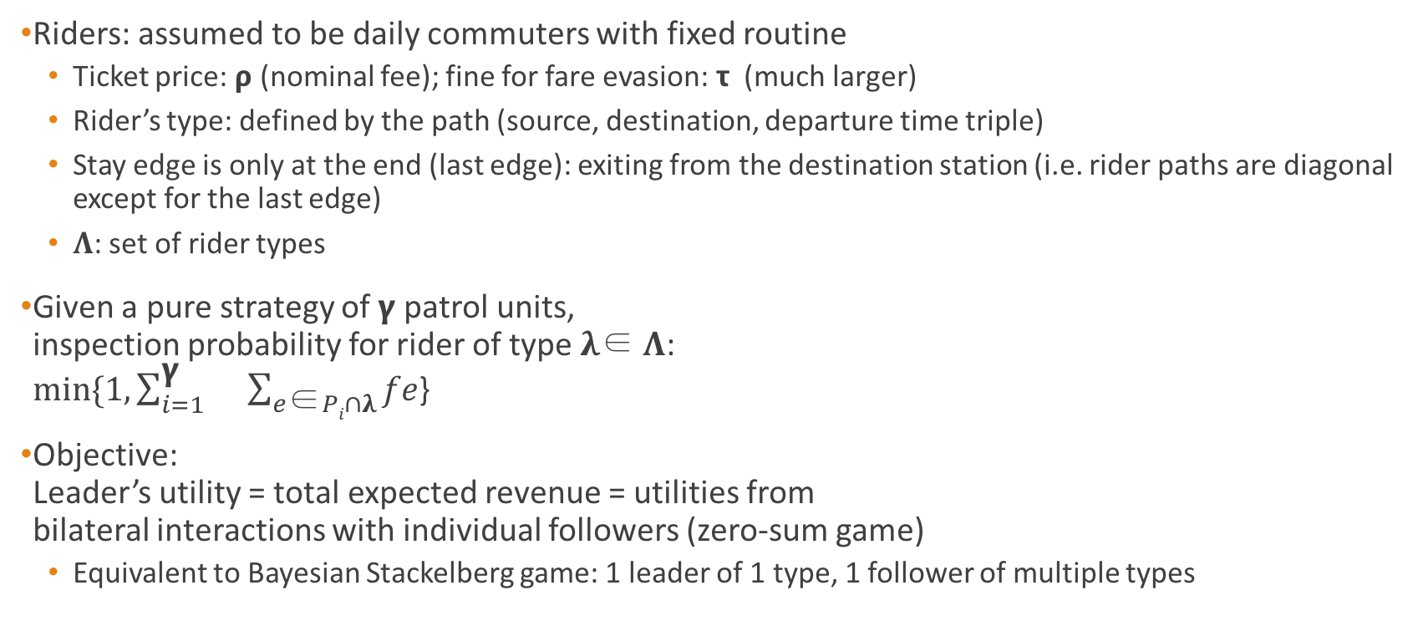
Problem Setting
Riders: assumed to be daily commuters with fixed routine
  Ticket price: 𝞀 (nominal fee); fine for fare evasion: 𝞃 (much larger)
  Rider’s type: defined by the path (source, destination, departure time triple)
  Stay edge is only at the end (last edge): exiting from the destination station (i.e. rider paths are diagonal except for the last edge)
  𝚲: set of rider types
Given a pure strategy of 𝝲 patrol units,
inspection probability for rider of type 𝛌∈ 𝚲:
$min⁡\{1, \sum_{i=1}^{\text{γ}}{}\sum_{e\text{∈}Pi∩λ}{fe}$}
Objective:
Leader’s utility = total expected revenue = utilities from
bilateral interactions with individual followers (zero-sum game)
  Equivalent to Bayesian Stackelberg game: 1 leader of 1 type, 1 follower of multiple types

Slide 6
Linear Program Formulation
Find maximum revenue (mixed) patrol strategy
  Leader’s pure strategies: exponentially large
  Represent mixed strategies by marginal coverage on edges x_{e} of the transition graph (expected no. of inspections on these edges)
Basic Formulation:
  For the transition graph G = ⟨V, E⟩:
  V⁺⊂ V: set of possible starting vertices; V⁻ ⊂ V: set of possible ending vertices
  Add source v⁺ and sink v⁻; edges from v⁺ to V⁺, and from V⁻ to v⁻
  u_{𝛌}: expected value paid by rider of type 𝛌

Slide 7
Basic Formulation
Expected total revenue from riders of type 𝛌
Conservation of flow
𝛂∈[1, 𝝲] : used as an upper-bound on x_{e}
limits the number of patrol units on an edge
Results in an overestimate of the actual inspection probability, and thus leader’s utility

Slide 8
Issues with Basic Formulation
2 fundamental issues:
  Failure to satisfy patrol length limit constraint
  Frequent/impractical switching between trains or in-station/on-train patrol
Assume 𝝲 = 1 and 𝝹 = 1

Slide 9
Extended Formulation
History-Duplicate Transition (HDT) graph: 𝒢 = ⟨𝒱, 𝜀⟩
Multiple restricted copies of G
For starting point t*, keep only the vertices v = ⟨s, t⟩ ∈ V, where t* ≤ t ≤ t* + 𝝹
Linear expansion of G: at most ⎡𝝹/𝛅⎤
  𝛅: difference between starting time points
𝝹 = 2

Slide 10
Extended Formulation
Used to penalize the switching edges
c_{e} = 1 for switching edge, 0 otherwise
y_{e}: represent marginal coverage in HDT
Convert back to get marginal coverage for original graph
𝛃=0 provides a tighter upper bound on the optimal revenue than that in Basic Formulation

Slide 11
Experimental Results
4 data sets, 1 each for LA Metro Rail line; 𝝲 = 1, 𝛅 = 1 hour, 𝝹 = 4 – 7 hours

Slide 12
Thanks

