Slide 1
Applied Mechanism Design For Social Good
John P Dickerson
Lecture #8 – 09/22/2016
CMSC828M
Tuesdays & Thursdays
12:30pm – 1:45pm

Slide 2
Let’s talk about projects

Slide 3
This class:
Matching & Not the NRMP

Slide 4
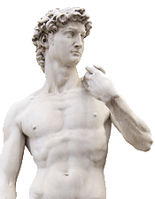

Overview of The Next 1.5 lectures
Stable marriage problem
  Bipartite, one vertex to one vertex
Stable roommates problem
  Not bipartite, one vertex to one vertex
Hospitals/Residents problem
  Bipartite, one vertex to many vertices

Slide 5
Matching without incentives
Given a graph G = (V, E), a matching is any set of pairwise non-adjacent edges
No two edges share the same vertex
Classical combinatorial optimization problem
Bipartite matching:
Bipartite graph G = (U, V, E)
Max cardinality/weight matching found easily – O(VE) and better
  E.g., through network flow, Hungarian algorithm, etc
Matching in general graphs:
Also PTIME via Edmond’s algorithm – O(V²E) and better

Slide 6

Stable marriage problem
Complete bipartite graph with equal sides:
  n men and n women (old school terminology ☹)
Each man has a strict, complete preference ordering over women, and vice versa
Want: a stable matching
Stable matching: No unmatched man and woman both prefer each other to their current spouses

Slide 7



Example preference profiles
>
>
Albert | Diane | Emily | Fergie
Bradley | Emily | Diane | Fergie
Charles | Diane | Emily | Fergie
Diane | Bradley | Albert | Charles
Emily | Albert | Bradley | Charles
Fergie | Albert | Bradley | Charles

Slide 8
Example matching #1
Albert | Diane | Emily | Fergie
Bradley | Emily | Diane | Fergie
Charles | Diane | Emily | Fergie
Diane | Bradley | Albert | Charles
Emily | Albert | Bradley | Charles
Fergie | Albert | Bradley | Charles
Is this a stable matching?

Slide 9
Example matching #1
Albert | Diane | Emily | Fergie
Bradley | Emily | Diane | Fergie
Charles | Diane | Emily | Fergie
Diane | Bradley | Albert | Charles
Emily | Albert | Bradley | Charles
Fergie | Albert | Bradley | Charles
No.
Albert and Emily form a blocking pair.

Slide 10
Example matching #2
Albert | Diane | Emily | Fergie
Bradley | Emily | Diane | Fergie
Charles | Diane | Emily | Fergie
Diane | Bradley | Albert | Charles
Emily | Albert | Bradley | Charles
Fergie | Albert | Bradley | Charles
What about this matching?

Slide 11
Example matching #2
Albert | Diane | Emily | Fergie
Bradley | Emily | Diane | Fergie
Charles | Diane | Emily | Fergie
Diane | Bradley | Albert | Charles
Emily | Albert | Bradley | Charles
Fergie | Albert | Bradley | Charles
Yes!
(Fergie and Charles are unhappy, but helpless.)

Slide 12



Some questions
Does a stable solution to the marriage problem always exist?
Can we compute such a solution efficiently?
Can we compute the best stable solution efficiently?
Hmm …
Hmm …
Lloyd Shapley
David Gale

Slide 13
Gale-Shapley [1962]
Everyone is unmatched
While some man m is unmatched:
  w := m’s most-preferred woman
  to whom he has not proposed yet
  If w is also unmatched:
    w and m are engaged
  Else if w prefers m to her current match m’
    w and m are engaged, m’ is unmatched
  Else: w rejects m
Return matched pairs

Slide 14
Claim
GS terminates in polynomial time (at most n² iterations of the outer loop)
Proof:
Each iteration, one man proposes to someone to whom he has never proposed before
n men, n women → n×n possible events
(Can tighten a bit to n(n - 1) + 1 iterations.)

Slide 15
Claim
GS results in a perfect matching
Proof by contradiction:
Suppose BWOC that m is unmatched at termination
n men, n women → w is unmatched, too
Once a woman is matched, she is never unmatched; she only swaps partners. Thus, nobody proposed to w
m proposed to everyone (by def. of GS): ><

Slide 16
Claim
GS results in a stable matching (i.e., there are no blocking pairs)
Proof by contradiction (1):
Assume m and w form a blocking pair
Case #1: m never proposed to w
GS: men propose in order of preferences
m prefers current partner w’ > w
→ m and w are not blocking

Slide 17
Claim
GS results in a stable matching (i.e., there are no blocking pairs)
Proof by contradiction (2):
Case #2: m proposed to w
w rejected m at some point
GS: women only reject for better partners
w prefers current partner m’ > m
→ m and w are not blocking
Case #1 and #2 exhaust space. ><

Slide 18

Recap: Some questions
Does a stable solution to the marriage problem always exist?
Can we compute such a solution efficiently?
Can we compute the best stable solution efficiently?
We’ll look at a specific notion of “the best” – optimality with respect to one side of the market

Slide 19
(Wo)Man optimality/pessimality
Let S be the set of stable matchings
m is a valid partner of w if there exists some stable matching S in S where they are paired
A matching is man optimal (resp. woman optimal) if each man (resp. woman) receives their best valid partner
  Is this a perfect matching? Stable?
A matching is man pessimal (resp. woman pessimal) if each man (resp. woman) receives their worst valid partner

Slide 20
Claim
GS – with the man proposing – results in a man-optimal matching
Proof by contradiction (1):
Men propose in order → at least one man was rejected by a valid partner
Let m and w be the first such reject in S
This happens because w chose some m’ > m
Let S’ be a stable matching with m, w paired
  (S’ exists by def. of valid)

Slide 21
Claim
GS – with the man proposing – results in a man-optimal matching
Proof by contradiction (2):
Let w’ be partner of m’ in S’
m’ was not rejected by valid woman in S before m was rejected by w (by assump.)
→ m’ prefers w to w’
Know w prefers m’ over m, her partner in S’
→ m’ and w form a blocking pair in S’ ><

Slide 22
Recap: Some questions
Does a stable solution to the marriage problem always exist?
Can we compute such a solution efficiently?
Can we compute the best stable solution efficiently?
*
For one side of the market. What about the other side?

Slide 23
Claim
GS – with the man proposing – results in a woman-pessimal matching
Proof by contradiction:
m and w matched in S, m is not worst valid
→ exists stable S’ with w paired to m’ < m
Let w’ be partner of m in S’
m prefers to w to w’ (by man-optimality)
→ m and w form blocking pair in S’ ><

Slide 24
Incentive issues
Can either side benefit by misreporting?
  (Slight extension for rest of talk: participants can mark possible matches as unacceptable – a form of preference list truncation)
Any algorithm that yields woman- (man-)optimal matching
→
truthful revelation by women (men) is dominant strategy [Roth 1982]

Slide 25
In GS with men proposing, women can benefit by misreporting preferences
Truthful reporting
Albert | Diane | Emily
Bradley | Emily | Diane
Diane | Bradley | Albert
Emily | Albert | Bradley
Albert | Diane | Emily
Bradley | Emily | Diane
Diane | Bradley | Albert
Emily | Albert | Bradley
Strategic reporting
Albert | Diane | Emily
Bradley | Emily | Diane
Diane | Bradley | 
Emily | Albert | Bradley
Albert | Diane | Emily
Bradley | Emily | Diane
Diane | Bradley | 
Emily | Albert | Bradley

Slide 26
Claim
There is no matching mechanism that:
is strategy proof (for both sides); and
always results in a stable outcome (given revealed preferences)

Slide 27
Extensions to stable marriage

Slide 28
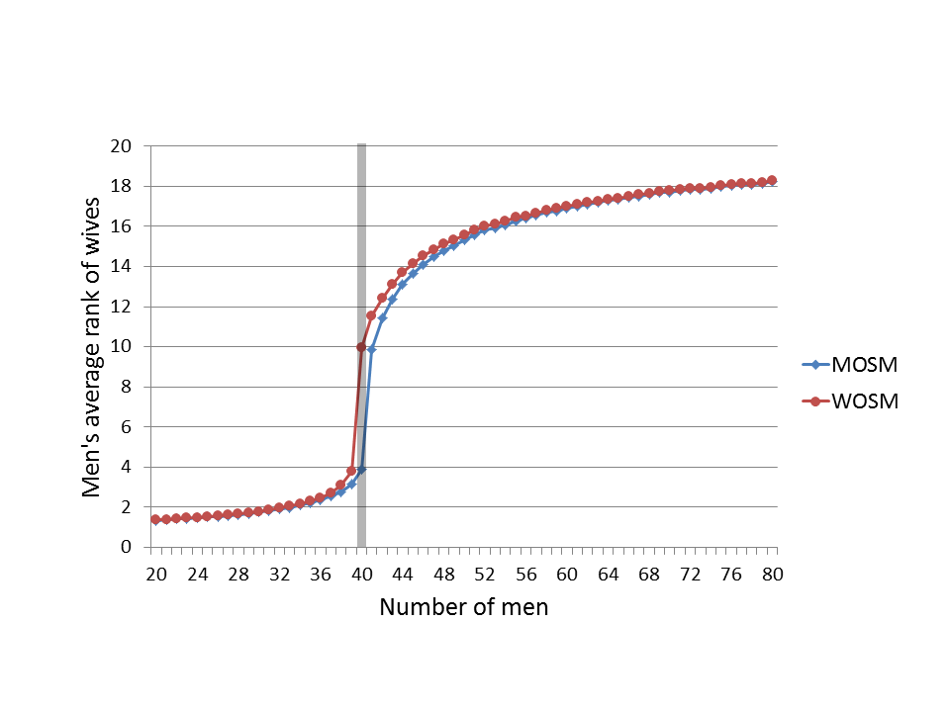
Imbalance [Ashlagi et al. 2013]
What if we have n men and n’ ≠ n women?
How does this affect participants? Core size?
Being on short side of market: good!
W.h.p., short side get rank ~log(n)
… long side gets
rank ~random
# women held constant at n’ = 40

Slide 29
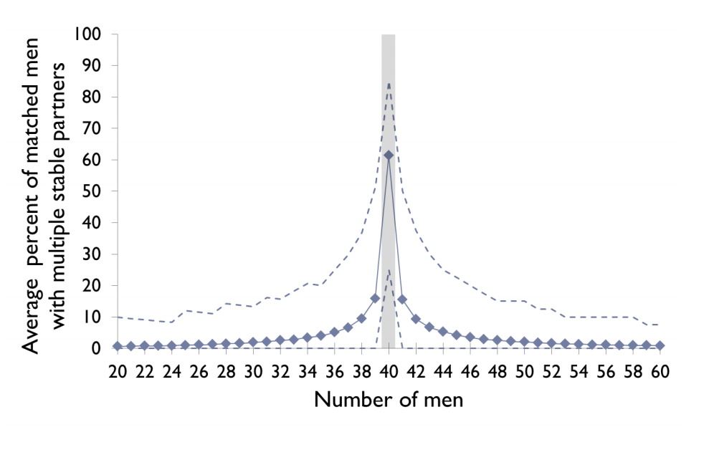
Imbalance [Ashlagi et al. 2013]
Not many stable matchings with even small imbalances in the market

Slide 30
Imbalance [Ashlagi et al. 2013]
“Rural hospital theorem” [Roth 1986]:
  The set of residents and hospitals that are unmatched is the same for all stable matchings
Assume n men, n+1 women
  One woman w unmatched in all stable matchings
  → Drop w, same stable matchings
Take stable matchings with n women
  Stay stable if we add in w if no men prefer w to their current match
  → average rank of men’s matches is low

Slide 31
Online arrival [Khuller et al. 1993]
Random preferences, men arrive over time, once matched nobody can switch
Algorithm: match m to highest-ranked free w
  On average, O(nlog(n)) unstable pairs
No deterministic or randomized algorithm can do better than Ω(n²) unstable pairs!
  Not better with randomization ☹

Slide 32
Incomplete prefs [Manlove et al. 2002]
Before: complete + strict preferences
  Easy to compute, lots of nice properties
Incomplete preferences
  May exist: stable matchings of different sizes
Everything becomes hard!
  Finding max or min cardinality stable matching
  Determining if <m,w> are stable
  Finding/approx. finding “egalitarian” matching

Slide 33
Non-bipartite graph …?
Matching is defined on general graphs:
  “Set of edges, each vertex included at most once”
  (Finally, no more “men” or “women” …)
The stable roommates problem is stable marriage generalized to any graph
Each vertex ranks all n-1 other vertices
  (Variations with/without truncation)
Same notion of stability

Slide 34

Is this different than stable marriage?
>
>
Alana | Brian | Cynthia | Dracula
Brian | Cynthia | Alana | Dracula
Cynthia | Alana | Brian | Dracula
Dracula | (Anyone) | (Anyone) | (Anyone)
No stable matching exists!
Anyone paired with Dracula (i) prefers some other v and (ii) is preferred by that v

Slide 35

Hopeless?
Can we build an algorithm that:
  Finds a stable matching; or
  Reports nonexistence
… In polynomial time?
Yes! [Irving 1985]
  Builds on Gale-Shapley ideas and
  work by McVitie and Wilson [1971]
Hmm …

Slide 36
Irving’s algorithm: Phase 1
Run a deferred acceptance-type algorithm
If at least one person is unmatched: nonexistence
Else: create a reduced set of preferences
    a holds proposal from b → a truncates all x after b
    Remove a from x’s preferences
    Note: a is at the top of b’s list
If any truncated list is empty: nonexistence
Else: this is a “stable table” – continue to Phase 2

Slide 37
Stable tables
a is first on b’s list iff b is last on a’s
a is not on b’s list iff
  b is not on a’s list
  a prefers last element on list to b
No reduced list is empty
Note 1: stable table with all lists length 1 is a stable matching
Note 2: any stable subtable of a stable table can be obtained via rotation eliminations

Slide 38
Irving’s algorithm: Phase 2
Stable table has length 1 lists: return matching
Identify a rotation:
Eliminate it:
  a₀ rejects b₀, proposes to b₁ (who accepts), etc.
If any list becomes empty: nonexistence
If the subtable hits length 1 lists: return matching
(a₀,b₀),(a₁,b₁),…,(a_{k-1},b_{k-1}) such that:
b_{i} is first on a_{i}’s reduced list
b_{i+1} is second on a_{i}’s reduced list (i+1 is mod k)

Slide 39
Claim
Irving’s algorithm for the stable roommates problem terminates in polynomial time – specifically O(n²).
This requires some data structure considerations
  Naïve implementation of rotations is ~O(n³)

Slide 40
One-to-many matching
The hospitals/residents problem (aka college/students problem aka admissions problem):
Strict preference rankings from each side
One side (hospitals) can accept q > 1 residents
Also introduced in [Gale and Shapley 1962]
Has seen lots of traction in the real world
Candice will tell you about some of this next lecture!
11/15 and 11/17 – will talk about school choice

Slide 41
Next Class:
Candice Schumann
Roth and Peranson. The Redesign of the Matching Market for American Physicians: Some Engineering Aspects of Economic Design. AER-99.
Lida Apergi
Bertsimas, Farias, and Trichakis. Fairness, Efficiency, and Flexibility in Organ Allocation for Kidney Transplantation. Operations Research, 2013.

