Slide 1
Redesign of the Matching Market for American Physicians
Alvin E. Roth and Elliott Peranson
(Presented by Candice Schumann)

Slide 2





The Matching Problem
National Resident Matching Program

Slide 3
The Matching Problem
Couples
Second-year positions need prerequisite first-year positions
Residency programs with positions that revert to other programs if they are unfilled
Programs that need an even number of positions filled
Notes:
These problems create complementaries between positions or applications

Slide 4
The Matching Problem
Simple Markets | Markets with Complementaries
Optimal stable matchings exist | No stable matching may exist AND there may by no optimal stable matchings
Same applicants matched, same positions filled | Different stable matchings may have different applicants and positions filled
When applicant proposing is used a dominant strategy for applicants to submit true preferences | No algorithm where a dominant strategy for all agents to state true preferences

Slide 5


History of the Program
1950’s Market Failure
1951 Clearinghouse Started
1990’s Crisis of Confidence
1995 Commissioned the design of a new algorithm
1997 Switched to new algorithm
1998 First match completed with new algorithm
Notes:
1950s market failure
Clearinghouse created in early 1950s
mid 1990s crisis of confidence
- American Medical Student Association, Ralph Nader’s Public Citizen Health Research Group, the Medical Student Section of the Amrican Medical Association
1995 Board of Directors commissioned the design of a new algorithm and a study comparing the old and new
1997 Switched to new algorithm
1998 First match successfully completed with new algorithm

Slide 6

The Preexisting Algorithm
Phase 1
  Program proposing
  Ignores most variations
  Couples hold onto offers
Phase 2
  Identifies instabilities
Phase 3
  Fixes instabilities one by one
  Sometimes couples propose to programs
When no match variations are present this produces program-optimal stable matching (Thoracic Surgery)

Slide 7
Is There a Problem?
Are there a lot of variations?
  4% couples
  8-12% submit supplemental ROLs
  7% of programs have positions that revert to other positions if unfilled
  Thoracic Surgery match is a simple match
Does a program optimal solution make the physicians happy?
Can applicants act strategically?

Slide 8
Applicant Proposing Algorithm
Assemble a set A(k) of residency programs and applicants.
Tentative matching M(k) with no instabilities.
No applicant or program in A(k) is matched to anyone outside of A(k).
When A(k) has grown to include all applicants and programs, then the matching M(k) is a stable matching
Notes:
No instabilities:
- no applicant or program in A(k) is matched to anyone outside of A(k).

Slide 9
Applicant Proposing Algorithm
A(0):
  consists of all positions offered in the match
  All positions are vacant
A(1):
  Select an applicant S(1) and add S(1) to A(0) to make A(1).

Slide 10
Applicant Proposing Algorithm
For any step k of the algorithm:
  Applicant S(k) proposes down his ROL to programs who also have S(k) in the rank.
  Stop when there is a vacant position or the program prefers S(k) to its least preferred accepted applicant
  The applicant S(k,2) is rejected and starts proposing to new programs down his ROL
  Each S(k,n) is displaced and proposes down his/her ROL

Slide 11
Applicant Proposing Algorithm
What about couples or supplemental positions?
  If a couple is displaced a position is left vacant. This is put on the “program stack”
  Couple propose to programs together
  They each may displace another applicant!
  One displaced applicant is processed immediately. Others are added to the “applicant stack”
  Proceed until the “applicant stack” is empty

Slide 12
Applicant Proposing Algorithm
Dealing with instabilities
  For each position in the “program stack” all applicants in A(k) are found that cause instabilities
  Add these applicants to the “applicant stack”
  Empty the “applicant stack”
Once both the applicant stack and the program stack are empty you now have the tentative matching M(k).
When all applicants have been added to A(k), even/odd requests and program reversions are adjusted.
  Handle inconsistencies the same way as before
Notes:
In a simple matching (no variations) the position and applicant stack will always remain empty. This is the same as in Thoracic Surgery

Slide 13
Loops in the Applicant Proposing Algorithm
…

Slide 14
Sequence Changes
Ran computational experiments
Differences in matches was extremely small and did not appear to be systematic
Did effect number of loops
  Fewest when couples where introduced last
Notes:
Does not change the prospects of couples

Slide 15
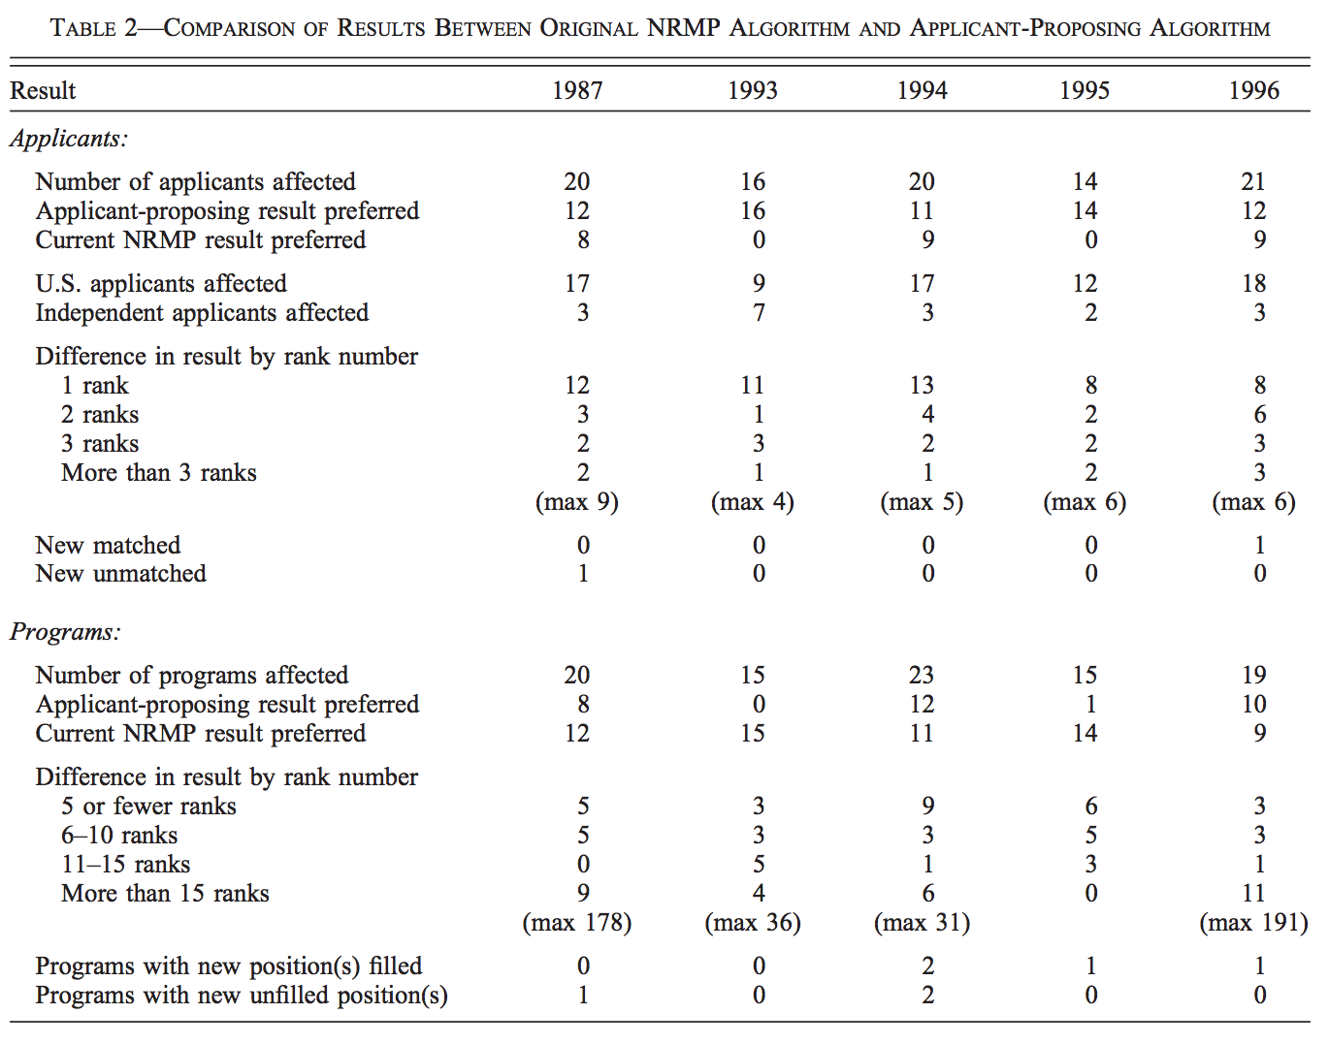
Results of the New Algorithm

Slide 16
Is the Change Worth It?
0.1% of applicants affected
Most of those affected prefer the new algorithm
0.5% of programs affected
Most of those affected prefer the old algorithm
This does not imply the associated change in welfare is small
  Large increase for affected applicants
  Small decrease for the affected programs

Slide 17
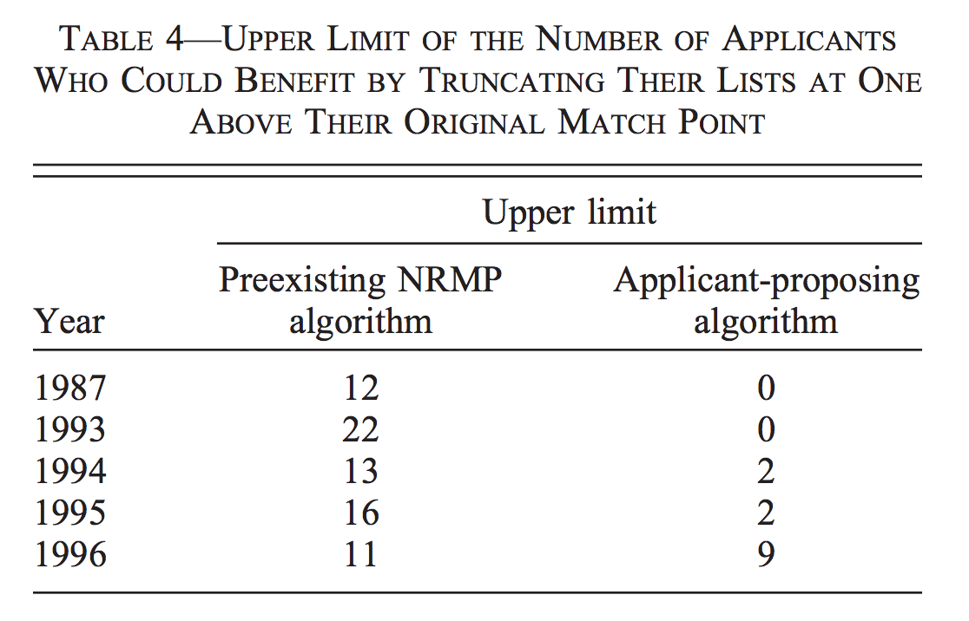
Strategic Behavior of Participants
Notes:
Assumes fill knowledge
- if they truncate one more than they should they could be not matched at all
- Extremely risky
Those that benefitted from ROL truncations were, for the most part, those who did differently when the algorithm was changed from their side proposing to the other side proposing.

Slide 18
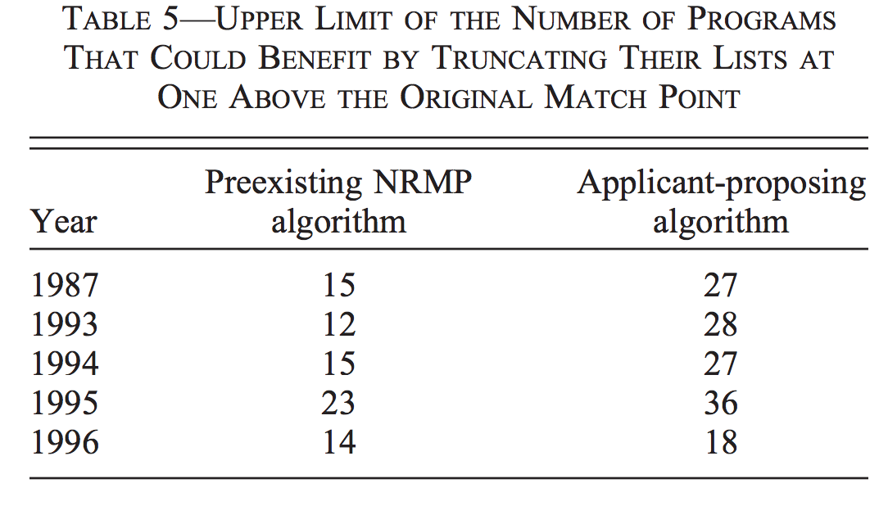
Strategic Behavior of Programs

Slide 19
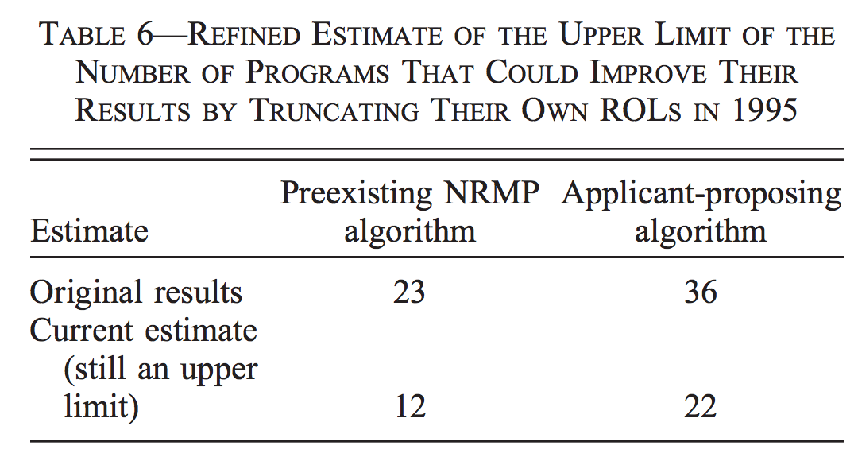
Strategic Behavior of Programs
Notes:
Very small number of programs could improve their remaining matches by reducing their quotas.
Not an advisable strategy for either algorithm

Slide 20
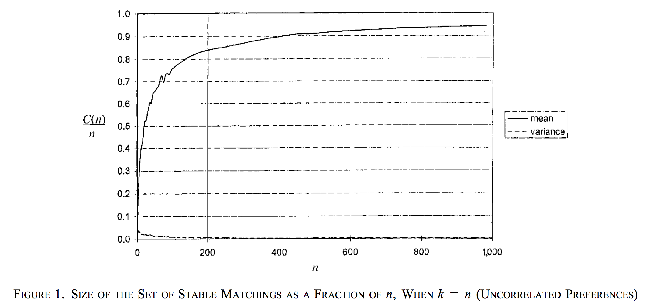
Market Size and Stable Matchings
Notes:
Assumes no correlation between preferences

Slide 21
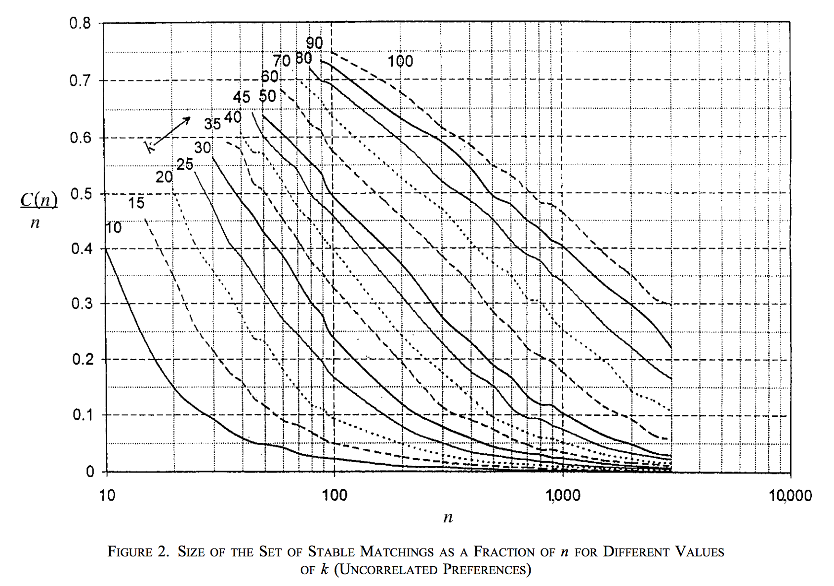
Number of Interviews
Notes:
The orders of magnitude of the effects studies in the actual matches are very comparable to what we should expect of simple matches with similar values of k and n.
Simple markets turn out to provide good approximations for the direction of the effects we are seeing and the size of the effects

Slide 22
Thank You

