Slide 1
Quick reviews / corrections

Slide 2
Question Review 4
Important lesson: Authentication does not imply encryption
Second lesson: pay attention to the definition

Slide 3
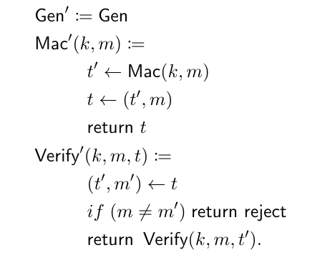
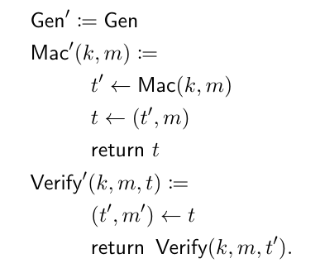
Some people would have said that the left is an authentication scheme and the right one isn’t

Slide 4


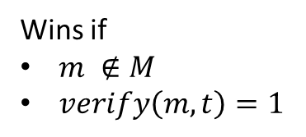





Mac forgery game
$$M ←\{\}$$
k $∈_{R}{\left\{0,1\right\}}^{s}$
$$m′$$
$$M←M∪\{m′\}$$
Repeat as many times
as the adversary wants
$$t′$$
$$t′ ←mac_{k}(m′)$$
$$(m,t)$$
Wins if
$m ∉M$
$verify\left(m,t\right)=1$

Slide 5
Some people would have said that the left is an authentication scheme and the right one isn’t
We can take a mac that is accepted on the right side
and easily turn it into a mac on the left

Slide 6

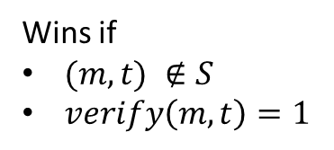


Strong version of the mac forgery game
$$S ←\{\}$$
k $∈_{R}{\left\{0,1\right\}}^{s}$
$$m′$$
$$t′ ←mac_{k}(m′)$$
Repeat as many times
as the adversary wants
$$t′$$
$$S←S∪\{(m^{′},t^{′})\}$$
$$(m,t)$$
Wins if
$(m,t) ∉S$
$verify\left(m,t\right)=1$

Slide 7
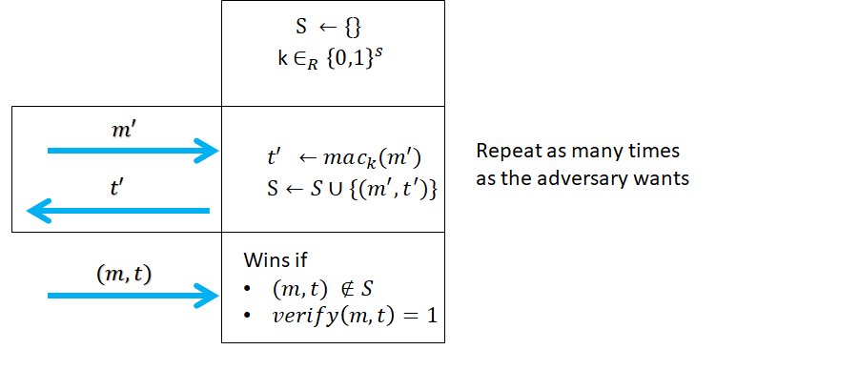
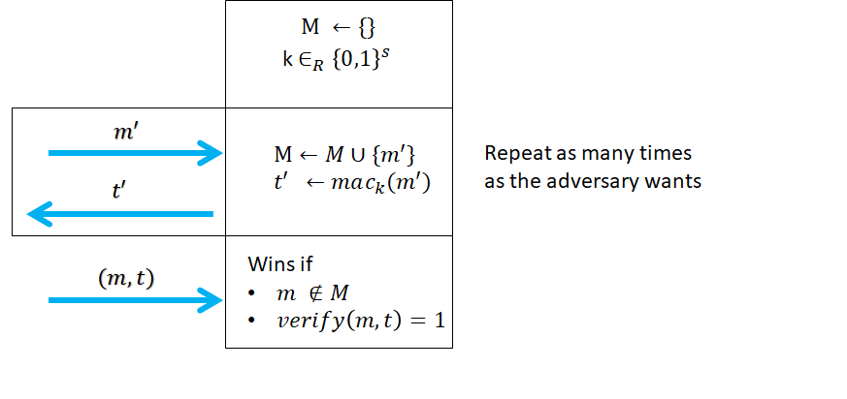
Mac game comparison
If a scheme (gen,mac,verify) is a strong mac scheme then it is also a mac scheme, the other way does not hold

Slide 8
According to the definition of strong authentication
If (Gen,Mac,Verify) is a strong mac
then the left scheme is a strong mac scheme but
not the right scheme

Slide 9
Interesting lesson
Some definitions of security for a task are stronger.
Depending on your variant of a definitions
  a schemes can be considered secure depending on which definition you use
We say that definition A implies definition B (A>B) if every scheme which satisfies definition A also satisfies definition B
  CCA => CPA
  CPA => distinguishability
  Strong authentication => weak authentication
You need precisely to look at a definition to see if a scheme fulfills or not

Slide 10
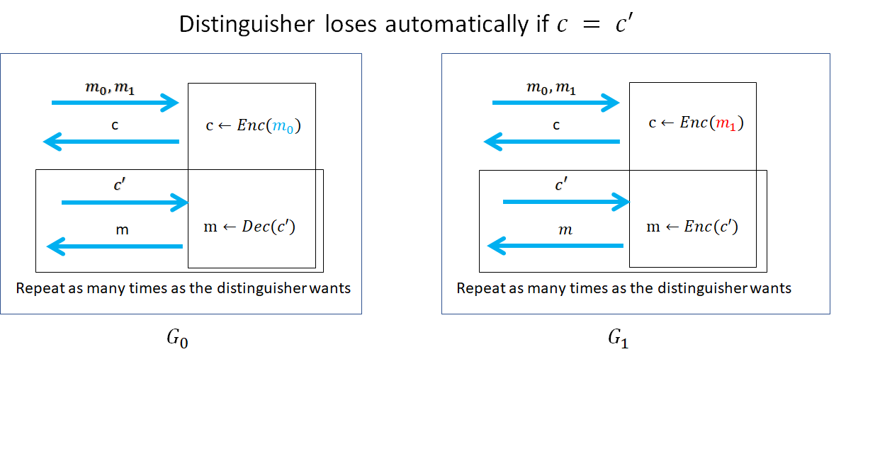
CCA game (chosen ciphertext)
In the CCA game the adversary also gets to encrypt messages of his choice

Slide 11
Groups, fields, primes

Slide 12
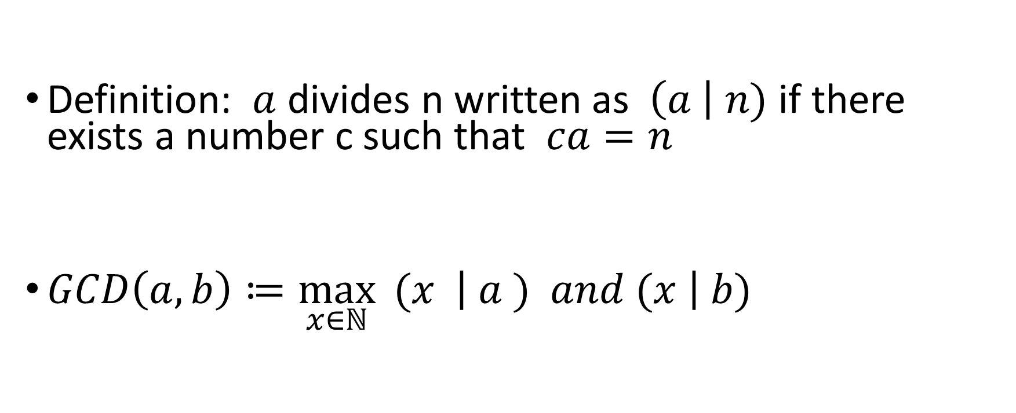
Divisibility
Definition: $a$ divides n written as$\left(a \right| n)$ if there exists a number c such that $ca=n$
$GCD\left(a,b\right)≔\max_{x∈ℕ}{ (x \left| a ) and (x \right| b)}$

Slide 13

Finding the GCD
$\text{If} (b | a) \text{then} GCD\left(a,b\right)=b$
$GCD(a,b) = GCD(max⁡(a,b),min⁡(a,b))$
(a>b)$⇒ GCD\left(a,b\right)=GCD(a−b,b)$

Slide 14

Simple algorithm for GCD
GCD(a,b)
if $(a<b)$
$return GCD(b,a)$
if $(a \% b == 0)$
return $b;$
return$GCD(a−b,b)$

Slide 15
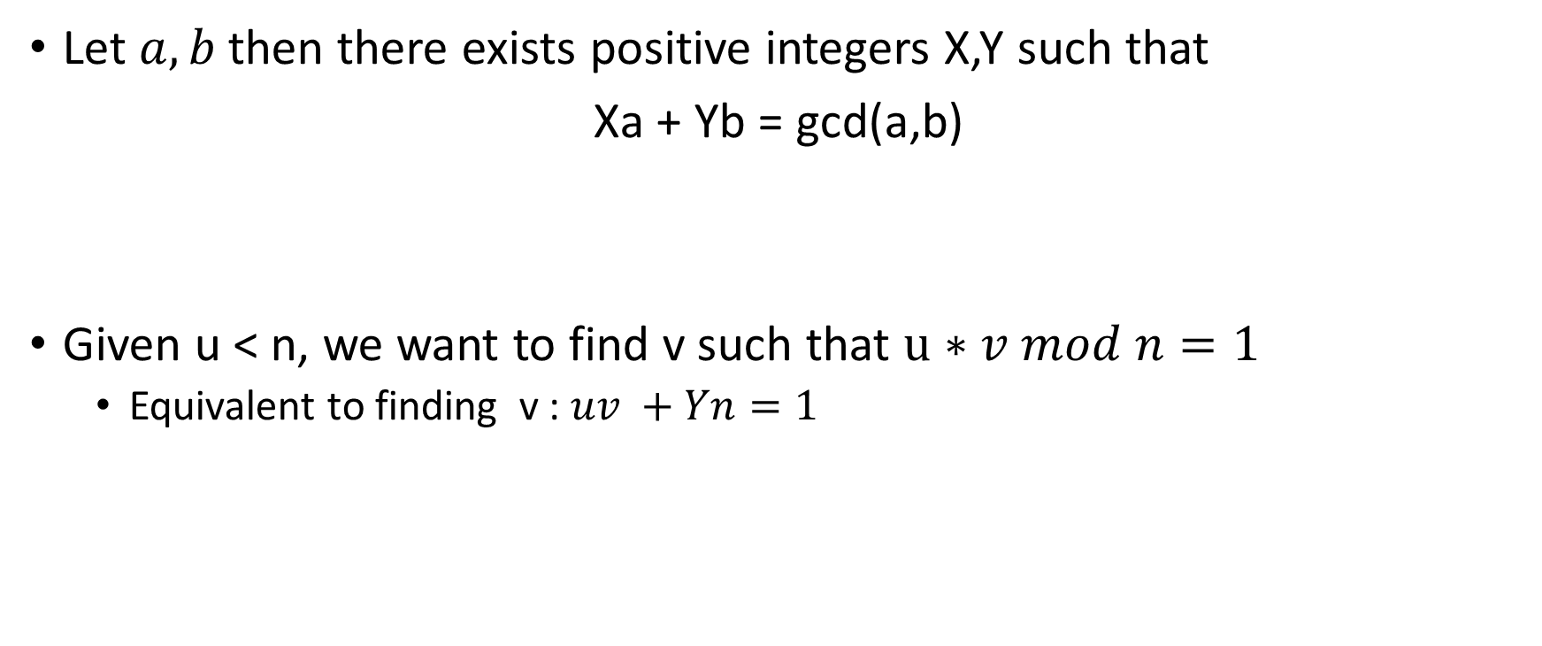
Proposition 8.3
Let $a,b$then there exists positive integers X,Y such that
Xa + Yb = gcd(a,b)
Given u < n, we want to find v such that $u∗v mod n=1$
  Equivalent to finding v : $uv +Yn=1$

Slide 16

Simple algorithm for GCD
GCD(a,b)
if $(a \% b == 0)$
return $b$
if $(a<b)$
return$GCD(a,b)$
return$GCD(b, a \% b)$

Slide 17

Extended GCD algorithm
Same as GCD except that for a,b we also want to find
We also want to find $X,Y$such that $aX+bY = GCD(a,b)$
Help us find inverse
  Given u < n, we want to find v such that $u∗v mod n=1$
  Equivalent to finding v : $uv +Yn=1$
  Can use EGC to find v

Slide 18
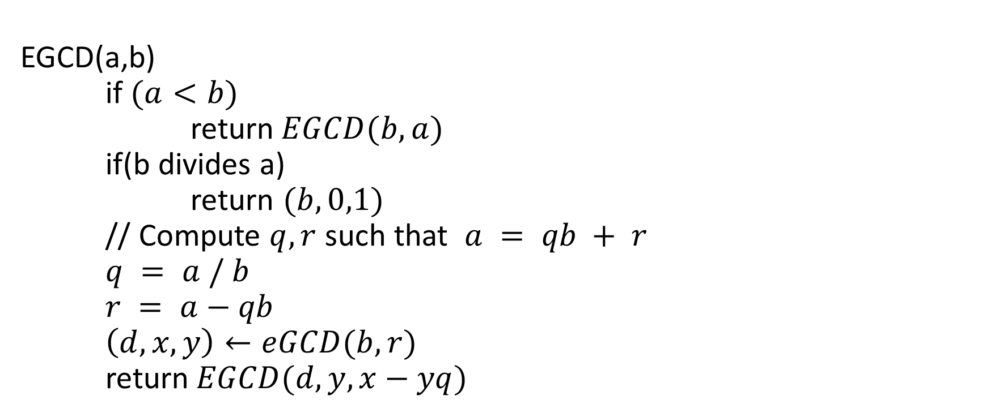
Extended GCD algorithm
EGCD(a,b)
if $(a<b)$
return$EGCD(b,a)$
if(b divides a)
return $(b,0,1)$
// Compute $q,r$ such that $a = qb + r$
$q = a / b$
$r = a−qb$
$\left(d,x,y\right)←eGCD(b,r)$
return$EGCD(d, y,x−yq)$

Slide 19

Multiplicative inverse
The multiplicative inverse of x in $Z_{n}$
$y∈ Z_{n}$ such that $x× y = 1 (mod n)$

Slide 20

Relatively prime
We say that two numbers $a,b$ are relatively prime (co-prime)
$GCD(a,b) = 1$
Examples
15,32
24, 35
Non-example
2,14
3, 183

Slide 21

Theorem on relatively prime
If $a>b$ then there exists unique $p, r < a$
$a=bq + r$

Slide 22
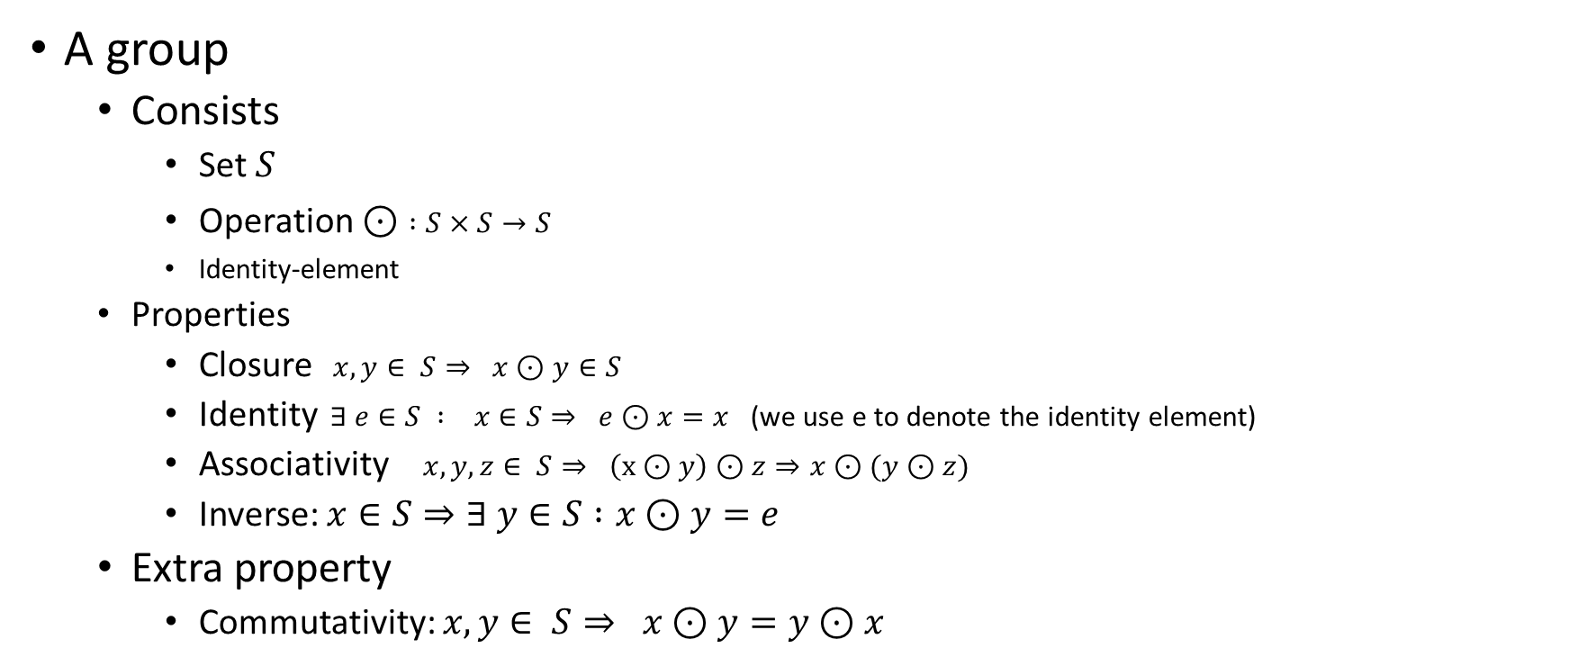
Group
A group
  Consists
    Set $S$
    Operation $⊙$ $:S×S→S$
    Identity-element
  Properties
    Closure $x,y∈ S⇒ x⊙y∈S$
    Identity $∃ e∈S : x∈S⇒ e⊙x=x$ (we use e to denote the identity element)
    Associativity $x,y,z∈ S⇒ \left(x⊙y\right)⊙z⇒x⊙(y⊙z)$
    Inverse: $x∈S⇒∃ y∈S :x⊙y=e$
  Extra property
    Commutativity: $x,y∈ S⇒ x⊙y=y⊙x$

Slide 23

Examples of groups
${(Z}_{n},+)$ is a group where + is addition mod n
  Closure $x,y∈ Z_{n} => x+y∈ Z_{n}$
  Identity e = 0, we have that x+0 = x
  Associativity x+y+z = (x + y) + z = x + (y+z)
  Inverse : x + (n-x) = 0

Slide 24
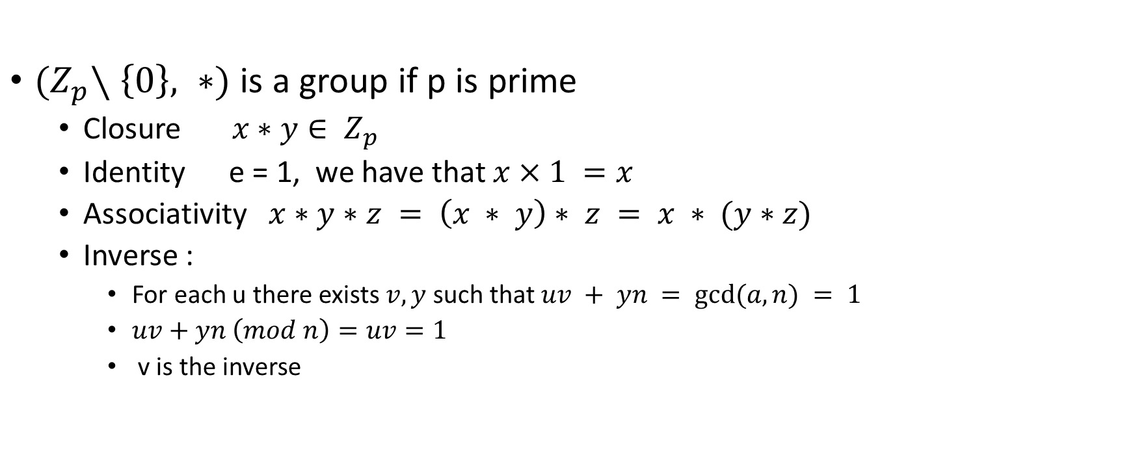
Examples of group
${(Z}_{p}∖\left\{0\right\}, ∗)$ is a group if p is prime
  Closure $x∗y∈ Z_{p}$
  Identity e = 1, we have that $x×1 =x$
  Associativity $x∗y∗z = \left(x ∗ y\right)∗ z = x ∗ (y∗z)$
  Inverse :
    For each u there exists $v,y$such that $uv + yn = gcd⁡(a,n) = 1$
    $uv+yn \left(mod n\right)=uv=1$
    v is the inverse

Slide 25
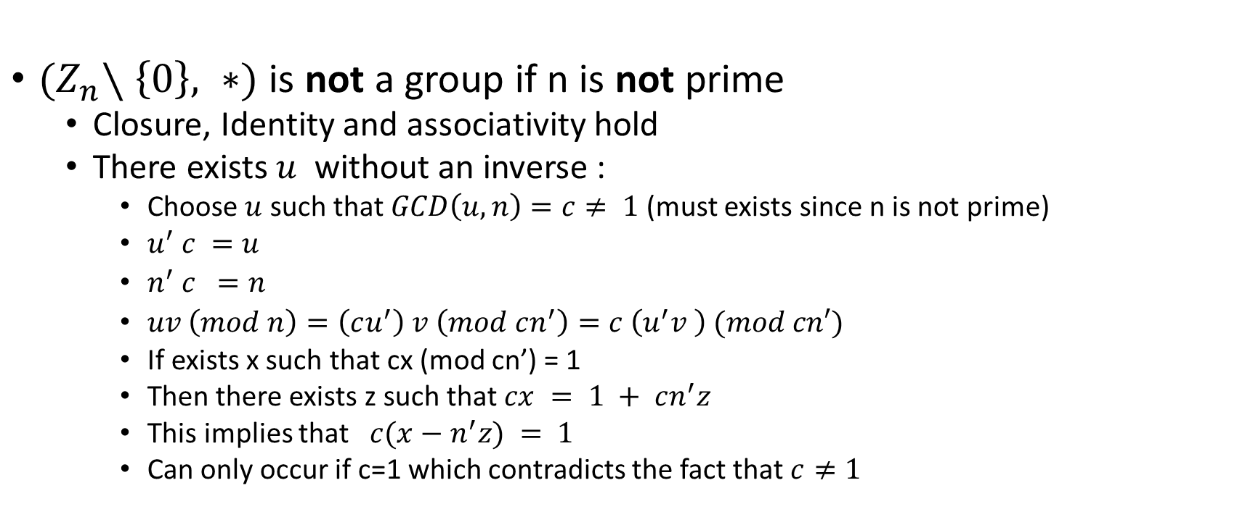
Examples of group
${(Z}_{n}∖\left\{0\right\}, ∗)$ is not a group if n is not prime
  Closure, Identity and associativity hold
  There exists $u$ without an inverse :
    Choose $u$ such that $GCD\left(u,n\right)=c≠ 1$(must exists since n is not prime)
    $u^{′} c =u$
    $n^{′} c =n$
    $uv \left(mod n\right)=\left(cu^{′}\right) v \left(mod cn^{′}\right)=c \left(u^{′}v \right) (mod cn′)$
    If exists x such that cx (mod cn’) = 1
    Then there exists z such that $cx = 1 + cn^{′}z$
    This implies that $c(x−n^{′}z) = 1$
    Can only occur if c=1 which contradicts the fact that $c≠1$

Slide 26
Examples of group
Examples of group
  Numbers with addition
  Real with addition
  Rationals with addition
Non-group
  Positive numbers under addition (no inverse)
  Odd numbers (not closed under addition)

Slide 27
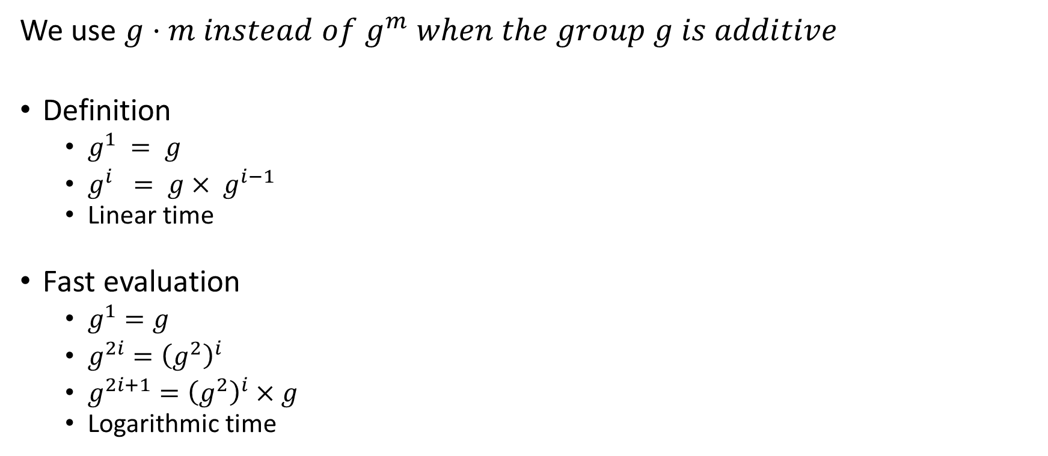
Exponential in groups
We use $g⋅m instead of g^{m} when the group g is additive$
Definition
  $g^{1} = g$
  $g^{i} = g× g^{i−1}$
  Linear time
Fast evaluation
  $g^{1}=g$
  $g^{2i}={\left(g^{2}\right)}^{i}$
  $g^{2i+1}={\left(g^{2}\right)}^{i}×g$
  Logarithmic time

Slide 28

Properties of group
Let $G≔ (S, ⋅)$ be a group, $|G| = |S| = m$ and let $g∈ S$
  Theorem: $g^{m}=1$
  Theorem: $g^{x}=g^{x mod m}$

Slide 29
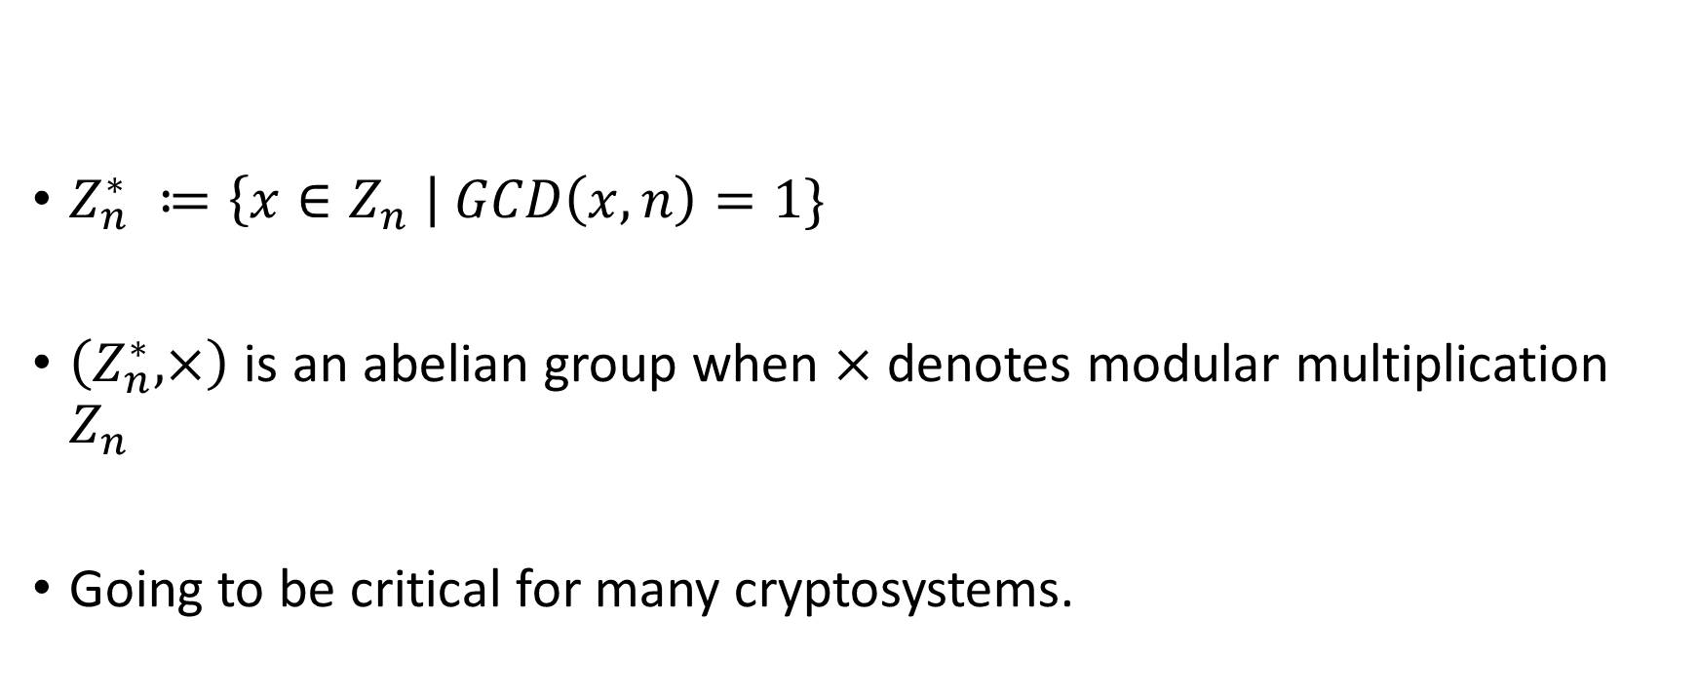

$$Z_{n}^{∗}$$
$Z_{n}^{∗} ≔\left\{x∈Z_{n} \right| GCD\left(x,n\right)=1\}$
$\left(Z_{n}^{∗},×\right)$ is an abelian group when $×$ denotes modular multiplication $Z_{n}$
Going to be critical for many cryptosystems.

Slide 30
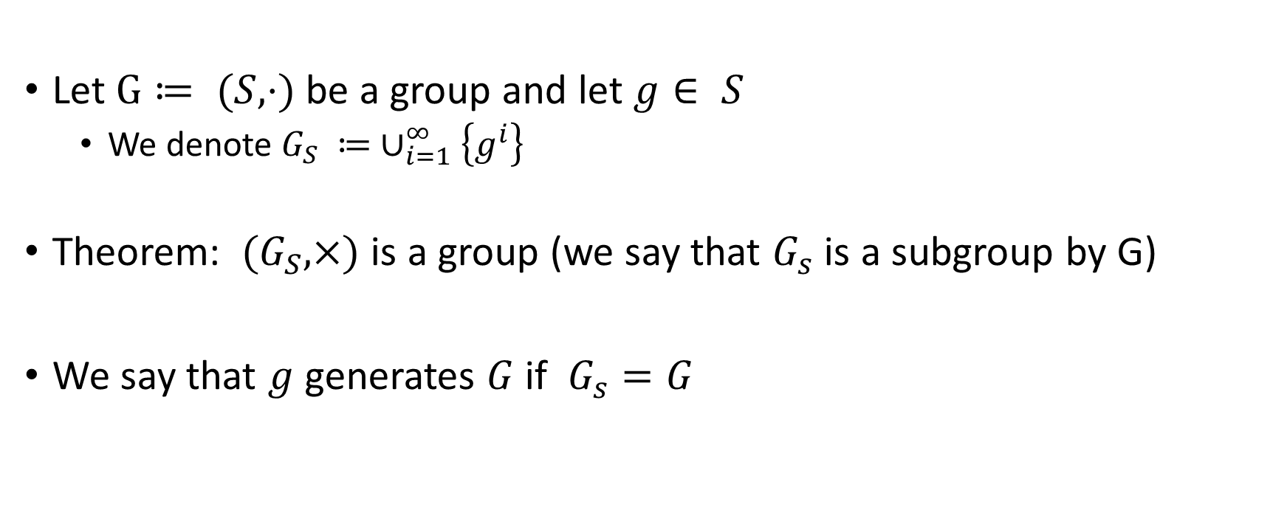
Subgroup generated from an element
Let $G≔ (S, ⋅)$ be a group and let $g∈ S$
  We denote $G_{S} ≔ ∪_{i=1}^{∞}\left\{g^{i}\right\}$
Theorem: ${(G}_{S},×)$ is a group (we say that $G_{s}$ is a subgroup by G)
We say that $g$ generates $G$ if $G_{s}=G$

Slide 31
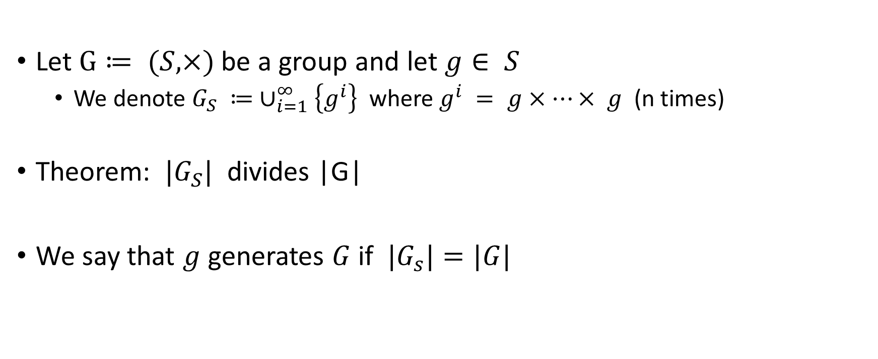
Subgroup generated from an element
Let $G≔ (S, ×)$ be a group and let $g∈ S$
  We denote $G_{S} ≔ ∪_{i=1}^{∞}\left\{g^{i}\right\}$ where $g^{i} = g×⋯× g$ (n times)
Theorem: ${|G}_{S}|$ divides |G|
We say that $g$ generates $G$ if ${|G}_{s}|=|G|$

Slide 32
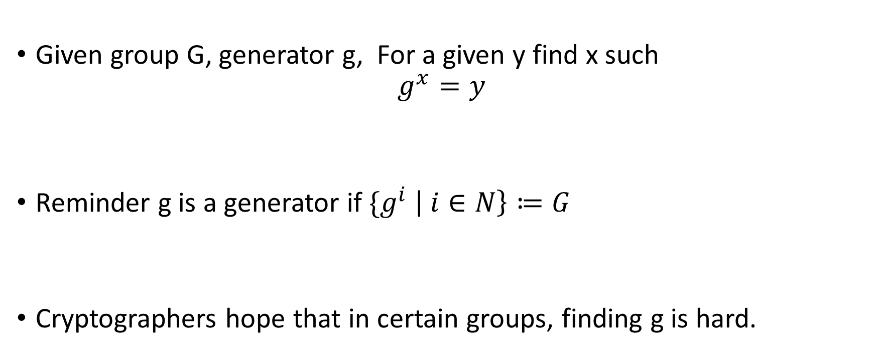
Discrete logarithm
Given group G, generator g, For a given y find x such
$$g^{x}=y$$
Reminder g is a generator if ${\{g}^{i} \left| i∈N\right\}≔G$
Cryptographers hope that in certain groups, finding g is hard.

Slide 33
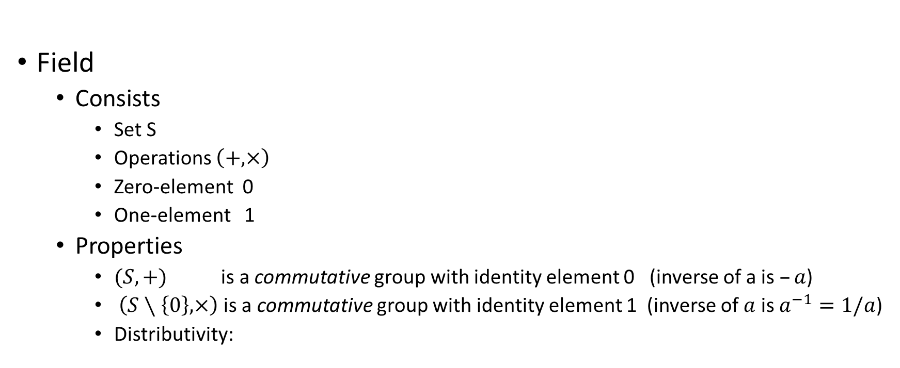
Field
Field
  Consists
    Set S
    Operations $\left(+,×\right)$
    Zero-element 0
    One-element 1
  Properties
    $(S,+)$ is a commutative group with identity element 0 (inverse of a is $–a$)
    $\left(S∖\left\{0\right\},×\right)$ is a commutative group with identity element 1 (inverse of $a$ is $a^{−1}=1/a$)
    Distributivity:

Slide 34

Example of field
$(Z_{p},+,∗)$ is a field if p is prime
  Distributivity $a∗(b+c) = ab + ac$
$(Z_{p},+,∗)$ is not a field if p is not prime

Slide 35
Message authentication code
Worked because it was a field
Did not work when it was not a field

Slide 36

Are there finite fields that do not have prime size
Yes
Conditions:
  Every finite field must have size of the form $p^{k}$
  For every such size there exists such a finite field

Slide 37
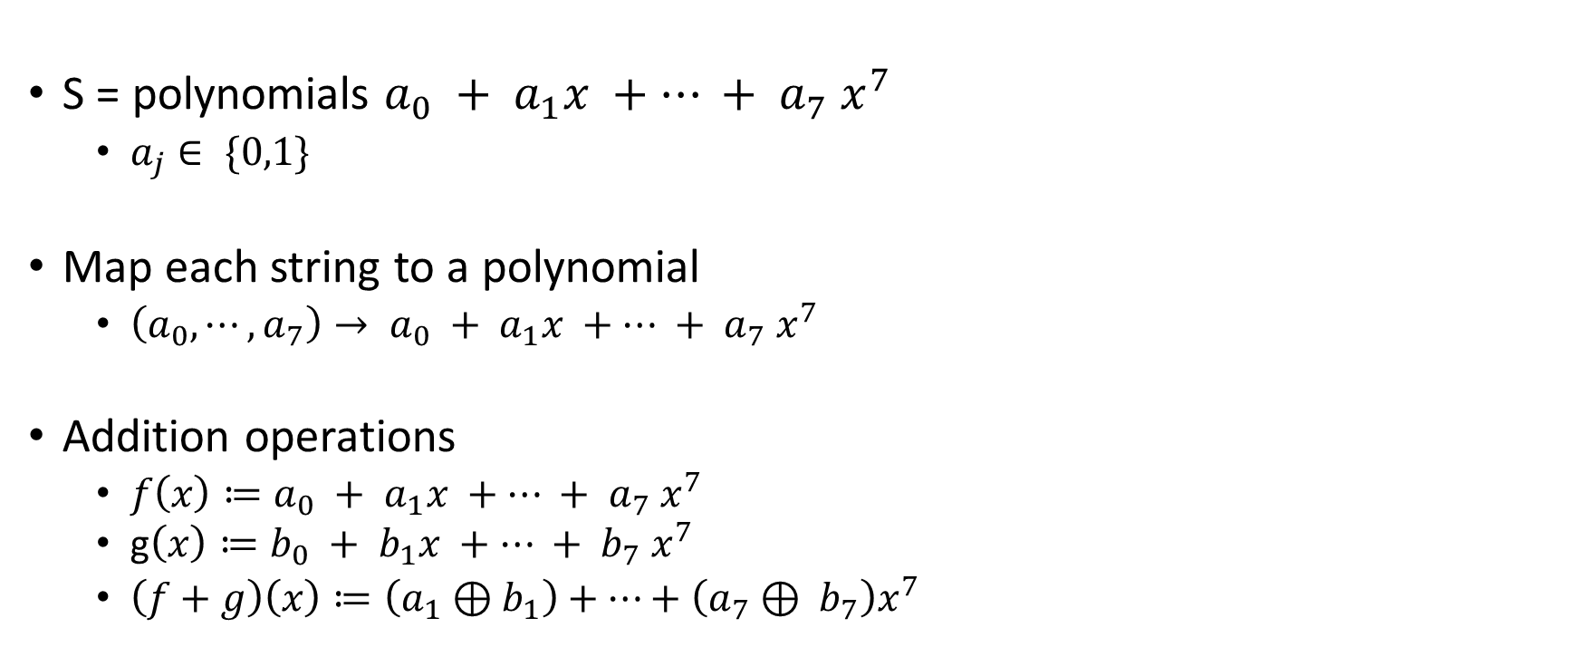

Finite Fields for $2^{8}$
S = polynomials $a_{0} + a_{1}x +⋯ + a_{7} x^{7}$
  $a_{j}∈ \{0,1\}$
Map each string to a polynomial
  $\left(a_{0},⋯,a_{7}\right)→ a_{0} + a_{1}x +⋯ + a_{7} x^{7}$
Addition operations
  $f\left(x\right)≔a_{0} + a_{1}x +⋯ + a_{7} x^{7}$
  g$\left(x\right)≔b_{0} + b_{1}x +⋯ + b_{7} x^{7}$
  $\left(f+g\right)\left(x\right)≔\left(a_{1}⊕b_{1}\right)+⋯+\left(a_{7}⊕ b_{7}\right)x^{7}$

Slide 38

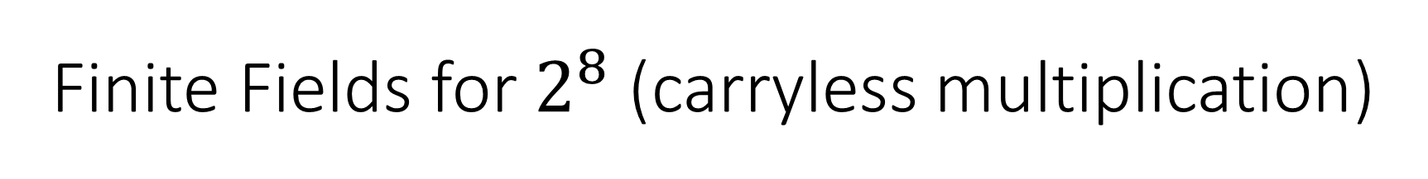
Finite Fields for $2^{8}$ (carryless multiplication)
$f(x) = x+1$
$g(x) = x+1$
$\left(x+1\right)×\left(x+1\right)= x\left(x+1\right)⊕\left(x+1\right)$
$$= {(x}^{2}+x)⊕(x+1)=x^{2}+1$$
Difference
$\left(x+1\right)× \left(x+1\right)= x+1→5$
$3 ∗3=9$

Slide 39
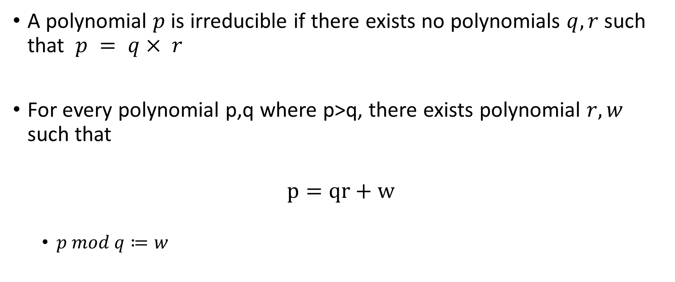
Irreducible polynomial
A polynomial $p$ is irreducible if there exists no polynomials $q,r$such that $p = q× r$
For every polynomial p,q where p>q, there exists polynomial $r,w$ such that
$$p=qr+w$$
  $p mod q≔w$

Slide 40
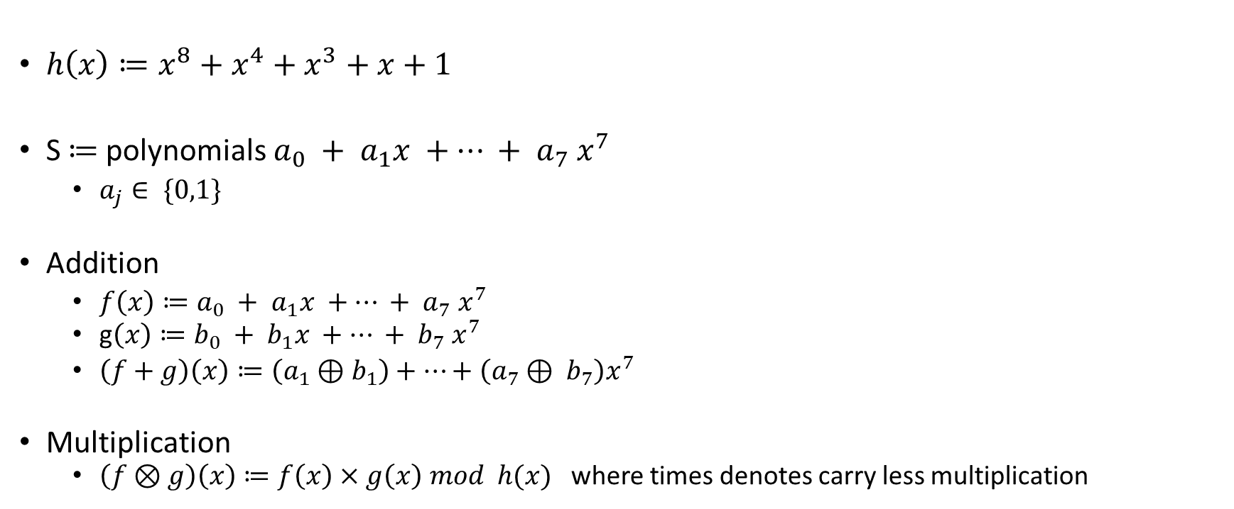
Field 256 (used for AES, MACS, etc)
$h\left(x\right)≔x^{8}+x^{4}+x^{3}+x+1$
S$≔$polynomials $a_{0} + a_{1}x +⋯ + a_{7} x^{7}$
  $a_{j}∈ \{0,1\}$
Addition
  $f\left(x\right)≔a_{0} + a_{1}x +⋯ + a_{7} x^{7}$
  g$\left(x\right)≔b_{0} + b_{1}x +⋯ + b_{7} x^{7}$
  $\left(f+g\right)\left(x\right)≔\left(a_{1}⊕b_{1}\right)+⋯+\left(a_{7}⊕ b_{7}\right)x^{7}$
Multiplication
  $\left(f⊗g\right)\left(x\right)≔f\left(x\right)×g\left(x\right) mod h(x)$ where times denotes carry less multiplication

