Slide 1
Homework #2

Slide 2

Question 2.1
Show that $\frac{1}{p\left(n\right)}$ + $μ\left(n\right)$ is non-negligible
$μ\left(n\right)+\frac{1}{p\left(n\right)}>\frac{1}{p\left(n\right)}$
Since $\frac{1}{p\left(n\right)}$ is non-negligible so is $μ\left(n\right)+\frac{1}{p\left(n\right)}$

Slide 3

Question 2.1
Show that $\frac{1}{p\left(n\right)}$ - $μ\left(n\right)$ is non-negligible
$μ\left(n\right)∈O(\frac{1}{2 ∗ p\left(n\right)})$
$∃n^{′} ∀ m>n^{′} : \frac{1}{2 ∗ p\left(m\right)}>μ\left(m\right)$
$∃n^{′} ∀ m>n^{′} :$ $\frac{1}{p\left(m\right)}$ - $μ\left(m\right)>\frac{1}{2p(m)}$
$\frac{1}{p\left(n\right)}$ - $μ\left(n\right)∈O(1/p(n))$

Slide 4
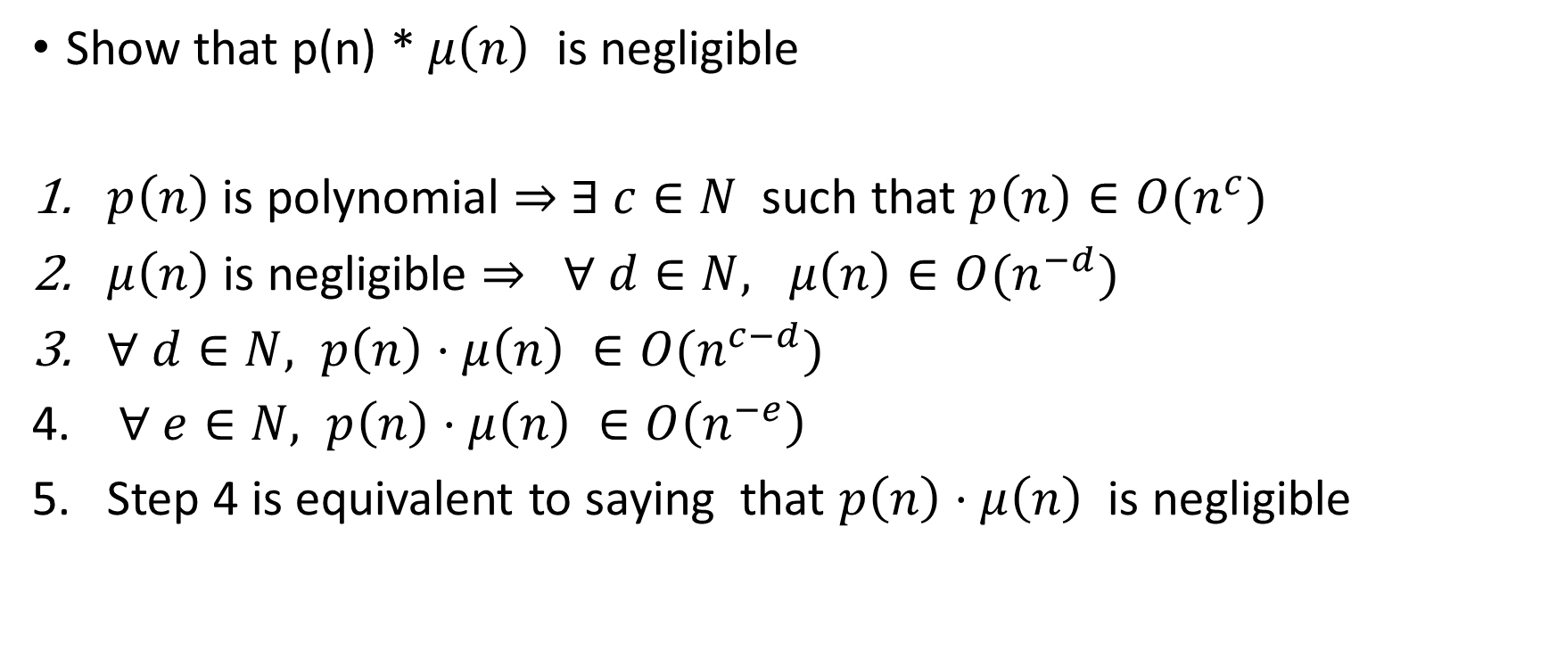
Question 2.2
Show that p(n) * $μ\left(n\right)$ is negligible
$p\left(n\right)$ is polynomial $⇒$ $∃ c∈N$ such that $p\left(n\right)∈O(n^{c})$
$μ\left(n\right)$ is negligible $⇒ ∀ d∈N, μ\left(n\right)∈O(n^{−d})$
$∀ d∈N, p\left(n\right)⋅μ\left(n\right) ∈O(n^{c−d})$
$∀ e∈N, p\left(n\right)⋅μ\left(n\right) ∈O\left(n^{−e}\right)$
Step 4 is equivalent to saying that $p\left(n\right)⋅μ\left(n\right)$ is negligible

Slide 5
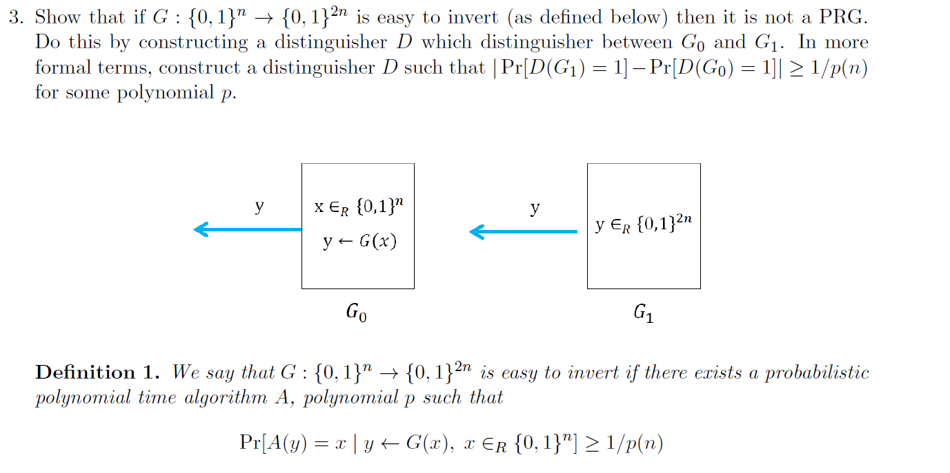
Question 3

Slide 6
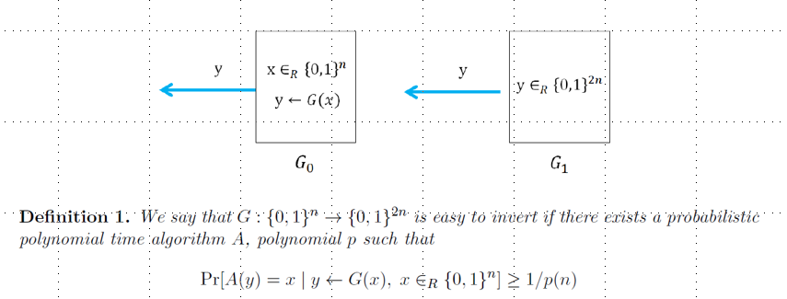





Question 3
Description of distinguisher
$$z$$
$$x←A(y)$$
$$y$$
$$z←g\left(x\right)≠y$$

Slide 7
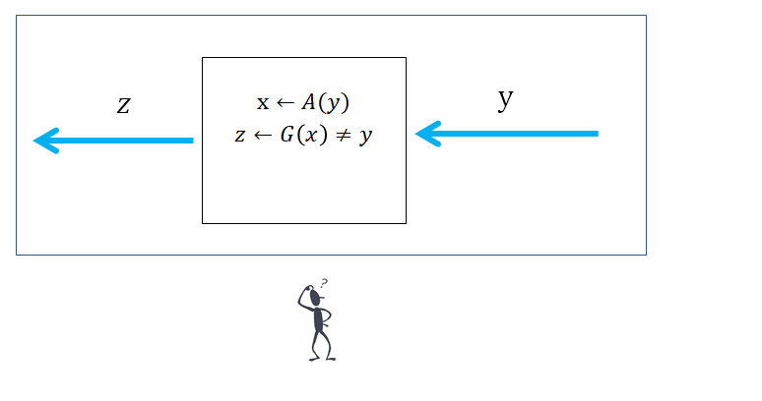

Question 3
$Pr⁡[D\left(G_{0}\right)=1)]≤1 −1/p(n)$
  $D\left(G_{0}\right)=0$ only when $g(A(y)) = y$
  $\operatorname{Pr}\left[g\left(A\left(y\right)\right)= y\right]≥1/p(n)$
  $\operatorname{Pr}\left[D\left(G_{0}\right)=0\right]≥1/p\left(n\right)$
  $\operatorname{Pr}\left[D\left(G_{0}\right)=1\right]≤1 −1/p(n)$

Slide 8

Question 3
$Pr⁡[D\left(G_{1}\right)=1)]≥1 −1/2^{n}$
  $D\left(G_{1}\right)=0$ only when $g(A(y)) = y$
  $\operatorname{Pr}\left[g\left(A\left(y\right)\right)= y\right]≤\operatorname{Pr}\left[g^{−1}\left(y\right)≠ ⊥\right]$
  $\operatorname{Pr}\left[g^{−1}\left(y\right)≠ ⊥\right]≤2^{−n}$
  $\operatorname{Pr}\left[D\left(G_{1}\right)=0\right]≤2^{−n}$
  $\operatorname{Pr}\left[D\left(G_{1}\right)=1\right]≥1 −2^{−n}$

Slide 9
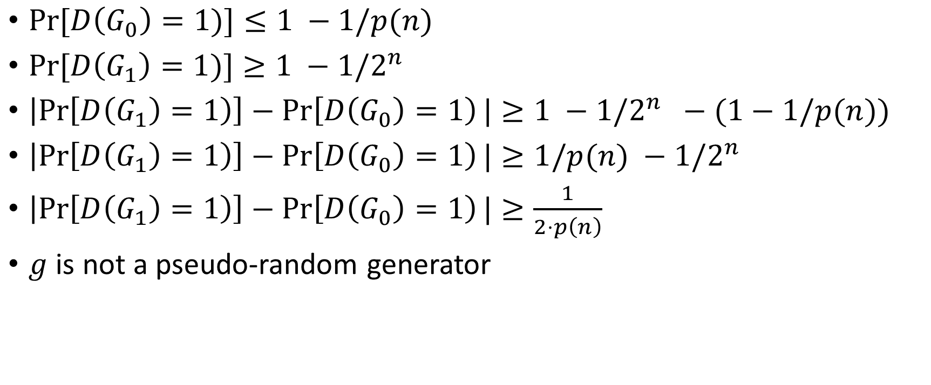
Question 3
$Pr⁡[D\left(G_{0}\right)=1)]≤1 −1/p(n)$
$Pr⁡[D\left(G_{1}\right)=1)]≥1 −1/2^{n}$
$\left|\operatorname{Pr}\left[D\left(G_{1}\right)=1\right)\right]−\operatorname{Pr}\left[D\left(G_{0}\right)=1\right)|≥1 −1/2^{n} −(1−1/p(n))$
$\left|\operatorname{Pr}\left[D\left(G_{1}\right)=1\right)\right]−\operatorname{Pr}\left[D\left(G_{0}\right)=1\right)|≥1/p(n) −1/2^{n}$
$\left|\operatorname{Pr}\left[D\left(G_{1}\right)=1\right)\right]−\operatorname{Pr}\left[D\left(G_{0}\right)=1\right)|≥\frac{1}{2⋅p\left(n\right)}$
$g$ is not a pseudo-random generator

Slide 10












$$G′(r) := G\left(r⊕ 1^{n}\right) is a PRG$$
$$r∈_{R}{\left\{0,1\right\}}^{n}$$
$$≈$$
$$y$$
$$r∈_{R}{\left\{0,1\right\}}^{n}$$
$$y$$
$$y←G(r⊕1^{n})$$
$$y←G(r)$$
$$≈$$
$$y$$
$$y∈_{R}{\left\{0,1\right\}}^{2n}$$
$≈$ := indistinguishable

Slide 11
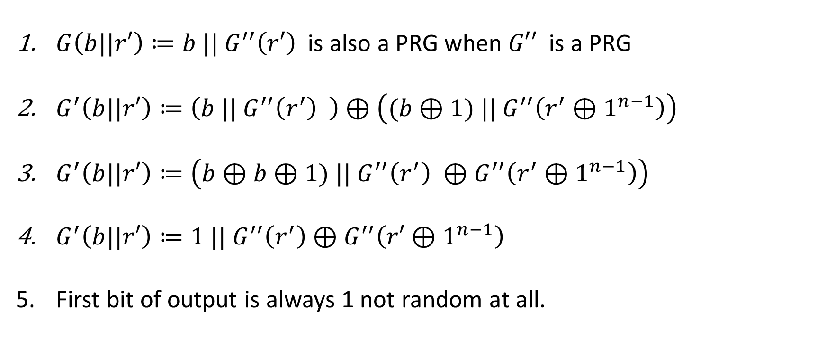
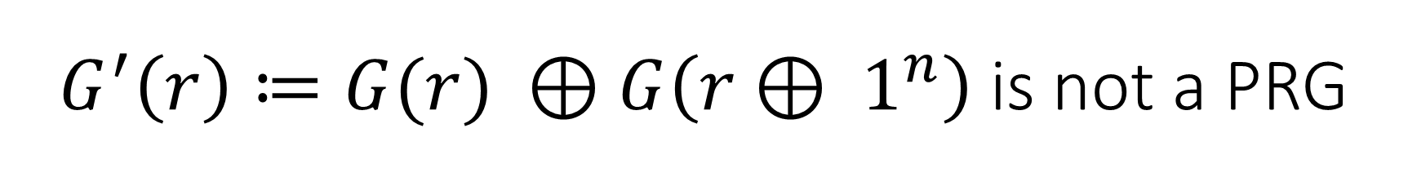
$G^{′}\left(r\right)≔G(r) ⊕G\left(r⊕ 1^{n}\right)$ is not a PRG
$G\left(b||r′\right)≔b || G^{′′}\left(r′\right)$ is also a PRG when $G′′$ is a PRG
$G^{′}\left(b||r′\right)≔\left(b || G^{′′}\left(r^{′}\right) \right)⊕\left((b⊕1) || G^{′′}\left(r^{′}⊕1^{n−1}\right)\right)$
$G^{′}\left(b||r′\right)≔\left(b⊕b⊕1) || G^{′′}\left(r^{′}\right) ⊕G^{′′}\left(r^{′}⊕1^{n−1}\right)\right)$
$G^{′}\left(b||r′\right)≔1 || G^{′′}\left(r^{′}\right)⊕G^{′′}\left(r′⊕1^{n−1}\right)$
First bit of output is always 1 not random at all.

Slide 12
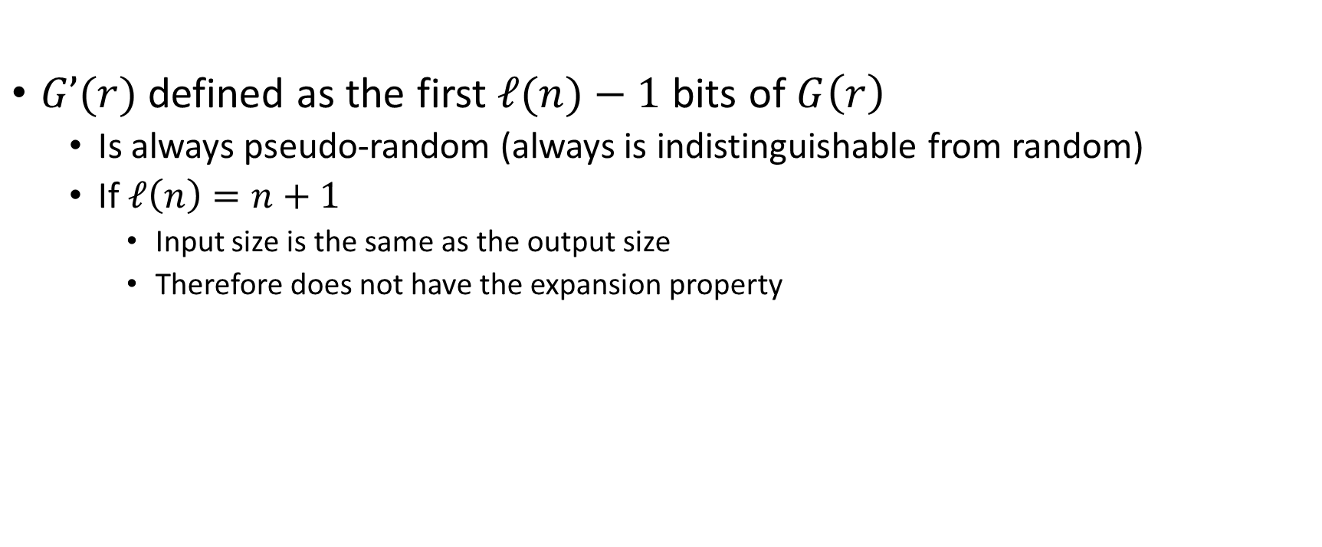
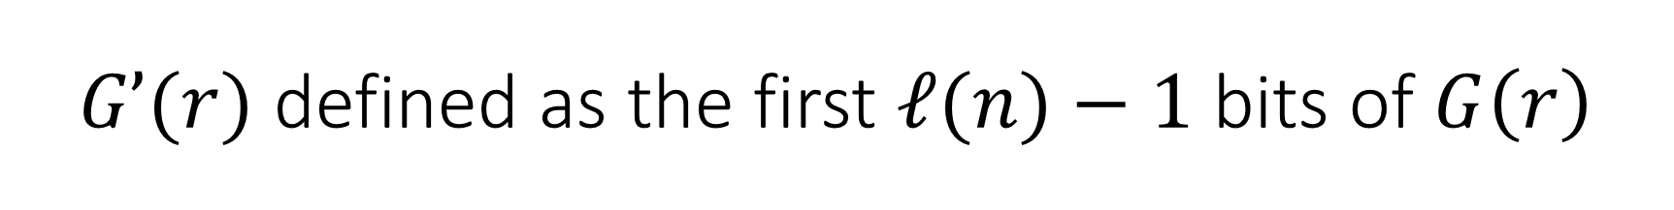
$G’(r)$ defined as the first $ℓ(n)−1$ bits of $G\left(r\right)$
$G’(r)$ defined as the first $ℓ(n)−1$ bits of $G\left(r\right)$
  Is always pseudo-random (always is indistinguishable from random)
  If $ℓ\left(n\right)=n+1$
    Input size is the same as the output size
    Therefore does not have the expansion property

Slide 13





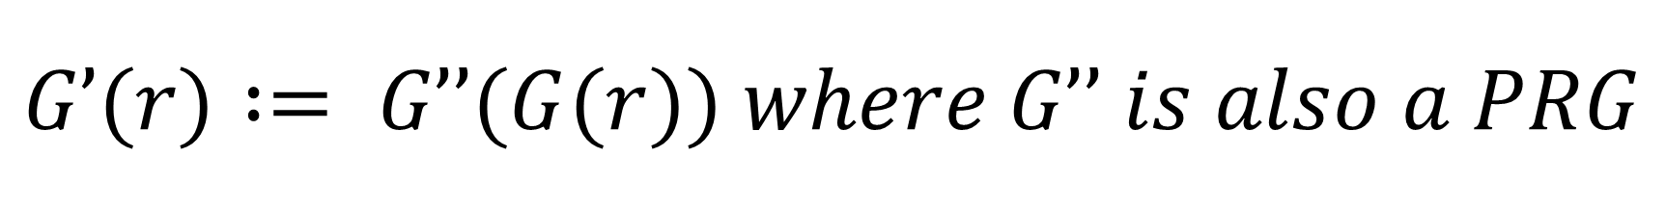






$$G’(r) := G’’(G(r)) where G’’ is also a PRG$$
$$r∈_{R}{\left\{0,1\right\}}^{n}$$
$$≈$$
$$y$$
$$r∈_{R}{\left\{0,1\right\}}^{ℓ(n)}$$
$$y$$
$$y←G′′(G(r))$$
$$y←G′′(r)$$
$$≈$$
$$y$$
$$y∈_{R}{\left\{0,1\right\}}^{ℓ′(n)}$$
$≈$ := indistinguishable

Slide 14
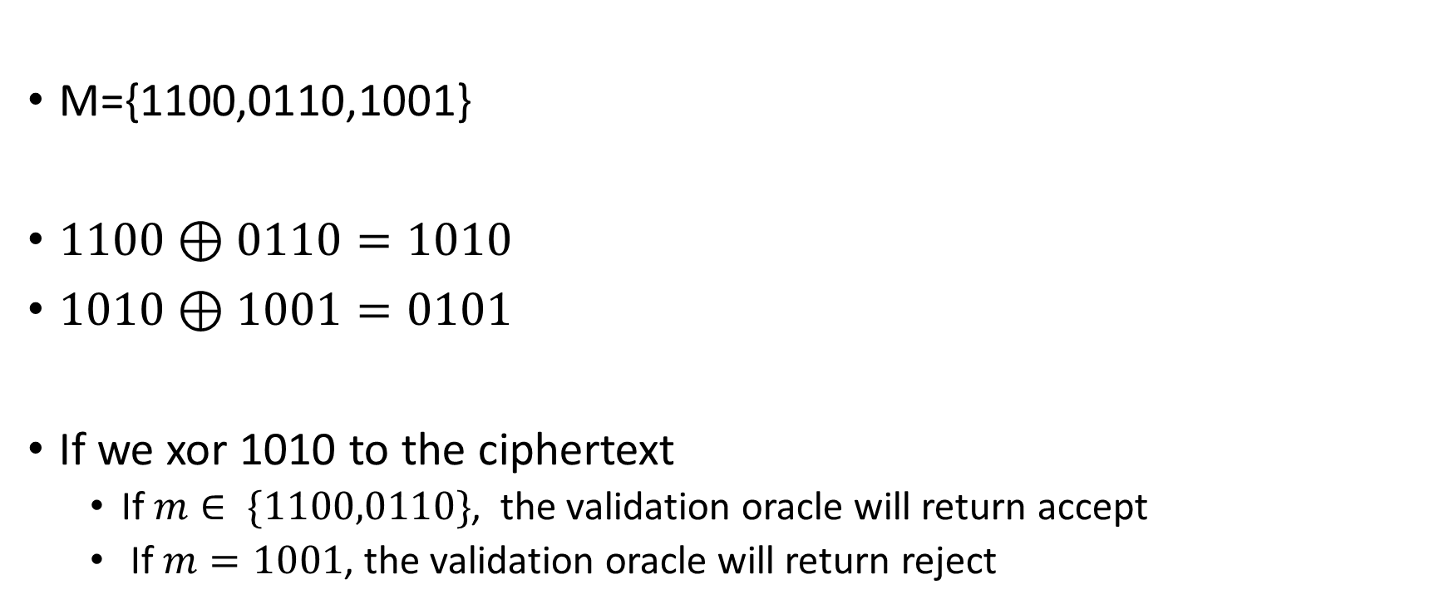
Question 5
M={1100,0110,1001}
$1100⊕0110=1010$
$1010⊕1001=0101$
If we xor 1010 to the ciphertext
  If $m∈ \{1100,0110\}$, the validation oracle will return accept
  If $m=1001$, the validation oracle will return reject

Slide 15
Question 6
Validation oracle always accepts since all messages are valid

Slide 16
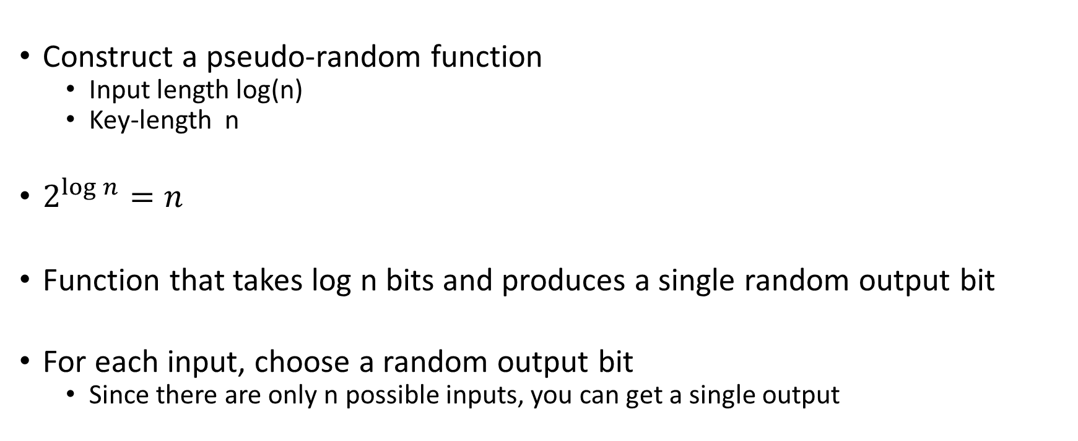
Question 3.9
Construct a pseudo-random function
  Input length log(n)
  Key-length n
$2^{\log{n}}=n$
Function that takes log n bits and produces a single random output bit
For each input, choose a random output bit
  Since there are only n possible inputs, you can get a single output

Slide 17
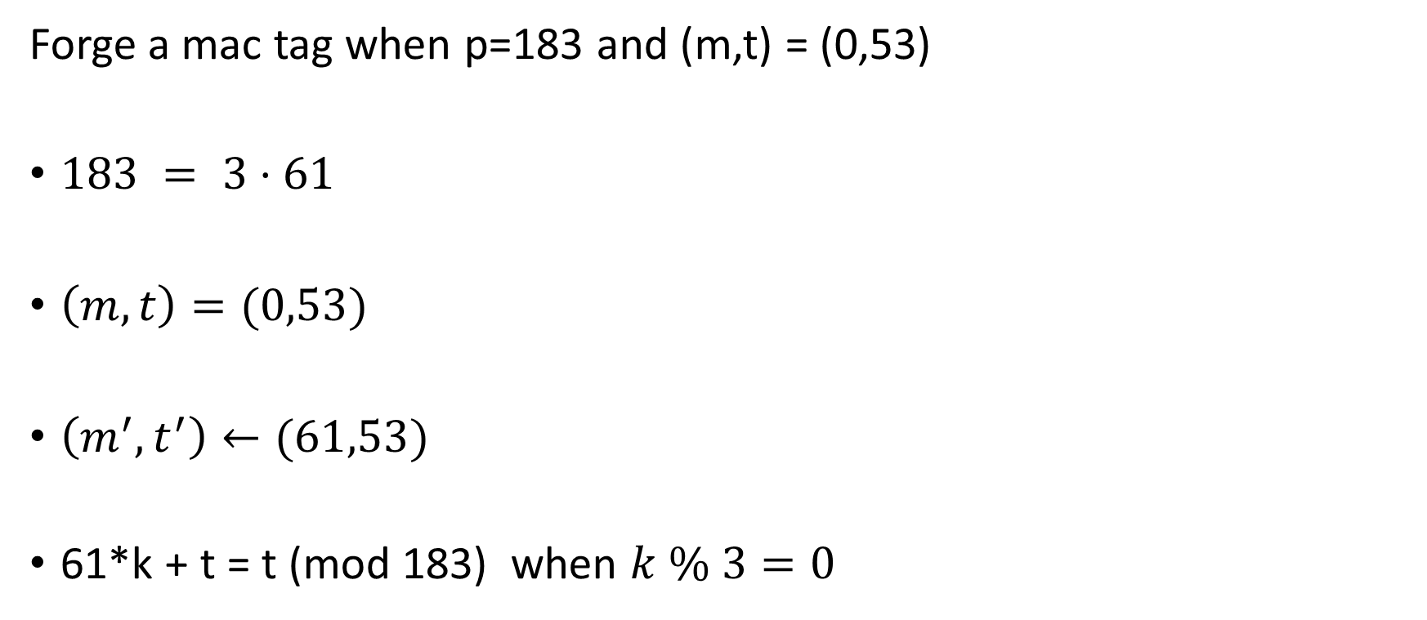
Question 8
Forge a mac tag when p=183 and (m,t) = (0,53)
$183 = 3⋅61$
$\left(m,t\right)=(0,53)$
$\left(m^{′},t^{′}\right)←(61,53)$
61*k + t = t (mod 183) when $k \% 3=0$

Slide 18
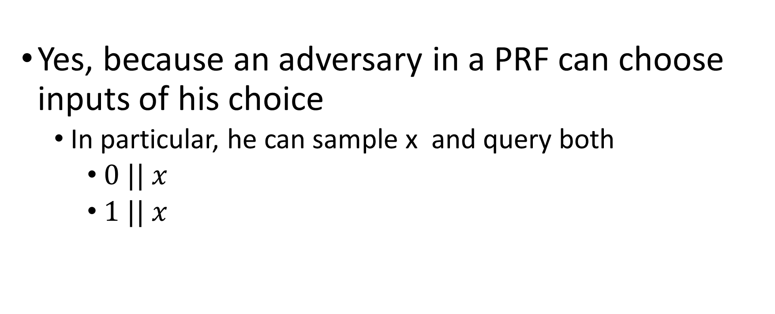

Is $F_{k}^{′}\left(x\right)≔F_{k}\left(0 || x\right)|| F_{k}\left(1||x\right)$ PRF?
Yes, because an adversary in a PRF can choose inputs of his choice
  In particular, he can sample x and query both
    $0 || x$
    $1 || x$

Slide 19

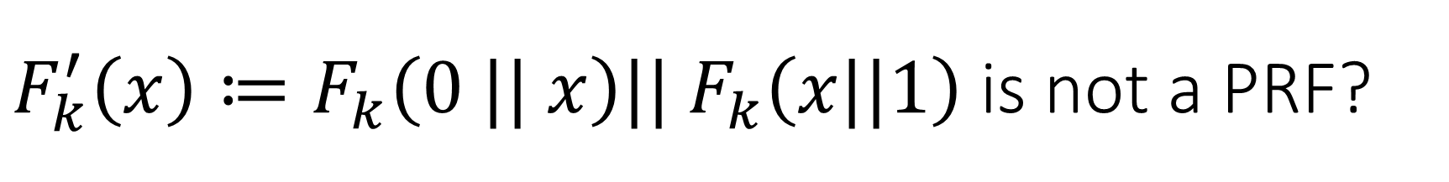
$F_{k}^{′}\left(x\right)≔F_{k}\left(0 || x\right)|| F_{k}\left(x||1\right)$ is not a PRF?
Choose $x$ such that $\left(0 || x\right)$ = $\left(x||1\right)$
Denote $x^{′}≔ \left(0 || x\right)$ = $\left(x||1\right)$
$F_{k}^{′}\left(x\right)=F_{k}\left(0 || x\right)|| F_{k}\left(x||1\right)=F_{k}\left(x′\right)|| F_{k}\left(x^{′}\right)=(c,c)$

Slide 20
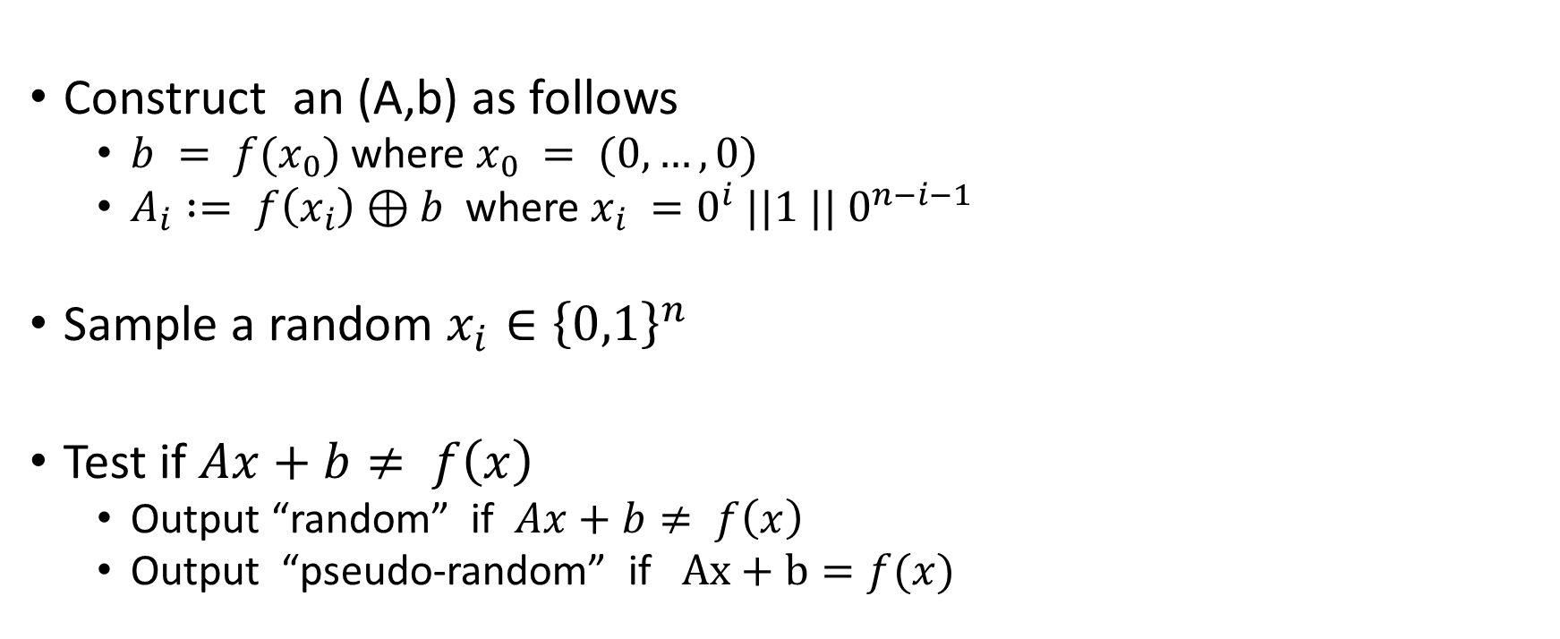
Show that Ax+b (mod 2) is not a pseudo-random function
Construct an (A,b) as follows
  $b = f(x_{0})$ where $x_{0} = (0,…,0)$
  $A_{i} := f\left(x_{i}\right)⊕b$ where $x_{i} =0^{i} ||1 || 0^{n−i−1}$
Sample a random $x_{i}∈{\left\{0,1\right\}}^{n}$
Test if $Ax+b≠ f\left(x\right)$
  Output “random” if $Ax+b≠ f\left(x\right)$
  Output “pseudo-random” if $Ax+b=f(x)$

Slide 21
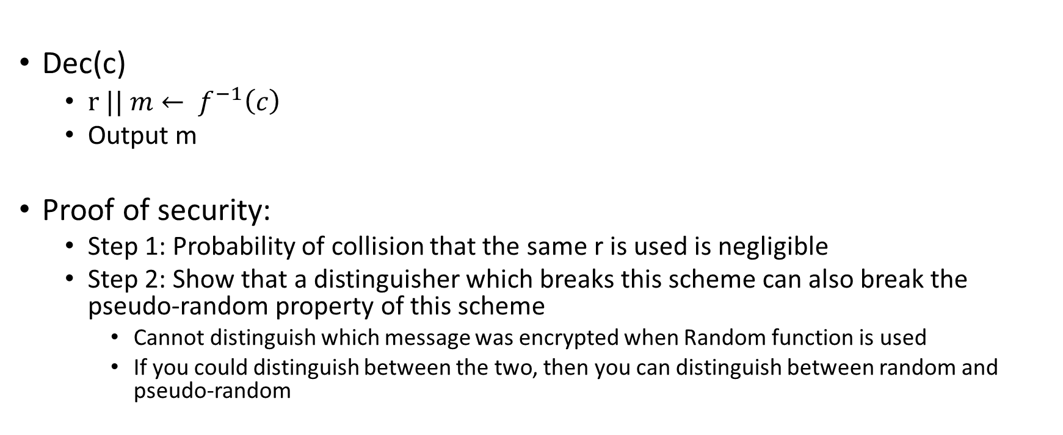
Question 3.18
Dec(c)
  $r || m← f^{−1}\left(c\right)$
  Output m
Proof of security:
  Step 1: Probability of collision that the same r is used is negligible
  Step 2: Show that a distinguisher which breaks this scheme can also break the pseudo-random property of this scheme
    Cannot distinguish which message was encrypted when Random function is used
    If you could distinguish between the two, then you can distinguish between random and pseudo-random

Slide 22
What happens with dropped blocks for CBC, OFB, CTR
All blocks after dropped block decrypt incorrectly
Possible to recover if you guess a block is missing for OFB and CTR

Slide 23













How to encrypt a message when one encryption scheme is insecure
One-time pad is the key
$$m$$
$$\left(c_{1},c_{2}\right)$$
$$r∈_{R}{\left\{0,1\right\}}^{n}$$
$$r←Dec_{1}(c_{1})$$
$$m^{′}←m⊕r$$
$$m^{′}←Dec_{2}(c_{2})$$
$$\left(c_{1},c_{2}\right)$$
$$c_{1}←Enc_{1}(r)$$
$$m$$
m $←m^{′}⊕r$
$$c_{2}←Enc_{2}(m′)$$
$$ENC$$
$$Dec$$

Slide 24
Groups, fields, primes

Slide 25
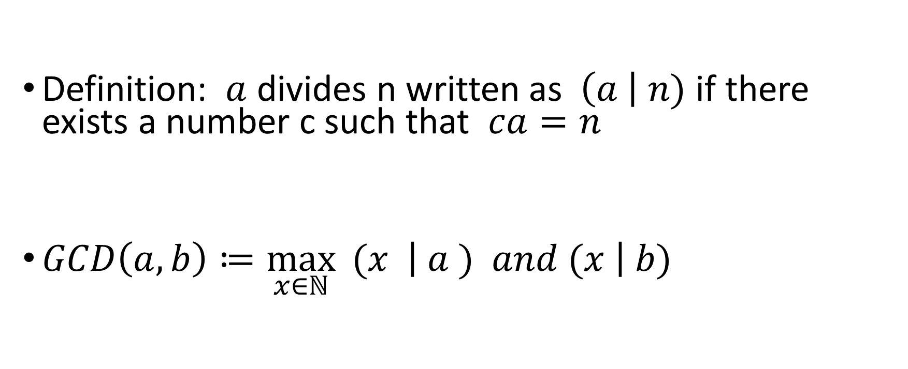
Divisibility
Definition: $a$ divides n written as$\left(a \right| n)$ if there exists a number c such that $ca=n$
$GCD\left(a,b\right)≔\max_{x∈ℕ}{ (x \left| a ) and (x \right| b)}$

Slide 26

Relatively prime
We say that two numbers $a,b$ are relatively prime (co-prime)
$GCD(a,b) = 1$
Examples
15,32
24, 35
Non-example
2,14
3, 183

Slide 27
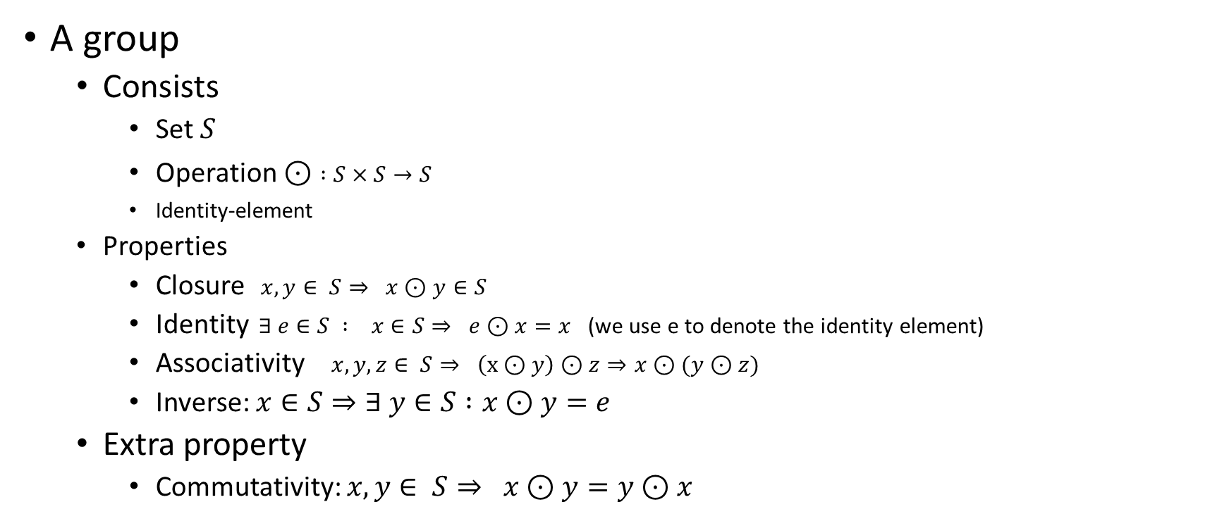
Group
A group
  Consists
    Set $S$
    Operation $⊙$ $:S×S→S$
    Identity-element
  Properties
    Closure $x,y∈ S⇒ x⊙y∈S$
    Identity $∃ e∈S : x∈S⇒ e⊙x=x$ (we use e to denote the identity element)
    Associativity $x,y,z∈ S⇒ \left(x⊙y\right)⊙z⇒x⊙(y⊙z)$
    Inverse: $x∈S⇒∃ y∈S :x⊙y=e$
  Extra property
    Commutativity: $x,y∈ S⇒ x⊙y=y⊙x$

Slide 28
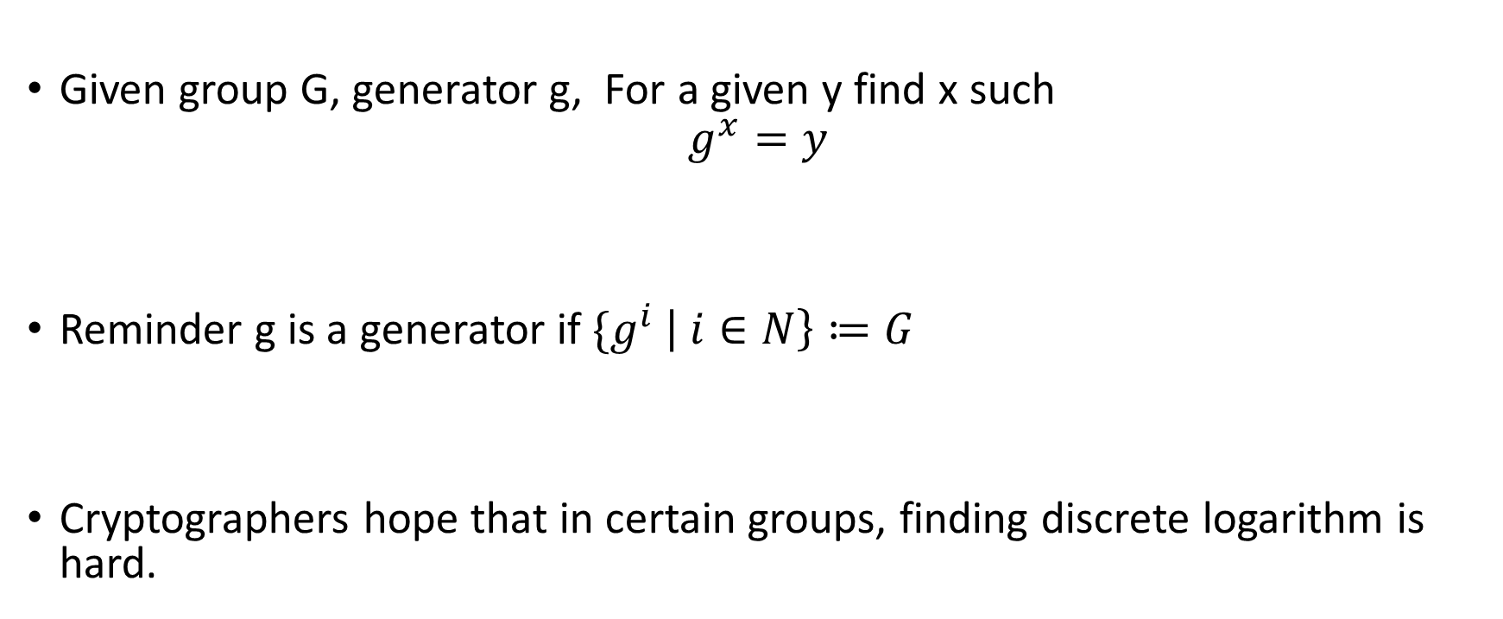
Discrete logarithm
Given group G, generator g, For a given y find x such
$$g^{x}=y$$
Reminder g is a generator if ${\{g}^{i} \left| i∈N\right\}≔G$
Cryptographers hope that in certain groups, finding discrete logarithm is hard.

Slide 29
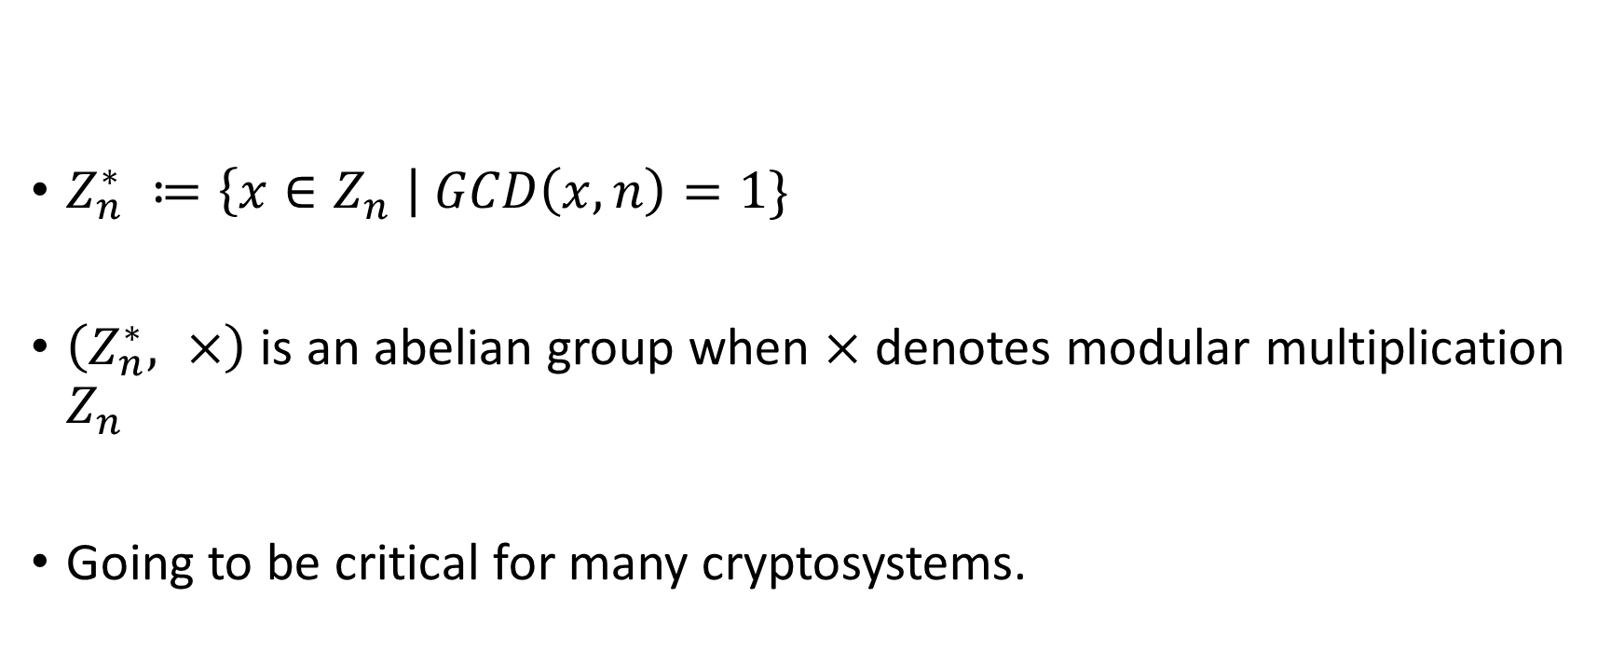

$$Z_{n}^{∗}$$
$Z_{n}^{∗} ≔\left\{x∈Z_{n} \right| GCD\left(x,n\right)=1\}$
$\left(Z_{n}^{∗}, ×\right)$ is an abelian group when $×$ denotes modular multiplication $Z_{n}$
Going to be critical for many cryptosystems.

Slide 30


$$Z_{6}^{∗}$$
$Z_{6}^{∗} ≔\left\{x∈Z_{6} \right| GCD\left(x,6\right)=1\} =\{1,5\}$

Slide 31

$$Z_{6}^{∗}$$
$Z_{6}^{∗} ≔\left\{x∈Z_{6} \right| GCD\left(x,6\right)=1\} =\{1,5\}$
The multiplicative inverse of x in $Z_{n}$
$y∈ Z_{n}$ such that $x⋅ y = 1 (mod n)$
Inverses :
  (1,1)
  (5,5)

Slide 32
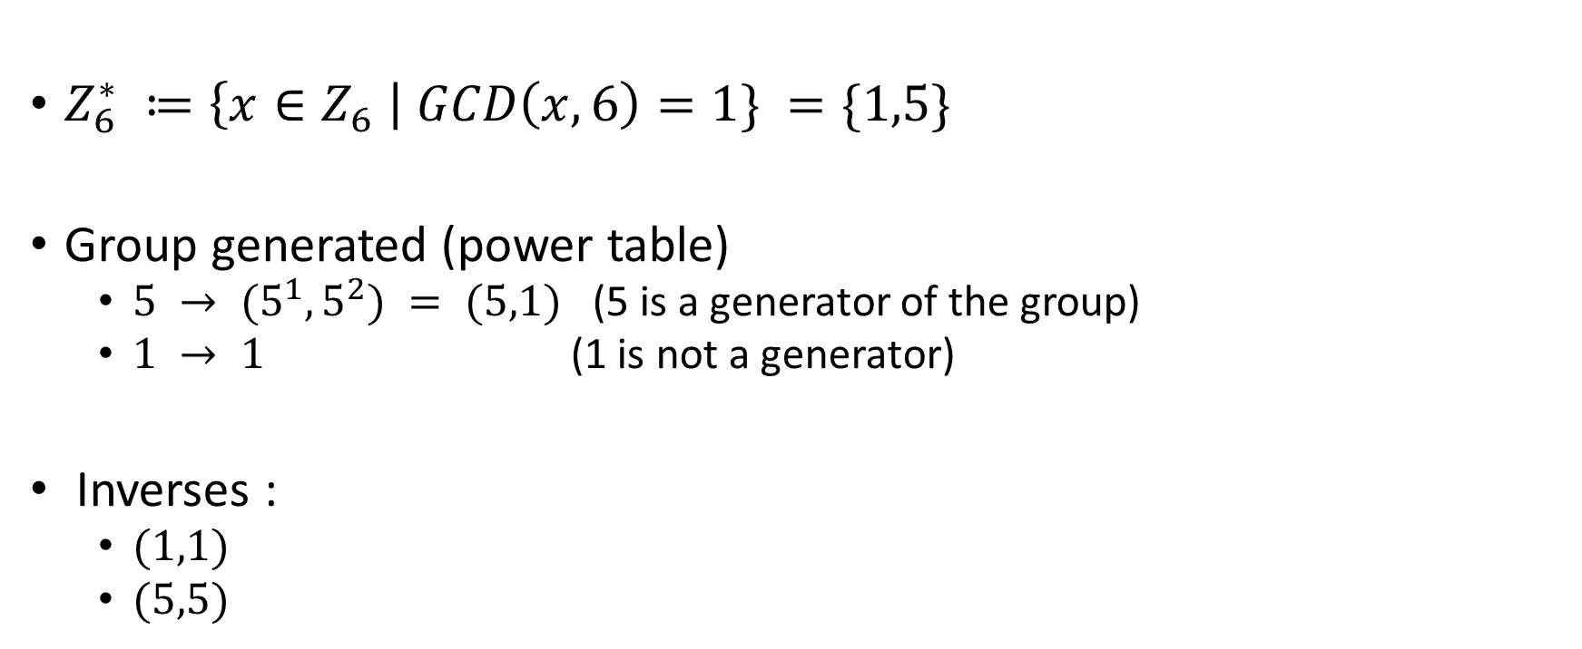
$$Z_{6}^{∗}$$
$Z_{6}^{∗} ≔\left\{x∈Z_{6} \right| GCD\left(x,6\right)=1\} =\{1,5\}$
Group generated (power table)
  $5 → (5^{1},5^{2}) = (5,1)$(5 is a generator of the group)
  $1 → 1$ (1 is not a generator)
Inverses :
  $(1,1)$
  $(5,5)$

Slide 33


$${(Z}_{7},∗)$$
Multiplicative inverse
  $\left(1,1\right)$
  (2,4)
  (3,5)
  (6,6)
Generator (power table)
  $3 →\left(3^{1},3^{2},3^{3},3^{4},3^{5},3^{6},3^{7}\right)= \left(3,2,6,4,5,1\right)$
  $5 →\left(5^{1},5^{2},5^{3},5^{4},5^{5},5^{6},5^{7}\right)= \left(5,4,6,2,3,1\right)$

Slide 34
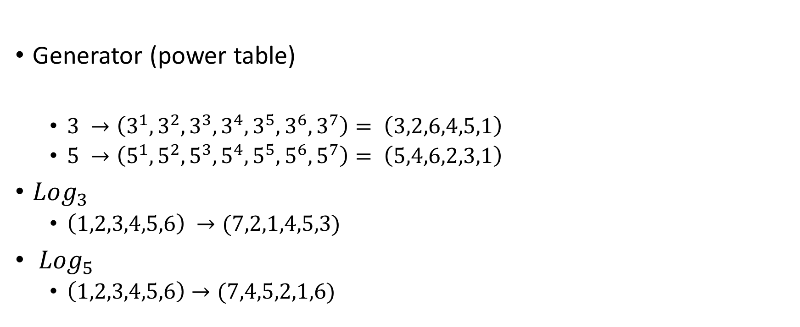
Discrete logarithm
Generator (power table)
  $3 →\left(3^{1},3^{2},3^{3},3^{4},3^{5},3^{6},3^{7}\right)= \left(3,2,6,4,5,1\right)$
  $5 →\left(5^{1},5^{2},5^{3},5^{4},5^{5},5^{6},5^{7}\right)= \left(5,4,6,2,3,1\right)$
$Log_{3}$
  $\left(1,2,3,4,5,6\right) →(7,2,1,4,5,3)$
${Log}_{5}$
  $\left(1,2,3,4,5,6\right)→(7,4,5,2,1,6)$

Slide 35


$$Z_{8}^{∗}$$
$Z_{8}^{∗} ≔\left\{x∈Z_{8} \right| GCD\left(x,8\right)=1\} =\{1,3,5,7\}$
The multiplicative inverse of x in $Z_{n}$
$y∈ Z_{n}$ such that $x⋅ y = 1 (mod n)$
Inverses :
  (1,1)
  (3,3)
  (5,5)
  (7,7)

Slide 36

$$Z_{8}^{∗}$$
$Z_{8}^{∗} ≔\left\{x∈Z_{8} \right| GCD\left(x,8\right)=1\} =\{1,3,5,7\}$
Subgroups of $Z_{8}^{∗}$ are either of size $1,2,4$
Group generated
  $1 →\{1\}$
  $3 →\left\{3,1\right\}$
  $5 →\{5,1\}$
  $7 →\{7,1\}$
  $Z_{8}^{∗}$ has no generators

Slide 37


$$Z_{15}^{∗}$$
$Z_{15}^{∗} ≔\left\{x∈Z_{15} \right| GCD\left(x,15\right)=1\} =\{1,2,4,7,8,11,13,14\}$
The multiplicative inverse of x in $Z_{n}$
$y∈ Z_{n}$ such that $x⋅ y = 1 (mod n)$
Inverses :
  (1,1)
  (2,8)
  (4,4)
  (7,13)
  (11,11)
  (14,14)

Slide 38
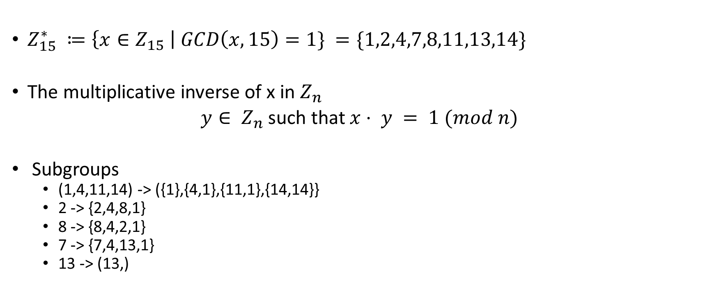
$$Z_{15}^{∗}$$
$Z_{15}^{∗} ≔\left\{x∈Z_{15} \right| GCD\left(x,15\right)=1\} =\{1,2,4,7,8,11,13,14\}$
The multiplicative inverse of x in $Z_{n}$
$y∈ Z_{n}$ such that $x⋅ y = 1 (mod n)$
Subgroups
  (1,4,11,14) -> ({1},{4,1},{11,1},{14,14}}
  2 -> {2,4,8,1}
  8 -> {8,4,2,1}
  7 -> {7,4,13,1}
  13 -> (13,)

Slide 39

Examples of group
${(Z}_{n}∖\left\{0\right\}, ∗)$ is a group if and only if n is prime

Slide 40
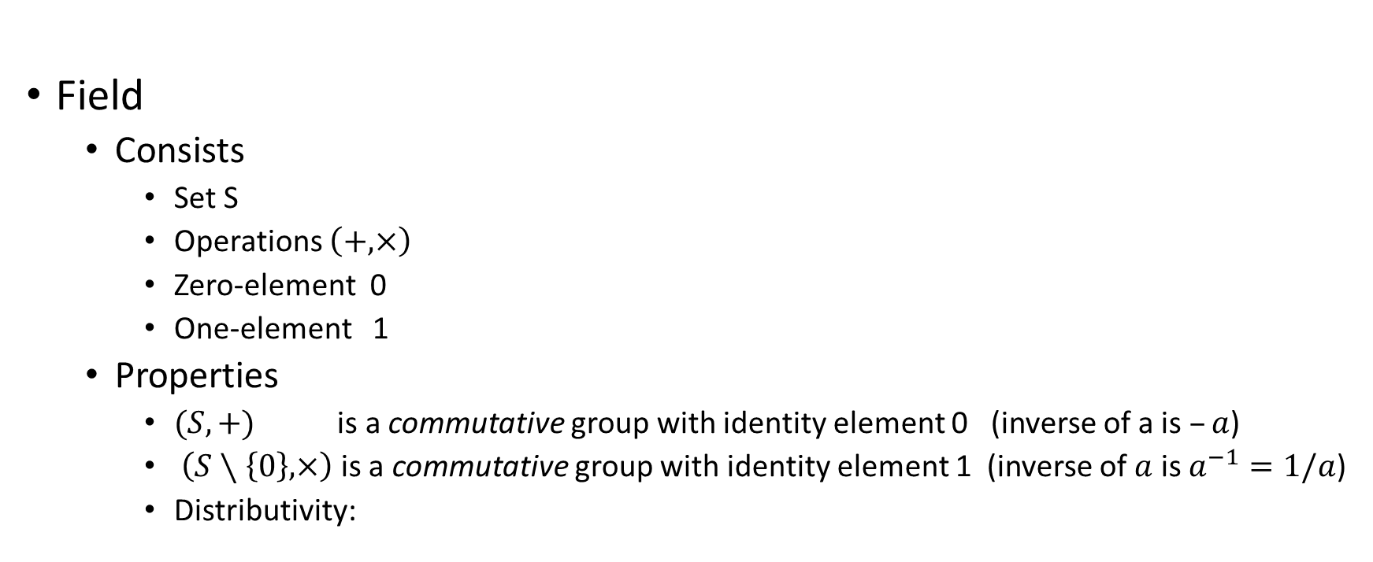
Field
Field
  Consists
    Set S
    Operations $\left(+,×\right)$
    Zero-element 0
    One-element 1
  Properties
    $(S,+)$ is a commutative group with identity element 0 (inverse of a is $–a$)
    $\left(S∖\left\{0\right\},×\right)$ is a commutative group with identity element 1 (inverse of $a$ is $a^{−1}=1/a$)
    Distributivity:

Slide 41

Arithmetic fields over (mod n)
$(Z_{n},+,∗)$ is a field if and only if n is prime

