Slide 1
Quiz 2 answers

Slide 2
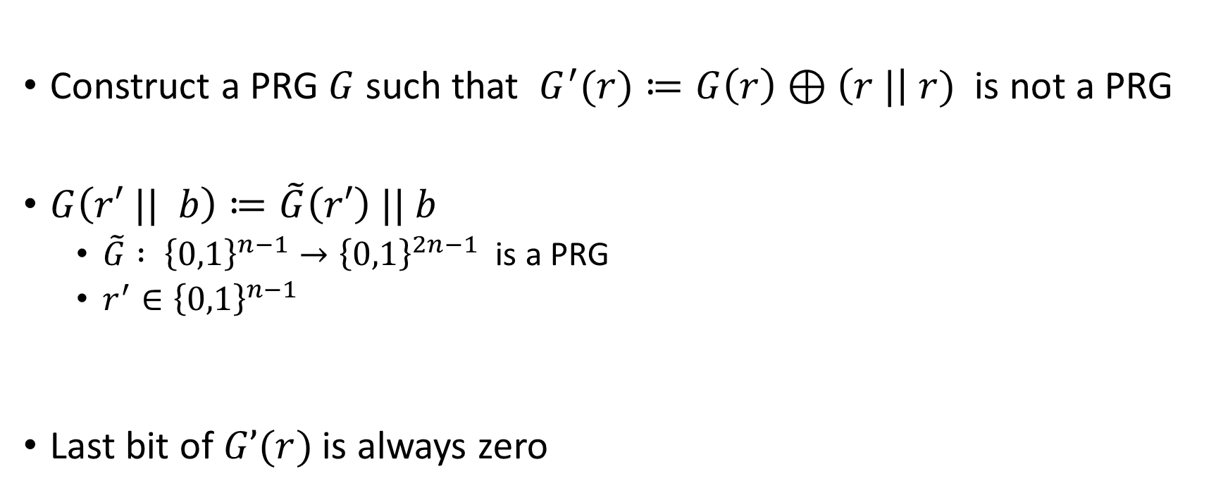
Question I
Construct a PRG $G$ such that $G^{′}(r)≔G\left(r\right)⊕\left(r |\right| r)$ is not a PRG
$G\left(r′ || b\right)≔\tilde{G}\left(r′\right) || b$
  $\tilde{G} : {\left\{0,1\right\}}^{n−1}→{\left\{0,1\right\}}^{2n−1}$ is a PRG
  $r^{′}∈{\left\{0,1\right\}}^{n−1}$
Last bit of $G’(r)$ is always zero

Slide 3
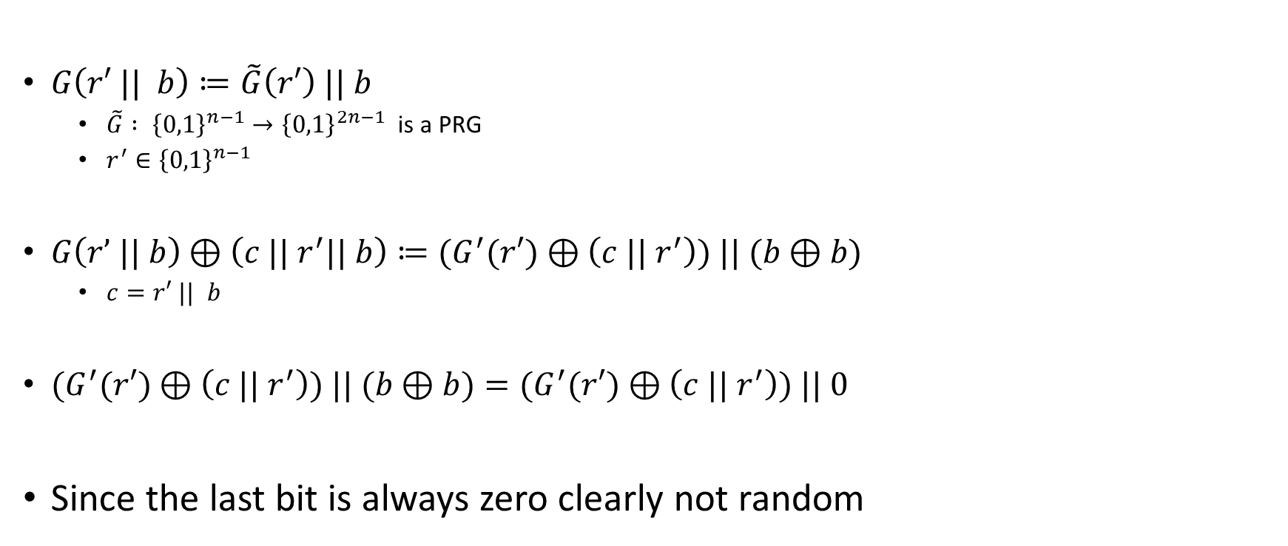
Question 1
$G\left(r′ || b\right)≔\tilde{G}\left(r′\right) || b$
  $\tilde{G} : {\left\{0,1\right\}}^{n−1}→{\left\{0,1\right\}}^{2n−1}$ is a PRG
  $r^{′}∈{\left\{0,1\right\}}^{n−1}$
$G\left(r’ || b\right)⊕\left(c || r^{′}|| b\right)≔{(G}^{′}(r′)⊕\left(c || r^{′}\right)) || (b⊕b)$
  $c=r′ || b$
${(G}^{′}(r′)⊕\left(c || r^{′}\right)) || (b⊕b)={(G}^{′}(r′)⊕\left(c || r^{′}\right)) || 0$
Since the last bit is always zero clearly not random

Slide 4

Question 2
Show that $G\left(r\right)≔F_{r}(r)$ is not a PRG
  $F_{k}\left(x\right)$ is a PRF from ${\left\{0,1\right\}}^{n}→{\left\{0,1\right\}}^{2n}$
$F_{k}\left(x\right) ≔if \left(x=k\right) then \left(k || k\right) else {F′}_{k}(x)$
  ${F′}_{k}(x)$ is a PRF
$G\left(r\right)=F_{r}\left(r\right)=(r||r)$ which is clearly not random

Slide 5

Question 3
Solve for $y = x^{2} +2x+6 mod 2^{n}$
If there is a solution output 0.
Otherwise output 1.

Slide 6

Question 4
Distinguisher
  If the game outputs $3$ then output $1$
  Otherwise output 0
$|Pr⁡[D(G_{1}) = 1] – Pr⁡[D(G_{0}) = 1]| = 1 – (1−\frac{1}{2^{2n}})$
Can’t do better

Slide 7








Show that encryption from PRG is secure
m
m
$$r∈_{R}{\left\{0,1\right\}}^{m(n)}$$
$$≈$$
$$w∈_{R}{\left\{0,1\right\}}^{n}$$
$$w←G(r)$$
c
$$c←m⊕w$$
c
$$c←m⊕w$$
$$G_{0}$$
$$G_{1}$$

Slide 8













Show that $F_{G\left(k\right)}(x)$ is a PRF if G is a PRG
r $∈_{R}{\left\{0,1\right\}}^{m(n)}$
$$k←G(r)$$
k $∈_{R}{\left\{0,1\right\}}^{n}$
$$F ←F_{K}$$
$$F ←F_{K}$$
m
$$≈$$
m
$$w←F(m)$$
$$w←F(m)$$
$$w$$
$$w$$
Repeat as many times as the distinguisher wants
Repeat as many times as the distinguisher wants
$${Game}_{1}$$
$${Game}_{2}$$

Slide 9












Show that PRF construction of encryption is secure
$$m_{0},m_{1}$$
k $∈_{R}{\left\{0,1\right\}}^{n}$
$$m_{0},m_{1}$$
$$F ←random$$
$$F ←F_{K}$$
r $∈_{R}{\left\{0,1\right\}}^{n}$
r $∈_{R}{\left\{0,1\right\}}^{n}$
$$≈$$
$$(r,c)$$
$$(r,c)$$
$$c←(r,F\left(r\right)⊕m_{0})$$
$$c←(r,F\left(r\right)⊕m_{0})$$
$$G_{0}$$
$$G_{1}$$

Slide 10













Show that PRF construction of encryption is secure
$$m_{0},m_{1}$$
$$F ←random$$
$$m_{0},m_{1}$$
$$F ←random$$
r $∈_{R}{\left\{0,1\right\}}^{n}$
r $∈_{R}{\left\{0,1\right\}}^{n}$
$$(r,c)$$
$$≈$$
$$(r,c)$$
$$c←(r,F\left(r\right)⊕m_{0})$$
$$c←(r,F\left(r\right)⊕m_{1})$$
$$G_{1}$$
$$G_{2}$$

Slide 11














Show that PRF construction of encryption is secure
$$m_{0},m_{1}$$
$$F ←random$$
$$m_{0},m_{1}$$
k $∈_{R}{\left\{0,1\right\}}^{n}$
$$F ←F_{K}$$
r $∈_{R}{\left\{0,1\right\}}^{n}$
$$≈$$
r $∈_{R}{\left\{0,1\right\}}^{n}$
$$(r,c)$$
$$(r,c)$$
$$c←(r,F\left(r\right)⊕m_{1})$$
$$c←(r,F\left(r\right)⊕m_{1})$$
$$G_{2}$$
$$G_{0}$$

Slide 12
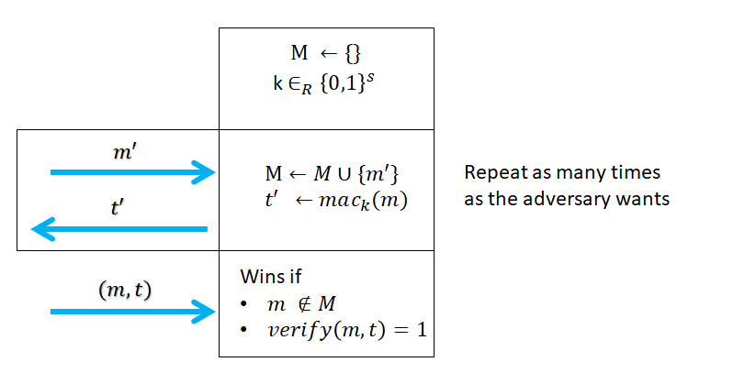

MAC forgery game
Allow the adversary to learn tags for as many message as he wants
A mac scheme is secure if
  $\operatorname{Pr}\left[adv wins the forgery game\right]≤negl(s)$

Slide 13
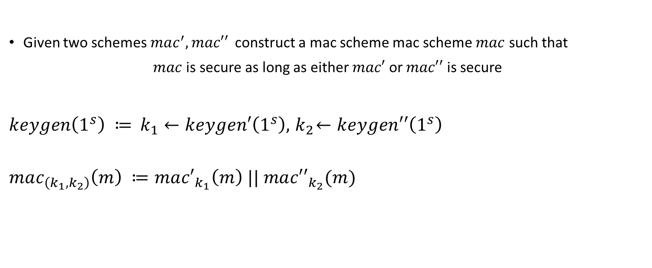
Mac example exercise
Given two schemes $mac^{′}, mac′′$ construct a mac scheme mac scheme $mac$ such that
$mac$ is secure as long as either $mac′$ or $mac′′$ is secure
$keygen\left(1^{s}\right) ≔$ $k_{1}←keygen′\left(1^{s}\right),{ k}_{2}←keygen′′\left(1^{s}\right)$
$$mac_{\left(k_{1},k_{2}\right)}\left(m\right) ≔ma{c′}_{k_{1}}\left(m\right) || ma{c′′}_{k_{2}}(m)$$

Slide 14






















Security of macs from PRF via hybrid games
k $∈_{R}{\left\{0,1\right\}}^{n}$
$$F ←random$$
$$F ←F_{K}$$
$$Repeat$$
$$M ←\{\}$$
$$Repeat$$
$$m$$
$$m$$
$$t←F(m)$$
$$t←F(m)$$
$$≈$$
$$t$$
$$M←M∪\{m\}$$
$$t$$
$$M←M∪\{m\}$$
$$(m^{′},t′)$$
$$(m^{′},t′)$$
Win if $F_{k}\left(m^{′}\right)=t′$
Win if $F\left(m^{′}\right)=t′$
and $m∉M$
and $m∉M$
$${Game}_{0}$$
$${Game}_{0}$$

Slide 15

Mac forgery example
Let mac’ and mac’’ be mac schemes, is the following a mac?
$mac_{k}\left(m\right)≔ mac_{k}^{′}\left(m\right)⊕mac_{k}^{′′}(m)$

Slide 16

Collision resistance hash function
A function $h$ is collision-resistant if it is hard to find $x,y$ such that
$$h\left(x\right)=h(y)$$

Slide 17
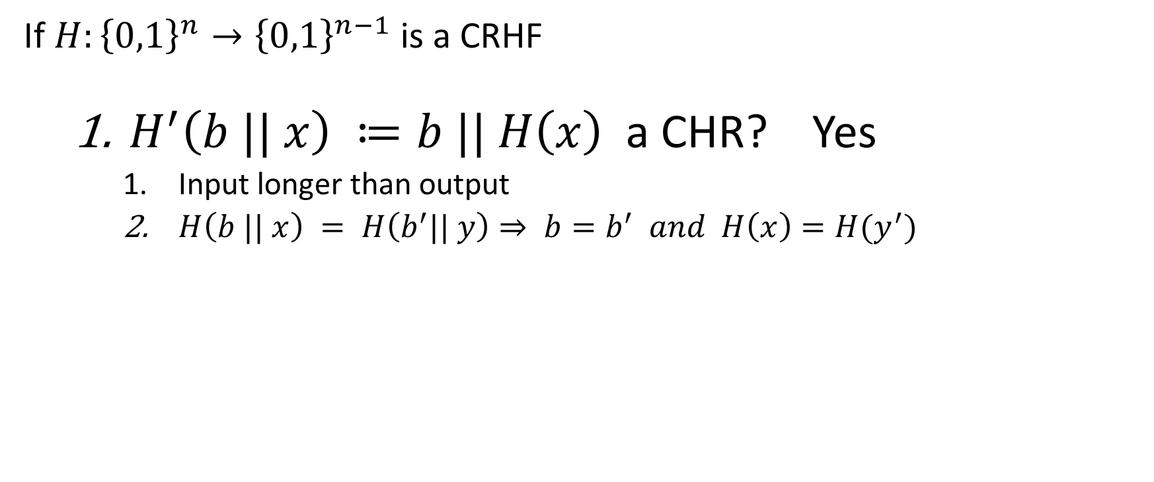
Collision-resistant hash function exercises
If $H:{\left\{0,1\right\}}^{n}→{\left\{0,1\right\}}^{n−1}$ is a CRHF
  $H^{′}\left(b || x\right) ≔b || H\left(x\right)$ a CHR? Yes
    Input longer than output
    $H\left(b || x\right) = H\left(b^{′}|| y\right)⇒ b=b^{′} and H\left(x\right)=H(y^{′})$

Slide 18
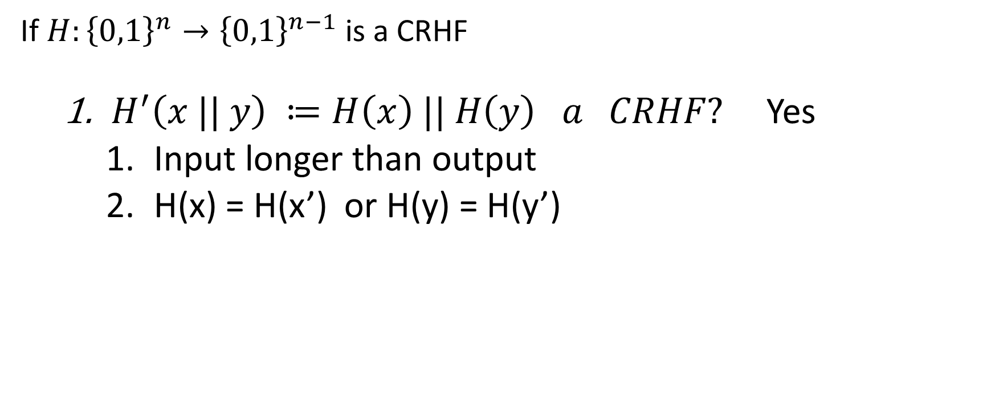
Collision-resistant hash function exercises
If $H:{\left\{0,1\right\}}^{n}→{\left\{0,1\right\}}^{n−1}$ is a CRHF
  $H^{′}\left(x || y\right) ≔H\left(x\right) || H\left(y\right) a CRHF?$ Yes
    Input longer than output
    H(x) = H(x’) or H(y) = H(y’)

Slide 19

Collision-resistant hash function exercises
If $H:{\left\{0,1\right\}}^{n}→{\left\{0,1\right\}}^{n−1}$ is a CRHF
  $H^{′}\left(x,y\right) ≔H\left(x\right)⊕H(y)$ a CRHF? No
    If x = y then $H’\left(x,y\right)=0$

Slide 20
Collision-resistant hash function exercises
If $H:{\left\{0,1\right\}}^{n}→{\left\{0,1\right\}}^{n−1}$ is a CRHF
  $H^{′}\left(x,y\right) ≔H\left(x\right)⊕H(y)$ a CRHF? No
    If x = y then $H’\left(x,y\right)=0$

Slide 21
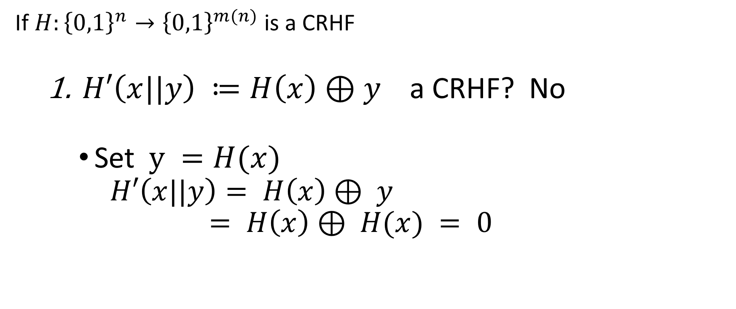
Collision-resistant hash function exercises
If $H:{\left\{0,1\right\}}^{n}→{\left\{0,1\right\}}^{m(n)}$ is a CRHF
  $H′\left(x||y\right) ≔H\left(x\right)⊕y$ a CRHF? No
    Set $y =H(x)$
      $$H′\left(x||y\right)= H\left(x\right)⊕ y$$
      $$= H\left(x\right)⊕ H(x) = 0$$

Slide 22
Computational assumptions

Slide 23
Types of computational assumptions
Decisional: distinguish between two distributions (or games)
Search: trying to find an element which fulfills certain properties

Slide 24

Discrete logarithm assumption
Reminder
  $G$ be group of size $n$
  $g$ is a generator of g if $\left\{g^{1},g^{2},…,g^{n}\right\}=g$
Given an output $y$sampled randomly, it is hard to find $x$ such that $g^{x}=y$

Slide 25

Examples of hardness reduction
Given $g,h$ random generators, finding $x,y$ such that $g^{x} = h^{y}$ is hard
${{(g}^{x})}^{y/x}=h^{y}$
Finding such$x,y$ is equivalent to finding the$\log_{g}(h)$

Slide 26












Decisional Diffie Hellman problem
Reminder
  $G$ be group of size $n$
  $g$ is a generator of g if $\left\{g^{1},g^{2},…,g^{n}\right\}=G$
The computational Diffie-Hellman assumption states that the two following game are indistinguishable
$$x,y∈_{R}G$$
$$x,y∈_{R}G$$
$$(a,b,c)$$
$$a←g^{x}$$
$$≈$$
$$(a,b,c)$$
$$a←g^{x}$$
$$b←g^{y}$$
$$b←g^{y}$$
$$c←g^{xy}$$
$$c∈_{R}G$$

Slide 27







Reduction
DDH is hard $⇒$ discrete logarithm is hard
  Equivalent to saying that an efficient solver for discrete logarithm can be used to construct an efficient distinguisher for DDH.
$$a,b,c$$
$$x←Log_{g}(a)$$
$$y←Log_{g}(b)$$
$$z←Log_{c}(b)$$
$$d$$
$$d←x⋅y≠z$$

Slide 28
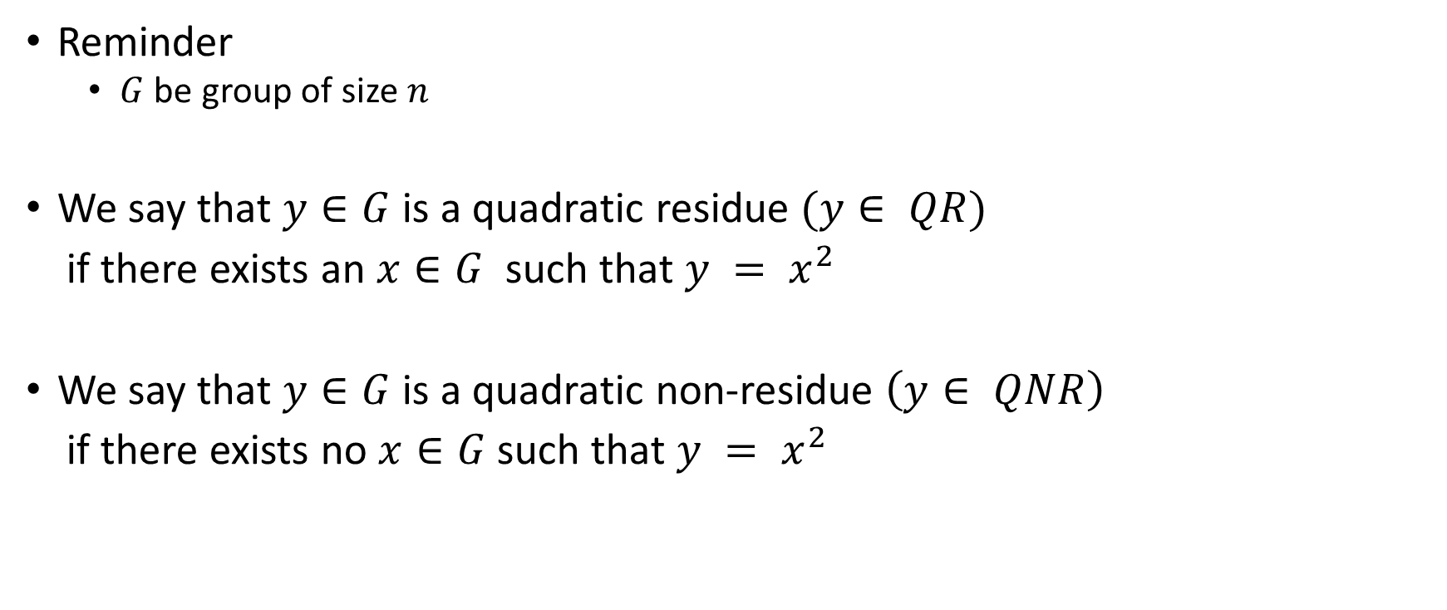
Quadratic Residuosity
Reminder
  $G$ be group of size $n$
We say that $y∈G$ is a quadratic residue $(y∈ QR)$
if there exists an $x∈G$ such that $y = x^{2}$
We say that $y∈G$ is a quadratic non-residue $\left(y∈ QNR\right)$
if there exists no $x∈G$ such that $y = x^{2}$

Slide 29

Quadratic Residuosity
Reminder
  $G$ be group of size $n$
Properties:
  $x,y∈QR⇒x⋅y∈QR$
  $x∈QR, y∈QNR⇒x⋅y∈QNR$
  $x∈QNR, y∈QNR⇒x⋅y∈QR$

Slide 30









Quadratic Residuosity
Reminder
  $G$ be group of size $n$
  $g$ is a generator of g if $\left\{g^{1},g^{2},…,g^{n}\right\}=g$
The quadratic Residuosity assumption states that the two following game are indistinguishable
$$x∈_{R}G$$
$$y$$
$$≈$$
$$x$$
$$y←x⋅x$$
$$y∈_{R}G$$
$$Game_{0}$$
$$Game_{1}$$

Slide 31








Equivalence for quadratic residuosity problem
$Game_{0}≈Game_{1}⇔Game_{0}≈Game_{2}$
$$y$$
$$x$$
$$x∈_{R}G$$
$$y∈_{R}G$$
$$y←x⋅x$$
$$Game_{0}$$
$$Game_{1}$$

Slide 32
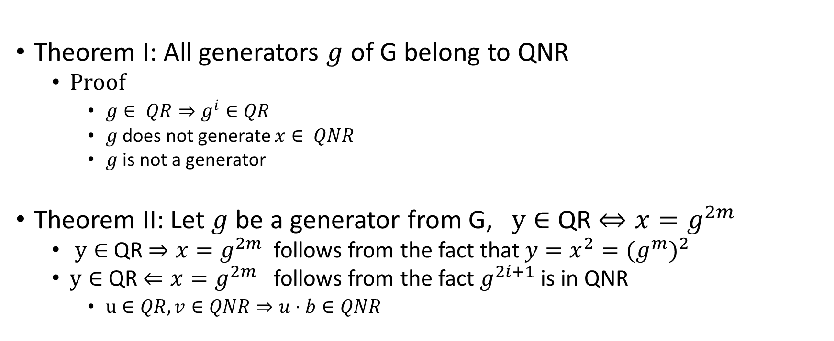
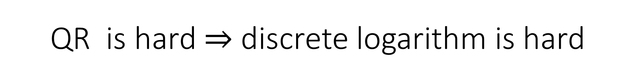
QR is hard $⇒$ discrete logarithm is hard
Theorem I: All generators $g$ of G belong to QNR
  Proof
    $g∈ QR⇒g^{i}∈QR$
    $g$ does not generate $x∈ QNR$
    $g$ is not a generator
Theorem II: Let $g$ be a generator from G, $y∈$ QR $⇔{x=g}^{2m}$
  $y∈$ QR $⇒{x=g}^{2m}$ follows from the fact that $y=x^{2}={{(g}^{m})}^{2}$
  $y∈$ QR $⇐{x=g}^{2m}$ follows from the fact $g^{2i+1}$ is in QNR
    $u∈QR, v∈QNR⇒u⋅b∈QNR$

Slide 33


QR is hard $⇒$ discrete logarithm is hard
$$y$$
$$x←Log_{g}(y)$$
If x is even
return 0;
$$d$$
If x is odd
return 1;

Slide 34

Factoring assumption
Given $n$ such that $n = p⋅q$where
  $p,q$ are prime
  $p,q$ were randomly sampled
  Most significant bits of $p,q$are $1,1$
It is hard to compute $p,q$

Slide 35
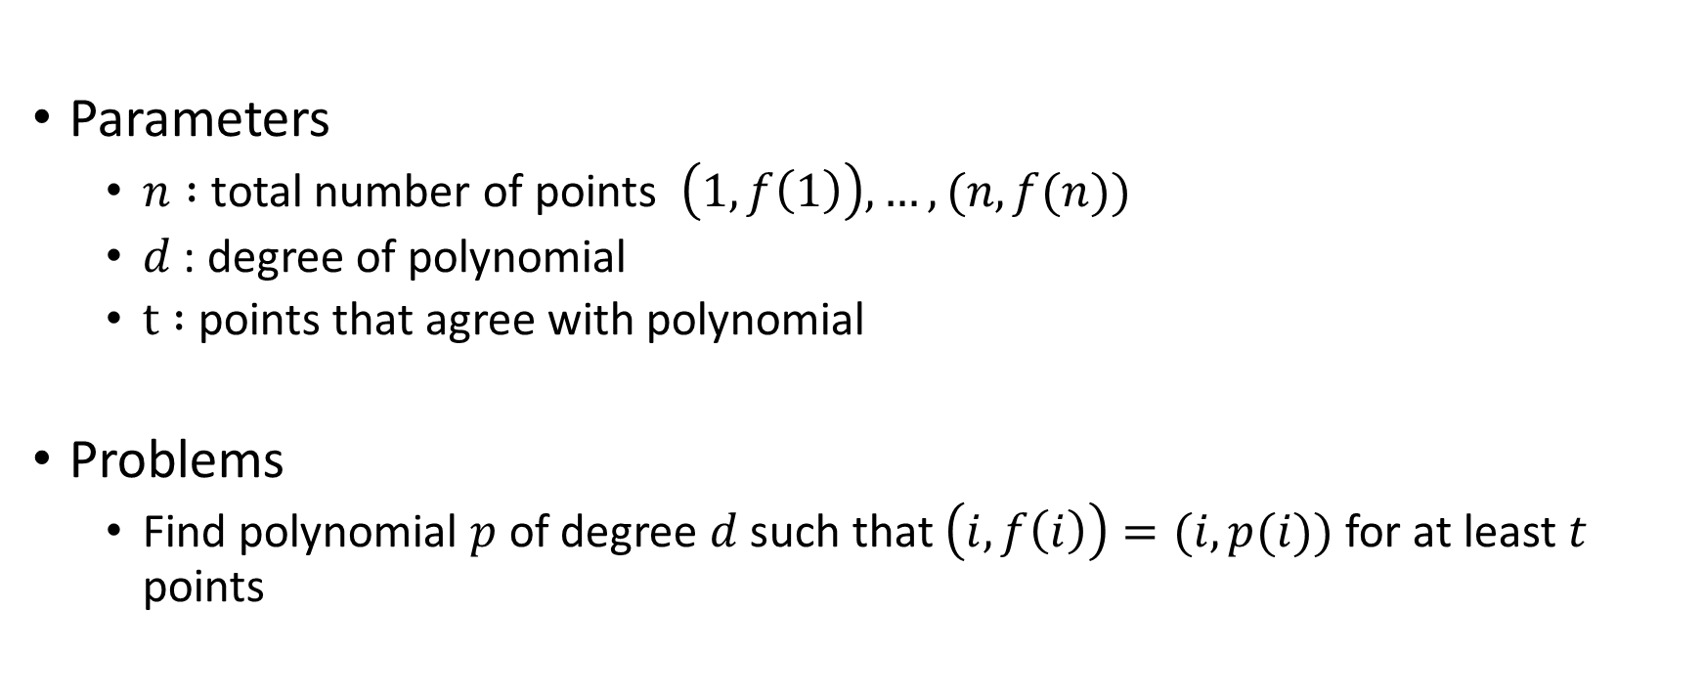
Polynomial recovery
Parameters
  $n :$ total number of points $\left(1,f\left(1\right)\right), …, (n,f(n))$
  $d$ : degree of polynomial
  $t :$ points that agree with polynomial
Problems
  Find polynomial $p$ of degree $d$ such that $\left(i,f\left(i\right)\right)=(i,p(i))$for at least $t$ points

Slide 36

Learning with errors
Parameters
  Random linear function $f$: $Z_{p}^{n} →Z_{p}$
  Error vectors $e$ chosen from some Distribution $𝒳$
  Random vectors $x_{i}$
Problem compute $f(x)$ from $f(x_{i}) + e_{i}$

Slide 37

Example of LWE problem
$X=\left\{−1,0,1\right\}$
f$\left(x,y,z\right)≔5x+7y+3z (mod 23)$
(x,y,z) = (2,3,1), e = 1 f(2,3,1) + 1 = 12
(x,y,z) = (1,1,3), e = -1 f(1,1,3) - 1 = 20

