Slide 1
RSA encryption

Slide 2

Greatest common divisor
$GCD\left(x,y\right) :=\max_{z}{(z | x) and (z | y)}$
  $a | b ≔a divides b$
$Z_{n}^{∗}≔\{ m ∣GCD\left(m,n\right)=1, m<n \}$

Slide 3

Modular inverse
Let (x,n) be integers such that $GCD\left(x,y\right)=1$
$\{x^{−1} \left(mod n\right)\}≔\{y∣y⋅x=1 (mod n), y<n \}$

Slide 4

Powers
$g^{x}≔g⋅…⋅g$ (n times)
$2^{5}mod 7 = 2 ∗2∗2 ∗2 ∗2 \left(mod 7\right)=32 \left(mod 7\right)=4$

Slide 5
Public key-encryption
How can people send encrypted messages to google, steam, your bank, even though they have never exchanged secret keys with those companies?
Public-key encryption allows you to do it
  Public key is revealed publicly so that everyone can encrypt messages
  Secret key is kept hidden and only the owner is allowed is able to decrypt the ciphertext

Slide 6
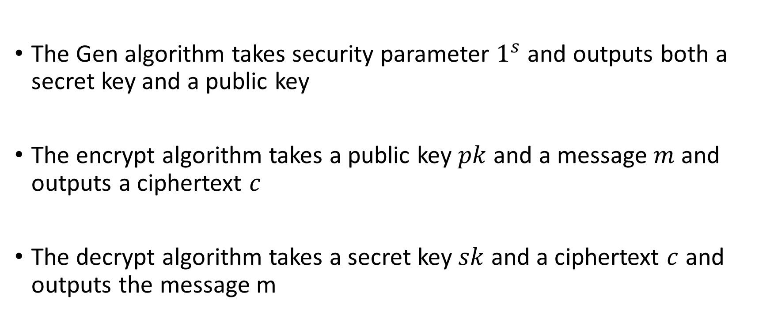
Public-key encryption
The Gen algorithm takes security parameter $1^{s}$ and outputs both a secret key and a public key
The encrypt algorithm takes a public key $pk$ and a message $m$ and outputs a ciphertext $c$
The decrypt algorithm takes a secret key $sk$ and a ciphertext $c$ and outputs the message m

Slide 7

Formal definition
$Gen\left(1^{s}\right)→(sk,pk)$
$Enc_{pk}\left(m\right)→c$ where $m∈M, c∈C$
$Dec_{sk}\left(c\right)→m$ where $m∈M, c∈C$
Correctness:
  $Pr[{Dec}_{sk}\left(Enc_{pk}\left(m\right)\right) =m | \left(sk,pk\right)←Gen\left(1^{s}\right)]=1$

Slide 8

















Multi-message indistinguishability
p$k$
p$k$
$$\left(sk,pk\right)←Gen(1^{s})$$
$$\left(sk,pk\right)←Gen(1^{s})$$
$$m_{0}^{1},…,m_{0}^{n}$$
$$m_{0}^{1},…,m_{0}^{n}$$
$$m_{1}^{1},…,m_{1}^{n}$$
$$c^{i}←Enc_{pk}(m_{0})$$
$$m_{1}^{1},…,m_{1}^{n}$$
$$c^{i}←Enc_{pk}(m_{1})$$
$$≈$$
$$c←c^{1},…,c^{n}$$
$$c←c^{1},…,c^{n}$$
$$c$$
$$c$$
$$G_{0}$$
$$G_{1}$$

Slide 9










Chosen-plaintext security
$$pk$$
$$pk$$
$$\left(sk,pk\right)←Gen(1^{s})$$
$$\left(sk,pk\right)←Gen(1^{s})$$
$$m_{0},m_{1}$$
$$m_{0},m_{1}$$
c
$$c←Enc_{pk}(m_{0})$$
c
$$c←Enc_{pk}(m_{1})$$
$$≈$$
m
m
$$c←Enc_{pk}(m)$$
$$c←Enc_{pk}(m)$$
c
c
Repeat as many times as the distinguisher wants
Repeat as many times as the distinguisher wants
$$G_{0}$$
$$G_{1}$$

Slide 10
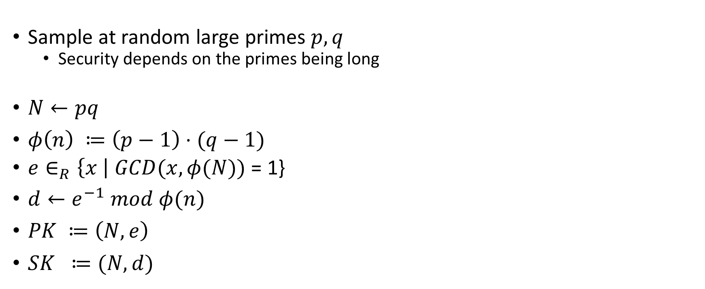
RSA keygen
Sample at random large primes $p,q$
  Security depends on the primes being long
$N←pq$
$φ\left(n\right) ≔\left(p−1\right)⋅(q−1)$
$e∈_{R}\left\{x \right| GCD(x,φ(N))$ = 1}
$d←e^{−1} mod φ(n)$
$PK ≔\left(N,e\right)$
$SK ≔(N,d)$

Slide 11

Example
$p =3$
$q=5$
$φ\left(n\right) =\left(p−1\right)⋅\left(q−1\right)=2⋅4=8$
$e=7$
$GCD\left(e,8\right)=1⁡$
${d= e}^{−1}=7$
$PK←\left(7,15\right)$
$SK←(7,15)$

Slide 12

Example
$p =3$
$q=11$
$φ\left(n\right) =\left(p−1\right)⋅\left(q−1\right)=2⋅10=20$
$e=7$
$GCD\left(e,20\right)=1⁡$
${d= e}^{−1}=3$
$PK←\left(7,33\right)$
$SK←(3,33)$

Slide 13
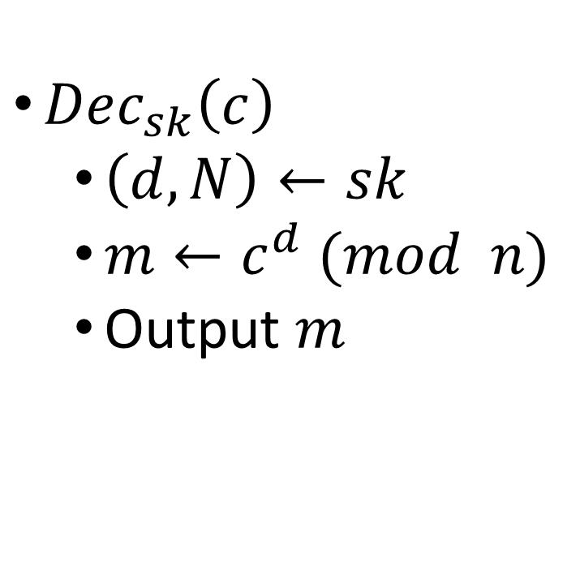
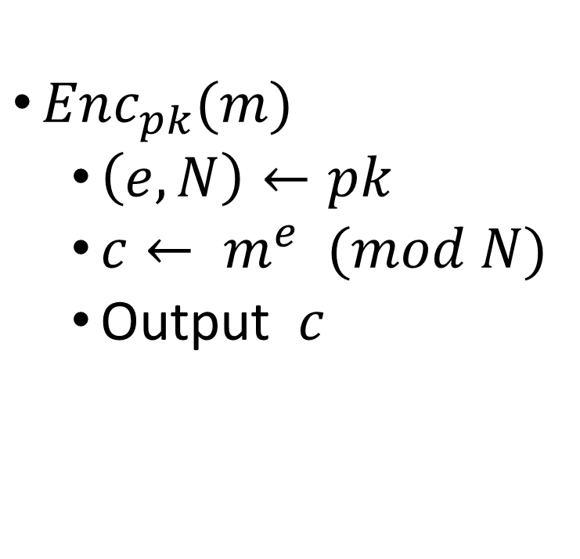
Textbook RSA (not secure at all)
$Enc_{pk}(m)$
  $\left(e,N\right)←pk$
  $c← m^{e} (mod N)$
  Output $c$
$Dec_{sk}\left(c\right)$
  $\left(d,N\right)←sk$
  $m←c^{d} (mod n)$
  Output $m$

Slide 14

Example
$p =3$
$q=5$
$PK←\left(7,15\right)$
$SK←\left(7,15\right)$
$Enc_{\left(7,15\right)}\left(2\right)=2^{7}\left(mod 15\right)=8 (mod 15)$
$Dec_{\left(7,15\right)}\left(8\right)=8^{7} \left(mod 15\right)=2$ $\left(mod 15\right)$

Slide 15
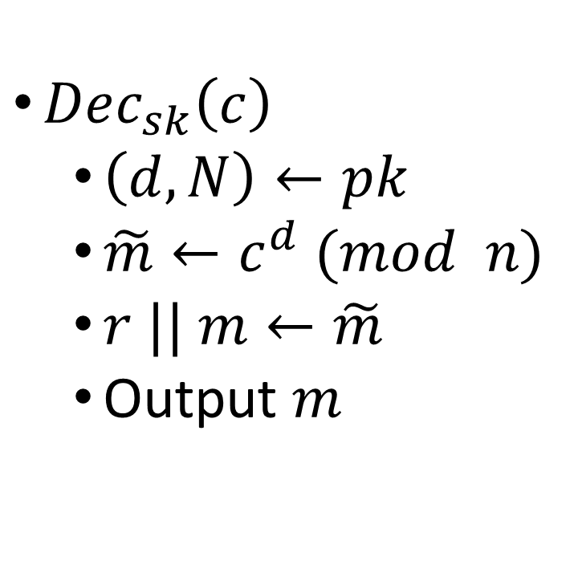
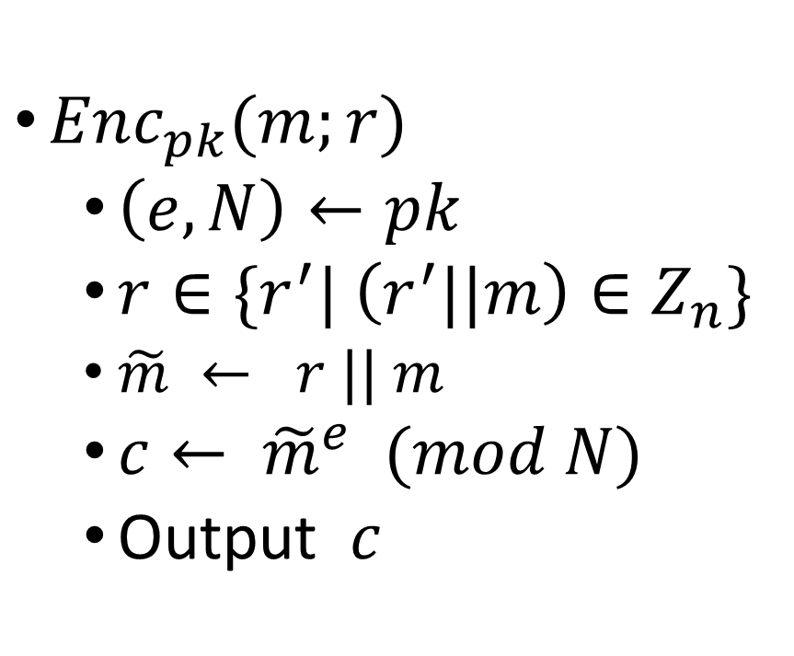
CPA-secure RSA
$Enc_{pk}(m;r)$
  $\left(e,N\right)←pk$
  $r∈\{r^{′}| \left(r^{′}||m\right)∈Z_{n}\}$
  $\tilde{m} ← r || m$
  $c← {\tilde{m}}^{e} (mod N)$
  Output $c$
$Dec_{sk}\left(c\right)$
  $\left(d,N\right)←pk$
  $\tilde{m}←c^{d} (mod n)$
  $r || m←\tilde{m}$
  Output $m$

Slide 16
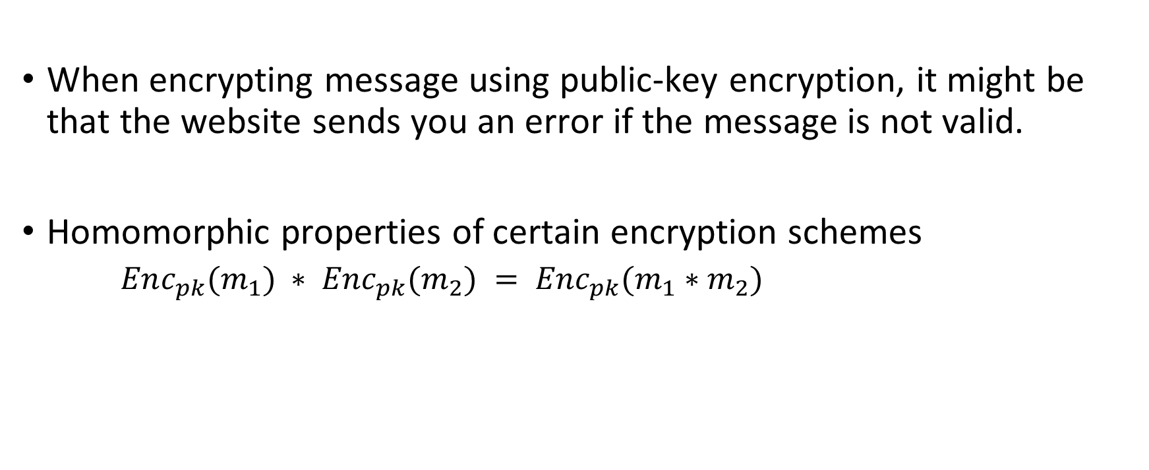
Validation oracles / error oracles
When encrypting message using public-key encryption, it might be that the website sends you an error if the message is not valid.
Homomorphic properties of certain encryption schemes
  $Enc_{pk}(m_{1}) ∗ Enc_{pk}(m_{2}) = {Enc}_{pk}(m_{1}∗m_{2})$

Slide 17

RSA is homomorphic
$Enc_{pk}(m)$
  $\left(e,N\right)←pk$
  $c← m^{e} (mod N)$
  Output $c$
$Enc_{pk}\left(m_{1}\right)⋅Enc_{pk}\left(m_{2}\right)≔{\left(m_{1}\right)}^{e}⋅{\left(m_{2}\right)}^{e}={\left(m_{1}⋅m_{2}\right)}^{e}$

Slide 18

Validation oracle attack using homomorphism
$M = \left\{x | x mod 3=0, x<n\right\}∪\left\{x | x mod 3=1, x<n\right\}$
$$Dec_{sk}\left(Enc_{pk}\left(x\right)∗Enc_{pk}\left(2\right)\right)∉M⇒$$
$$Dec_{sk}\left(Enc_{pk}\left(x∗2\right)\right)∉M⇒$$
$$x mod 3=1$$

Slide 19
Exams distribution

