Slide 1
Introduction to cryptology
Samuel Ranellucci
samuel@umd.edu

Slide 2
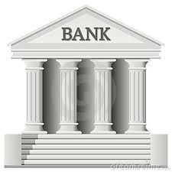
Doing online Banking
How do you know you are connecting with the bank’s website
How do you exchange a secret key with your bank
How does your password stay secret
  Even if the hacker accesses the database of passwords
How does the bank hide the information it sends you
When you make a transfer, how can we verify
  amount
  recipient

Slide 3

Ethymology
Kryptos$⇒$Hidden, concealed, secret
-graphy $⇒$ writing
-ology $⇒$ branch of learning

Slide 4
Why cryptology and not cryptography
A cryptosystem uses cryptography to protect either
  Confidentiality
  Integrity
Cryptography is the art of making cryptosystems
Cryptology is the science (math) of making cryptosystems

Slide 5
How is it science?
Clear definitions of security
Formal protocol descriptions
Proofs of security
Why a science?
  Crypto is hard

Slide 6
Bad things can happen when crypto is bad
Millions of bitcoins stolen
Fake windows updates
Adobe leaked password database

Slide 7
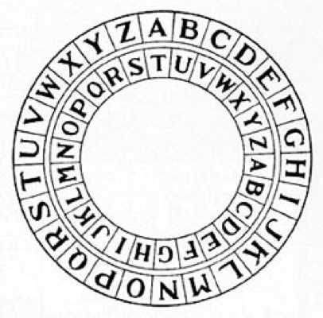
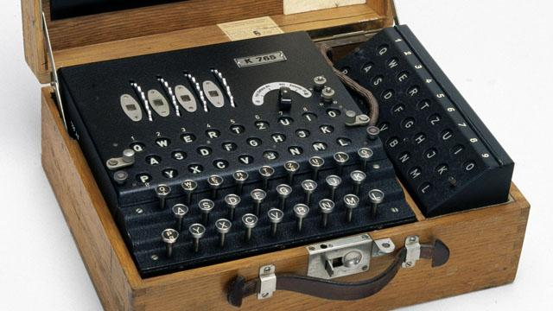
Historical perspective on computational encryption scheme
Caesar cipher
Enigma
Lessons from historical perspective

Slide 8
Perfect security
Encryption: When you want to completely hide your message.
  Used to hide your bank account information
Message authentication code: What to do to make sure the right person sent the message.
  Ensures that your bank transfers don’t get modified

Slide 9
Perfect security
One-time pad
  How to perfectly encrypt a message
One-time mac
  How to perfectly authenticate a message

Slide 10
Private-key encryption
Definition of indistinguishability
Pseudo-random generator
Chosen-plaintext security
Pseudo-random function
Secure encryption from PRG and PRF

Slide 11
Private-key encryption
Block ciphers
Modes of encryption
Construction of block ciphers

Slide 12
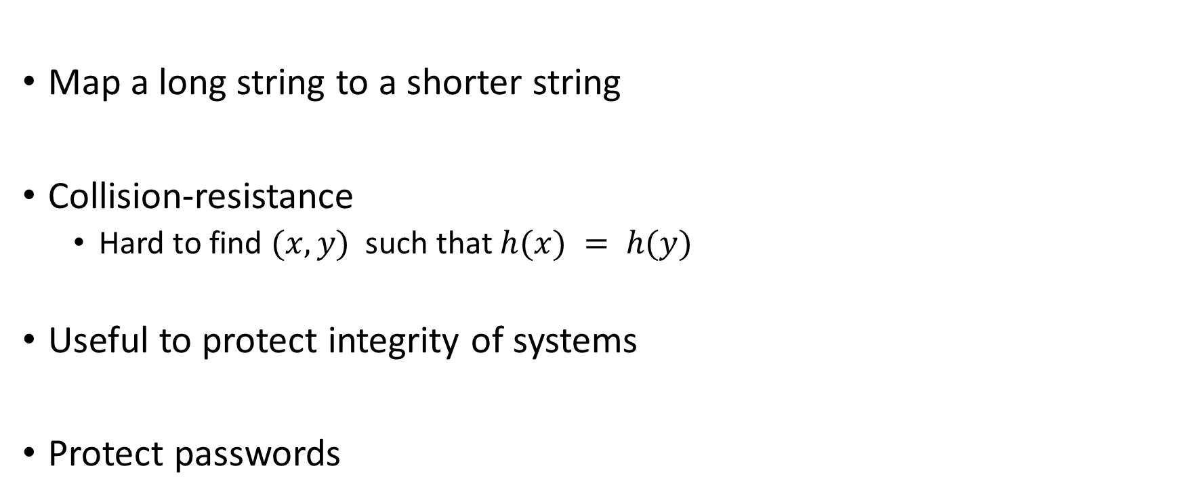
Hash function
Map a long string to a shorter string
Collision-resistance
  Hard to find $(x,y)$ such that $h(x) = h(y)$
Useful to protect integrity of systems
Protect passwords

Slide 13


Public-key encryption
Public (encryption) key
  Anyone can encrypt a message
Private (decryption) key
  Only the creator can decrypt a ciphertext
Allows client to send a secret key to the bank

Slide 14
Public-key encryption
RSA
DDH
LWE
Etc.

Slide 15

Digital signature
Signing (private) key
  Sign a message
Verification (Public) key
  Everyone can verify signature
Enables us to verify that we are
connecting to the right website

Slide 16


Post-quantum cryptography
Bad news
  quantum computers break security of the internet
  factoring made easy
  Discrete logarithm
Good news
  Quantum computers are really hard to build
  Exists assumption (we think) are hard

Slide 17
Quantum Cryptography
Fun facts of quantum mechanics
  No cloning
  Reading a quantum state disturbs the quantum state
Result
  Perfect encryption using quantum mechanics

Slide 18
Modern cryptology
Zero-knowledge
Secure computation
Fully-homomorphic encryption

