Slide 1
Perfect security
Samuel Ranellucci
Notes:
Défacne de these
Date
To many slides

Slide 2
Assumption
Key is always assumed hidden from the adversary
One-time means that the key is discarded after use

Slide 3
Overview
One-time pad
One-time mac
Disavantages of perfect security

Slide 4
Trap game #1
Alice tells Bob either to go left or right
Eve can then place trap on either
  Left side
  Right side
Eve wins if
  trap placed is on the same side that Bob went

Slide 5



How eve can win game #1
Left
Left
Goes left
Eve reads the message and places trap based on message
Eve always wins.

Slide 6
Encryption
When Alice and Bob want to hide messages from Eve.
Prevents Eve from knowing where to put the trap.

Slide 7
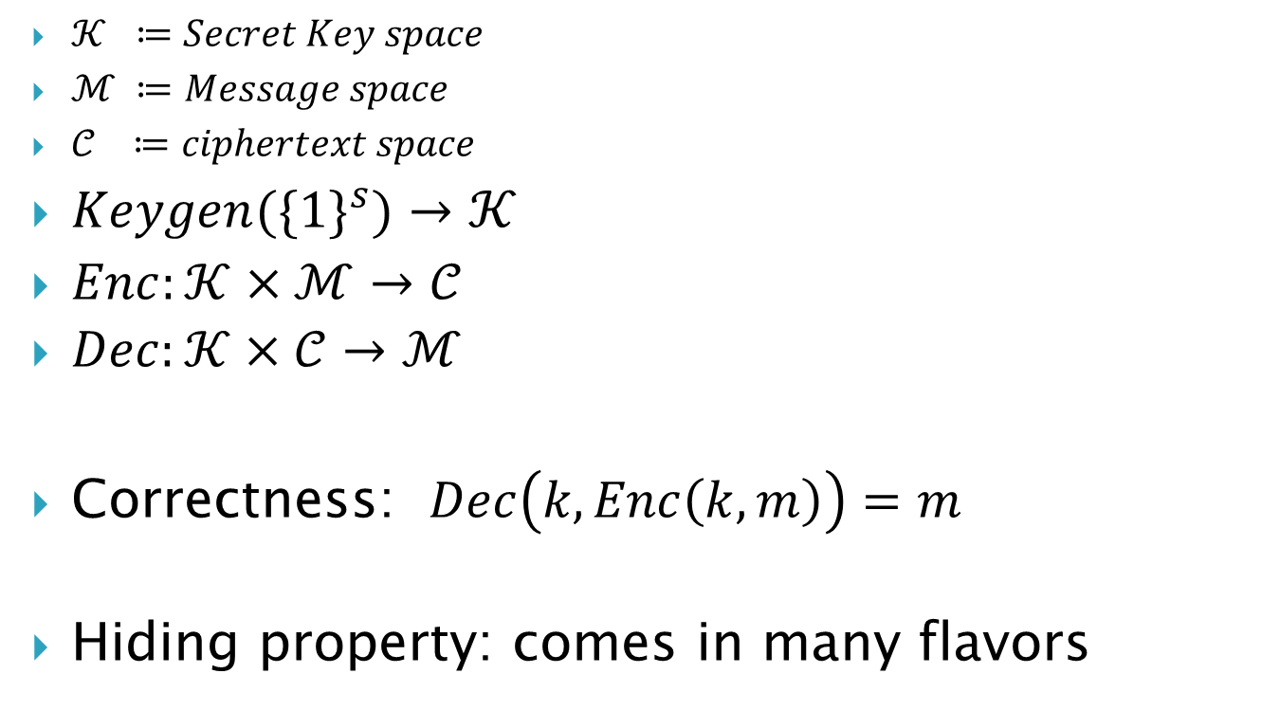
Encryption scheme
$𝒦 ≔Secret Key space$
$ℳ ≔Message space$
$𝒞 ≔ciphertext space$
$Keygen({\{1\}}^{s})→𝒦$
$Enc:𝒦×ℳ→𝒞$
$Dec:𝒦×𝒞→ℳ$
Correctness: $Dec\left(k,Enc\left(k,m\right)\right)=m$
Hiding property: comes in many flavors

Slide 8

One-time pad
$𝒦 ≔{\left\{0,1\right\}}^{n}$
$ℳ ≔{\left\{0,1\right\}}^{n}$
$𝒞 ≔{\left\{0,1\right\}}^{n}$
$keygen$
  $k∈_{R} {\left\{0,1\right\}}^{n}$
$Encrypt$
  $Enc\left(k,m\right) ≔k⊕m$
Decrypt
  $Dec\left(k,c\right) ≔k⊕c$

Slide 9

Security one-time pad
Correctness
  $Dec\left(k,Enc\left(k,m\right)\right)=$
  $Dec\left(k,k⊕m\right) =$
  $k⊕k⊕m =$
  m
Perfect security
  $\operatorname{Pr}\left[m=m_{1} \right| C=c]=Pr⁡[m=m_{1}]$

Slide 10

Perfect security for $n=1$
m=0
m=1
k=0
0
1
k=1
1
0

Slide 11




One-time pad vs Eve
$$c=0$$
$$k= ?$$
$$m= ?$$
$$c=0$$
$$k= ?$$
$$c= ?$$
$$m= ?$$
?????????
$$left→0$$
$$right→1$$

Slide 12



Bob could go left
$$c=0$$
$$k=0$$
$$m=0$$
$$c=k⊕m=0$$
$$k=0$$
$$c=0$$
$$m=k⊕c=0$$
?????????
$$left→0$$
$$right→1$$

Slide 13



Bob could go right
$$c=0$$
$$k=1$$
$$m=1$$
$$c=k⊕m=0$$
$$k=1$$
$$c=1$$
$$m=k⊕c=1$$
?????????
$$left→0$$
$$right→1$$

Slide 14
Trap game #2
Eve places a trap
Alice tells which side to go to Bob
  She knows where trap is
Eve wins if
  Bob goes where the trap is

Slide 15
How eve can win game #2
Left
Right
Goes Right
Eve places trap on right side.
Eve replaces message
Eve always wins.

Slide 16
Authentication
Allows Bob to know that a message really came from Alice
Prevents Eve from redirecting Bob towards the trap

Slide 17
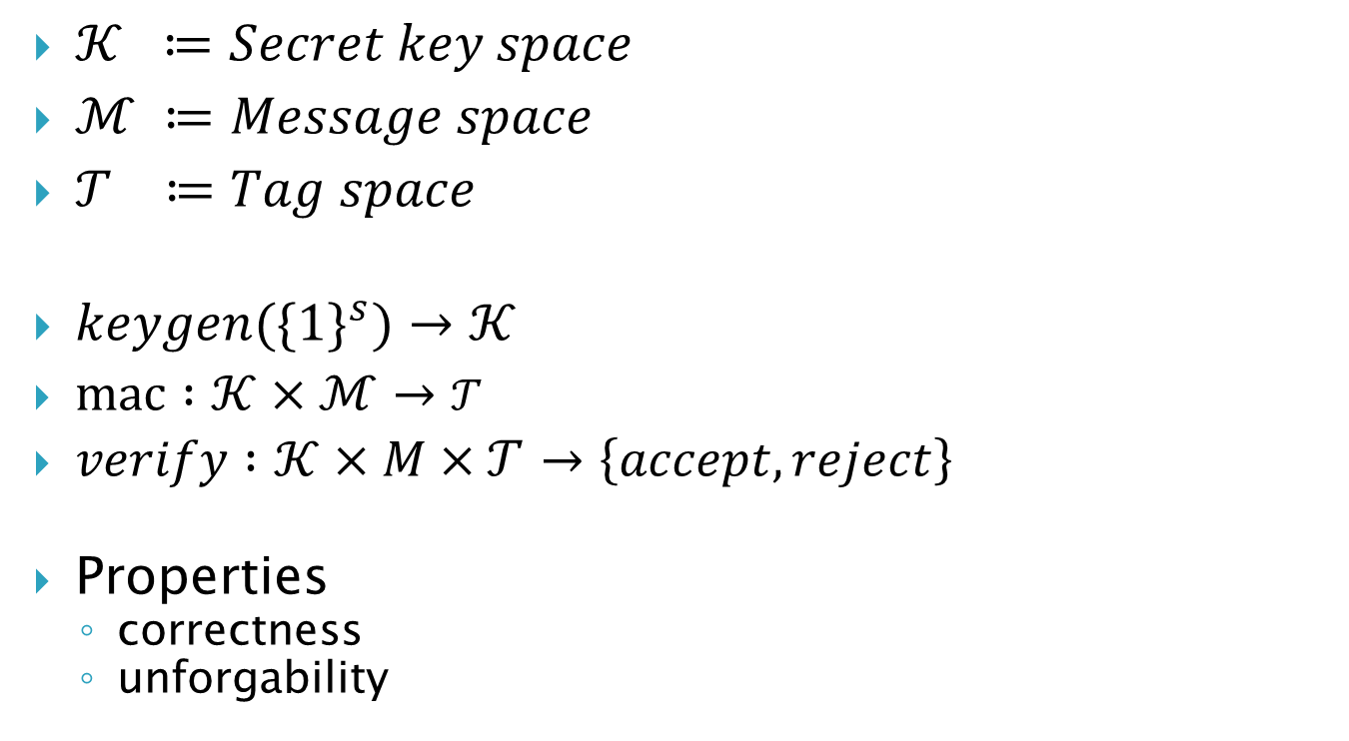
Message authentication code
$𝒦 ≔Secret key space$
$ℳ ≔Message space$
$𝒯 ≔Tag space$
$keygen({\{1\}}^{s})→𝒦$
$mac :𝒦×ℳ→𝒯$
$verify :𝒦×M×𝒯→\left\{accept,reject\right\}$
Properties
  correctness
  unforgability

Slide 18
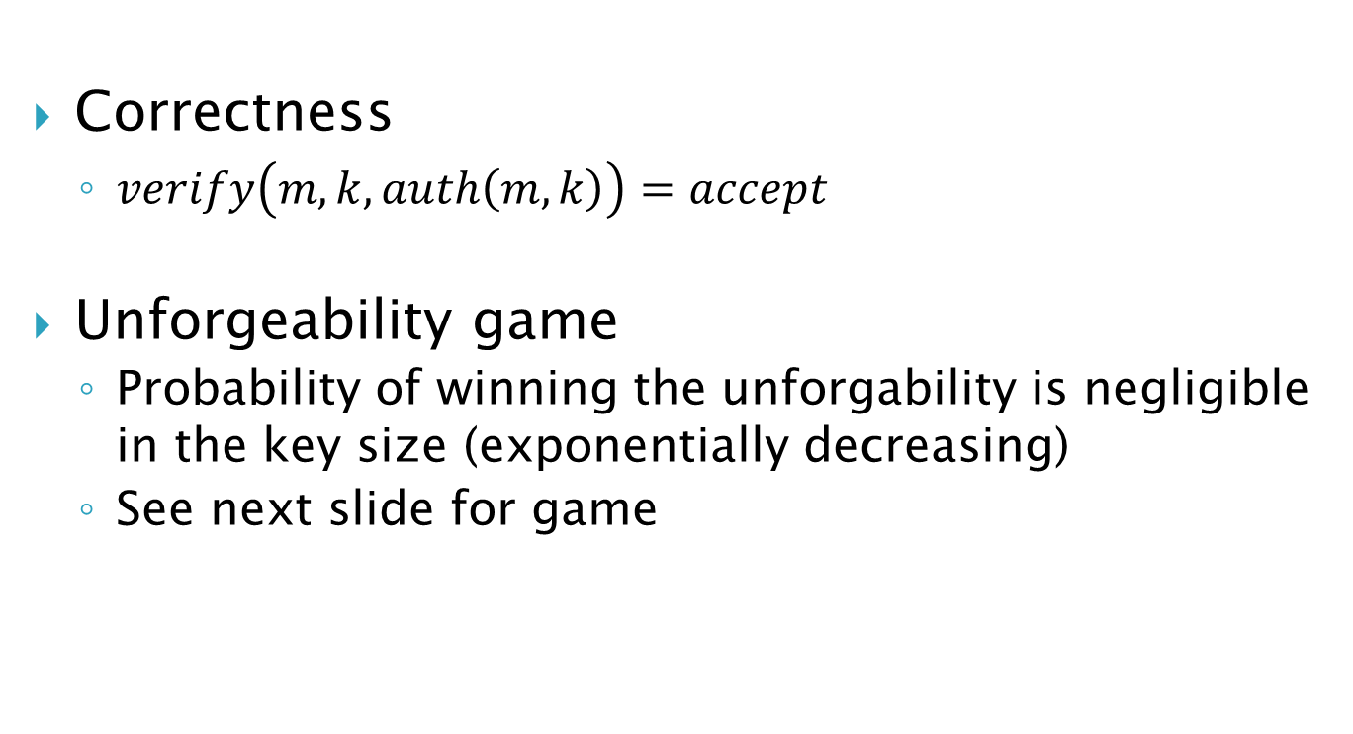
One-time mac
Correctness
  $verify\left(m,k,auth\left(m,k\right)\right)=accept$
Unforgeability game
  Probability of winning the unforgability is negligible in the key size (exponentially decreasing)
  See next slide for game

Slide 19


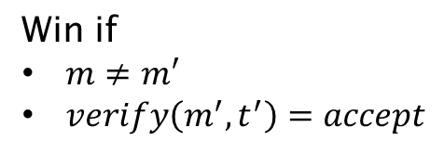
Unforgeability game
m
$k←keygen$()
$$t←mac(k,m)$$
t
$$(m^{′},t′)$$
Win if
$m≠m′$
$verify\left(m^{′},t^{′}\right)=accept$

Slide 20

Bit-mac
$b∈\{0,1\}$
$Keygen({\{1\}}^{s})$
  $k_{1},k_{2}∈_{R}{\left\{0,1\right\}}^{s}$
  $k←(k_{1},k_{2})$
$mac(k, b)$
  $\left(k_{1},k_{2}\right)←k$ (split key in two)
  $τ←k_{1}⋅b⊕k_{2}$
$verify\left(k,b,t\right)$
  $\left(k_{1},k_{2}\right)←k$
  $accept if t= k_{1}⋅b⊕k_{2}$

Slide 21

MAC (expensive)
$m∈F_{p}$
$Keygen\left({\left\{1\right\}}^{s}\right)$
  $F_{p} :\left|p\right|≥2^{s}$
  $k_{1},k_{2} ∈_{R}F_{p}$
  $k←(k_{1},k_{2})$
$Auth(k, m)$
  $\left(k_{1},k_{2}\right)←k$ (split key in two)
  $t←k_{1}∗m+k_{2} (mod p)$
$verify\left(k,m,t\right)$
  $\left(k_{1},k_{2}\right)←k$
  $accept if t= \left(k_{1}∗m+k_{2}\right) (mod p)$

Slide 22

MAC (cheap) (make example clear)
$m∈F_{p}^{n}$
$(m_{1},⋯{,m}_{n})←m$
$p_{m}\left(x\right)≔\sum_{i=1}^{n}{m_{i}}∗x^{i}$
  View message a polynomial
$Keygen()$
  $k_{1},k_{2}∈_{R}F_{p}$
  $k←(k_{1},k_{2})$
$Auth(k, m)$
  $\left(k_{1},k_{2}\right)←k$
  $t←p_{m}\left(k_{1}\right)+k_{2} (mod p)$
$verify\left(k,m,t\right)$
  $\left(k_{1},k_{2}\right)←k$
  $accept if$ $t= \left(p_{m}\left(k_{1}\right)+k_{2}\right) (mod p)$

Slide 23
Review
Encryption: Hide the message from Eve
Authentication: Allows Bob to verify that the message came from Alice
Message can be perfectly encrypted using one-time pad
  Requires key as long as the message
One-time mac
  2s bits of keys can authenticate an arbitrary long message by viewing the message as a polynomial

Slide 24
Disadvantages of perfect security
Perfect encryption
  key as long as message
Perfect authentication
  2s bits of key per message sent

