Slide 1
Historic perspective on computational encryption and the lessons we learned

Slide 2
Computational cryptography
Reuse the same key to encrypt multiple messages
Since it is not longer perfectly secure, what we want is the amount of effort it requires to break is larger than all the computational power in the universe

Slide 3
Historical perspective
Caesar cipher
Reusing one-time pad
Substitution cipher

Slide 4
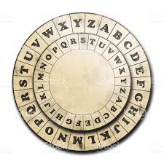

Caesar cipher
Keygen
  Select a random key $k∈ [1,26]$
Encryption
  Convert each letter to a number
    $\left(a,…,z\right)→ (0,…,25)$
  Encrypt each number letter using the shift
    $c_{i}← m_{i}+k (mod 26)$
  Convert the result back to number
    $\left(0,…,25\right)→(a,z)$
Example
  k$= 4$
  m$= Caesar$
  $c =geiwev$

Slide 5
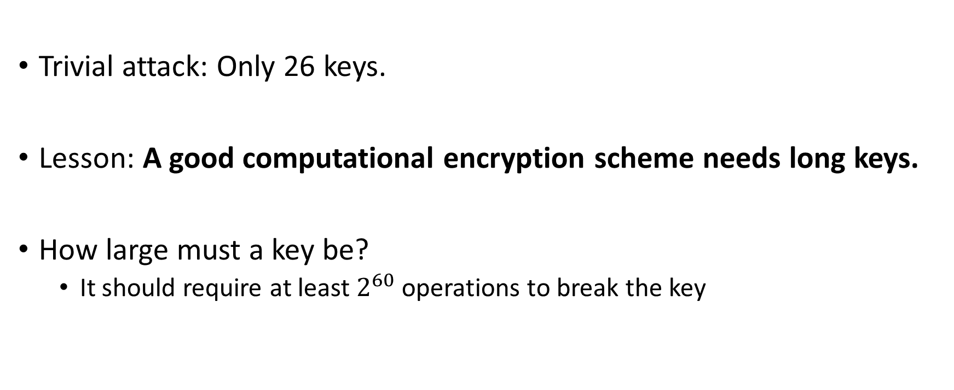
Very easy to break
Trivial attack: Only 26 keys.
Lesson: A good computational encryption scheme needs long keys.
How large must a key be?
  It should require at least $2^{60}$ operations to break the key

Slide 6
Exercise
Decrypt
OVDTHUFWVZZPISLRLFZHYLAOLYL
Encrypt a random message with a random key
Give someone else your encrypted message and ask them to decrypt them (without )

Slide 7
Useful for writing spoilers on the internet
Use caesar cipher (mod 13) to write spoilers on the internet
Game of throne spoiler
  Tnzr bs guebar fcbvyre vf jung vf jevggra

Slide 8
Obscurity does not help
Trying to hide the encryption algorithm is a bad idea
  Enigma fell into the hands of allies
  Untested assumptions
  Insider attacks
  Difficulty of evaluating parameters

Slide 9

Letter substitution cipher
Permutation cipher
Key generation
  Sample permutation $π:\left[a,…,z\right] →[a,…,z]$
Encryption
  $c_{i}←π\left(m_{i}\right)$
Decryption
  $m_{i}←π^{−1}(c_{i})$

Slide 10
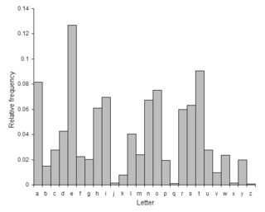
Frequency of letters in the English language

Slide 11
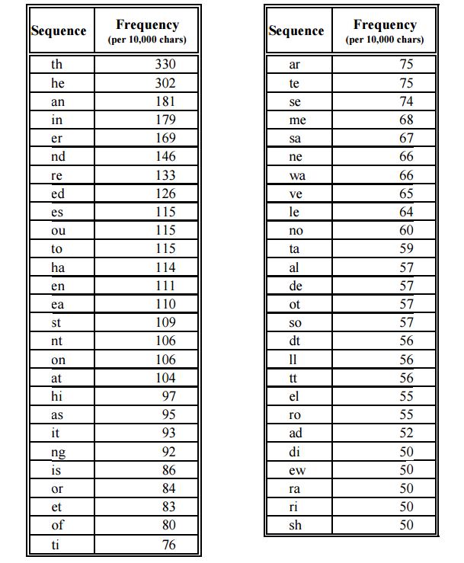
Most common two letter pairs

Slide 12
Other attack vectors
Most common words.
Most common expressions
Knowledge about the plaintext

Slide 13
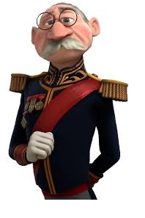



Which princess are they plotting to kidnap?
WMMW
Anna
Elsa

Slide 14
Security of permutation cipher
# Keys = 26! = 2^88
Lesson: Encryption scheme should break correlations

Slide 15
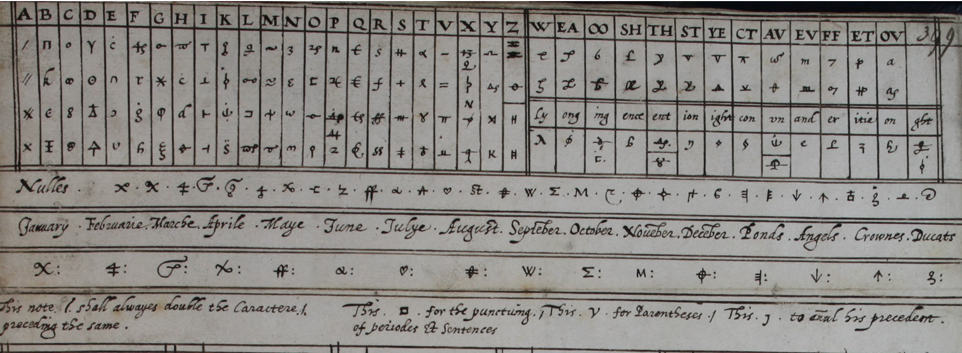
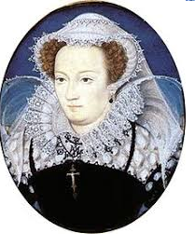
Mary Queen of Scots
Planned to depose the queen
Sent secret messages using
the cipher on the right

Slide 16
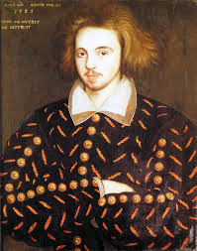
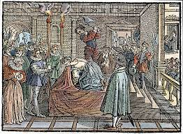
Cryptanalysis of Mary’s cipher and ultimate faith of Mary
Thomas Phelippes
Broke the cipher using statistical analysis.

Slide 17
Problem with substitution cipher
Map each symbol (letter, place or thing) to a set of symbols.
  Caesar cipher
  Permutation cipher
  Using special symbols for places, locations and things

Slide 18
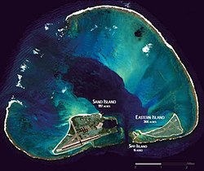
Midway islands
Site of one of the most important battles of world war two
Americans cryptographers were able to predict the attack ahead of time.

Slide 19
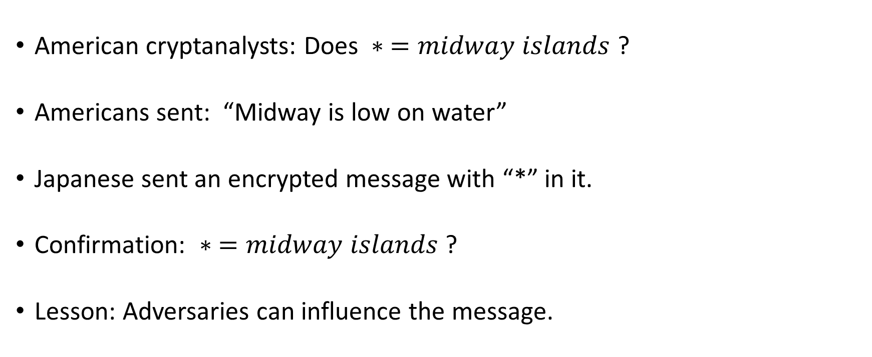
Midway islands
American cryptanalysts: Does $∗ =midway islands$ ?
Americans sent: “Midway is low on water”
Japanese sent an encrypted message with “*” in it.
Confirmation: $∗ =midway islands$ ?
Lesson: Adversaries can influence the message.

Slide 20

Reusing the one-time pad
Keygen
  $k∈_{R} {\left\{0,1\right\}}^{ℓ}$
Enc
  $m=m_{1}…m_{ℓ}∈{\left\{0,1\right\}}^{m⋅d}$
  $c←m_{1}⊕k, …, m_{d}⊕k$
Breaking reusing the one-time pad
  Try it for every length.

Slide 21





Problem with reusing the one-time pad
$$c=0$$
$$c=1$$
Goes left
Goes right
Since Eve knows Alice is reusing One-time pad, Eve knows Bob is going to the right

Slide 22
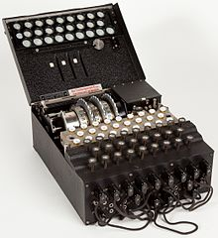
Enigma machine
Consisted of rotors
Each time a letter was presented
  Letter substituted by other letter
    Based on rotor position
  Rotors configuration changed.

Slide 23
Lessons from enigma
Weakness: a letter can never be encrypted back to itself
  Misused encryption scheme
Polish cryptanalysts were able to reverse engineer enigma’s settings
  Hiding your method of Encryption is foolish
Lessons: Encryption scheme should not exclude any possibility

Slide 24
Which princess are they plotting to kidnap?
UVND
Anna
Elsa

Slide 25
Kerckhoff’s principle
Lesson: A cryptosystem should be secure even if it is known by the adversary
Why security through obscurity fails
  Analysis
  Stealing of machines (as occurred with enigma)
  Spies
Modern extension
  Security of a cryptosystem should rely only on the secrecy of the key
  NSA assumed that their machines would fall into Soviet hands

Slide 26
Justifications for Kerckhoff’s principle
Easier to change a short key than to change an algorithm
Algorithm can be leaked by insider

Slide 27
Justifications for Kerckhoff’s principle
If you have n parties, which of these is easier?
  One secret encryption algorithm for each pair of party
  A secret key between each party

Slide 28
Application of Kerckhoff’s
Lesson: Only public (well-studied) algorithms should be used
Secret algorithms could
  Contain flaws
  Weak parameters
  Vulnerable to reverse-engineering
  Backdoors

Slide 29
Principals of modern cryptography
Principal #1:
  The first problem in solving a cryptographic problem is the formulation of a rigorous and precise definition of security

Slide 30
Principals of modern cryptography
Principal #2:
  When the security of a cryptographic scheme relies on an unproven assumption, the assumption should be made explicit
Ideally the assumption should be simple.

Slide 31
Comparing encryption schemes
Efficiency
Level of security
Simplicity
Tradeoff

Slide 32
Simplicity
Why do we care if a cryptographic algorithm is simple?
The more simpler a crypto algorithm
  The easier it is to avoid bugs
  The easier it is to protect against side-channel attacks

Slide 33
Trying to define encryption
Attempt #1: An encryption scheme is secure if no adversary can learn the key
Why it fails: In the princess example, you knew which princess to capture without knowing the key.

Slide 34
Trying to define encryption
Attempt #2: An encryption scheme is secure if no adversary can find the plaintext that corresponds to the ciphertext.
Why it fails: In the midway example, you just needed to learn which island they were referring to and didn’t really care about what the rest of the message said.

Slide 35
Trying to define encryption
Attempt #3: An encryption scheme is secure if no adversary can determine any character of the plaintext that corresponds to the ciphertext.
Why it fails: In the princess example with enigma, we were able to learn which message it was by excluding a character

Slide 36
A valid definition of security for encryption
An encryption scheme is secure if no adversary can derive any function of the plaintext from the ciphertext.
Lesson: Definition of security should apply in every context

Slide 37
Cryptographic assumption
Assumptions where that a problem is hard to solve (conjecture)
  Finding the prime factors of a number
  Solving the discrete logarithm

Slide 38
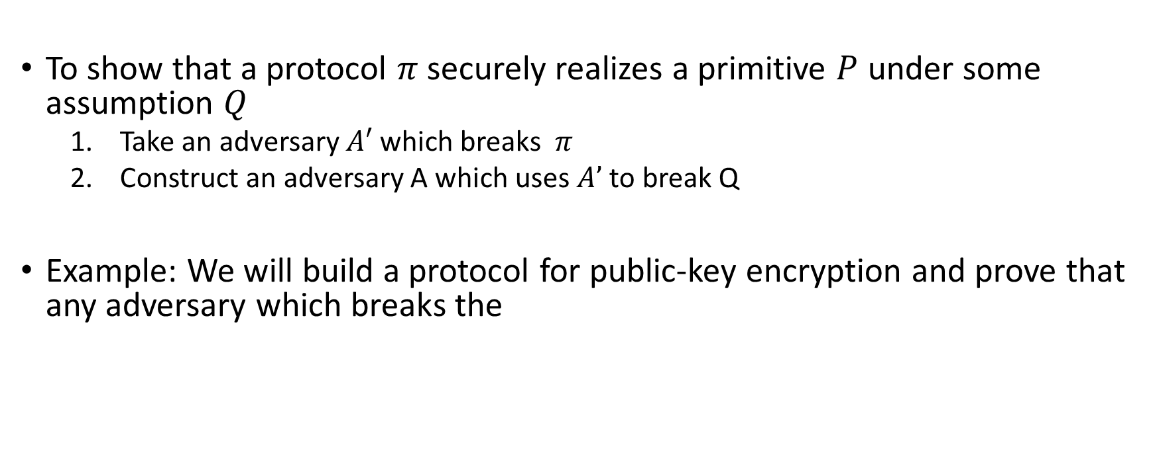
Reductionist approach to security
To show that a protocol $π$ securely realizes a primitive $P$ under some assumption $Q$
  Take an adversary $A′$ which breaks $π$
  Construct an adversary A which uses $A’$ to break Q
Example: We will build a protocol for public-key encryption and prove that any adversary which breaks the

Slide 39
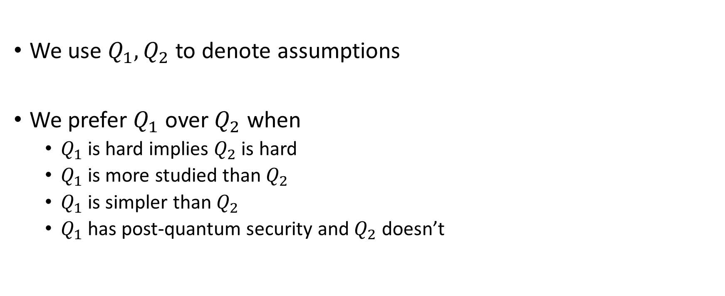
Preferences in term of assumptions
We use $Q_{1},Q_{2}$ to denote assumptions
We prefer $Q_{1}$ over $Q_{2}$ when
  $Q_{1}$ is hard implies $Q_{2}$ is hard
  $Q_{1}$ is more studied than $Q_{2}$
  $Q_{1}$ is simpler than $Q_{2}$
  $Q_{1}$ has post-quantum security and $Q_{2}$ doesn’t

