Slide 1
Modern symmetric-key Encryption

Slide 2
Computational Security
What does it mean to be pseudo-random
  Things can look random when they are not
This can be used to achieve secure encryption while using short keys

Slide 3
Security
A scheme is secure if:
  Every Probabilistic Polynomial Time Adversary succeeds in breaking the scheme with only negligible probability.

Slide 4
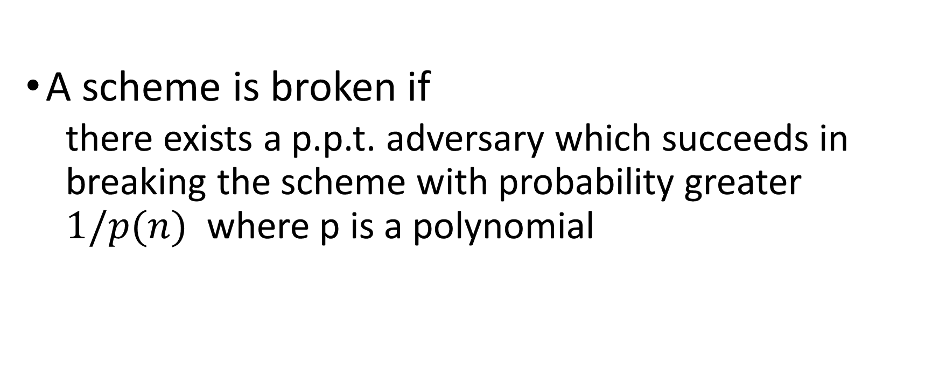
Insecurity of a scheme
A scheme is broken if
  there exists a p.p.t. adversary which succeeds in breaking the scheme with probability greater $1/p(n)$ where p is a polynomial

Slide 5







Definition of Pseudo-random generator
A function $G :{\left\{0,1\right\}}^{n}→{\left\{0,1\right\}}^{ℓ\left(n\right)}$ is a PRG if
  Expansion: $ℓ\left(n\right)>n$ (trivial if $ℓ\left(n\right)≤n)$
  Pseudo-random: following two games are computationally indistinguishable
$$r∈_{R}{\left\{0,1\right\}}^{n}$$
w
w
$$w←G(r)$$
$$w∈_{R}{\left\{0,1\right\}}^{ℓ(n)}$$
$$G_{0}$$
$$G_{1}$$

Slide 6
Pseudo-random generator exercise
Make groups of two where each player takes a role
  Game
  Distinguisher

Slide 7
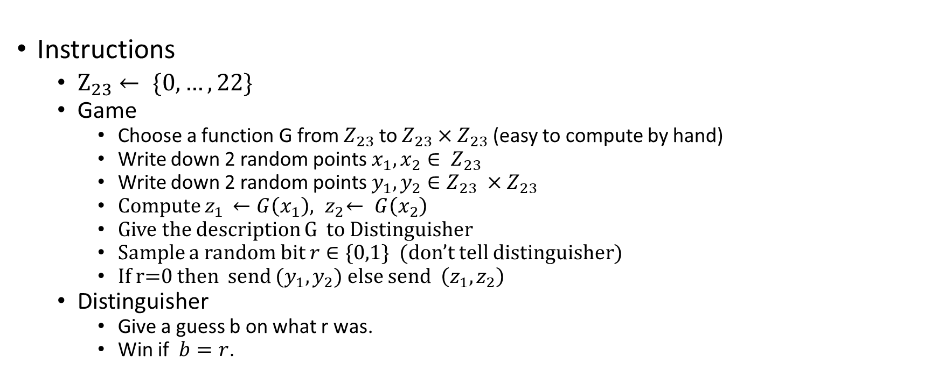
Pseudo-random generator exercise
Instructions
  $Z_{23}← \{0,…,22\}$
  Game
    Choose a function G from $Z_{23}$ to $Z_{23}×Z_{23}$ (easy to compute by hand)
    Write down 2 random points $x_{1}, x_{2}∈ Z_{23}$
    Write down 2 random points $y_{1},y_{2}∈Z_{23} ×Z_{23}$
    Compute $z_{1 }←G\left(x_{1}\right),{ z}_{2}← G\left(x_{2}\right)$
    Give the description G to Distinguisher
    Sample a random bit $r∈\{0,1\}$ (don’t tell distinguisher)
    If r=0 then send $(y_{1},y_{2})$ else send $\left(z_{1},z_{2}\right)$
  Distinguisher
    Give a guess b on what r was.
    Win if $b=r$.

Slide 8
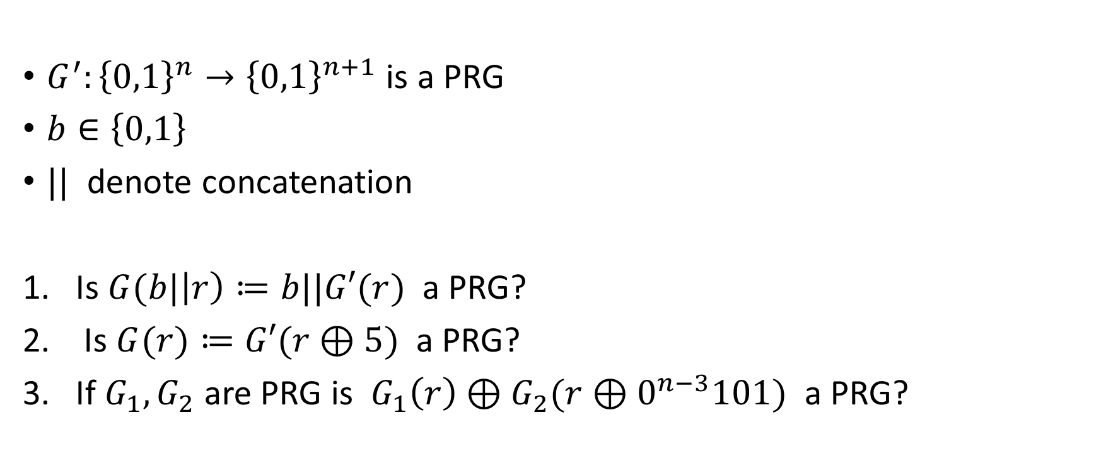
Questions on generators
$G^{′}:{\left\{0,1\right\}}^{n}→{\left\{0,1\right\}}^{n+1}$ is a PRG
$b∈\left\{0,1\right\}$
$||$ denote concatenation
Is $G(b|\left|r\right)≔b||G′(r)$ a PRG?
Is $G(r)≔G′(r⊕5)$ a PRG?
If $G_{1},G_{2}$ are PRG is $G_{1}\left(r\right)⊕G_{2}(r⊕0^{n−3}101)$ a PRG?
Yes
Yes
No

Slide 9
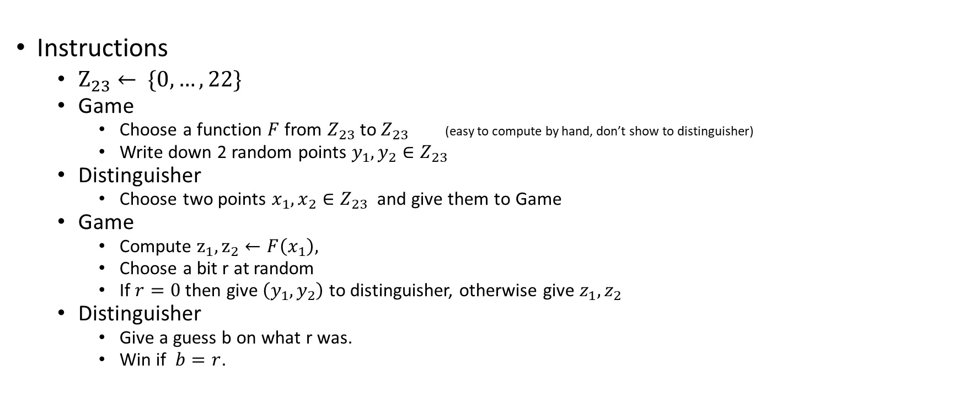
Pseudo-random function exercise
Instructions
  $Z_{23}← \{0,…,22\}$
  Game
    Choose a function $F$ from $Z_{23}$ to $Z_{23}$ (easy to compute by hand, don’t show to distinguisher)
    Write down 2 random points $y_{1},y_{2}∈Z_{23}$
  Distinguisher
    Choose two points $x_{1},x_{2}∈Z_{23}$ and give them to Game
  Game
    Compute $z_{1},z_{2}←F\left(x_{1}\right),$
    Choose a bit r at random
    If $r=0$ then give$\left(y_{1},y_{2}\right)$ to distinguisher, otherwise give $z_{1},z_{2}$
  Distinguisher
    Give a guess b on what r was.
    Win if $b=r$.

Slide 10

CPA-secure encryption scheme from PRF
$Keygen\left({\{1\}}^{s}\right)$
  $k∈_{R}{\left\{0,1\right\}}^{s}$
$Enc_{k}\left(m\right)$
  $r∈_{R}{\left\{0,1\right\}}^{n}$
  $c←\left(r, F_{k}\left(r\right)⊕m\right)$
$Dec_{k}\left(c\right)$
  $\left(r,d\right)←c$
  $m←F_{k}\left(r\right)⊕d$

Slide 11
Proving security of encryption from PRG
We will use the distinguisher for the encryption scheme to build a distinguisher which distinguisher between a random function and the PRF.
This would thus imply that the function is not PRF and therefore the construction is secure when instantiated as a PRF.

Slide 12























Building a distinguisher for the PRF using a distinguisher for the encryption scheme
$$r∈_{R}{\left\{0,1\right\}}^{n}$$
$$m_{0},m_{1}$$
$$r$$
k $∈_{R}{\left\{0,1\right\}}^{n}$
Since the red part is an encryption of the message the distinguisher will guess which game he is in with good probability
m$←m_{0}$
guess
$$d←w⊕m$$
$$f ←F_{K}$$
$$c$$
$$c←(r,d)$$
$$w$$
$$w ←f(r)$$
$$r∈_{R}{\left\{0,1\right\}}^{n}$$
$$m_{0},m_{1}$$
$$r$$
k $∈_{R}{\left\{0,1\right\}}^{n}$
m$←m_{1}$
$$f ←F_{K}$$
$$guess$$
$$d←w⊕m$$
$$c$$
$$w$$
$$w ←f(r)$$
$$c←(r,d)$$

Slide 13
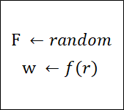



Building a distinguisher for the PRF using a distinguisher for the encryption scheme
$$r∈_{R}{\left\{0,1\right\}}^{n}$$
k $∈_{R}{\left\{0,1\right\}}^{n}$
$$m_{0},m_{1}$$
$$r$$
k $∈_{R}{\left\{0,1\right\}}^{n}$
m$←m_{0}$
$$f ←F_{K}$$
Since the red part is random no distinguisher
can distinguish between these two games.
guess
$$d←w⊕m$$
$$f ←F_{K}$$
$$c$$
$$w$$
$$w ←f(r)$$
$$c←(r,d)$$
$$w ←f(r)$$
$$r∈_{R}{\left\{0,1\right\}}^{n}$$
k $∈_{R}{\left\{0,1\right\}}^{n}$
$$m_{0},m_{1}$$
$$r$$
k $∈_{R}{\left\{0,1\right\}}^{n}$
m$←m_{1}$
$$f ←F_{K}$$
$$f ←F_{K}$$
$$guess$$
$$d←w⊕m$$
$$c$$
$$w$$
$$w ←f(r)$$
$$c←(r,d)$$
$$w ←f(r)$$

Slide 14
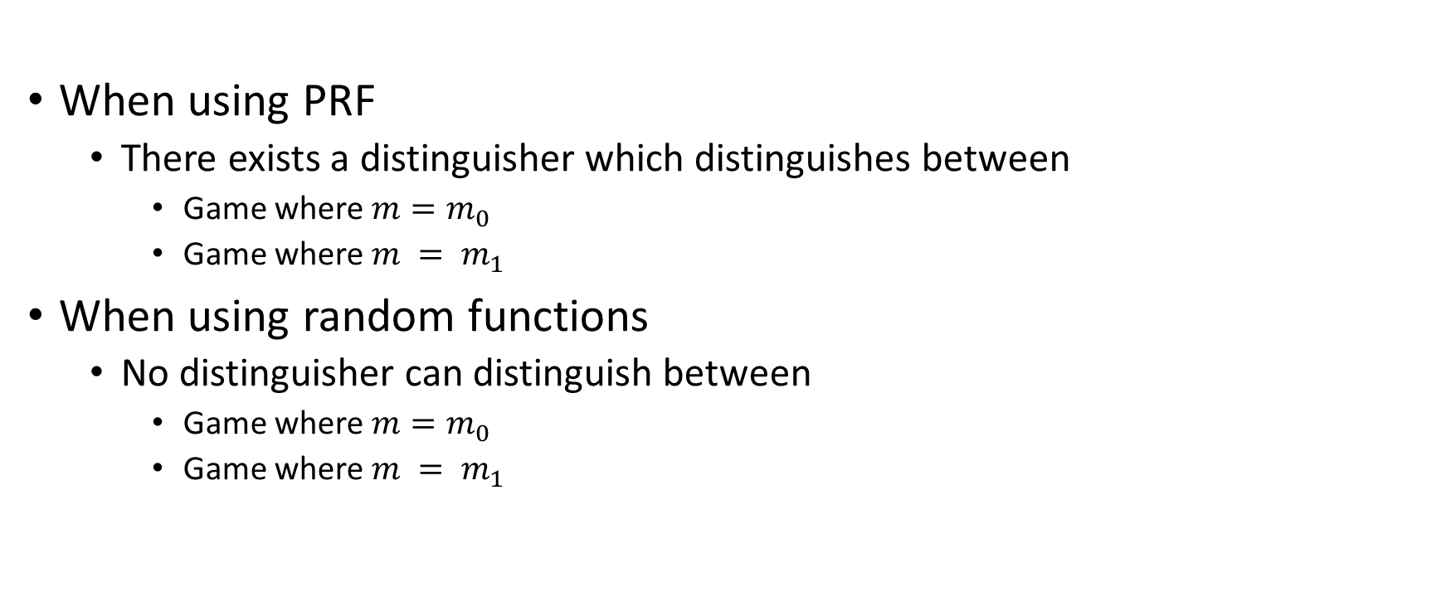
Building a distinguisher for the PRF using a distinguisher for the encryption scheme
When using PRF
  There exists a distinguisher which distinguishes between
    Game where $m=m_{0}$
    Game where $m = m_{1}$
When using random functions
  No distinguisher can distinguish between
    Game where $m=m_{0}$
    Game where $m = m_{1}$

Slide 15










Building a distinguisher for the PRF using a distinguisher for the encryption scheme
$$r∈_{R}{\left\{0,1\right\}}^{n}$$
$$m_{0},m_{1}$$
$$b∈_{R}\{0,1\}$$
$$r$$
$$guess:= guess^{′}⊕ b$$
$$Guess’$$
$$d←(w⊕m_{b})$$
$$c$$
$$c←(r,d)$$
$$w$$
$$≔distinguisher for the encryption scheme$$

Slide 16
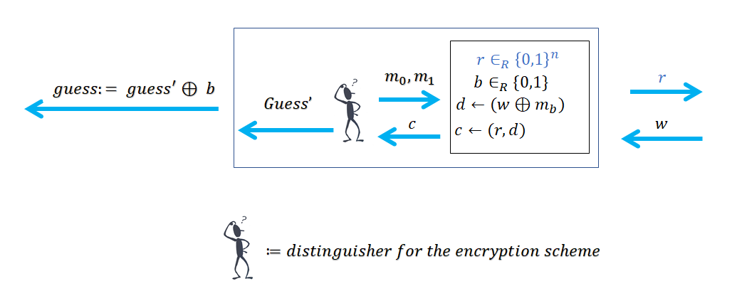
Result
With a PRF, the distinguisher guesses correctly with good probability
With a random function, the distinguisher guesses correctly about half to the time
Therefore the distinguisher can distinguish between PRF and random function. Therefore the function is not a PRF.

