Slide 1
Computational indistinguishability
Last time I promise

Slide 2

Unitary notation
Writing numbers only using 1
  1 -> 1
  2- > 11
  3 -> 111
  $⋯$
  $n →1…1$ (n times)
$1^{n}$ is shorthand for writing n in unitary

Slide 3
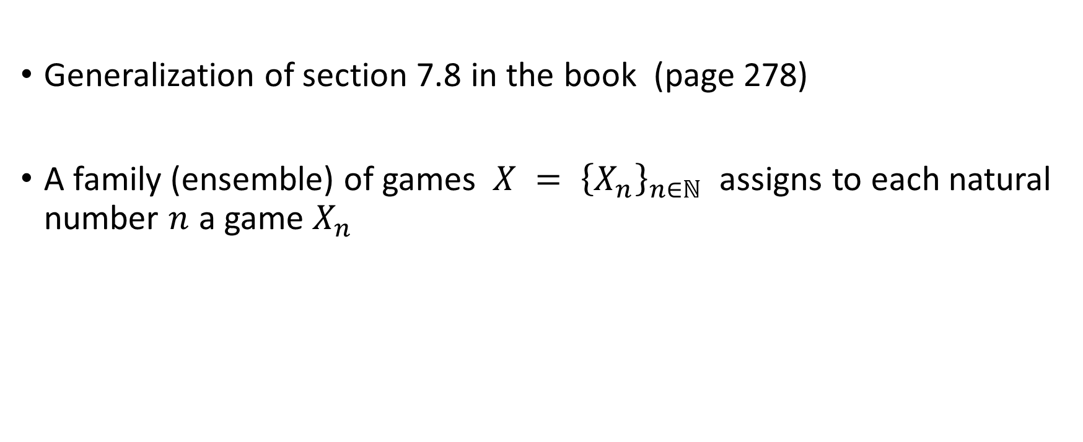
Family of games
Generalization of section 7.8 in the book (page 278)
A family (ensemble) of games $X = {\left\{X_{n}\right\}}_{n∈ℕ}$ assigns to each natural number $n$ a game $X_{n}$

Slide 4

Distinguisher
Definition of distinguisher
  Input
    Game g
    Index i written in unitary
  Outputs a bit $b∈\{0,1\}$

Slide 5
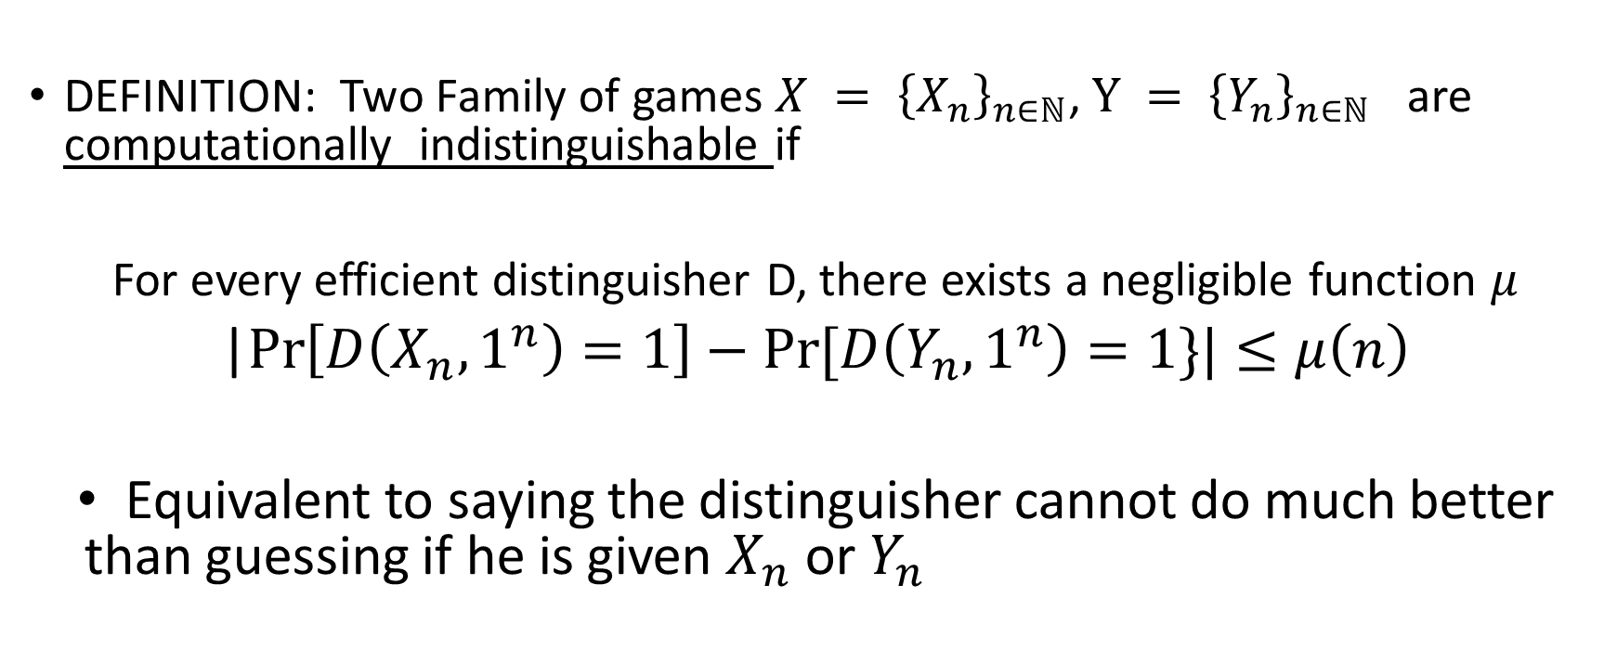
Computational indistinguishability
DEFINITION: Two Family of games $X = {\left\{X_{n}\right\}}_{n∈ℕ}$, $Y = {\left\{Y_{n}\right\}}_{n∈ℕ}$ are computationally indistinguishable if
For every efficient distinguisher D, there exists a negligible function $μ$
|$\operatorname{Pr}\left[D\left(X_{n},1^{n}\right)=1\right]−\operatorname{Pr}{[D\left(Y_{n},1^{n}\right)}=1\}|≤μ\left(n\right)$
Equivalent to saying the distinguisher cannot do much better than guessing if he is given $X_{n}$ or $Y_{n}$

Slide 6



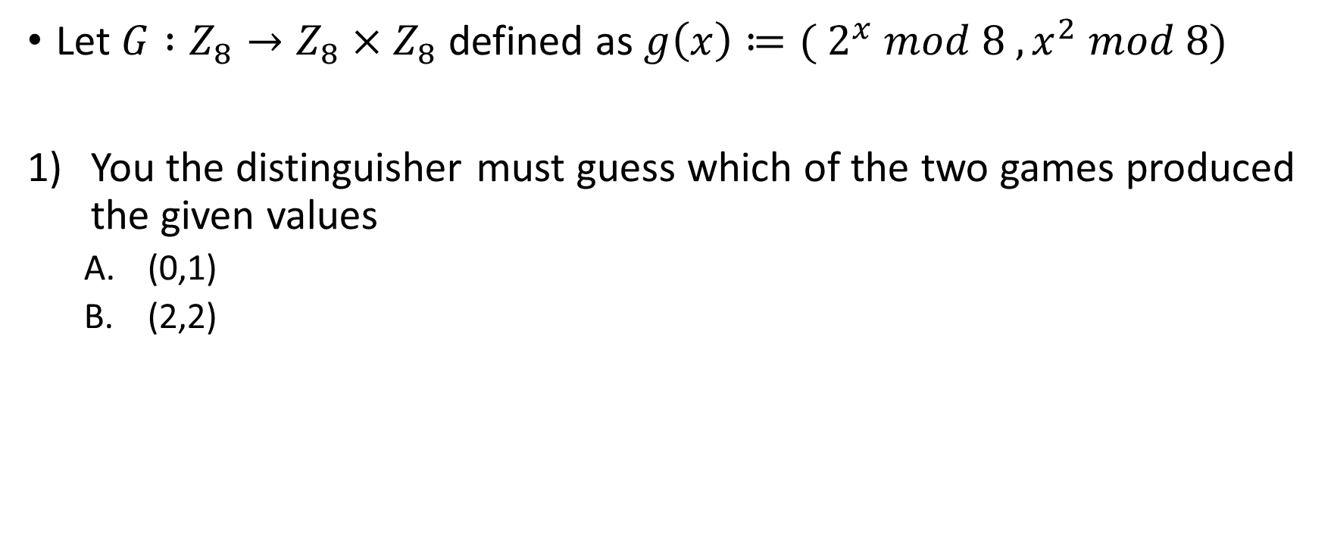





Play the role of the distinguisher
Let $G :Z_{8}→Z_{8}×Z_{8}$ defined as $g\left(x\right)≔( 2^{x} mod 8 , x^{2} mod 8)$
You the distinguisher must guess which of the two games produced the given values
  (0,1)
  (2,2)
$$x∈_{R}Z_{8}$$
$$x∈_{R}Z_{8}$$
$$y$$
$$y$$
$$y←_{R}g(x)$$
$$y←_{R}Z_{8}×Z_{8}$$
$$G_{0}$$
$$G_{1}$$

Slide 7

Distinguisher
Answer
  $(1,1) −>$ $G_{0}$ is your best guess
    g(3) = (2^3 mod 8,3^2 mod 8 ) = (1,1)
      $PR\left[G_{0}=\left(1,1\right)\right]=\frac{1}{8}$
      $Pr⁡[G_{1}=(1,1,)]$ = 1/64
  $\left(2,2\right)−>Only G_{1}$ can output (2,2).
    $PR\left[G_{0}=\left(2,2\right)\right]=0$
    $Pr⁡[G_{1}=(1,1,)]$ = 1/64

Slide 8

Problem #1
1 0 1 1 0 0 0 0 1 1 0 1
$$⊕$$
0 1 1 0 1 0 1 1 0 0 0 1
1 1 0 1 1 0 1 1 1 1 0 0

Slide 9
Problem #2
Known plaintext, ciphertext
  we attack in a week -> 16 letters
  DWFTABWDUMAWDXS -> 16 letters
attack
  FMAKFINQNFMWQH -> 14
  We attack by land -> 14
  We attack by sea -> 13

Slide 10
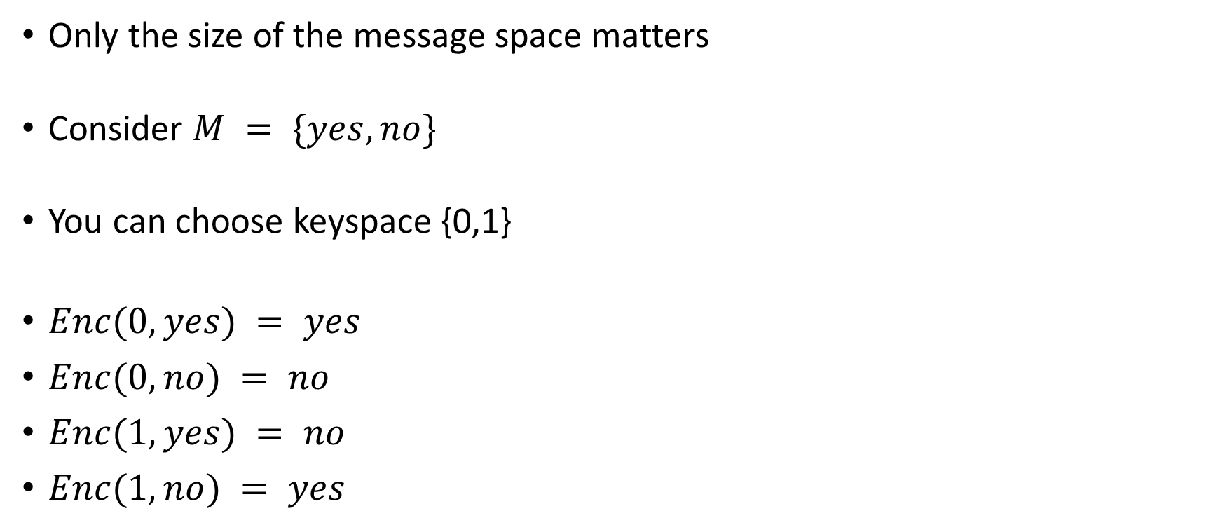
Problem #3
Only the size of the message space matters
Consider $M = \{yes,no\}$
You can choose keyspace {0,1}
$Enc(0,yes) = yes$
$Enc(0,no) = no$
$Enc(1,yes) = no$
$Enc(1,no) = yes$

Slide 11

Problem 4
p = 23
m = 11
k = (12,5)
$mac\left(\left(12,5\right),11\right)=11⋅12+5 \left(mod 23\right)=$22

Slide 12

Problem 5
p = 23
m = (11,4)
k = (14,2)
$mac\left(\left(14,2\right),(11,4)\right)=11⋅14+4⋅{14}^{2}+2 \left(mod 23\right)=20$

Slide 13

Problem 6
p = 32
m = 0
t = 14
$\left(m’,t’\right)←(16,14)$
$mac\left(\left(k_{1},k_{2}\right),0\right)=k_{2} ⇒k_{2}=14$
m$ac\left(\left(k_{1},14\right),16\right)=16⋅k_{1}+14 \left(mod 32\right)$
If $k_{1}$ is even then ${16⋅k}_{1} \left(mod 32\right)=0 ⇒mac\left(\left(k_{1},14\right),16\right)=14$
$\operatorname{Pr}\left[k_{1} is even\right]=\frac{1}{2}$
Forgery accepted with probability $½ >\frac{1}{32}$

Slide 14
Problem 6
p = 32
m = 0
t = 14
$\left(m’,t’\right)←(16,14)$
$mac\left(\left(k_{1},k_{2}\right),0\right)=k_{2} ⇒k_{2}=14$
m$ac\left(\left(k_{1},14\right),16\right)=16⋅k_{1}+14 \left(mod 32\right)$
If $k_{1}$ is even then ${16⋅k}_{1} \left(mod 32\right)=0 ⇒mac\left(\left(k_{1},14\right),16\right)=14$
$\operatorname{Pr}\left[k_{1} is even\right]=\frac{1}{2}$
Forgery accepted with probability $½ >\frac{1}{32}$

Slide 15

Problem 7
Evan is insecure
  Let $m=0$
    $mac_{1}(k_{1},k_{2},k_{3},0) = k_{2}$
    $mac_{2}(k_{1},k_{2},k_{3},0) = k_{2}$
    $mac_{1}\left(k_{1},k_{2},k_{3},0\right)=mac_{2}(k_{1},k_{2},k_{3},0)$

Slide 16





Problem 7 : one definition of two-time mac
$$m_{1},m_{2}$$
$$t_{1}←mac(k_{1},k_{2},k_{3},m_{1})$$
$$t_{1},t_{2}$$
$$t_{2}←mac(k_{1},k_{2},k_{3},m_{2})$$
$$m,t$$
Win if $(m≠m_{1}$ and $m≠m_{2})∧(\left(mac_{1}\left(k_{1},k_{2},k_{3},m\right)=t\right)∨$ $\left(mac_{2}\left(k_{1},k_{2},k_{3},m\right)=t\right))$

Slide 17

Problem seven : security
Dave is secure because $k_{1}$ is always hidden: first by $k_{2}$ and then $k_{3}$

Slide 18

Problem 8: Extending the two-time mac
$mac_{i}\left(m,k_{1},…,k_{n+1}\right)≔m⋅k_{1}+k_{i+1}$

Slide 19
Relationship between enigma and 2.7
Excluding possibilities never helps

Slide 20
Book problem 1.5
Shift: one letter
Substitution: some subset of the letters (wheel of fortune)
Vignere: as long as the key

Slide 21
Book problem 1.5
Shift: one letter
Substitution: some subset of the letters (wheel of fortune)
Vignere: as long as the key

Slide 22

Book problem 2.3
Refute
  Keygen
    $b_{1},b_{2}∈_{R}\{0,1\}$
    $k^{′}∈_{R}\{{0,1\}}^{n}$
  $$Enc(\left(b_{1},b_{2},k\right),m)$$
  ($b_{1}∧b_{2},k⊕ m)$
  Dec($b_{1},b_{2},k)$,(d,c))
  $m←c⊕m$

Slide 23
Book problem 2.6
No
Yes

Slide 24
Book problem 2.7
NOOOOOOOOOOOOOOOOOOOOOOOOOOOOOOOOOO

Slide 25
Book problem 2.10
For every key and ciphertext there is at most 1 plaintext which the ciphertext can decrypt too
Since |keyspace| < |message space|, for every ciphertext there must be at least one message which cannot be encrypted to that ciphertext
We are using pigeon-hole principle

Slide 26
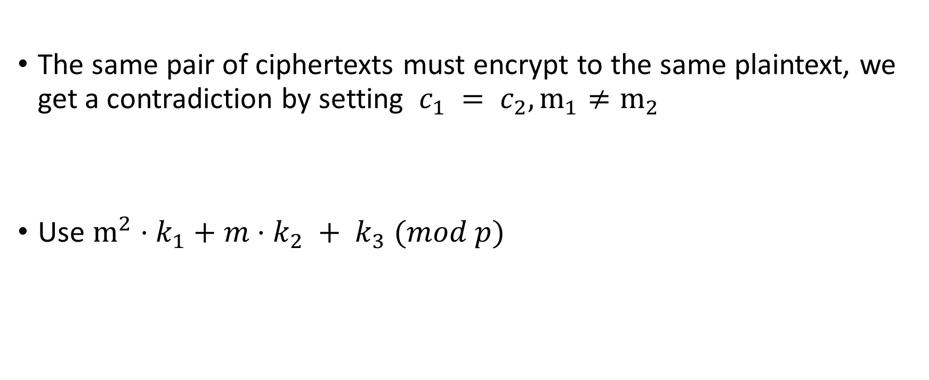
Book problem 2.13
The same pair of ciphertexts must encrypt to the same plaintext, we get a contradiction by setting $c_{1} = c_{2}, m_{1}≠m_{2}$
Use $m^{2}⋅k_{1}+m⋅k_{2} + k_{3} (mod p)$

Slide 27
Computational message authentication code

Slide 28


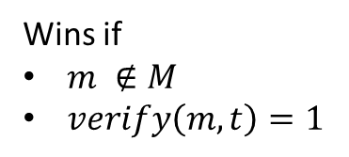





Mac forgery game
$$M ←\{\}$$
k $∈_{R}{\left\{0,1\right\}}^{s}$
$$m′$$
$$M←M∪\{m′\}$$
Repeat as many times
as the adversary wants
$$t′$$
$$t′ ←mac_{k}(m′)$$
$$(m,t)$$
Wins if
$m ∉M$
$verify\left(m,t\right)=1$

Slide 29
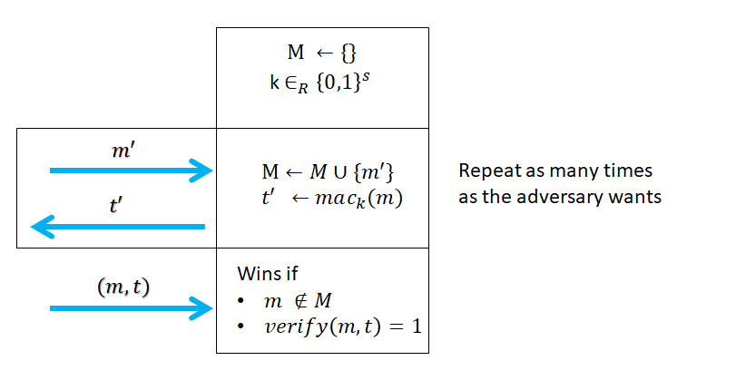

Mac forgery game
Allow the adversary to learn tags for as many message as he wants
A mac scheme is secure if
  $\operatorname{Pr}\left[adv wins the forgery game\right]≤negl(s)$

Slide 30
Does encryption imply authentication
Let’s take as example the one-time pad
What happens if the adversary flips a bit of the ciphertext
Lesson: Encryption does not imply authentication

Slide 31


Fixed-length mac from PRF
Keygen
  $k∈_{R}{\left\{0,1\right\}}^{n}$
Authenticate
m
m
$$F_{k}$$
t
t

Slide 32

Pitfalls of authenticating arbitrary length message
${\tilde{auth}}_{k}\left(m_{1},…,m_{n}\right)≔auth\left(m_{1}\right),…,auth(m_{n})$

Slide 33

Pitfalls of authenticating arbitrary length message
${\tilde{auth}}_{k}\left(m_{1},…,m_{n}\right)≔auth\left(m_{1}\right),…,auth(m_{n})$
${\tilde{auth}}_{k}\left(m_{1},…,m_{n}\right) ≔auth\left(1,m_{1}\right),…,auth\left(n,m_{n}\right)$

Slide 34
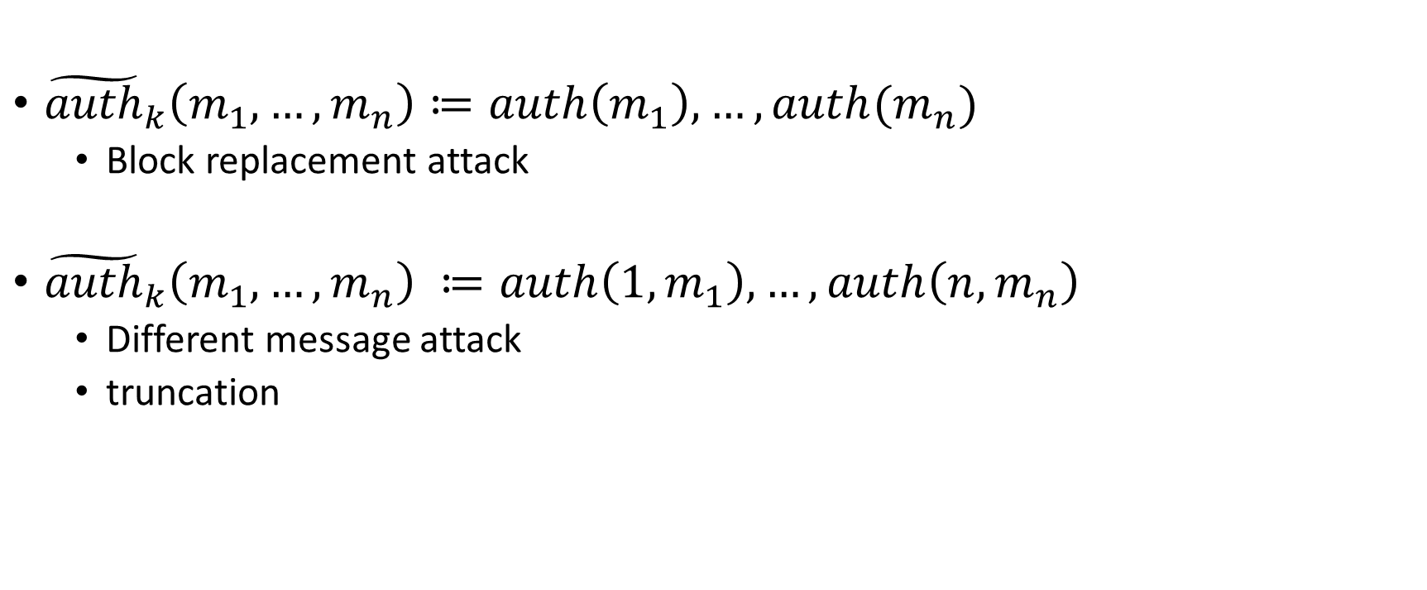
Pitfalls of authenticating arbitrary length message
${\tilde{auth}}_{k}\left(m_{1},…,m_{n}\right)≔auth\left(m_{1}\right),…,auth(m_{n})$
  Block replacement attack
${\tilde{auth}}_{k}\left(m_{1},…,m_{n}\right) ≔auth\left(1,m_{1}\right),…,auth\left(n,m_{n}\right)$
  Different message attack
  truncation

Slide 35
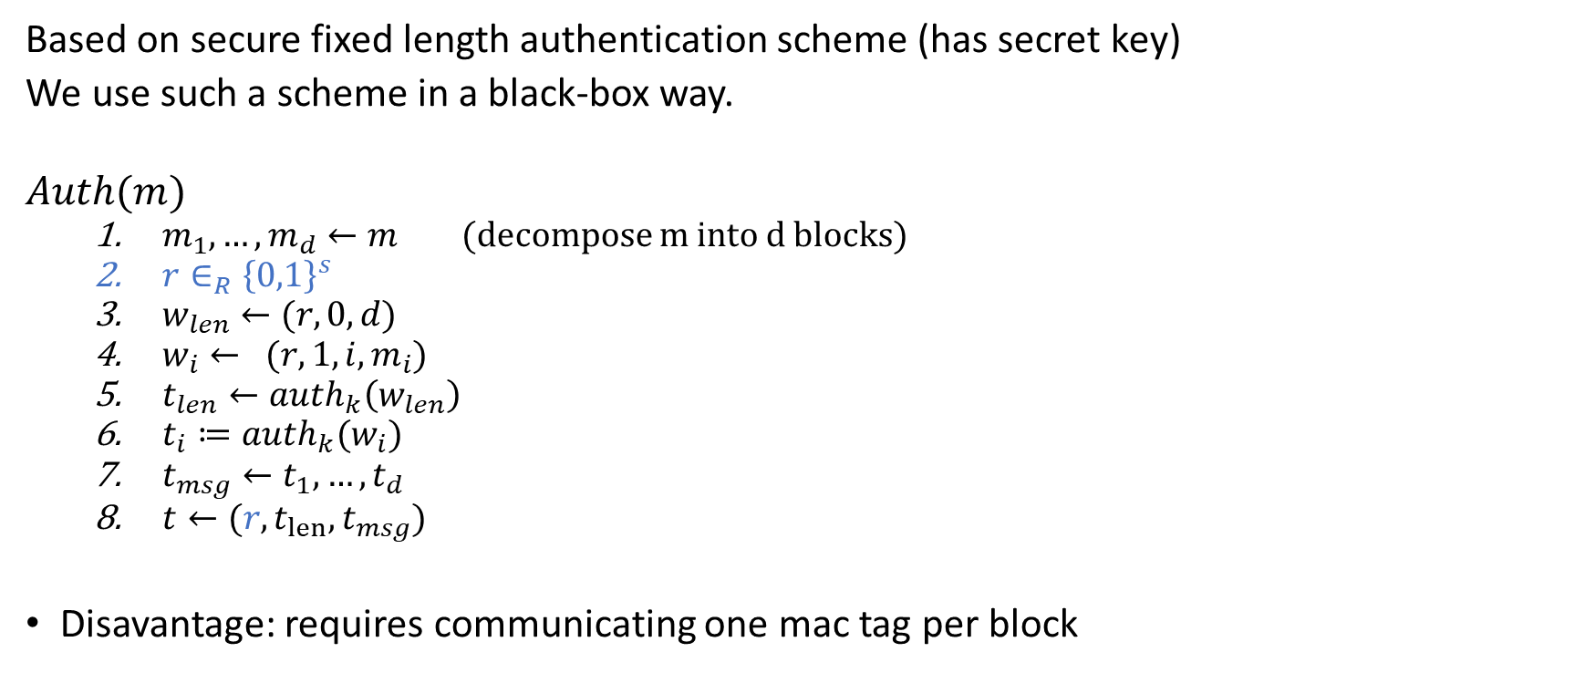
Arbitrary-length mac scheme
Based on secure fixed length authentication scheme (has secret key)
We use such a scheme in a black-box way.
$$Auth(m)$$
  $m_{1},…,m_{d}←m$ (decompose m into d blocks)
  $r∈_{R}{\left\{0,1\right\}}^{s}$
  $w_{len}←(r,0,d)$
  $w_{i}← (r,1,i,m_{i})$
  $t_{len}←auth_{k}\left(w_{len}\right)$
  $t_{i}≔auth_{k}(w_{i})$
  $t_{msg}←t_{1},…,t_{d}$
  $t←{(r,t}_{len}, t_{msg})$
Disavantage: requires communicating one mac tag per block

Slide 36

CBC-mac (fixed-length extension)
$$Auth(m)$$
  $m_{1},…,m_{d}←m$
  $t_{0}←0^{n}$
  For $i=1,…,d$
    $t_{i}←F_{k}(t_{i−1}⊕m_{i})$
  Output $t_{d}$

Slide 37
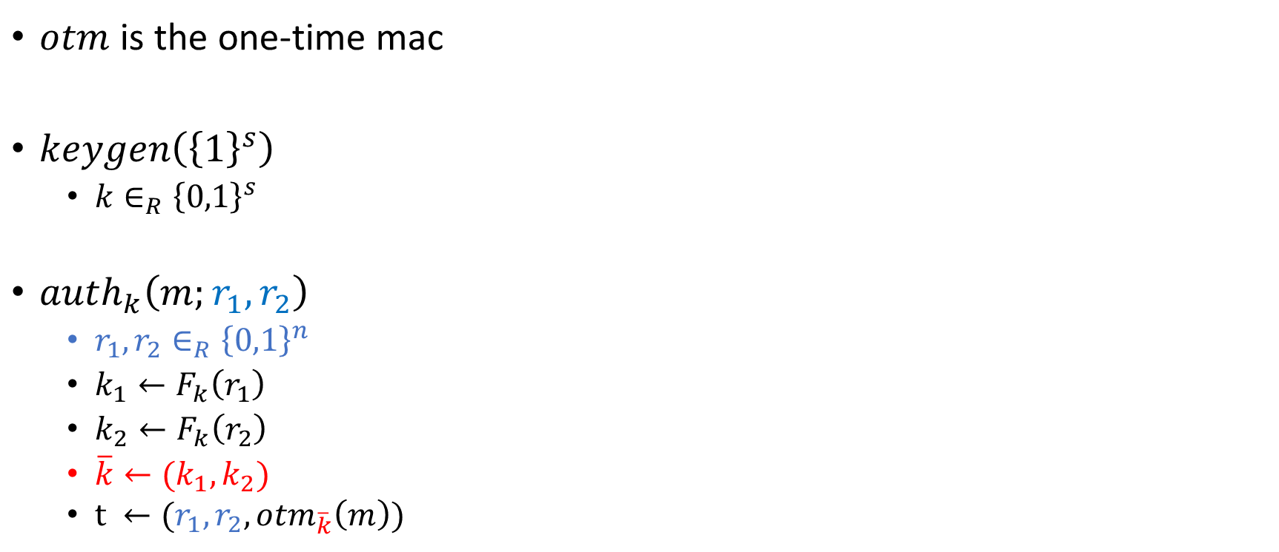
Computational mac from PRF and one-time mac
$otm$ is the one-time mac
$keygen\left({\left\{1\right\}}^{s}\right)$
  $k∈_{R}{\left\{0,1\right\}}^{s}$
$auth_{k}\left(m;r_{1},r_{2}\right)$
  $r_{1},r_{2}∈_{R}{\left\{0,1\right\}}^{n}$
  $k_{1}←F_{k}\left(r_{1}\right)$
  $k_{2}←F_{k}\left(r_{2}\right)$
  $\overline{k}←(k_{1},k_{2})$
  $t ←(r_{1},r_{2},{otm}_{\overline{k}}\left(m\right))$

Slide 38
Authenticated encryption
Authenticated encryption
  Authenticated (adversary cannot forge a ciphertext)
  Encrypted (adversary cannot learn message)

Slide 39

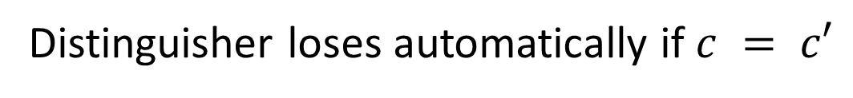










Chosen-ciphertext game
Distinguisher loses automatically if $c = c′$
$$m_{0},m_{1}$$
$$m_{0},m_{1}$$
c
$$c←Enc(m_{0})$$
c
$$c←Enc(m_{1})$$
$$c′$$
$$c^{′}$$
m
$$m←Dec(c′)$$
$$m$$
$$m←Enc(c′)$$
Repeat as many times as the distinguisher wants
Repeat as many times as the distinguisher wants
$$G_{0}$$
$$G_{1}$$

Slide 40

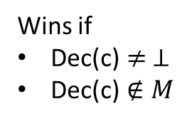


Unforgeability game
$$M ←\{\}$$
k $∈_{R}{\left\{0,1\right\}}^{s}$
$$m′$$
$$M←M∪\{m′\}$$
c$′$
$$c′ ←Enc(m′)$$
Wins if
Dec(c)$≠ ⊥$
$\text{Dec}\text{(}\text{c}\text{)}∉M$
$$c$$

Slide 41

Authenticated encryption
An Encryption scheme $(Gen,Enc,Dec)$ is an authenticated encryption scheme if
  Unforgeable
  CCA-secure

Slide 42
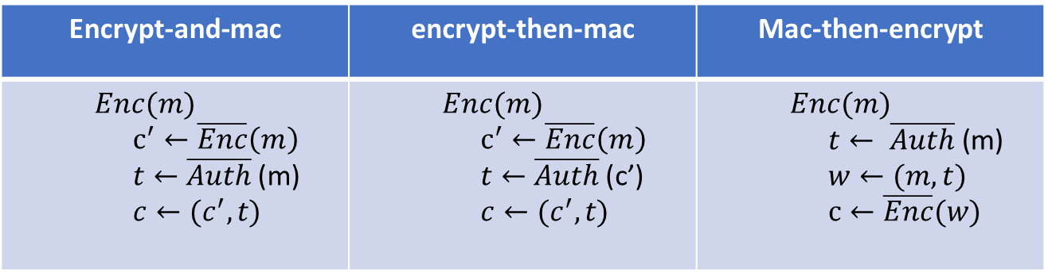

Three Candidates for AE from mac + enc
We assume
  $\overline{Enc}$ is a secure encryption scheme
  $\overline{Auth}$ is a secure message authentication code
Encrypt-and-mac | encrypt-then-mac | Mac-then-encrypt
$$Enc(m)$$ $$c^{′}←\overline{Enc}\left(m\right)$$ $t←$ $\overline{Auth}$ (m) $$c←(c^{′},t)$$ | $$Enc(m)$$ $$c^{′}←\overline{Enc}\left(m\right)$$ $t←$ $\overline{Auth}$ (c’) $$c←(c^{′},t)$$ | $$Enc(m)$$ $$t← \overline{Auth}\text{ (}\text{m}\text{)}$$ $$w←(m,t)$$ $$c←\overline{Enc}(w)$$

Slide 43
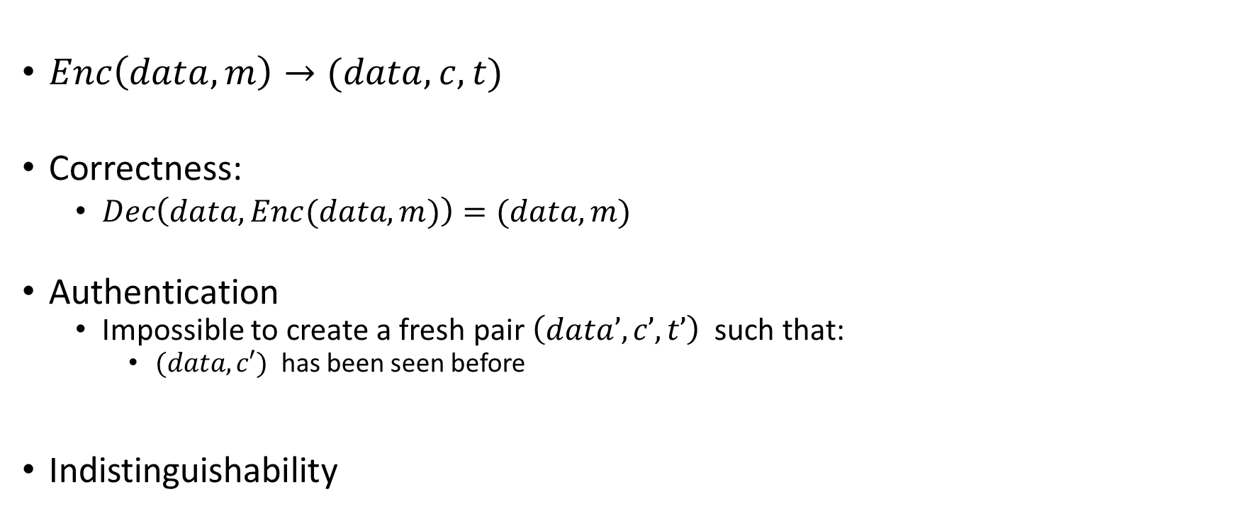
Authenticated encryption with associated (public) data
$Enc\left(data,m\right)→(data,c,t)$
Correctness:
  $Dec\left(data,Enc(data,m)\right)=(data,m)$
Authentication
  Impossible to create a fresh pair $\left(data’,c’,t’\right)$ such that:
    $(data,c′)$ has been seen before
Indistinguishability

Slide 44

Galois-counter mode
$Enc(data,m)$
  $m_{1},…,m_{d}←m$
  $A_{1},…,A_{ℓ}←data$
  $H←E_{k}(IV,0)$
  $c_{1},…,c_{d}←CTR(m_{1},…,m_{n} ;counter=\left(IV || 1\right))$
  $τ_{0}←0$
  $τ_{i}← \left\{\begin{aligned}{(τ_{i−1}⊕A}_{i})⋅H, i∈\{1,d\} \\ \left(τ_{i−1}⊕C_{i}\right)⋅H, i∈\{d+1,d+ℓ\} \\ \left(τ_{i−1}⊕(d || ℓ)\right)⋅H, i=d+ℓ+1 \end{aligned}\right.$
  $c←(d,ℓ,data,c_{1},…,c_{d},τ_{d+ℓ+1})$

