Slide 1
Authenticated encryption

Slide 3


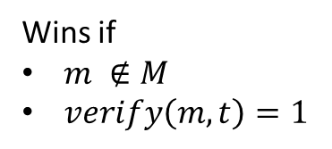





Mac forgery game
$$M ←\{\}$$
k $∈_{R}{\left\{0,1\right\}}^{s}$
$$m′$$
$$M←M∪\{m′\}$$
Repeat as many times
as the adversary wants
$$t′$$
$$t′ ←mac_{k}(m′)$$
$$(m,t)$$
Wins if
$m ∉M$
$verify\left(m,t\right)=1$

Slide 4
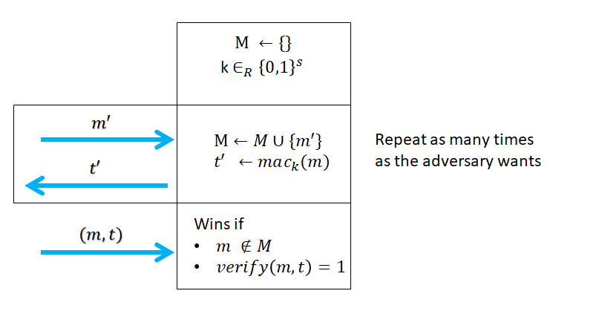

Mac forgery game
Allow the adversary to learn tags for as many message as he wants
A mac scheme is secure if
  $\operatorname{Pr}\left[adv wins the forgery game\right]≤negl(s)$

Slide 5
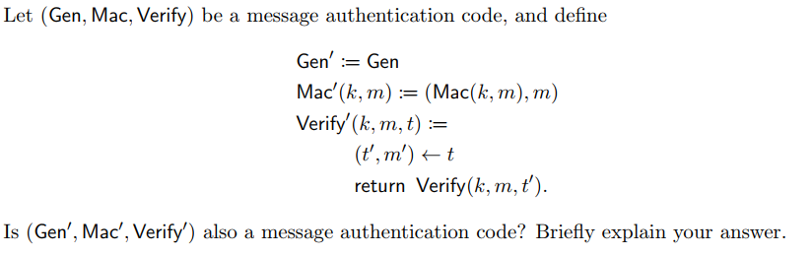
Does authentication imply secrecy
Consider the question from the quiz
The answer is yes.
To prove this is the case, we will take an adversary which forges a mac for this scheme and breaks the original mac scheme

Slide 6

Does authentication imply secrecy
Consider the question from the quiz
More formally, if the scheme is insecure => $∃$ $A∈ PPT$which produces $t=(t’,m’)$
such that $Verify(k,m,(t’,m’)) = acctept$ for a fresh m’
However since $Verify’ (k,m,(t’,m’)) = Verify(k,m,t’)$, this means that the adversary created a mac tag for the original scheme.
Hence, the original scheme is not a mac scheme.
By contradiction, we have a mac scheme.

Slide 7
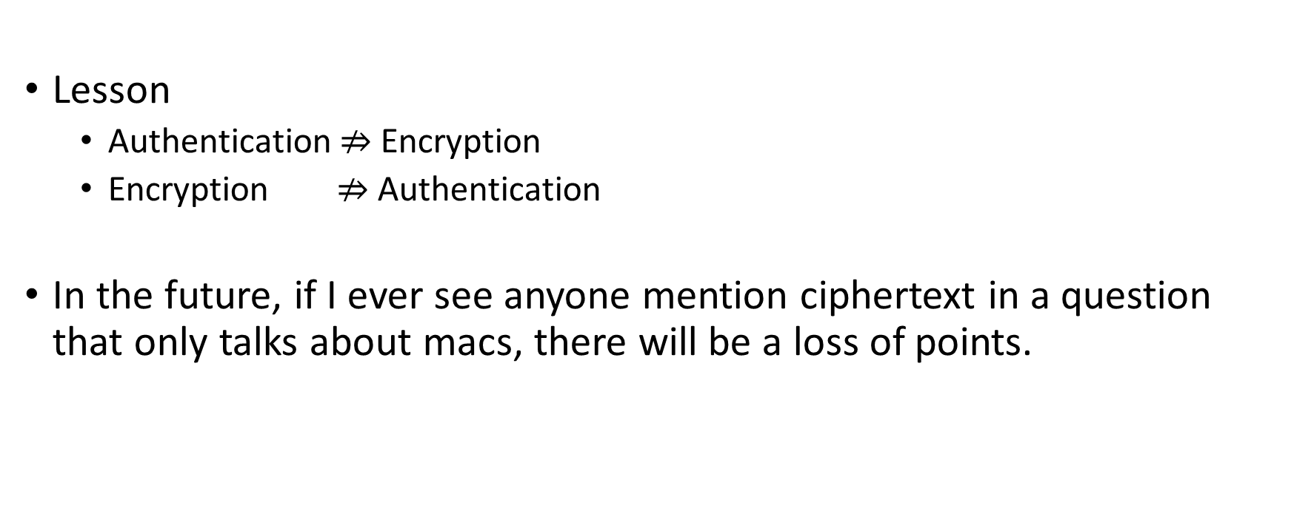
Lesson
Lesson
  Authentication $⇏$Encryption
  Encryption $⇏$Authentication
In the future, if I ever see anyone mention ciphertext in a question that only talks about macs, there will be a loss of points.

Slide 8
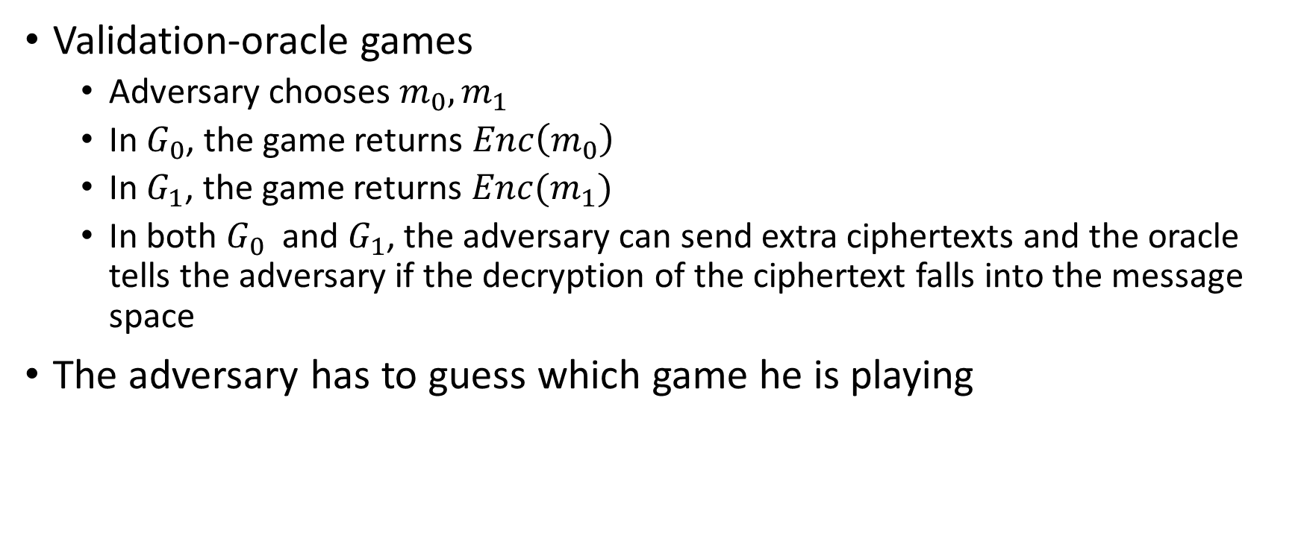
Validation-oracle indistinguishability game
Validation-oracle games
  Adversary chooses $m_{0}, m_{1}$
  In $G_{0}$, the game returns $Enc\left(m_{0}\right)$
  In $G_{1}$, the game returns $Enc(m_{1})$
  In both $G_{0}$and $G_{1}$, the adversary can send extra ciphertexts and the oracle tells the adversary if the decryption of the ciphertext falls into the message space
The adversary has to guess which game he is playing

Slide 9











Validation-oracle indistinguishability game
$$m_{0},m_{1}$$
$$m_{0},m_{1}$$
c
$$c←Enc(m_{0})$$
c
$$c←Enc(m_{1})$$
$$c′$$
$$c^{′}$$
$$v←Dec\left(c′\right)∈M$$
$$v←Dec\left(c′\right)∈M$$
v
$$v$$
Repeat as many times as the distinguisher wants
Repeat as many times as the distinguisher wants
$$G_{0}$$
$$G_{1}$$

Slide 10










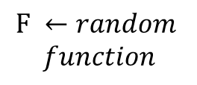
Pseudo-random function
A class of functions $(F_{1},…,F_{2^{n}})$ is pseudo-random if the following two games are indistinguishable
$$F ←random$$
$$function$$
k $∈_{R}{\left\{0,1\right\}}^{n}$
$$F ←F_{K}$$
m
m
$$w←F(m)$$
$$w$$
$$w←F(m)$$
$$w$$
Repeat as many times as the distinguisher wants
Repeat as many times as the distinguisher wants
$$G_{0}$$
$$G_{1}$$

Slide 11

CPA-secure encryption scheme from PRF
$Keygen\left({\{1\}}^{s}\right)$
  $k∈_{R}{\left\{0,1\right\}}^{s}$
$Enc_{k}\left(m\right)$
  $r∈_{R}{\left\{0,1\right\}}^{n}$
  $c←\left(r, F_{k}\left(r\right)⊕m\right)$
$Dec_{k}\left(c\right)$
  $\left(r,d\right)←c$
  $m←F_{k}\left(r\right)⊕d$
Important property $Dec\left(Enc\left(m\right)⊕ ε\right)=m+ε$

Slide 12
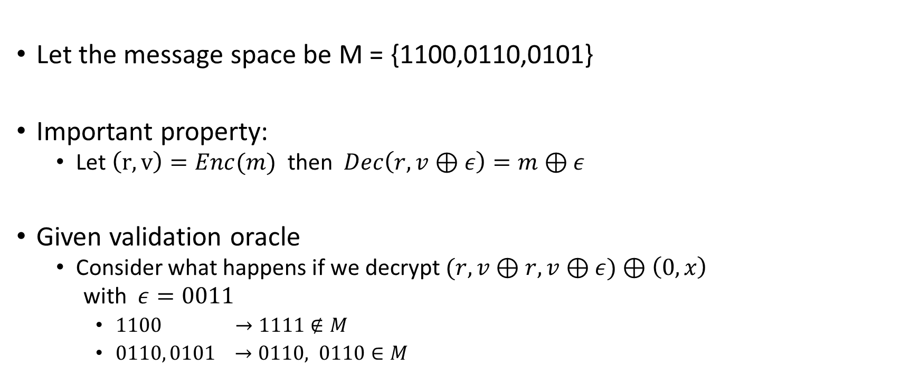
Breaking security of the scheme using validation oracle
Let the message space be M = {1100,0110,0101}
Important property:
  Let $\left(r,v\right)=Enc(m)$ then $Dec\left(r,v⊕ε\right)=m⊕ε$
Given validation oracle
  Consider what happens if we decrypt $(r,v⊕r,v⊕ε)⊕\left(0,x\right)$
  with $ε=0011$
    $1100 →1111∉M$
    $0110, 0101 →0110, 0110∈M$

Slide 13
Why do we care about the validation oracle
When people encrypt messages and send it to servers, it is typical that if the decrypted message does not have the right format it returns an error
Original PKCS paper (detailing how to use Crypto in the real world) had an attack where the attacker can modify the ciphertext and learn one bit depending on if an error received a message

Slide 14
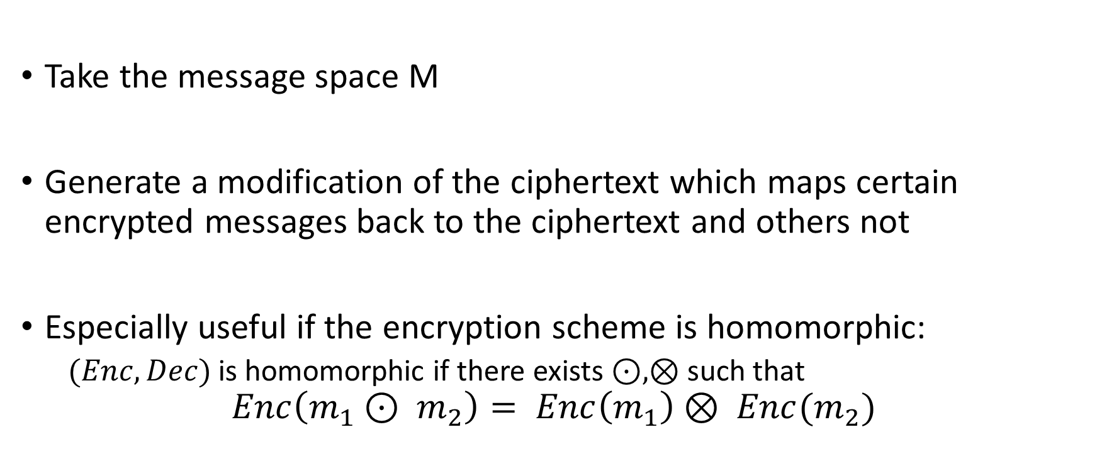
General format of a validation attack
Take the message space M
Generate a modification of the ciphertext which maps certain encrypted messages back to the ciphertext and others not
Especially useful if the encryption scheme is homomorphic:
  $(Enc,Dec)$ is homomorphic if there exists $⊙,⊗$ such that
$$Enc\left(m_{1}⊙ m_{2}\right)= Enc\left(m_{1}\right)⊗ Enc(m_{2})$$

Slide 15
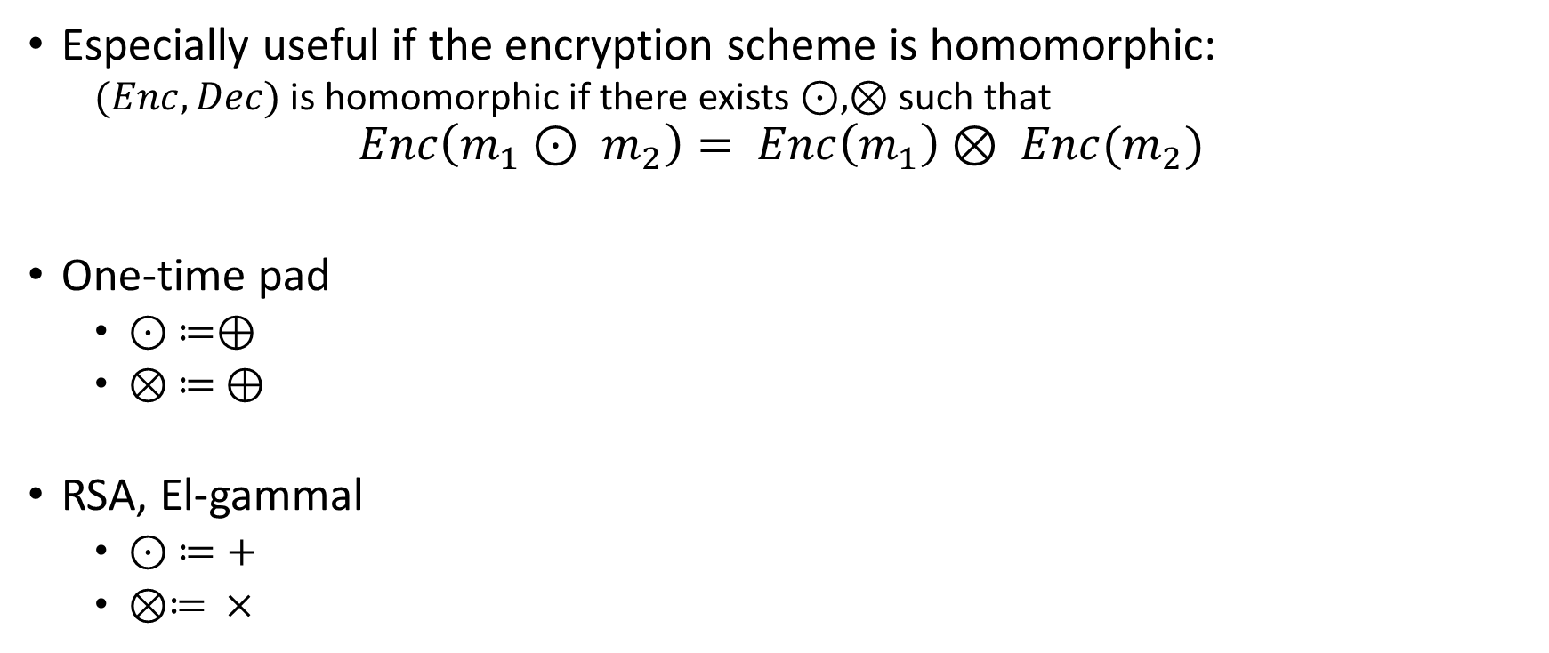
Some homomorphic encryption scheme
Especially useful if the encryption scheme is homomorphic:
  $(Enc,Dec)$ is homomorphic if there exists $⊙,⊗$ such that
$$Enc\left(m_{1}⊙ m_{2}\right)= Enc\left(m_{1}\right)⊗ Enc(m_{2})$$
One-time pad
  $⊙ ≔⊕$
  $⊗ ≔ ⊕$
RSA, El-gammal
  $⊙ ≔+$
  $⊗≔ ×$

Slide 16
Authenticated encryption
Authenticated encryption
  Authenticated (adversary cannot forge a ciphertext)
  Encrypted (adversary cannot learn message)

Slide 17
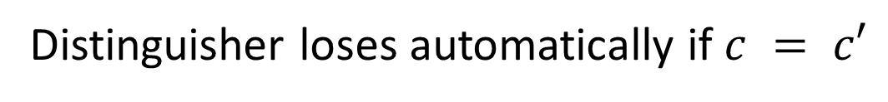



Chosen-ciphertext game
Distinguisher loses automatically if $c = c′$
$$m_{0},m_{1}$$
$$m_{0},m_{1}$$
c
$$c←Enc(m_{0})$$
c
$$c←Enc(m_{1})$$
$$c′$$
$$c^{′}$$
m
$$m←Dec(c′)$$
$$m$$
$$m←Enc(c′)$$
Repeat as many times as the distinguisher wants
Repeat as many times as the distinguisher wants
$$G_{0}$$
$$G_{1}$$

Slide 18

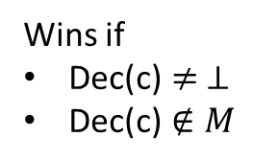


Unforgeability game
$$M ←\{\}$$
k $∈_{R}{\left\{0,1\right\}}^{s}$
$$m′$$
$$M←M∪\{m′\}$$
c$′$
$$c′ ←Enc(m′)$$
Wins if
Dec(c)$≠ ⊥$
$\text{Dec}\text{(}\text{c}\text{)}∉M$
$$c$$

Slide 19

Authenticated encryption
An Encryption scheme $(Gen,Enc,Dec)$ is an authenticated encryption scheme if
  Unforgeable
  CCA-secure

Slide 20
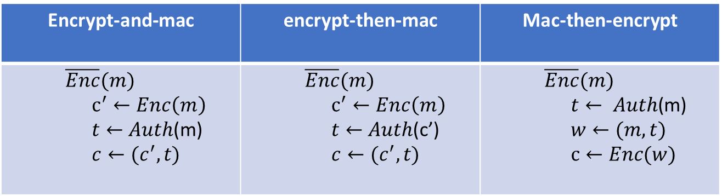

Three Candidates for AE from mac + enc
We assume
  $Enc$ is a secure encryption scheme
  $Auth$ is a secure message authentication code
  Show which two are insecure and which is secure, here are the hint
    $Enc’(m_{1}||m_{2}) = Enc(m_{1}) || Enc(m_{2})$ is a secure encryption scheme
    Auth’(m) = (auth(m),m) is a secure encryption scheme
Encrypt-and-mac | encrypt-then-mac | Mac-then-encrypt
$$\overline{Enc}(m)$$ $$c^{′}←Enc\left(m\right)$$ $t←$ $Auth$(m) $$c←(c^{′},t)$$ | $$\overline{Enc}(m)$$ $$c^{′}←Enc\left(m\right)$$ $t←$ $Auth$(c’) $$c←(c^{′},t)$$ | $$\overline{Enc}(m)$$ $$t← Auth\text{(}\text{m}\text{)}$$ $$w←(m,t)$$ $$c←Enc(w)$$

Slide 21
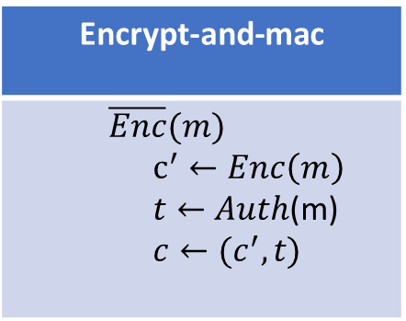
Insecure schemes
Encrypt and mac
Answer: if authentication leaks the message, then this encryption scheme also leaks the message
Encrypt-and-mac
$$\overline{Enc}(m)$$ $$c^{′}←Enc\left(m\right)$$ $t←$ $Auth$(m) $$c←(c^{′},t)$$

Slide 22
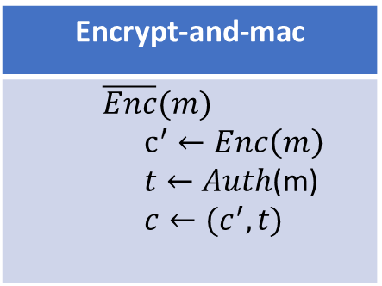

Insecure schemes
Mac then encrypt
Answer: Let$\left(c_{0},t_{0}\right)=\overline{Enc}\left(m_{0}\right), \left(c_{2},t_{2}\right)=\overline{Enc}\left(m′\right)$
We have that $Dec(c_{2},t_{0}) = m_{0}$if and only if $c_{2} = Dec\left(m_{0}\right)$
Encrypt-and-mac
$$\overline{Enc}(m)$$ $$c^{′}←Enc\left(m\right)$$ $t←$ $Auth$(m) $$c←(c^{′},t)$$

Slide 23
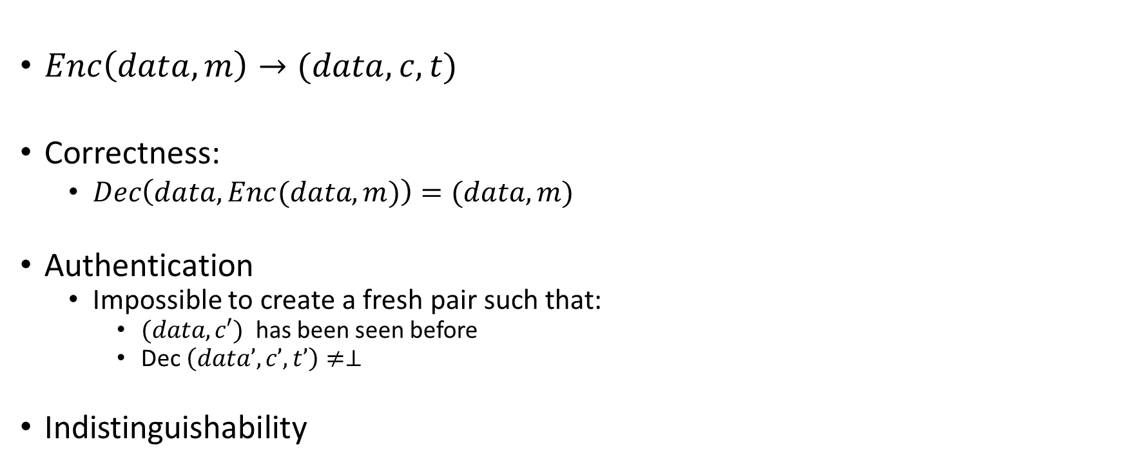
Authenticated encryption with associated (public) data
$Enc\left(data,m\right)→(data,c,t)$
Correctness:
  $Dec\left(data,Enc(data,m)\right)=(data,m)$
Authentication
  Impossible to create a fresh pair such that:
    $(data,c′)$ has been seen before
    Dec $\left(data’,c’,t’\right)≠⊥$
Indistinguishability

Slide 24
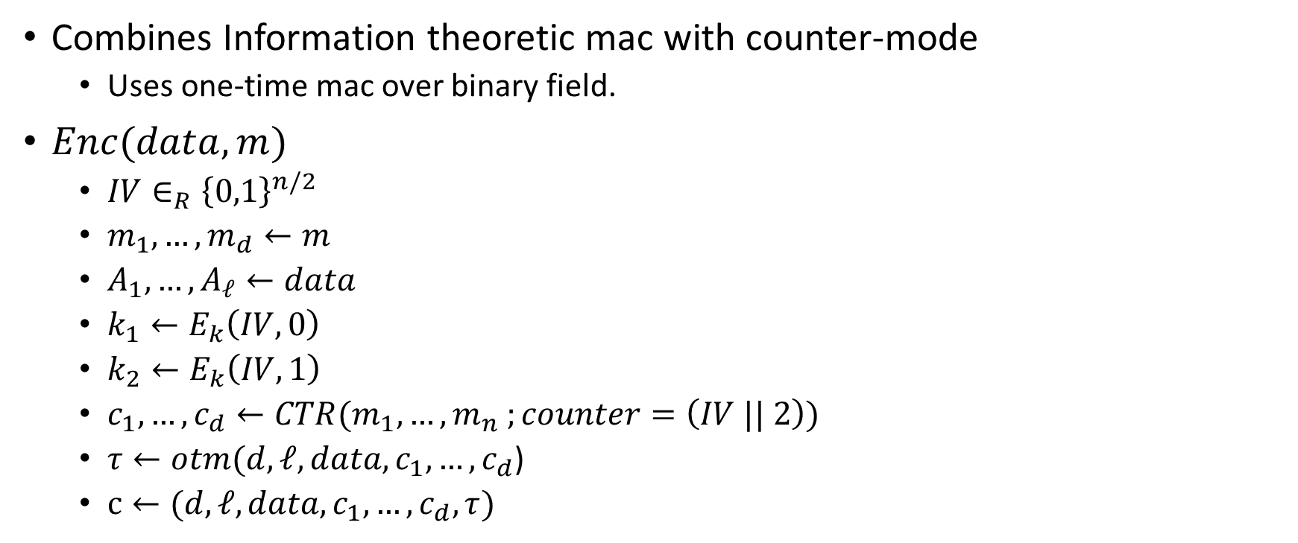
Galois-counter mode
Combines Information theoretic mac with counter-mode
  Uses one-time mac over binary field.
$Enc(data,m)$
  $IV∈_{R}{\left\{0,1\right\}}^{n/2}$
  $m_{1},…,m_{d}←m$
  $A_{1},…,A_{ℓ}←data$
  $k_{1}←E_{k}\left(IV,0\right)$
  $k_{2}←E_{k}\left(IV,1\right)$
  $c_{1},…,c_{d}←CTR(m_{1},…,m_{n} ;counter=\left(IV || 2\right))$
  $τ←otm(d,ℓ,data,c_{1},…,c_{d}$)
  $c←(d,ℓ,data,c_{1},…,c_{d},τ)$

