Slide 1
Cryptographic hash functions

Slide 2
Definition of hash function
$H≔{\{h}_{1},…,h_{m}\}$
$h_{i} :{\left\{0,1\right\}}^{n}→{\left\{0,1\right\}}^{ℓ(n)}$
Compression : $ℓ\left(n\right)<n$
$Gen\left(1^{s}\right)$ picks an index between 1 and m.

Slide 3
Collision resistance
i
$$i←gen(\{{1\}}^{s})$$
$$x,x′$$
$wins$ if
$$h_{i}\left(x\right)=h_{i}(x′)$$

Slide 4
Second-collision resistant
$$i←gen(\{{1\}}^{s})$$
$$x∈_{R}{\left\{0,1\right\}}^{s}$$
$$i,x$$
$$x′$$
$wins$ if
$$h_{i}\left(x\right)=h_{i}(x′)$$

Slide 5
Preimage resistance
$$i←gen(\{{1\}}^{s})$$
$$y ∈_{R}{\left\{0,1\right\}}^{ℓ(s)}$$
$$i,y$$
$$x$$
$wins$ if
$$h_{i}\left(x\right)=y$$

Slide 6
Comparison between different security
i
$$i←gen(\{{1\}}^{s})$$
$$i←gen(\{{1\}}^{s})$$
$$x∈_{R}{\left\{0,1\right\}}^{s}$$
$$i←gen(\{{1\}}^{s})$$
$$y ∈_{R}{\left\{0,1\right\}}^{ℓ(s)}$$
$$i,x$$
$$i,y$$
$$x,x′$$
$$x′$$
$$x$$
$wins$ if
$$h_{i}\left(x\right)=h_{i}(x′)$$
$wins$ if
$$h_{i}\left(x\right)=h_{i}(x′)$$
$wins$ if
$$h_{i}\left(x\right)=y$$
$$collision resistant$$
$$target−collision resistance$$
$preimage resistant$

Slide 7
Birthday attack
What is the probability that in a class of 23 people there are at least two people with the same birthday.
Answer: more than 50% chance
General question: Suppose you sample m values from n values, what is the probability that there exists at least two values that are the same.
Answer: if $m=\sqrt{n}$ then probability is about one-half

Slide 8
Proof of the birthday attack
If you store $\sqrt{n}$ output with a given input the probability that a new input gets sent to a previously visited output is $1/\sqrt{n}$
The probability that $\sqrt{n}$ elements all get mapped to fresh output is ${\left(1−\frac{1}{\sqrt{n}}\right)}^{\sqrt{n} }≥1/e$

Slide 9
Mac using hash functions
$$m$$
$$H_{i}$$
$${mac}_{k}$$

Slide 10
HMAC
Global constants $v_{1},v_{2}$
Gen
$s←Gen\left(1^{s}\right)$
$k∈_{R}{\left\{0,1\right\}}^{s}$
Auth(m)
$w_{1}←(k⊕v_{2},m)$
$w_{2}←H^{s}\left(w_{1}\right)$
$w_{3}←(k⊕v_{1},w_{1})$
$t←H(w_{3})$

Slide 11
Random oracle heuristic
Assume that a hash function acts as a random function
Allows us to prove security for efficient schemes
Unsound but
Only for contrived example
Never broken for practical schemes

Slide 12
Applications of hash functions
Virus fingerprinting
Deduplication
Password hashing
File changes/integrity

Slide 13
Virus fingerprinting
Hash the virus using the hash function
To lookup a virus, simply look at the output of the function and see if it maps to a known virus
False positives imply collision

Slide 14
Deduplication
Avoid storing the same thing in memory many times
Uses hash function to index values so that we don’t need to copy the same thing many times.

Slide 15
File changes / integrity
To keep track of changes, we keep a list of hash for every function
The output of the hash function can be much shorter than the size of the files

Slide 16
Proper way to hash passwords
Naïve way to hash passwords
$h←H(pwd)$
Same password hashed to same value
Correct way to hash a password
$r∈_{R}{\left\{0,1\right\}}^{n}$
$h←H\left(r,pwd\right)$
$(r,h)$

Slide 17
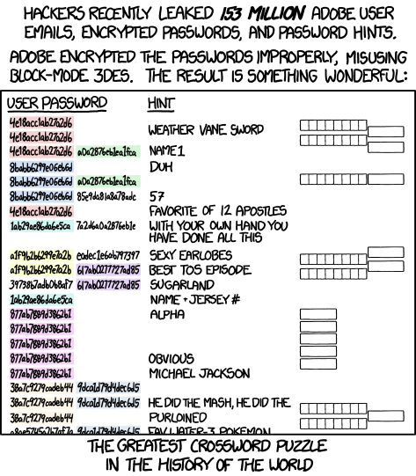
Bad way to hash passwords (xkcd)

Slide 18
Hash tree
Goal
Client has constant overhead
Server holds client’s database $x_{1},…,x_{n}$
Client requests $x_{i}$
Server sends ${x′}_{i}$
How can client verify that ${x′}_{i}=x_{i}$ with only logarithmic overhead

Slide 19
Hash tree
$Leaf_{i} = Hash(File_{i})$
Non-leaf node
Hash(Hash(node.left) || Hash(node.right))
Client only need to store the root
To prove that a given file is correct, the server only needs to send the client hashes of nodes that follow the path from the given leaf to the root node.

