Slide 1
Introduction to
Data Science
John P Dickerson
Prem Saggar
Today!
Lecture #2 – 08/29/2018
CMSC320
Mondays & Wednesdays
2:00pm – 3:15pm

Slide 2
Announcements
Register on Piazza: piazza.com/umd/fall2018/cmsc320
103 have registered already
122 have not registered yet
If you were on Piazza, you’d know …
Project 0 is out! It is due next Wednesday evening.
Link: https://github.com/JohnDickerson/cmsc320-fall2018/tree/master/project0
We’ll also link some reading for the week soon!
First quiz will be due Wednesday at noon.

Slide 3
The Data Lifecycle
Data collection
Data processing
Exploratory analysis
&
Data viz
Analysis, hypothesis testing, & ML
Insight & Policy Decision

Slide 4
Today’s Lecture
Data collection
Data processing
Exploratory analysis
&
Data viz
Analysis, hypothesis testing, & ML
Insight & Policy Decision

Slide 5
But first, snakes!
Python is an interpreted, dynamically-typed, high-level, garbage-collected, object-oriented-functional-imperative, and widely used scripting language.
Interpreted: instructions executed without being compiled into (virtual) machine instructions*
Dynamically-typed: verifies type safety at runtime
High-level: abstracted away from the raw metal and kernel
Garbage-collected: memory management is automated
OOFI: you can do bits of OO, F, and I programming
Not the point of this class!
Python is fast (developer time), intuitive, and used in industry!
*you can compile Python source, but it’s not required

Slide 6
The Zen of Python
Beautiful is better than ugly.
Explicit is better than implicit.
Simple is better than complex.
Complex is better than complicated.
Flat is better than nested.
Sparse is better than dense.
Readability counts.
Special cases aren't special enough to break the rules …
… although practicality beats purity.
Errors should never pass silently …
… unless explicitly silenced.
Thanks: SDSMT ACM/LUG

Slide 7
Literate Programming
Literate code contains in one document:
the source code;
text explanation of the code; and
the end result of running the code.
Basic idea: present code in the order that logic and flow of human thoughts demand, not the machine-needed ordering
Necessary for data science!
Many choices made need textual explanation, ditto results.
Stuff you’ll be using in Project 0 (and beyond)!

Slide 8
10-minute Python primer
Define a function:
Python is whitespace-delimited
Define a function that returns a tuple:
def my_func(x, y):
if x > y:
return x
else:
return y
def my_func(x, y):
return (x-1, y+2)
(a, b) = my_func(1, 2)
a = 0; b = 4

Slide 9
Useful Built-in Functions: Counting and Iterating
len: returns the number of items of an enumerable object
range: returns an iterable object
enumerate: returns iterable tuple (index, element) of a list
https://docs.python.org/3/library/functions.html
len( [‘c’, ‘m’, ‘s’, ‘c’, 3, 2, 0] )
7
list( range(10) )
[0, 1, 2, 3, 4, 5, 6, 7, 8, 9]
enumerate( [“311”, “320”, “330”] )
[(0, “311”), (1, “320”), (2, “330”)]
Notes:
do demo

Slide 10
Useful Built-In Functions: Map and Filter
map: apply a function to a sequence or iterable
filter: returns a list of elements for which a predicate is true
We’ll go over in much greater depth with pandas/numpy.
arr = [1, 2, 3, 4, 5]
map(lambda x: x**2, arr)
[1, 4, 9, 16, 25]
arr = [1, 2, 3, 4, 5, 6, 7]
filter(lambda x: x % 2 == 0, arr)
[2, 4, 6]

Slide 11
Pythonic Programming
Basic iteration over an array in Java:
Direct translation into Python:
A more “Pythonic” way of iterating:
int[] arr = new int[10];
for(int idx=0; idx<arr.length; ++idx) {
System.out.println( arr[idx] );
}
idx = 0
while idx < len(arr):
print( arr[idx] ); idx += 1
for element in arr:
print( element )

Slide 12
List comprehensions
Construct sets like a mathematician!
P = { 1, 2, 4, 8, 16, …, 2¹⁶ }
E = { x | x in ℕ and x is odd and x < 1000 }
Construct lists like a mathematician who codes!
Very similar to map, but:
You’ll see these way more than map in the wild
Many people consider map/filter not “pythonic”
They can perform differently (map is “lazier”)
P = [ 2**x for x in range(17) ]
E = [ x for x in range(1000) if x % 2 != 0 ]

Slide 13
Exceptions
Syntactically correct statement throws an exception:
tweepy (Python Twitter API) returns “Rate limit exceeded”
sqlite (a file-based database) returns IntegrityError
print('Python', python_version())
try:
cause_a_NameError
except NameError as err:
print(err, '-> some extra text')

Slide 14
Python 2 vs 3
Python 3 is intentionally backwards incompatible
(But not that incompatible)
Biggest changes that matter for us:
print “statement” → print(“function”)
1/2 = 0 → 1/2 = 0.5 and 1//2 = 0
ASCII str default → default Unicode
Namespace ambiguity fixed:
i = 1
[i for i in range(5)]
print(i) # ????????
Notes:
Prints “4” in Python 2 and “1” (i.e., unchanged because the list comprehension scope is dead) in Python 3.

Slide 15
To any Curmudgeons …
If you’re going to use Python 2 anyway, use the _future_ module:
Python 3 introduces features that will throw runtime errors in Python 2 (e.g., with statements)
_future_ module incrementally brings 3 functionality into 2
https://docs.python.org/2/library/__future__.html
from _future_ import division
from _future_ import print_function
from _future_ import please_just_use_python_3

Slide 16
Python vS R (For Data Scientists)
There is no right answer here!
Python is a “full” programming language – easier to integrate with systems in the field
R has a more mature set of pure stats libraries …
… but Python is catching up quickly …
… and is already ahead specifically for ML.
You will see Python more in the tech industry.

Slide 17
Extra resources
Plenty of tutorials on the web:
https://www.learnpython.org/
Work through Project 0, which will take you through some baby steps with Python and the Pandas library:
(We’ll also post some readings soon.)
Come hang out at office hours (or chat with me privately)
All office hours will be on the website/Piazza very soon.
Will have coverage MTWThF.

Slide 19
Today’s Lecture
Data collection
Data processing
Exploratory analysis
&
Data viz
Analysis, hypothesis testing, & ML
Insight & Policy Decision
with
Thanks: Zico Kolter’s 15-388

Slide 20
GotTa Catch ‘Em All
Five ways to get data:
Direct download and load from local storage
Generate locally via downloaded code (e.g., simulation)
Query data from a database (covered in a few lectures)
Query an API from the intra/internet
Scrape data from a webpage
Covered today.

Slide 21
Wherefore art thou, API?
A web-based Application Programming Interface (API) like we’ll be using in this class is a contract between a server and a user stating:
“If you send me a specific request, I will return some information in a structured and documented format.”
(More generally, APIs can also perform actions, may not be web-based, be a set of protocols for communicating between processes, between an application and an OS, etc.)
Notes:
”Wherefore” means “why”, not “where”!

Slide 22
“Send me a specific request”
Most web API queries we’ll be doing will use HTTP requests:
conda install –c anaconda requests=2.12.4
r = requests.get( 'https://api.github.com/user', auth=('user', 'pass') )
r.status_code
200
r.headers[‘content-type’]
‘application/json; charset=utf8’
r.json()
{u'private_gists': 419, u'total_private_repos': 77, ...}
http://docs.python-requests.org/en/master/

Slide 23
HTTP Requests
https://www.google.com/?q=cmsc320&tbs=qdr:m
HTTP GET Request:
GET /?q=cmsc320&tbs=qdr:m HTTP/1.1
Host: www.google.com
User-Agent: Mozilla/5.0 (X11; Linux x86_64; rv:10.0.1) Gecko/20100101 Firefox/10.0.1
??????????
params = { “q”: “cmsc320”, “tbs”: “qdr:m” }
r = requests.get( “https://www.google.com”,
params = params )
*be careful with https:// calls; requests will not verify SSL by default

Slide 24
Restful APIs
This class will just query web APIs, but full web APIs typically allow more.
Representational State Transfer (RESTful) APIs:
GET: perform query, return data
POST: create a new entry or object
PUT: update an existing entry or object
DELETE: delete an existing entry or object
Can be more intricate, but verbs (“put”) align with actions

Slide 25
Querying a Restful API
Stateless: with every request, you send along a token/authentication of who you are
GitHub is more than a GETHub:
PUT/POST/DELETE can edit your repositories, etc.
Try it out: https://github.com/settings/tokens/new
token = ”super_secret_token”
r = requests.get(“https://github.com/user”,
params={”access_token”: token})
print( r.content )
{"login":”JohnDickerson","id":472985,"avatar_url":"ht…

Slide 26
Authentication and OAuth
Old and busted:
New hotness:
What if I wanted to grant an app access to, e.g., my Facebook account without giving that app my password?
OAuth: grants access tokens that give (possibly incomplete) access to a user or app without exposing a password
r = requests.get(“https://api.github.com/user”,
auth=(“JohnDickerson”, “ILoveKittens”))

Slide 27
“… I will return information in a structured format.”
So we’ve queried a server using a well-formed GET request via the requests Python module. What comes back?
General structured data:
Comma-Separated Value (CSV) files & strings
Javascript Object Notation (JSON) files & strings
HTML, XHTML, XML files & strings
Domain-specific structured data:
Shapefiles: geospatial vector data (OpenStreetMap)
RVT files: architectural planning (Autodesk Revit)
You can make up your own! Always document it.

Slide 28
CSV Files in Python
Any CSV reader worth anything can parse files with any delimiter, not just a comma (e.g., “TSV” for tab-separated)
1,26-Jan,Introduction,—,"pdf, pptx",Dickerson,
2,31-Jan,Scraping Data with Python,Anaconda's Test Drive.,,Dickerson,
3,2-Feb,"Vectors, Matrices, and Dataframes",Introduction to pandas.,,Dickerson,
4,7-Feb,Jupyter notebook lab,,,"Denis, Anant, & Neil",
5,9-Feb,Best Practices for Data Science Projects,,,Dickerson,
Don’t write your own CSV or JSON parser
(We’ll use pandas to do this much more easily and efficiently)
import csv
with open(“schedule.csv”, ”rb”) as f:
reader = csv.reader(f, delimiter=“,”, quotechar=’”’)
for row in reader:
print(row)

Slide 29
JSON Files & Strings
JSON is a method for serializing objects:
Convert an object into a string (done in Java in 131/132?)
Deserialization converts a string back to an object
Easy for humans to read (and sanity check, edit)
Defined by three universal data structures
Python dictionary, Java Map, hash table, etc …
Python list, Java array, vector, etc …
Python string, float, int, boolean, JSON object, JSON array, …
Images from: http://www.json.org/

Slide 30
JSON In Python
Some built-in types: “Strings”, 1.0, True, False, None
Lists: [“Goodbye”, “Cruel”, “World”]
Dictionaries: {“hello”: “bonjour”, “goodbye”, “au revoir”}
Dictionaries within lists within dictionaries within lists:
[1, 2, {“Help”:[
“I’m”, {“trapped”: “in”},
“CMSC320”
]}]

Slide 31
JSON From Twitter
GET https://api.twitter.com/1.1/friends/list.json?cursor=-1&screen_name=twitterapi&skip_status=true&include_user_entities=false
{
"previous_cursor": 0,
"previous_cursor_str": "0",
"next_cursor": 1333504313713126852,
"users": [{
"profile_sidebar_fill_color": "252429",
"profile_sidebar_border_color": "181A1E",
"profile_background_tile": false,
"name": "Sylvain Carle",
"profile_image_url": "http://a0.twimg.com/profile_images/2838630046/4b82e286a659fae310012520f4f756bb_normal.png",
"created_at": "Thu Jan 18 00:10:45 +0000 2007", …

Slide 32
Parsing JSON In Python
Repeat: don’t write your own CSV or JSON parser
https://news.ycombinator.com/item?id=7796268
rsdy.github.io/posts/dont_write_your_json_parser_plz.html
Python comes with a fine JSON parser
import json
r = requests.get( “https://api.twitter.com/1.1/statuses/user_timeline.json?screen_name=JohnPDickerson&count=100”, auth=auth )
data = json.loads(r.content)
json.load(some_file) # loads JSON from a file
json.dump(json_obj, some_file) # writes JSON to file
json.dumps(json_obj) # returns JSON string

Slide 33
XML, XHTML, HTML files and Strings
Still hugely popular online, but JSON has essentially replaced XML for:
Asynchronous browser ←→ server calls
Many (most?) newer web APIs
XML is a hierarchical markup language:
<tag attribute=“value1”>
<subtag>
Some content goes here
</subtag>
<openclosetag attribute=“value2” />
</tag>
You probably won’t see much XML, but you will see plenty of HTML, its substantially less well-behaved cousin …
Example XML from: Zico Kolter

Slide 34
Scraping HTML in Python
HTML – the specification – is fairly pure
HTML – what you find on the web – is horrifying
We’ll use BeautifulSoup:
conda install -c asmeurer beautiful-soup=4.3.2
import requests
from bs4 import BeautifulSoup
r = requests.get( “https://cs.umd.edu/class/fall2018/cmsc320/” )
root = BeautifulSoup( r.content )
root.find(“div”, id=“schedule”)\
.find(“table”)\ # find all schedule
.find(“tbody”).findAll(“a”) # links for CMSC320

Slide 35
Building a web scraper in python
Totally not hypothetical situation:
You really want to learn about data science, so you choose to download all of last semester’s CMSC320 lecture slides to wallpaper your room …
… but you now have carpal tunnel syndrome from clicking refresh on Piazza last night, and can no longer click on the PDF and PPTX links.
Hopeless? No! Earlier, you built a scraper to do this!
Sort of. You only want PDF and PPTX files, not links to other websites or files.
lnks = root.find(“div”, id=“schedule”)\
.find(“table”)\ # find all schedule
.find(“tbody”).findAll(“a”) # links for CMSC320

Slide 36
Regular Expressions
Given a list of URLs (strings), how do I find only those strings that end in *.pdf or *.pptx?
Regular expressions!
(Actually Python strings come with a built-in endswith function.)
What about .pDf or .pPTx, still legal extensions for PDF/PPTX?
Regular expressions!
(Or cheat the system again: built-in string lower function.)
“this_is_a_filename.pdf”.endswith((“.pdf”, “.pptx”))
“tHiS_IS_a_FileNAme.pDF”.lower().endswith(
(“.pdf”, “.pptx”))

Slide 37
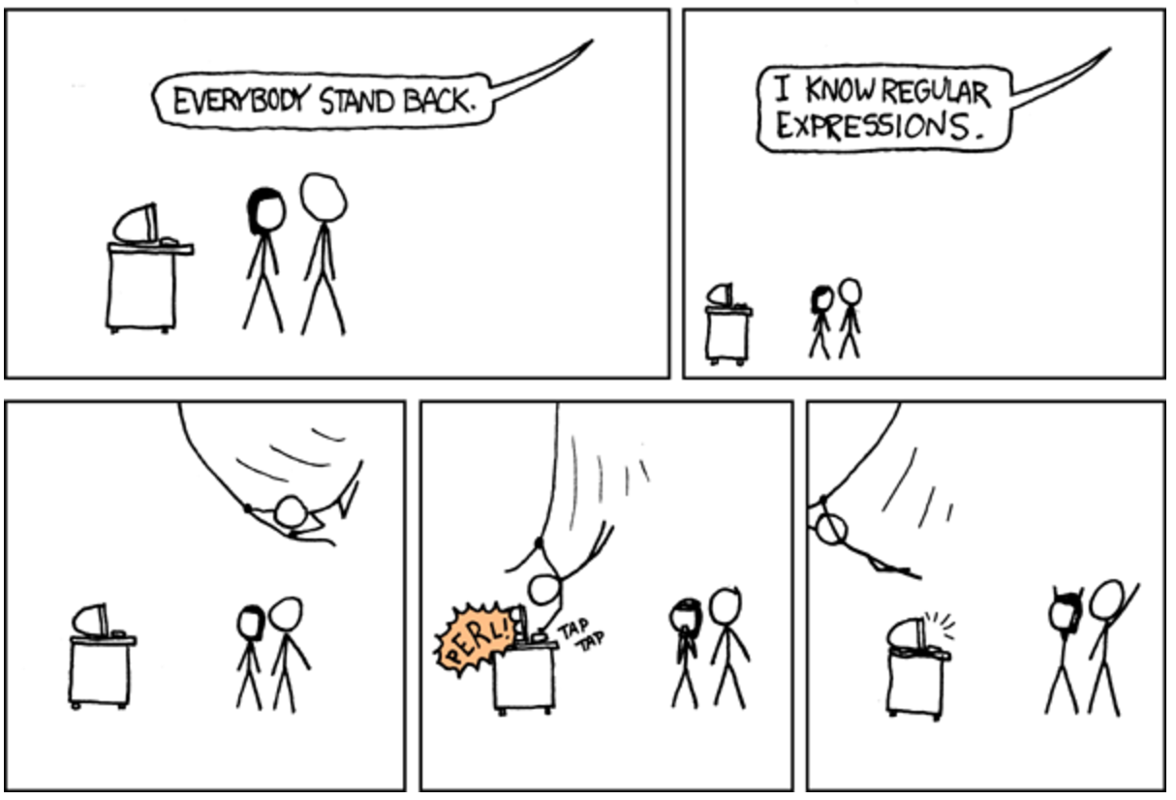

Slide 38
Regular Expressions
Used to search for specific elements, or groups of elements, that match a pattern
import re
# Find the index of the 1st occurrence of “cmsc320”
match = re.search(r”cmsc320”, text)
print( match.start() )
# Does start of text match “cmsc320”?
match = re.match(r”cmsc320”, text)
# Iterate over all matches for “cmsc320” in text
for match in re.finditer(r”cmsc320”, text):
print( match.start() )
# Return all matches of “cmsc320” in the text
match = re.findall(r”cmsc320”, text)

Slide 39
Matching Multiple Characters
Can match sets of characters, or multiple and more elaborate sets and sequences of characters:
Match the character ‘a’: a
Match the character ‘a’, ‘b’, or ‘c’: [abc]
Match any character except ‘a’, ‘b’, or ‘c’: [^abc]
Match any digit: \d (= [0123456789] or [0-9])
Match any alphanumeric: \w (= [a-zA-Z0-9_])
Match any whitespace: \s (= [ \t\n\r\f\v])
Match any character: .
Special characters must be escaped: .^$*+?{}\[]|()
Thanks to: Zico Kolter

Slide 40
Matching sequences and repeated characters
A few common modifiers (available in Python and most other high-level languages; +, {n}, {n,} may not):
Match character ‘a’ exactly once: a
Match character ‘a’ zero or once: a?
Match character ‘a’ zero or more times: a*
Match character ‘a’ one or more times: a+
Match character ‘a’ exactly n times: a{n}
Match character ‘a’ at least n times: a{n,}
Example: match all instances of “University of <somewhere>” where <somewhere> is an alphanumeric string with at least 3 characters:
\s*University\sof\s\w{3,}

Slide 41
Compiled Regexes
If you’re going to reuse the same regex many times, or if you aren’t but things are going slowly for some reason, try compiling the regular expression.
https://blog.codinghorror.com/to-compile-or-not-to-compile/
Interested? CMSC330, CMSC430, CMSC452, talk to me.
# Compile the regular expression “cmsc320”
regex = re.compile(r”cmsc320”)
# Use it repeatedly to search for matches in text
regex.match( text ) # does start of text match?
regex.search( text ) # find the first match or None
regex.findall( text ) # find all matches

Slide 42
Downloading a bunch of files
Import the modules
import re
import requests
from bs4 import BeautifulSoup
try:
from urllib.parse import urlparse
except ImportError:
from urlparse import urlparse
Get some HTML via HTTP
# HTTP GET request sent to the URL url
r = requests.get( url )
# Use BeautifulSoup to parse the GET response
root = BeautifulSoup( r.content )
lnks = root.find("div", id="schedule")\
.find("table")\
.find("tbody").findAll("a")

Slide 43
Downloading a bunch of files
Parse exactly what you want
# Cycle through the href for each anchor, checking
# to see if it's a PDF/PPTX link or not
for lnk in lnks:
href = lnk['href']
# If it's a PDF/PPTX link, queue a download
if href.lower().endswith(('.pdf', '.pptx')):
Get some more data?!
urld = urlparse.urljoin(url, href)
rd = requests.get(urld, stream=True)
# Write the downloaded PDF to a file
outfile = path.join(outbase, href)
with open(outfile, 'wb') as f:
f.write(rd.content)

Slide 44
Next Lecture
Data collection
Data processing
Exploratory analysis
&
Data viz
Analysis, hypothesis testing, & ML
Insight & Policy Decision

Slide 45
Next Class:
NumPy, Scipy, And DataFrames

