Slide 1
Introduction to
Data Science
John P Dickerson
Prem Saggar
Today!
Lecture #3 – 9/5/2018
CMSC320
Mondays & Wednesdays
2pm – 3:15pm

Slide 2
Announcements
Register on Piazza: piazza.com/umd/fall2018/cmsc320
219 have registered already
>6 have not registered yet or not activated account
Office Hours Posted over the Weekend
Reminder: Weekly quizzes, due on Mondays at noon (except first one that was due today)
Project 1 will be released soon (mid-next week)

Slide 3
The Data Lifecycle
Data collection
Data processing
Exploratory analysis
&
Data viz
Analysis, hypothesis testing, & ML
Insight & Policy Decision

Slide 4
Wrapping Up Last Lecture ……..
Data collection
Data processing
Exploratory analysis
&
Data viz
Analysis, hypothesis testing, & ML
Insight & Policy Decision

Slide 5
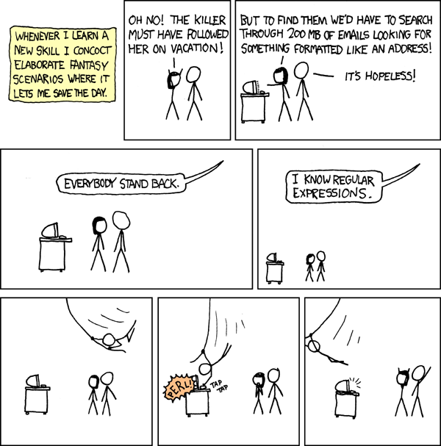

Slide 6
Regular Expressions
Used to search for specific elements, or groups of elements, that match a pattern
Indispensable for data munging and wrangling
Many constructs to search a variety of different patterns
Many languages/libraries (including Python) allow “compiling”
Much faster for repeated applications of the regex pattern
https://blog.codinghorror.com/to-compile-or-not-to-compile/

Slide 7
Groups
What if we want to know more than just “did we find a match” or “where is the first match” …?
Grouping asks the regex matcher to keep track of certain portions – surrounded by (parentheses) – of the match
\s*([Uu]niversity)\s([Oo]f)\s(\w{3,})
regex = r”\s*([Uu]niversity)\s([Oo]f)\s(\w{3,})”
m = re.search( regex, “university Of Maryland” )
print( m.groups() )
('university', 'Of', 'Maryland')

Slide 8
Simple Example: Parse an Email Address
(?:(?:\r\n)?[ \t])*(?:(?:(?:[^()<>@,;:\\".\[\] \000-\031]+(?:(?:(?:\r\n)?[ \t] )+|\Z|(?=[\["()<>@,;:\\".\[\]]))|"(?:[^\"\r\\]|\\.|(?:(?:\r\n)?[ \t]))*"(?:(?: \r\n)?[ \t])*)(?:\.(?:(?:\r\n)?[ \t])*(?:[^()<>@,;:\\".\[\] \000-\031]+(?:(?:( ?:\r\n)?[ \t])+|\Z|(?=[\["()<>@,;:\\".\[\]]))|"(?:[^\"\r\\]|\\.|(?:(?:\r\n)?[ \t]))*"(?:(?:\r\n)?[ \t])*))*@(?:(?:\r\n)?[ \t])*(?:[^()<>@,;:\\".\[\] \000-\0 31]+(?:(?:(?:\r\n)?[ \t])+|\Z|(?=[\["()<>@,;:\\".\[\]]))|\[([^\[\]\r\\]|\\.)*\ ](?:(?:\r\n)?[ \t])*)(?:\.(?:(?:\r\n)?[ \t])*(?:[^()<>@,;:\\".\[\] \000-\031]+ (?:(?:(?:\r\n)?[ \t])+|\Z|(?=[\["()<>@,;:\\".\[\]]))|\[([^\[\]\r\\]|\\.)*\](?: (?:\r\n)?[ \t])*))*|(?:[^()<>@,;:\\".\[\] \000-\031]+(?:(?:(?:\r\n)?[ \t])+|\Z |(?=[\["()<>@,;:\\".\[\]]))|"(?:[^\"\r\\]|\\.|(?:(?:\r\n)?[ \t]))*"(?:(?:\r\n) ?[ \t])*)*\<(?:(?:\r\n)?[ \t])*(?:@(?:[^()<>@,;:\\".\[\] \000-\031]+(?:(?:(?:\ r\n)?[ \t])+|\Z|(?=[\["()<>@,;:\\".\[\]]))|\[([^\[\]\r\\]|\\.)*\](?:(?:\r\n)?[ \t])*)(?:\.(?:(?:\r\n)?[ \t])*(?:[^()<>@,;:\\".\[\] \000-\031]+(?:(?:(?:\r\n) ?[ \t])+|\Z|(?=[\["()<>@,;:\\".\[\]]))|\[([^\[\]\r\\]|\\.)*\](?:(?:\r\n)?[ \t] )*))*(?:,@(?:(?:\r\n)?[ \t])*(?:[^()<>@,;:\\".\[\] \000-\031]+(?:(?:(?:\r\n)?[ \t])+|\Z|(?=[\["()<>@,;:\\".\[\]]))|\[([^\[\]\r\\]|\\.)*\](?:(?:\r\n)?[ \t])* )(?:\.(?:(?:\r\n)?[ \t])*(?:[^()<>@,;:\\".\[\] \000-\031]+(?:(?:(?:\r\n)?[ \t] )+|\Z|(?=[\["()<>@,;:\\".\[\]]))|\[([^\[\]\r\\]|\\.)*\](?:(?:\r\n)?[ \t])*))*) *:(?:(?:\r\n)?[ \t])*)?(?:[^()<>@,;:\\".\[\] \000-\031]+(?:(?:(?:\r\n)?[ \t])+ |\Z|(?=[\["()<>@,;:\\".\[\]]))|"(?:[^\"\r\\]|\\.|(?:(?:\r\n)?[ \t]))*"(?:(?:\r \n)?[ \t])*)(?:\.(?:(?:\r\n)?[ \t])*(?:[^()<>@,;:\\".\[\] \000-\031]+(?:(?:(?: \r\n)?[ \t])+|\Z|(?=[\["()<>@,;:\\".\[\]]))|"(?:[^\"\r\\]|\\.|(?:(?:\r\n)?[ \t ]))*"(?:(?:\r\n)?[ \t])*))*@(?:(?:\r\n)?[ \t])*(?:[^()<>@,;:\\".\[\] \000-\031 ]+(?:(?:(?:\r\n)?[ \t])+|\Z|(?=[\["()<>@,;:\\".\[\]]))|\[([^\[\]\r\\]|\\.)*\]( ?:(?:\r\n)?[ \t])*)(?:\.(?:(?:\r\n)?[ \t])*(?:[^()<>@,;:\\".\[\] \000-\031]+(? :(?:(?:\r\n)?[ \t])+|\Z|(?=[\["()<>@,;:\\".\[\]]))|\[([^\[\]\r\\]|\\.)*\](?:(? :\r\n)?[ \t])*))*\>(?:(?:\r\n)?[ \t])*)|(?:[^()<>@,;:\\".\[\] \000-\031]+(?:(? :(?:\r\n)?[ \t])+|\Z|(?=[\["()<>@,;:\\".\[\]]))|"(?:[^\"\r\\]|\\.|(?:(?:\r\n)? [ \t]))*"(?:(?:\r\n)?[ \t])*)*:(?:(?:\r\n)?[ \t])*(?:(?:(?:[^()<>@,;:\\".\[\] \000-\031]+(?:(?:(?:\r\n)?[ \t])+|\Z|(?=[\["()<>@,;:\\".\[\]]))|"(?:[^\"\r\\]| \\.|(?:(?:\r\n)?[ \t]))*"(?:(?:\r\n)?[ \t])*)(?:\.(?:(?:\r\n)?[ \t])*(?:[^()<> @,;:\\".\[\] \000-\031]+(?:(?:(?:\r\n)?[ \t])+|\Z|(?=[\["()<>@,;:\\".\[\]]))|" (?:[^\"\r\\]|\\.|(?:(?:\r\n)?[ \t]))*"(?:(?:\r\n)?[ \t])*))*@(?:(?:\r\n)?[ \t] )*(?:[^()<>@,;:\\".\[\] \000-\031]+(?:(?:(?:\r\n)?[ \t])+|\Z|(?=[\["()<>@,;:\\ ".\[\]]))|\[([^\[\]\r\\]|\\.)*\](?:(?:\r\n)?[ \t])*)(?:\.(?:(?:\r\n)?[ \t])*(? :[^()<>@,;:\\".\[\] \000-\031]+(?:(?:(?:\r\n)?[ \t])+|\Z|(?=[\["()<>@,;:\\".\[ \]]))|\[([^\[\]\r\\]|\\.)*\](?:(?:\r\n)?[ \t])*))*|(?:[^()<>@,;:\\".\[\] \000- \031]+(?:(?:(?:\r\n)?[ \t])+|\Z|(?=[\["()<>@,;:\\".\[\]]))|"(?:[^\"\r\\]|\\.|( ?:(?:\r\n)?[ \t]))*"(?:(?:\r\n)?[ \t])*)*\<(?:(?:\r\n)?[ \t])*(?:@(?:[^()<>@,; :\\".\[\] \000-\031]+(?:(?:(?:\r\n)?[ \t])+|\Z|(?=[\["()<>@,;:\\".\[\]]))|\[([ ^\[\]\r\\]|\\.)*\](?:(?:\r\n)?[ \t])*)(?:\.(?:(?:\r\n)?[ \t])*(?:[^()<>@,;:\\" .\[\] \000-\031]+(?:(?:(?:\r\n)?[ \t])+|\Z|(?=[\["()<>@,;:\\".\[\]]))|\[([^\[\ ]\r\\]|\\.)*\](?:(?:\r\n)?[ \t])*))*(?:,@(?:(?:\r\n)?[ \t])*(?:[^()<>@,;:\\".\ [\] \000-\031]+(?:(?:(?:\r\n)?[ \t])+|\Z|(?=[\["()<>@,;:\\".\[\]]))|\[([^\[\]\ r\\]|\\.)*\](?:(?:\r\n)?[ \t])*)(?:\.(?:(?:\r\n)?[ \t])*(?:[^()<>@,;:\\".\[\] \000-\031]+(?:(?:(?:\r\n)?[ \t])+|\Z|(?=[\["()<>@,;:\\".\[\]]))|\[([^\[\]\r\\] |\\.)*\](?:(?:\r\n)?[ \t])*))*)*:(?:(?:\r\n)?[ \t])*)?(?:[^()<>@,;:\\".\[\] \0 00-\031]+(?:(?:(?:\r\n)?[ \t])+|\Z|(?=[\["()<>@,;:\\".\[\]]))|"(?:[^\"\r\\]|\\ .|(?:(?:\r\n)?[ \t]))*"(?:(?:\r\n)?[ \t])*)(?:\.(?:(?:\r\n)?[ \t])*(?:[^()<>@, ;:\\".\[\] \000-\031]+(?:(?:(?:\r\n)?[ \t])+|\Z|(?=[\["()<>@,;:\\".\[\]]))|"(? :[^\"\r\\]|\\.|(?:(?:\r\n)?[ \t]))*"(?:(?:\r\n)?[ \t])*))*@(?:(?:\r\n)?[ \t])* (?:[^()<>@,;:\\".\[\] \000-\031]+(?:(?:(?:\r\n)?[ \t])+|\Z|(?=[\["()<>@,;:\\". \[\]]))|\[([^\[\]\r\\]|\\.)*\](?:(?:\r\n)?[ \t])*)(?:\.(?:(?:\r\n)?[ \t])*(?:[ ^()<>@,;:\\".\[\] \000-\031]+(?:(?:(?:\r\n)?[ \t])+|\Z|(?=[\["()<>@,;:\\".\[\] ]))|\[([^\[\]\r\\]|\\.)*\](?:(?:\r\n)?[ \t])*))*\>(?:(?:\r\n)?[ \t])*)(?:,\s*( ?:(?:[^()<>@,;:\\".\[\] \000-\031]+(?:(?:(?:\r\n)?[ \t])+|\Z|(?=[\["()<>@,;:\\ ".\[\]]))|"(?:[^\"\r\\]|\\.|(?:(?:\r\n)?[ \t]))*"(?:(?:\r\n)?[ \t])*)(?:\.(?:( ?:\r\n)?[ \t])*(?:[^()<>@,;:\\".\[\] \000-\031]+(?:(?:(?:\r\n)?[ \t])+|\Z|(?=[ \["()<>@,;:\\".\[\]]))|"(?:[^\"\r\\]|\\.|(?:(?:\r\n)?[ \t]))*"(?:(?:\r\n)?[ \t ])*))*@(?:(?:\r\n)?[ \t])*(?:[^()<>@,;:\\".\[\] \000-\031]+(?:(?:(?:\r\n)?[ \t ])+|\Z|(?=[\["()<>@,;:\\".\[\]]))|\[([^\[\]\r\\]|\\.)*\](?:(?:\r\n)?[ \t])*)(? :\.(?:(?:\r\n)?[ \t])*(?:[^()<>@,;:\\".\[\] \000-\031]+(?:(?:(?:\r\n)?[ \t])+| \Z|(?=[\["()<>@,;:\\".\[\]]))|\[([^\[\]\r\\]|\\.)*\](?:(?:\r\n)?[ \t])*))*|(?: [^()<>@,;:\\".\[\] \000-\031]+(?:(?:(?:\r\n)?[ \t])+|\Z|(?=[\["()<>@,;:\\".\[\ ]]))|"(?:[^\"\r\\]|\\.|(?:(?:\r\n)?[ \t]))*"(?:(?:\r\n)?[ \t])*)*\<(?:(?:\r\n) ?[ \t])*(?:@(?:[^()<>@,;:\\".\[\] \000-\031]+(?:(?:(?:\r\n)?[ \t])+|\Z|(?=[\[" ()<>@,;:\\".\[\]]))|\[([^\[\]\r\\]|\\.)*\](?:(?:\r\n)?[ \t])*)(?:\.(?:(?:\r\n) ?[ \t])*(?:[^()<>@,;:\\".\[\] \000-\031]+(?:(?:(?:\r\n)?[ \t])+|\Z|(?=[\["()<> @,;:\\".\[\]]))|\[([^\[\]\r\\]|\\.)*\](?:(?:\r\n)?[ \t])*))*(?:,@(?:(?:\r\n)?[ \t])*(?:[^()<>@,;:\\".\[\] \000-\031]+(?:(?:(?:\r\n)?[ \t])+|\Z|(?=[\["()<>@, ;:\\".\[\]]))|\[([^\[\]\r\\]|\\.)*\](?:(?:\r\n)?[ \t])*)(?:\.(?:(?:\r\n)?[ \t] )*(?:[^()<>@,;:\\".\[\] \000-\031]+(?:(?:(?:\r\n)?[ \t])+|\Z|(?=[\["()<>@,;:\\ ".\[\]]))|\[([^\[\]\r\\]|\\.)*\](?:(?:\r\n)?[ \t])*))*)*:(?:(?:\r\n)?[ \t])*)? (?:[^()<>@,;:\\".\[\] \000-\031]+(?:(?:(?:\r\n)?[ \t])+|\Z|(?=[\["()<>@,;:\\". \[\]]))|"(?:[^\"\r\\]|\\.|(?:(?:\r\n)?[ \t]))*"(?:(?:\r\n)?[ \t])*)(?:\.(?:(?: \r\n)?[ \t])*(?:[^()<>@,;:\\".\[\] \000-\031]+(?:(?:(?:\r\n)?[ \t])+|\Z|(?=[\[ "()<>@,;:\\".\[\]]))|"(?:[^\"\r\\]|\\.|(?:(?:\r\n)?[ \t]))*"(?:(?:\r\n)?[ \t]) *))*@(?:(?:\r\n)?[ \t])*(?:[^()<>@,;:\\".\[\] \000-\031]+(?:(?:(?:\r\n)?[ \t]) +|\Z|(?=[\["()<>@,;:\\".\[\]]))|\[([^\[\]\r\\]|\\.)*\](?:(?:\r\n)?[ \t])*)(?:\ .(?:(?:\r\n)?[ \t])*(?:[^()<>@,;:\\".\[\] \000-\031]+(?:(?:(?:\r\n)?[ \t])+|\Z |(?=[\["()<>@,;:\\".\[\]]))|\[([^\[\]\r\\]|\\.)*\](?:(?:\r\n)?[ \t])*))*\>(?:( ?:\r\n)?[ \t])*))*)?;\s*)
Mail::RFC822::Address Perl module for RFC 822

Slide 9
Named Groups
Raw grouping is useful for one-off exploratory analysis, but may get confusing with longer regexes
Much scarier regexes than that email one exist in the wild …
Named groups let you attach position-independent identifiers to groups in a regex
(?P<some_name> …)
regex = "\s*[Uu]niversity\s[Oo]f\s(?P<school>(\w{3,}))"
m = re.search( regex, “University of Maryland” )
print( m.group(‘school’) )
'Maryland'

Slide 10
Substitutions
The Python string module contains basic functionality for find-and-replace within strings:
For more complicated stuff, use regexes:
Can incorporate groups into the matching
”abcabcabc”.replace(“a”, ”X”)
‘XbcXbcXbc`
text = “I love Introduction to Data Science”
re.sub(r”Data Science”, r”Schmada Schmience”, text)
‘I love Introduction to Schmada Schmience`
re.sub(r”(\w+)\s([Ss]cience”, r”\1 \2hmience”, text)
Thanks to: Zico Kolter

Slide 11
Downloading a bunch of files
Import the modules
import re
import requests
from bs4 import BeautifulSoup
try:
from urllib.parse import urlparse
except ImportError:
from urlparse import urlparse
Get some HTML via HTTP
# HTTP GET request sent to the URL url
r = requests.get( url )
# Use BeautifulSoup to parse the GET response
root = BeautifulSoup( r.content )
lnks = root.find("div", id="schedule")\
.find("table")\
.find("tbody").findAll("a")

Slide 12
Downloading a bunch of files
Parse exactly what you want
# Cycle through the href for each anchor, checking
# to see if it's a PDF/PPTX link or not
for lnk in lnks:
href = lnk['href']
# If it's a PDF/PPTX link, queue a download
if href.lower().endswith(('.pdf', '.pptx')):
Get some more data?!
urld = urlparse.urljoin(url, href)
rd = requests.get(urld, stream=True)
# Write the downloaded PDF to a file
outfile = path.join(outbase, href)
with open(outfile, 'wb') as f:
f.write(rd.content)

Slide 13
Today’s Lecture
Data collection
Data processing
Exploratory analysis
&
Data viz
Analysis, hypothesis testing, & ML
Insight & Policy Decision

Slide 14
Data Manipulation and Computation
Data Science == manipulating and computing on data
Large to very large, but somewhat “structured” data
We will see several tools for doing that this semester
Thousands more out there that we won’t cover
Need to learn to shift thinking from:
Imperative code to manipulate data structures
to:
Sequences/pipelines of operations on data
Should still know how to implement the operations themselves, especially for debugging performance (covered in classes like 420, 424), but we won’t cover that much

Slide 15
Data Manipulation and Computation
Data Representation, i.e., what is the natural way to think about given data
Data Processing Operations, which take one or more datasets as input and produce one or more datasets as output
Indexing
Slicing/subsetting
Filter
‘map’ → apply a function to every element
’reduce/aggregate’ → combine values to get a single scalar (e.g., sum, median)
Given two vectors: Dot and cross products
One-dimensional Arrays, Vectors
0.1 | 2 | 3.2 | 6.5 | 3.4 | 4.1
“data” | ”representation” | ”i.e.”

Slide 16
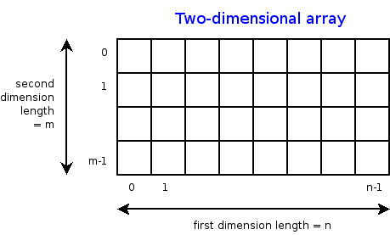
Data Manipulation and Computation
Data Representation, i.e., what is the natural way to think about given data
Data Processing Operations, which take one or more datasets as input and produce one or more datasets as output
Indexing
Slicing/subsetting
Filter
‘map’ → apply a function to every element
’reduce/aggregate’ → combine values across a row or a column (e.g., sum, average, median etc..)
n-dimensional arrays

Slide 17
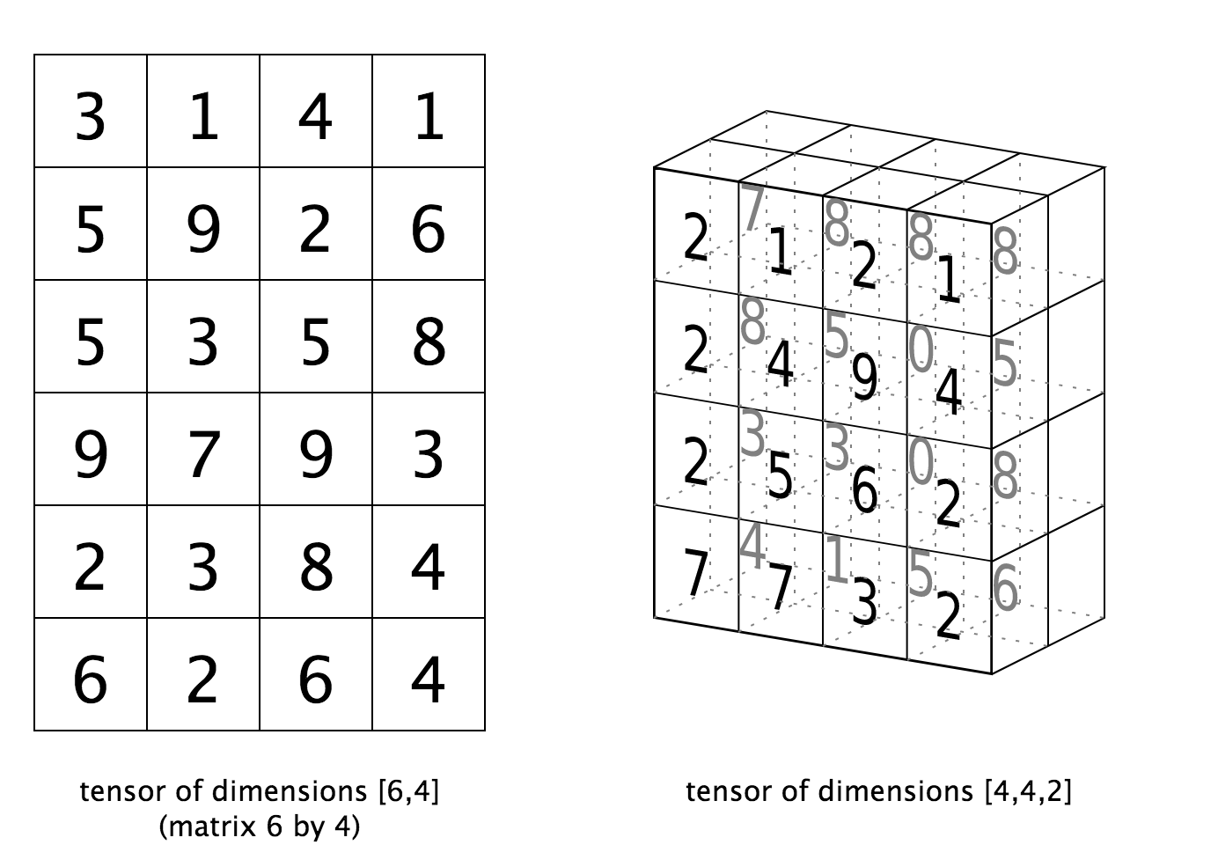
Data Manipulation and Computation
Data Representation, i.e., what is the natural way to think about given data
Data Processing Operations, which take one or more datasets as input and produce one or more datasets as output
Matrices, Tensors
n-dimensional array operations
+
Linear Algebra
Matrix/tensor multiplication
Transpose
Matrix-vector multiplication
Matrix factorization

Slide 18
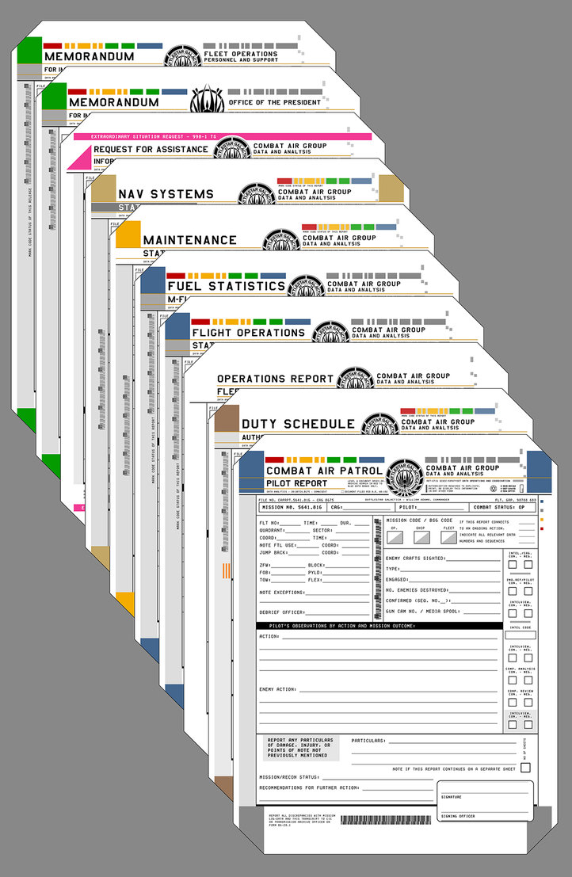
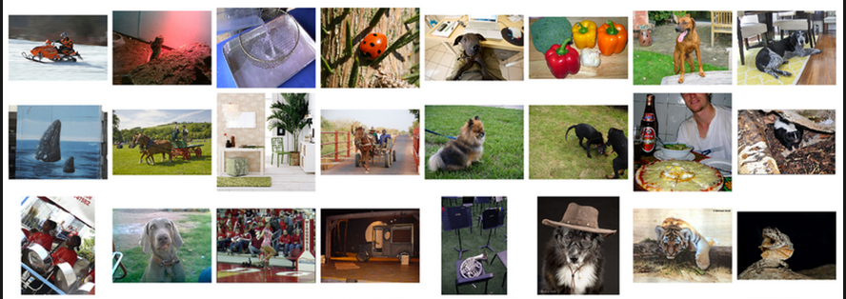
Data Manipulation and Computation
Data Representation, i.e., what is the natural way to think about given data
Data Processing Operations, which take one or more datasets as input and produce one or more datasets as output
Sets: of Objects
Filter
Map
Union
Reduce/Aggregate
Given two sets, Combine/Join using “keys”
Group and then aggregate
Sets: of (Key, Value Pairs)
(amol@cs.umd.edu,(email1, email2,…))
(john@cs.umd.edu,(email3, email4,…))

Slide 19
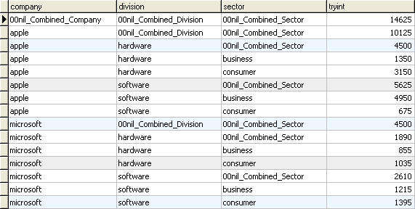
Data Manipulation and Computation
Data Representation, i.e., what is the natural way to think about given data
Data Processing Operations, which take one or more datasets as input and produce one or more datasets as output
Filter rows or columns
”Join” two or more relations
”Group” and “aggregate” them
Relational Algebra formalizes some of them
Structured Query Language (SQL)
  Many other languages and constructs, that look very similar
Tables/Relations == Sets of Tuples

Slide 20
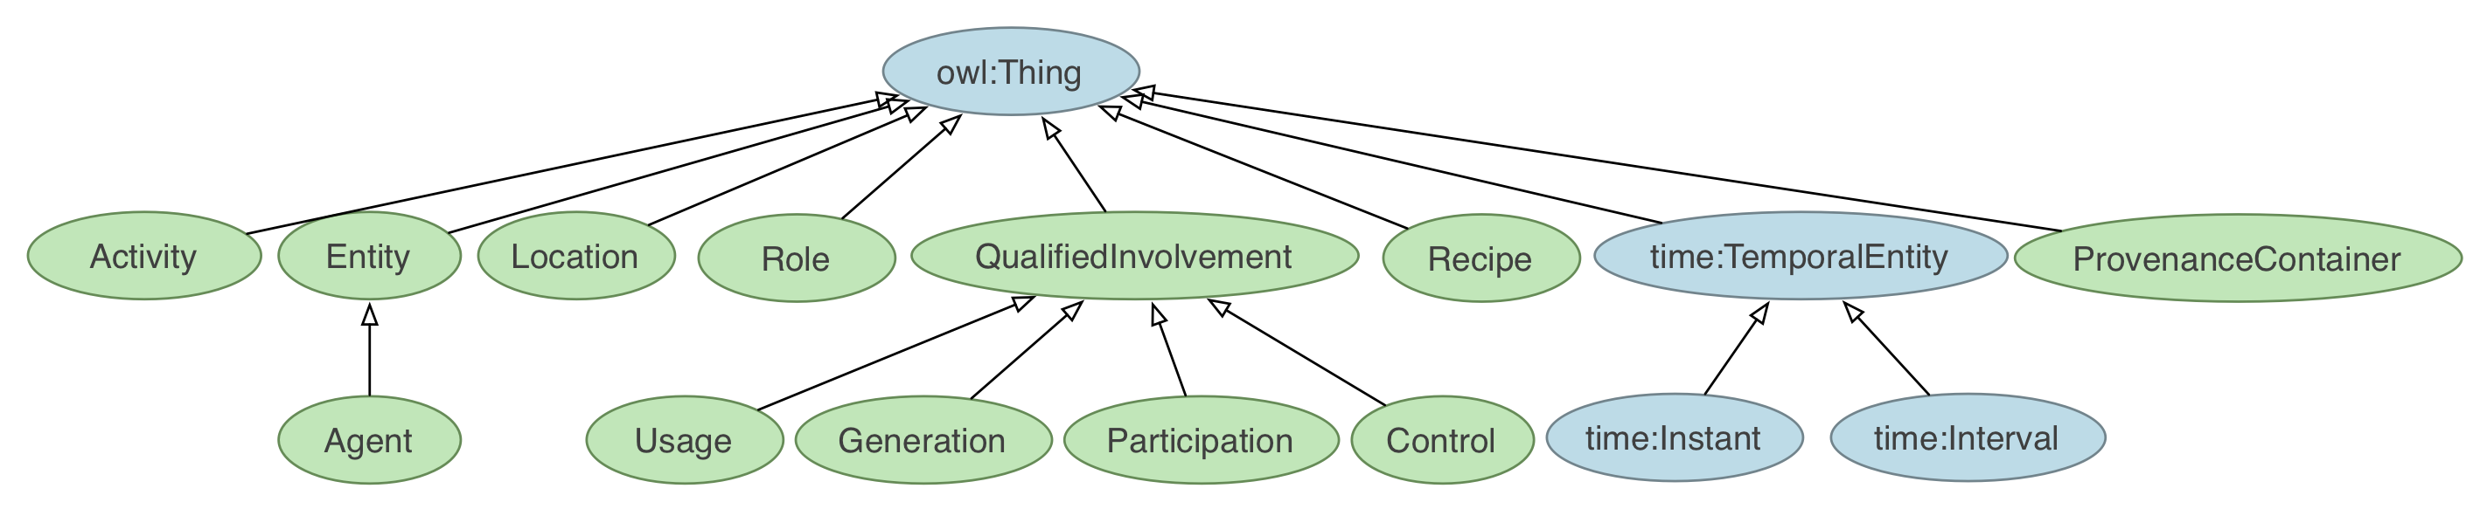
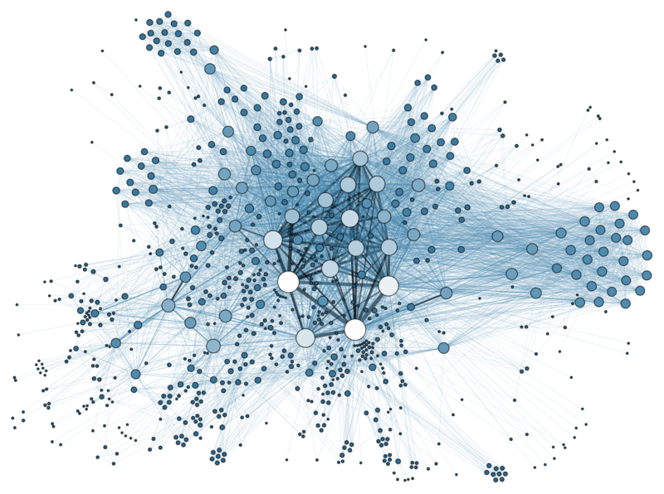
Data Manipulation and Computation
Data Representation, i.e., what is the natural way to think about given data
Data Processing Operations, which take one or more datasets as input and produce one or more datasets as output
Hierarchies/Trees/Graphs
”Path” queries
Graph Algorithms and Transformations
Network Science
Somewhat more ad hoc and special-purpose
Changing in recent years

Slide 21
Data Manipulation and Computation
Data Representation, i.e., what is the natural way to think about given data
Data Processing Operations, which take one or more datasets as input and produce
Why?
  Allows one to think at a higher level of abstraction, leading to simpler and easier-to-understand scripts
  Provides ”independence” between the abstract operations and concrete implementation
  Can switch from one implementation to another easily
For performance debugging, useful to know how they are implemented and rough characteristics

Slide 22
Next Few classes
NumPy: Python Library for Manipulating nD Arrays
  Multidimensional Arrays, and a variety of operations including Linear Algebra
Pandas: Python Library for Manipulating Tabular Data
  Series, Tables (also called DataFrames)
  Many operations to manipulate and combine tables/series
Relational Databases
  Tables/Relations, and SQL (similar to Pandas operations)
4. Apache Spark
  Sets of objects or key-value pairs
  MapReduce and SQL-like operations

Slide 23
Next Few classes
NumPy: Python Library for Manipulating nD Arrays
  Multidimensional Arrays, and a variety of operations including Linear Algebra
Pandas: Python Library for Manipulating Tabular Data
  Series, Tables (also called DataFrames)
  Many operations to manipulate and combine tables/series
Relational Databases
  Tables/Relations, and SQL (similar to Pandas operations)
4. Apache Spark
  Sets of objects or key-value pairs
  MapReduce and SQL-like operations

Slide 24
Numeric & scientific applications
Number of third-party packages available for numerical and scientific computing
These include:
NumPy/SciPy – numerical and scientific function libraries.
numba – Python compiler that support JIT compilation.
ALGLIB – numerical analysis library.
pandas – high-performance data structures and data analysis tools.
pyGSL – Python interface for GNU Scientific Library.
ScientificPython – collection of scientific computing modules.
Many, many thanks to: FSU CIS4930

Slide 25
NumPy and friends
By far, the most commonly used packages are those in the NumPy stack. These packages include:
NumPy: similar functionality as Matlab
SciPy: integrates many other packages like NumPy
Matplotlib & Seaborn – plotting libraries
iPython via Jupyter – interactive computing
Pandas – data analysis library
SymPy – symbolic computation library
[FSU]

Slide 26
The Numpy Stack
November
Later
Today/next class
Image from Continuum Analytics
Notes:
NumPy = low-level LinAlg storage and manipulation
SciPy = scientific computing & stats algorithms built on top of NumPy
Pandas = friendlier version of NumPy backed by raw NumPy

Slide 27
numpy
Among other things, NumPy contains:
A powerful n-dimensional array object.
Sophisticated (broadcasting/universal) functions.
Tools for integrating C/C++ and Fortran code.
Useful linear algebra, Fourier transform, and random number capabilities, etc.
Besides its obvious scientific uses, NumPy can also be used as an efficient multi-dimensional container of generic data.
[FSU]

Slide 28
numpy
ndarray object: an n-dimensional array of homogeneous data types, with many operations being performed in compiled code for performance
Several important differences between NumPy arrays and the standard Python sequences:
NumPy arrays have a fixed size. Modifying the size means creating a new array.
NumPy arrays must be of the same data type, but this can include Python objects – may not get performance benefits
More efficient mathematical operations than built-in sequence types.
[FSU]

Slide 29
Numpy datatypes
Wider variety of data types than are built-in to the Python language by default.
Defined by the numpy.dtype class and include:
intc (same as a C integer) and intp (used for indexing)
int8, int16, int32, int64
uint8, uint16, uint32, uint64
float16, float32, float64
complex64, complex128
bool_, int_, float_, complex_ are shorthand for defaults.
These can be used as functions to cast literals or sequence types, as well as arguments to NumPy functions that accept the dtype keyword argument.
[FSU]

Slide 30
Numpy datatypes
>>> import numpy as np
>>> x = np.float32(1.0)
>>> x
1.0
>>> y = np.int_([1,2,4])
>>> y
array([1, 2, 4])
>>> z = np.arange(3, dtype=np.uint8)
>>> z
array([0, 1, 2], dtype=uint8)
>>> z.dtype
dtype('uint8')
[FSU]

Slide 31
Numpy arrays
There are a couple of mechanisms for creating arrays in NumPy:
Conversion from other Python structures (e.g., lists, tuples)
  Any sequence-like data can be mapped to a ndarray
Built-in NumPy array creation (e.g., arange, ones, zeros, etc.)
  Create arrays with all zeros, all ones, increasing numbers from 0 to 1 etc.
Reading arrays from disk, either from standard or custom formats (e.g., reading in from a CSV file)
[FSU]

Slide 32
Numpy arrays
In general, any numerical data that is stored in an array-like container can be converted to an ndarray through use of the array() function. The most obvious examples are sequence types like lists and tuples.
>>> x = np.array([2,3,1,0])
>>> x = np.array([2, 3, 1, 0])
>>> x = np.array([[1,2.0],[0,0],(1+1j,3.)])
>>> x = np.array([[ 1.+0.j, 2.+0.j], [ 0.+0.j, 0.+0.j], [ 1.+1.j, 3.+0.j]])
[FSU]

Slide 33
Numpy arrays
Creating arrays from scratch in NumPy:
zeros(shape)– creates an array filled with 0 values with the specified shape. The default dtype is float64.
ones(shape) – creates an array filled with 1 values.
arange() – like Python’s built-in range
>>> np.zeros((2, 3))
array([[ 0., 0., 0.], [ 0., 0., 0.]])
>>> np.arange(10)
array([0, 1, 2, 3, 4, 5, 6, 7, 8, 9])
>>> np.arange(2, 10, dtype=np.float)
array([ 2., 3., 4., 5., 6., 7., 8., 9.])
>>> np.arange(2, 3, 0.2)
array([ 2. , 2.2, 2.4, 2.6, 2.8])
[FSU]

Slide 34
Numpy arrays
linspace()– creates arrays with a specified number of elements, and spaced equally between the specified beginning and end values.
random.random(shape) – creates arrays with random floats over the interval [0,1).
>>> np.linspace(1., 4., 6)
array([ 1. , 1.6, 2.2, 2.8, 3.4, 4. ])
>>> np.random.random((2,3))
array([[ 0.75688597, 0.41759916, 0.35007419],
[ 0.77164187, 0.05869089, 0.98792864]])
[FSU]

Slide 35
Numpy arrays
>>> import numpy as np
>>> a = np.arange(3)
>>> print(a)
[0 1 2]
>>> a
array([0, 1, 2])
>>> b = np.arange(9).reshape(3,3)
>>> print(b)
[[0 1 2]
[3 4 5]
[6 7 8]]
>>> c = np.arange(8).reshape(2,2,2)
>>> print(c)
[[[0 1]
[2 3]]
[[4 5]
[6 7]]]
Printing an array can be done with the print
statement (Python 2)
function (Python 3)
[FSU]

Slide 36
indexing
Single-dimension indexing is accomplished as usual.
Multi-dimensional arrays support multi-dimensional indexing.
>>> x = np.arange(10)
>>> x[2]
2
>>> x[-2]
8
>>> x.shape = (2,5) # now x is 2-dimensional
>>> x[1,3]
8
>>> x[1,-1]
9

Slide 37
indexing
Using fewer dimensions to index will result in a subarray:
This means that x[i, j] == x[i][j] but the second method is less efficient.
>>> x = np.arange(10)
>>> x.shape = (2,5)
>>> x[0]
array([0, 1, 2, 3, 4])

Slide 38
indexing
Slicing is possible just as it is for typical Python sequences:
>>> x = np.arange(10)
>>> x[2:5]
array([2, 3, 4])
>>> x[:-7]
array([0, 1, 2])
>>> x[1:7:2]
array([1, 3, 5])
>>> y = np.arange(35).reshape(5,7)
>>> y[1:5:2,::3]
array([[ 7, 10, 13], [21, 24, 27]])

Slide 39
Array operations
Basic operations apply element-wise. The result is a new array with the resultant elements.
>>> a = np.arange(5)
>>> b = np.arange(5)
>>> a+b
array([0, 2, 4, 6, 8])
>>> a-b
array([0, 0, 0, 0, 0])
>>> a**2
array([ 0, 1, 4, 9, 16])
>>> a>3
array([False, False, False, False, True], dtype=bool)
>>> 10*np.sin(a)
array([ 0., 8.41470985, 9.09297427, 1.41120008, -7.56802495])
>>> a*b
array([ 0, 1, 4, 9, 16])

Slide 40
Array operations
>>> a = np.zeros(4).reshape(2,2)
>>> a
array([[ 0., 0.],
[ 0., 0.]])
>>> a[0,0] = 1
>>> a[1,1] = 1
>>> b = np.arange(4).reshape(2,2)
>>> b
array([[0, 1],
[2, 3]])
>>> a*b
array([[ 0., 0.],
[ 0., 3.]])
>>> np.dot(a,b)
array([[ 0., 1.],
[ 2., 3.]])
Since multiplication is done element-wise, you need to specifically perform a dot product to perform matrix multiplication.

Slide 41
Array operations
>>> a = np.random.random((2,3))
>>> a
array([[ 0.68166391, 0.98943098, 0.69361582],
[ 0.78888081, 0.62197125, 0.40517936]])
>>> a.sum()
4.1807421388722164
>>> a.min()
0.4051793610379143
>>> a.max(axis=0)
array([ 0.78888081, 0.98943098, 0.69361582])
>>> a.min(axis=1)
array([ 0.68166391, 0.40517936])
There are also some built-in methods of ndarray objects.
Universal functions which may also be applied include exp, sqrt, add, sin,
cos, etc.

Slide 42
Array operations
>>> a = np.floor(10*np.random.random((3,4)))
>>> print(a)
[[ 9. 8. 7. 9.]
[ 7. 5. 9. 7.]
[ 8. 2. 7. 5.]]
>>> a.shape
(3, 4)
>>> a.ravel()
array([ 9., 8., 7., 9., 7., 5., 9., 7., 8., 2., 7., 5.])
>>> a.shape = (6,2)
>>> print(a)
[[ 9. 8.]
[ 7. 9.]
[ 7. 5.]
[ 9. 7.]
[ 8. 2.]
[ 7. 5.]]
>>> a.transpose()
array([[ 9., 7., 7., 9., 8., 7.],
[ 8., 9., 5., 7., 2., 5.]])
An array shape can be manipulated by a number of methods.
resize(size) will modify an array in place.
reshape(size) will return a copy of the array with a new shape.

Slide 43
Linear algebra
One of the most common reasons for using the NumPy package is its linear algebra module.
It’s like Matlab, but free!
>>> from numpy import *
>>> from numpy.linalg import *
>>> a = array([[1.0, 2.0],
[3.0, 4.0]])
>>> print(a)
[[ 1. 2.]
[ 3. 4.]]
>>> a.transpose()
array([[ 1., 3.],
[ 2., 4.]])
>>> inv(a) # inverse
array([[-2. , 1. ],
[ 1.5, -0.5]])

Slide 44
Linear algebra
>>> u = eye(2) # unit 2x2 matrix; "eye" represents "I"
>>> u
array([[ 1., 0.],
[ 0., 1.]])
>>> j = array([[0.0, -1.0], [1.0, 0.0]])
>>> dot(j, j) # matrix product
array([[-1., 0.],
[ 0., -1.]])
>>> trace(u) # trace (sum of elements on diagonal)
2.0
>>> y = array([[5.], [7.]])
>>> solve(a, y) # solve linear matrix equation
array([[-3.],
[ 4.]])
>>> eig(j) # get eigenvalues/eigenvectors of matrix
(array([ 0.+1.j, 0.-1.j]),
array([[ 0.70710678+0.j, 0.70710678+0.j],
[ 0.00000000-0.70710678j, 0.00000000+0.70710678j]]))
(We’ll talk about this stuff as needed in the March/April machine learning and statistics lectures.)

Slide 45
SciPy?
In its own words:
Basically, SciPy contains various tools and functions for solving common problems in scientific computing.
SciPy is a collection of mathematical algorithms and convenience functions built on the NumPy extension of Python. It adds significant power to the interactive Python session by providing the user with high-level commands and classes for manipulating and visualizing data.

Slide 46
SciPY
SciPy gives you access to a ton of specialized mathematical functionality.
Just know it exists. We won’t use it much in this class.
Some functionality:
Special mathematical functions (scipy.special) -- elliptic, bessel, etc.
Integration (scipy.integrate)
Optimization (scipy.optimize)
Interpolation (scipy.interpolate)
Fourier Transforms (scipy.fftpack)
Signal Processing (scipy.signal)
Linear Algebra (scipy.linalg)
Compressed Sparse Graph Routines (scipy.sparse.csgraph)
Spatial data structures and algorithms (scipy.spatial)
Statistics (scipy.stats)
Multidimensional image processing (scipy.ndimage)
Data IO (scipy.io) – overlaps with pandas, covers some other formats

Slide 47
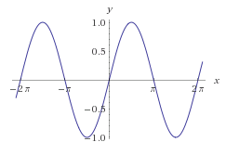

One SciPy Example
We can’t possibly tour all of the SciPy library and, even if we did, it might be a little boring.
Often, you’ll be able to find higher-level modules that will work around your need to directly call low-level SciPy functions
Say you want to compute an integral:
$$\int_{a}^{b}{\sin{x}dx}$$

Slide 48

Scipy.integrate
We have a function object – np.sin defines the sin function for us.
We can compute the definite integral from $x=0$ to $x=π$ using the quad function.
>>> res = scipy.integrate.quad(np.sin, 0, np.pi)
>>> print(res)
(2.0, 2.220446049250313e-14) # 2 with a very small error margin!
>>> res = scipy.integrate.quad(np.sin, -np.inf, +np.inf)
>>> print(res)
(0.0, 0.0) # Integral does not converge

Slide 49
Scipy.integrate
Let’s say that we don’t have a function object, we only have some (x,y) samples that “define” our function.
We can estimate the integral using the trapezoidal rule.
>>> sample_x = np.linspace(0, np.pi, 1000)
>>> sample_y = np.sin(sample_x) # Creating 1,000 samples
>>> result = scipy.integrate.trapz(sample_y, sample_x)
>>> print(result)
1.99999835177
>>> sample_x = np.linspace(0, np.pi, 1000000)
>>> sample_y = np.sin(sample_x) # Creating 1,000,000 samples
>>> result = scipy.integrate.trapz(sample_y, sample_x)
>>> print(result)
2.0

Slide 50
Wrap up
Shift thinking from imperative coding to operations on datasets
Numpy: A low-level abstraction that gives us really fast multi-dimensional arrays
Next class:
Pandas: Higher-level tabular abstraction and operations to manipulate and combine tables
Reading Homework focuses on Pandas and SQL: Aim to release by tomorrow

