Slide 1
Introduction to
Data Science
John P Dickerson
Prem Saggar
Lecture #10 – 10/1/2018
CMSC320
Mondays & Wednesdays
2:00pm – 3:15pm

Slide 2
Announcements
Mini-Project #1 is due tonight!
It is linked to from ELMS; also available at: https://github.com/umddb/cmsc320-fall2018/tree/master/project1
Deliverable is a .ipynb file submitted to ELMS
Mini-Project #2 is out!
It is linked to from ELMS; also available at: https://github.com/umddb/cmsc320-fall2018/tree/master/project2
Deliverable is a .ipynb file submitted to ELMS
Due Friday, October 19th

Slide 3
Handling Missing Data …
Continued from last lecture …

Slide 4
Single Imputation
Mean imputation: imputing the average from observed cases for all missing values of a variable
Hot-deck imputation: imputing a value from another subject, or “donor,” that is most like the subject in terms of observed variables
Last observation carried forward (LOCF): order the dataset somehow and then fill in a missing value with its neighbor
Cold-deck imputation: bring in other datasets
Old and busted:
All fundamentally impose too much precision.
Have uncertainty over what unobserved values actually are
Developed before cheap computation

Slide 5
Multiple Imputation
Developed to deal with noise during imputation
Impute once → treats imputed value as observed
We have uncertainty over what the observed value would have been
Multiple imputation: generate several random values for each missing data point during imputation

Slide 6
Imputation Process
s₁
a₁
Incomplete data
s₂
a₂
Pooled results
s_{N}
a_{N}
Impute N times
Analysis performed on each imputed set

Slide 7
Tiny example
X | Y
32 | 2
43 | ?
56 | 6
25 | ?
84 | 5
Independent variable: X
Dependent variable: Y
We assume Y has a linear relationship with X

Slide 8
Let’s Impute Some Data!
Use a predictive distribution of the missing values:
Given the observed values, make random draws of the observed values and fill them in.
Do this N times and make N imputed datasets
X | Y
32 | 2
43 | 5.5
56 | 6
25 | 8
84 | 5
X | Y
32 | 2
43 | 7.2
56 | 6
25 | 1.1
84 | 5
For very large values of N=2 …

Slide 9
Inference with Multiple Imputation
Now that we have our imputed data sets, how do we make use of them? ???????????
Analyze each of the separately
X | Y
32 | 2
43 | 5.5
56 | 6
25 | 8
84 | 5
X | Y
32 | 2
43 | 7.2
56 | 6
25 | 1.1
84 | 5
Slope | -0.8245
Standard error | 6.1845
Slope | 4.932
Standard error | 4.287
Y
=
β
+
β
X
+
ε
Y
=
β
+
β
X
+
ε
i
0
1
i
i
i
0
1
i
i

Slide 10
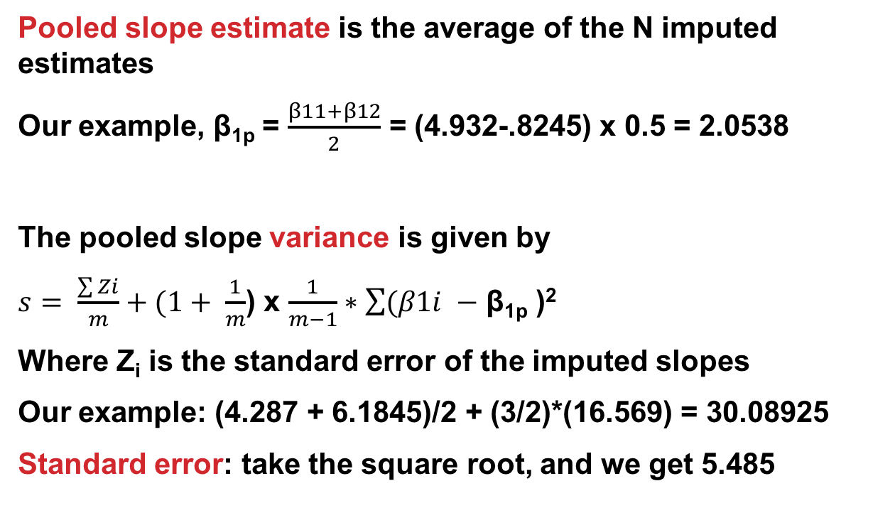
Pooling analyses
Pooled slope estimate is the average of the N imputed estimates
Our example, β_{1p} = $\frac{β11+β12}{2}$ = (4.932-.8245) x 0.5 = 2.0538
The pooled slope variance is given by
$s= \frac{\sum{Zi}}{m}+(1+ \frac{1}{m}$) x $\frac{1}{m−1}∗\sum{(β1i }−$ β_{1p} )²
Where Z_{i} is the standard error of the imputed slopes
Our example: (4.287 + 6.1845)/2 + (3/2)*(16.569) = 30.08925
Standard error: take the square root, and we get 5.485
Notes:
For those following from home:
Variance: roughly how much a set of numbers are “spread around” their mean
Standard deviation: similar to variance (square root of variance) – same units as main data
Standard error (of the sample mean): how far the sample mean is from the population mean

Slide 11
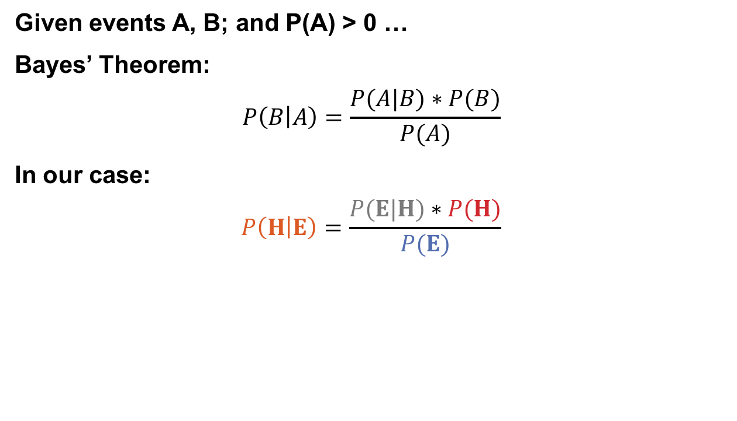
Predicting the missing data given the observed data
Given events A, B; and P(A) > 0 …
Bayes’ Theorem:
$$P\left(B | A\right)=\frac{P(A|B)∗P(B)}{P(A)}$$
In our case:
$$P\left(H | E\right)=\frac{P(E|H)∗P(H)}{P(E)}$$
Probability of seeing evidence given the hypothesis
Prior probability of hypotheses
Posterior probability of the hypothesis given the evidence
Prior over the evidence

Slide 12
Bayesian Imputation
Establish a prior distribution:
Some distribution of parameters of interest θ before considering the data, P(θ)
We want to estimate θ
Given θ, can establish a distribution P(X_{obs}|θ)
Use Bayes Theorem to establish P(θ|X_{obs}) …
Make random draws for θ
Use these draws to make predictions of Y_{miss}

Slide 13
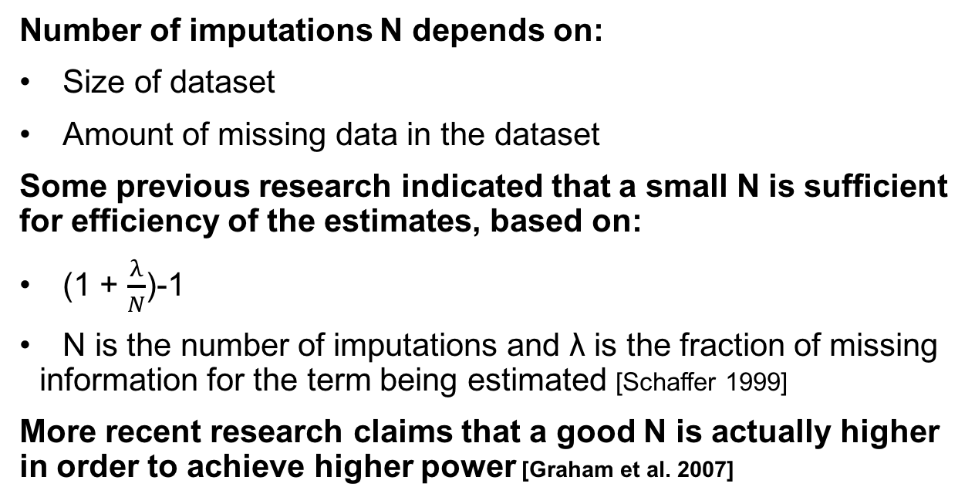
How big should N Be?
Number of imputations N depends on:
Size of dataset
Amount of missing data in the dataset
Some previous research indicated that a small N is sufficient for efficiency of the estimates, based on:
(1 + $\frac{λ}{N}$)-1
N is the number of imputations and λ is the fraction of missing information for the term being estimated [Schaffer 1999]
More recent research claims that a good N is actually higher in order to achieve higher power [Graham et al. 2007]

Slide 14
More advanced methods
Interested? Further reading:
Regression-based MI methods
Multiple Imputation Chained Equations (MICE) or Fully Conditional Specification (FCS)
  Readable summary from JHU School of Public Health: https://www.ncbi.nlm.nih.gov/pmc/articles/PMC3074241/
Markov Chain Monte Carlo (MCMC)
  We’ll cover this a bit, but also check out CMSC422!

Slide 15
Rest of Today’s Lecture
Data collection
Data processing
Exploratory analysis
&
Data viz
Analysis, hypothesis testing, & ML
Insight & Policy Decision
Continue with the general topic of data wrangling and cleaning
Many slides from Amol Deshpande (UMD)

Slide 16
Overview
Goal: get data into a structured form suitable for analysis
  Variously called: data preparation, data munging, data curation
  Also often called ETL (Extract-Transform-Load) process
Often the step where majority of time (80-90%) is spent
Key steps:
  Scraping: extracting information from sources, e.g., webpages, spreadsheets
  Data transformation: to get it into the right structure
  Data integration: combine information from multiple sources
  Information extraction: extracting structured information from unstructured/text sources
  Data cleaning: remove inconsistencies/errors

Slide 17
Overview
Goal: get data into a structured form suitable for analysis
  Variously called: data preparation, data munging, data curation
  Also often called ETL (Extract-Transform-Load) process
Often the step where majority of time (80-90%) is spent
Key steps:
  Scraping: extracting information from sources, e.g., webpages, spreadsheets
  Data transformation: to get it into the right structure
  Information extraction: extracting structured information from unstructured/text sources
  Data integration: combine information from multiple sources
  Data cleaning: remove inconsistencies/errors
Already covered
In a few
classes

Slide 18
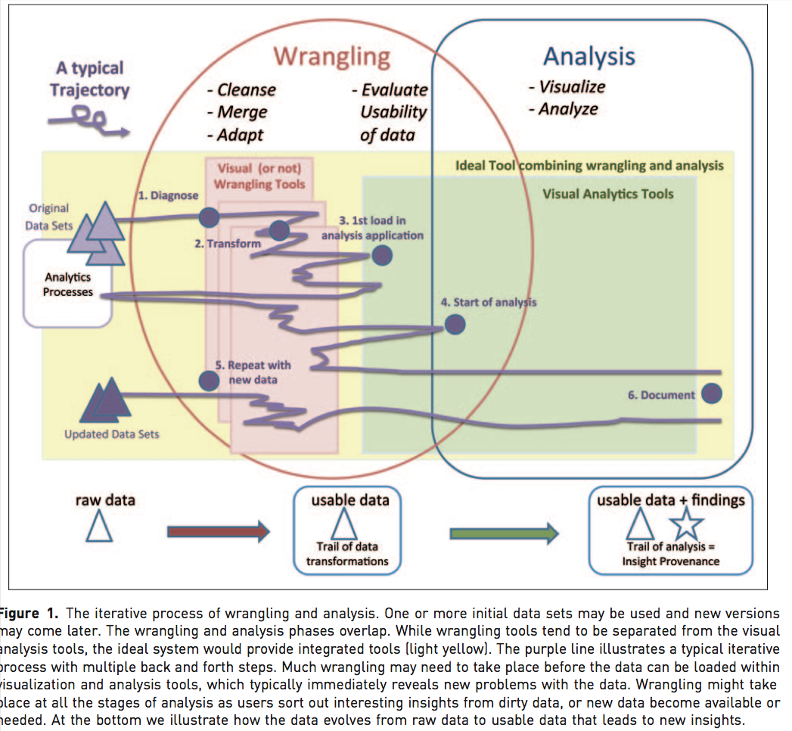
Overview

Slide 19
Overview
Many of the problems are not easy to formalize, and have seen little work
  E.g., Cleaning
  Others aspects of integration, e.g., schema mapping, have been studied in depth
A mish-mash of tools typically used
  Visual (e.g., Trifacta), or not (UNIX grep/sed/awk, Pandas)
  Ad hoc programs for cleaning data, depending on the exact type of errors
  Different types of transformation tools
  Visualization and exploratory data analysis to understand and remove outliers/noise
  Several tools for setting up the actual pipelines, assuming the individual steps are setup (e.g., Talend, AWS Glue)

Slide 20
Outline
Data Integration
Data Quality Issues
Data Cleaning
Entity Resolution

Slide 21
Outline
Data Integration
Data Quality Issues
Data Cleaning
Entity Resolution

Slide 22
Data Integration
Linkage
Queries
Querying integrated information sources (e.g. queries to views, execution of web-based queries, …)
Data mining & analyzing integrated information (e.g., collaborative filtering/classification learning using extracted data, …)
Discovering information sources (e.g. deep web modeling, schema learning, …)
Gathering data (e.g., wrapper learning & information extraction, federated search, …)
Cleaning data (e.g., de-duping and linking records) to form a single [virtual] database

Slide 23
Data Integration
Goal: Combine data residing in different sources and provide users with a unified view of these data for querying or analysis
  Each data source has its own schema called local schemas (much work assumes relational schemas, but some work on XML as well)
  The unified schema is often called mediated schema or global schema
Two different setups:
Bring the data together into a single repository (often called data warehousing)
Keep the data where it is, and send queries back and forth

Slide 24
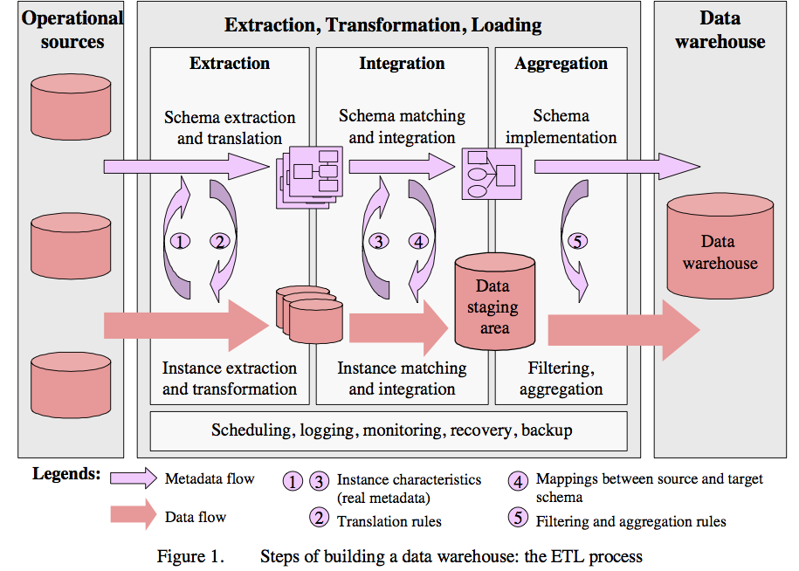
1. Data Warehousing
  From Data Cleaning: Problems and Current Approaches
Many of the problems are not easy to formalize, and have seen little work
  E.g., Cleaning
  Others aspects of integration, e.g., schema mapping, have been studied in depth
Typical workflow
  From Data Cleaning: Problems and Current Approaches
  Somewhat old: data is mostly coming from structured sources
  For a data scientist, the data scraping is equally important

Slide 25
2. In-place integration
Query Q
Mediated Schema
Q’
Q’
Q’
Q’
Q’
Source
Source
Source
Source
Source

Slide 26
Data Integration
Two different setups:
Bring the data together into a single repository (often called data warehousing)
  Relatively easier problem - only need one-way-mappings
  Query performance predictable and under your control
Keep the data where it is, and send queries back and forth
  Need two-way mappings -- a query on the mediated schema needs to be translated into queries over data source schemas
  Not as efficient and clean as data warehousing, but a better fit for dynamic data
  Or when data warehousing is not feasible

Slide 27
Data Integration: Key Challenges
Data extraction, reconciliation, and cleaning
  Get the data from each source in a structured form
  Often need to use wrappers to extract data from web sources
  May need to define a schema
Schema alignment and mapping
  Decide on the best mediated schema
  Figure out mappings and matchings between the local schemas and the global schema
Answer queries over the global schema
  In the second scenario, need to figure out how to map a query on global schema onto queries over local schemas
  Also need to decide which sources contain relevant data
Limitations in mechanisms for accessing sources
  Many sources have limits on how you can access them
  Limits on the number of queries you can issues (say 100 per min)
  Limits on the types of queries (e.g., must enter a zipcode to get information from a web source)

Slide 28
Schema Matching or Alignment
Flashbacks to Project 1 …
Goal: Identify corresponding elements in two schemas
  As a first step toward constructing a global schema
  Schema heterogeneity is a key roadblock
    Different data sources speak their own schema
Hotel, Restaurant,
AdventureSports, HistoricalSites
Data Source
Consumer
Hotel, Gaststätte
Brauerei, Kathedrale
Data Source
Mediator
Data Source
Lodges, Restaurants
Beaches, Volcanoes

Slide 29
Schema Matching or Alignment
Books
Title
ISBN
Price
DiscountPrice
Edition
Authors
ISBN
FirstName
LastName
BooksAndMusic
Title
Author
Publisher
ItemID
ItemType
SuggestedPrice
Categories
Keywords
BookCategories
ISBN
Category
CDCategories
ASIN
Category
CDs
Album
ASIN
Price
DiscountPrice
Studio
Inventory
Database A
Artists
ASIN
ArtistName
GroupName
Inventory Database B

Slide 30
summary
Data integration continues to be a very active area in research and increasingly industry
Solutions still somewhat ad hoc and manual, although tools beginning to emerge
Need to minimize the time needed to integrate a new data source
  Crucial opportunities may be lost otherwise
  Can take weeks to do it properly
Dealing with changes to the data sources a major headache
  Especially for data sources not under your control

Slide 31
Outline
Data Integration
Data Quality Issues
Data Cleaning
Entity Resolution

Slide 32
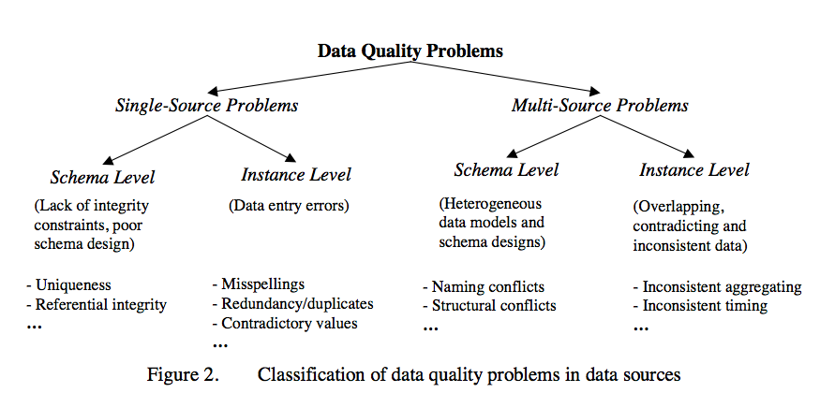
Data quality Problems
Different sources are developed separately, and maintained by different people
Issue 1: Mapping information across sources (schema mapping/transformation)
  Naming conflicts: same name used for different objects
  Structural conflicts: different representations across sources
  We will cover this later
Issue 2: Entity Resolution: Matching entities across sources
Issue 3: Data quality issues
  Contradicting information, Mismatched information, etc.
  From Data Cleaning: Problems and Current Approaches

Slide 33
Single-source problems
Depends largely on the source
Databases can enforce constraints, whereas data extracted from files or spreadsheets, or scraped from webpages is much more messy
Types of problems:
  Ill-formatted data, especially from webpages or files or spreadsheets
  Missing or illegal values, Misspellings, Use of wrong fields, Extraction issues (not easy to separate out different fields)
  Duplicated records, Contradicting Information, Referential Integrity Violations
  Unclear default values (e.g., data entry software needs something)
  Evolving schemas or classification schemes (for categorical attributes)
  Outliers

Slide 34
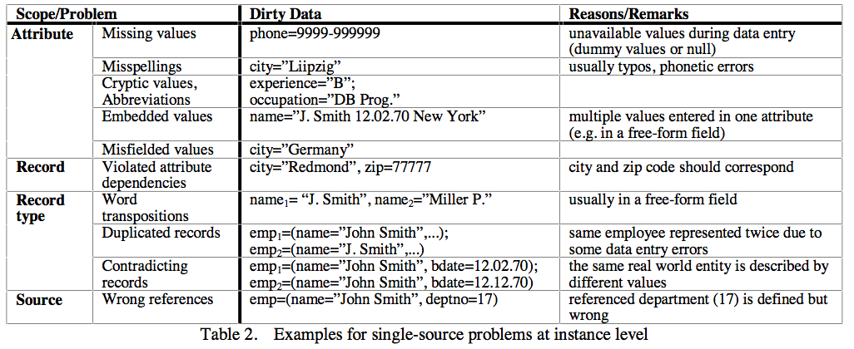
Data quality Problems

Slide 35
Multi-source problems
Different sources are developed separately, and maintained by different people
Issue 1: Mapping information across sources (schema mapping/transformation)
  Naming conflicts: same name used for different objects
  Structural conflicts: different representations across sources
  We will cover this later
Issue 2: Entity Resolution: Matching entities across sources
Issue 3: Data quality issues
  Contradicting information, Mismatched information, etc.

Slide 36
Outline
Data Integration
Data Quality Issues
Data Cleaning
  Outlier Detection
  Constraint-based Cleaning
  Entity Resolution

Slide 37
Univariate outliers
A set of values can be characterized by metrics such as center (e.g., mean), dispersion (e.g., standard deviation), and skew
Can be used to identify outliers
  Must watch out for "masking": one extreme outlier may alter the metrics sufficiently to mask other outliers
  Should use robust statistics: considers effect of corrupted data values on distributions – we will talk about this in depth later
  Robust center metrics: median, k% trimmed mean (discard lowest and highest k% values)
  Robust dispersion:
    Median Absolute Deviation (MAD): median distance of all the values from the median value
A reasonable approach to find outliers: any data points 1.4826x MAD away from median
  The above assumes that data follows a normal distribution
  May need to eyeball the data (e.g., plot a histogram) to decide if this is true

Slide 38
Univariate outliers
Wikipedia Article on Outliers lists several other normality-based tests for outliers
If data appears to be not normally distributed:
  Distance-based methods: look for data points that do not have many neighbors
  Density-based methods:
    Define density to be average distance to k nearest neighbors
    Relative density = density of node/average density of its neighbors
    Use relative density to decide if a node is an outlier
Most of these techniques start breaking down as the dimensionality of the data increases
  Curse of dimensionality
  Can project data into lower-dimensional space and look for outliers there
    Not as straightforward

Slide 39
Multivariate outliers
Analogous to above, one set of techniques based on assuming data follows a multi-variate normal distribution
  Defined by a mean, μ, and a covariance matrix, Σ
  Mahalanobis Depth of a point: Square root of (x - μ)'Σ⁻¹(x - μ)
  Measures how far the point x is from the multivariate normal distribution
    Look for points that are too far away
Mean/Covariance are not robust -- they are sensitive to outliers
  Iterative approach: remove points with high Mahalanobis distance, recompute the mean and covariance
  Several other general approaches discussed in the reference above (by Hellerstein)
  No clear guidelines here -- need to try different techniques based on the data

Slide 40
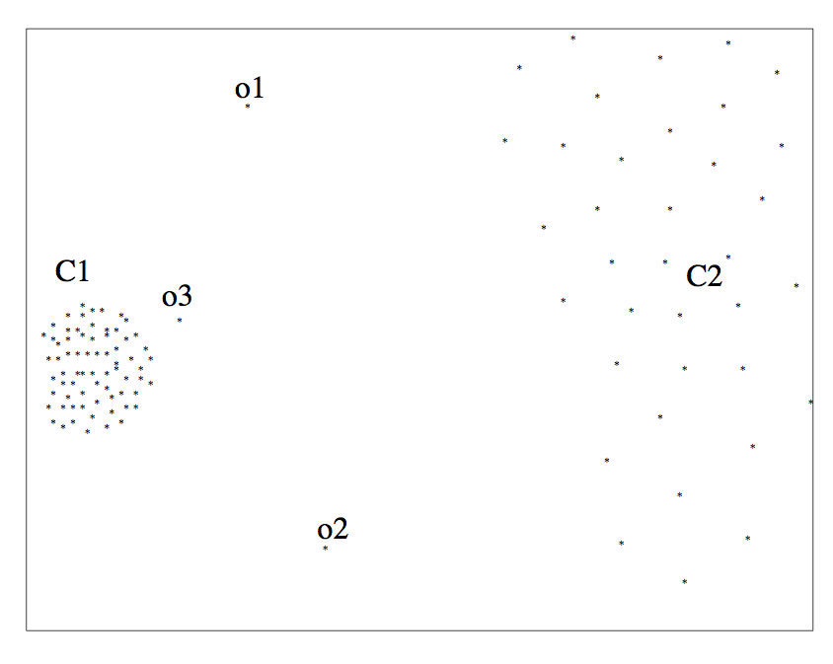
outliers

Slide 41
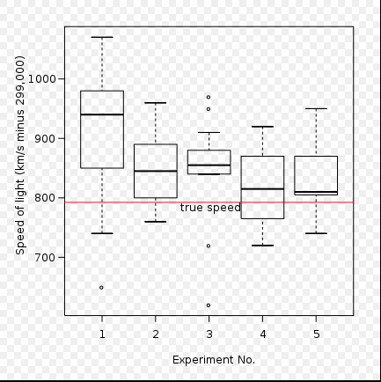
outliers

Slide 42
Other outliers
Timeseries outliers
  Often the data is in the form of a timeseries
  Can use the historical values/patterns in the data to flag outliers
  Rich literature on forecasting in timeseries data
Frequency-based outliers
  An item is considered a "heavy hitter" if it is much more frequent than other items
  In relational tables, can be found using a simple groupby-count
  Often the volume of data may be too much (e.g., internet routers)
    Approximation techniques often used
    To be discussed sometime later in the class
Things generally not as straightforward with other types of data
  Outlier detection continues to be a major research area

Slide 43
Wrap-up
Data wrangling/cleaning are a key component of data science pipeline
Still largely ad hoc although much tooling in recent years
Specifically, we covered:
Schema mapping and matching
Outliers
Next up:
Constraint-based Cleaning
Entity Resolution/Record Linkage/Data Matching

Slide 44
Data Cleaning: Outlier Resolution
From: Entity Resolution Tutorial
Identify different manifestations of the same real world object
  Also called: identity reconciliation, record linkage, deduplication, fuzzy matching, Object consolidation, Coreference resolution, and several others
Motivating examples: ?????????????
  Postal addresses
  Entity recognition in NLP/Information Extraction
  Identifying companies in financial records
  Comparison shopping
  Author disambiguation in citation data
  Connecting up accounts on online networks
  Crime/Fraud Detection
  Census
  ...

Slide 45
Data Cleaning: Outlier Resolution
Important to correctly identify references
  Often actions taken based on extracted data
  Cleaning up data by entity resolution can show structure that may not be apparent before
Challenges
  Such data is naturally ambiguous (e.g., names, postal addresses)
  Abbreviations/data truncation
  Data entry errors, Missing values, Data formatting issues complicate the problem
  Heterogeneous data from many diverse sources
No magic bullet here !!
  Approaches fairly domain-specific
  Be prepared to do a fair amount of manual work

Slide 46
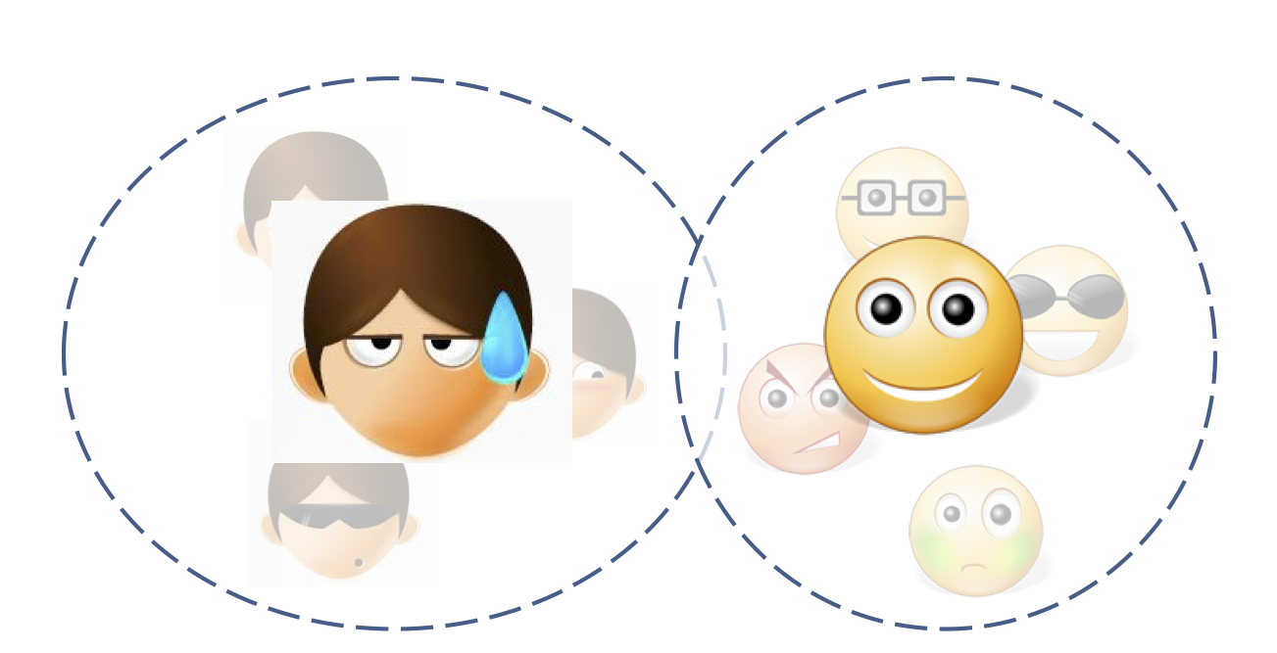
Entity Resolution: Three Slightly Different Problems
Setup:
  Real world: there are entities (people, addresses, businesses)
  We have a large collection of noisy, ambiguous "references" to those entities (also called "mentions")
  Somewhat different techniques, but a lot of similarities
Deduplication
  Cluster records/mentions that correspond to the same entity
  Choose/construct a cluster representative
    This is in itself a non-trivial task (e.g., averaging may work for numerical attributes, but what about string attributes?)

Slide 47
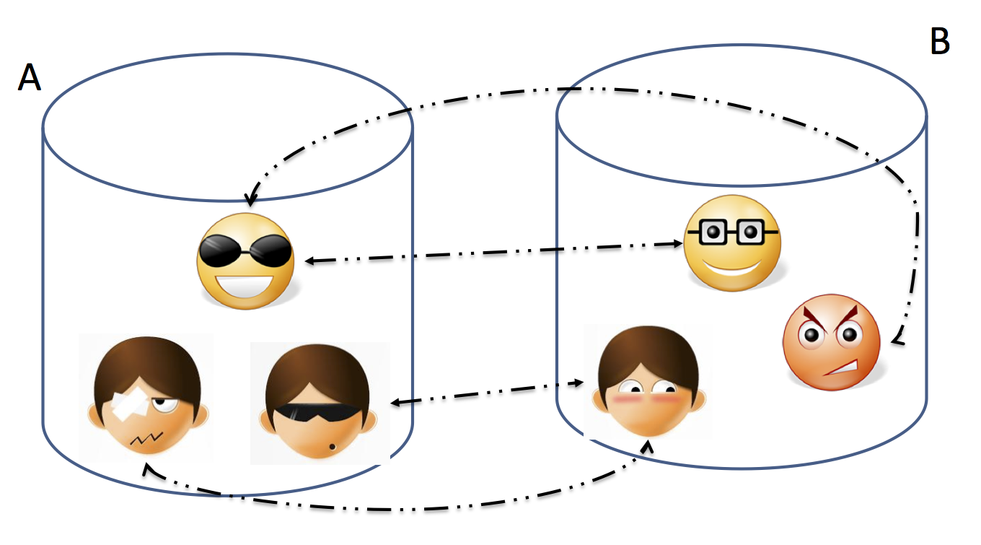
Entity Resolution: Three Slightly Different Problems
Setup:
  Real world: there are entities (people, addresses, businesses)
  We have a large collection of noisy, ambiguous "references" to those entities (also called "mentions")
  Somewhat different techniques, but a lot of similarities
Record Linkage
  Match records across two different databases (e.g., two social networks, or financial records w/ campaign donations)
  Typically assume that the two databases are fairly clean

Slide 48
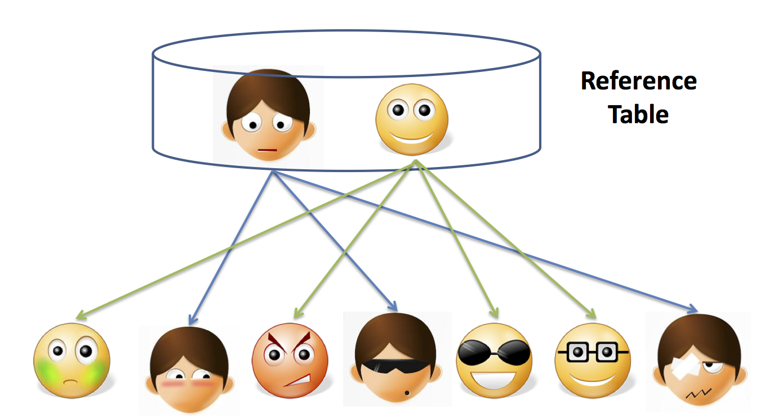
Entity Resolution: Three Slightly Different Problems
Setup:
  Real world: there are entities (people, addresses, businesses)
  We have a large collection of noisy, ambiguous "references" to those entities (also called "mentions")
  Somewhat different techniques, but a lot of similarities
Reference Matching
  Match "references" to clean records in a reference table
  Commonly comes up in "entity recognition" (e.g., matching newspaper article mentions to names of people)

Slide 49
Entity Resolution: Data Matching
Comprehensive treatment: Data Matching; P. Christen; 2012 (Springer Books -- not available for free)
One of the key issues is finding similarities between two references
  What similarity function to use?
Edit Distance Functions
  Levenstein: min number of changes to go from one reference to another
    A change is defined to be: a single character insertion or deletion or substitution
    May add transposition
  Many adjustments to the basic idea proposed (e.g., higher weights to changes at the start)
  Not cheap to compute, especially for millions of pairs
Set Similarity
  Some function of intersection size and union size
  E.g., Jaccard distance = size of intersection/size of union
  Much faster to compute
Vector Similarity
  Cosine similarity – we’ll talk about this much more in NLP lectures

Slide 50
Entity Resolution: Data Matching
Q-Grams
  Find all length-q substrings in each string
  Use set/vector similarity on the resulting set
Several approaches that combine the above (especially q-grams and edit distance, e.g., Jaro-Winkler)
Soundex: Phonetic Similarity Metric
  Homophones should be encoded to the same representation so spelling errors can be handled
  Robert and Rupert get assigned the same code (R163), but Rubin yields R150
May need to use Translation Tables
  To handle abbreviations, nicknames, other synonyms
Different types of data requires more domain-specific functions
  E.g., geographical locations, postal addresses
  Also much work on computing distances between XML documents etc.

Slide 51
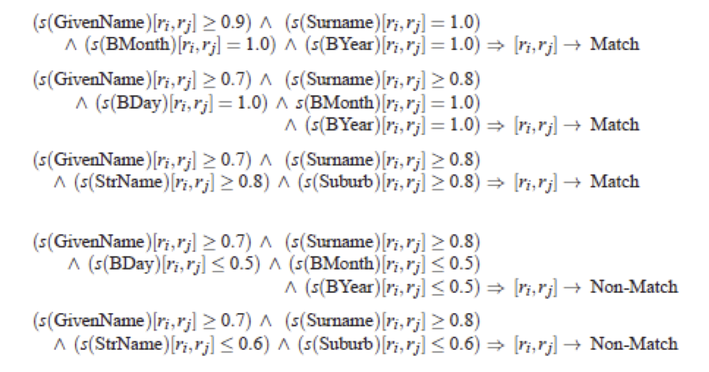
Entity Resolution: Algorithms
Simple threshold method
  If the distance below some number, the two references are assumed to be equal
  May review borderline matches manually
Can be generalized to rule-based:
  Example from Christen, 2012

Slide 52
Entity Resolution: Algorithms
May want to give more weight to matches involving rarer words
  More naturally applicable to record linkage problem
  If two records match on a rare name like "Machanavajjhala", they are likely to be a match
  Can formalize this as "probabilistic record linkage”
Constraints: May need to be satisfied, but can also be used to find matches
  Often have constraints on the matching possibilities
  Transitivity: M1 and M2 match, and M2 and M3 match, and M1 and M3 must match
  Exclusivity: M1 and M2 match --> M3 cannot match with M2
  Other types of constraints:
    E.g., if two papers match, their venues must match

Slide 53
Entity Resolution: Algorithms
Clustering-based ER Techniques:
  Deduplication is basically a clustering problem
  Can use clustering algorithms for this purpose
  But most clusters are very small (in fact of size = 1)
  Some clustering algorithms are better suited for this, especially Agglomerative Clustering
    Unlikely K-Means would work here

Slide 54
Entity Resolution: Algorithms
Crowdsourcing
  Humans are often better at this task
  Can use one of the crowdsourcing mechanisms (e.g., Mechanical Turk) for getting human input on the difficult pairs
  Quite heavily used commercially (e.g., to disambiguate products, restaurants, etc.)

Slide 55
Entity Resolution: Scaling to Big Data
One immediate problem
  There are O(N²) possible matches
  Must reduce the search space
Use some easy-to-evaluate criterion to restrict the pairs considered further
  May lead to false negative (i.e., missed matches) depending on how noisy the data is
Much work on this problem as well, but domain-specific knowledge likely to be more useful in practice
One useful technique to know: min-hash signatures
  Can quickly find potentially overlapping sets
  Turns up to be very useful in many domains (beyond ER)

Slide 56
Next Class:
Summary Statistics &Visualization

