Slide 1
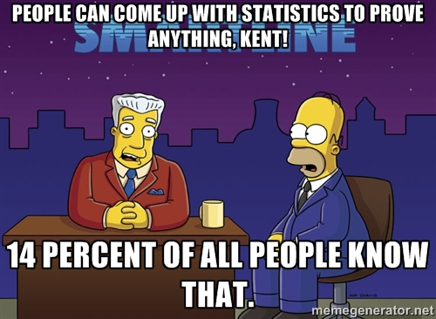
Hypothesis Testing

Slide 2

Statistics = Use random samples to make confident statements about entire populations. Intelligent guesses/speculation.

Slide 3
Sample, shape, location, and spread
Sample = make sure it's random, handle missing data (mcar, mar, nmar), imputation methods. NMAR!
Shape = Is the data skewed, normal, or flat? If normal then we can use statistical analysis for normal distributions
Location = Where does the data accumulate? Is it skewed, if so the median tells a better story.
Spread = How much does the data differ? Standard deviations!

Slide 4
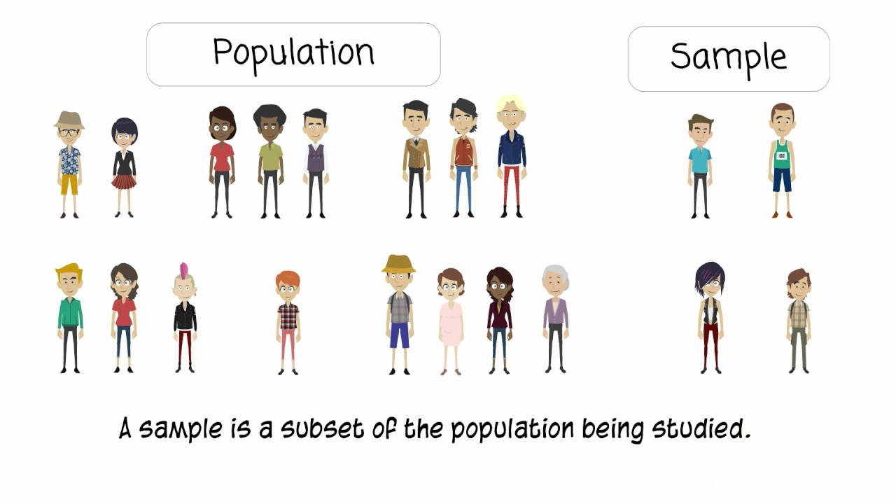
Samples give statistics, and populations (which we may never know give parameters)

Slide 5
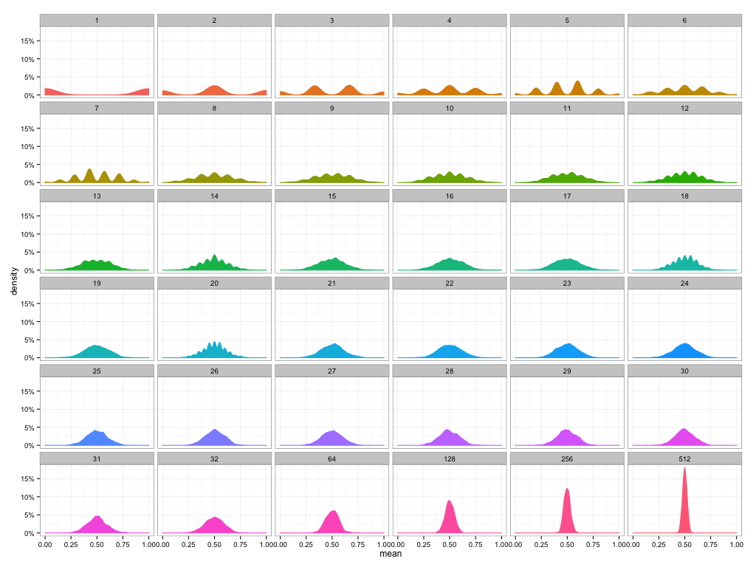
The Central Limit Theorem
If we:
Sample randomly
And use the averages of the sampled data
In the long term an n goes ballistic, the distribution will be normal and narrow. Why?

Slide 6
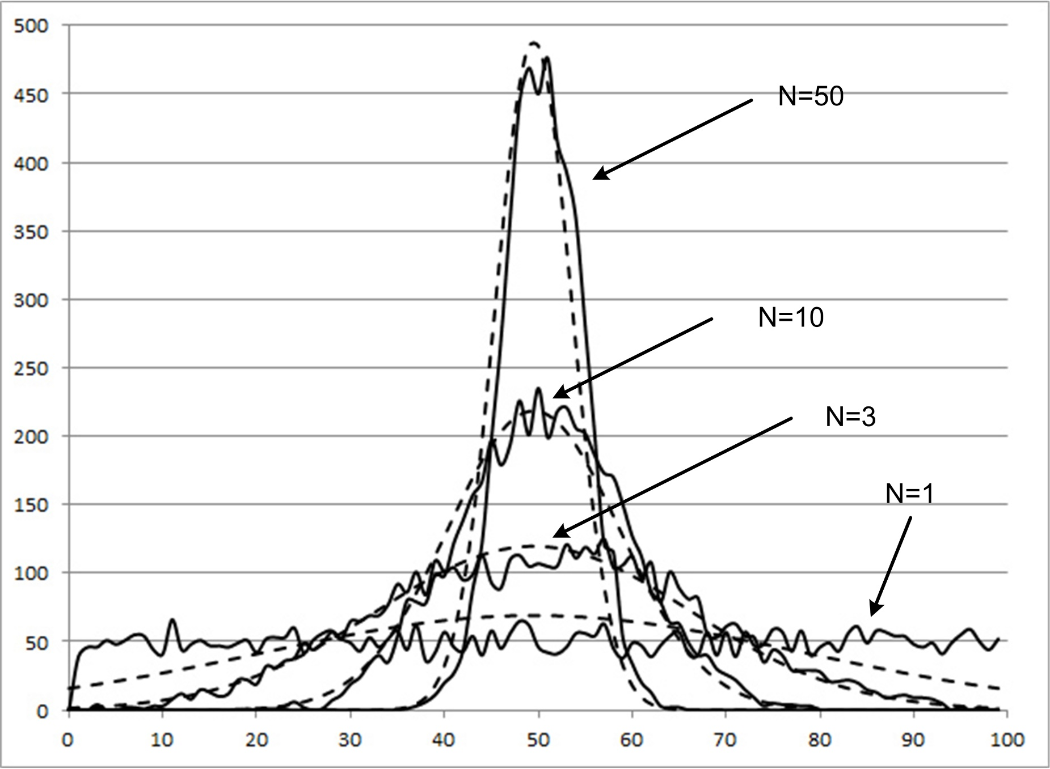

Slide 7


Slide 8

How do we prove our statistical claims?
Hypothesis Testing! The point of hypothesis testing is to make sure we don't jump to bad conclusions. Conclusions can be confusing (xylitol vs. fluoride). We are inherently speculating albeit rigorously. So we try to control the guessing by being conservative and use innocent until proven guilty.

Slide 9
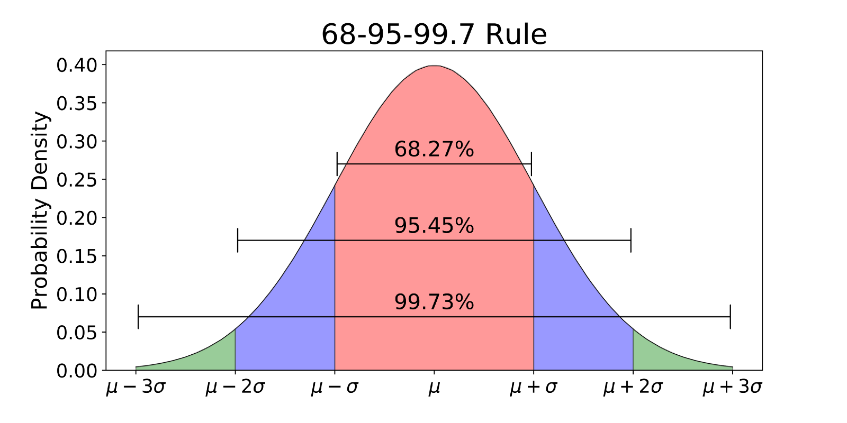
Standard deviations and probability of the population mean

Slide 10
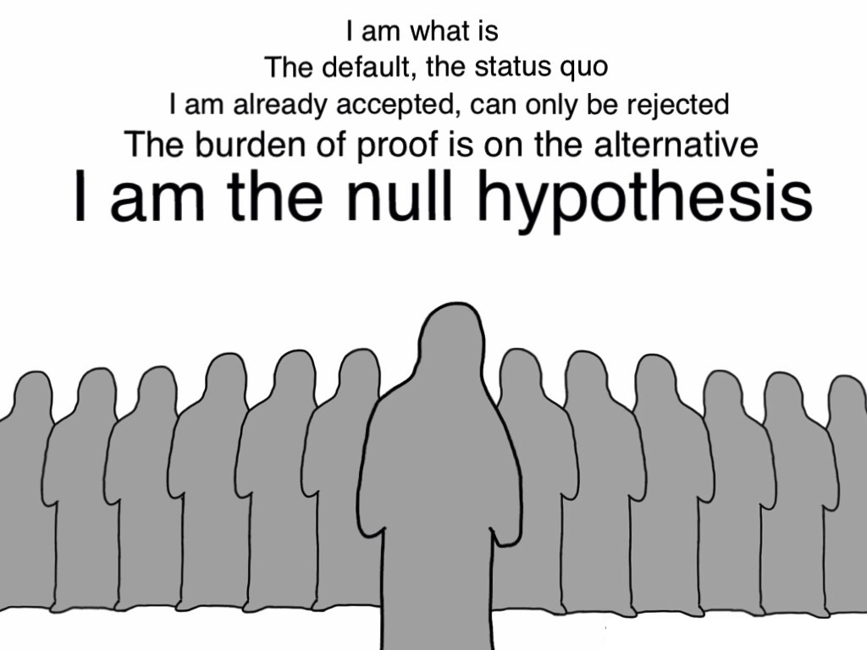

Slide 11

The alternative hypothesis tries to nullify the ghosts!

Slide 12
An example
Ghosts say the best server config for a query we run is X config and the best results are returned in 10 minutes.
Alternative hypothesis: A different server config is better and returns results in 4 minutes.
Can we reject the null hypothesis and kill the ghosts?

Slide 13
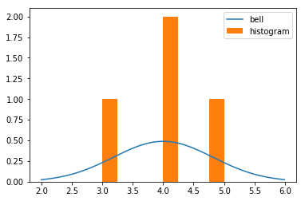
Collect data, randomly and take averages

Slide 14
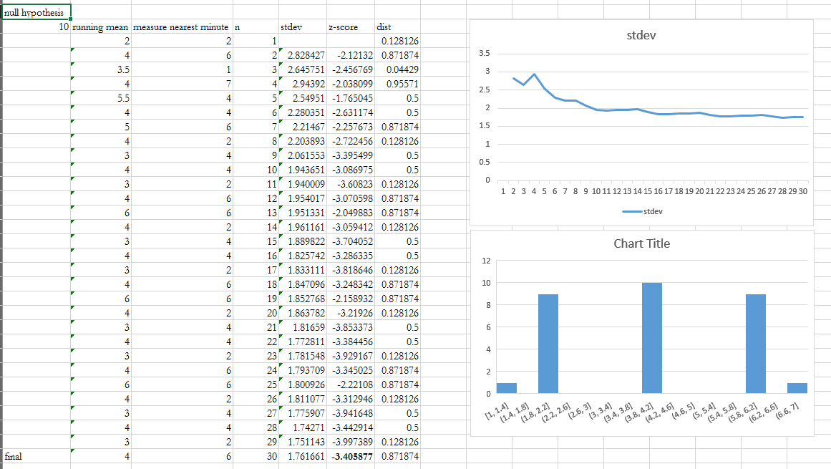

Slide 15
Warning
It's important to note that statistics and inferences about "populations" are always approximations. We aren't using probabilities when we do have the entire population e.g., the entire Data Science class is our population. Here I can get the population mean etc... No guess work is necessary. Now what if we said all data science students in the world currently? That’s much harder if not impossible. Inference time!

Slide 16
Sample Size?
THE MATH IN STATISTICS IS BUILT AROUND YOU NOT KNOWING THE POPULATION SIZE. WHICH IS WHY WE CAN PICK N WITHOUT KNOWING IT AND N IS REALLY A FUNCTION OF TIME+COST.

