Slide 1
Hypothesis Testing II
?10/10/1977?

Slide 2
Where’s Waldo

Slide 3
Waldo Stats. Is this a normal distribution?

Slide 4
Standard deviations and probability of the population mean

Slide 5
The process of testing hypothesis
Examine null hypothesis
If suspicious, try to disprove it (where’s the confidence numbers)
Decide how to sample randomly
Figure out how many N to sample?
Calculate mean
Calculate standard deviation
Calculate Z score (how many deviations away are you)
Reject or accept based on probability usually >=95%, definitely if over 99.7%

Slide 6
How many N to sample?
More is better
Cost + time a factor
As N increases the standard deviation decreases
Confidence interval decreases, +- error

Slide 7
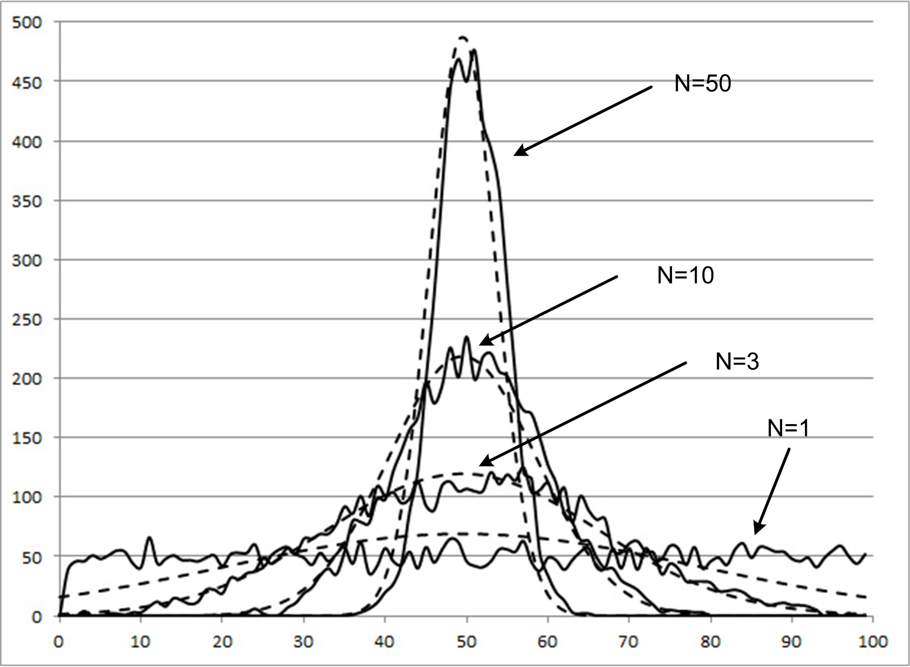

Slide 8
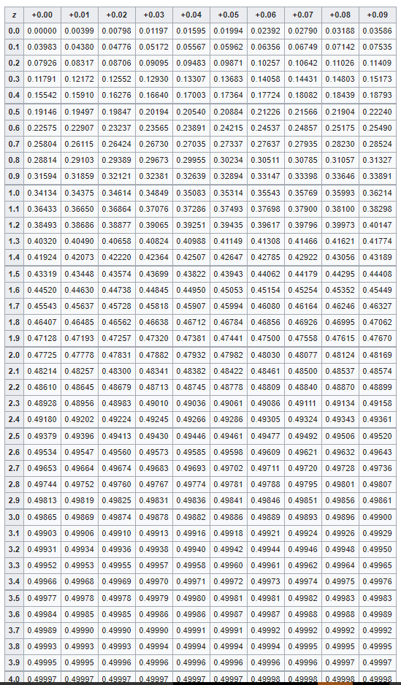
Z-Values A z-value gives you p-value (probability of getting this value) This is a cumulative from the mean so multiply your Z*2 to get a total probability. E.g., z=2 → p = .47*2 = 95%

Slide 9
T-Values If N <30 then the standard deviations become larger since n is smaller. So it now takes 2.262 deviations to get 95% of the data.

Slide 10
Any statistic has an error +- (we’re speculating)
We call this the margin of error
For the mean we have:
Mean +-Z*(Standard Deviation/sqrt(N))
E.g., for the Query analysis we did we have
Mean = 4, Z=-3.40, S=1.76, so we have
4 +- 1.09 @99.97%. So we can say we are 999.7% confident that population mean is 4 +- 1.09 or we are 999.7% confident that the population mean is within the confidence interval 2.91 and 5.09

Slide 11
Margin of Error continued
We could have chosen a 95% margin of error also and by doing so our confidence interval would have decreased. E.g.,
Mean = 4, Z=2, S=1.76, so we have
4 +- .64 @95%. So we can say we are 95% confident that population mean is 4 +- .64 or we are 95% confident that the population mean is within the confidence interval 3.36 and 4.64. This is how you should present your findings. Statistic, N, Standard Deviation and confidence numbers.

Slide 13
Type I & Type II errors

Slide 14
Some examples
The average time it takes to find Waldo at Comic Con by a random group of people over age 6 is 7 minutes. We surveyed 30 random people over age six and they found Waldo in an average time of 5 minutes. Who is right?
Null hypo = mean = 7
New hypo = mean = 5. N = 30, calculated sdev = 2.08, Z-Score = -.96
Z-table look up gives = .33*2 → p = 66%. So there’s a 66% chance that the population mean is in this range. Margin of error = 5+-.36 66% confidence. Should we reject?

Slide 15
Time permitting in class examples with Waldo

