Slide 1
Introduction to
Data Science
John P Dickerson
Lecture #16 – 10/22/2018
CMSC320
Mondays & Wednesdays
2:00pm – 3:15pm

Slide 2
Announcements
Mini-Project #3 is not out yet! Will be out after the midterm.
It will be linked to from ELMS; will also be available at: https://github.com/umddb/cmsc641-fall2018/tree/master/project3
Deliverable is a .ipynb file submitted to ELMS
Due before Thanksgiving (TBD)
Please label your ipynb file something like <lastname>_<firstname>_project3.ipynb
E.g., dickerson_john_project3.ipynb

Slide 3
Project 1 Grades are up!
General comments:
People did really well!
We used a fairly strict rubric, but if you have a real bone to pick with your grade, please triage through TAs/office hours!
Comments for our sanity, moving forward:
df.head(n) -- defaults to n = 5, use ~10, 20, 50 as needed
Please label your ipynb file something like <lastname>_<firstname>_project3.ipynb
E.g., dickerson_john_project3.ipynb

Slide 4
Common issue
A value is trying to be set on a copy of a slice from a DataFrame
Often not a problem! But, sometimes a problem …
Example:
df[df[‘intensity’] > 0.1][‘color’] = ‘red’
??????????
This will not set a value in df – assignment is chained
Instead, use df.loc[df[‘intensity’] > 0.1, ‘color’] = ‘red’

Slide 5
Midterm: Structure
50 points = 25% of the total grade
10 points:
10 True/False questions, 1 point each
10 points:
5 multiple choice questions, 2 points each
30 points:
10 short answer questions, 3 points each
Compared to the CMSC320 midterm I posted from last semester, this midterm is shorter.

Slide 6
Midterm: Cheat Sheet
You can use a cheat sheet on the exam:
Create it on your own
Handwritten notes only
One side of one 8.5x11 inch ("normal-sized”) sheet of paper
You’ll turn in your cheat sheet with your midterm

Slide 7
Quick midterm review
As discussed in previous lectures and on Piazza, the midterm can cover:
Up to and including last Wednesday’s lecture (10/17)
Quizzes that were due on or before last Wednesday
Stuff that you should know from doing P1 and P2
Everything is online: http://www.cs.umd.edu/class/fall2018/cmsc320/
I know this is a lot of material.
Rule of thumb: open up a slide deck
Do you feel “comfortable” with the material?
Test will be more qualitative than prior 1xx, 2xx, 3xx tests

Slide 8
Quick Midterm Review
Data collection
Data processing
Exploratory analysis
&
Data viz
Analysis, hypothesis testing, & ML
Insight & Policy Decision
Not exhaustive! Ask questions!

Slide 9
Data Collection (DC) & Data Processing (DP)
We talked about:
Scraping data
RESTful APIs
Structured data formats (JSON, XML, etc)
Regexes
Data manipulation via Numpy Stack (Numpy, Pandas, etc)
Indexing, slicing, groups, joins, aggregate queries, etc
Tidy data + melting
Version control (just know how this works qualitatively)
RDMS, a little bit of SQL
Entity resolution & other data integration issues
Storing stuff as a graph, and manipulating it

Slide 10
DC: HTTP Requests
https://www.google.com/?q=cmsc320&tbs=qdr:m
HTTP GET Request:
GET /?q=cmsc320&tbs=qdr:m HTTP/1.1
Host: www.google.com
User-Agent: Mozilla/5.0 (X11; Linux x86_64; rv:10.0.1) Gecko/20100101 Firefox/10.0.1
??????????
params = { “q”: “cmsc320”, “tbs”: “qdr:m” }
r = requests.get( “https://www.google.com”,
params = params )
*be careful with https:// calls; requests will not verify SSL by default

Slide 11
DC: Restful APIs
This class will just query web APIs, but full web APIs typically allow more.
Representational State Transfer (RESTful) APIs:
GET: perform query, return data
POST: create a new entry or object
PUT: update an existing entry or object
DELETE: delete an existing entry or object
Can be more intricate, but verbs (“put”) align with actions

Slide 12
DC: Pandas: series
Subclass of numpy.ndarray
Data: any type
Index labels need not be ordered
Duplicates possible but result in reduced functionality

Slide 13
DC: Pandas: DataFrame
Each column can have a different type
Row and Column index
Mutable size: insert and delete columns
Note the use of word “index” for what we called “key”
  Relational databases use “index” to mean something else
Non-unique index values allowed
  May raise an exception for some operations

Slide 14
DC: Storing a Graph
Three main ways to represent a graph in memory:
Adjacency lists
Adjacency dictionaries
Adjacency matrix
The storage decision should be made based on the expected use case of your graph:
Static analysis only?
Frequent updates to the structure?
Frequent updates to semantic information?

Slide 15
DC: Adjacency Lists
For each vertex, store an array of the vertices it connects to
Pros: ????????
Iterate over all outgoing edges; easy to add an edge
Cons: ????????
Checking for the existence of an edge is O(|V|), deleting is hard
A
C
Vertex | Neighbors
A | [C]
B | [C, D]
C | [A]
D | []
B
D

Slide 16
DC: Adjacency Dictionaries
For each vertex, store a dictionary of vertices it connects to
Pros: ?????????
O(1) to add, remove, query edges
Cons: ?????????
Overhead (memory, caching, etc)
A
C
Vertex | Neighbors
A | {C: 1.0}
B | {C: 1.0, D: 1.0}
C | {A: 1.0}
D | {}
B
D

Slide 17
DC: Adjacency Matrix
Store the connectivity of the graph in a matrix
Cons: ?????????
O(|V|²) space regardless of the number of edges
Almost always stored as a sparse matrix
From
A
C
 | A | B | C | D
A | 0 | 0 | 1 | 0
B | 0 | 0 | 0 | 0
C | 1 | 1 | 0 | 0
D | 0 | 1 | 0 | 0
To
B
D

Slide 18
DP: Select/slicing
Select only some of the rows, or some of the columns, or a combination
ID | age
1 | 12.2
2 | 11.0
3 | 15.6
4 | 35.1
ID | age | wgt_kg | hgt_cm
1 | 12.2 | 42.3 | 145.1
2 | 11.0 | 40.8 | 143.8
3 | 15.6 | 65.3 | 165.3
4 | 35.1 | 84.2 | 185.8
Only columns
ID and Age
Both
Only rows with wgt > 41
ID | age
1 | 12.2
3 | 15.6
4 | 35.1
ID | age | wgt_kg | hgt_cm
1 | 12.2 | 42.3 | 145.1
3 | 15.6 | 65.3 | 165.3
4 | 35.1 | 84.2 | 185.8

Slide 19
DP: Aggregate/Reduce
Combine values across a column into a single value
73.9 | 232.6 | 640.0
ID | age | wgt_kg | hgt_cm
1 | 12.2 | 42.3 | 145.1
2 | 11.0 | 40.8 | 143.8
3 | 15.6 | 65.3 | 165.3
4 | 35.1 | 84.2 | 185.8
SUM
MAX
35.1 | 84.2 | 185.8
SUM(wgt_kg^2 - hgt_cm)
What about ID/Index column?
Usually not meaningful to aggregate across it
May need to explicitly add an ID column
14167.66

Slide 20
DP: Map
Apply a function to every row, possibly creating more or fewer columns
ID | Address
1 | College Park, MD, 20742
2 | Washington, DC, 20001
3 | Silver Spring, MD 20901
ID | City | State | Zipcode
1 | College Park | MD | 20742
2 | Washington | DC | 20001
3 | Silver Spring | MD | 20901
Variations that allow one row to generate multiple rows in the output (sometimes called “flatmap”)

Slide 21
DP: Group By
A = foo
Group tuples together by column/dimension
ID | B | C
1 | 3 | 6.6
3 | 4 | 3.1
4 | 3 | 8.0
7 | 4 | 2.3
8 | 3 | 8.0
ID | A | B | C
1 | foo | 3 | 6.6
2 | bar | 2 | 4.7
3 | foo | 4 | 3.1
4 | foo | 3 | 8.0
5 | bar | 1 | 1.2
6 | bar | 2 | 2.5
7 | foo | 4 | 2.3
8 | foo | 3 | 8.0
By ‘A’
A = bar
ID | B | C
2 | 2 | 4.7
5 | 1 | 1.2
6 | 2 | 2.5

Slide 22
DP: Group By
B = 1
ID | A | C
5 | bar | 1.2
Group tuples together by column/dimension
B = 2
ID | A | C
2 | bar | 4.7
6 | bar | 2.5
ID | A | B | C
1 | foo | 3 | 6.6
2 | bar | 2 | 4.7
3 | foo | 4 | 3.1
4 | foo | 3 | 8.0
5 | bar | 1 | 1.2
6 | bar | 2 | 2.5
7 | foo | 4 | 2.3
8 | foo | 3 | 8.0
B = 3
By ‘B’
ID | A | C
1 | foo | 6.6
4 | foo | 8.0
8 | foo | 8.0
B = 4
ID | A | C
3 | foo | 3.1
7 | foo | 2.3

Slide 23
DP: Group By
A = bar, B = 1
ID | C
5 | 1.2
Group tuples together by column/dimension
A = bar, B = 2
ID | C
2 | 4.7
6 | 2.5
ID | A | B | C
1 | foo | 3 | 6.6
2 | bar | 2 | 4.7
3 | foo | 4 | 3.1
4 | foo | 3 | 8.0
5 | bar | 1 | 1.2
6 | bar | 2 | 2.5
7 | foo | 4 | 2.3
8 | foo | 3 | 8.0
A = foo, B = 3
By ‘A’, ‘B’
ID | C
1 | 6.6
4 | 8.0
8 | 8.0
A = foo, B = 4
ID | C
3 | 3.1
7 | 2.3

Slide 24
DP: Group By Aggregate
B = 1
B = 1
ID | A | C
5 | bar | 1.2
Sum (C)
1.2
B = 2
Compute one aggregate
Per group
ID | A | C
2 | bar | 4.7
6 | bar | 2.5
B = 2
Sum (C)
7.2
ID | A | B | C
1 | foo | 3 | 6.6
2 | bar | 2 | 4.7
3 | foo | 4 | 3.1
4 | foo | 3 | 8.0
5 | bar | 1 | 1.2
6 | bar | 2 | 2.5
7 | foo | 4 | 2.3
8 | foo | 3 | 8.0
B = 3
B = 3
ID | A | C
1 | foo | 6.6
4 | foo | 8.0
8 | foo | 8.0
Group by ‘B’
Sum on C
Sum (C)
22.6
B = 4
B = 4
Sum (C)
5.4
ID | A | C
3 | foo | 3.1
7 | foo | 2.3
24

Slide 25
DP: Group By Aggregate
B = 1
Sum (C)
1.2
Final result usually seen
As a table
B = 2
Sum (C)
7.2
ID | A | B | C
1 | foo | 3 | 6.6
2 | bar | 2 | 4.7
3 | foo | 4 | 3.1
4 | foo | 3 | 8.0
5 | bar | 1 | 1.2
6 | bar | 2 | 2.5
7 | foo | 4 | 2.3
8 | foo | 3 | 8.0
B | SUM(C )
1 | 1.2
2 | 7.2
3 | 22.6
4 | 5.4
B = 3
Group by ‘B’
Sum on C
Sum (C)
22.6
B = 4
Sum (C)
5.4
25

Slide 26
DP: Union/Intersection/Difference
Set operations – only if the two tables have identical attributes/columns
ID | A | B | C
1 | foo | 3 | 6.6
2 | bar | 2 | 4.7
3 | foo | 4 | 3.1
4 | foo | 3 | 8.0
5 | bar | 1 | 1.2
6 | bar | 2 | 2.5
7 | foo | 4 | 2.3
8 | foo | 3 | 8.0
ID | A | B | C
1 | foo | 3 | 6.6
2 | bar | 2 | 4.7
3 | foo | 4 | 3.1
4 | foo | 3 | 8.0
ID | A | B | C
5 | bar | 1 | 1.2
6 | bar | 2 | 2.5
7 | foo | 4 | 2.3
8 | foo | 3 | 8.0
U
Similarly Intersection and Set Difference manipulate tables as Sets
IDs may be treated in different ways, resulting in somewhat different behaviors
26

Slide 27
7. Merge or Join
Combine rows/tuples across two tables if they have the same key
ID | A | B
1 | foo | 3
2 | bar | 2
3 | foo | 4
4 | foo | 3
ID | C
1 | 1.2
2 | 2.5
3 | 2.3
5 | 8.0
ID | A | B | C
1 | foo | 3 | 1.2
2 | bar | 2 | 2.5
3 | foo | 4 | 2.3
⨝
What about IDs not present in both tables?
Often need to keep them around
Can “pad” with NaN
27

Slide 28
DP: Merge or Join
Combine rows/tuples across two tables if they have the same key
Outer joins can be used to ”pad” IDs that don’t appear in both tables
Three variants: LEFT, RIGHT, FULL
SQL Terminology -- Pandas has these operations as well
ID | A | B
1 | foo | 3
2 | bar | 2
3 | foo | 4
4 | foo | 3
ID | C
1 | 1.2
2 | 2.5
3 | 2.3
5 | 8.0
ID | A | B | C
1 | foo | 3 | 1.2
2 | bar | 2 | 2.5
3 | foo | 4 | 2.3
4 | foo | 3 | NaN
5 | NaN | NaN | 8.0
⟗
28

Slide 29
DP: Google Image Search One Slide SQL Join Visual
Image credit: http://www.dofactory.com/sql/join

Slide 30
DC/DP: How a relational DB fits into your workflow
Persists!
Raw Input
Python
SQLite File
SQL
SQL
Structured output (trained classifiers, JSON for D3, visualizations)
SQLite CLI & GUI Frontend
Persists!

Slide 31
EDA & Viz
Missing data
MCAR
MAR
MNAR
Single & multiple imputation
Analysis
Basic linear regression
Outlier detection
Summary statistics / robust statistics
Variance, stdev, covariance, Pearson’s correlation coefficient
Hypothesis testing
Bayes’ rule

Slide 32
EDA: Missing Data
Missing data is information that we want to know, but don’t
It can come in many forms, e.g.:
People not answering questions on surveys
Inaccurate recordings of the height of plants that need to be discarded
Canceled runs in a driving experiment due to rain
Could also consider missing columns (no collection at all) to be missing data …
[JA]

Slide 33
EDA: Complete Case Analysis
Delete all tuples with any missing values at all, so you are left only with observations with all variables observed
Default behavior for libraries for analysis (e.g., regression)
We’ll talk about this much more during the Stats/ML lectures
This is the simplest way to handle missing data. In some cases, will work fine; in others, ?????????????:
Loss of sample will lead to variance larger than reflected by the size of your data
May bias your sample
# Clean out rows with nil values
df = df.dropna()
[JA]

Slide 34
EDA: Your Sample
Hair Color | Gender | Grade
Red | M | A
Brown | F | A
Black | F | B
Black | M | A
Brown | M
Brown | M
Brown | F
Black | M | B
Black | M | B
Brown | F | A
Black | F
Brown | F | C
Red | M
Red | F | A
Brown | M | A
Black | M | A
Summary:
7 students received As
3 students received Bs
1 student received a C
Nobody is failing!
But 5 students did not reveal their grade …
[JA]

Slide 35
EDA: What influences a data point’s Presence?
Same dataset, but the values are replaced with a “0” if the data point is observed and “1” if it is not
Question: for any one of these data points, what is the probability that the point is equal to “1” …?
What type of missing-ness do the grades exhibit?
Hair Color | Gender | Grade
0 | 0 | 0
0 | 0 | 0
0 | 0 | 0
0 | 0 | 0
0 | 0 | 1
0 | 0 | 1
0 | 0 | 1
0 | 0 | 0
0 | 0 | 0
0 | 0 | 0
0 | 0 | 1
0 | 0 | 0
0 | 0 | 1
0 | 0 | 0
0 | 0 | 0
0 | 0 | 0
[JA]

Slide 36
EDA: MCAR: Missing Completely at Random
If this probability is not dependent on any of the data, observed or unobserved, then the data is Missing Completely at Random (MCAR)
Suppose that X is the observed data and Y is the unobserved data. Call our “missing matrix” R
Then, if the data are MCAR, P(R|X,Y) = ??????????
P(R|X,Y) = P(R)
Probability of those rows missing is independent of anything.
[JA]

Slide 37
EDA: MAR: Missing at Random
Missing at Random (MAR): probability of missing data is dependent on the observed data but not the unobserved data
Suppose that X is the observed data and Y is the unobserved data. Call our “missing matrix” R
Then, if the data are MAR, P(R|X,Y) = ??????????
P(R|X,Y) = P(R|X)
Not exactly random (in the vernacular sense).
There is a probabilistic mechanism that is associated with whether the data is missing
Mechanism takes the observed data as input

Slide 38
EDA: MNAR: Missing Not at Random
MNAR: missing-ness has something to do with the missing data itself
Examples: ??????????
Do you binge drink? Do you have a trust fund? Do you use illegal drugs? What is your sexuality? Are you depressed?
Said to be “non-ignorable”:
Missing data mechanism must be considered as you deal with the missing data
Must include model for why the data are missing, and best guesses as to what the data might be

Slide 39
EDA: Back to CSIC …
Is the the missing data:
MCAR;
MAR; or
MNAR?
???????????
Hair Color | Gender | Grade
Red | M | A
Brown | F | A
Black | F | B
Black | M | A
Brown | M
Brown | M
Brown | F
Black | M | B
Black | M | B
Brown | F | A
Black | F
Brown | F | C
Red | M
Red | F | A
Brown | M | A
Black | M | A

Slide 40
EDA: Add a variable
Bring in the GPA:
Does this change anything?
Hair Color | GPA | Gender | Grade
Red | 3.4 | M | A
Brown | 3.6 | F | A
Black | 3.7 | F | B
Black | 3.9 | M | A
Brown | 2.5 | M
Brown | 3.2 | M
Brown | 3.0 | F
Black | 2.9 | M | B
Black | 3.3 | M | B
Brown | 4.0 | F | A
Black | 3.65 | F
Brown | 3.4 | F | C
Red | 2.2 | M
Red | 3.8 | F | A
Brown | 3.8 | M | A
Black | 3.67 | M | A

Slide 41
EDA: Multiple Imputation Process
s₁
a₁
Incomplete data
s₂
a₂
Pooled results
s_{N}
a_{N}
Impute N times
Analysis performed on each imputed set

Slide 42
Analysis: Importance of vertices
Not all vertices are equally important
Centrality Analysis:
Find out the most important node(s) in one network
Used as a feature in classification, for visualization, etc …
Commonly-used Measures
Degree Centrality
Closeness Centrality
Betweenness Centrality
Eigenvector Centrality

Slide 43


Analysis: Degree Centrality
The importance of a vertex is determined by the number of vertices adjacent to it
The larger the degree, the more important the vertex is
Only a small number of vertex have high degrees in many real-life networks
Degree Centrality:
Normalized Degree Centrality:
For vertex 1, degree centrality is 3;
Normalized degree centrality is
3/(9-1)=3/8.
Notes:
“A small number of nodes have high degrees” thanks to the power law

Slide 44
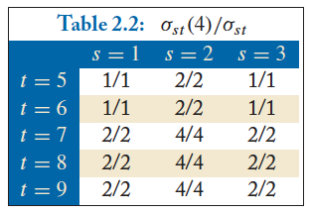

Analysis: Betweenness CentralitY
The number of shortest paths between s and t
The number of shortest paths between s and t that pass v_{i}
What is the betweenness centrality for node 4 ?????????

Slide 46
Notes:
Null hypothesis tests validity of a claim about a population (e.g., “men and women do not score differently on CMSC320 exams.”)
Alternative hypothesis: men and women score differently / women score higher / women do not score higher (two-sided vs one-sided)

Slide 49
One last thing …
Bring a writing utensil. You will need to it. To write.

Slide 50
This lecture
Data collection
Data processing
Exploratory analysis
&
Data viz
Analysis, hypothesis testing, & ML
Insight & Policy Decision

Slide 51
This lecture:
Words words words!
Free text and natural language processing in data science
Bag of words and TF-IDF
N-Grams and language models
Sentiment mining
Thanks to: Zico Kolter (CMU) & Marine Carpuat’s 723 (UMD)

Slide 52
Precursor to Natural language processing
For we can easily understand a machine's being constituted so that it can utter words, and even emit some responses to action on it of a corporeal kind, which brings about a change in its organs; for instance, if touched in a particular part it may ask what we wish to say to it; if in another part it may exclaim that it is being hurt, and so on.
(But it never happens that it arranges its speech in various ways, in order to reply appropriately to everything that may be said in its presence, as even the lowest type of man can do.)
-- René Descartes, 1600s
Notes:
Precursor to the Turing Test – Descartes seems to think we’ll never pass it

Slide 53
Precursor to Natural Language processing
Turing’s Imitation Game [1950]:
Person A and Person B go into separate rooms
Guests send questions in, read questions that come out – but they are not told who sent the answers
Person A (B) wants to convince group that she is Person B (A)
We now ask the question, "What will happen when a machine takes the part of [Person] A in this game?" Will the interrogator decide wrongly as often when the game is played like this as he does when the game is played between [two humans]? These questions replace our original, "Can machines think?"

Slide 54
Precursor to Natural language processing
Mechanical translation started in the 1930s
Largely based on dictionary lookups
Georgetown-IBM Experiment:
Translated 60 Russian sentences to English
Fairly basic system behind the scenes
Highly publicized, system ended up spectacularly failing
Funding dried up; not much research in “mechanical translation” until the 1980s …

Slide 55
Statistical Natural Language Processing
Pre-1980s: primarily based on sets of hand-tuned rules
Post-1980s: introduction of machine learning to NLP
Initially, decision trees learned what-if rules automatically
Then, hidden Markov models (HMMs) were used for part of speech (POS) tagging
Explosion of statistical models for language
Recent work focuses on purely unsupervised or semi-supervised learning of models
We’ll cover some of this in the machine learning lectures!

Slide 56
NLP in Data Science
In Mini-Project #1, you used requests and BeautifulSoup to scrape structured data from the web
Lots of data come as unstructured free text: ???????????
Facebook posts
Amazon Reviews
Wikileaks dump
Data science: want to get some meaningful information from unstructured text
Need to get some level of understanding what the text says

Slide 57
Understanding language is hard
One morning I shot an elephant in my pajamas.
How he got into my pajamas, I'll never know.
Groucho Marx
?

Slide 58
Understanding language is hard
The Winograd Schema Challenge:
Proposed by Levesque as a complement to the Turing Test
Formally, need to pick out the antecedent of an ambiguous pronoun:
Levesque argues that understanding such sentences requires more than NLP, but also commonsense reasoning and deep contextual reasoning
The city councilmen refused the demonstrators a permit because they [feared/advocated] violence.
Terry Winograd

Slide 59
Understanding language is hard?
I haven't played it that much yet, but it's shaping to be one of the greatest games ever made! It exudes beauty in every single pixel of it. It's a masterpiece. 10/10
fabchan, March 3, 2017, Metacritic
a horrible stupid game,it's like 5 years ago game,900p 20~30f, i don't play this **** anymore it's like someone give me a **** to play ,no this time sorry,so Nintendo go f yourself pls
Nsucks7752, March 6, 2017, Metacritic
Perhaps we can get some signal (in this case, sentiment) without truly understanding the text …

Slide 60
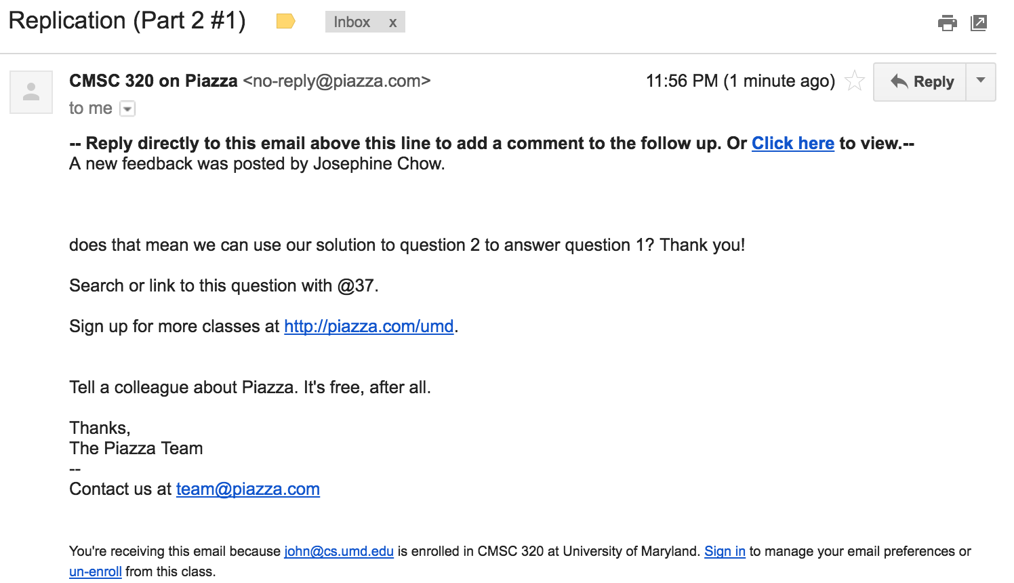
“Some Signal”
or
Possible signals ?????????

Slide 61

“Some Signal”
What type of article is this?
Sports
Political
Dark comedy
What entities are covered?
And are they covered with positive or negative sentiment?
Possible signals ????????

Slide 62
Aside: Terminology
Documents: groups of free text
Actual documents (NYT article, journal paper)
Entries in a table
Corpus: a collection of documents
Terms: individual words
Separated by whitespace or punctuation

Slide 63
NLP Tasks
Syntax: refers to the grammatical structure of language
The rules via which one forms sentences/expressions
Semantics: the study of meaning of language
John is rectangular and a rainbow.
Syntactically correct
Semantically meaningless

Slide 64
Syntax
Tokenization
  Splitting sentences into tokens
Lemmatization/Stemming
  Turning “organizing” and “organized” into “organiz”
Morphological Segmentation
  How words are formed, and relationships of different parts
  Easy for English, but other languages are difficult
Part-of-speech (POS) Tagging
  Determine whether a word is a noun/adverb/verb etc.
Parsing
  Create a “parse tree” for a sentence

Slide 65
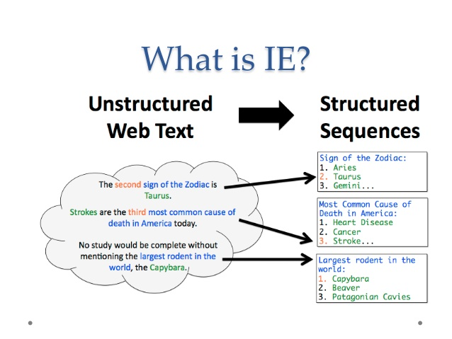
Semantics: information extraction

Slide 66
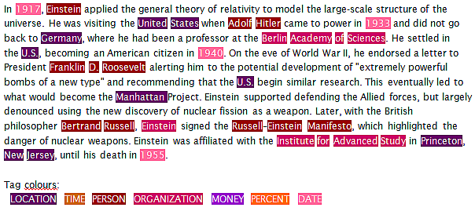
Semantics: named entity recognition
Identifying key entities in text

Slide 67
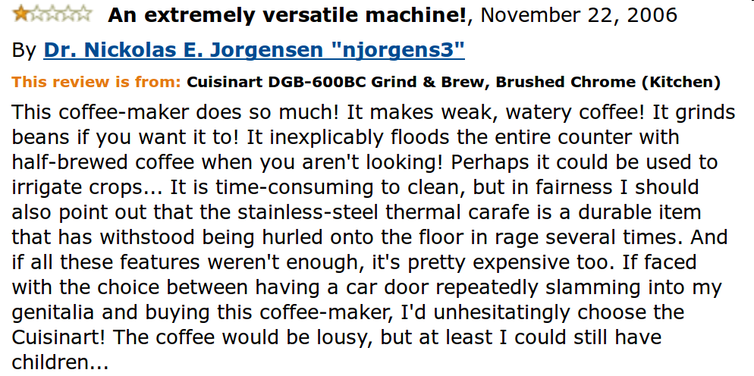
Semantics: sentiment analysis
Deciding if reviews/opinions are positive or negative
Heavily used by ad industry today

Slide 68
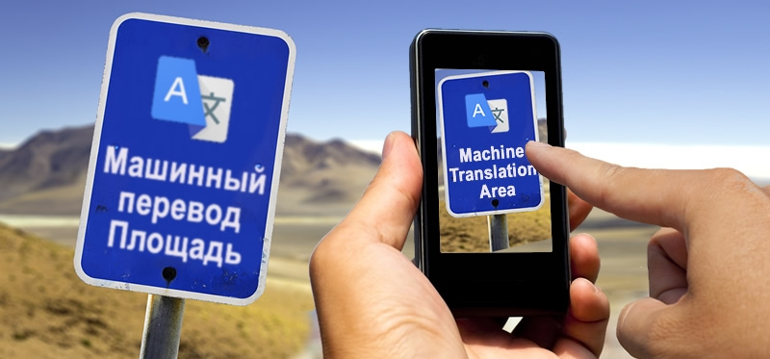
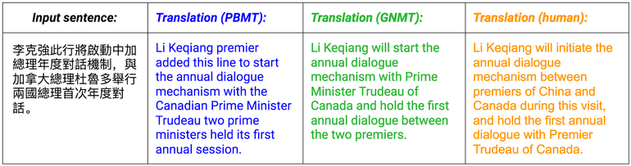
Semantics: Machine translation
Translating from one language to another
Simple substitution of words doesn’t work very well
(Image: Google)

Slide 69
Semantics: Machine translation
0> how long before the next flight to Alice Springs?
1> wie lang vor dem folgenden Flug zu Alice Springs?
2> how long before the following flight to Alice jump?
3> wie lang vor dem folgenden Flug zu Alice springen Sie?
4> how long before the following flight to Alice do you jump?
5> wie lang, bevor der folgende Flug zu Alice tun, Sie springen?
6> how long, before the following flight to Alice does, do you jump?
7> wie lang bevor der folgende Flug zu Alice tut, tun Sie springen?
8> how long before the following flight to Alice does, do you jump?
9> wie lang, bevor der folgende Flug zu Alice tut, tun Sie springen?
10> how long, before the following flight does to Alice, do do you jump?
11> wie lang bevor der folgende Flug zu Alice tut, Sie tun Sprung?
12> how long before the following flight does leap to Alice, does you?
From NLTK Book

Slide 70
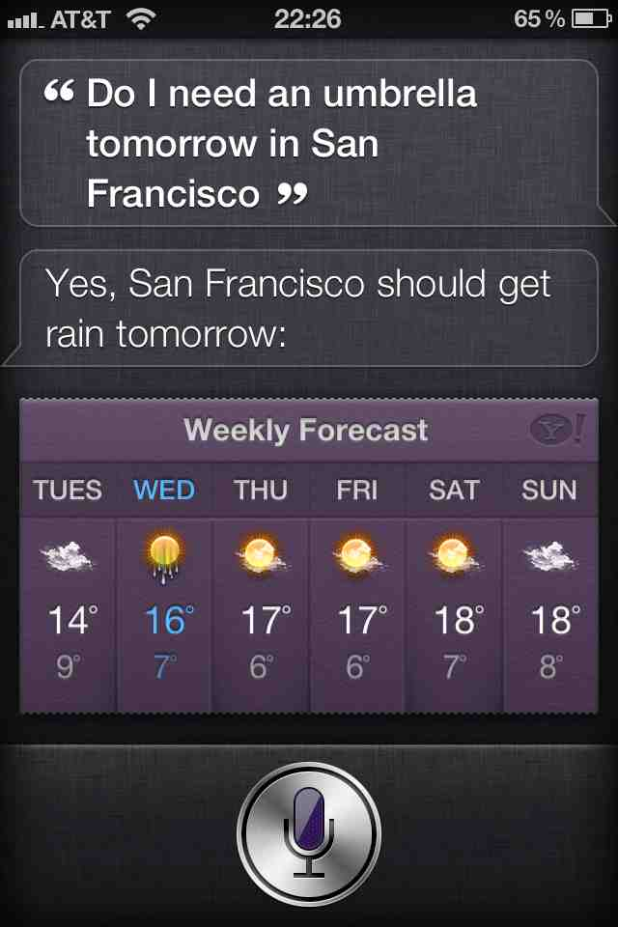
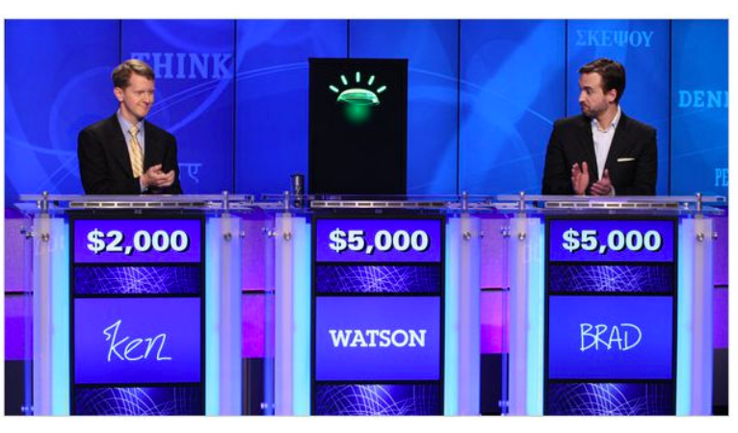
Semantics: question answering
Answer questions posed a user with specific answers
WILLIAM WILKINSON’S
“AN ACCOUNT OF THE PRINCIPALITIES OF
WALLACHIA AND MOLDOVIA”
INSPIRED THIS AUTHOR’S
MOST FAMOUS NOVEL
Bram Stoker

Slide 71
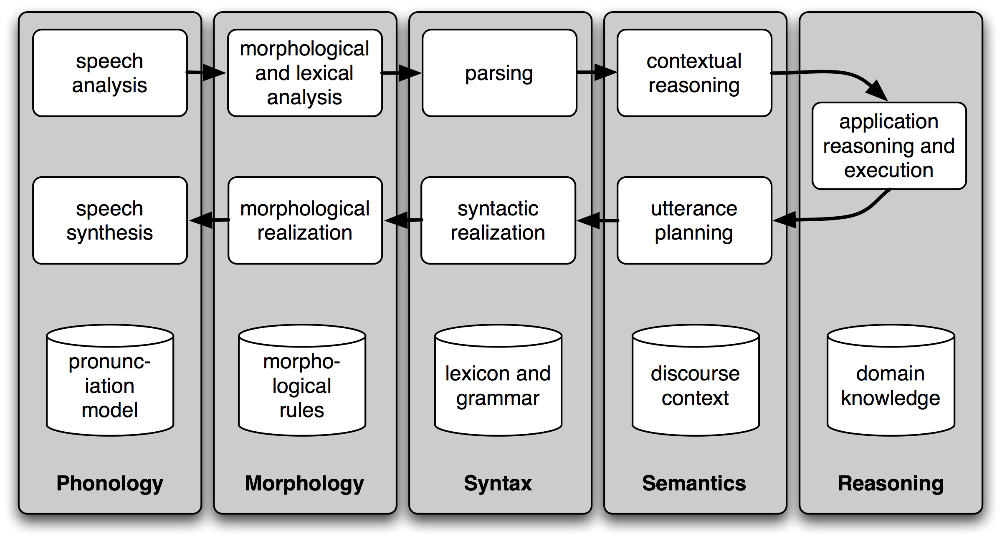
Semantics: Spoken Dialogue Systems

Slide 72
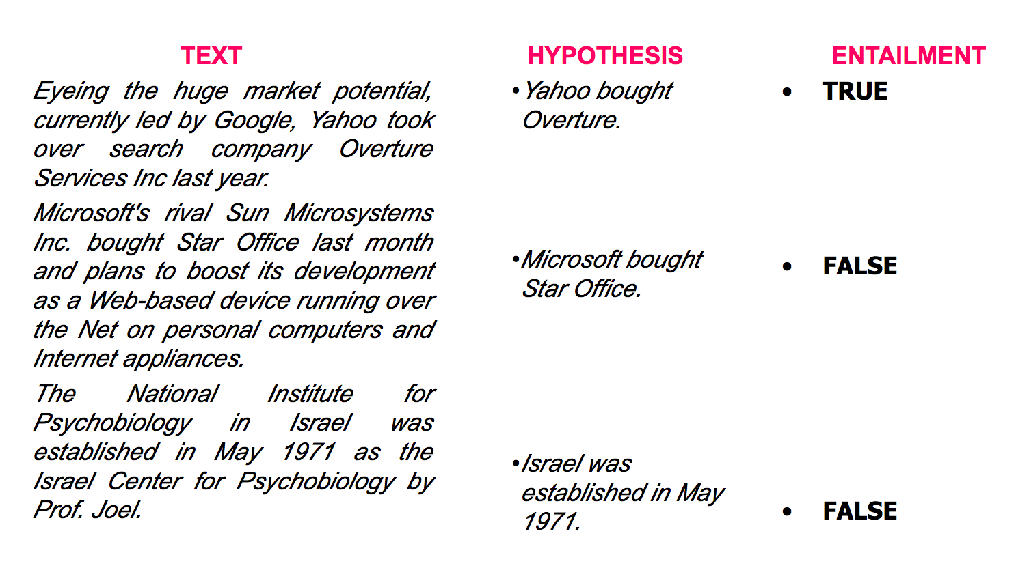
Semantics: textual entailment
Given two text fragments, determine if one being true entails the other, entails the other's negation, or allows the other to be either true or false

Slide 73
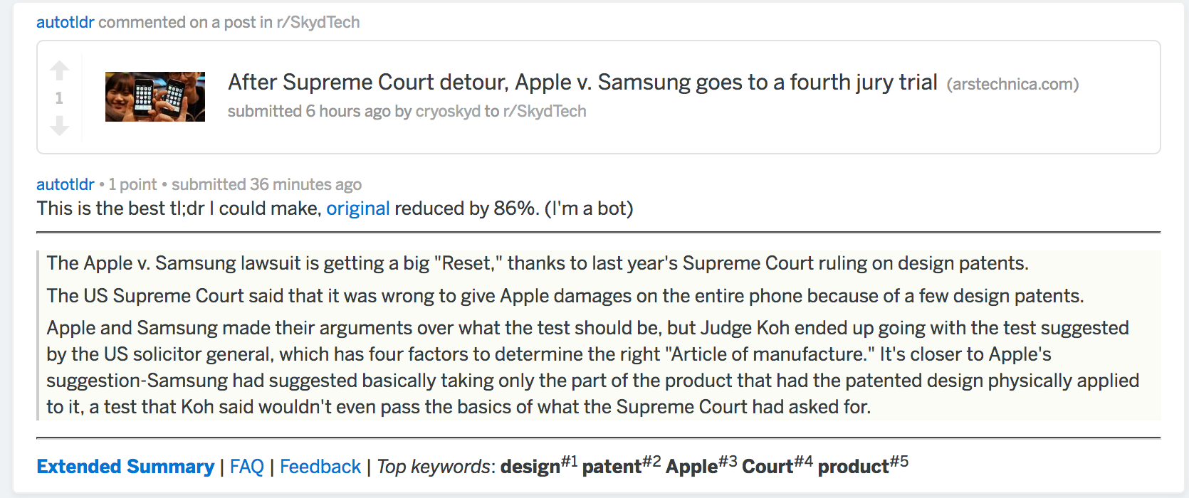
Semantics: document summarization
Quite a few tools out there today… e.g., SMMRY

Slide 74
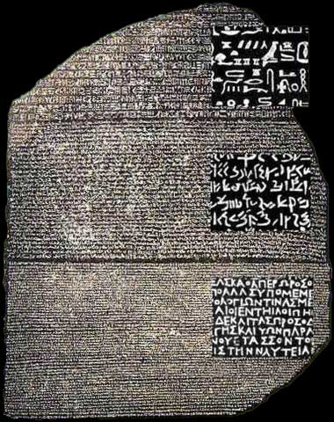
Other tasks
Speech Recognition
Caption Generation
Natural Language Generation
Optical Character Recognition
Word Sense Disambiguation
  serve: help with food or drink; hold an office; put ball into play
…
Doing all of these for many different languages

Slide 75
Semantics: Text classification
Is it spam?
Who wrote this paper? (Author identification)
https://en.wikipedia.org/wiki/The_Federalist_Papers#Authorship
https://www.uwgb.edu/dutchs/pseudosc/hidncode.htm
¡Identificación del idioma!
Sentiment analysis
What type of document is this?
When was this document written?
Readability assessment

Slide 76
Text classification
Input:
A document w
A set of classes Y = {y₁, y₂, …, y_{J}}
Output:
A predicted class y ∈ Y
(You will spend much more time on classification problems throughout the program, this is just a light intro!)

Slide 77
Text classification
Hand-coded rules based on combinations of terms (and possibly other context)
If email w:
Sent from a DNSBL (DNS blacklist) OR
Contains “Nigerian prince” OR
Contains URL with Unicode OR …
Then: y_{w} = spam
Pros: ?????????
Domain expertise, human-understandable
Cons: ?????????
Brittle, expensive to maintain, overly conservative

Slide 78
Text classification
Input:
A document w
A set of classes Y = {y₁, y₂, …, y_{J}}
A training set of m hand-labeled documents
{(w₁, y₁), (w₂, y₂), …, (w_{m}, y_{m})}
Output:
A learned classifier w → y
This is an example of supervised learning

Slide 79
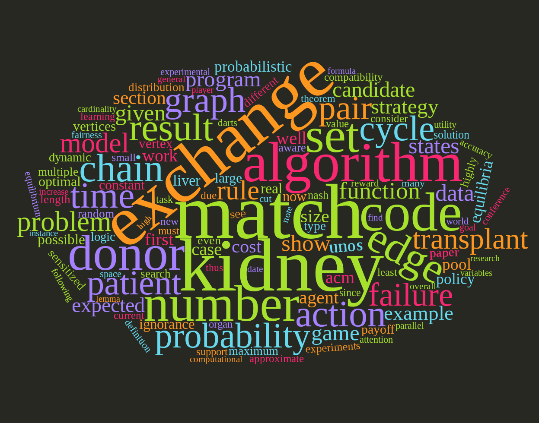
Representing a document “in math”
Simplest method: bag of words
Represent each document as a vector of word frequencies
Order of words does not matter, just #occurrences

Slide 80
Bag of words Example
the quick brown fox jumps over the lazy dog
I am he as you are he as you are me
he said the CMSC320 is 189 more CMSCs than the CMSC131
the | CMSC320 | you | he | I | quick | dog | me | CMSCs | … | than
2 | 0 | 0 | 0 | 0 | 1 | 1 | 0 | 0 | … | 0
0 | 0 | 2 | 2 | 1 | 0 | 0 | 1 | 0 |  | 0
2 | 1 | 0 | 1 | 0 | 0 | 0 | 0 | 1 |  | 1
Document 1
Document 2
Document 3

Slide 81
Term Frequency
Term frequency: the number of times a term appears in a specific document
tf_{ij}: frequency of word j in document i
This can be the raw count (like in the BOW in the last slide):
tf_{ij} ∈ {0,1} if word j appears or doesn’t appear in doc i
log(1 + tf_{ij}) – reduce the effect of outliers
tf_{ij} / max_{j} tf_{ij} – normalize by document i’s most frequent word
What can we do with this?
Use as features to learn a classifier w → y …!

Slide 82
Defining features From Term Frequency
Suppose we are classifying if a document was written by The Beatles or not (i.e., binary classification):
Two classes y ∈ Y = { 0, 1 } = { not_beatles, beatles }
Let’s use tf_{ij} ∈ {0,1}, which gives:
Then represent documents with a feature function:
f(x, y = not_beatles = 0) = [x^{T}, 0^{T}, 1]^{T}
f(x, y = beatles = 1) = [0^{T}, x^{T}, 1]^{T}
the | CMSC641 | you | he | I | quick | dog | me | CMSCs | … | than
1 | 0 | 0 | 0 | 0 | 1 | 1 | 0 | 0 | … | 0
0 | 0 | 1 | 1 | 1 | 0 | 0 | 1 | 0 |  | 0
1 | 1 | 0 | 1 | 0 | 0 | 0 | 0 | 1 |  | 1
x₁^{T} =
y₁ = 0
x₂^{T} =
y₂ = 1
x₃^{T} =
y₃ = 0

Slide 83
Linear classification
We can then define weights θ for each feature
θ = { <CMSC320, not_beatles> = +1,
<CMSC320, beatles> = -1,
<walrus, not_beatles> = -0.3,
<walrus, beatles> = +1,
<the, not_beatles> = 0,
<the, beatles>, 0, … }
Write weights as vector that aligns with feature mapping
Score 𝝍 of an instance x and class y is the sum of the weights for the features in that class:
𝝍_{xy} = Σ θ_{n} f_{n}(x, y)
= θ^{T} f(x, y)

Slide 84
Linear classification
We have a feature function f(x, y) and a score 𝝍_{xy} = θ^{T} f(x, y)
And return the class with highest score!
Compute the score of the document for that class
For each class y ∈ { not_beatles, beatles }
Where did these weights come from? We’ll talk about this in the ML lectures …
(… and also this whole “linear classifier” thing.)

Slide 85
Explicit Example
We are interested in classifying documents into one of two classes y ∈ Y = { 0, 1 } = { hates_cats, likes_cats}
Document 1: I like cats
Document 2: I hate cats
Now, represent documents with a feature function:
f(x, y = hates_cats = 0) = [x^{T}, 0^{T}, 1]^{T}
f(x, y = likes_cats = 1) = [0^{T}, x^{T}, 1]^{T}
I | like | hate | cats
1 | 1 | 0 | 1
1 | 0 | 1 | 1
x₁^{T} =
y₁ = ?
x₂^{T} =
y₂ = ?

Slide 86
Explicit Example
I | like | hate | cats
1 | 1 | 0 | 1
1 | 0 | 1 | 1
f(x, y = 0) = [x^{T}, 0^{T}, 1]^{T}
f(x, y = 1) = [0^{T}, x^{T}, 1]^{T}
x₁^{T} =
y₁ = ?
x₂^{T} =
y₂ = ?
y=0: hates_cats
y=1: likes_cats
(1)
I | like | hate | cats | I | like | hate | cats | --
1 | 1 | 0 | 1 | 0 | 0 | 0 | 0 | 1
0 | 0 | 0 | 0 | 1 | 1 | 0 | 1 | 1
1 | 0 | 1 | 1 | 0 | 0 | 0 | 0 | 1
0 | 0 | 0 | 0 | 1 | 0 | 1 | 1 | 1
f(x₁, y = hates_cats = 0) =
f(x₁, y = likes_cats = 1) =
f(x₂, y = hates_cats = 0) =
f(x₂, y = likes_cats = 1) =

Slide 87
Explicit Example
Now, assume we have weights θ for each feature
θ = { <I, hates_cats> = 0, <I, likes_cats> = 0,
<like, hates_cats> = -1, <like, likes_cats> = +1,
<hate, hates_cats> = +1, <hate, likes_cats> = -1,
<cats, hates_cats> = -0.1, <cats, likes_cats = +0.5> }
Write weights as vector that aligns with feature mapping:
y=0: hates_cats
y=1: likes_cats
(1)
Parameter vector θ ^{T} =
0 | -1 | 1 | -0.1 | 0 | 1 | -1 | 0.5 | 1
I | like | hate | cats | I | like | hate | cats | --
1 | 1 | 0 | 1 | 0 | 0 | 0 | 0 | 1
0 | 0 | 0 | 0 | 1 | 1 | 0 | 1 | 1
1 | 0 | 1 | 1 | 0 | 0 | 0 | 0 | 1
0 | 0 | 0 | 0 | 1 | 0 | 1 | 1 | 1
f(x₁, y = hates_cats = 0) =
f(x₁, y = likes_cats = 1) =
f(x₂, y = hates_cats = 0) =
f(x₂, y = likes_cats = 1) =

Slide 88
Explicit example
Score 𝝍 of an instance x and class y is the sum of the weights for the features in that class:
𝝍_{xy} = Σ θ_{n} f_{n}(x, y)
= θ^{T} f(x, y)
Let’s compute 𝝍_{x1,y=hates_cats} …
𝝍_{x1,y=hates_cats} = θ^{T} f(x₁, y = hates_cats = 0)
= 0*1 + -1*1 + 1*0 + -0.1*1 + 0*0 + 1*0 + -1*0 + 0.5*0 + 1*1
= -1 - 0.1 + 1 = -0.1
1 | I
1 | like
0 | hate
1 | cats
0 | I
0 | like
0 | hate
0 | cats
1 | –
hates_cats
likes_cats
θ ^{T} =
0 | -1 | 1 | -0.1 | 0 | 1 | -1 | 0.5 | 1
(1)
f(x₁, y = 0)

Slide 89
Explicit example
Saving the boring stuff:
𝝍_{x1,y=hates_cats} = -0.1; 𝝍_{x1,y=likes_cats} = +2.5
𝝍_{x2,y=hates_cats} = +1.9; 𝝍_{x2,y=likes_cats} = +0.5
We want to predict the class of each document:
Document 1: argmax{ 𝝍_{x1,y=hates_cats}, 𝝍_{x1,y=likes_cats} } ????????
Document 2: argmax{ 𝝍_{x2,y=hates_cats}, 𝝍_{x2,y=likes_cats} } ????????
Document 1: I like cats
Document 2: I hate cats

Slide 90
Inverse Document Frequency
Recall:
tf_{ij}: frequency of word j in document i
Any issues with this ??????????
Term frequency gets overloaded by common words
Inverse Document Frequency (IDF): weight individual words negatively by how frequently they appear in the corpus:
IDF is just defined for a word j, not word/document pair j, i

Slide 91
Inverse Document Frequency
the | CMSC320 | you | he | I | quick | dog | me | CMSCs | … | than
2 | 0 | 0 | 0 | 0 | 1 | 1 | 0 | 0 | … | 0
0 | 0 | 2 | 2 | 1 | 0 | 0 | 1 | 0 |  | 0
2 | 1 | 0 | 1 | 0 | 0 | 0 | 0 | 1 |  | 1
Document 1
Document 2
Document 3

Slide 92
TF-IDF
How do we use the IDF weights?
Term frequency inverse document frequency (TF-IDF):
TF-IDF score: tf_{ij} x idf_{j}
This ends up working better than raw scores for classification and for computing similarity between documents.
the | CMSC320 | you | he | I | quick | dog | me | CMSCs | … | than
0.8 | 0 | 0 | 0 | 0 | 1.1 | 1.1 | 0 | 0 | … | 0
0 | 0 | 2.2 | 0.8 | 1.1 | 0 | 0 | 1.1 | 0 |  | 0
0.8 | 1.1 | 0 | 0.4 | 0 | 0 | 0 | 0 | 1.1 |  | 1.1
Document 1
Document 2
Document 3

Slide 93
Similarity between Documents
Given two documents x and y, represented by their TF-IDF vectors (or any vectors), the cosine similarity is:
Formally, it measures the cosine of the angle between two vectors x and y:
cos(0º) = 1, cos(90º) = 0 ??????????
Similar documents have high cosine similarity;
dissimilar documents have low cosine similarity.

Slide 94
Tokenization
First step towards text processing
For English, just split on non-alphanumerical characters
  Need to deal with cases like: I’m, or France’s, or Hewlett-Packard
  Should “San Francisco” be one token or two?
Other languages introduce additional issues
  L'ensemble → one token or two?
  German noun compounds are not segmented
    Lebensversicherungsgesellschaftsangestellter
  Chinese/Japanese more complicated because of white spaces

Slide 95
Other basic terms
Lemmatization
  Reduce inflections or variant forms to base form
    am, are, is → be
    car, cars, car's, cars' → car
  the boy's cars are different colors → the boy car be different color
Morphology/Morphemes
  The small meaningful units that make up words
  Stems: The core meaning-bearing units
  Affixes: Bits and pieces that adhere to stems
    Often with grammatical functions

Slide 96
Stemming
Reduce terms to their stems in information retrieval
Stemming is crude chopping of affixes
  language dependent
  e.g., automate(s), automatic, automation all reduced to automat.
for example compressed
and compression are both
accepted as equivalent to
compress.
for exampl compress and
compress ar both accept
as equival to compress

Slide 97
(Minimum) Edit distance
How similar are two strings?
Many different distance metrics (as we saw earlier when discussing entity resolution
  Typically based on the number of edit operations needed to transform from one to the other
Useful in NLP context for spelling correction, information extraction, speech recognition, etc.

Slide 98
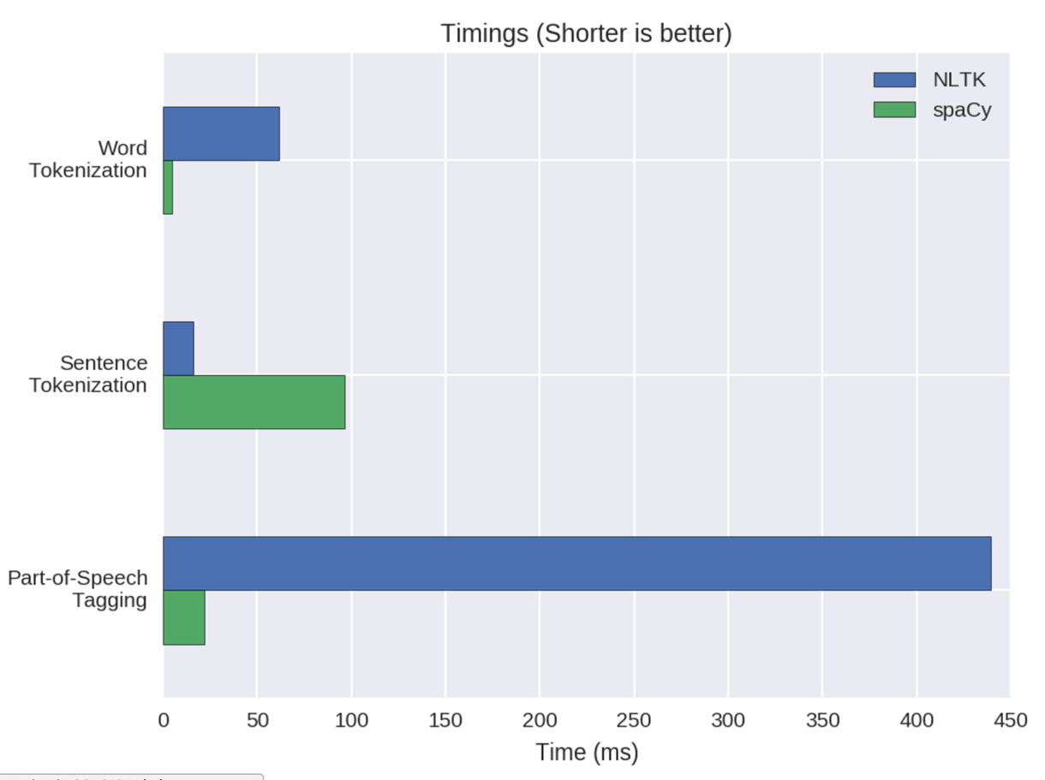
NLP in Python
Two majors libraries for performing basic NLP in Python:
Natural Language Toolkit (NLTK): started as research code, now widely used in industry and research
Spacy: much newer implementation, more streamlined
Pros and cons to both:
NLTK has more “stuff” implemented, is more customizable
  This is a blessing and a curse
Spacy is younger and feature
sparse, but can be much faster
Both are Anaconda packages

Slide 99
NLTK examples
import nltk
# Tokenize, aka find the terms in, a sentence
sentence = ”A wizard is never late, nor is he early. He arrives precisely when he means to.”
tokens = nltk.word_tokenize(sentence)
LookupError:
**********************************************************************
Resource 'tokenizers/punkt/PY3/english.pickle' not found.
Please use the NLTK Downloader to obtain the resource: >>>
nltk.download()
Searched in:
- '/Users/spook/nltk_data'
- '/usr/share/nltk_data'
- '/usr/local/share/nltk_data'
- '/usr/lib/nltk_data'
- '/usr/local/lib/nltk_data'
- ''
**********************************************************************
Fool of a Took!

Slide 100
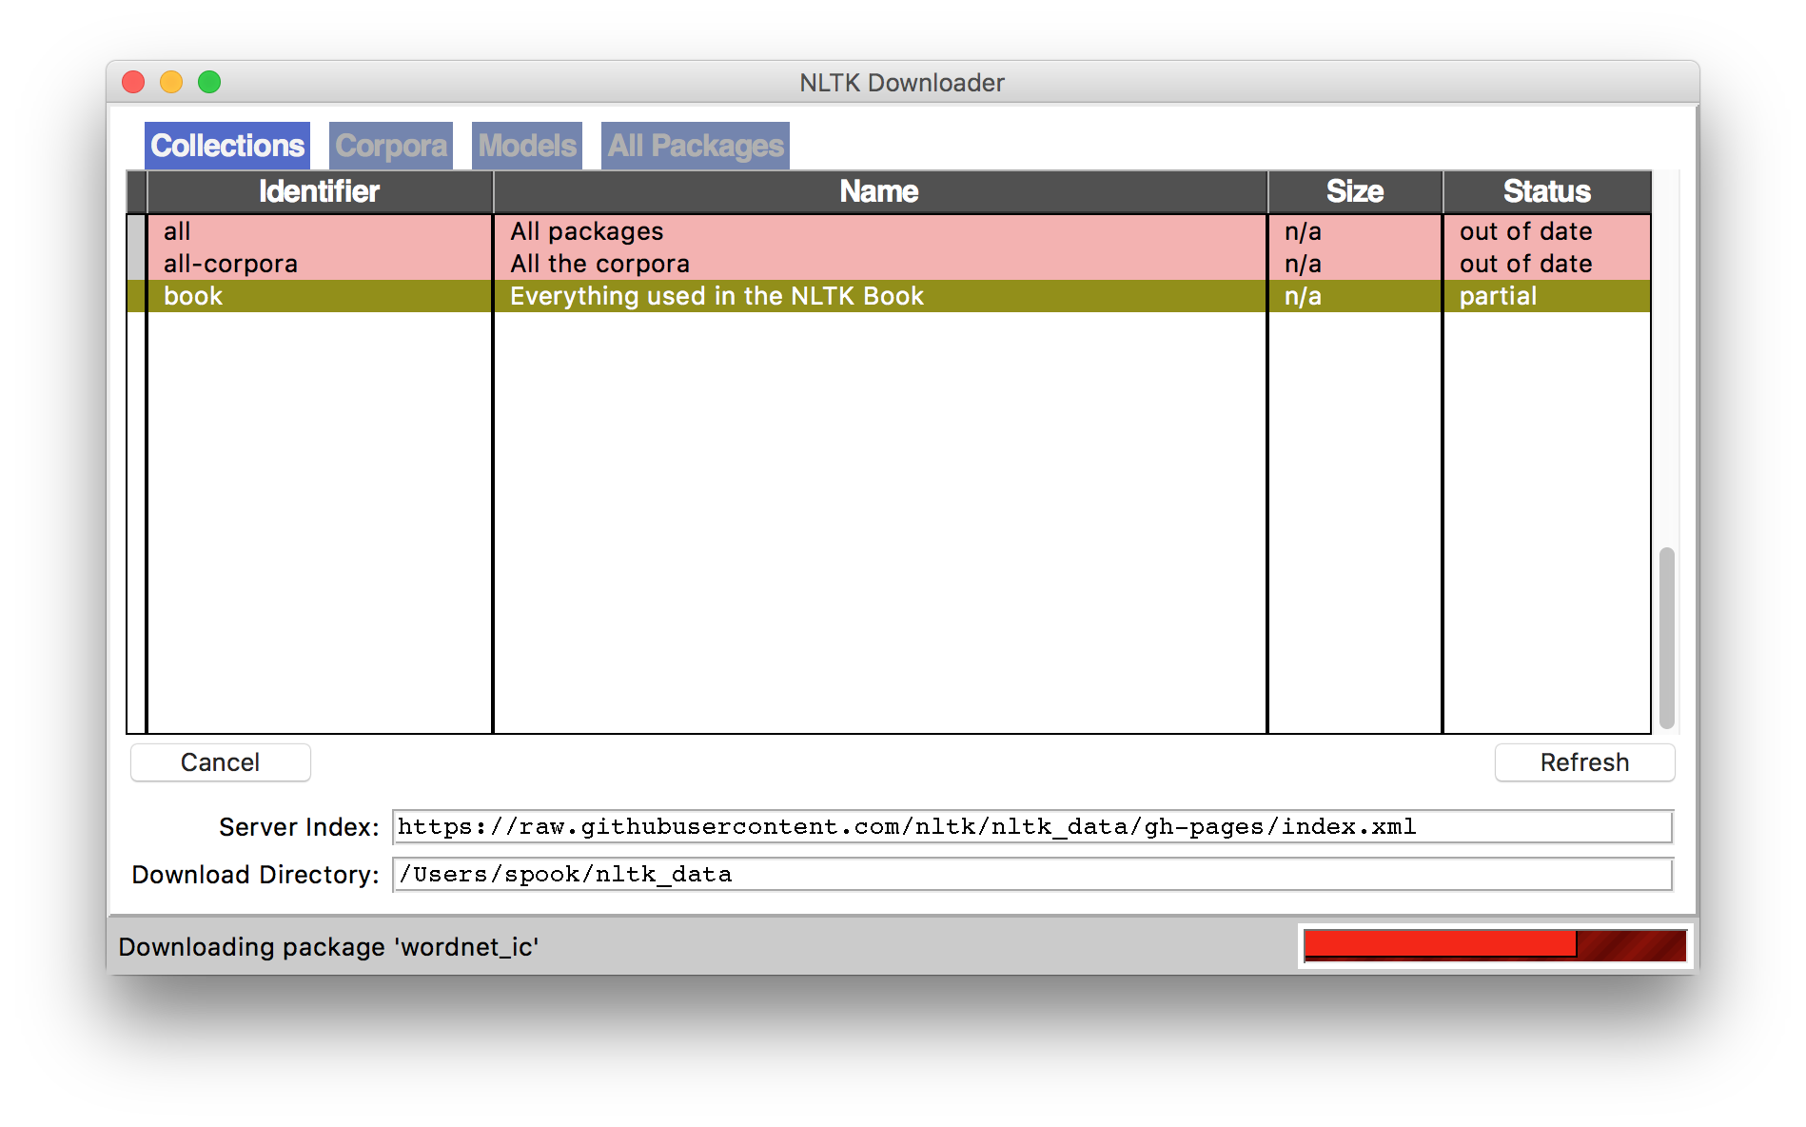
NLTK Examples
Corpora are, by definition, large bodies of text
NLTK relies on a large corpus set to perform various functionalities; you can pick and choose:
# Launch a GUI browser of available corpora
nltk.download()
# Or download everything at once!
nltk.download(“all”)

Slide 101
NLTK Examples
import nltk
# Tokenize, aka find the terms in, a sentence
sentence = ”A wizard is never late, nor is he early. He arrives precisely when he means to.”
tokens = nltk.word_tokenize(sentence)
['A', 'wizard', 'is', 'never', 'late', ',', 'nor', 'is', 'he', 'early', '.', 'He', 'arrives', 'precisely', 'when', 'he', 'means', 'to', '.']
(This will also tokenize words like “o’clock” into one term, and “didn’t” into two term, “did” and “n’t”.)

Slide 102
NLTK Examples
# Determine parts of speech (POS) tags
tagged = nltk.pos_tag(tokens)
tagged[:10]
[('A', 'DT'), ('wizard', 'NN'), ('is', 'VBZ'), ('never', 'RB'), ('late', 'RB'), (',', ','), ('nor', 'CC'), ('is', 'VBZ'), ('he', 'PRP'), ('early', 'RB')]
Abbreviation | POS
DT | Determiner
NN | Noun
VBZ | Verb (3rd person singular present)
RB | Adverb
CC | Conjunction
PRP | Personal Pronoun
Full list: https://cs.nyu.edu/grishman/jet/guide/PennPOS.html

Slide 103
NLTK Examples
# Find named entities & visualize
entities = nltk.chunk.ne_chunk( nltk.pos_tag( nltk.word_tokenize(“””
The Shire was divided into four quarters, the Farthings already referred to. North, South, East, and West; and these again each into a number of folklands, which still bore the names of some of the old leading families, although by the time of this history these names were no longer found only in their proper folklands. Nearly all Tooks still lived in the Tookland, but that was not true of many other families, such as the Bagginses or the Boffins. Outside the Farthings were the East and West Marches: the Buckland (see beginning of Chapter V, Book I); and the Westmarch added to the Shire in S.R. 1462.
“””)))
entities.draw()

Slide 104
Brief Aside: n-grams
n-gram: Contiguous sequence of n tokens/words etc.
Unigram, bigram, trigram, “four-gram”, “five-gram”, …
Text: David Golinkin is the editor or author of eighteen books, and over 150 responsa, articles, sermons and books

Slide 105
Language Modeling
Assign a probability to a sentence
  Machine Translation:
    P(high winds tonite) > P(large winds tonite)
  Spell Correction
    The office is about fifteen minuets from my house
      P(about fifteen minutes from) > P(about fifteen minuets from)
  Speech Recognition
    P(I saw a van) >> P(eyes awe of an)
  + Summarization, question-answering, etc., etc.!!

Slide 106
Language Modeling
Goal: compute the probability of a sentence or sequence of words:
P(W) = P(w₁,w₂,w₃,w₄,w₅…w_{n})
Related task: probability of an upcoming word:
P(w₅|w₁,w₂,w₃,w₄)
A model that computes either of these:
P(W) or P(w_{n}|w₁,w₂…w_{n-1}) is called a language model.
(We won’t talk about this much further in this class.)

Slide 107
Simplest case:
Unigram model
Some automatically generated sentences from a unigram model
fifth, an, of, futures, the, an, incorporated, a, a, the, inflation, most, dollars, quarter, in, is, mass
thrift, did, eighty, said, hard, 'm, july, bullish
that, or, limited, the

Slide 108
Bigram Model
Condition on the previous word:
texaco, rose, one, in, this, issue, is, pursuing, growth, in, a, boiler, house, said, mr., gurria, mexico, 's, motion, control, proposal, without, permission, from, five, hundred, fifty, five, yen
outside, new, car, parking, lot, of, the, agreement, reached
this, would, be, a, record, november

Slide 109
N-gram models
We can extend to trigrams, 4-grams, 5-grams
In general this is an insufficient model of language
  because language has long-distance dependencies:
  “The computer which I had just put into the machine room on the fifth floor crashed.”
But we can often get away with N-gram models

