Slide 1
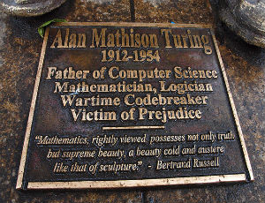
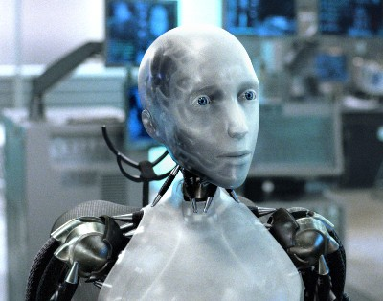
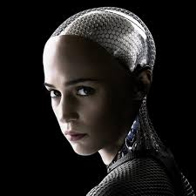
AI and Machine Learning

Slide 2
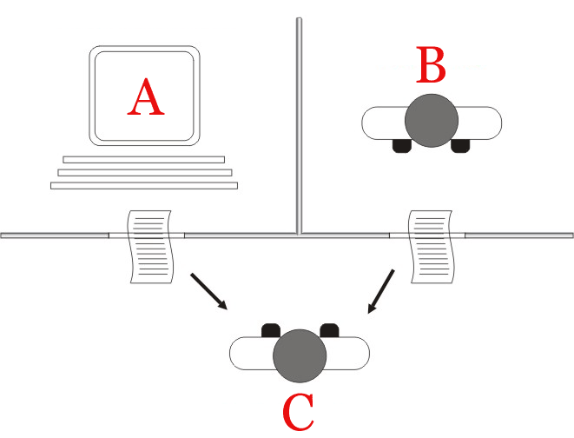
The Turing Test

Slide 3
Turing attack
      How can we show a machine is Intelligent? Let A = machine. Let C = Intelligent. Let B = someone that “we” claim is intelligent. How can we show A = C? Hmm. It’s subjective? Well most (normal) say B = C. So if can we show that A = B, then we can show that A = C!

Slide 4
Turing attack
      So subjective criteria when normal can be reasoned with transitivity!
      E.g., let C = Greatest basketball player ever. Most “normal” say Jordan. Let Jordan = B. Now is Lebron = the greatest ever? Let Lebron = A.
      Well we have to show that A = C, or A = B. Let’s assume A = B. Do we wind up in a contradiction? If so A!=B. If not A = B and A = C. Is Lebron the greatest?

Slide 5
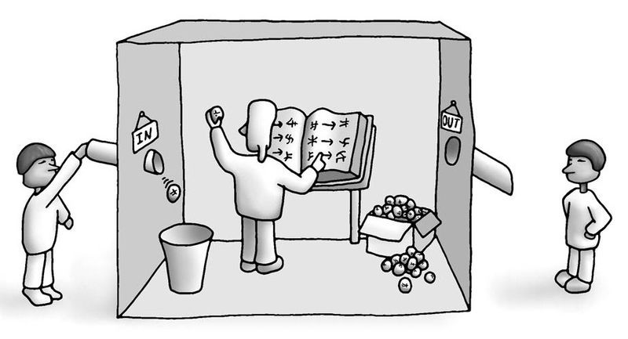
Chinese Room Argument

Slide 6
Chinese Room Argument
Searle defines:
Strong AI = Understanding
Weak AI = pattern recognition and mappings
What do you think?

Slide 7
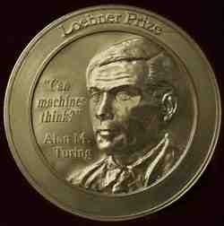
Loebner prize Mitsuka
The Loebner Prize is an annual competition in artificial intelligence that awards prizes to the computer programs considered by the judges to be the most human-like. The format of the competition is that of a standard Turing test. No one has ever won the silver or gold medal!

Slide 8
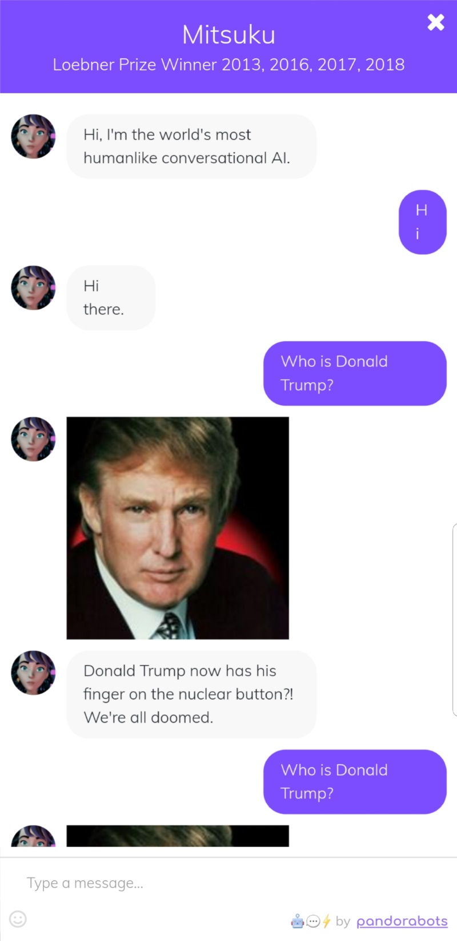
Mitsuko
Loebner bronze winner in 2013, 2016, 2017, 2018

Slide 9
Unsupervised vs. Supervised Learning
Supervised learning is aided by training data and human correction. Here’s some training data. Learn the patterns. Make your best guess at what the patterns are. We’ll feed you test data to figure out if you’ve understood it. If you stray of course we’ll correct you and retrain. Examples include Decision Trees and Neural Networks.
Unsupervised learning is uncorrected and runs on data. It can’t classify things “yet”. But is very good at clustering and anomaly detection.

Slide 10
Decision Tree Learning
Task:
  Given: collection of examples (x, f(x))
  Return: a function h (hypothesis) that approximates f
  h is a decision tree
Input: an object or situation described by a set of attributes (or features)
Output: a “decision” – the predicts output value for the input.
The input attributes and the outputs can be discrete or continuous.
We will focus on decision trees for Boolean classification:
each example is classified as positive or negative.

Slide 11
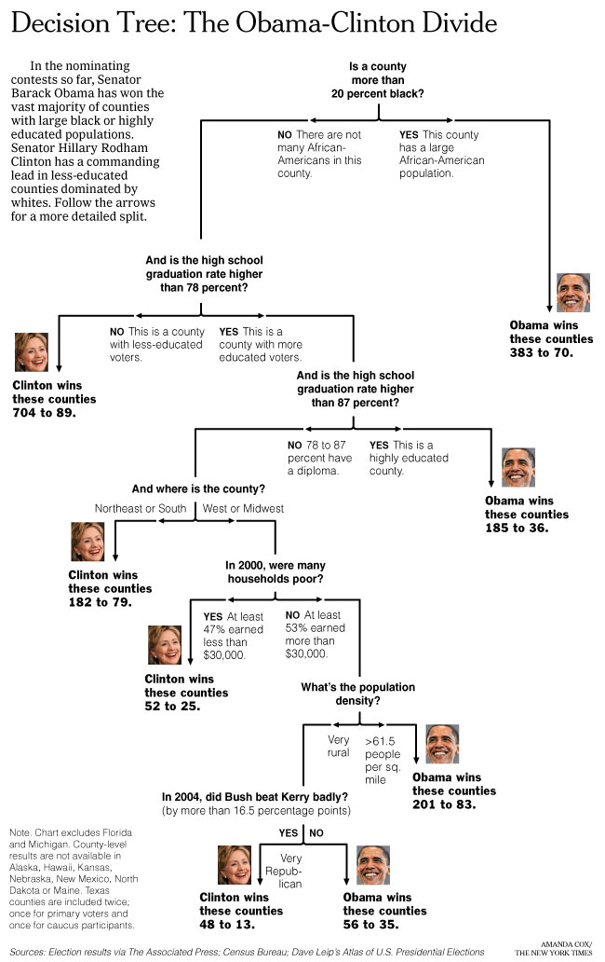
Can we learn
how counties vote?
New York Times
April 16, 2008
Decision Trees:
a sequence of tests.
Representation very natural for humans.
Style of many “How to” manuals and trouble-shooting
procedures.

Slide 12
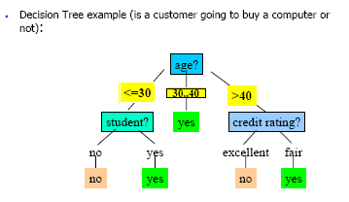
Decision Tree
What is a decision tree?
A tree with two types of nodes:
Decision nodes
Leaf nodes
Decision node: Specifies a choice or test of some attribute with 2 or more alternatives;
→ every decision node is part of a path to a leaf node
Leaf node: Indicates classification of an example

Slide 13
Inductive Learning Example
Etc.
Instance Space X: Set of all possible objects described by attributes (often called features).
Target Function f: Mapping from Attributes to Target Feature
(often called label) (f is unknown)
Hypothesis Space H: Set of all classification rules h_{i} we allow.
Training Data D: Set of instances labeled with Target Feature
What is the best Variable (Feature) to use as an indicator of a BigTip?

Slide 14
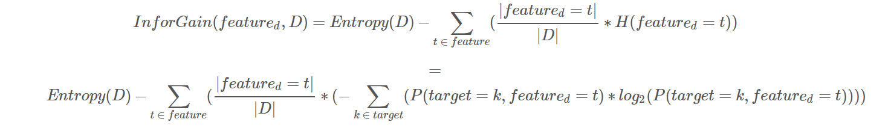
Entropy & Information Gain
Obviously ☺
Don’t Panic. Entropy is just a way to measure disorder = uncertainty in data and uncertainty in “data mappings”.

Slide 15
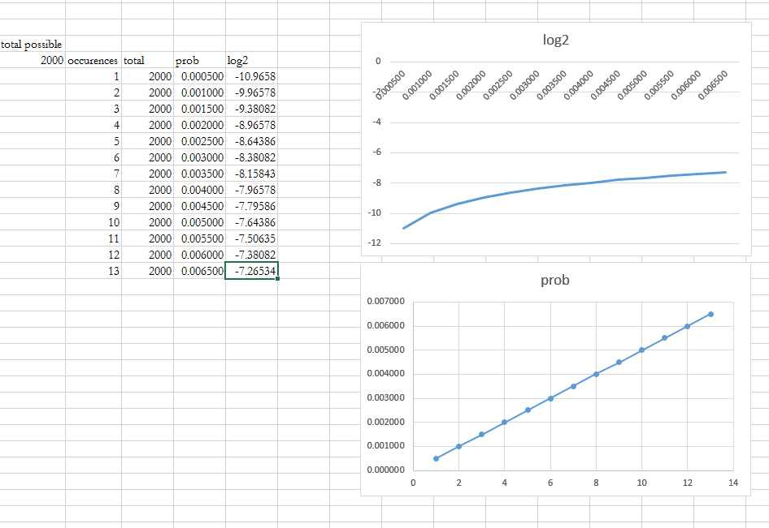
Information Gain

Slide 16
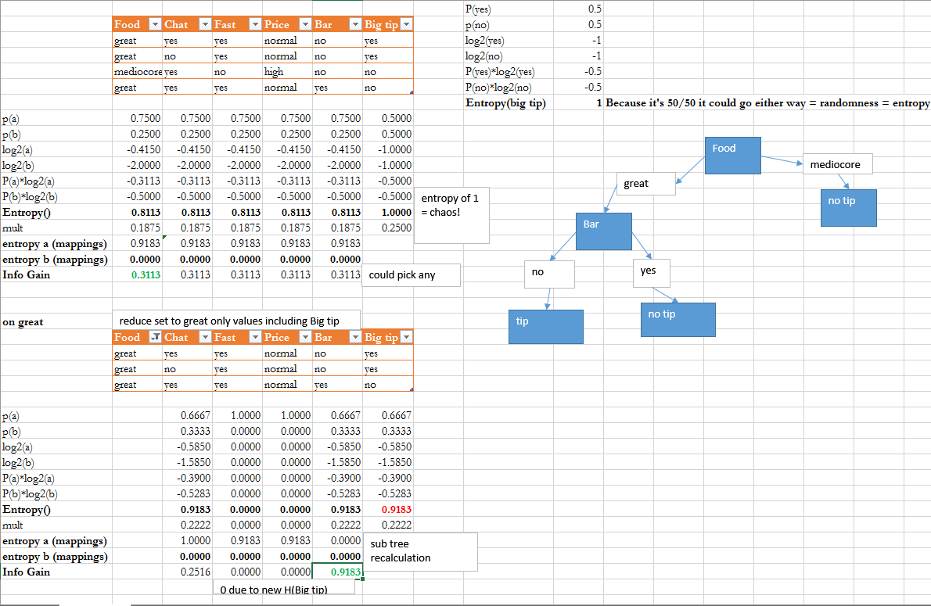
Excel example

Slide 17
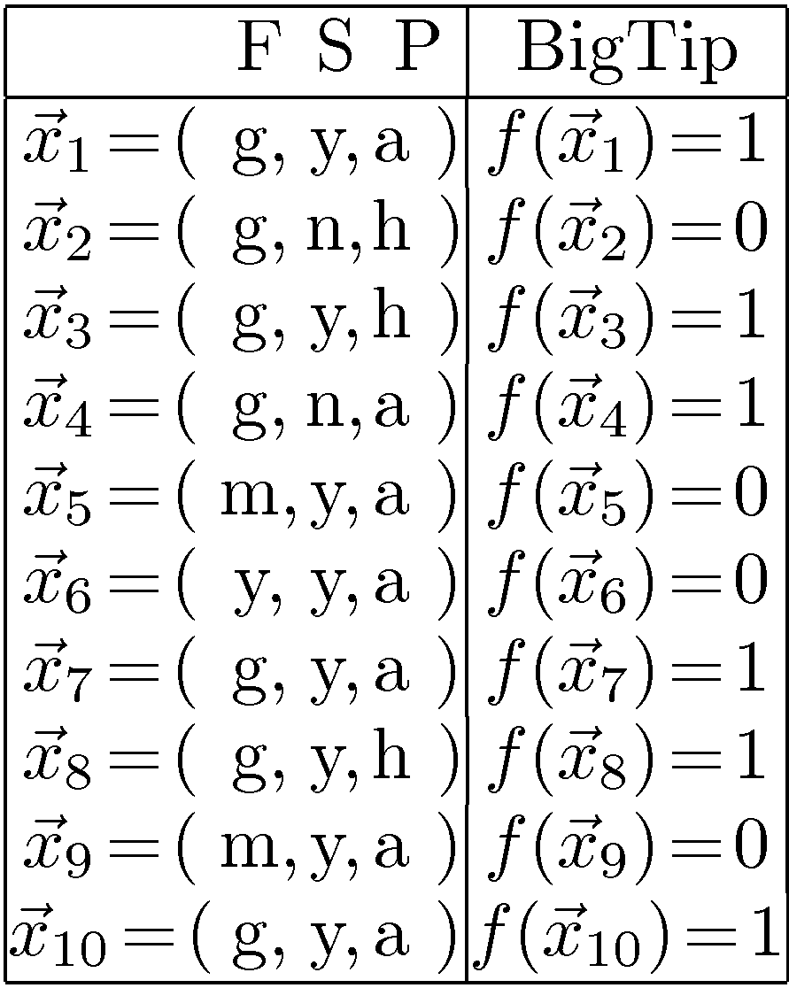
Decision Tree Example: “BigTip”
great
Food
yuck
mediocre
Speedy
no
no
no
yes
Our data
yes
Price
high
adequate
yes
no
Is the decision tree we learned consistent?
Yes, it agrees with all the examples!
Data: Not all 2x2x3 = 12 tuples
Also, some repeats! These are
literally “observations.”
Notes:
Definition of components
Internal nodes: tests on attributes
Branches: attribute value (one branch for each value)
Leaves: assign classification
Understanding example tree
Classify Example 1: yes
Classify Example 2: yes
Classify Example 3: no
Classify Example 4: yes
Classify: $x_2=(Food=great, Chat=no, Fast=no, Price=adequate, Bar=no)$ $\rightarrow$ yes
Example represents function: (Food=great) AND ((Fast=yes) OR ((Fast=no) AND (Price=adequate)))
→ Simplify to: (Food=great) AND ((Fast=yes) OR (Price=adequate))
How would you represent:
A AND B
A OR B
A XOR B

Slide 18
Top-Down Induction of Decision Tree:
Big Tip Example
Node “done” when uniform label or “no
further
uncertainty.”
1
3
4
7
8
10
2
5
6
9
10 examples:
6+
Food
4-
y
1
3
4
7
8
10
m
g
2
No
No
Speedy
6
5
9
n
4
y
Yes
Price
2
a
h
1
3
7
8
10
Yes
No
4
2
How many + and - examples
per subclass, starting with y?
Let’s consider next
the attribute Speedy
Notes:
Definition of components
Internal nodes: tests on attributes
Branches: attribute value (one branch for each value)
Leaves: assign classification
Understanding example tree
Classify Example 1: yes
Classify Example 2: yes
Classify Example 3: no
Classify Example 4: yes
Classify: $x_2=(Food=great, Chat=no, Fast=no, Price=adequate, Bar=no)$ $\rightarrow$ yes
Example represents function: (Food=great) AND ((Fast=yes) OR ((Fast=no) AND (Price=adequate)))
→ Simplify to: (Food=great) AND ((Fast=yes) OR (Price=adequate))
How would you represent:
A AND B
A OR B
A XOR B

Slide 19
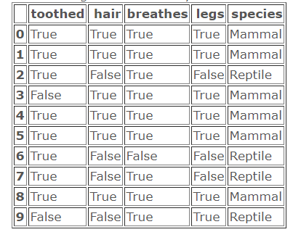
An example

Slide 20
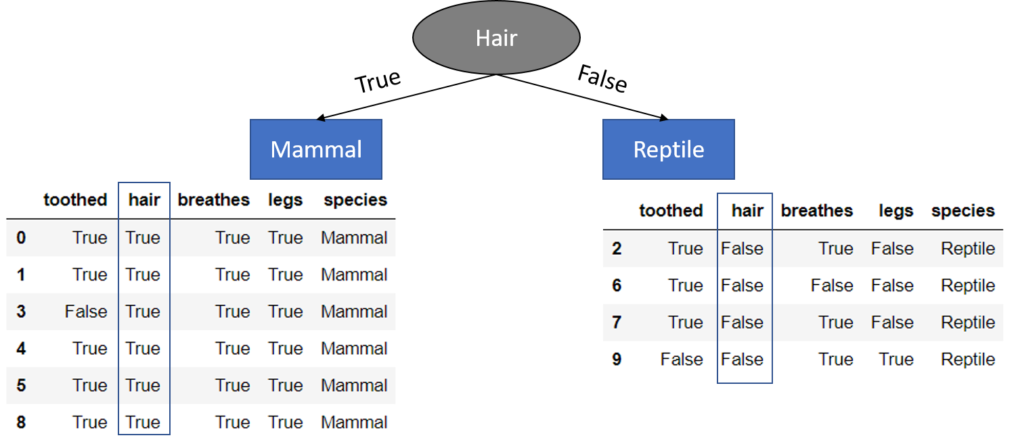
An example

Slide 21
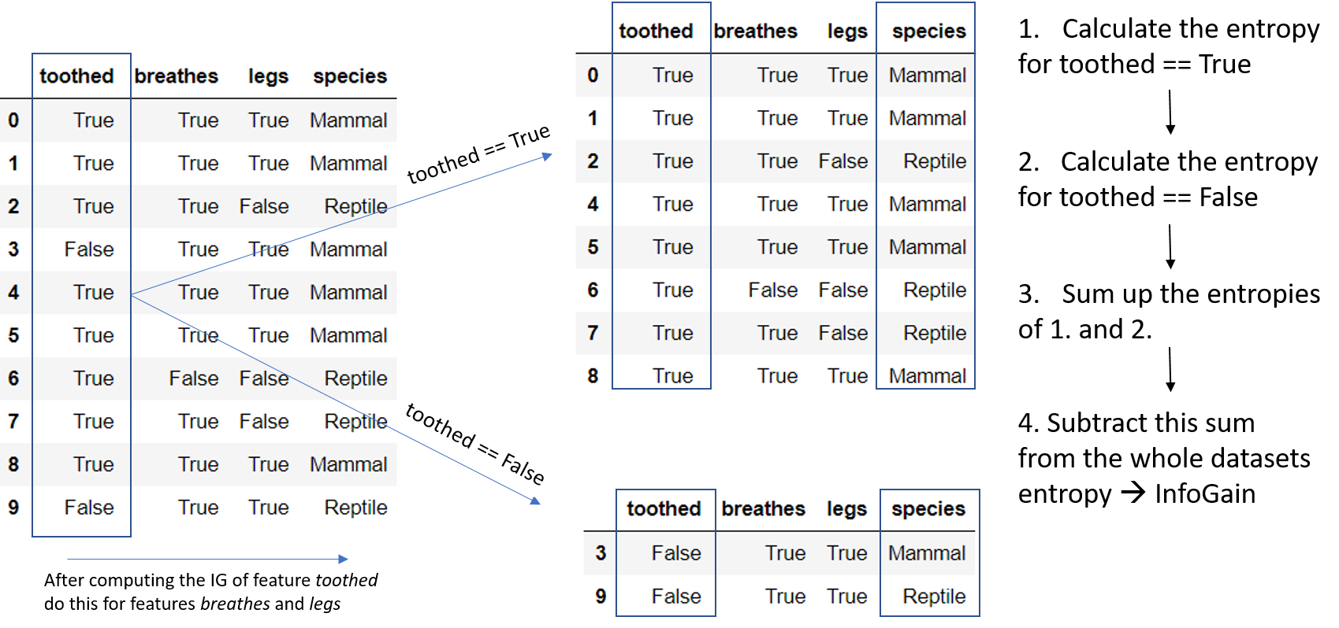
An example

Slide 22
