Slide 1
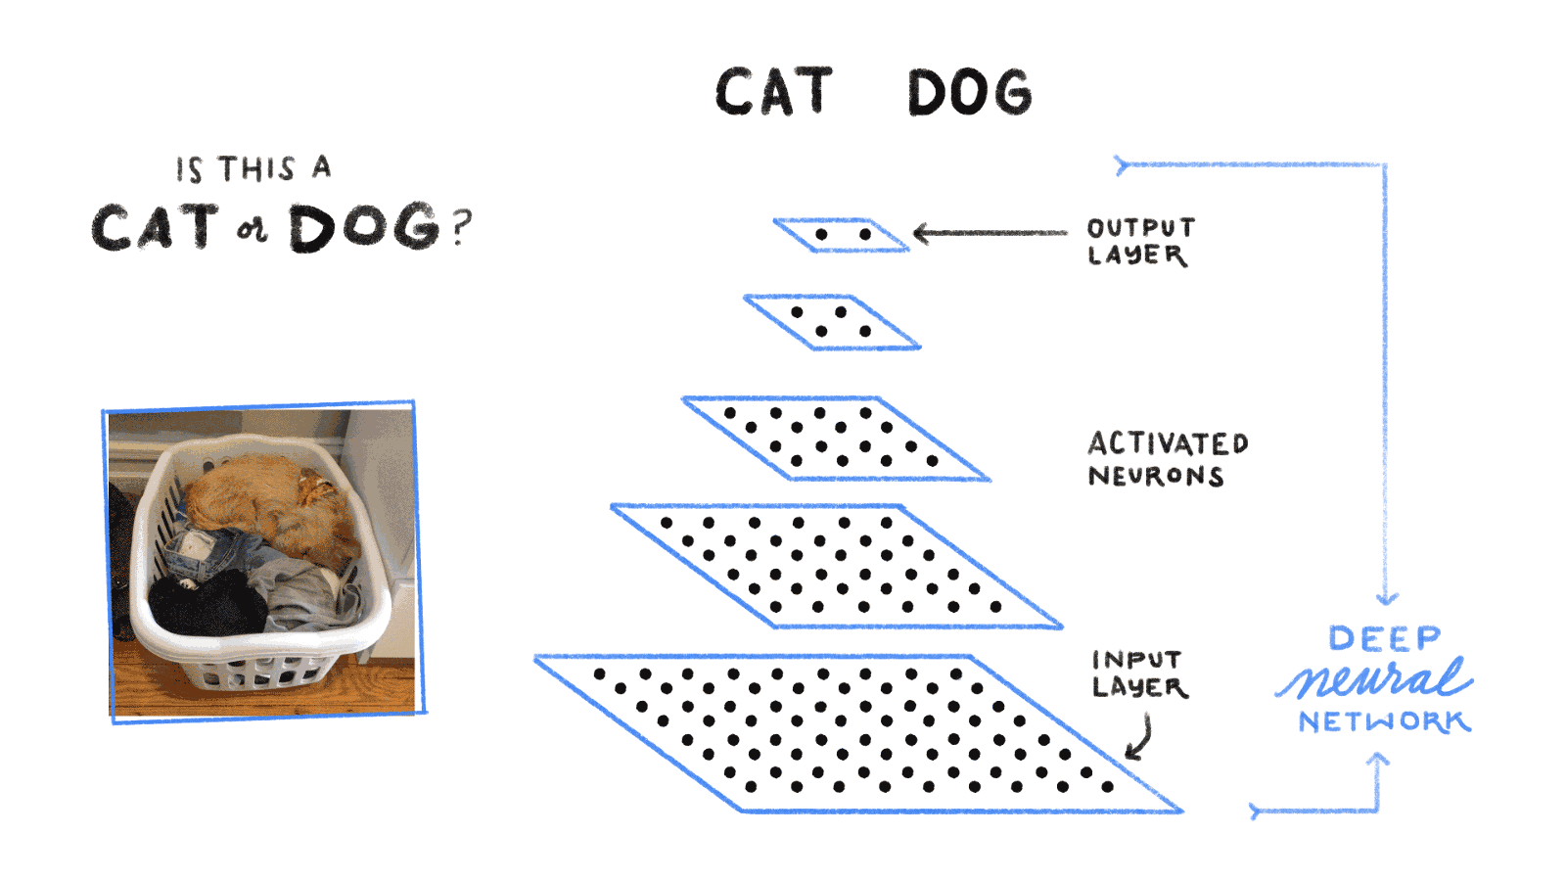
Artificial Neural Networks

Slide 2
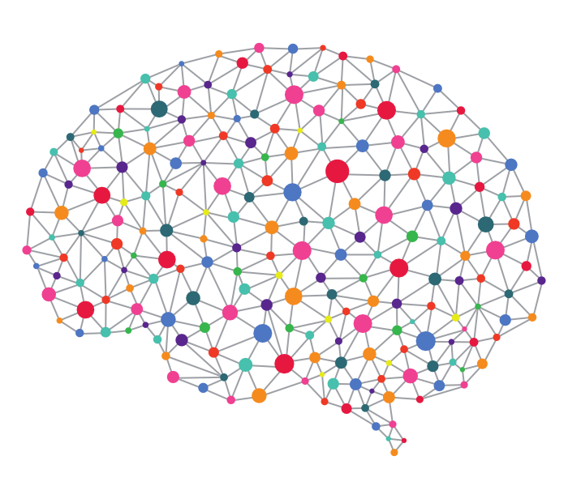
What are they?
Inspired by the Human Brain.
The human brain has about 86 Billion neurons and requires 20% of your body’s energy to function.
These neurons are connected to between 100 Trillion to 1 Quadrillion synapses!

Slide 3
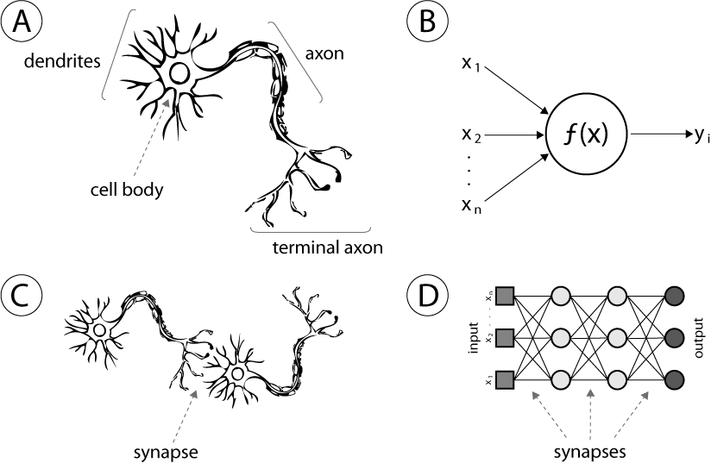
What are they?

Slide 4
What are they?
Originally developed by Warren McCulloch and Walter Pitts^{[3]} (1943)
Started off as an unsupervised learning tool.
  Had problems with computing time and could not compute XOR
  Was abandoned in favor of other algorithms
Werbos's (1975) backpropagation algorithm
  Incorporated supervision and solved XOR
  But were still too slow vs. other algorithms e.g., Support Vector Machines
Backpropagation was accelerated by GPUs in 2010 and shown to be more efficient and cost effective

Slide 5

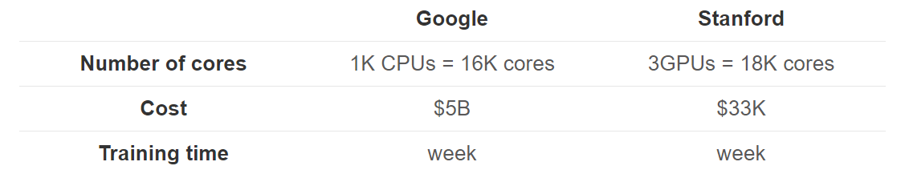
GPUS
GPUS handle parallel operations much better (thousands of threads per core) but are not as quick as CPUs. However, the matrix multiplication steps in ANNs can be run in parallel resulting in considerable time + cost savings. The best CPUs handle about 50GB/s while the best GPUs handle 750GB/s memory bandwidth.

Slide 6
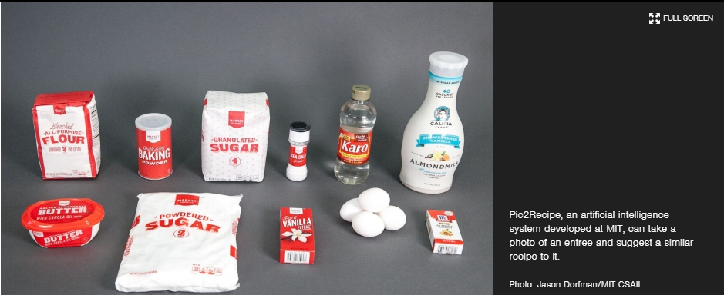
Applications
http://news.mit.edu/2017/artificial-intelligence-suggests-recipes-based-on-food-photos-0720
Image to food to ingredients to recipes.

Slide 7
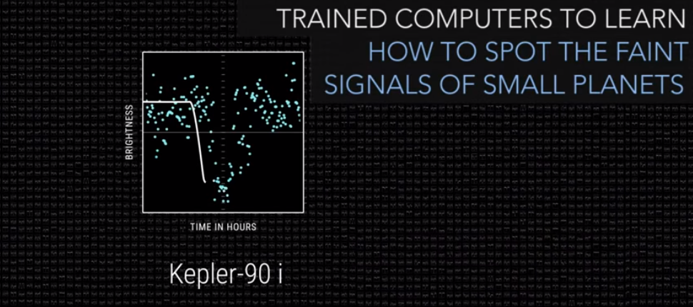
Applications
https://www.nasa.gov/press-release/artificial-intelligence-nasa-data-used-to-discover-eighth-planet-circling-distant-star
Images of light drop compared and new ones found.

Slide 8
Idea behind them
Obtain some structured data (always a good idea ☺).
Use some subset of that data as training
Feed each training example through the network
  Calculate the error for each training example
  Update the weights for each neuron to minimize the error using Gradient Descent (Back Propagation)
  Feed in the data again until you reach the desired % error or trials run out
  If you reached % error or trials stop and go to the next training input
    Else (Back Propagation)

Slide 9
An example

Slide 10
Forward Propagation
Assign random weights to the synapses
Feed in the training data
Calculate the hidden layers neurons from the inputs and the weights using an activation function
Calculate the output from the hidden layer neurons and the output weights
Calculate the error from what is expected

Slide 11
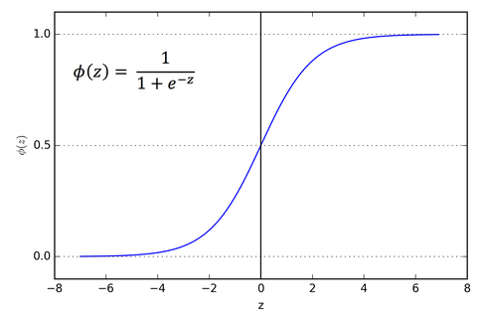
Activation Function

Slide 12
Forward propagation

Slide 13
Back propagation
We need to adjust the weights to minimize the error

Slide 14
Back propagation

Slide 15

Back Propagation

Slide 16
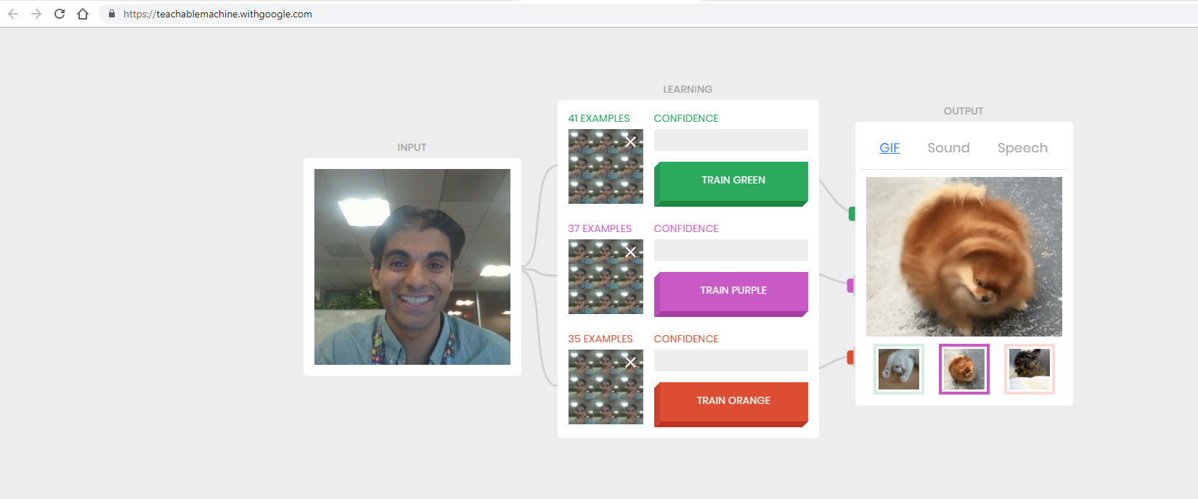
Live Example!
https://teachablemachine.withgoogle.com/

Slide 17
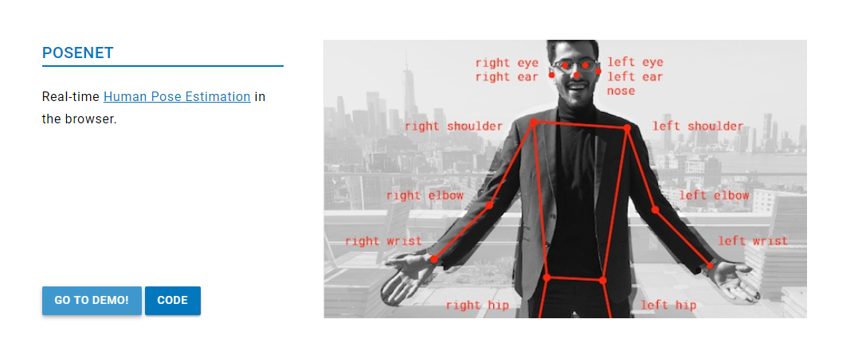
Strike the pose
https://storage.googleapis.com/tfjs-models/demos/posenet/camera.html

Slide 18
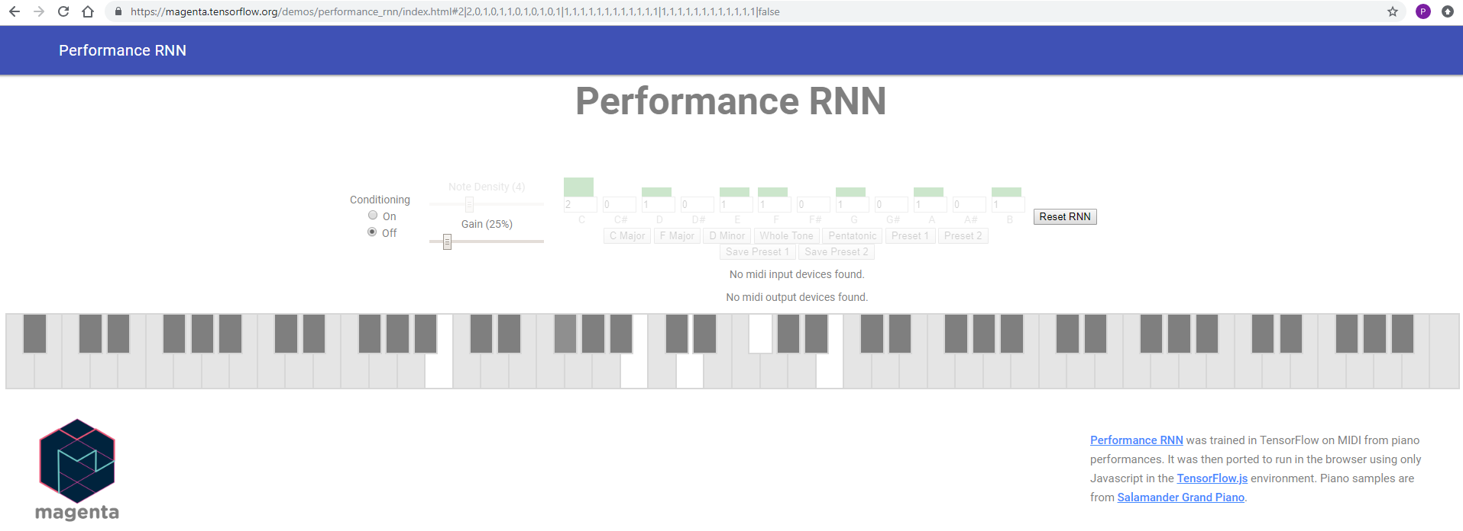
Can a machine play music?
https://magenta.tensorflow.org/demos/performance_rnn/index.html#2|2,0,1,0,1,1,0,1,0,1,0,1|1,1,1,1,1,1,1,1,1,1,1,1|1,1,1,1,1,1,1,1,1,1,1,1|false

Slide 19
Tensor Flow & Keras
import numpy as np
from keras.models import Sequential
from keras.layers.core import Dense
# the four different states of the XOR gate
training_data = np.array([[0,0],[0,1],[1,0],[1,1]], "float32")
# the four expected results in the same order
target_data = np.array([[0],[1],[1],[0]], "float32")
#use sequential vs functional since we’re feedforward
model = Sequential()
#Dense is used for single input data 0,1,1,0 for each neuron
model.add(Dense(16, input_dim=2, activation='relu'))
model.add(Dense(1, activation='sigmoid'))
#this is the building of the net
model.compile(loss='mean_squared_error',
optimizer='adam',
metrics=['binary_accuracy'])
#now optimize
model.fit(training_data, target_data, nb_epoch=500, verbose=2)
print model.predict(training_data).round()

Slide 20
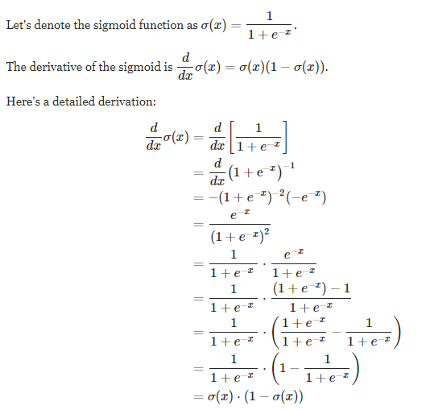
Derivative of the sigmoid

