Slide 1
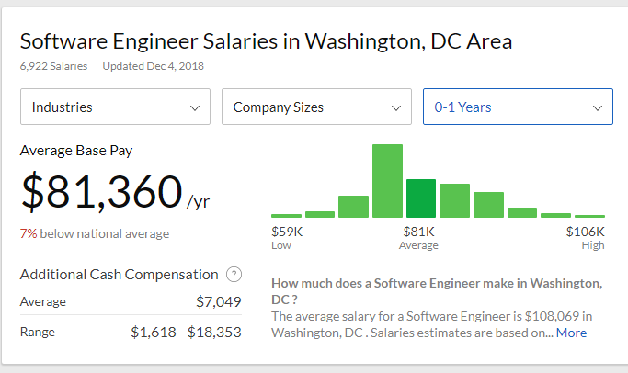
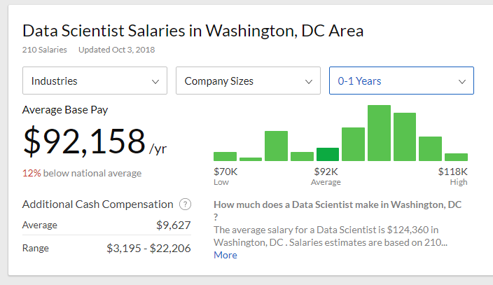
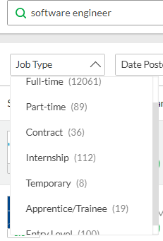
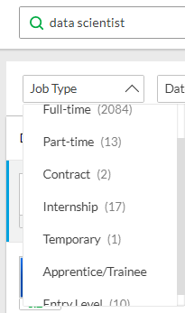
Data Science in Industry

Slide 2
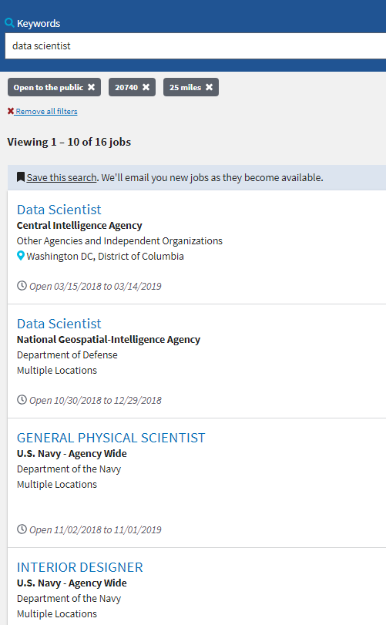
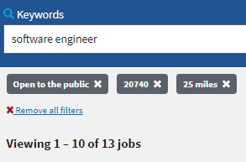
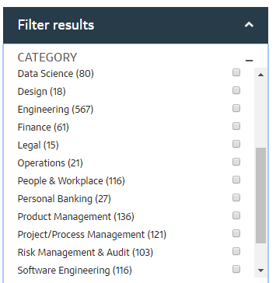

Slide 3
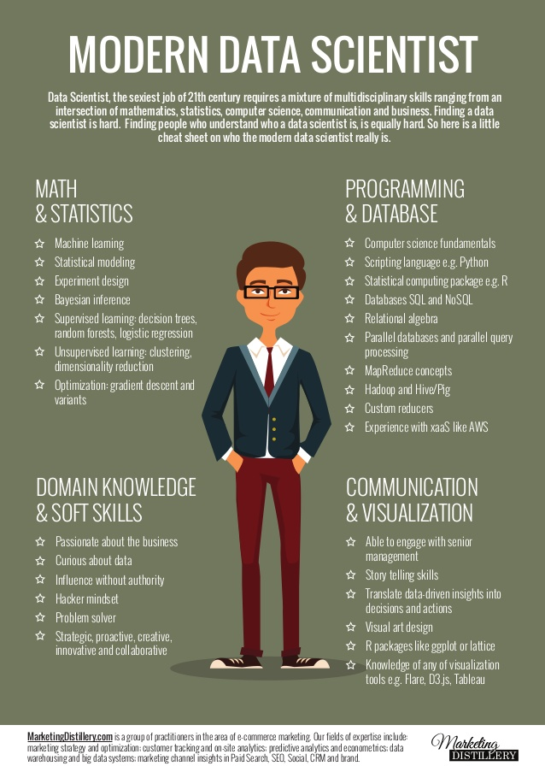

Slide 4
What is the hardest part of data science?

Slide 5
What is the hardest part of data science?
Dealing with people ☺
Figuring out what questions to ask (domain knowledge)
Getting the data for those questions
Organizing the data
Dealing with missing data
Training supervised Machine Learning

Slide 6
How to become successful?

Slide 7
Association Rules
Gather all frequent item sets (specified by support % of occurrences)
From those frequent items consider each possible combination and calculate the supports.
The most frequent rules that match our support level are presented.

Slide 8
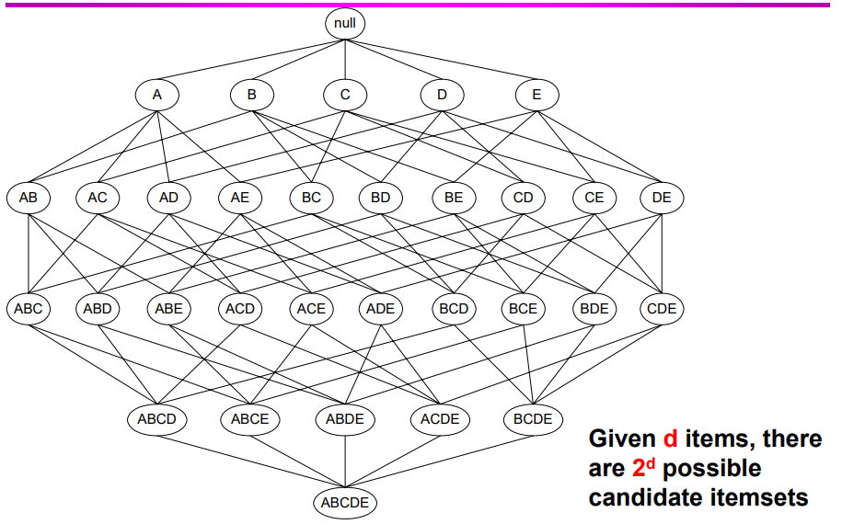
Basic idea behind rule generation

Slide 9
Association rule terminology
Confidence: Confidence (x→y) = support(xUy)/support(x)
Lift: Lift (x→y) = support(xUy)/(support(x)*support(y))
If the rule had a lift of 1, it would imply that the probability of occurrence
of the antecedent and that of the consequent are independent of each other.
When two events are independent of each other,
no rule can be drawn involving those two events.
Conviction:
interpreted as the ratio of the expected frequency that X occurs
without Y (that is to say, the frequency that the rule makes an incorrect prediction)
if X and Y were independent divided by the observed frequency of incorrect
predictions.

Slide 10
Jupyter Example

Slide 11
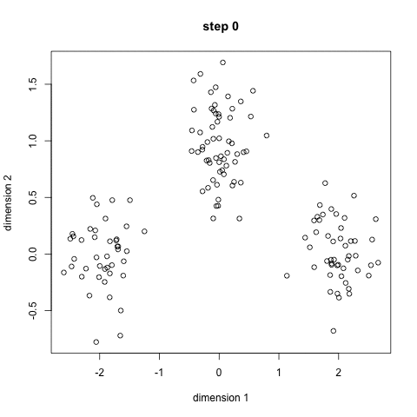
Clustering
K-Means will give you clusters that you can label!

Slide 12
Putting it together
From clusters you can label them which allows you to engineer statistically the association rule role ups.
From there you can see all the rules and target a dependent variable
Set your decision tree, random forests, or neural network to target this dependent variable and independent variables
Update with feedback from the field and you don’t have to worry about changing any code. Plus what code/variables would you change? The time savings of ML ☺.

Slide 13
Questions ☺

