Slide 1
CMSC417
Computer Networks
Prof. Ashok K . Agrawala
© 2019 Ashok Agrawala
September 4, 2018

Slide 2
Connecting Application Programs
User A
Server
App A
App B
OS
OS
Disk

Slide 3
Connecting Application Programs
User A
Server
App A
App B
OS
OS
Disk
Internet

Slide 4
Network Software
Protocol layers »
Design issues for the layers »
Connection-oriented vs. connectionless service »
Service primitives »
Relationship of services to protocols »

Slide 5
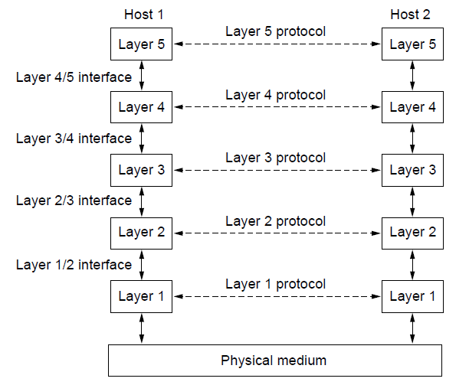
Protocol layers
Protocol layering is the main structuring method used to divide up network functionality.
Each protocol instance talks virtually to its peer
Each layer communicates only by using the one below
Lower layer services are accessed by an interface
At bottom, messages are carried by the medium

Slide 6
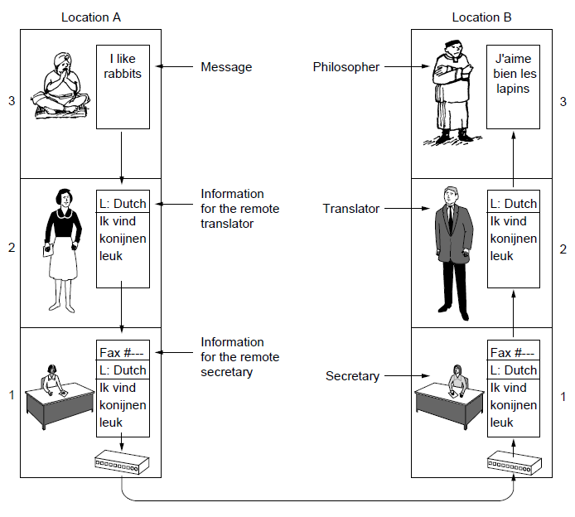
Protocol layers
Example: the philosopher-translator-secretary architecture
Each protocol at different layers serves a different purpose

Slide 7
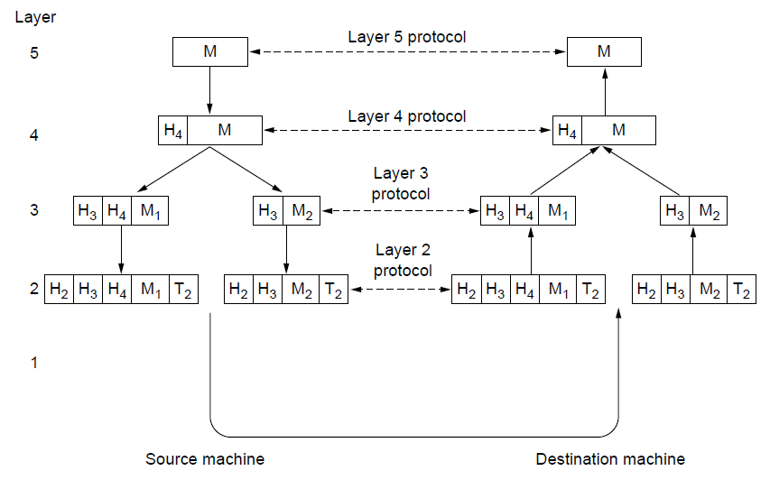
Protocol layers
Each lower layer adds its own header (with control inform-ation) to the message to transmit and removes it on receive
Layers may also split and join messages, etc.

Slide 8
Design issues for the layers
Each layer solves a particular problem but must include mechanisms to address a set of recurring design issues
Issue | Example mechanisms at different layers
Reliability despite failures | Codes for error detection/correction (§3.2, 3.3) Routing around failures (§5.2)
Network growth and evolution | Addressing (§5.6) and naming (§7.1) Protocol layering (§1.3)
Allocation of resources like bandwidth | Multiple access (§4.2) Congestion control (§5.3, 6.3)
Security against various threats | Confidentiality of messages (§8.2, 8.6) Authentication of communicating parties (§8.7)

Slide 9
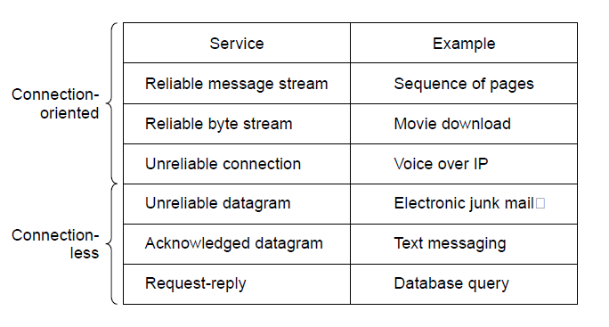
Connection-oriented vs. connectionless
Service provided by a layer may be kinds of either:
Connection-oriented, must be set up for ongoing use (and torn down after use), e.g., phone call
Connectionless, messages are handled separately, e.g., postal delivery

Slide 10
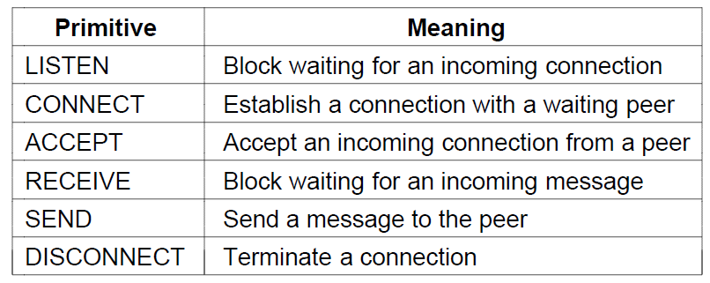
Service primitives
A service is provided to the layer above as primitives
Hypothetical example of service primitives that may provide a reliably byte stream (connection-oriented) service:

Slide 11
Service primitives
Hypothetical example of how these primitives may be used for a client-server interaction
Client
Server
LISTEN (0)
CONNECT (1)
Connect request
ACCEPT
(2)
Accept response
RECEIVE
SEND
Request for data
(3)
RECEIVE
SEND (4)
Reply
DISCONNECT (5)
Disconnect
DISCONNECT (6)
Disconnect

Slide 12
Service primitives
Packets sent in a simple client-server interaction on a connection-oriented network:

Slide 13
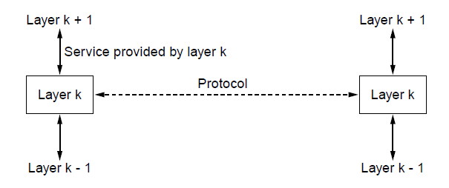
Relationship of services to protocols
A layer provides a service to the one above [vertical]
A layer talks to its peer using a protocol [horizontal]

Slide 14
Reference models
Reference models describe the layers in a network architecture.
OSI reference model »
TCP/IP reference model »
Model used for this text »

Slide 15
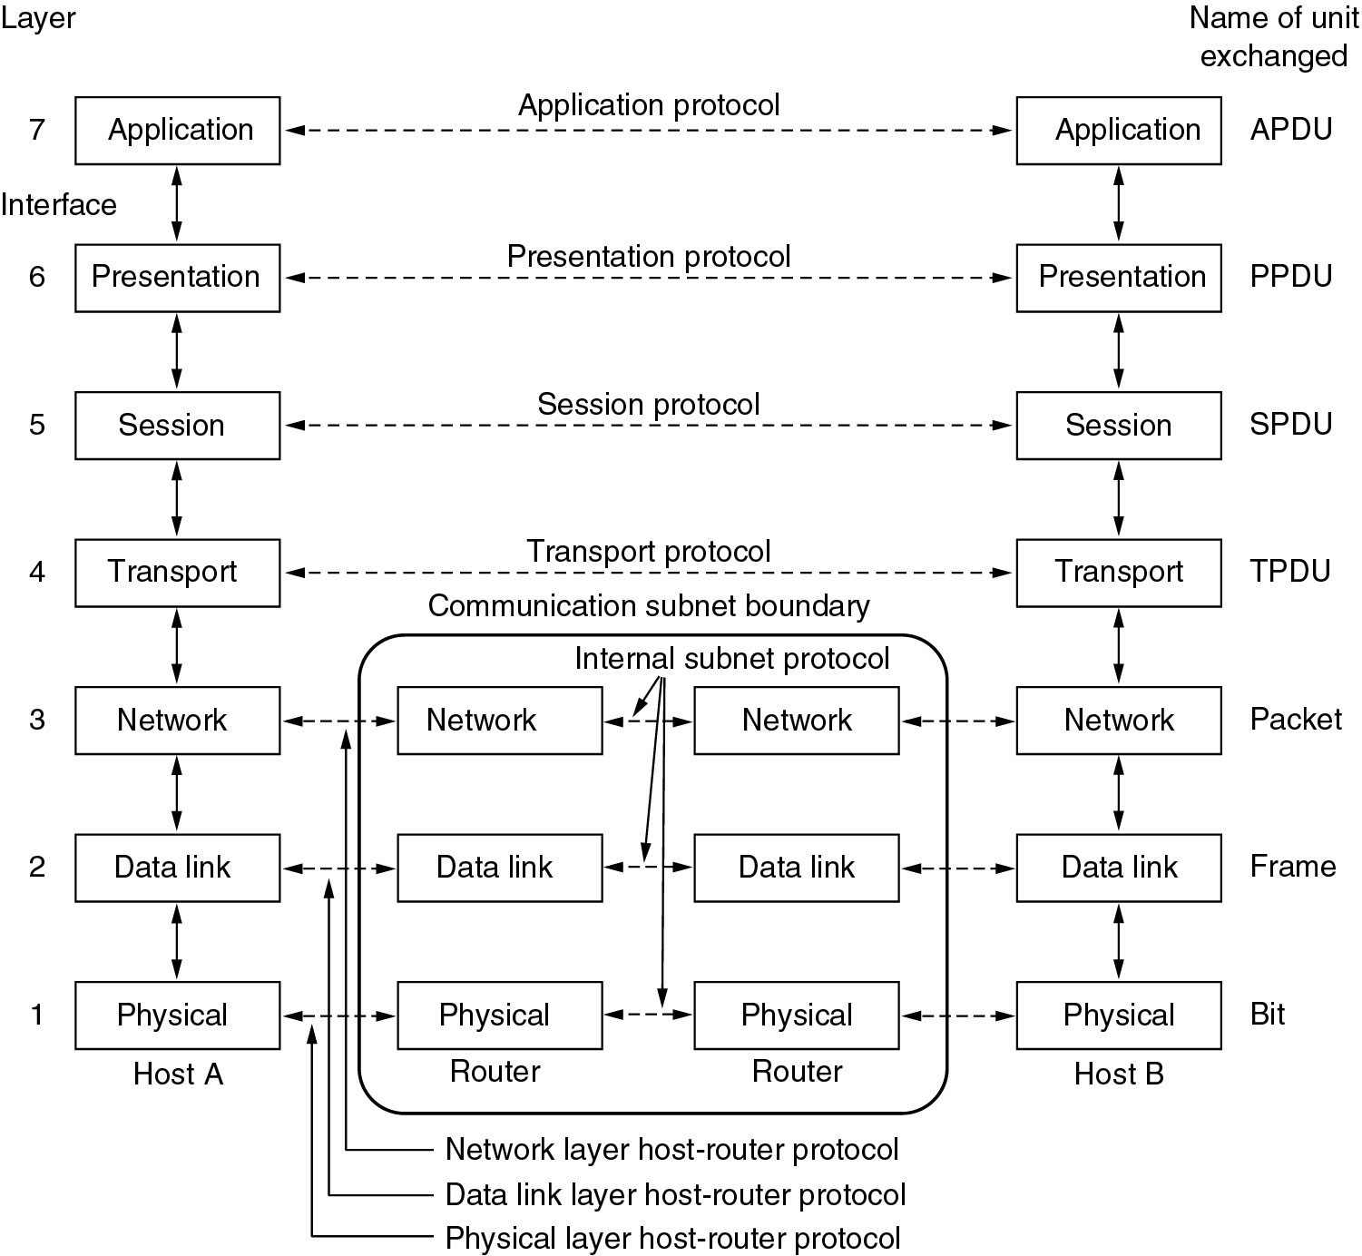
Reference models
The OSI reference model

Slide 16
OSI reference model
A principled, international standard, seven layer model to connect different systems.
Provides functions needed by users
Converts different representations
Manages task dialogs
Provides end-to-end delivery
Sends packets over multiple links
Sends frames of information
Sends bits as signals

Slide 17
The TCP/IP reference model layers
Link layer
Internet layer
Transport layer
Application layer

Slide 18
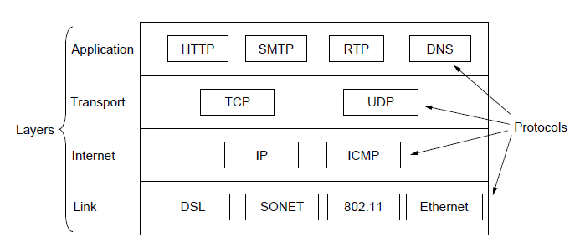
TCP/IP reference model
A four layer model derived from experimentation; omits some OSI layers and uses the IP as the network.
IP is the “narrow waist” of the Internet
Protocols are shown in their respective layers

Slide 19
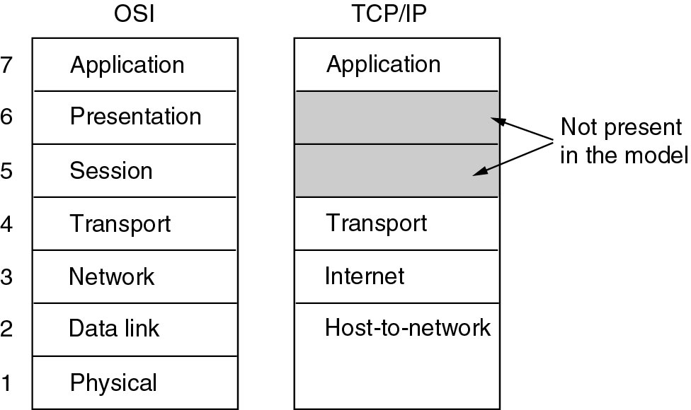
Comparison of OSI and TCP/IP models

Slide 20
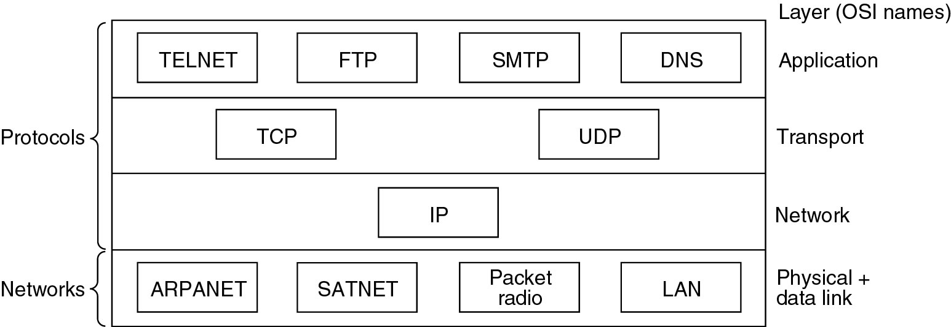
Reference models

Slide 21
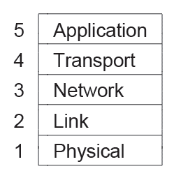
Model used in this course
It is based on the TCP/IP model but we call out the physical layer and look beyond Internet protocols.

Slide 22
Network standardization
Who’s Who in the Telecommunications World »
Who’s Who in the International Standards World »
Who’s Who in the Internet Standards World »

Slide 23
Network standardization
Standards define what is needed for interoperability.
Some of the many standards bodies:
Body | Area | Examples
ITU | Telecommunications | G.992, ADSL H.264, MPEG4
IEEE | Communications | 802.3, Ethernet 802.11, WiFi
IETF | Internet | RFC 2616, HTTP/1.1 RFC 1034/1035, DNS
W3C | Web | HTML5 standard CSS standard

Slide 24
ITU: International Telecommunications Union
Main sectors
Radiocommunications
Telecommunications Standardization
Development
Classes of Members
National governments
Sector members
Associate members
Regulatory agencies

Slide 25
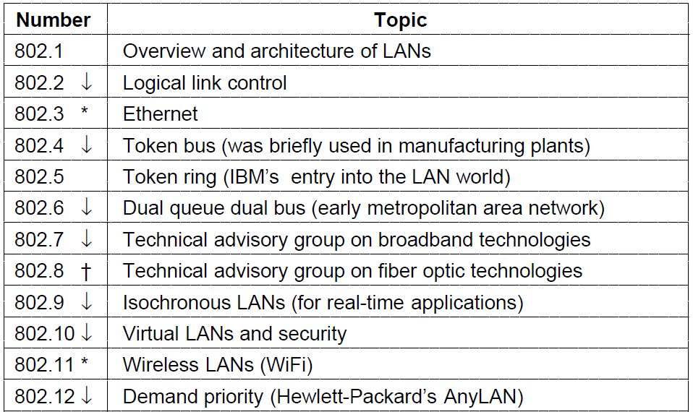
Who’s who in international standards
The 802 working groups. The important ones are marked with *.
The ones marked with ↓ are hibernating. The one marked with † gave up and disbanded itself.

Slide 26
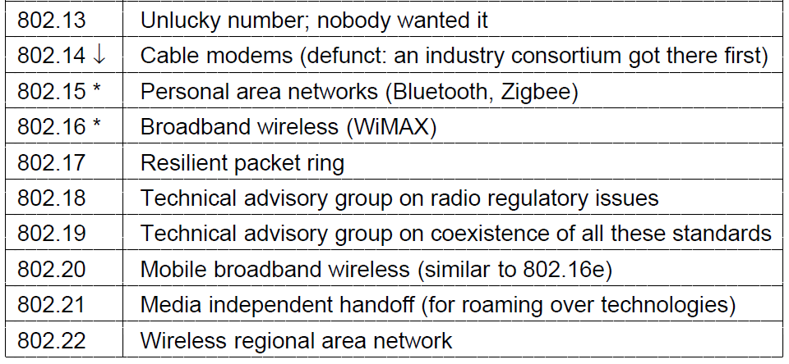
Who’s who in international standards
The 802 working groups. The important ones are marked with *.
The ones marked with ↓ are hibernating. The one marked with † gave up and disbanded itself.

Slide 27
Metric units
The main prefix we use:
Prefix | Exp. | prefix | exp.
K(ilo) | 10³ | m(illi) | 10⁻³
M(ega) | 10⁶ | μ(micro) | 10⁻⁶
G(iga) | 10⁹ | n(ano) | 10⁻⁹
Use powers of 10 for rates, powers of 2 for storage (e. g. 1 Mbps = 1,000,000 bps, 1 KB = 1024 bytes)
B is for bytes, b is for bits

Slide 28
Metric units
The principle metric prefixes

Slide 29
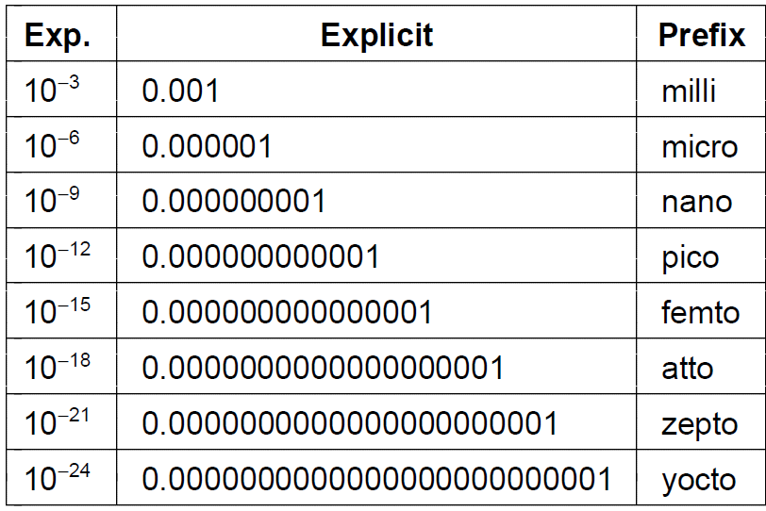
Metric units
The principle metric prefixes

Slide 30
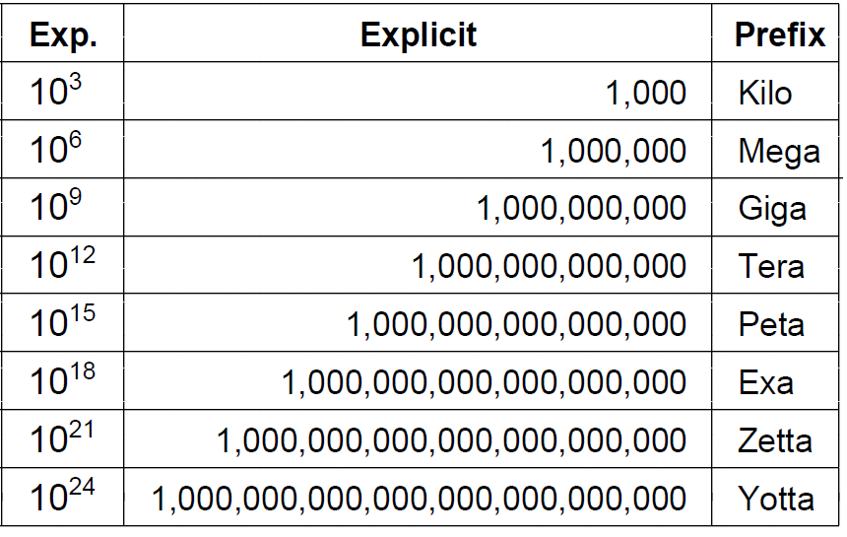
Metric units
The principle metric prefixes

