Slide 1
Principles of
Data Science
John P Dickerson
Lecture #1 – 08/29/2018
CMSC641
Wednesdays
7:00pm – 9:30pm

Slide 2
Introduction to
?????????????

Slide 3
Data science is the application of computational and statistical techniques to address or gain [managerial or scientific] insight into some problem in the real world.
Zico Kolter
Machine Learning Prof, CMU

Slide 4
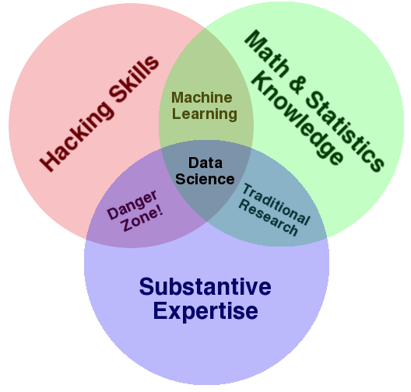
Drew Conway
CEO, Alluvium (analytics company)

Slide 5
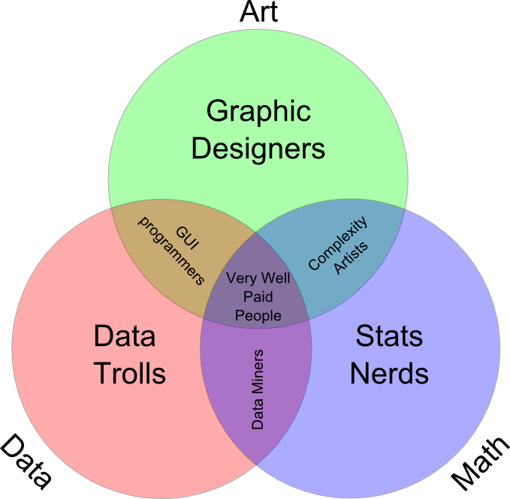
Many definitions
Broad: necessarily larger than a single discipline
Interdisciplinary: statistics, computer science, operations research, statistical and machine learning, data warehousing, visualization, mathematics, information science, …
Insight-focused: grounded in the desire to find insights in data and leverage them to inform decision making
Tuomas Carsey, UNC

Slide 6
The Data LifeCycle
Data collection
Data processing
Exploratory analysis
&
Data viz
Analysis, hypothesis testing, & ML
Insight & Policy Decision

Slide 7
“The ability to take data—to be able to understand it, to process it, to extract value from it, to visualize it, to communicate it—that’s going to be a hugely important skill in the next decades, not only at the professional level but even at the educational level for elementary school kids, for high school kids, for college kids.”
Hal Varian
Chief Economist at Google

Slide 8
Motivation
Explosion of data, in pretty much every domain
  Sensing devices and sensor networks that can monitor everything 24/7 from temperature to pollution to vital signs
  Increasingly sophisticated smart phones
  Internet, social networks makes it easy to publish data
  Scientific experiments and simulations → astronomical data volumes
  Internet of Things
  Dataification: taking all aspects of life and turning them into data (e.g., what you like/enjoy has been turned into a stream of your "likes")
How to handle that data? How to extract interesting actionable insights and scientific knowledge?
Data volumes expected to get much worse

Slide 9
Four V’s of Big Data
Increasing data Volumes
  Scientific data: 1.5GB per genome -- can be sequenced in .5 hrs
  500M tweets per day (as of 2013)
  As of 2012: 2.5 Exabytes of data created every day
Variety:
  Structured data, spreadsheets, photos, videos, natural text, ...
Velocity
  Sensors everywhere -- can generate high-rate "data streams"
  Real-time analytics requires data to be consumed as fast as it is generated
Veracity
  How do you decide what to trust? How to remove noise? How to fill in missing values?

Slide 10
This Certificate Program
You’ll learn to take data:
Process it
Visualize it
Understand it
Communicate it
Extract value from it
Info: https://www.cs.umd.edu/class/fall2018/cmsc641/
Piazza: piazza.com/umd/fall2018/cmsc641
ELMS: (everyone should be registered automatically)
Hal Varian

Slide 11
This Certificate Program
CMSC 641: Principles of Data Science
  An introduction to the data science pipeline, i.e., the end-to-end process of going from unstructured, messy data to knowledge and actionable insights. Provides a broad overview of what data science means and systems and tools commonly used for data science, and illustrates the principles of data science through several case studies.
CMSC 642: Big Data Systems
CMSC 643: Machine Learning and Data Mining
CMSC 644: Algorithms for Data Science

Slide 12
This Certificate Program
CMSC 641: Principles of Data Science
CMSC 642: Big Data Systems
  An overview of data management systems for performing data science on large volumes of data, including relational databases, and NoSQL systems. The topics covered include: different types of data management systems, their pros and cons, how and when to use those systems, and best practices for data modeling.
CMSC 643: Machine Learning and Data Mining
CMSC 644: Algorithms for Data Science

Slide 13
This Certificate Program
CMSC 641: Principles of Data Science
CMSC 642: Big Data Systems
CMSC 643: Machine Learning and Data Mining
  Provides a broad overview of key machine learning and data mining algorithms, and how to apply those to very large datasets. Topics covered include decision trees, linear models for classification and regression, support vector machines, neural networks and deep learning, online learning, recommendation systems, clustering and dimensionality reduction, and systems for large-scale machine learning.
CMSC 644: Algorithms for Data Science

Slide 14
This Certificate Program
CMSC 641: Principles of Data Science
CMSC 642: Big Data Systems
CMSC 643: Machine Learning and Data Mining
CMSC 644: Algorithms for Data Science
  Provides an in-depth understanding of some of the key data structures and algorithms essential for advanced data science. Topics include random sampling, graph algorithms, network science, data streams, and optimization.

Slide 15
This Course
End-to-end data science lifecycle
Acquiring, wrangling, cleaning, and integrating data; Setting up pipelines for ETL
Data modeling
Information Visualization
Ethics, Privacy, and Reproducibility
Feel free to tell me if there are topics that you think we should cover…

Slide 16
Prerequisite Knowledge
Aimed at folks with some CS knowledge – but likely accessible to others with programming experience and mathematical maturity.
We do not assume:
Experience with Python, pandas, scikit-learn, matplotlib, etc …
Deep statistics or any ML knowledge
Database or distributed systems knowledge
We do assume: You want to be here!

Slide 17





Who am I?
http://jpdickerson.com

Slide 18
Who are you?
STAT400?
CMSC422?
CMSC424?
Register on Piazza: piazza.com/umd/fall2018/cmsc641

Slide 19
(Tentative) Course structure
First 2 lectures: intro & primers in the Python data science stack
Next 3 lectures: data collection & management
Best practices, data wrangling, exploratory analysis, ethics, debugging, visualization, etc …
Next 4-5 lectures: statistical modeling & ML
Statistical learning, regression, classification, cross-validation, model evaluation, hypothesis testing, etc …
Midterm
Final 4.5 lectures: advanced topics
Dimensionality reduction, distributed learning, big data, distributed computation
Either group presentations or more lectures
Ambitious …

Slide 20
Grade #1: Mini-Projects
Students will complete four mini-project assignments:
Case studies meant to mimic what you, a future data scientist, will see in industry. They should be fun ☺.
The rules:
Allowed: small group discussions
Required: individual programming & writing
Never allowed: public posting of solutions
Deliverable:
Turn in an .ipynb of a Jupyter notebook on ELMS

Slide 21
Grade #2: Reading Homeworks
We will post (bi)weekly reading assignments. Mix of:
Blog posts
Academic articles
News articles
Weekly quiz to be taken on ELMS covering the readings
Individual quiz grades are pass/fail:
At least 60% correct → Pass
Less than 60% correct → Fail
Must take at least ten of these quizzes over the semester

Slide 22
Grade #3: Midterm
You know what this is.
Will cover roughly the first 3/5 of class:
Qualitative (more)
Quantitative (less)
Currently scheduled for October 24th (might change – let me know if you have hard constraints, etc)

Slide 23
Grade #3: Mini-Tutorial
In lieu of a final exam, you’ll create a mini-tutorial that:
Identifies a raw data source
Processes and stores that data
Performs exploratory data analysis & visualization
Derives insight(s) using statistics and ML
Communicates those insights as actionable text
Individual or group project
Will be hosted publicly online (GitHub Pages) and will strengthen your portfolio.

Slide 24
Ready-Made Dataset repositories
https://www.data.gov/
US-centric agriculture, climate, education, energy, finance, health, manufacturing data, …
https://cloud.google.com/bigquery/public-data/
BigQuery (Google Cloud) public datasets (bikeshare, GitHub, Hacker News, Form 990 non-profits, NOAA, …)
https://www.kaggle.com/datasets
Microsoft-owned, various (Billboard Top 100 lyrics, credit card fraud, crime in Chicago, global terrorism, world happiness, …)
https://aws.amazon.com/public-datasets/
AWS-hosted, various (NASA, a bunch of genome stuff, Google Books n-grams, Multimedia Commons, …)

Slide 25
New Dataset Ideas
Fraternal Order of Police vs Black Lives Matter
Linking finance data to ${anything_else}
Something having to do with Pokémon statistics?
Look through http://www.alexa.com/topsites and scrape something interesting!
University of Maryland-related, or College Park-related, stuff
Check out http://umd.io/ – open source project; maybe your data collection and cleaning scripts can be added to this!
Honestly, pretty much anything! Just document everything.
Reproducibility!

Slide 26
Final Tutorial
Deliverable: URL of your own GitHub Pages site hosting an .ipynb/.html export of your final tutorial
https://pages.github.com/ – make a GitHub account, too!
https://github.com/blog/1995-github-jupyter-notebooks-3
The project itself:
~1500+ words of Markdown prose
~150+ lines of Python
Should be viewable as a static webpage – that is, if I (or anyone else) opens the link up, everything should render and I shouldn’t have to run any cells to generate output

Slide 27
Final Tutorial Rubric
The TAs and I will grade on a scale of 1-10:
Motivation: Does the tutorial make the reader believe the topic is important (a) in general and (b) with respect to data science?
Understanding: After reading the tutorial, does the reader understand the topic?
Further resources: Does the tutorial “call out” to other resources that would help the reader understand basic concepts, deep dive, related work, etc?
Prose: Does the prose in the Markdown portion of the .ipynb add to the reader’s understanding of the tutorial?
Code: Does the code help solidify understanding, is it well documented, and does it include helpful examples?
Subjective Evaluation: If somebody linked to this tutorial from Hacker News, would people actually read the whole thing?
Thanks to: Zico Kolter

Slide 28
Grade #☺: Class Participation
Please please please please please do the required reading, if available, before coming to class!
Earn full credit via:
Lecture participation
Piazza participation
Regular attendance at office hours (can be just to chat!)
Aim to ask/answer a question at least once every two weeks; or attend office hours at least once a month
Please I’m so lonely …
And so are the TAs …

Slide 29
Grade Breakdown
60% mini-projects:
There are 3 of them
Equal weighting @ 20% each
10% reading homeworks
30% final tutorial
(+5% course participation)
= A+

Slide 30
Some Technologies we will use
Notes:
Docker – containerization, build and ship apps
Spark – cluster computing framework, nice data parallelism etc

Slide 31
(Don’t tell CMSC330 …)

Slide 32
Important Walls of Text

Slide 33
Anti-Harassment
Common Sense!
(Adapted from ACM SIGCOMM’s policies)
The open exchange of ideas and the freedom of thought and expression are central to our aims and goals. These require an environment that recognizes the inherent worth of every person and group, that fosters dignity, understanding, and mutual respect, and that embraces diversity. For these reasons, we are dedicated to providing a harassment-free experience for participants in (and out) of this class.
Harassment is unwelcome or hostile behavior, including speech that intimidates, creates discomfort, or interferes with a person's participation or opportunity for participation, in a conference, event or program.

Slide 34
Academic Integrity
Common Sense!
(Text unironically stolen from Hal Daumé III)
Any assignment or exam that is handed in must be your own work (unless otherwise stated). However, talking with one another to understand the material better is strongly encouraged. Recognizing the distinction between cheating and cooperation is very important. If you copy someone else's solution, you are cheating. If you let someone else copy your solution, you are cheating (this includes posting solutions online in a public place). If someone dictates a solution to you, you are cheating.
Everything you hand in must be in your own words, and based on your own understanding of the solution. If someone helps you understand the problem during a high-level discussion, you are not cheating. We strongly encourage students to help one another understand the material presented in class, in the book, and general issues relevant to the assignments. When taking an exam, you must work independently. Any collaboration during an exam will be considered cheating. Any student who is caught cheating will be given an F in the course and referred to the University Office of Student Conduct. Please don't take that chance – if you're having trouble understanding the material, please let me know and I will be more than happy to help.

Slide 35
(A few) Data Science Success Stories & Cautionary Tales

Slide 36
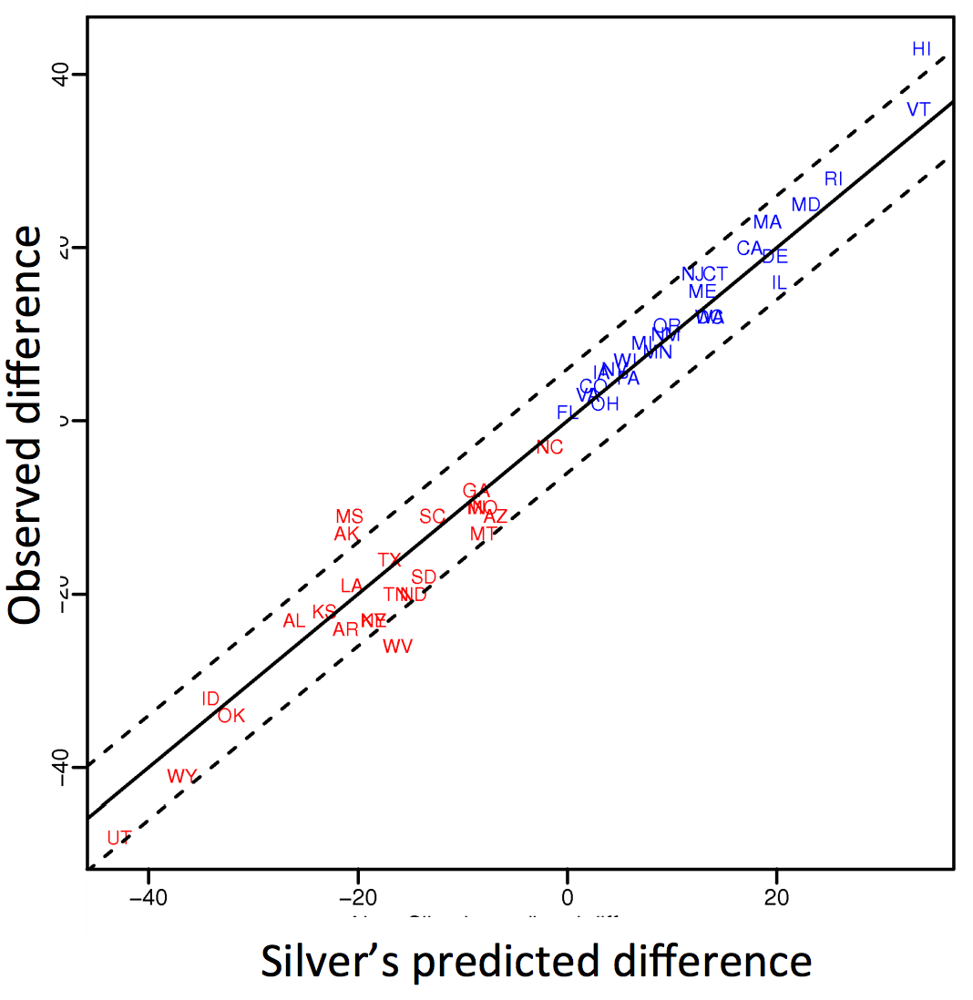
Polling: 2008 & 2012
Nate Silver uses a simple idea – taking a principled approach to aggregating polling instead of relying on punditry – and:
Predicts 49/50 states in 2008
Predicts 50/50 states in 2012
(He is also a great case study
in creating a brand.)
https://hbr.org/2012/11/how-nate-silver-won-the-2012-p
Democrat (+) or Republican (-) in 2012

Slide 37
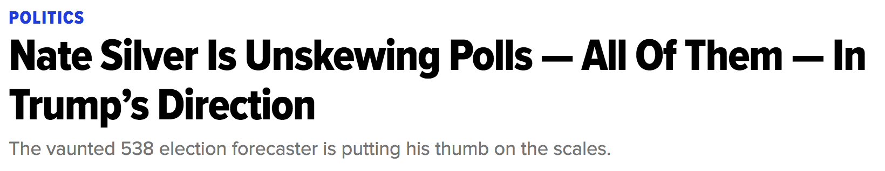
Polling: 2016
HuffPo: “He may end up being right, but he’s just guessing. A “trend line adjustment” is merely political punditry dressed up as sophisticated mathematical modeling.”
538: Offers quantitative reasoning for re-/under-weighting older polls, & changing as election approaches
http://www.huffingtonpost.com/entry/nate-silver-election-forecast_us_581e1c33e4b0d9ce6fbc6f7f
https://fivethirtyeight.com/features/a-users-guide-to-fivethirtyeights-2016-general-election-forecast/

Slide 38
Ad Targeting
Pregnancy is an expensive & habit-forming time
Thus, valuable to consumer-facing firms
2012:
Target identifies 25 products and subsets thereof that are commonly bought in early pregnancy
Uses purchase history of patrons to predict pregnancy, targets advertising for post-natal products (cribs, etc)
Good: increased revenue
Bad: this can expose pregnancies – as famously happened in Minneapolis to a high schooler
http://www.businessinsider.com/the-incredible-story-of-how-target-exposed-a-teen-girls-pregnancy-2012-2

Slide 39










Automated decisions of consequence
[Sweeney 2013, Miller 2015, Byrnes 2016,
Rudin 2013, Barry-Jester et al. 2015]
  Hiring
Lending
Policing/
sentencing
Search for minority names →
ads for DUI/arrest records
Female cookies →
less freq. shown professional job opening ads

Slide 40
“… a lot remains unknown about how big data-driven decisions may or may not use factors that are proxies for race, sex, or other traits that U.S. laws generally prohibit from being used in a wide range of commercial decisions … What can be done to make sure these products and services–and the companies that use them treat consumers fairly and ethically?”
- FTC Commissioner Julie Brill [2015]

Slide 41
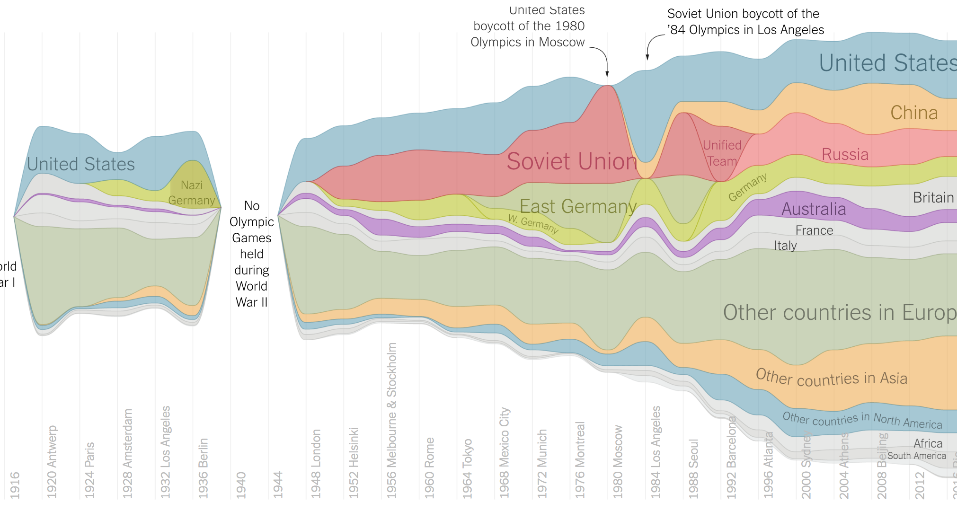
Olympic Medals
https://www.nytimes.com/interactive/2016/08/08/sports/olympics/history-olympic-dominance-charts.html

Slide 42
Netflix Prize I
Recommender systems: predict a user’s rating of an item
Netflix Prize: $1MM to the first team that beats our in-house engine by 10%
Happened after about three years
Model was never used by Netflix for a variety of reasons
  Out of date (DVDs vs streaming)
  Too complicated / not interpretable
 | Twilight | Wall-E | Twilight II | Furious 7
User 1 | +1 | -1 | +1 | ?
User 2 | +1 | -1 | ? | ?
User 3 | -1 | +1 | -1 | +1

Slide 43
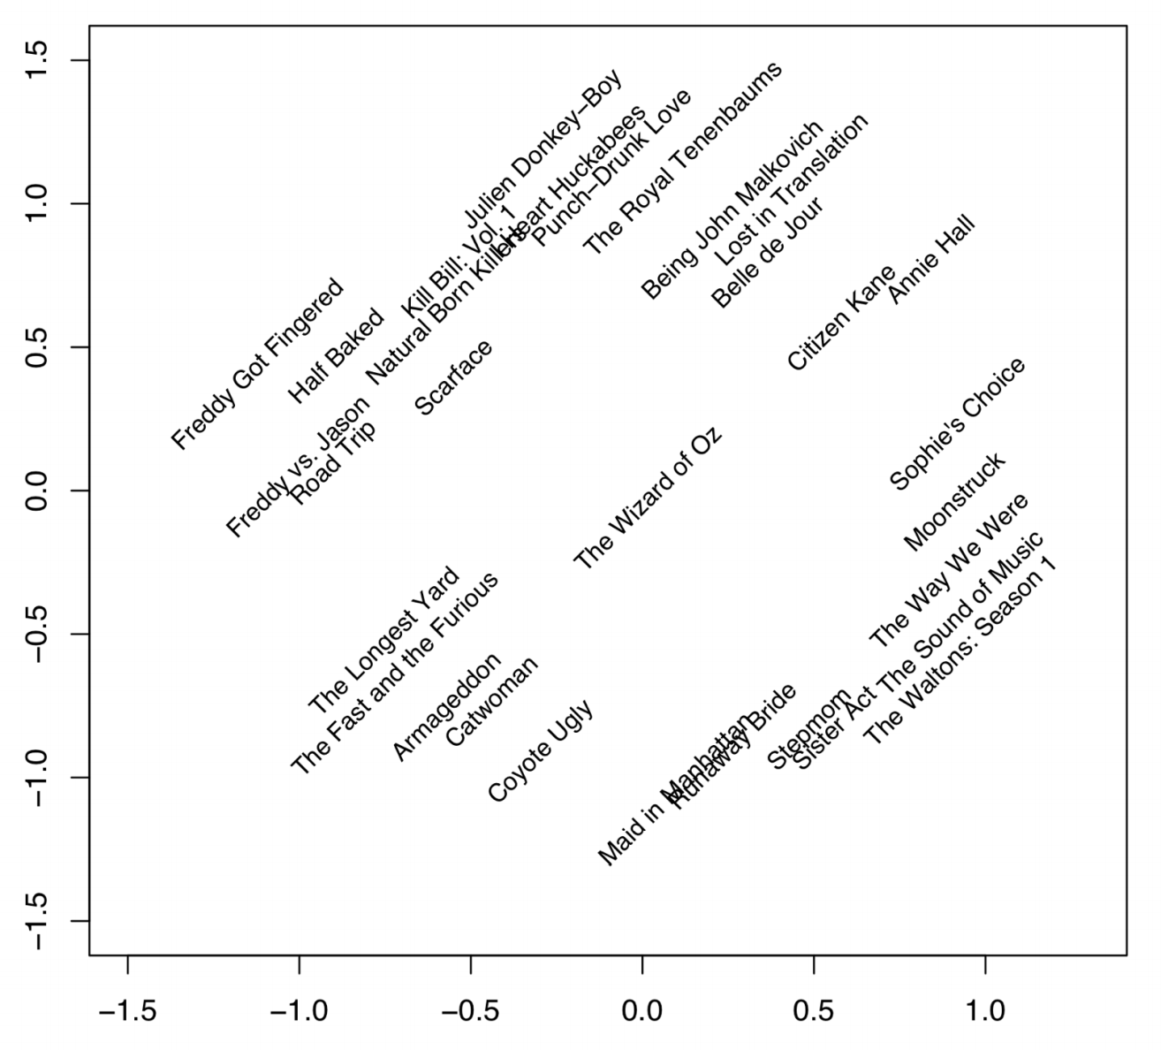
Netflix Prize II
Frat/Gross-Out Comedy
Critically-Acclaimed/Strong Female Lead
Artsy
Latent factors model:
Identify factors with max discrimination between movies
Latent factor 1
BB
Latent factor 2
Image courtesy of Christopher Volinsky

Slide 44
Netflix Prize III
Netflix initially planned a follow-up competition
In 2007, UT Austin managed to deanonymize portions of the original released (anonymized) Netflix dataset:
????????????
Matched rating against those made publicly on IMDb
Why could this be bad?
2009—2010, four Netflix users filed a class-action lawsuit against Netflix over

Slide 45
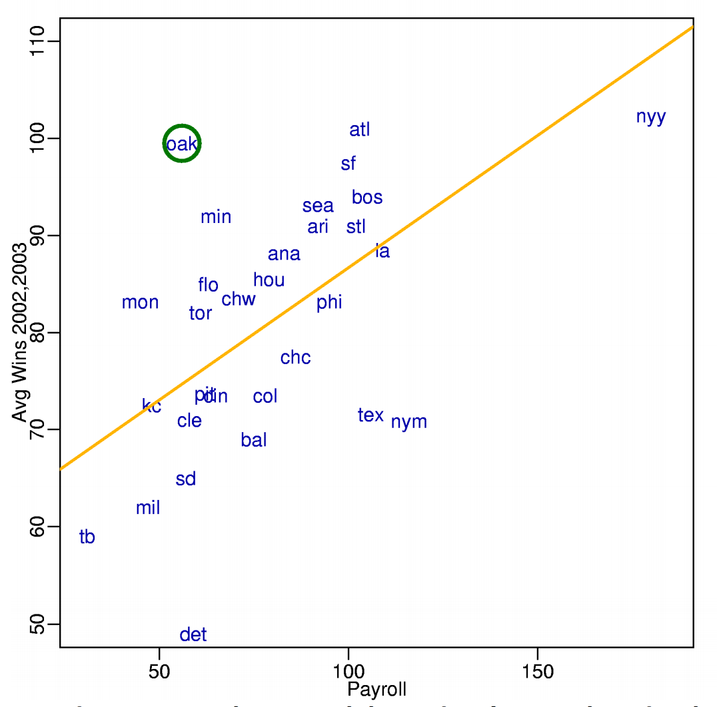
MoneyBall
Baseball teams drafted rookie players primarily based on human scouts’ opinions of their talents
Peter Brand, data scientist du jour, convinces the {bad, poor} Oakland Athletics to use a quantitative aka sabermetric approach to hiring
(Spoiler: Red Sox offer Brand a job, he says no, they take a sabermetric approach and win the World Series.)
Notes:
“Sabermetrics” = “SABR” = “Society for American Baseball Research”

Slide 46
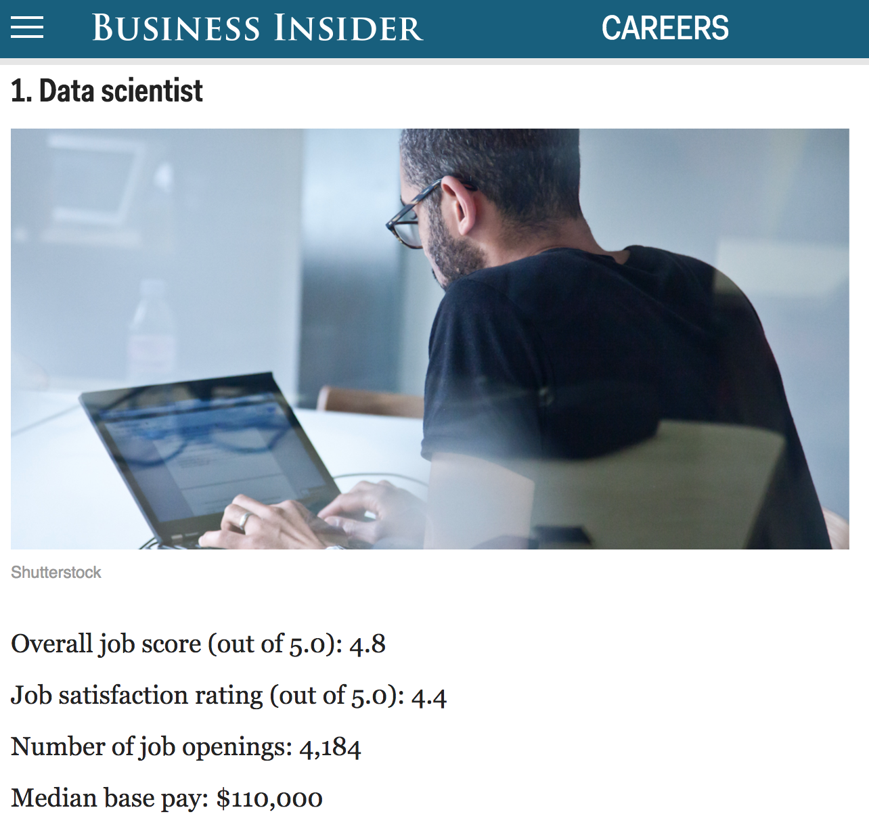
http://www.businessinsider.com/best-jobs-in-america-in-2017-2017-1/

Slide 47
Wrap-Up For Part I
Register on Piazza using your UMD address:
piazza.com/umd/fall2018/cmsc641
Please chat with me if you’re unsure of whether or not you’re at the right {programming, math} level for this course:
My guess is that you are!
This is a young class, so we’re quite flexible
Read about Docker & Jupyter!
Works on *nix, OSX, Windows
https://www.docker.com/
(We’ll post a small project shortly.)

Slide 48
After the break:
Scraping Data With Python

Slide 49
The Data Lifecycle
Data collection
Data processing
Exploratory analysis
&
Data viz
Analysis, hypothesis testing, & ML
Insight & Policy Decision

Slide 50
Today’s Lecture
Data collection
Data processing
Exploratory analysis
&
Data viz
Analysis, hypothesis testing, & ML
Insight & Policy Decision

Slide 51
But first, snakes!
Python is an interpreted, dynamically-typed, high-level, garbage-collected, object-oriented-functional-imperative, and widely used scripting language.
Interpreted: instructions executed without being compiled into (virtual) machine instructions*
Dynamically-typed: verifies type safety at runtime
High-level: abstracted away from the raw metal and kernel
Garbage-collected: memory management is automated
OOFI: you can do bits of OO, F, and I programming
Not the point of this class!
Python is fast (developer time), intuitive, and used in industry!
*you can compile Python source, but it’s not required

Slide 52
The Zen of Python
Beautiful is better than ugly.
Explicit is better than implicit.
Simple is better than complex.
Complex is better than complicated.
Flat is better than nested.
Sparse is better than dense.
Readability counts.
Special cases aren't special enough to break the rules …
… although practicality beats purity.
Errors should never pass silently …
… unless explicitly silenced.
Thanks: SDSMT ACM/LUG

Slide 53
Literate Programming
Literate code contains in one document:
the source code;
text explanation of the code; and
the end result of running the code.
Basic idea: present code in the order that logic and flow of human thoughts demand, not the machine-needed ordering
Necessary for data science!
Many choices made need textual explanation, ditto results.
Stuff you’ll be using in Project 0 (and beyond)!

Slide 54
10-minute Python primer
Define a function:
Python is whitespace-delimited
Define a function that returns a tuple:
def my_func(x, y):
if x > y:
return x
else:
return y
def my_func(x, y):
return (x-1, y+2)
(a, b) = my_func(1, 2)
a = 0; b = 4

Slide 55
Useful Built-in Functions: Counting and Iterating
len: returns the number of items of an enumerable object
range: returns an iterable object
enumerate: returns iterable tuple (index, element) of a list
https://docs.python.org/3/library/functions.html
len( [‘c’, ‘m’, ‘s’, ‘c’, 3, 2, 0] )
7
list( range(10) )
[0, 1, 2, 3, 4, 5, 6, 7, 8, 9]
enumerate( [“311”, “320”, “330”] )
[(0, “311”), (1, “320”), (2, “330”)]
Notes:
do demo

Slide 56
Useful Built-In Functions: Map and Filter
map: apply a function to a sequence or iterable
filter: returns a list of elements for which a predicate is true
We’ll go over in much greater depth with pandas/numpy.
arr = [1, 2, 3, 4, 5]
map(lambda x: x**2, arr)
[1, 4, 9, 16, 25]
arr = [1, 2, 3, 4, 5, 6, 7]
filter(lambda x: x % 2 == 0, arr)
[2, 4, 6]

Slide 57
Pythonic Programming
Basic iteration over an array in Java:
Direct translation into Python:
A more “Pythonic” way of iterating:
int[] arr = new int[10];
for(int idx=0; idx<arr.length; ++idx) {
System.out.println( arr[idx] );
}
idx = 0
while idx < len(arr):
print( arr[idx] ); idx += 1
for element in arr:
print( element )

Slide 58
List comprehensions
Construct sets like a mathematician!
P = { 1, 2, 4, 8, 16, …, 2¹⁶ }
E = { x | x in ℕ and x is odd and x < 1000 }
Construct lists like a mathematician who codes!
Very similar to map, but:
You’ll see these way more than map in the wild
Many people consider map/filter not “pythonic”
They can perform differently (map is “lazier”)
P = [ 2**x for x in range(17) ]
E = [ x for x in range(1000) if x % 2 != 0 ]

Slide 59
Exceptions
Syntactically correct statement throws an exception:
tweepy (Python Twitter API) returns “Rate limit exceeded”
sqlite (a file-based database) returns IntegrityError
print('Python', python_version())
try:
cause_a_NameError
except NameError as err:
print(err, '-> some extra text')

Slide 60
Python 2 vs 3
Python 3 is intentionally backwards incompatible
(But not that incompatible)
Biggest changes that matter for us:
print “statement” → print(“function”)
1/2 = 0 → 1/2 = 0.5 and 1//2 = 0
ASCII str default → default Unicode
Namespace ambiguity fixed:
i = 1
[i for i in range(5)]
print(i) # ????????
Notes:
Prints “4” in Python 2 and “1” (i.e., unchanged because the list comprehension scope is dead) in Python 3.

Slide 61
To any Curmudgeons …
If you’re going to use Python 2 anyway, use the _future_ module:
Python 3 introduces features that will throw runtime errors in Python 2 (e.g., with statements)
_future_ module incrementally brings 3 functionality into 2
https://docs.python.org/2/library/__future__.html
from _future_ import division
from _future_ import print_function
from _future_ import please_just_use_python_3

Slide 62
Python vS R (For Data Scientists)
There is no right answer here!
Python is a “full” programming language – easier to integrate with systems in the field
R has a more mature set of pure stats libraries …
… but Python is catching up quickly …
… and is already ahead specifically for ML.
You will see Python more in the tech industry.

Slide 63
Extra resources
Plenty of tutorials on the web:
https://www.learnpython.org/
Work through Project 0, which will take you through some baby steps with Python and the Pandas library:
(We’ll also post some readings soon.)
Come hang out at office hours (or chat with me privately)
Office hours will be on the website/Piazza very soon.
Also, email me – I realize your schedules are not like undergrads’ schedules ☺.

Slide 65
Today’s Lecture
Data collection
Data processing
Exploratory analysis
&
Data viz
Analysis, hypothesis testing, & ML
Insight & Policy Decision
with
Thanks: Zico Kolter’s 15-388

Slide 66
GotTa Catch ‘Em All
Five ways to get data:
Direct download and load from local storage
Generate locally via downloaded code (e.g., simulation)
Query data from a database (covered in a few lectures)
Query an API from the intra/internet
Scrape data from a webpage
Covered today.

Slide 67
Wherefore art thou, API?
A web-based Application Programming Interface (API) like we’ll be using in this class is a contract between a server and a user stating:
“If you send me a specific request, I will return some information in a structured and documented format.”
(More generally, APIs can also perform actions, may not be web-based, be a set of protocols for communicating between processes, between an application and an OS, etc.)
Notes:
”Wherefore” means “why”, not “where”!

Slide 68
“Send me a specific request”
Most web API queries we’ll be doing will use HTTP requests:
conda install –c anaconda requests=2.12.4
r = requests.get( 'https://api.github.com/user', auth=('user', 'pass') )
r.status_code
200
r.headers[‘content-type’]
‘application/json; charset=utf8’
r.json()
{u'private_gists': 419, u'total_private_repos': 77, ...}
http://docs.python-requests.org/en/master/

Slide 69
HTTP Requests
https://www.google.com/?q=cmsc320&tbs=qdr:m
HTTP GET Request:
GET /?q=cmsc320&tbs=qdr:m HTTP/1.1
Host: www.google.com
User-Agent: Mozilla/5.0 (X11; Linux x86_64; rv:10.0.1) Gecko/20100101 Firefox/10.0.1
??????????
params = { “q”: “cmsc320”, “tbs”: “qdr:m” }
r = requests.get( “https://www.google.com”,
params = params )
*be careful with https:// calls; requests will not verify SSL by default

Slide 70
Restful APIs
This class will just query web APIs, but full web APIs typically allow more.
Representational State Transfer (RESTful) APIs:
GET: perform query, return data
POST: create a new entry or object
PUT: update an existing entry or object
DELETE: delete an existing entry or object
Can be more intricate, but verbs (“put”) align with actions

Slide 71
Querying a Restful API
Stateless: with every request, you send along a token/authentication of who you are
GitHub is more than a GETHub:
PUT/POST/DELETE can edit your repositories, etc.
Try it out: https://github.com/settings/tokens/new
token = ”super_secret_token”
r = requests.get(“https://github.com/user”,
params={”access_token”: token})
print( r.content )
{"login":”JohnDickerson","id":472985,"avatar_url":"ht…

Slide 72
Authentication and OAuth
Old and busted:
New hotness:
What if I wanted to grant an app access to, e.g., my Facebook account without giving that app my password?
OAuth: grants access tokens that give (possibly incomplete) access to a user or app without exposing a password
r = requests.get(“https://api.github.com/user”,
auth=(“JohnDickerson”, “ILoveKittens”))

Slide 73
“… I will return information in a structured format.”
So we’ve queried a server using a well-formed GET request via the requests Python module. What comes back?
General structured data:
Comma-Separated Value (CSV) files & strings
Javascript Object Notation (JSON) files & strings
HTML, XHTML, XML files & strings
Domain-specific structured data:
Shapefiles: geospatial vector data (OpenStreetMap)
RVT files: architectural planning (Autodesk Revit)
You can make up your own! Always document it.

Slide 74
CSV Files in Python
Any CSV reader worth anything can parse files with any delimiter, not just a comma (e.g., “TSV” for tab-separated)
1,26-Jan,Introduction,—,"pdf, pptx",Dickerson,
2,31-Jan,Scraping Data with Python,Anaconda's Test Drive.,,Dickerson,
3,2-Feb,"Vectors, Matrices, and Dataframes",Introduction to pandas.,,Dickerson,
4,7-Feb,Jupyter notebook lab,,,"Denis, Anant, & Neil",
5,9-Feb,Best Practices for Data Science Projects,,,Dickerson,
Don’t write your own CSV or JSON parser
(We’ll use pandas to do this much more easily and efficiently)
import csv
with open(“schedule.csv”, ”rb”) as f:
reader = csv.reader(f, delimiter=“,”, quotechar=’”’)
for row in reader:
print(row)

Slide 75
JSON Files & Strings
JSON is a method for serializing objects:
Convert an object into a string (done in Java in 131/132?)
Deserialization converts a string back to an object
Easy for humans to read (and sanity check, edit)
Defined by three universal data structures
Python dictionary, Java Map, hash table, etc …
Python list, Java array, vector, etc …
Python string, float, int, boolean, JSON object, JSON array, …
Images from: http://www.json.org/

Slide 76
JSON In Python
Some built-in types: “Strings”, 1.0, True, False, None
Lists: [“Goodbye”, “Cruel”, “World”]
Dictionaries: {“hello”: “bonjour”, “goodbye”, “au revoir”}
Dictionaries within lists within dictionaries within lists:
[1, 2, {“Help”:[
“I’m”, {“trapped”: “in”},
“CMSC641”
]}]

Slide 77
JSON From Twitter
GET https://api.twitter.com/1.1/friends/list.json?cursor=-1&screen_name=twitterapi&skip_status=true&include_user_entities=false
{
"previous_cursor": 0,
"previous_cursor_str": "0",
"next_cursor": 1333504313713126852,
"users": [{
"profile_sidebar_fill_color": "252429",
"profile_sidebar_border_color": "181A1E",
"profile_background_tile": false,
"name": "Sylvain Carle",
"profile_image_url": "http://a0.twimg.com/profile_images/2838630046/4b82e286a659fae310012520f4f756bb_normal.png",
"created_at": "Thu Jan 18 00:10:45 +0000 2007", …

Slide 78
Parsing JSON In Python
Repeat: don’t write your own CSV or JSON parser
https://news.ycombinator.com/item?id=7796268
rsdy.github.io/posts/dont_write_your_json_parser_plz.html
Python comes with a fine JSON parser
import json
r = requests.get( “https://api.twitter.com/1.1/statuses/user_timeline.json?screen_name=JohnPDickerson&count=100”, auth=auth )
data = json.loads(r.content)
json.load(some_file) # loads JSON from a file
json.dump(json_obj, some_file) # writes JSON to file
json.dumps(json_obj) # returns JSON string

Slide 79
XML, XHTML, HTML files and Strings
Still hugely popular online, but JSON has essentially replaced XML for:
Asynchronous browser ←→ server calls
Many (most?) newer web APIs
XML is a hierarchical markup language:
<tag attribute=“value1”>
<subtag>
Some cool words or values go here!
</subtag>
<openclosetag attribute=“value2” />
</tag>
You probably won’t see much XML, but you will see plenty of HTML, its substantially less well-behaved cousin …

Slide 80
Document Object Model (DOM)

Slide 81
Scraping HTML in Python
HTML – the specification – is fairly pure
HTML – what you find on the web – is horrifying
We’ll use BeautifulSoup:
conda install -c asmeurer beautiful-soup=4.3.2
import requests
from bs4 import BeautifulSoup
r = requests.get( “https://cs.umd.edu/class/spring2017/cmsc320/” )
root = BeautifulSoup( r.content )
root.find(“div”, id=“schedule”)\
.find(“table”)\ # find all schedule
.find(“tbody”).findAll(“a”) # links for CMSC320

Slide 82
Building a web scraper in python
Totally not hypothetical situation:
You really want to learn about data science, so you choose to download all of last semester’s CMSC320 lecture slides to wallpaper your room …
… but you now have carpal tunnel syndrome from clicking refresh on Piazza last night, and can no longer click on the PDF and PPTX links.
Hopeless? No! Earlier, you built a scraper to do this!
Sort of. You only want PDF and PPTX files, not links to other websites or files.
lnks = root.find(“div”, id=“schedule”)\
.find(“table”)\ # find all schedule
.find(“tbody”).findAll(“a”) # links for CMSC320

Slide 83
Regular Expressions
Given a list of URLs (strings), how do I find only those strings that end in *.pdf or *.pptx?
Regular expressions!
(Actually Python strings come with a built-in endswith function.)
What about .pDf or .pPTx, still legal extensions for PDF/PPTX?
Regular expressions!
(Or cheat the system again: built-in string lower function.)
“this_is_a_filename.pdf”.endswith((“.pdf”, “.pptx”))
“tHiS_IS_a_FileNAme.pDF”.lower().endswith(
(“.pdf”, “.pptx”))

Slide 84
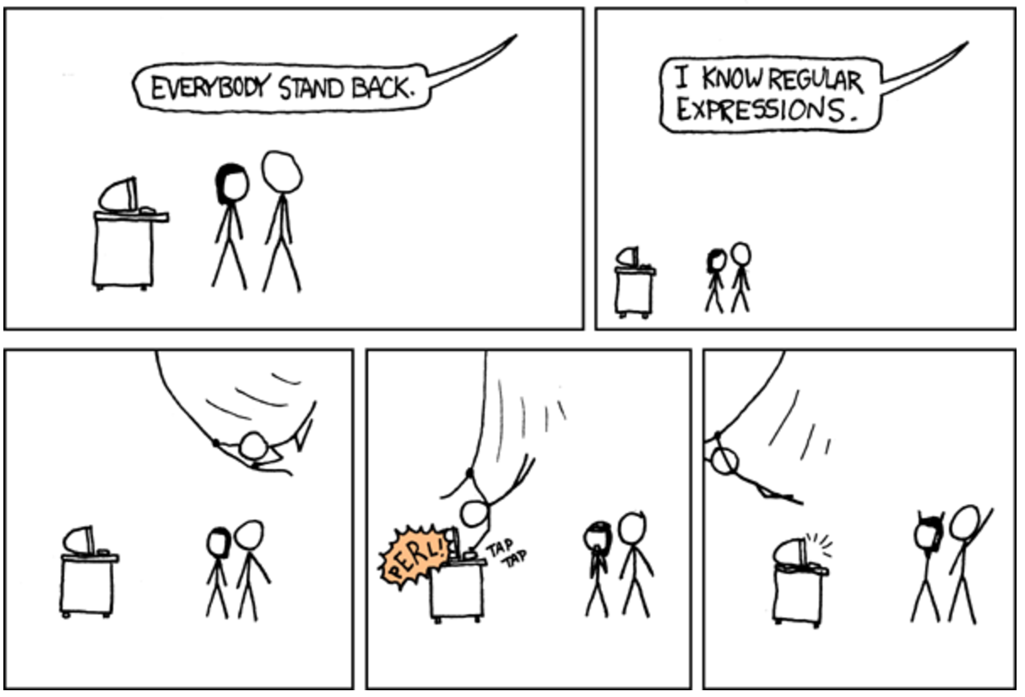

Slide 85
Regular Expressions
Used to search for specific elements, or groups of elements, that match a pattern
import re
# Find the index of the 1st occurrence of “cmsc641”
match = re.search(r”cmsc641”, text)
print( match.start() )
# Does start of text match “cmsc641”?
match = re.match(r”cmsc641”, text)
# Iterate over all matches for “cmsc641” in text
for match in re.finditer(r”cmsc641”, text):
print( match.start() )
# Return all matches of “cmsc641” in the text
match = re.findall(r”cmsc641”, text)

Slide 86
Matching Multiple Characters
Can match sets of characters, or multiple and more elaborate sets and sequences of characters:
Match the character ‘a’: a
Match the character ‘a’, ‘b’, or ‘c’: [abc]
Match any character except ‘a’, ‘b’, or ‘c’: [^abc]
Match any digit: \d (= [0123456789] or [0-9])
Match any alphanumeric: \w (= [a-zA-Z0-9_])
Match any whitespace: \s (= [ \t\n\r\f\v])
Match any character: .
Special characters must be escaped: .^$*+?{}\[]|()

Slide 87
Matching sequences and repeated characters
A few common modifiers (available in Python and most other high-level languages; +, {n}, {n,} may not):
Match character ‘a’ exactly once: a
Match character ‘a’ zero or once: a?
Match character ‘a’ zero or more times: a*
Match character ‘a’ one or more times: a+
Match character ‘a’ exactly n times: a{n}
Match character ‘a’ at least n times: a{n,}
Example: match all instances of “University of <somewhere>” where <somewhere> is an alphanumeric string with at least 3 characters:
\s*University\sof\s\w{3,}

Slide 88
Compiled Regexes
If you’re going to reuse the same regex many times, or if you aren’t but things are going slowly for some reason, try compiling the regular expression.
https://blog.codinghorror.com/to-compile-or-not-to-compile/
Interested? CMSC6*, CMSC7*, CMSC8*, talk to me.
# Compile the regular expression “cmsc320”
regex = re.compile(r”cmsc320”)
# Use it repeatedly to search for matches in text
regex.match( text ) # does start of text match?
regex.search( text ) # find the first match or None
regex.findall( text ) # find all matches

Slide 89
Downloading a bunch of files
Import the modules
import re
import requests
from bs4 import BeautifulSoup
try:
from urllib.parse import urlparse
except ImportError:
from urlparse import urlparse
Get some HTML via HTTP
# HTTP GET request sent to the URL url
r = requests.get( url )
# Use BeautifulSoup to parse the GET response
root = BeautifulSoup( r.content )
lnks = root.find("div", id="schedule")\
.find("table")\
.find("tbody").findAll("a")

Slide 90
Downloading a bunch of files
Parse exactly what you want
# Cycle through the href for each anchor, checking
# to see if it's a PDF/PPTX link or not
for lnk in lnks:
href = lnk['href']
# If it's a PDF/PPTX link, queue a download
if href.lower().endswith(('.pdf', '.pptx')):
Get some more data?!
urld = urlparse.urljoin(url, href)
rd = requests.get(urld, stream=True)
# Write the downloaded PDF to a file
outfile = path.join(outbase, href)
with open(outfile, 'wb') as f:
f.write(rd.content)

Slide 91
Next Lecture
Data collection
Data processing
Exploratory analysis
&
Data viz
Analysis, hypothesis testing, & ML
Insight & Policy Decision

Slide 92
Next Class:
NumPy, Scipy, And DataFrames

