Slide 1
Principles of
Data Science
John P Dickerson
Lecture #2 – 9/5/2018
CMSC641
Wednesdays
7pm – 9:30pm

Slide 2
Announcements
Register on Piazza: piazza.com/umd/fall2018/cmsc641
I am a hypocrite! Somehow wasn’t getting notifications – I will be much more responsive from here on out.
Office Hours: 6pm-7pm on Wednesdays, and also by appointment, or via email/text, or …
Reminder: Weekly quizzes, due on Mondays at noon (except first one that was due today)
Project 1 will be released soon (early next week)

Slide 3
The Data Lifecycle
Data collection
Data processing
Exploratory analysis
&
Data viz
Analysis, hypothesis testing, & ML
Insight & Policy Decision

Slide 4
Today’s Lecture
Data collection
Data processing
Exploratory analysis
&
Data viz
Analysis, hypothesis testing, & ML
Insight & Policy Decision

Slide 5
But first, snakes!
Python is an interpreted, dynamically-typed, high-level, garbage-collected, object-oriented-functional-imperative, and widely used scripting language.
Interpreted: instructions executed without being compiled into (virtual) machine instructions*
Dynamically-typed: verifies type safety at runtime
High-level: abstracted away from the raw metal and kernel
Garbage-collected: memory management is automated
OOFI: you can do bits of OO, F, and I programming
Not the point of this class!
Python is fast (developer time), intuitive, and used in industry!
*you can compile Python source, but it’s not required

Slide 6
The Zen of Python
Beautiful is better than ugly.
Explicit is better than implicit.
Simple is better than complex.
Complex is better than complicated.
Flat is better than nested.
Sparse is better than dense.
Readability counts.
Special cases aren't special enough to break the rules …
… although practicality beats purity.
Errors should never pass silently …
… unless explicitly silenced.
Thanks: SDSMT ACM/LUG

Slide 7
Literate Programming
Literate code contains in one document:
the source code;
text explanation of the code; and
the end result of running the code.
Basic idea: present code in the order that logic and flow of human thoughts demand, not the machine-needed ordering
Necessary for data science!
Many choices made need textual explanation, ditto results.
Stuff you’ll be using in Project 1 (and beyond)!

Slide 8
Jupyter Project
Started as iPython Notebooks, a web-based frontend to the iPython Shell
  Notebook functionality separated out a few years ago
  Now supports over 40 languages/kernels
  Notebooks can be shared easily
  Can leverage big data tools like Spark
Apache Zeppelin:
  https://www.linkedin.com/pulse/comprehensive-comparison-jupyter-vs-zeppelin-hoc-q-phan-mba-
Several others including RStudio (specific to R)

Slide 9
10-minute Python primer
Define a function:
Python is whitespace-delimited
Define a function that returns a tuple:
def my_func(x, y):
if x > y:
return x
else:
return y
def my_func(x, y):
return (x-1, y+2)
(a, b) = my_func(1, 2)
a = 0; b = 4

Slide 10
Useful Built-in Functions: Counting and Iterating
len: returns the number of items of an enumerable object
range: returns an iterable object
enumerate: returns iterable tuple (index, element) of a list
https://docs.python.org/3/library/functions.html
len( [‘c’, ‘m’, ‘s’, ‘c’, 3, 2, 0] )
7
list( range(10) )
[0, 1, 2, 3, 4, 5, 6, 7, 8, 9]
enumerate( [“311”, “320”, “330”] )
[(0, “311”), (1, “320”), (2, “330”)]
Notes:
do demo

Slide 11
Useful Built-In Functions: Map and Filter
map: apply a function to a sequence or iterable
filter: returns a list of elements for which a predicate is true
We’ll go over in much greater depth with pandas/numpy.
arr = [1, 2, 3, 4, 5]
map(lambda x: x**2, arr)
[1, 4, 9, 16, 25]
arr = [1, 2, 3, 4, 5, 6, 7]
filter(lambda x: x % 2 == 0, arr)
[2, 4, 6]

Slide 12
Pythonic Programming
Basic iteration over an array in Java:
Direct translation into Python:
A more “Pythonic” way of iterating:
int[] arr = new int[10];
for(int idx=0; idx<arr.length; ++idx) {
System.out.println( arr[idx] );
}
idx = 0
while idx < len(arr):
print( arr[idx] ); idx += 1
for element in arr:
print( element )

Slide 13
List comprehensions
Construct sets like a mathematician!
P = { 1, 2, 4, 8, 16, …, 2¹⁶ }
E = { x | x in ℕ and x is odd and x < 1000 }
Construct lists like a mathematician who codes!
Very similar to map, but:
You’ll see these way more than map in the wild
Many people consider map/filter not “pythonic”
They can perform differently (map is “lazier”)
P = [ 2**x for x in range(17) ]
E = [ x for x in range(1000) if x % 2 != 0 ]

Slide 14
Exceptions
Syntactically correct statement throws an exception:
tweepy (Python Twitter API) returns “Rate limit exceeded”
sqlite (a file-based database) returns IntegrityError
print('Python', python_version())
try:
cause_a_NameError
except NameError as err:
print(err, '-> some extra text')

Slide 15
Python 2 vs 3
Python 3 is intentionally backwards incompatible
(But not that incompatible)
Biggest changes that matter for us:
print “statement” → print(“function”)
1/2 = 0 → 1/2 = 0.5 and 1//2 = 0
ASCII str default → default Unicode
Namespace ambiguity fixed:
i = 1
[i for i in range(5)]
print(i) # ????????
Notes:
Prints “4” in Python 2 and “1” (i.e., unchanged because the list comprehension scope is dead) in Python 3.

Slide 16
To any Curmudgeons …
If you’re going to use Python 2 anyway, use the _future_ module:
Python 3 introduces features that will throw runtime errors in Python 2 (e.g., with statements)
_future_ module incrementally brings 3 functionality into 2
https://docs.python.org/2/library/__future__.html
from _future_ import division
from _future_ import print_function
from _future_ import please_just_use_python_3

Slide 17
Python vS R (For Data Scientists)
There is no right answer here!
Python is a “full” programming language – easier to integrate with systems in the field
R has a more mature set of pure stats libraries …
… but Python is catching up quickly …
… and is already ahead specifically for ML.
You will see Python more in the tech industry.

Slide 18
Extra resources
Plenty of tutorials on the web:
https://www.learnpython.org/
Come hang out at office hours (or chat with me privately)
Office hours are on the website/Piazza very soon.
Also, email me – I realize your schedules are not like undergrads’ schedules ☺.

Slide 20
Today’s Lecture
Data collection
Data processing
Exploratory analysis
&
Data viz
Analysis, hypothesis testing, & ML
Insight & Policy Decision
with

Slide 21
GotTa Catch ‘Em All
Five ways to get data:
Direct download and load from local storage
Generate locally via downloaded code (e.g., simulation)
Query data from a database (covered in a few lectures)
Query an API from the intra/internet
Scrape data from a webpage
Covered today.

Slide 22
Wherefore art thou, API?
A web-based Application Programming Interface (API) like we’ll be using in this class is a contract between a server and a user stating:
“If you send me a specific request, I will return some information in a structured and documented format.”
(More generally, APIs can also perform actions, may not be web-based, be a set of protocols for communicating between processes, between an application and an OS, etc.)
Notes:
”Wherefore” means “why”, not “where”!

Slide 23
“Send me a specific request”
Most web API queries we’ll be doing will use HTTP requests:
conda install –c anaconda requests=2.12.4
r = requests.get( 'https://api.github.com/user', auth=('user', 'pass') )
r.status_code
200
r.headers[‘content-type’]
‘application/json; charset=utf8’
r.json()
{u'private_gists': 419, u'total_private_repos': 77, ...}
http://docs.python-requests.org/en/master/

Slide 24
HTTP Requests
https://www.google.com/?q=cmsc641&tbs=qdr:m
HTTP GET Request:
GET /?q=cmsc641&tbs=qdr:m HTTP/1.1
Host: www.google.com
User-Agent: Mozilla/5.0 (X11; Linux x86_64; rv:10.0.1) Gecko/20100101 Firefox/10.0.1
??????????
params = { “q”: “cmsc641”, “tbs”: “qdr:m” }
r = requests.get( “https://www.google.com”,
params = params )
*be careful with https:// calls; requests will not verify SSL by default

Slide 25
Restful APIs
This class will just query web APIs, but full web APIs typically allow more.
Representational State Transfer (RESTful) APIs:
GET: perform query, return data
POST: create a new entry or object
PUT: update an existing entry or object
DELETE: delete an existing entry or object
Can be more intricate, but verbs (“put”) align with actions

Slide 26
Querying a Restful API
Stateless: with every request, you send along a token/authentication of who you are
GitHub is more than a GETHub:
PUT/POST/DELETE can edit your repositories, etc.
Try it out: https://github.com/settings/tokens/new
token = ”super_secret_token”
r = requests.get(“https://github.com/user”,
params={”access_token”: token})
print( r.content )
{"login":”JohnDickerson","id":472985,"avatar_url":"ht…

Slide 27
Authentication and OAuth
Old and busted:
New hotness:
What if I wanted to grant an app access to, e.g., my Facebook account without giving that app my password?
OAuth: grants access tokens that give (possibly incomplete) access to a user or app without exposing a password
r = requests.get(“https://api.github.com/user”,
auth=(“JohnDickerson”, “ILoveKittens”))

Slide 28
“… I will return information in a structured format.”
So we’ve queried a server using a well-formed GET request via the requests Python module. What comes back?
General structured data:
Comma-Separated Value (CSV) files & strings
Javascript Object Notation (JSON) files & strings
HTML, XHTML, XML files & strings
Domain-specific structured data:
Shapefiles: geospatial vector data (OpenStreetMap)
RVT files: architectural planning (Autodesk Revit)
You can make up your own! Always document it.

Slide 29
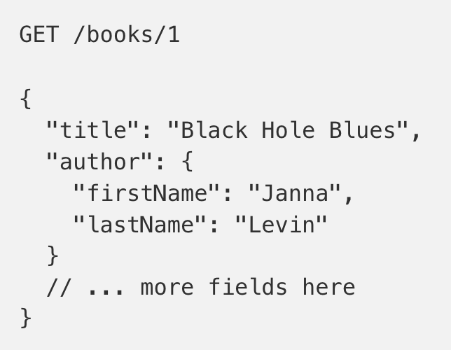
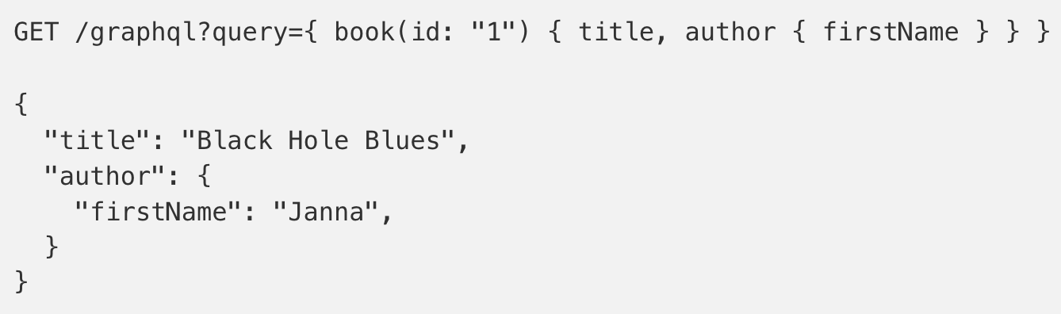
GraphQL?
An alternative to REST and ad-hoc webservice architectures
  Developed internally by Facebook and released publicly
Unlike REST, the requester specifies the format of the response
https://dev-blog.apollodata.com/graphql-vs-rest-5d425123e34b

Slide 30
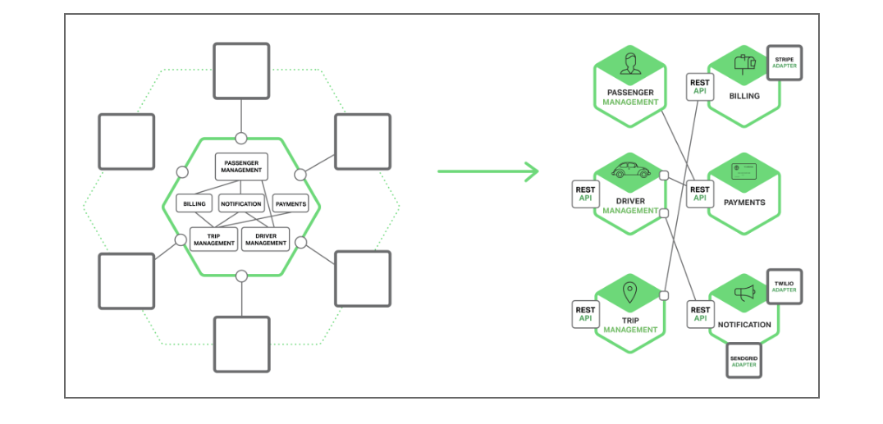
APIs and Microservices
Use of APIs growing rapidly, especially because of increasing trend towards “microservices”
OpenAPI (Swagger) Specification emerging as a standard for exposing APIs

Slide 31
CSV Files in Python
Any CSV reader worth anything can parse files with any delimiter, not just a comma (e.g., “TSV” for tab-separated)
1,26-Jan,Introduction,—,"pdf, pptx",Dickerson,
2,31-Jan,Scraping Data with Python,Anaconda's Test Drive.,,Dickerson,
3,2-Feb,"Vectors, Matrices, and Dataframes",Introduction to pandas.,,Dickerson,
4,7-Feb,Jupyter notebook lab,,,"Denis, Anant, & Neil",
5,9-Feb,Best Practices for Data Science Projects,,,Dickerson,
Don’t write your own CSV or JSON parser
(We’ll use pandas to do this much more easily and efficiently)
import csv
with open(“schedule.csv”, ”rb”) as f:
reader = csv.reader(f, delimiter=“,”, quotechar=’”’)
for row in reader:
print(row)

Slide 32
JSON Files & Strings
JSON is a method for serializing objects:
Convert object into a string (Java: “implements Serializable”)
Deserialization converts a string back to an object
Easy for humans to read (and sanity check, edit)
Defined by three universal data structures
Python dictionary, Java Map, hash table, etc …
Python list, Java array, vector, etc …
Python string, float, int, boolean, JSON object, JSON array, …
Images from: http://www.json.org/

Slide 33
JSON In Python
Some built-in types: “Strings”, 1.0, True, False, None
Lists: [“Goodbye”, “Cruel”, “World”]
Dictionaries: {“hello”: “bonjour”, “goodbye”, “au revoir”}
Dictionaries within lists within dictionaries within lists:
[1, 2, {“Help”:[
“I’m”, {“trapped”: “in”},
“CMSC641”
]}]

Slide 34
JSON From Twitter
GET https://api.twitter.com/1.1/friends/list.json?cursor=-1&screen_name=twitterapi&skip_status=true&include_user_entities=false
{
"previous_cursor": 0,
"previous_cursor_str": "0",
"next_cursor": 1333504313713126852,
"users": [{
"profile_sidebar_fill_color": "252429",
"profile_sidebar_border_color": "181A1E",
"profile_background_tile": false,
"name": "Sylvain Carle",
"profile_image_url": "http://a0.twimg.com/profile_images/2838630046/4b82e286a659fae310012520f4f756bb_normal.png",
"created_at": "Thu Jan 18 00:10:45 +0000 2007", …

Slide 35
Parsing JSON In Python
Repeat: don’t write your own CSV or JSON parser
https://news.ycombinator.com/item?id=7796268
rsdy.github.io/posts/dont_write_your_json_parser_plz.html
Python comes with a fine JSON parser
import json
r = requests.get( “https://api.twitter.com/1.1/statuses/user_timeline.json?screen_name=JohnPDickerson&count=100”, auth=auth )
data = json.loads(r.content)
json.load(some_file) # loads JSON from a file
json.dump(json_obj, some_file) # writes JSON to file
json.dumps(json_obj) # returns JSON string

Slide 36
XML, XHTML, HTML files and Strings
Still hugely popular online, but JSON has essentially replaced XML for:
Asynchronous browser ←→ server calls
Many (most?) newer web APIs
XML is a hierarchical markup language:
<tag attribute=“value1”>
<subtag>
Some cool words or values go here!
</subtag>
<openclosetag attribute=“value2” />
</tag>
You probably won’t see much XML, but you will see plenty of HTML, its substantially less well-behaved cousin …

Slide 37
Document Object Model (DOM)

Slide 38
Scraping HTML in Python
HTML – the specification – is fairly pure
HTML – what you find on the web – is horrifying
We’ll use BeautifulSoup:
conda install -c asmeurer beautiful-soup=4.3.2
import requests
from bs4 import BeautifulSoup
r = requests.get( “https://cs.umd.edu/class/fall2018/cmsc641/” )
root = BeautifulSoup( r.content )
root.find(“div”, id=“schedule”)\
.find(“table”)\ # find all schedule
.find(“tbody”).findAll(“a”) # links for CMSC641

Slide 39
Building a web scraper in python
Totally not hypothetical situation:
You really want to learn about data science, so you choose to download all of this year’s CMSC641 lecture slides to wallpaper your room …
… but you now have carpal tunnel syndrome from clicking refresh on Piazza last night, and can no longer click on the PDF and PPTX links.
Hopeless? No! Earlier, you built a scraper to do this!
Sort of. You only want PDF and PPTX files, not links to other websites or files.
lnks = root.find(“div”, id=“schedule”)\
.find(“table”)\ # find all schedule
.find(“tbody”).findAll(“a”) # links for CMSC641

Slide 40
Regular Expressions
Given a list of URLs (strings), how do I find only those strings that end in *.pdf or *.pptx?
Regular expressions!
(Actually Python strings come with a built-in endswith function.)
What about .pDf or .pPTx, still legal extensions for PDF/PPTX?
Regular expressions!
(Or cheat the system again: built-in string lower function.)
“this_is_a_filename.pdf”.endswith((“.pdf”, “.pptx”))
“tHiS_IS_a_FileNAme.pDF”.lower().endswith(
(“.pdf”, “.pptx”))

Slide 41
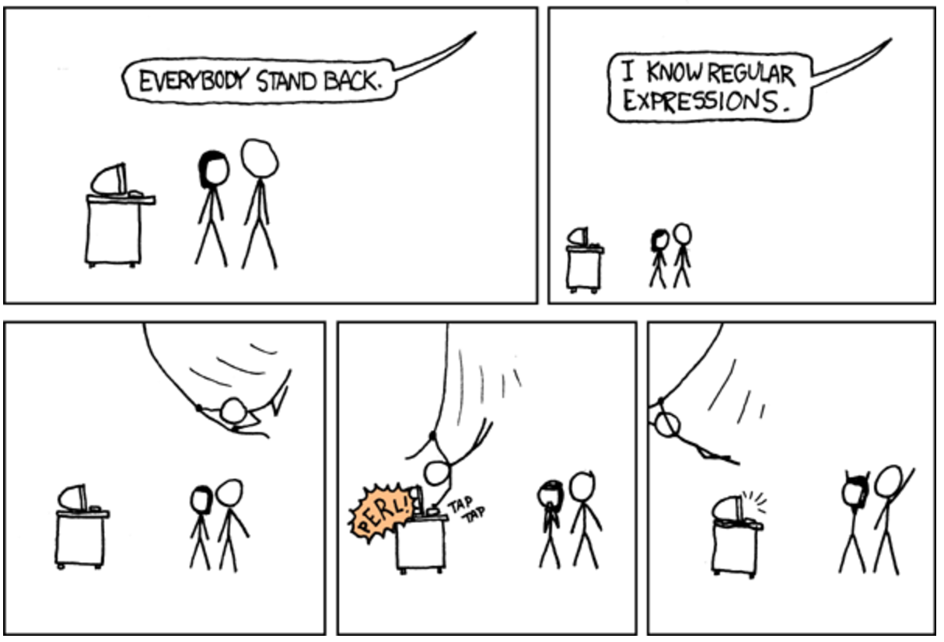

Slide 42
Regular Expressions
Used to search for specific elements, or groups of elements, that match a pattern
import re
# Find the index of the 1st occurrence of “cmsc641”
match = re.search(r”cmsc641”, text)
print( match.start() )
# Does start of text match “cmsc641”?
match = re.match(r”cmsc641”, text)
# Iterate over all matches for “cmsc641” in text
for match in re.finditer(r”cmsc641”, text):
print( match.start() )
# Return all matches of “cmsc641” in the text
match = re.findall(r”cmsc641”, text)

Slide 43
Matching Multiple Characters
Can match sets of characters, or multiple and more elaborate sets and sequences of characters:
Match the character ‘a’: a
Match the character ‘a’, ‘b’, or ‘c’: [abc]
Match any character except ‘a’, ‘b’, or ‘c’: [^abc]
Match any digit: \d (= [0123456789] or [0-9])
Match any alphanumeric: \w (= [a-zA-Z0-9_])
Match any whitespace: \s (= [ \t\n\r\f\v])
Match any character: .
Special characters must be escaped: .^$*+?{}\[]|()

Slide 44
Matching sequences and repeated characters
A few common modifiers (available in Python and most other high-level languages; +, {n}, {n,} may not):
Match character ‘a’ exactly once: a
Match character ‘a’ zero or once: a?
Match character ‘a’ zero or more times: a*
Match character ‘a’ one or more times: a+
Match character ‘a’ exactly n times: a{n}
Match character ‘a’ at least n times: a{n,}
Example: match all instances of “University of <somewhere>” where <somewhere> is an alphanumeric string with at least 3 characters:
\s*University\sof\s\w{3,}

Slide 45
Compiled Regexes
If you’re going to reuse the same regex many times, or if you aren’t but things are going slowly for some reason, try compiling the regular expression.
https://blog.codinghorror.com/to-compile-or-not-to-compile/
Interested? CMSC6*, CMSC7*, CMSC8*, talk to me.
# Compile the regular expression “cmsc320”
regex = re.compile(r”cmsc320”)
# Use it repeatedly to search for matches in text
regex.match( text ) # does start of text match?
regex.search( text ) # find the first match or None
regex.findall( text ) # find all matches

Slide 46
Groups
What if we want to know more than just “did we find a match” or “where is the first match” …?
Grouping asks the regex matcher to keep track of certain portions – surrounded by (parentheses) – of the match
\s*([Uu]niversity)\s([Oo]f)\s(\w{3,})
regex = r”\s*([Uu]niversity)\s([Oo]f)\s(\w{3,})”
m = re.search( regex, “university Of Maryland” )
print( m.groups() )
('university', 'Of', 'Maryland')

Slide 47
Simple Example: Parse an Email Address
(?:(?:\r\n)?[ \t])*(?:(?:(?:[^()<>@,;:\\".\[\] \000-\031]+(?:(?:(?:\r\n)?[ \t] )+|\Z|(?=[\["()<>@,;:\\".\[\]]))|"(?:[^\"\r\\]|\\.|(?:(?:\r\n)?[ \t]))*"(?:(?: \r\n)?[ \t])*)(?:\.(?:(?:\r\n)?[ \t])*(?:[^()<>@,;:\\".\[\] \000-\031]+(?:(?:( ?:\r\n)?[ \t])+|\Z|(?=[\["()<>@,;:\\".\[\]]))|"(?:[^\"\r\\]|\\.|(?:(?:\r\n)?[ \t]))*"(?:(?:\r\n)?[ \t])*))*@(?:(?:\r\n)?[ \t])*(?:[^()<>@,;:\\".\[\] \000-\0 31]+(?:(?:(?:\r\n)?[ \t])+|\Z|(?=[\["()<>@,;:\\".\[\]]))|\[([^\[\]\r\\]|\\.)*\ ](?:(?:\r\n)?[ \t])*)(?:\.(?:(?:\r\n)?[ \t])*(?:[^()<>@,;:\\".\[\] \000-\031]+ (?:(?:(?:\r\n)?[ \t])+|\Z|(?=[\["()<>@,;:\\".\[\]]))|\[([^\[\]\r\\]|\\.)*\](?: (?:\r\n)?[ \t])*))*|(?:[^()<>@,;:\\".\[\] \000-\031]+(?:(?:(?:\r\n)?[ \t])+|\Z |(?=[\["()<>@,;:\\".\[\]]))|"(?:[^\"\r\\]|\\.|(?:(?:\r\n)?[ \t]))*"(?:(?:\r\n) ?[ \t])*)*\<(?:(?:\r\n)?[ \t])*(?:@(?:[^()<>@,;:\\".\[\] \000-\031]+(?:(?:(?:\ r\n)?[ \t])+|\Z|(?=[\["()<>@,;:\\".\[\]]))|\[([^\[\]\r\\]|\\.)*\](?:(?:\r\n)?[ \t])*)(?:\.(?:(?:\r\n)?[ \t])*(?:[^()<>@,;:\\".\[\] \000-\031]+(?:(?:(?:\r\n) ?[ \t])+|\Z|(?=[\["()<>@,;:\\".\[\]]))|\[([^\[\]\r\\]|\\.)*\](?:(?:\r\n)?[ \t] )*))*(?:,@(?:(?:\r\n)?[ \t])*(?:[^()<>@,;:\\".\[\] \000-\031]+(?:(?:(?:\r\n)?[ \t])+|\Z|(?=[\["()<>@,;:\\".\[\]]))|\[([^\[\]\r\\]|\\.)*\](?:(?:\r\n)?[ \t])* )(?:\.(?:(?:\r\n)?[ \t])*(?:[^()<>@,;:\\".\[\] \000-\031]+(?:(?:(?:\r\n)?[ \t] )+|\Z|(?=[\["()<>@,;:\\".\[\]]))|\[([^\[\]\r\\]|\\.)*\](?:(?:\r\n)?[ \t])*))*) *:(?:(?:\r\n)?[ \t])*)?(?:[^()<>@,;:\\".\[\] \000-\031]+(?:(?:(?:\r\n)?[ \t])+ |\Z|(?=[\["()<>@,;:\\".\[\]]))|"(?:[^\"\r\\]|\\.|(?:(?:\r\n)?[ \t]))*"(?:(?:\r \n)?[ \t])*)(?:\.(?:(?:\r\n)?[ \t])*(?:[^()<>@,;:\\".\[\] \000-\031]+(?:(?:(?: \r\n)?[ \t])+|\Z|(?=[\["()<>@,;:\\".\[\]]))|"(?:[^\"\r\\]|\\.|(?:(?:\r\n)?[ \t ]))*"(?:(?:\r\n)?[ \t])*))*@(?:(?:\r\n)?[ \t])*(?:[^()<>@,;:\\".\[\] \000-\031 ]+(?:(?:(?:\r\n)?[ \t])+|\Z|(?=[\["()<>@,;:\\".\[\]]))|\[([^\[\]\r\\]|\\.)*\]( ?:(?:\r\n)?[ \t])*)(?:\.(?:(?:\r\n)?[ \t])*(?:[^()<>@,;:\\".\[\] \000-\031]+(? :(?:(?:\r\n)?[ \t])+|\Z|(?=[\["()<>@,;:\\".\[\]]))|\[([^\[\]\r\\]|\\.)*\](?:(? :\r\n)?[ \t])*))*\>(?:(?:\r\n)?[ \t])*)|(?:[^()<>@,;:\\".\[\] \000-\031]+(?:(? :(?:\r\n)?[ \t])+|\Z|(?=[\["()<>@,;:\\".\[\]]))|"(?:[^\"\r\\]|\\.|(?:(?:\r\n)? [ \t]))*"(?:(?:\r\n)?[ \t])*)*:(?:(?:\r\n)?[ \t])*(?:(?:(?:[^()<>@,;:\\".\[\] \000-\031]+(?:(?:(?:\r\n)?[ \t])+|\Z|(?=[\["()<>@,;:\\".\[\]]))|"(?:[^\"\r\\]| \\.|(?:(?:\r\n)?[ \t]))*"(?:(?:\r\n)?[ \t])*)(?:\.(?:(?:\r\n)?[ \t])*(?:[^()<> @,;:\\".\[\] \000-\031]+(?:(?:(?:\r\n)?[ \t])+|\Z|(?=[\["()<>@,;:\\".\[\]]))|" (?:[^\"\r\\]|\\.|(?:(?:\r\n)?[ \t]))*"(?:(?:\r\n)?[ \t])*))*@(?:(?:\r\n)?[ \t] )*(?:[^()<>@,;:\\".\[\] \000-\031]+(?:(?:(?:\r\n)?[ \t])+|\Z|(?=[\["()<>@,;:\\ ".\[\]]))|\[([^\[\]\r\\]|\\.)*\](?:(?:\r\n)?[ \t])*)(?:\.(?:(?:\r\n)?[ \t])*(? :[^()<>@,;:\\".\[\] \000-\031]+(?:(?:(?:\r\n)?[ \t])+|\Z|(?=[\["()<>@,;:\\".\[ \]]))|\[([^\[\]\r\\]|\\.)*\](?:(?:\r\n)?[ \t])*))*|(?:[^()<>@,;:\\".\[\] \000- \031]+(?:(?:(?:\r\n)?[ \t])+|\Z|(?=[\["()<>@,;:\\".\[\]]))|"(?:[^\"\r\\]|\\.|( ?:(?:\r\n)?[ \t]))*"(?:(?:\r\n)?[ \t])*)*\<(?:(?:\r\n)?[ \t])*(?:@(?:[^()<>@,; :\\".\[\] \000-\031]+(?:(?:(?:\r\n)?[ \t])+|\Z|(?=[\["()<>@,;:\\".\[\]]))|\[([ ^\[\]\r\\]|\\.)*\](?:(?:\r\n)?[ \t])*)(?:\.(?:(?:\r\n)?[ \t])*(?:[^()<>@,;:\\" .\[\] \000-\031]+(?:(?:(?:\r\n)?[ \t])+|\Z|(?=[\["()<>@,;:\\".\[\]]))|\[([^\[\ ]\r\\]|\\.)*\](?:(?:\r\n)?[ \t])*))*(?:,@(?:(?:\r\n)?[ \t])*(?:[^()<>@,;:\\".\ [\] \000-\031]+(?:(?:(?:\r\n)?[ \t])+|\Z|(?=[\["()<>@,;:\\".\[\]]))|\[([^\[\]\ r\\]|\\.)*\](?:(?:\r\n)?[ \t])*)(?:\.(?:(?:\r\n)?[ \t])*(?:[^()<>@,;:\\".\[\] \000-\031]+(?:(?:(?:\r\n)?[ \t])+|\Z|(?=[\["()<>@,;:\\".\[\]]))|\[([^\[\]\r\\] |\\.)*\](?:(?:\r\n)?[ \t])*))*)*:(?:(?:\r\n)?[ \t])*)?(?:[^()<>@,;:\\".\[\] \0 00-\031]+(?:(?:(?:\r\n)?[ \t])+|\Z|(?=[\["()<>@,;:\\".\[\]]))|"(?:[^\"\r\\]|\\ .|(?:(?:\r\n)?[ \t]))*"(?:(?:\r\n)?[ \t])*)(?:\.(?:(?:\r\n)?[ \t])*(?:[^()<>@, ;:\\".\[\] \000-\031]+(?:(?:(?:\r\n)?[ \t])+|\Z|(?=[\["()<>@,;:\\".\[\]]))|"(? :[^\"\r\\]|\\.|(?:(?:\r\n)?[ \t]))*"(?:(?:\r\n)?[ \t])*))*@(?:(?:\r\n)?[ \t])* (?:[^()<>@,;:\\".\[\] \000-\031]+(?:(?:(?:\r\n)?[ \t])+|\Z|(?=[\["()<>@,;:\\". \[\]]))|\[([^\[\]\r\\]|\\.)*\](?:(?:\r\n)?[ \t])*)(?:\.(?:(?:\r\n)?[ \t])*(?:[ ^()<>@,;:\\".\[\] \000-\031]+(?:(?:(?:\r\n)?[ \t])+|\Z|(?=[\["()<>@,;:\\".\[\] ]))|\[([^\[\]\r\\]|\\.)*\](?:(?:\r\n)?[ \t])*))*\>(?:(?:\r\n)?[ \t])*)(?:,\s*( ?:(?:[^()<>@,;:\\".\[\] \000-\031]+(?:(?:(?:\r\n)?[ \t])+|\Z|(?=[\["()<>@,;:\\ ".\[\]]))|"(?:[^\"\r\\]|\\.|(?:(?:\r\n)?[ \t]))*"(?:(?:\r\n)?[ \t])*)(?:\.(?:( ?:\r\n)?[ \t])*(?:[^()<>@,;:\\".\[\] \000-\031]+(?:(?:(?:\r\n)?[ \t])+|\Z|(?=[ \["()<>@,;:\\".\[\]]))|"(?:[^\"\r\\]|\\.|(?:(?:\r\n)?[ \t]))*"(?:(?:\r\n)?[ \t ])*))*@(?:(?:\r\n)?[ \t])*(?:[^()<>@,;:\\".\[\] \000-\031]+(?:(?:(?:\r\n)?[ \t ])+|\Z|(?=[\["()<>@,;:\\".\[\]]))|\[([^\[\]\r\\]|\\.)*\](?:(?:\r\n)?[ \t])*)(? :\.(?:(?:\r\n)?[ \t])*(?:[^()<>@,;:\\".\[\] \000-\031]+(?:(?:(?:\r\n)?[ \t])+| \Z|(?=[\["()<>@,;:\\".\[\]]))|\[([^\[\]\r\\]|\\.)*\](?:(?:\r\n)?[ \t])*))*|(?: [^()<>@,;:\\".\[\] \000-\031]+(?:(?:(?:\r\n)?[ \t])+|\Z|(?=[\["()<>@,;:\\".\[\ ]]))|"(?:[^\"\r\\]|\\.|(?:(?:\r\n)?[ \t]))*"(?:(?:\r\n)?[ \t])*)*\<(?:(?:\r\n) ?[ \t])*(?:@(?:[^()<>@,;:\\".\[\] \000-\031]+(?:(?:(?:\r\n)?[ \t])+|\Z|(?=[\[" ()<>@,;:\\".\[\]]))|\[([^\[\]\r\\]|\\.)*\](?:(?:\r\n)?[ \t])*)(?:\.(?:(?:\r\n) ?[ \t])*(?:[^()<>@,;:\\".\[\] \000-\031]+(?:(?:(?:\r\n)?[ \t])+|\Z|(?=[\["()<> @,;:\\".\[\]]))|\[([^\[\]\r\\]|\\.)*\](?:(?:\r\n)?[ \t])*))*(?:,@(?:(?:\r\n)?[ \t])*(?:[^()<>@,;:\\".\[\] \000-\031]+(?:(?:(?:\r\n)?[ \t])+|\Z|(?=[\["()<>@, ;:\\".\[\]]))|\[([^\[\]\r\\]|\\.)*\](?:(?:\r\n)?[ \t])*)(?:\.(?:(?:\r\n)?[ \t] )*(?:[^()<>@,;:\\".\[\] \000-\031]+(?:(?:(?:\r\n)?[ \t])+|\Z|(?=[\["()<>@,;:\\ ".\[\]]))|\[([^\[\]\r\\]|\\.)*\](?:(?:\r\n)?[ \t])*))*)*:(?:(?:\r\n)?[ \t])*)? (?:[^()<>@,;:\\".\[\] \000-\031]+(?:(?:(?:\r\n)?[ \t])+|\Z|(?=[\["()<>@,;:\\". \[\]]))|"(?:[^\"\r\\]|\\.|(?:(?:\r\n)?[ \t]))*"(?:(?:\r\n)?[ \t])*)(?:\.(?:(?: \r\n)?[ \t])*(?:[^()<>@,;:\\".\[\] \000-\031]+(?:(?:(?:\r\n)?[ \t])+|\Z|(?=[\[ "()<>@,;:\\".\[\]]))|"(?:[^\"\r\\]|\\.|(?:(?:\r\n)?[ \t]))*"(?:(?:\r\n)?[ \t]) *))*@(?:(?:\r\n)?[ \t])*(?:[^()<>@,;:\\".\[\] \000-\031]+(?:(?:(?:\r\n)?[ \t]) +|\Z|(?=[\["()<>@,;:\\".\[\]]))|\[([^\[\]\r\\]|\\.)*\](?:(?:\r\n)?[ \t])*)(?:\ .(?:(?:\r\n)?[ \t])*(?:[^()<>@,;:\\".\[\] \000-\031]+(?:(?:(?:\r\n)?[ \t])+|\Z |(?=[\["()<>@,;:\\".\[\]]))|\[([^\[\]\r\\]|\\.)*\](?:(?:\r\n)?[ \t])*))*\>(?:( ?:\r\n)?[ \t])*))*)?;\s*)
Mail::RFC822::Address Perl module for RFC 822

Slide 48
Named Groups
Raw grouping is useful for one-off exploratory analysis, but may get confusing with longer regexes
Much scarier regexes than that email one exist in the wild …
Named groups let you attach position-independent identifiers to groups in a regex
(?P<some_name> …)
regex = "\s*[Uu]niversity\s[Oo]f\s(?P<school>(\w{3,}))"
m = re.search( regex, “University of Maryland” )
print( m.group(‘school’) )
'Maryland'

Slide 49
Substitutions
The Python string module contains basic functionality for find-and-replace within strings:
For more complicated stuff, use regexes:
Can incorporate groups into the matching
”abcabcabc”.replace(“a”, ”X”)
‘XbcXbcXbc`
text = “I love Principles of Data Science”
re.sub(r”Data Science”, r”Schmada Schmience”, text)
‘I love Principles of Schmada Schmience`
re.sub(r”(\w+)\s([Ss])cience”, r”\1 \2hmience”, text)
re.sub(r”([a-zA-Z0123456789_]+)\s([Ss])cience”, r”\1 \2hmience”, text)
Thanks to: Zico Kolter

Slide 50
Downloading a bunch of files
Import the modules
import re
import requests
from bs4 import BeautifulSoup
try:
from urllib.parse import urlparse
except ImportError:
from urlparse import urlparse
Get some HTML via HTTP
# HTTP GET request sent to the URL url
r = requests.get( url )
# Use BeautifulSoup to parse the GET response
root = BeautifulSoup( r.content )
lnks = root.find("div", id="schedule")\
.find("table")\
.find("tbody").findAll("a")

Slide 51
Downloading a bunch of files
Parse exactly what you want
# Cycle through the href for each anchor, checking
# to see if it's a PDF/PPTX link or not
for lnk in lnks:
href = lnk['href']
# If it's a PDF/PPTX link, queue a download
if href.lower().endswith(('.pdf', '.pptx')):
Get some more data?!
urld = urlparse.urljoin(url, href)
rd = requests.get(urld, stream=True)
# Write the downloaded PDF to a file
outfile = path.join(outbase, href)
with open(outfile, 'wb') as f:
f.write(rd.content)

Slide 52
After the break, and Some of next class:
NumPy, Scipy, And DataFrames

Slide 53
The Data Lifecycle
Data collection
Data processing
Exploratory analysis
&
Data viz
Analysis, hypothesis testing, & ML
Insight & Policy Decision

Slide 54
Data Manipulation and Computation
Data Science == manipulating and computing on data
Large to very large, but somewhat “structured” data
We will see several tools for doing that this semester
Thousands more out there that we won’t cover
Need to learn to shift thinking from:
Imperative code to manipulate data structures
to:
Sequences/pipelines of operations on data
Should still know how to implement the operations themselves, especially for debugging performance (covered in classes like 642?, 643?), but we won’t cover that much

Slide 55
Data Manipulation and Computation
Data Representation, i.e., what is the natural way to think about given data
Data Processing Operations, which take one or more datasets as input and produce one or more datasets as output
Indexing
Slicing/subsetting
Filter
‘map’ → apply a function to every element
’reduce/aggregate’ → combine values to get a single scalar (e.g., sum, median)
Given two vectors: Dot and cross products
One-dimensional Arrays, Vectors
0.1 | 2 | 3.2 | 6.5 | 3.4 | 4.1
“data” | ”representation” | ”i.e.”

Slide 56
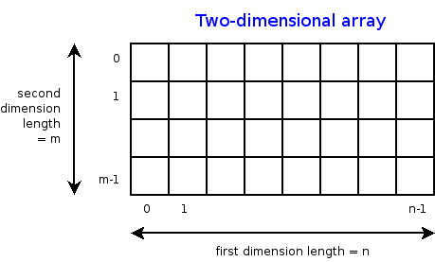
Data Manipulation and Computation
Data Representation, i.e., what is the natural way to think about given data
Data Processing Operations, which take one or more datasets as input and produce one or more datasets as output
Indexing
Slicing/subsetting
Filter
‘map’ → apply a function to every element
’reduce/aggregate’ → combine values across a row or a column (e.g., sum, average, median etc..)
n-dimensional arrays

Slide 57
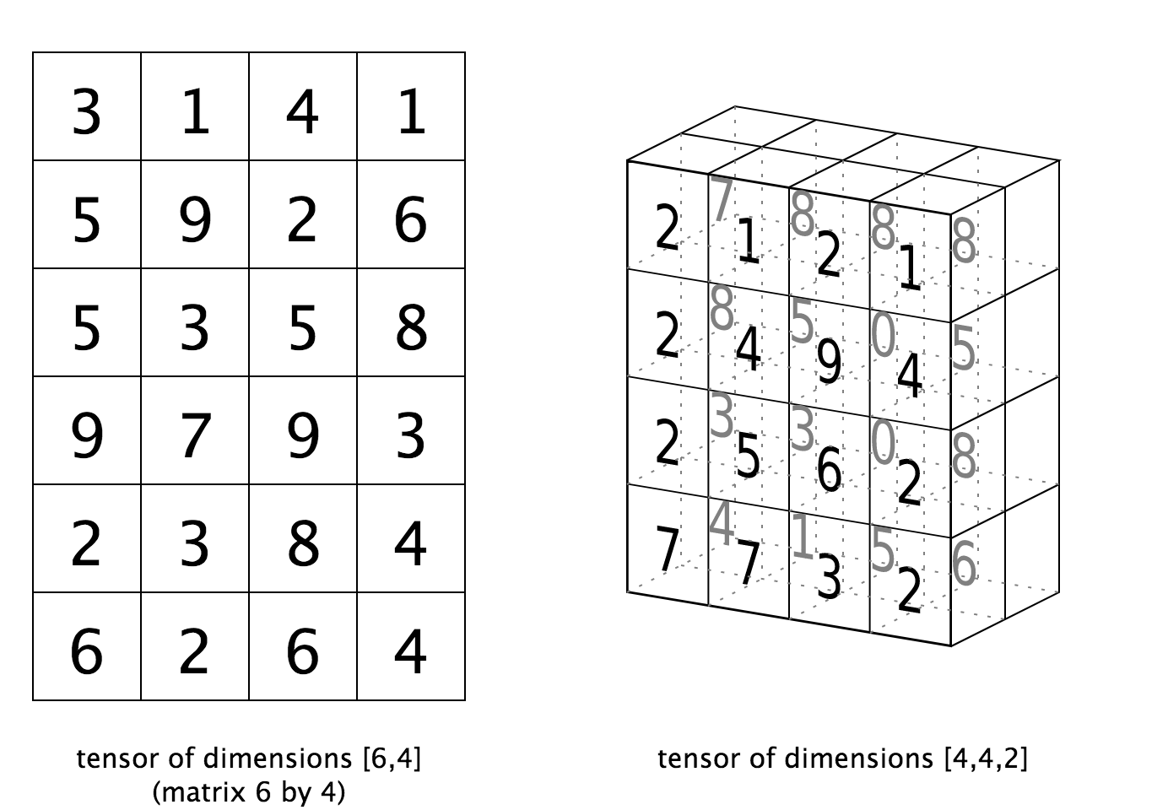
Data Manipulation and Computation
Data Representation, i.e., what is the natural way to think about given data
Data Processing Operations, which take one or more datasets as input and produce one or more datasets as output
Matrices, Tensors
n-dimensional array operations
+
Linear Algebra
Matrix/tensor multiplication
Transpose
Matrix-vector multiplication
Matrix factorization

Slide 58
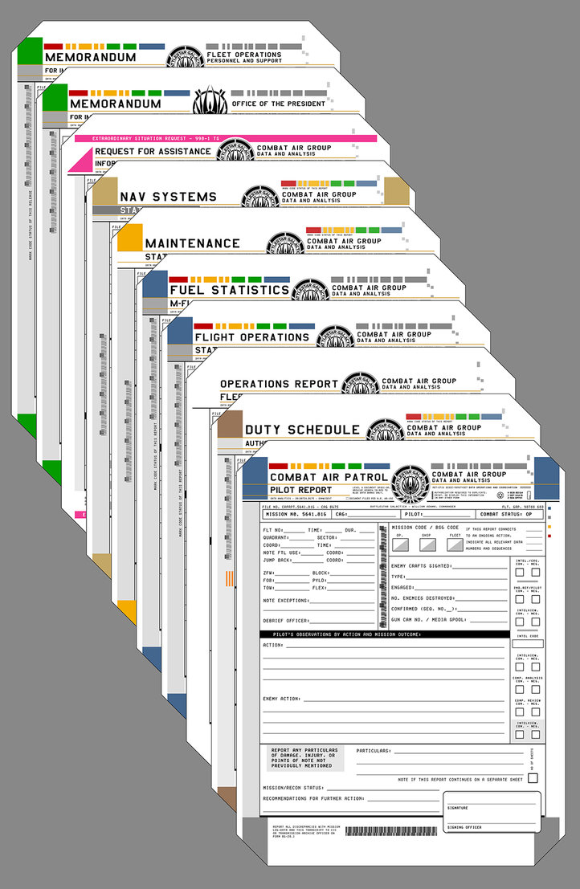

Data Manipulation and Computation
Data Representation, i.e., what is the natural way to think about given data
Data Processing Operations, which take one or more datasets as input and produce one or more datasets as output
Sets: of Objects
Filter
Map
Union
Reduce/Aggregate
Given two sets, Combine/Join using “keys”
Group and then aggregate
Sets: of (Key, Value Pairs)
(amol@cs.umd.edu,(email1, email2,…))
(john@cs.umd.edu,(email3, email4,…))

Slide 59
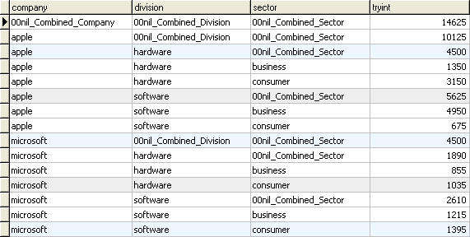
Data Manipulation and Computation
Data Representation, i.e., what is the natural way to think about given data
Data Processing Operations, which take one or more datasets as input and produce one or more datasets as output
Filter rows or columns
”Join” two or more relations
”Group” and “aggregate” them
Relational Algebra formalizes some of them
Structured Query Language (SQL)
  Many other languages and constructs, that look very similar
Tables/Relations == Sets of Tuples

Slide 60
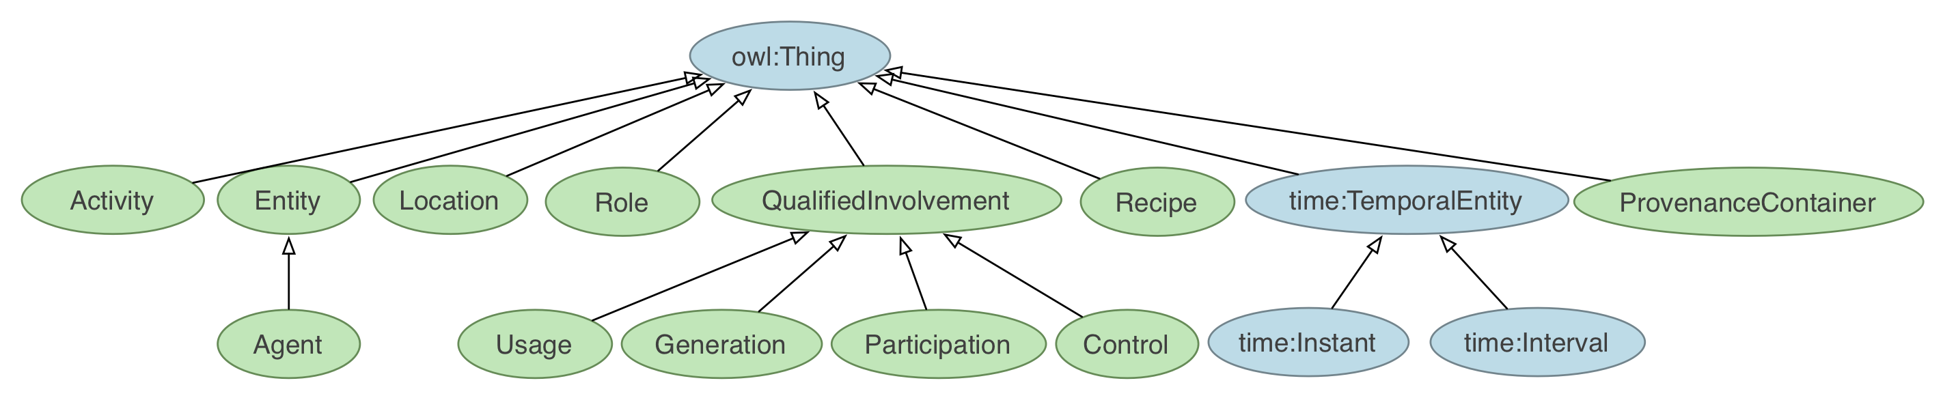
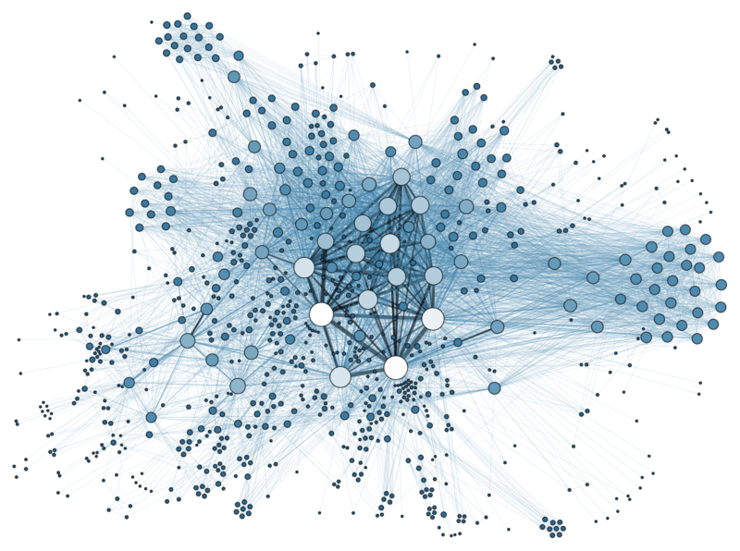
Data Manipulation and Computation
Data Representation, i.e., what is the natural way to think about given data
Data Processing Operations, which take one or more datasets as input and produce one or more datasets as output
Hierarchies/Trees/Graphs
”Path” queries
Graph Algorithms and Transformations
Network Science
Somewhat more ad hoc and special-purpose
Changing in recent years

Slide 61
Data Manipulation and Computation
Data Representation, i.e., what is the natural way to think about given data
Data Processing Operations, which take one or more datasets as input and produce
Why?
  Allows one to think at a higher level of abstraction, leading to simpler and easier-to-understand scripts
  Provides ”independence” between the abstract operations and concrete implementation
  Can switch from one implementation to another easily
For performance debugging, useful to know how they are implemented and rough characteristics

Slide 62
Next couple of classes
NumPy: Python Library for Manipulating nD Arrays
  Multidimensional Arrays, and a variety of operations including Linear Algebra
Pandas: Python Library for Manipulating Tabular Data
  Series, Tables (also called DataFrames)
  Many operations to manipulate and combine tables/series
Relational Databases
  Tables/Relations, and SQL (similar to Pandas operations)
4. Apache Spark
  Sets of objects or key-value pairs
  MapReduce and SQL-like operations

Slide 63
Next Couple of classes
NumPy: Python Library for Manipulating nD Arrays
  Multidimensional Arrays, and a variety of operations including Linear Algebra
Pandas: Python Library for Manipulating Tabular Data
  Series, Tables (also called DataFrames)
  Many operations to manipulate and combine tables/series
Relational Databases
  Tables/Relations, and SQL (similar to Pandas operations)
4. Apache Spark
  Sets of objects or key-value pairs
  MapReduce and SQL-like operations

Slide 64
Numeric & scientific applications
Number of third-party packages available for numerical and scientific computing
These include:
NumPy/SciPy – numerical and scientific function libraries.
numba – Python compiler that support JIT compilation.
ALGLIB – numerical analysis library.
pandas – high-performance data structures and data analysis tools.
pyGSL – Python interface for GNU Scientific Library.
ScientificPython – collection of scientific computing modules.
Many, many thanks to: FSU CIS4930

Slide 65
NumPy and friends
By far, the most commonly used packages are those in the NumPy stack. These packages include:
NumPy: similar functionality as Matlab
SciPy: integrates many other packages like NumPy
Matplotlib & Seaborn – plotting libraries
iPython via Jupyter – interactive computing
Pandas – data analysis library
SymPy – symbolic computation library
[FSU]

Slide 66
The Numpy Stack
CMSC643
Later
Today/next class
Image from Continuum Analytics
Notes:
NumPy = low-level LinAlg storage and manipulation
SciPy = scientific computing & stats algorithms built on top of NumPy
Pandas = friendlier version of NumPy backed by raw NumPy

Slide 67
numpy
Among other things, NumPy contains:
A powerful n-dimensional array object.
Sophisticated (broadcasting/universal) functions.
Tools for integrating C/C++ and Fortran code.
Useful linear algebra, Fourier transform, and random number capabilities, etc.
Besides its obvious scientific uses, NumPy can also be used as an efficient multi-dimensional container of generic data.
[FSU]

Slide 68
numpy
ndarray object: an n-dimensional array of homogeneous data types, with many operations being performed in compiled code for performance
Several important differences between NumPy arrays and the standard Python sequences:
NumPy arrays have a fixed size. Modifying the size means creating a new array.
NumPy arrays must be of the same data type, but this can include Python objects – may not get performance benefits
More efficient mathematical operations than built-in sequence types.
[FSU]

Slide 69
Numpy datatypes
Wider variety of data types than are built-in to the Python language by default.
Defined by the numpy.dtype class and include:
intc (same as a C integer) and intp (used for indexing)
int8, int16, int32, int64
uint8, uint16, uint32, uint64
float16, float32, float64
complex64, complex128
bool_, int_, float_, complex_ are shorthand for defaults.
These can be used as functions to cast literals or sequence types, as well as arguments to NumPy functions that accept the dtype keyword argument.
[FSU]

Slide 70
Numpy datatypes
>>> import numpy as np
>>> x = np.float32(1.0)
>>> x
1.0
>>> y = np.int_([1,2,4])
>>> y
array([1, 2, 4])
>>> z = np.arange(3, dtype=np.uint8)
>>> z
array([0, 1, 2], dtype=uint8)
>>> z.dtype
dtype('uint8')
[FSU]

Slide 71
Numpy arrays
There are a couple of mechanisms for creating arrays in NumPy:
Conversion from other Python structures (e.g., lists, tuples)
  Any sequence-like data can be mapped to a ndarray
Built-in NumPy array creation (e.g., arange, ones, zeros, etc.)
  Create arrays with all zeros, all ones, increasing numbers from 0 to 1 etc.
Reading arrays from disk, either from standard or custom formats (e.g., reading in from a CSV file)
[FSU]

Slide 72
Numpy arrays
In general, any numerical data that is stored in an array-like container can be converted to an ndarray through use of the array() function. The most obvious examples are sequence types like lists and tuples.
>>> x = np.array([2,3,1,0])
>>> x = np.array([2, 3, 1, 0])
>>> x = np.array([[1,2.0],[0,0],(1+1j,3.)])
>>> x = np.array([[ 1.+0.j, 2.+0.j], [ 0.+0.j, 0.+0.j], [ 1.+1.j, 3.+0.j]])
[FSU]

Slide 73
Numpy arrays
Creating arrays from scratch in NumPy:
zeros(shape)– creates an array filled with 0 values with the specified shape. The default dtype is float64.
ones(shape) – creates an array filled with 1 values.
arange() – like Python’s built-in range
>>> np.zeros((2, 3))
array([[ 0., 0., 0.], [ 0., 0., 0.]])
>>> np.arange(10)
array([0, 1, 2, 3, 4, 5, 6, 7, 8, 9])
>>> np.arange(2, 10, dtype=np.float)
array([ 2., 3., 4., 5., 6., 7., 8., 9.])
>>> np.arange(2, 3, 0.2)
array([ 2. , 2.2, 2.4, 2.6, 2.8])
[FSU]

Slide 74
Numpy arrays
linspace()– creates arrays with a specified number of elements, and spaced equally between the specified beginning and end values.
random.random(shape) – creates arrays with random floats over the interval [0,1).
>>> np.linspace(1., 4., 6)
array([ 1. , 1.6, 2.2, 2.8, 3.4, 4. ])
>>> np.random.random((2,3))
array([[ 0.75688597, 0.41759916, 0.35007419],
[ 0.77164187, 0.05869089, 0.98792864]])
[FSU]

Slide 75
Numpy arrays
>>> import numpy as np
>>> a = np.arange(3)
>>> print(a)
[0 1 2]
>>> a
array([0, 1, 2])
>>> b = np.arange(9).reshape(3,3)
>>> print(b)
[[0 1 2]
[3 4 5]
[6 7 8]]
>>> c = np.arange(8).reshape(2,2,2)
>>> print(c)
[[[0 1]
[2 3]]
[[4 5]
[6 7]]]
Printing an array can be done with the print
statement (Python 2)
function (Python 3)
[FSU]

Slide 76
indexing
Single-dimension indexing is accomplished as usual.
Multi-dimensional arrays support multi-dimensional indexing.
>>> x = np.arange(10)
>>> x[2]
2
>>> x[-2]
8
>>> x.shape = (2,5) # now x is 2-dimensional
>>> x[1,3]
8
>>> x[1,-1]
9

Slide 77
indexing
Using fewer dimensions to index will result in a subarray:
This means that x[i, j] == x[i][j] but the second method is less efficient.
>>> x = np.arange(10)
>>> x.shape = (2,5)
>>> x[0]
array([0, 1, 2, 3, 4])

Slide 78
indexing
Slicing is possible just as it is for typical Python sequences:
>>> x = np.arange(10)
>>> x[2:5]
array([2, 3, 4])
>>> x[:-7]
array([0, 1, 2])
>>> x[1:7:2]
array([1, 3, 5])
>>> y = np.arange(35).reshape(5,7)
>>> y[1:5:2,::3]
array([[ 7, 10, 13], [21, 24, 27]])

Slide 79
Array operations
Basic operations apply element-wise. The result is a new array with the resultant elements.
>>> a = np.arange(5)
>>> b = np.arange(5)
>>> a+b
array([0, 2, 4, 6, 8])
>>> a-b
array([0, 0, 0, 0, 0])
>>> a**2
array([ 0, 1, 4, 9, 16])
>>> a>3
array([False, False, False, False, True], dtype=bool)
>>> 10*np.sin(a)
array([ 0., 8.41470985, 9.09297427, 1.41120008, -7.56802495])
>>> a*b
array([ 0, 1, 4, 9, 16])

Slide 80
Array operations
>>> a = np.zeros(4).reshape(2,2)
>>> a
array([[ 0., 0.],
[ 0., 0.]])
>>> a[0,0] = 1
>>> a[1,1] = 1
>>> b = np.arange(4).reshape(2,2)
>>> b
array([[0, 1],
[2, 3]])
>>> a*b
array([[ 0., 0.],
[ 0., 3.]])
>>> np.dot(a,b)
array([[ 0., 1.],
[ 2., 3.]])
Since multiplication is done element-wise, you need to specifically perform a dot product to perform matrix multiplication.

Slide 81
Array operations
>>> a = np.random.random((2,3))
>>> a
array([[ 0.68166391, 0.98943098, 0.69361582],
[ 0.78888081, 0.62197125, 0.40517936]])
>>> a.sum()
4.1807421388722164
>>> a.min()
0.4051793610379143
>>> a.max(axis=0)
array([ 0.78888081, 0.98943098, 0.69361582])
>>> a.min(axis=1)
array([ 0.68166391, 0.40517936])
There are also some built-in methods of ndarray objects.
Universal functions which may also be applied include exp, sqrt, add, sin,
cos, etc.

Slide 82
Array operations
>>> a = np.floor(10*np.random.random((3,4)))
>>> print(a)
[[ 9. 8. 7. 9.]
[ 7. 5. 9. 7.]
[ 8. 2. 7. 5.]]
>>> a.shape
(3, 4)
>>> a.ravel()
array([ 9., 8., 7., 9., 7., 5., 9., 7., 8., 2., 7., 5.])
>>> a.shape = (6,2)
>>> print(a)
[[ 9. 8.]
[ 7. 9.]
[ 7. 5.]
[ 9. 7.]
[ 8. 2.]
[ 7. 5.]]
>>> a.transpose()
array([[ 9., 7., 7., 9., 8., 7.],
[ 8., 9., 5., 7., 2., 5.]])
An array shape can be manipulated by a number of methods.
resize(size) will modify an array in place.
reshape(size) will return a copy of the array with a new shape.

Slide 83
Linear algebra
One of the most common reasons for using the NumPy package is its linear algebra module.
It’s like Matlab, but free!
>>> from numpy import *
>>> from numpy.linalg import *
>>> a = array([[1.0, 2.0],
[3.0, 4.0]])
>>> print(a)
[[ 1. 2.]
[ 3. 4.]]
>>> a.transpose()
array([[ 1., 3.],
[ 2., 4.]])
>>> inv(a) # inverse
array([[-2. , 1. ],
[ 1.5, -0.5]])

Slide 84
Linear algebra
>>> u = eye(2) # unit 2x2 matrix; "eye" represents "I"
>>> u
array([[ 1., 0.],
[ 0., 1.]])
>>> j = array([[0.0, -1.0], [1.0, 0.0]])
>>> dot(j, j) # matrix product
array([[-1., 0.],
[ 0., -1.]])
>>> trace(u) # trace (sum of elements on diagonal)
2.0
>>> y = array([[5.], [7.]])
>>> solve(a, y) # solve linear matrix equation
array([[-3.],
[ 4.]])
>>> eig(j) # get eigenvalues/eigenvectors of matrix
(array([ 0.+1.j, 0.-1.j]),
array([[ 0.70710678+0.j, 0.70710678+0.j],
[ 0.00000000-0.70710678j, 0.00000000+0.70710678j]]))
(We’ll talk about this stuff as needed in the March/April machine learning and statistics lectures.)

Slide 85
SciPy?
In its own words:
Basically, SciPy contains various tools and functions for solving common problems in scientific computing.
SciPy is a collection of mathematical algorithms and convenience functions built on the NumPy extension of Python. It adds significant power to the interactive Python session by providing the user with high-level commands and classes for manipulating and visualizing data.

Slide 86
SciPY
SciPy gives you access to a ton of specialized mathematical functionality.
Just know it exists. We won’t use it much in this class.
Some functionality:
Special mathematical functions (scipy.special) -- elliptic, bessel, etc.
Integration (scipy.integrate)
Optimization (scipy.optimize)
Interpolation (scipy.interpolate)
Fourier Transforms (scipy.fftpack)
Signal Processing (scipy.signal)
Linear Algebra (scipy.linalg)
Compressed Sparse Graph Routines (scipy.sparse.csgraph)
Spatial data structures and algorithms (scipy.spatial)
Statistics (scipy.stats)
Multidimensional image processing (scipy.ndimage)
Data IO (scipy.io) – overlaps with pandas, covers some other formats

Slide 87
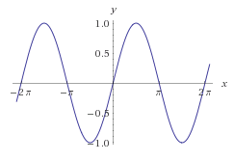

One SciPy Example
We can’t possibly tour all of the SciPy library and, even if we did, it might be a little boring.
Often, you’ll be able to find higher-level modules that will work around your need to directly call low-level SciPy functions
Say you want to compute an integral:
$$\int_{a}^{b}{\sin{x}dx}$$

Slide 88

Scipy.integrate
We have a function object – np.sin defines the sin function for us.
We can compute the definite integral from $x=0$ to $x=π$ using the quad function.
>>> res = scipy.integrate.quad(np.sin, 0, np.pi)
>>> print(res)
(2.0, 2.220446049250313e-14) # 2 with a very small error margin!
>>> res = scipy.integrate.quad(np.sin, -np.inf, +np.inf)
>>> print(res)
(0.0, 0.0) # Integral does not converge

Slide 89
Scipy.integrate
Let’s say that we don’t have a function object, we only have some (x,y) samples that “define” our function.
We can estimate the integral using the trapezoidal rule.
>>> sample_x = np.linspace(0, np.pi, 1000)
>>> sample_y = np.sin(sample_x) # Creating 1,000 samples
>>> result = scipy.integrate.trapz(sample_y, sample_x)
>>> print(result)
1.99999835177
>>> sample_x = np.linspace(0, np.pi, 1000000)
>>> sample_y = np.sin(sample_x) # Creating 1,000,000 samples
>>> result = scipy.integrate.trapz(sample_y, sample_x)
>>> print(result)
2.0

Slide 90
Wrap up
Shift thinking from imperative coding to operations on datasets
Numpy: A low-level abstraction that gives us really fast multi-dimensional arrays
Next class:
Pandas: Higher-level tabular abstraction and operations to manipulate and combine tables
Reading Homework focuses on Pandas and SQL: Aim to release by tonight, probably by tomorrow

Slide 91
Rest of Today’s Lecture
By popular request …
Version control primer!
Specifically, git via GitHub and GitLab
Thanks: Mark Groves (Microsoft), Ilan Biala & Aaron Perley (CMU), Sharif U., & the HJCB Senior Design Team!
And then a bit on keeping your data … tidy data.

Slide 92
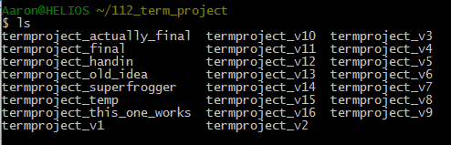
What is version control?

Slide 93
Development Tool
When working with a team, the need for a central repository is essential
Need a system to allow versioning, and a way to acquire the latest edition of the code
A system to track and manage bugs was also needed

Slide 94
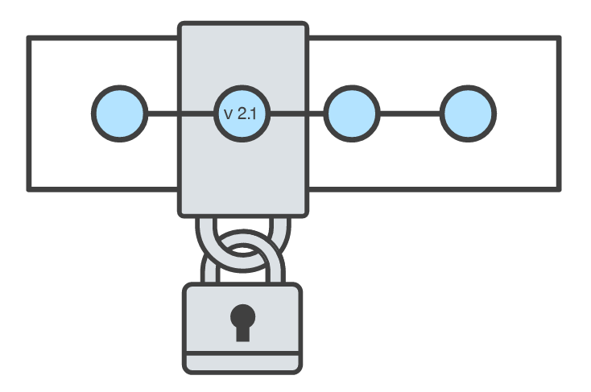
Goals of Version Control
Be able to search through revision history and retrieve previous versions of any file in a project
Be able to share changes with collaborators on a project
Be able to confidently make large changes to existing files
atlassian.com/git/tutorials/what-is-version-control

Slide 95
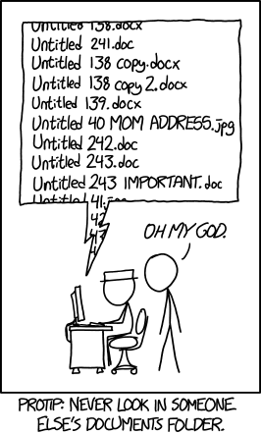
Named Folders Approach
Can be hard to track
Memory-intensive
Can be slow
Hard to share
No record of authorship

Slide 96
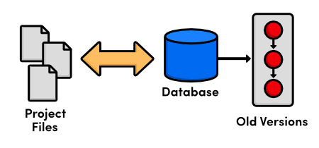
Local Database of Versions Approach
Provides an abstraction over finding the right versions of files and replacing them in the project
Records who changes what, but hard to parse that
Can’t share with collaborators

Slide 97
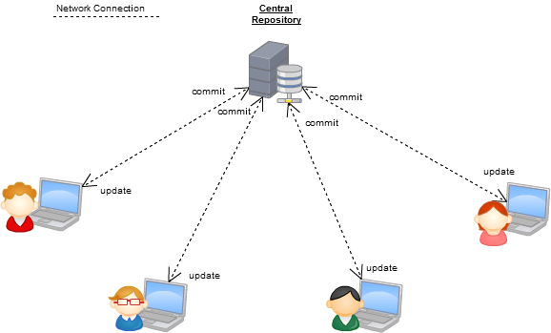
Centralized Version Control Systems
A central, trusted repository determines the order of commits (“versions” of the project)
Collaborators “push” changes (commits) to this repository.
Any new commits must be compatible with the most recent commit. If it isn’t, somebody must “merge” it in.
Examples: SVN, CVS, Perforce

Slide 98
Distributed Version Control Systems (DVCS)
No central repository
Every repository has every commit
Examples: Git, Mercurial
Developer A’s local files
Developer B’s local files
Commit
Dev C’s Repo
Commit
Dev A’s Repo
Push/Fetch
Commit
Commit
Checkout
Central Repository
Checkout
Push/Fetch
Push/Fetch
Push/Fetch
Commit
Commit
Commit
Dev D’s Repo
Developer C’s local files
Checkout
Checkout
Developer D’s local files
Push/Fetch
Dev B’s Repo
Push/Fetch
Centralized Version Control System
Distributed Version Control System
Commit

Slide 99
What is Git
Git is a version control system
Developed as a repository system for both local and remote changes
Allows teammates to work simultaneously on a project
Tracks each commit, allowing for a detailed documentation of the project along every step
Allows for advanced merging and branching operations

Slide 100
A short history of Git
Linux kernel development
1991-2002
Changes passed around as archived file
2002-2005
Using a DVCS called BitKeeper
2005
Relationship broke down between two communities (BitKeeper licensing issues)

Slide 101
A short history of Git
Goals:
Speed
Simple design
Strong support for non-linear development (thousands of parallel branches)
Fully distributed – not a requirement, can be centralized
Able to handle large projects like the Linux kernel efficiently (speed and data size)

Slide 102
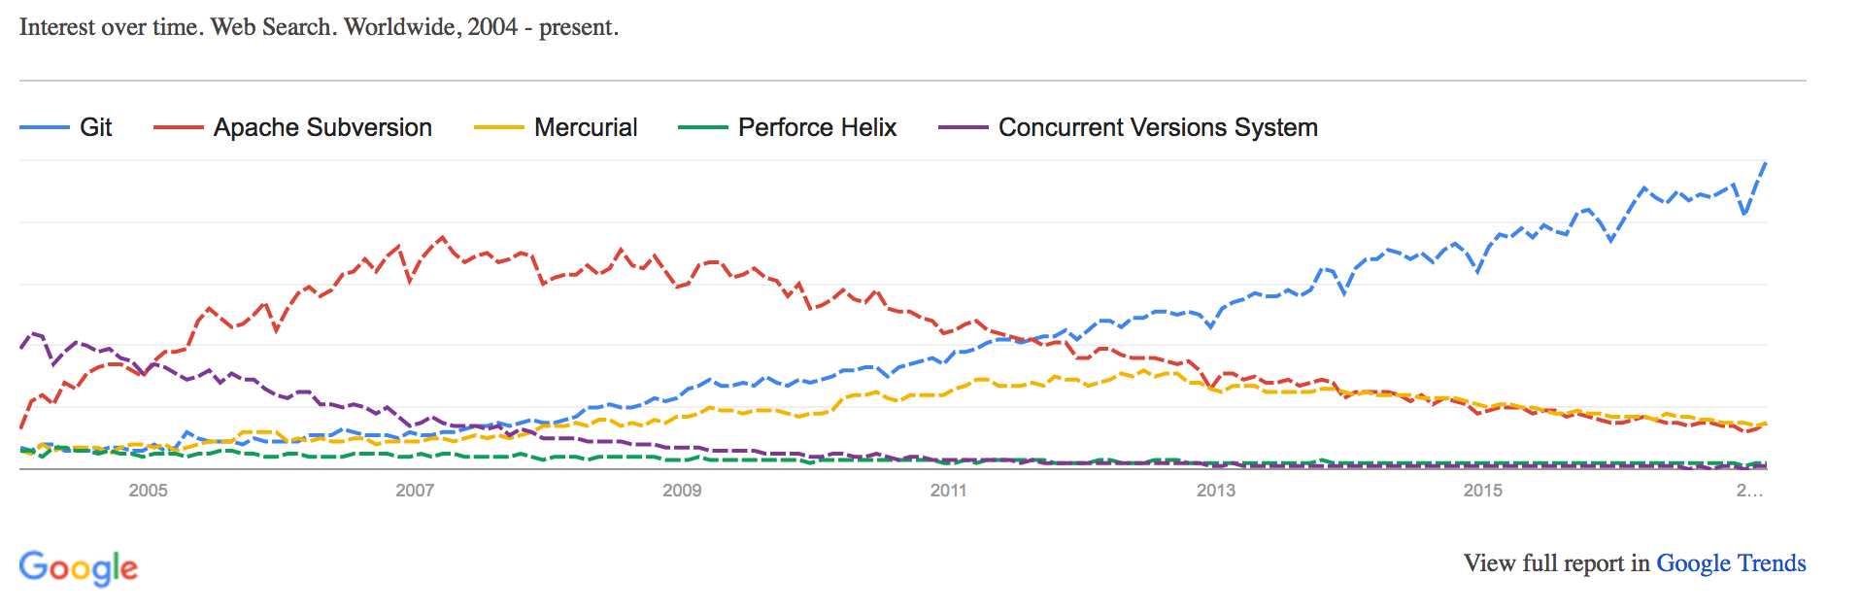
A short history of Git
Popularity:
Git is now the most widely used source code management tool
33.3% of professional software developers use Git (often through GitHub) as their primary source control system
[citation needed]

Slide 103
Git in Industry
Companies and projects currently using Git
Google
Android
Facebook
Microsoft
Netflix
Linux
Ruby on Rails
Gnome
KDE
Eclipse
X.org

Slide 104
Git Basics
Snapshots, not changes
A picture of what all your files look like at that moment
If a file has not changed, store a reference
Nearly every operation is local
Browsing the history of project
See changes between two versions

Slide 105
Why Git is Better
Git tracks the content rather than the files
Branches are lightweight, and merging is a simple process
Allows for a more streamlined offline development process
Repositories are smaller in size and are stored in a single .git directory
Allows for advanced staging operations, and the use of stashing when working through troublesome sections

Slide 106
What about SVN?
Subversion has been the most pointless project ever started … Subversion used to say CVS done right: with that slogan there is nowhere you can go. There is no way to do CVS right … If you like using CVS, you should be in some kind of mental institution or somewhere else.
Linus Torvalds

Slide 107
Git vs {CVS, SVN, …}
Why you should care:
Many places use legacy systems that will cause problems in the future – be the change you believe in!
Git is much faster than SVN:
Coded in C, which allows for a great amount of optimization
Accomplishes much of the logic client side, thereby reducing time needed for communication
Developed to work on the Linux kernel, so that large project manipulation is at the forefront of the benchmarks

Slide 108
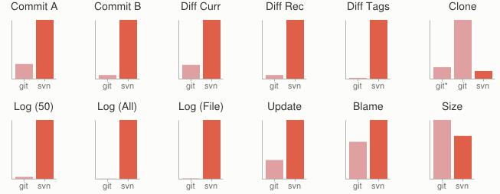
Git vs {CVS, SVN, …}
Speed benchmarks:
Benchmarks performed by http://git-scm.com/about/small-and-fast

Slide 109
Git vs {CVS, SVN, …}
Git is significantly smaller than SVN
All files are contained in a small decentralized .git file
In the case of Mozilla’s projects, a Git repository was 30 times smaller than an identical SVN repository
Entire Linux kernel with 5 years of versioning contained in a single 1 GB .git file
SVN carries two complete copies of each file, while Git maintains a simple and separate 100 bytes of data per file, noting changes and supporting operations
Nice because you can (and do!) store the whole thing locally

Slide 110
Git vs {CVS, SVN, …}
Git is more secure than SVN
All commits are uniquely hashed for both security and indexing purposes
Commits can be authenticated through numerous means
  In the case of SSH commits, a key may be provided by both the client and server to guarantee authenticity and prevent against unauthorized access

Slide 111
Git vs {CVS, SVN, …}
Git is decentralized:
Each user contains an individual repository and can check commits against itself, allowing for detailed local revisioning
Being decentralized allows for easy replication and deployment
In this case, SVN relies on a single centralized repository and is unusable without

Slide 112
Git vs {CVS, SVN, …}
Git is flexible:
Due to it’s decentralized nature, git commits can be stored locally, or committed through HTTP, SSH, FTP, or even by Email
No need for a centralized repository
Developed as a command line utility, which allows a large amount of features to be built and customized on top of it

Slide 113
Git vs {CVS, SVN, …}
Data assurance: a checksum is performed on both upload and download to ensure sure that the file hasn’t been corrupted.
Commit IDs are generated upon each commit:
Linked list style of commits
Each commit is linked to the next, so that if something in the history was changed, each following commit will be rebranded to indicate the modification

Slide 114
Git vs {CVS, SVN, …}
Branching:
Git allows the usage of advanced branching mechanisms and procedures
Individual divisions of the code can be separated and developed separately within separate branches of the code
Branches can allow for the separation of work between developers, or even for disposable experimentation
Branching is a precursor and a component of the merging process
Will give an example shortly.

Slide 115
Git vs {CVS, SVN, …}
Merging
The process of merging is directly related to the process of branching
Individual branches may be merged together, solving code conflicts, back into the default or master branch of the project
Merges are usually done automatically, unless a conflict is presented, in which case the user is presented with several options with which to handle the conflict
Will give an example shortly.

Slide 116
Git vs {CVS, SVN, …}
Merging: content of the files is tracked rather than the file itself:
This allows for a greater element of tracking and a smarter and more automated process of merging
SVN is unable to accomplish this, and will throw a conflict if, e.g., a file name is changed and differs from the name in the central repository
Git is able to solve this problem with its use of managing a local repository and tracking individual changes to the code

Slide 117
Initialization of a git repository
C:\> mkdir CoolProject
C:\> cd CoolProject
C:\CoolProject > git init
Initialized empty Git repository in C:/CoolProject/.git
C:\CoolProject > notepad README.txt
C:\CoolProject > git add .
C:\CoolProject > git commit -m 'my first commit'
[master (root-commit) 7106a52] my first commit
1 file changed, 1 insertion(+)
create mode 100644 README.txt
Notes:
After you install git on your machine to get started you will need to initialize a repository.
You can do this by going into your file system, creating a folder and doing git init within the folder.
All the magic happens in the Dot Git folder. This folder IS GIT. You can copy this folder to another machine and it will work.
When I first started playing with git, I had setup a new machine, and was having a hell of a time trying to figure out how I should move my git projects over to the new machine. It was kind of embarrassing. Eventually I just tried to copy it over and it worked.
At this point you really don’t have much. You need to do your first commit to make this light up.
You create a file. When then stage it, but telling git the track this file. In this case I told git to add all files.
Then I was able to commit with a message say this is my first commit.

Slide 118
Git Basics I
The three (or four) states of a file:
Modified:
  File has changed but not committed
Staged:
  Marked to go to next commit snapshot
Committed:
  Safely stored in local database
Untracked!
  Newly added or removed files

Slide 119
Git Basics II
Three main areas of a git project:
Working directory
  Single checkout of one version of the project.
Staging area
  Simple file storing information about what will go into your next commit
Git directory
  What is copied when cloning a repository

Slide 120
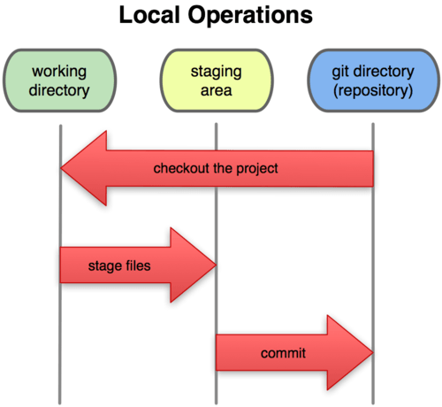
Git Basics III
Three main areas of a git project:

Slide 121
Branches Illustrated
(Default branch is called “master”; your first commit will be on this branch.)
master
A
> git commit –m ‘my first commit’
Notes:
Now lets see what this visually looks like.
On my first commit I have A.
The default branch that gets created with git is a branch names Master.
This is just a default name. As I mentioned before, most everything in git is done by convention. Master does not mean anything special to git.

Slide 122
Branches Illustrated
master
A
B
C
> git commit (x2)
Notes:
We make a set of commits, moving master and our current pointer (*) along

Slide 123
Branches Illustrated
master
A
B
C
bug123
> git checkout –b bug123
Notes:
Suppose we want to work on a bug. We start by creating a local “story branch” for this work.
Notice that the new branch is really just a pointer to the same commit (C) but our current pointer (*) is moved.

Slide 124
Branches Illustrated
master
A
B
C
D
E
bug123
> git commit (x2)
Notes:
Now we make commits and they move along, with the branch and current pointer following along.

Slide 125
Branches Illustrated
master
A
B
C
D
E
bug123
> git checkout master
Notes:
We can “checkout” to go back to the master branch.
This is where I was freaked out the first time I did this. My IDE removed the changes I just made. It can be pretty startling, but don’t worry you didn’t lose anything.

Slide 126
Branches Illustrated
master
A
B
C
D
E
bug123
> git merge bug123
Notes:
And then merge from the story branch, bringing those change histories together.

Slide 127
Branches Illustrated
master
A
B
C
D
E
> git branch -d bug123
Notes:
And since we’re done with the story branch, we can delete it. This all happened locally, without affecting anyone upstream.

Slide 128
Branches Illustrated
master
A
B
C
D
E
F
G
bug456
Notes:
Let’s consider another scenario. Here we created our bug story branch back off of (C). But some changes have happened in master (bug 123 which we just merged) since then.
And we made a couple of commits in bug 456.

Slide 129
Branches Illustrated
master
A
B
C
D
E
F
G
bug456
> git checkout master
Notes:
Again, to merge, we checkout back to master which moves our (*) pointer.

Slide 130
Branches Illustrated
master
A
B
C
D
E
H
F
G
bug456
> git merge bug456
Notes:
And now we merge, connecting the new (H) to both (E) and (G). Note that this merge, especially if there are conflicts, can be unpleasant to perform.

Slide 131
Branches Illustrated
master
A
B
C
D
E
H
F
G
> git branch -d bug456
Notes:
Now we delete the branch pointer.
But notice the structure we have now. This is very non-linear. That will make it challenging to see the changes independently. And it can get very messy over time.

Slide 132
Branches Illustrated
master
A
B
C
D
E
F
G
bug456
Notes:
Rebase flow - Let’s go back in time and look at another approach that git enables. So here we are ready to merge.

Slide 133
Branches Illustrated
master
A
B
C
D
E
F’
G’
bug456
> git rebase master
Notes:
Instead of merging, we “rebase”.
What this means is something like this:
1. Take the changes we had made against (C) and undo them, but remember what they were
2. Re-apply them on (E) instead

Slide 134
Branches Illustrated
master
A
B
C
D
E
F’
G’
bug456
> git checkout master
> git merge bug456
Notes:
Now when we merge them, we get a nice linear flow.
Also, the actual changeset ordering in the repository mirrors what actually happened. (F’) and (G’) come after E rather than in parallel to it. Also, there is one fewer snapshots in the repository.

Slide 135
When to branch?
General rule of thumb:
Anything in the master branch is always deployable.
Local branching is very lightweight!
New feature? Branch!
Experiment that you won’t ever deploy? Branch!
Good habits:
Name your branch something descriptive (add-like-button, refactor-jobs, create-ai-singularity)
Make your commit messages descriptive, too!

Slide 136
So you want somebody else to host this for you …
Git: general distributed version control system
GitHub / BitBucket / GitLab / …: hosting services for git repositories
In general, GitHub is the most popular:
Lots of big projects (e.g., Python, Bootstrap, Angular, D3, node, Django, Visual Studio)
Lots of ridiculously awesome projects (e.g., https://github.com/maxbbraun/trump2cash)
There are reasons to use the competitors (e.g., private repositories, access control)

Slide 137
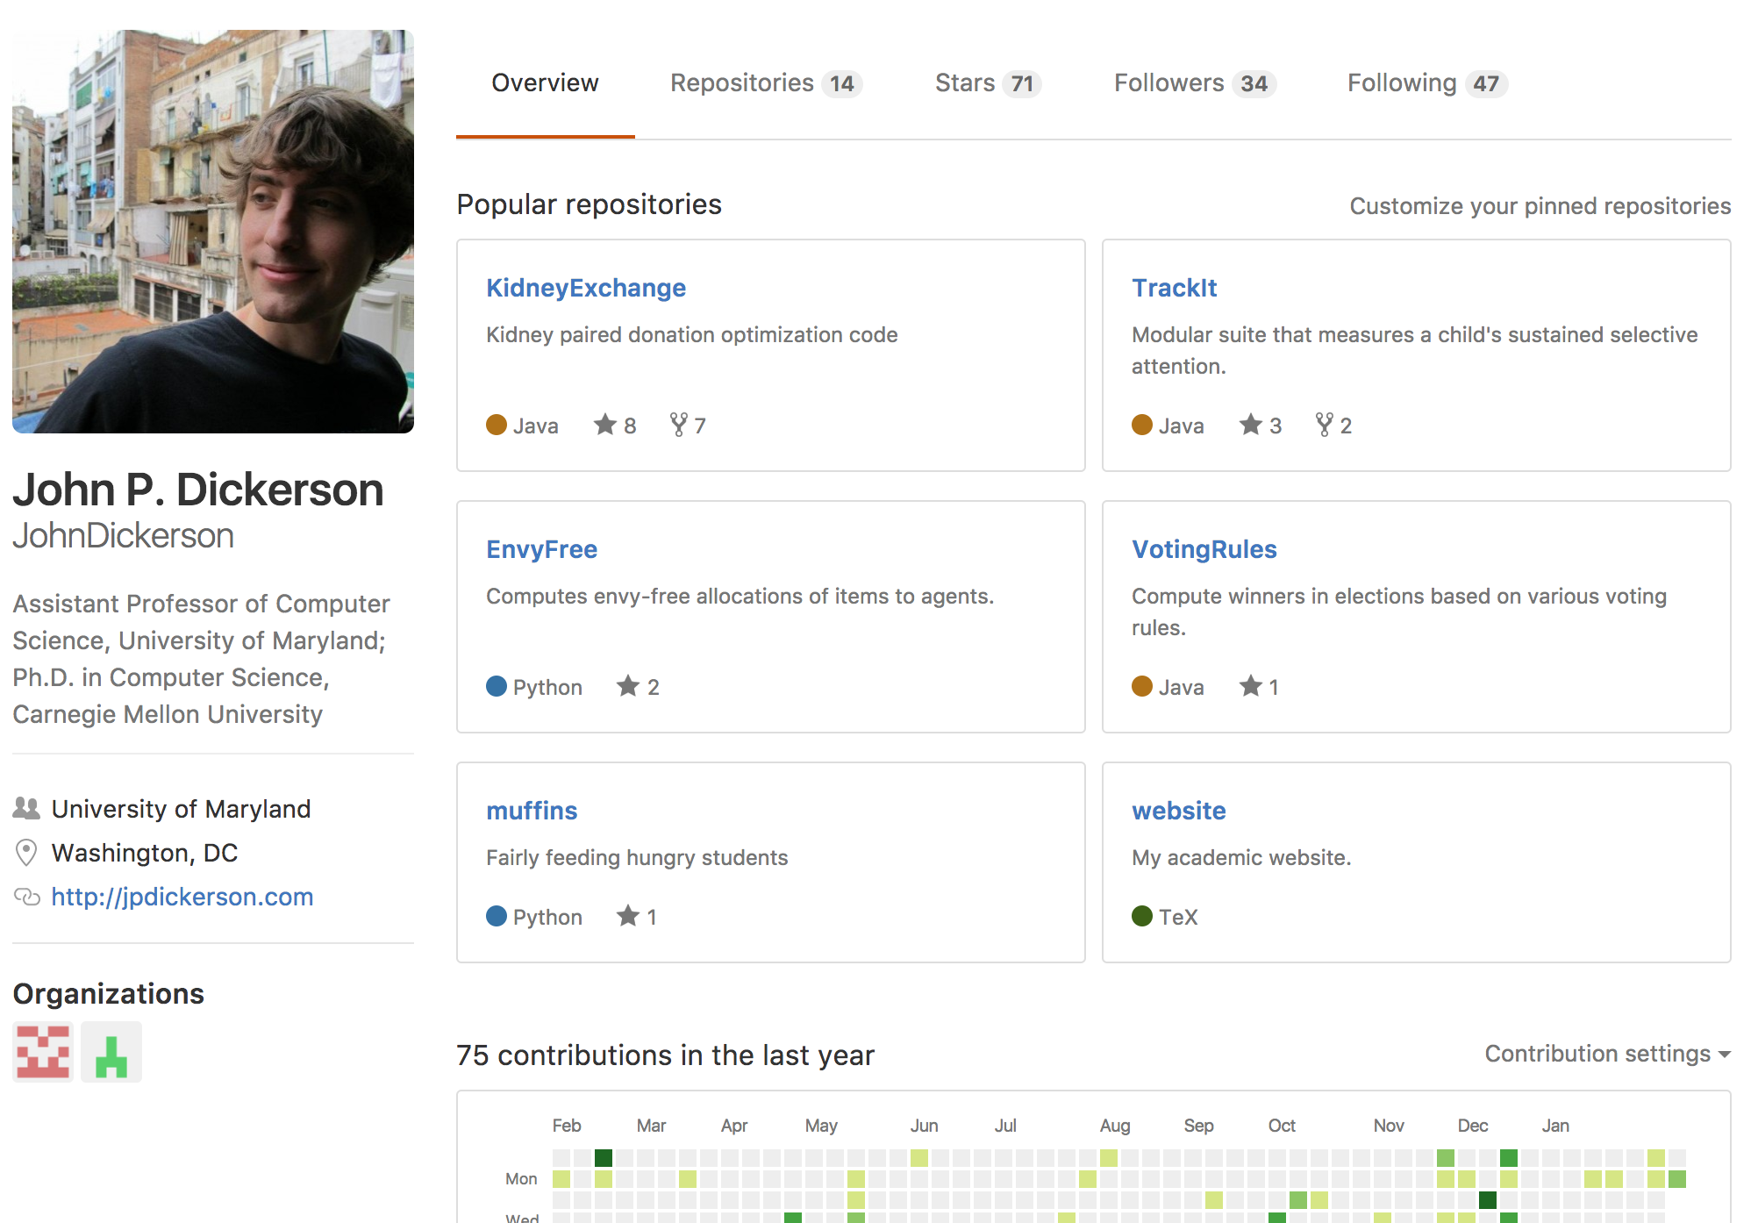
“Social coding”

Slide 138
Review: How to Use
Git commands for everyday usage are relatively simple
git pull
  Get the latest changes to the code
git add .
  Add any newly created files to the repository for tracking
git add –u
  Remove any deleted files from tracking and the repository
git commit –m ‘Changes’
  Make a version of changes you have made
git push
  Deploy the latest changes to the central repository
Make a repo on GitHub and clone it to your machine:
https://guides.github.com/activities/hello-world/

Slide 139
Stuff to click on
Git
http://git-scm.com/
GitHub
https://github.com/
https://guides.github.com/activities/hello-world/
^-- Just do this one. You’ll need it for your tutorial ☺.
GitLab
http://gitlab.org/
Git and SVN Comparison
  https://git.wiki.kernel.org/index.php/GitSvnComparison

