Slide 1
Principles of
Data Science
John P Dickerson
Lecture #3 – 9/12/2018
CMSC641
Wednesdays
7pm – 9:30pm

Slide 2
Announcements
The website is up! Hopefully …
http://www.cs.umd.edu/class/fall2018/cmsc641/
Office Hours: 6pm-7pm on Wednesdays, and also by appointment, or via email/text, or …
Reminder: Weekly quizzes, due on Mondays at noon
Project 1 will be released this week

Slide 3
The Data Lifecycle
Data collection
Data processing
Exploratory analysis
&
Data viz
Analysis, hypothesis testing, & ML
Insight & Policy Decision

Slide 4
The Data Lifecycle
Data collection
Data processing
Exploratory analysis
&
Data viz
Analysis, hypothesis testing, & ML
Insight & Policy Decision

Slide 5
Data Manipulation and Computation
Data Science == manipulating and computing on data
Large to very large, but somewhat “structured” data
We will see several tools for doing that this semester
Thousands more out there that we won’t cover
Need to learn to shift thinking from:
Imperative code to manipulate data structures
to:
Sequences/pipelines of operations on data
Should still know how to implement the operations themselves, especially for debugging performance (covered in classes like 642?, 643?), but we won’t cover that much

Slide 6
Data Manipulation and Computation
Data Representation, i.e., what is the natural way to think about given data
Data Processing Operations, which take one or more datasets as input and produce one or more datasets as output
Indexing
Slicing/subsetting
Filter
‘map’ → apply a function to every element
’reduce/aggregate’ → combine values to get a single scalar (e.g., sum, median)
Given two vectors: Dot and cross products
One-dimensional Arrays, Vectors
0.1 | 2 | 3.2 | 6.5 | 3.4 | 4.1
“data” | ”representation” | ”i.e.”

Slide 7
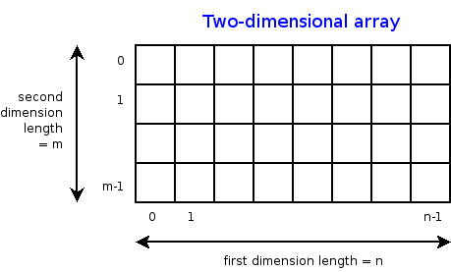
Data Manipulation and Computation
Data Representation, i.e., what is the natural way to think about given data
Data Processing Operations, which take one or more datasets as input and produce one or more datasets as output
Indexing
Slicing/subsetting
Filter
‘map’ → apply a function to every element
’reduce/aggregate’ → combine values across a row or a column (e.g., sum, average, median etc..)
n-dimensional arrays

Slide 8
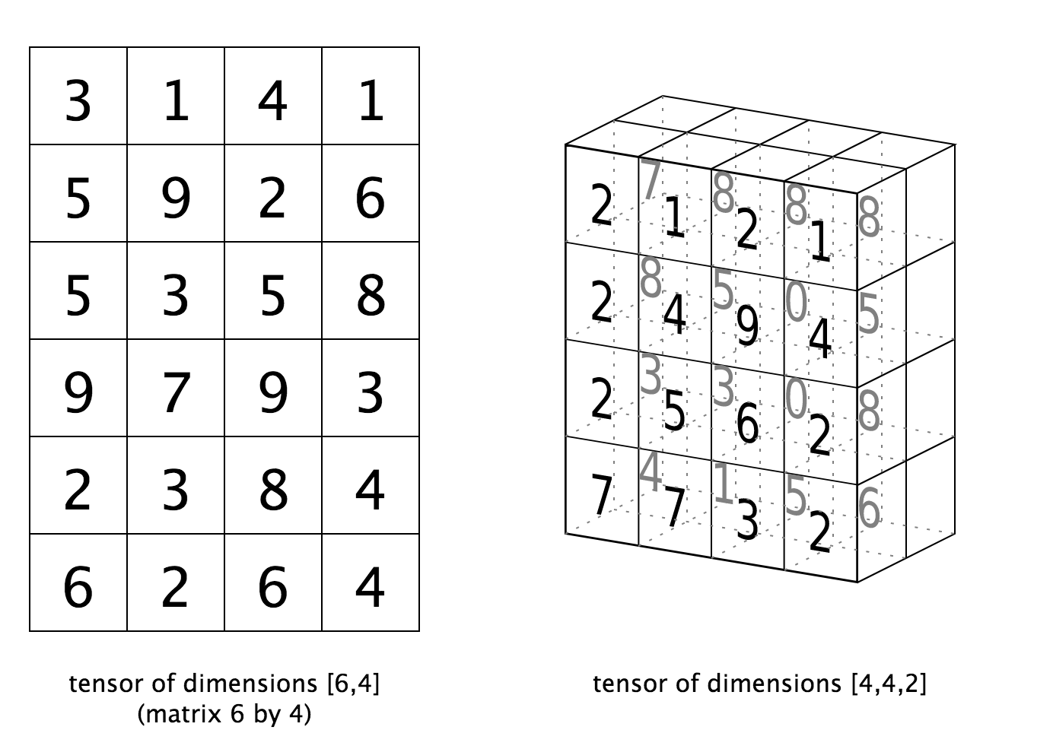
Data Manipulation and Computation
Data Representation, i.e., what is the natural way to think about given data
Data Processing Operations, which take one or more datasets as input and produce one or more datasets as output
Matrices, Tensors
n-dimensional array operations
+
Linear Algebra
Matrix/tensor multiplication
Transpose
Matrix-vector multiplication
Matrix factorization

Slide 9
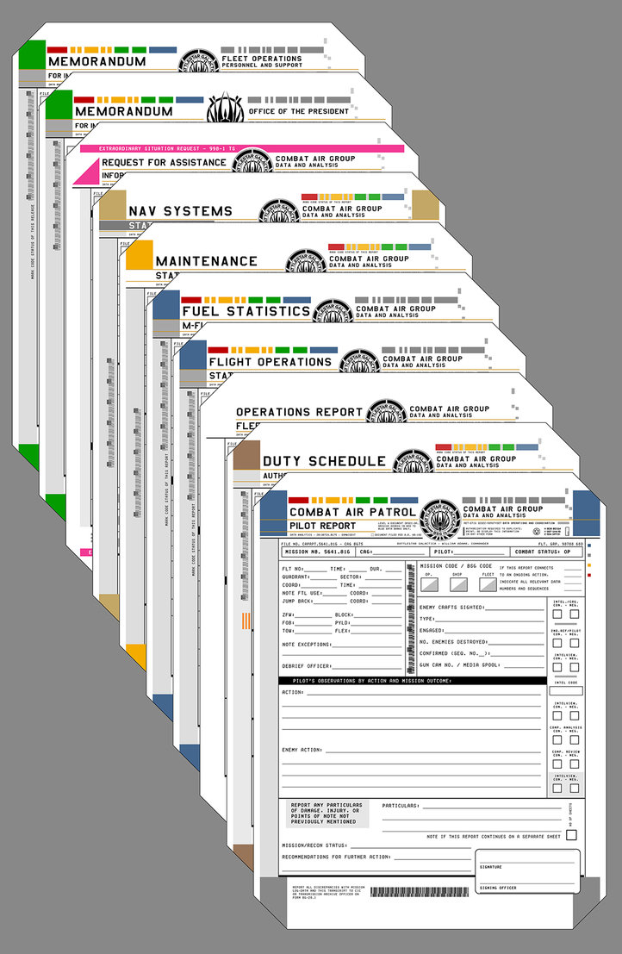
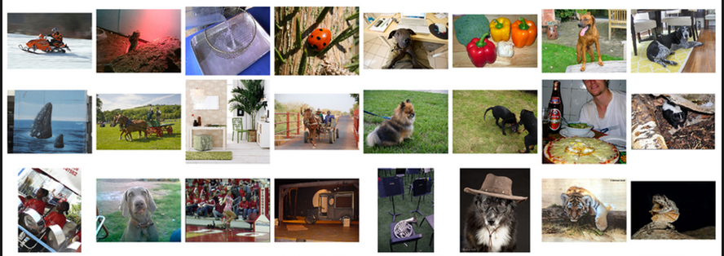
Data Manipulation and Computation
Data Representation, i.e., what is the natural way to think about given data
Data Processing Operations, which take one or more datasets as input and produce one or more datasets as output
Sets: of Objects
Filter
Map
Union
Reduce/Aggregate
Given two sets, Combine/Join using “keys”
Group and then aggregate
Sets: of (Key, Value Pairs)
(amol@cs.umd.edu,(email1, email2,…))
(john@cs.umd.edu,(email3, email4,…))

Slide 10
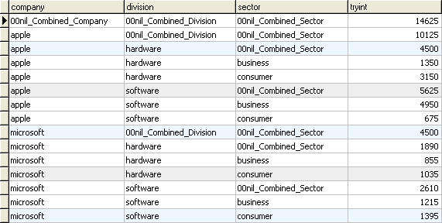
Data Manipulation and Computation
Data Representation, i.e., what is the natural way to think about given data
Data Processing Operations, which take one or more datasets as input and produce one or more datasets as output
Filter rows or columns
”Join” two or more relations
”Group” and “aggregate” them
Relational Algebra formalizes some of them
Structured Query Language (SQL)
  Many other languages and constructs, that look very similar
Tables/Relations == Sets of Tuples

Slide 11
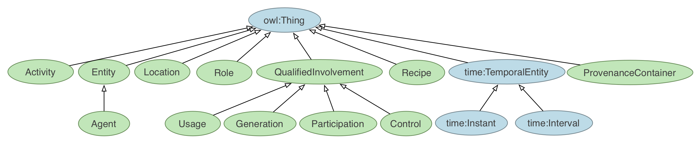
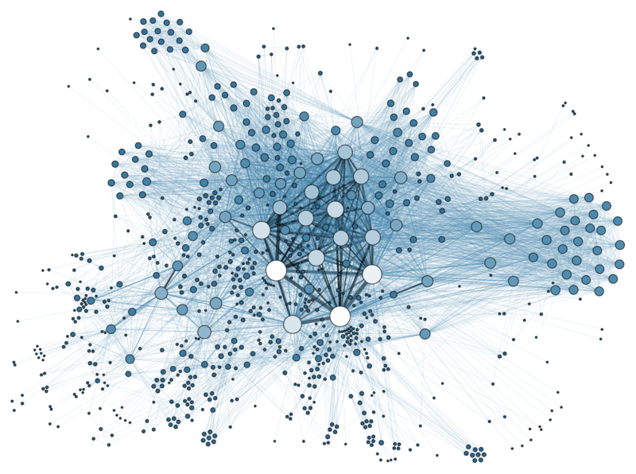
Data Manipulation and Computation
Data Representation, i.e., what is the natural way to think about given data
Data Processing Operations, which take one or more datasets as input and produce one or more datasets as output
Hierarchies/Trees/Graphs
”Path” queries
Graph Algorithms and Transformations
Network Science
Somewhat more ad hoc and special-purpose
Changing in recent years

Slide 12
Data Manipulation and Computation
Data Representation, i.e., what is the natural way to think about given data
Data Processing Operations, which take one or more datasets as input and produce
Why?
  Allows one to think at a higher level of abstraction, leading to simpler and easier-to-understand scripts
  Provides ”independence” between the abstract operations and concrete implementation
  Can switch from one implementation to another easily
For performance debugging, useful to know how they are implemented and rough characteristics

Slide 13
Next couple of classes
NumPy: Python Library for Manipulating nD Arrays
  Multidimensional Arrays, and a variety of operations including Linear Algebra
Pandas: Python Library for Manipulating Tabular Data
  Series, Tables (also called DataFrames)
  Many operations to manipulate and combine tables/series
Relational Databases
  Tables/Relations, and SQL (similar to Pandas operations)
4. Apache Spark
  Sets of objects or key-value pairs
  MapReduce and SQL-like operations

Slide 14
Next Couple of classes
NumPy: Python Library for Manipulating nD Arrays
  Multidimensional Arrays, and a variety of operations including Linear Algebra
Pandas: Python Library for Manipulating Tabular Data
  Series, Tables (also called DataFrames)
  Many operations to manipulate and combine tables/series
Relational Databases
  Tables/Relations, and SQL (similar to Pandas operations)
4. Apache Spark
  Sets of objects or key-value pairs
  MapReduce and SQL-like operations

Slide 15
Numeric & scientific applications
Number of third-party packages available for numerical and scientific computing
These include:
NumPy/SciPy – numerical and scientific function libraries.
numba – Python compiler that support JIT compilation.
ALGLIB – numerical analysis library.
pandas – high-performance data structures and data analysis tools.
pyGSL – Python interface for GNU Scientific Library.
ScientificPython – collection of scientific computing modules.
Many, many thanks to: FSU CIS4930

Slide 16
NumPy and friends
By far, the most commonly used packages are those in the NumPy stack. These packages include:
NumPy: similar functionality as Matlab
SciPy: integrates many other packages like NumPy
Matplotlib & Seaborn – plotting libraries
iPython via Jupyter – interactive computing
Pandas – data analysis library
SymPy – symbolic computation library
[FSU]

Slide 17
The Numpy Stack
CMSC643
Later
Today/next class
Image from Continuum Analytics
Notes:
NumPy = low-level LinAlg storage and manipulation
SciPy = scientific computing & stats algorithms built on top of NumPy
Pandas = friendlier version of NumPy backed by raw NumPy

Slide 18
numpy
Among other things, NumPy contains:
A powerful n-dimensional array object.
Sophisticated (broadcasting/universal) functions.
Tools for integrating C/C++ and Fortran code.
Useful linear algebra, Fourier transform, and random number capabilities, etc.
Besides its obvious scientific uses, NumPy can also be used as an efficient multi-dimensional container of generic data.
[FSU]

Slide 19
numpy
ndarray object: an n-dimensional array of homogeneous data types, with many operations being performed in compiled code for performance
Several important differences between NumPy arrays and the standard Python sequences:
NumPy arrays have a fixed size. Modifying the size means creating a new array.
NumPy arrays must be of the same data type, but this can include Python objects – may not get performance benefits
More efficient mathematical operations than built-in sequence types.
[FSU]

Slide 20
Numpy datatypes
Wider variety of data types than are built-in to the Python language by default.
Defined by the numpy.dtype class and include:
intc (same as a C integer) and intp (used for indexing)
int8, int16, int32, int64
uint8, uint16, uint32, uint64
float16, float32, float64
complex64, complex128
bool_, int_, float_, complex_ are shorthand for defaults.
These can be used as functions to cast literals or sequence types, as well as arguments to NumPy functions that accept the dtype keyword argument.
[FSU]

Slide 21
Numpy datatypes
>>> import numpy as np
>>> x = np.float32(1.0)
>>> x
1.0
>>> y = np.int_([1,2,4])
>>> y
array([1, 2, 4])
>>> z = np.arange(3, dtype=np.uint8)
>>> z
array([0, 1, 2], dtype=uint8)
>>> z.dtype
dtype('uint8')
[FSU]

Slide 22
Numpy arrays
There are a couple of mechanisms for creating arrays in NumPy:
Conversion from other Python structures (e.g., lists, tuples)
  Any sequence-like data can be mapped to a ndarray
Built-in NumPy array creation (e.g., arange, ones, zeros, etc.)
  Create arrays with all zeros, all ones, increasing numbers from 0 to 1 etc.
Reading arrays from disk, either from standard or custom formats (e.g., reading in from a CSV file)
[FSU]

Slide 23
Numpy arrays
In general, any numerical data that is stored in an array-like container can be converted to an ndarray through use of the array() function. The most obvious examples are sequence types like lists and tuples.
>>> x = np.array([2,3,1,0])
>>> x = np.array([2, 3, 1, 0])
>>> x = np.array([[1,2.0],[0,0],(1+1j,3.)])
>>> x = np.array([[ 1.+0.j, 2.+0.j], [ 0.+0.j, 0.+0.j], [ 1.+1.j, 3.+0.j]])
[FSU]

Slide 24
Numpy arrays
Creating arrays from scratch in NumPy:
zeros(shape)– creates an array filled with 0 values with the specified shape. The default dtype is float64.
ones(shape) – creates an array filled with 1 values.
arange() – like Python’s built-in range
>>> np.zeros((2, 3))
array([[ 0., 0., 0.], [ 0., 0., 0.]])
>>> np.arange(10)
array([0, 1, 2, 3, 4, 5, 6, 7, 8, 9])
>>> np.arange(2, 10, dtype=np.float)
array([ 2., 3., 4., 5., 6., 7., 8., 9.])
>>> np.arange(2, 3, 0.2)
array([ 2. , 2.2, 2.4, 2.6, 2.8])
[FSU]

Slide 25
Numpy arrays
linspace()– creates arrays with a specified number of elements, and spaced equally between the specified beginning and end values.
random.random(shape) – creates arrays with random floats over the interval [0,1).
>>> np.linspace(1., 4., 6)
array([ 1. , 1.6, 2.2, 2.8, 3.4, 4. ])
>>> np.random.random((2,3))
array([[ 0.75688597, 0.41759916, 0.35007419],
[ 0.77164187, 0.05869089, 0.98792864]])
[FSU]

Slide 26
Numpy arrays
>>> import numpy as np
>>> a = np.arange(3)
>>> print(a)
[0 1 2]
>>> a
array([0, 1, 2])
>>> b = np.arange(9).reshape(3,3)
>>> print(b)
[[0 1 2]
[3 4 5]
[6 7 8]]
>>> c = np.arange(8).reshape(2,2,2)
>>> print(c)
[[[0 1]
[2 3]]
[[4 5]
[6 7]]]
Printing an array can be done with the print
statement (Python 2)
function (Python 3)
[FSU]

Slide 27
indexing
Single-dimension indexing is accomplished as usual.
Multi-dimensional arrays support multi-dimensional indexing.
>>> x = np.arange(10)
>>> x[2]
2
>>> x[-2]
8
>>> x.shape = (2,5) # now x is 2-dimensional
>>> x[1,3]
8
>>> x[1,-1]
9

Slide 28
indexing
Using fewer dimensions to index will result in a subarray:
This means that x[i, j] == x[i][j] but the second method is less efficient.
>>> x = np.arange(10)
>>> x.shape = (2,5)
>>> x[0]
array([0, 1, 2, 3, 4])

Slide 29
indexing
Slicing is possible just as it is for typical Python sequences:
>>> x = np.arange(10)
>>> x[2:5]
array([2, 3, 4])
>>> x[:-7]
array([0, 1, 2])
>>> x[1:7:2]
array([1, 3, 5])
>>> y = np.arange(35).reshape(5,7)
>>> y[1:5:2,::3]
array([[ 7, 10, 13], [21, 24, 27]])

Slide 30
Array operations
Basic operations apply element-wise. The result is a new array with the resultant elements.
>>> a = np.arange(5)
>>> b = np.arange(5)
>>> a+b
array([0, 2, 4, 6, 8])
>>> a-b
array([0, 0, 0, 0, 0])
>>> a**2
array([ 0, 1, 4, 9, 16])
>>> a>3
array([False, False, False, False, True], dtype=bool)
>>> 10*np.sin(a)
array([ 0., 8.41470985, 9.09297427, 1.41120008, -7.56802495])
>>> a*b
array([ 0, 1, 4, 9, 16])

Slide 31
Array operations
>>> a = np.zeros(4).reshape(2,2)
>>> a
array([[ 0., 0.],
[ 0., 0.]])
>>> a[0,0] = 1
>>> a[1,1] = 1
>>> b = np.arange(4).reshape(2,2)
>>> b
array([[0, 1],
[2, 3]])
>>> a*b
array([[ 0., 0.],
[ 0., 3.]])
>>> np.dot(a,b)
array([[ 0., 1.],
[ 2., 3.]])
Since multiplication is done element-wise, you need to specifically perform a dot product to perform matrix multiplication.

Slide 32
Array operations
>>> a = np.random.random((2,3))
>>> a
array([[ 0.68166391, 0.98943098, 0.69361582],
[ 0.78888081, 0.62197125, 0.40517936]])
>>> a.sum()
4.1807421388722164
>>> a.min()
0.4051793610379143
>>> a.max(axis=0)
array([ 0.78888081, 0.98943098, 0.69361582])
>>> a.min(axis=1)
array([ 0.68166391, 0.40517936])
There are also some built-in methods of ndarray objects.
Universal functions which may also be applied include exp, sqrt, add, sin,
cos, etc.

Slide 33
Array operations
>>> a = np.floor(10*np.random.random((3,4)))
>>> print(a)
[[ 9. 8. 7. 9.]
[ 7. 5. 9. 7.]
[ 8. 2. 7. 5.]]
>>> a.shape
(3, 4)
>>> a.ravel()
array([ 9., 8., 7., 9., 7., 5., 9., 7., 8., 2., 7., 5.])
>>> a.shape = (6,2)
>>> print(a)
[[ 9. 8.]
[ 7. 9.]
[ 7. 5.]
[ 9. 7.]
[ 8. 2.]
[ 7. 5.]]
>>> a.transpose()
array([[ 9., 7., 7., 9., 8., 7.],
[ 8., 9., 5., 7., 2., 5.]])
An array shape can be manipulated by a number of methods.
resize(size) will modify an array in place.
reshape(size) will return a copy of the array with a new shape.

Slide 34
Linear algebra
One of the most common reasons for using the NumPy package is its linear algebra module.
It’s like Matlab, but free!
>>> from numpy import *
>>> from numpy.linalg import *
>>> a = array([[1.0, 2.0],
[3.0, 4.0]])
>>> print(a)
[[ 1. 2.]
[ 3. 4.]]
>>> a.transpose()
array([[ 1., 3.],
[ 2., 4.]])
>>> inv(a) # inverse
array([[-2. , 1. ],
[ 1.5, -0.5]])

Slide 35
Linear algebra
>>> u = eye(2) # unit 2x2 matrix; "eye" represents "I"
>>> u
array([[ 1., 0.],
[ 0., 1.]])
>>> j = array([[0.0, -1.0], [1.0, 0.0]])
>>> dot(j, j) # matrix product
array([[-1., 0.],
[ 0., -1.]])
>>> trace(u) # trace (sum of elements on diagonal)
2.0
>>> y = array([[5.], [7.]])
>>> solve(a, y) # solve linear matrix equation
array([[-3.],
[ 4.]])
>>> eig(j) # get eigenvalues/eigenvectors of matrix
(array([ 0.+1.j, 0.-1.j]),
array([[ 0.70710678+0.j, 0.70710678+0.j],
[ 0.00000000-0.70710678j, 0.00000000+0.70710678j]]))
(We’ll talk about this stuff as needed in the March/April machine learning and statistics lectures.)

Slide 36
SciPy?
In its own words:
Basically, SciPy contains various tools and functions for solving common problems in scientific computing.
SciPy is a collection of mathematical algorithms and convenience functions built on the NumPy extension of Python. It adds significant power to the interactive Python session by providing the user with high-level commands and classes for manipulating and visualizing data.

Slide 37
SciPY
SciPy gives you access to a ton of specialized mathematical functionality.
Just know it exists. We won’t use it much in this class.
Some functionality:
Special mathematical functions (scipy.special) -- elliptic, bessel, etc.
Integration (scipy.integrate)
Optimization (scipy.optimize)
Interpolation (scipy.interpolate)
Fourier Transforms (scipy.fftpack)
Signal Processing (scipy.signal)
Linear Algebra (scipy.linalg)
Compressed Sparse Graph Routines (scipy.sparse.csgraph)
Spatial data structures and algorithms (scipy.spatial)
Statistics (scipy.stats)
Multidimensional image processing (scipy.ndimage)
Data IO (scipy.io) – overlaps with pandas, covers some other formats

Slide 38
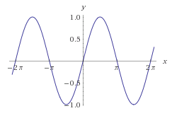

One SciPy Example
We can’t possibly tour all of the SciPy library and, even if we did, it might be a little boring.
Often, you’ll be able to find higher-level modules that will work around your need to directly call low-level SciPy functions
Say you want to compute an integral:
$$\int_{a}^{b}{\sin{x}dx}$$

Slide 39

Scipy.integrate
We have a function object – np.sin defines the sin function for us.
We can compute the definite integral from $x=0$ to $x=π$ using the quad function.
>>> res = scipy.integrate.quad(np.sin, 0, np.pi)
>>> print(res)
(2.0, 2.220446049250313e-14) # 2 with a very small error margin!
>>> res = scipy.integrate.quad(np.sin, -np.inf, +np.inf)
>>> print(res)
(0.0, 0.0) # Integral does not converge

Slide 40
Scipy.integrate
Let’s say that we don’t have a function object, we only have some (x,y) samples that “define” our function.
We can estimate the integral using the trapezoidal rule.
>>> sample_x = np.linspace(0, np.pi, 1000)
>>> sample_y = np.sin(sample_x) # Creating 1,000 samples
>>> result = scipy.integrate.trapz(sample_y, sample_x)
>>> print(result)
1.99999835177
>>> sample_x = np.linspace(0, np.pi, 1000000)
>>> sample_y = np.sin(sample_x) # Creating 1,000,000 samples
>>> result = scipy.integrate.trapz(sample_y, sample_x)
>>> print(result)
2.0

Slide 41
Wrap up
Shift thinking from imperative coding to operations on datasets
Numpy: A low-level abstraction that gives us really fast multi-dimensional arrays
In a bit:
Pandas: Higher-level tabular abstraction and operations to manipulate and combine tables
Reading Homework focuses on Pandas and SQL: Aim to release by tonight, probably by tomorrow

Slide 42
Rest of Today’s Lecture
By popular request …
Version control primer!
Specifically, git via GitHub and GitLab
Thanks: Mark Groves (Microsoft), Ilan Biala & Aaron Perley (CMU), Sharif U., & the HJCB Senior Design Team!
And then a bit on keeping your data … tidy data.

Slide 43
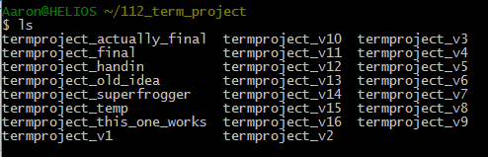
What is version control?

Slide 44
Development Tool
When working with a team, the need for a central repository is essential
Need a system to allow versioning, and a way to acquire the latest edition of the code
A system to track and manage bugs was also needed

Slide 45
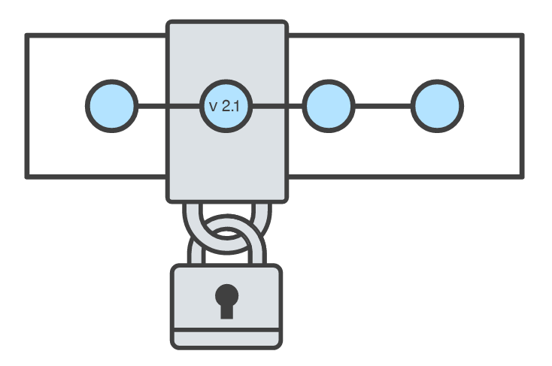
Goals of Version Control
Be able to search through revision history and retrieve previous versions of any file in a project
Be able to share changes with collaborators on a project
Be able to confidently make large changes to existing files
atlassian.com/git/tutorials/what-is-version-control

Slide 46
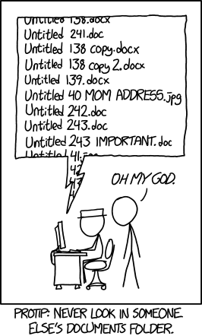
Named Folders Approach
Can be hard to track
Memory-intensive
Can be slow
Hard to share
No record of authorship

Slide 47
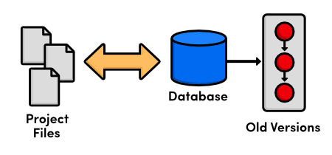
Local Database of Versions Approach
Provides an abstraction over finding the right versions of files and replacing them in the project
Records who changes what, but hard to parse that
Can’t share with collaborators

Slide 48
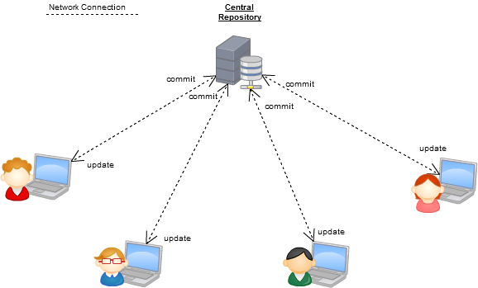
Centralized Version Control Systems
A central, trusted repository determines the order of commits (“versions” of the project)
Collaborators “push” changes (commits) to this repository.
Any new commits must be compatible with the most recent commit. If it isn’t, somebody must “merge” it in.
Examples: SVN, CVS, Perforce

Slide 49
Distributed Version Control Systems (DVCS)
No central repository
Every repository has every commit
Examples: Git, Mercurial
Developer A’s local files
Developer B’s local files
Commit
Dev C’s Repo
Commit
Dev A’s Repo
Push/Fetch
Commit
Commit
Checkout
Central Repository
Checkout
Push/Fetch
Push/Fetch
Push/Fetch
Commit
Commit
Commit
Dev D’s Repo
Developer C’s local files
Checkout
Checkout
Developer D’s local files
Push/Fetch
Dev B’s Repo
Push/Fetch
Centralized Version Control System
Distributed Version Control System
Commit

Slide 50
What is Git
Git is a version control system
Developed as a repository system for both local and remote changes
Allows teammates to work simultaneously on a project
Tracks each commit, allowing for a detailed documentation of the project along every step
Allows for advanced merging and branching operations

Slide 51
A short history of Git
Linux kernel development
1991-2002
Changes passed around as archived file
2002-2005
Using a DVCS called BitKeeper
2005
Relationship broke down between two communities (BitKeeper licensing issues)

Slide 52
A short history of Git
Goals:
Speed
Simple design
Strong support for non-linear development (thousands of parallel branches)
Fully distributed – not a requirement, can be centralized
Able to handle large projects like the Linux kernel efficiently (speed and data size)

Slide 53
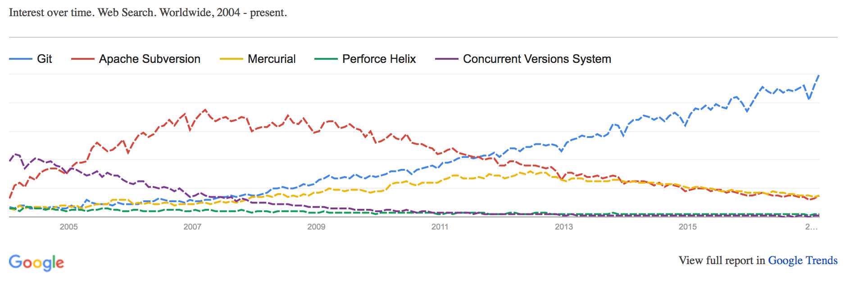
A short history of Git
Popularity:
Git is now the most widely used source code management tool
33.3% of professional software developers use Git (often through GitHub) as their primary source control system
[citation needed]

Slide 54
Git in Industry
Companies and projects currently using Git
Google
Android
Facebook
Microsoft
Netflix
Linux
Ruby on Rails
Gnome
KDE
Eclipse
X.org

Slide 55
Git Basics
Snapshots, not changes
A picture of what all your files look like at that moment
If a file has not changed, store a reference
Nearly every operation is local
Browsing the history of project
See changes between two versions

Slide 56
Why Git is Better
Git tracks the content rather than the files
Branches are lightweight, and merging is a simple process
Allows for a more streamlined offline development process
Repositories are smaller in size and are stored in a single .git directory
Allows for advanced staging operations, and the use of stashing when working through troublesome sections

Slide 57
Git vs {CVS, SVN, …}
Why you should care:
Many places use legacy systems that will cause problems in the future – be the change you believe in!
Git is much faster than SVN:
Coded in C, which allows for a great amount of optimization
Accomplishes much of the logic client side, thereby reducing time needed for communication
Developed to work on the Linux kernel, so that large project manipulation is at the forefront of the benchmarks

Slide 58
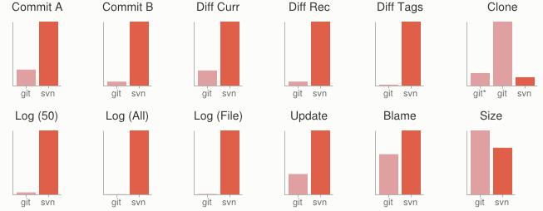
Git vs {CVS, SVN, …}
Speed benchmarks:
Benchmarks performed by http://git-scm.com/about/small-and-fast

Slide 59
Git vs {CVS, SVN, …}
Git is significantly smaller than SVN
All files are contained in a small decentralized .git file
In the case of Mozilla’s projects, a Git repository was 30 times smaller than an identical SVN repository
Entire Linux kernel with 5 years of versioning contained in a single 1 GB .git file
SVN carries two complete copies of each file, while Git maintains a simple and separate 100 bytes of data per file, noting changes and supporting operations
Nice because you can (and do!) store the whole thing locally

Slide 60
Git vs {CVS, SVN, …}
Git is more secure than SVN
All commits are uniquely hashed for both security and indexing purposes
Commits can be authenticated through numerous means
  In the case of SSH commits, a key may be provided by both the client and server to guarantee authenticity and prevent against unauthorized access

Slide 61
Git vs {CVS, SVN, …}
Git is decentralized:
Each user contains an individual repository and can check commits against itself, allowing for detailed local revisioning
Being decentralized allows for easy replication and deployment
In this case, SVN relies on a single centralized repository and is unusable without

Slide 62
Git vs {CVS, SVN, …}
Git is flexible:
Due to it’s decentralized nature, git commits can be stored locally, or committed through HTTP, SSH, FTP, or even by Email
No need for a centralized repository
Developed as a command line utility, which allows a large amount of features to be built and customized on top of it

Slide 63
Git vs {CVS, SVN, …}
Data assurance: a checksum is performed on both upload and download to ensure sure that the file hasn’t been corrupted.
Commit IDs are generated upon each commit:
Linked list style of commits
Each commit is linked to the next, so that if something in the history was changed, each following commit will be rebranded to indicate the modification

Slide 64
Git vs {CVS, SVN, …}
Branching:
Git allows the usage of advanced branching mechanisms and procedures
Individual divisions of the code can be separated and developed separately within separate branches of the code
Branches can allow for the separation of work between developers, or even for disposable experimentation
Branching is a precursor and a component of the merging process
Will give an example shortly.

Slide 65
Git vs {CVS, SVN, …}
Merging
The process of merging is directly related to the process of branching
Individual branches may be merged together, solving code conflicts, back into the default or master branch of the project
Merges are usually done automatically, unless a conflict is presented, in which case the user is presented with several options with which to handle the conflict
Will give an example shortly.

Slide 66
Git vs {CVS, SVN, …}
Merging: content of the files is tracked rather than the file itself:
This allows for a greater element of tracking and a smarter and more automated process of merging
SVN is unable to accomplish this, and will throw a conflict if, e.g., a file name is changed and differs from the name in the central repository
Git is able to solve this problem with its use of managing a local repository and tracking individual changes to the code

Slide 67
Initialization of a git repository
C:\> mkdir CoolProject
C:\> cd CoolProject
C:\CoolProject > git init
Initialized empty Git repository in C:/CoolProject/.git
C:\CoolProject > notepad README.txt
C:\CoolProject > git add .
C:\CoolProject > git commit -m 'my first commit'
[master (root-commit) 7106a52] my first commit
1 file changed, 1 insertion(+)
create mode 100644 README.txt
Notes:
After you install git on your machine to get started you will need to initialize a repository.
You can do this by going into your file system, creating a folder and doing git init within the folder.
All the magic happens in the Dot Git folder. This folder IS GIT. You can copy this folder to another machine and it will work.
When I first started playing with git, I had setup a new machine, and was having a hell of a time trying to figure out how I should move my git projects over to the new machine. It was kind of embarrassing. Eventually I just tried to copy it over and it worked.
At this point you really don’t have much. You need to do your first commit to make this light up.
You create a file. When then stage it, but telling git the track this file. In this case I told git to add all files.
Then I was able to commit with a message say this is my first commit.

Slide 68
Git Basics I
The three (or four) states of a file:
Modified:
  File has changed but not committed
Staged:
  Marked to go to next commit snapshot
Committed:
  Safely stored in local database
Untracked!
  Newly added or removed files

Slide 69
Git Basics II
Three main areas of a git project:
Working directory
  Single checkout of one version of the project.
Staging area
  Simple file storing information about what will go into your next commit
Git directory
  What is copied when cloning a repository

Slide 70
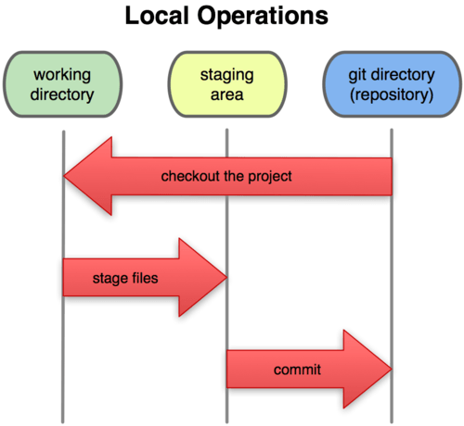
Git Basics III
Three main areas of a git project:

Slide 71
Branches Illustrated
(Default branch is called “master”; your first commit will be on this branch.)
master
A
> git commit –m ‘my first commit’
Notes:
Now lets see what this visually looks like.
On my first commit I have A.
The default branch that gets created with git is a branch names Master.
This is just a default name. As I mentioned before, most everything in git is done by convention. Master does not mean anything special to git.

Slide 72
Branches Illustrated
master
A
B
C
> git commit (x2)
Notes:
We make a set of commits, moving master and our current pointer (*) along

Slide 73
Branches Illustrated
master
A
B
C
bug123
> git checkout –b bug123
Notes:
Suppose we want to work on a bug. We start by creating a local “story branch” for this work.
Notice that the new branch is really just a pointer to the same commit (C) but our current pointer (*) is moved.

Slide 74
Branches Illustrated
master
A
B
C
D
E
bug123
> git commit (x2)
Notes:
Now we make commits and they move along, with the branch and current pointer following along.

Slide 75
Branches Illustrated
master
A
B
C
D
E
bug123
> git checkout master
Notes:
We can “checkout” to go back to the master branch.
This is where I was freaked out the first time I did this. My IDE removed the changes I just made. It can be pretty startling, but don’t worry you didn’t lose anything.

Slide 76
Branches Illustrated
master
A
B
C
D
E
bug123
> git merge bug123
Notes:
And then merge from the story branch, bringing those change histories together.

Slide 77
Branches Illustrated
master
A
B
C
D
E
> git branch -d bug123
Notes:
And since we’re done with the story branch, we can delete it. This all happened locally, without affecting anyone upstream.

Slide 78
Branches Illustrated
master
A
B
C
D
E
F
G
bug456
Notes:
Let’s consider another scenario. Here we created our bug story branch back off of (C). But some changes have happened in master (bug 123 which we just merged) since then.
And we made a couple of commits in bug 456.

Slide 79
Branches Illustrated
master
A
B
C
D
E
F
G
bug456
> git checkout master
Notes:
Again, to merge, we checkout back to master which moves our (*) pointer.

Slide 80
Branches Illustrated
master
A
B
C
D
E
H
F
G
bug456
> git merge bug456
Notes:
And now we merge, connecting the new (H) to both (E) and (G). Note that this merge, especially if there are conflicts, can be unpleasant to perform.

Slide 81
Branches Illustrated
master
A
B
C
D
E
H
F
G
> git branch -d bug456
Notes:
Now we delete the branch pointer.
But notice the structure we have now. This is very non-linear. That will make it challenging to see the changes independently. And it can get very messy over time.

Slide 82
Branches Illustrated
master
A
B
C
D
E
F
G
bug456
Notes:
Rebase flow - Let’s go back in time and look at another approach that git enables. So here we are ready to merge.

Slide 83
Branches Illustrated
master
A
B
C
D
E
F’
G’
bug456
> git rebase master
Notes:
Instead of merging, we “rebase”.
What this means is something like this:
1. Take the changes we had made against (C) and undo them, but remember what they were
2. Re-apply them on (E) instead

Slide 84
Branches Illustrated
master
A
B
C
D
E
F’
G’
bug456
> git checkout master
> git merge bug456
Notes:
Now when we merge them, we get a nice linear flow.
Also, the actual changeset ordering in the repository mirrors what actually happened. (F’) and (G’) come after E rather than in parallel to it. Also, there is one fewer snapshots in the repository.

Slide 85
When to branch?
General rule of thumb:
Anything in the master branch is always deployable.
Local branching is very lightweight!
New feature? Branch!
Experiment that you won’t ever deploy? Branch!
Good habits:
Name your branch something descriptive (add-like-button, refactor-jobs, create-ai-singularity)
Make your commit messages descriptive, too!

Slide 86
So you want somebody else to host this for you …
Git: general distributed version control system
GitHub / BitBucket / GitLab / …: hosting services for git repositories
In general, GitHub is the most popular:
Lots of big projects (e.g., Python, Bootstrap, Angular, D3, node, Django, Visual Studio)
Lots of ridiculously awesome projects (e.g., https://github.com/maxbbraun/trump2cash)
There are reasons to use the competitors (e.g., private repositories, access control)

Slide 87
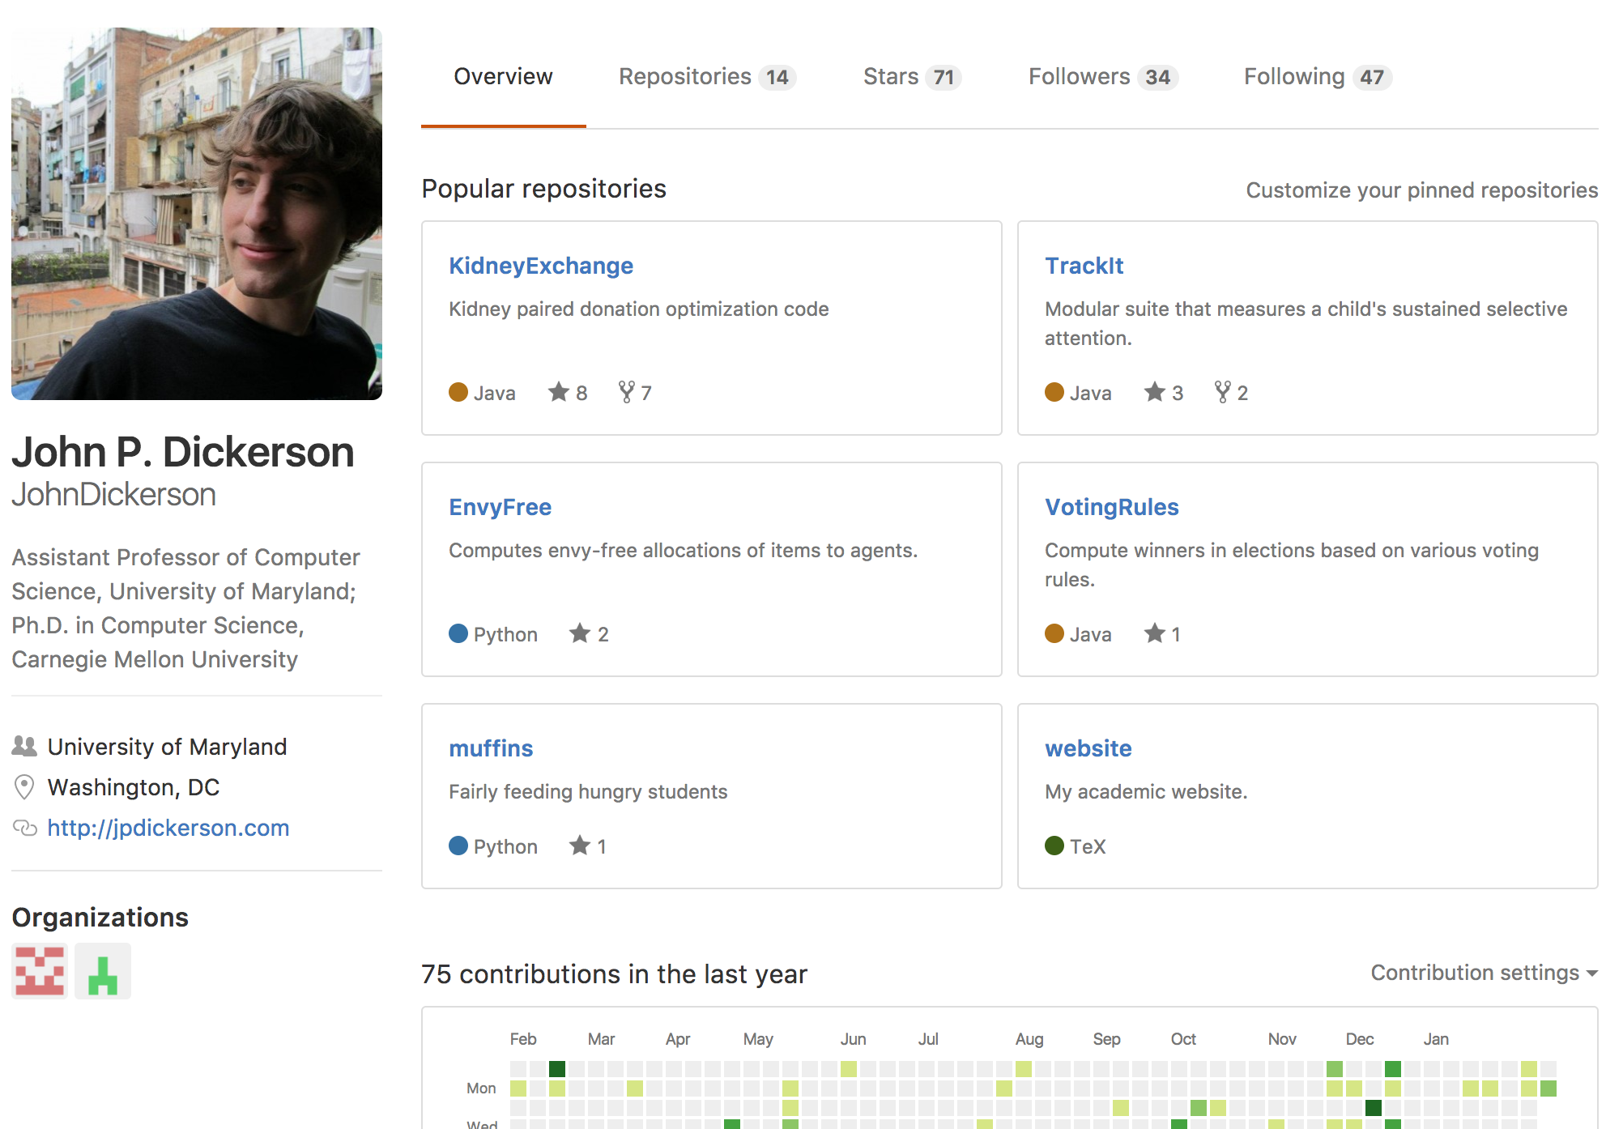
“Social coding”

Slide 88
Review: How to Use
Git commands for everyday usage are relatively simple
git pull
  Get the latest changes to the code
git add .
  Add any newly created files to the repository for tracking
git add –u
  Remove any deleted files from tracking and the repository
git commit –m ‘Changes’
  Make a version of changes you have made
git push
  Deploy the latest changes to the central repository
Make a repo on GitHub and clone it to your machine:
https://guides.github.com/activities/hello-world/

Slide 89
Stuff to click on
Git
http://git-scm.com/
GitHub
https://github.com/
https://guides.github.com/activities/hello-world/
^-- Just do this one. You’ll need it for your tutorial ☺.
GitLab
http://gitlab.org/
Git and SVN Comparison
  https://git.wiki.kernel.org/index.php/GitSvnComparison

Slide 91
Today/Next Class
Tables
  Abstraction
  Operations
Pandas
Tidy Data
SQL

Slide 92
Tables
Special Column, called “Index”, or “ID”, or “Key”
Usually, no duplicates Allowed
Variables
(also called Attributes, or Columns, or Labels)
ID | age | wgt_kg | hgt_cm
1 | 12.2 | 42.3 | 145.1
2 | 11.0 | 40.8 | 143.8
3 | 15.6 | 65.3 | 165.3
4 | 35.1 | 84.2 | 185.8
Observations,
Rows, or
Tuples

Slide 93
Tables
ID | Address
1 | College Park, MD, 20742
2 | Washington, DC, 20001
3 | Silver Spring, MD 20901
ID | age | wgt_kg | hgt_cm
1 | 12.2 | 42.3 | 145.1
2 | 11.0 | 40.8 | 143.8
3 | 15.6 | 65.3 | 165.3
4 | 35.1 | 84.2 | 185.8
199.72.81.55 - - [01/Jul/1995:00:00:01 -0400] "GET /history/apollo/ HTTP/1.0" 200 6245
unicomp6.unicomp.net - - [01/Jul/1995:00:00:06 -0400] "GET /shuttle/countdown/ HTTP/1.0" 200 3985
199.120.110.21 - - [01/Jul/1995:00:00:09 -0400] "GET /shuttle/missions/sts-73/mission-sts-73.html HTTP/1.0" 200 4085

Slide 94
1. Select/slicing
Select only some of the rows, or some of the columns, or a combination
ID | age
1 | 12.2
2 | 11.0
3 | 15.6
4 | 35.1
ID | age | wgt_kg | hgt_cm
1 | 12.2 | 42.3 | 145.1
2 | 11.0 | 40.8 | 143.8
3 | 15.6 | 65.3 | 165.3
4 | 35.1 | 84.2 | 185.8
Only columns
ID and Age
Both
Only rows with wgt > 41
ID | age
1 | 12.2
3 | 15.6
4 | 35.1
ID | age | wgt_kg | hgt_cm
1 | 12.2 | 42.3 | 145.1
3 | 15.6 | 65.3 | 165.3
4 | 35.1 | 84.2 | 185.8

Slide 95
2. Aggregate/Reduce
Combine values across a column into a single value
73.9 | 232.6 | 640.0
ID | age | wgt_kg | hgt_cm
1 | 12.2 | 42.3 | 145.1
2 | 11.0 | 40.8 | 143.8
3 | 15.6 | 65.3 | 165.3
4 | 35.1 | 84.2 | 185.8
SUM
MAX
35.1 | 84.2 | 185.8
SUM(wgt_kg^2 - hgt_cm)
What about ID/Index column?
Usually not meaningful to aggregate across it
May need to explicitly add an ID column
14167.66

Slide 96
3. Map
Apply a function to every row, possibly creating more or fewer columns
ID | Address
1 | College Park, MD, 20742
2 | Washington, DC, 20001
3 | Silver Spring, MD 20901
ID | City | State | Zipcode
1 | College Park | MD | 20742
2 | Washington | DC | 20001
3 | Silver Spring | MD | 20901
Variations that allow one row to generate multiple rows in the output (sometimes called “flatmap”)

Slide 97
4. Group By
A = foo
Group tuples together by column/dimension
ID | B | C
1 | 3 | 6.6
3 | 4 | 3.1
4 | 3 | 8.0
7 | 4 | 2.3
8 | 3 | 8.0
ID | A | B | C
1 | foo | 3 | 6.6
2 | bar | 2 | 4.7
3 | foo | 4 | 3.1
4 | foo | 3 | 8.0
5 | bar | 1 | 1.2
6 | bar | 2 | 2.5
7 | foo | 4 | 2.3
8 | foo | 3 | 8.0
By ‘A’
A = bar
ID | B | C
2 | 2 | 4.7
5 | 1 | 1.2
6 | 2 | 2.5

Slide 98
4. Group By
B = 1
ID | A | C
5 | bar | 1.2
Group tuples together by column/dimension
B = 2
ID | A | C
2 | bar | 4.7
6 | bar | 2.5
ID | A | B | C
1 | foo | 3 | 6.6
2 | bar | 2 | 4.7
3 | foo | 4 | 3.1
4 | foo | 3 | 8.0
5 | bar | 1 | 1.2
6 | bar | 2 | 2.5
7 | foo | 4 | 2.3
8 | foo | 3 | 8.0
B = 3
By ‘B’
ID | A | C
1 | foo | 6.6
4 | foo | 8.0
8 | foo | 8.0
B = 4
ID | A | C
3 | foo | 3.1
7 | foo | 2.3

Slide 99
4. Group By
A = bar, B = 1
ID | C
5 | 1.2
Group tuples together by column/dimension
A = bar, B = 2
ID | C
2 | 4.7
6 | 2.5
ID | A | B | C
1 | foo | 3 | 6.6
2 | bar | 2 | 4.7
3 | foo | 4 | 3.1
4 | foo | 3 | 8.0
5 | bar | 1 | 1.2
6 | bar | 2 | 2.5
7 | foo | 4 | 2.3
8 | foo | 3 | 8.0
A = foo, B = 3
By ‘A’, ‘B’
ID | C
1 | 6.6
4 | 8.0
8 | 8.0
A = foo, B = 4
ID | C
3 | 3.1
7 | 2.3

Slide 100
5. Group By Aggregate
B = 1
B = 1
ID | A | C
5 | bar | 1.2
Sum (C)
1.2
B = 2
Compute one aggregate
Per group
ID | A | C
2 | bar | 4.7
6 | bar | 2.5
B = 2
Sum (C)
7.2
ID | A | B | C
1 | foo | 3 | 6.6
2 | bar | 2 | 4.7
3 | foo | 4 | 3.1
4 | foo | 3 | 8.0
5 | bar | 1 | 1.2
6 | bar | 2 | 2.5
7 | foo | 4 | 2.3
8 | foo | 3 | 8.0
B = 3
B = 3
ID | A | C
1 | foo | 6.6
4 | foo | 8.0
8 | foo | 8.0
Group by ‘B’
Sum on C
Sum (C)
22.6
B = 4
B = 4
Sum (C)
5.4
ID | A | C
3 | foo | 3.1
7 | foo | 2.3
100

Slide 101
5. Group By Aggregate
B = 1
Sum (C)
1.2
Final result usually seen
As a table
B = 2
Sum (C)
7.2
ID | A | B | C
1 | foo | 3 | 6.6
2 | bar | 2 | 4.7
3 | foo | 4 | 3.1
4 | foo | 3 | 8.0
5 | bar | 1 | 1.2
6 | bar | 2 | 2.5
7 | foo | 4 | 2.3
8 | foo | 3 | 8.0
B | SUM(C )
1 | 1.2
2 | 7.2
3 | 22.6
4 | 5.4
B = 3
Group by ‘B’
Sum on C
Sum (C)
22.6
B = 4
Sum (C)
5.4
101

Slide 102
6. Union/Intersection/Difference
Set operations – only if the two tables have identical attributes/columns
ID | A | B | C
1 | foo | 3 | 6.6
2 | bar | 2 | 4.7
3 | foo | 4 | 3.1
4 | foo | 3 | 8.0
5 | bar | 1 | 1.2
6 | bar | 2 | 2.5
7 | foo | 4 | 2.3
8 | foo | 3 | 8.0
ID | A | B | C
1 | foo | 3 | 6.6
2 | bar | 2 | 4.7
3 | foo | 4 | 3.1
4 | foo | 3 | 8.0
ID | A | B | C
5 | bar | 1 | 1.2
6 | bar | 2 | 2.5
7 | foo | 4 | 2.3
8 | foo | 3 | 8.0
U
Similarly Intersection and Set Difference manipulate tables as Sets
IDs may be treated in different ways, resulting in somewhat different behaviors
102

Slide 103
7. Merge or Join
Combine rows/tuples across two tables if they have the same key
ID | A | B
1 | foo | 3
2 | bar | 2
3 | foo | 4
4 | foo | 3
ID | C
1 | 1.2
2 | 2.5
3 | 2.3
5 | 8.0
ID | A | B | C
1 | foo | 3 | 1.2
2 | bar | 2 | 2.5
3 | foo | 4 | 2.3
⨝
What about IDs not present in both tables?
Often need to keep them around
Can “pad” with NaN
103

Slide 104
7. Merge or Join
Combine rows/tuples across two tables if they have the same key
Outer joins can be used to ”pad” IDs that don’t appear in both tables
Three variants: LEFT, RIGHT, FULL
SQL Terminology -- Pandas has these operations as well
ID | A | B
1 | foo | 3
2 | bar | 2
3 | foo | 4
4 | foo | 3
ID | C
1 | 1.2
2 | 2.5
3 | 2.3
5 | 8.0
ID | A | B | C
1 | foo | 3 | 1.2
2 | bar | 2 | 2.5
3 | foo | 4 | 2.3
4 | foo | 3 | NaN
5 | NaN | NaN | 8.0
⟗
104

Slide 105
Summary
Tables: A simple, common abstraction
  Subsumes a set of “strings” – a common input
Operations
  Select, Map, Aggregate, Reduce, Join/Merge, Union/Concat, Group By
In a given system/language, the operations may be named differently
  E.g., SQL uses “join”, whereas Pandas uses “merge”
Subtle variations in the definitions, especially for more complex operations

Slide 106

How many tuples in the answer?
ID | A | B | C
1 | foo | 3 | 6.6
2 | baz | 2 | 4.7
3 | foo | 4 | 3.1
4 | baz | 3 | 8.0
5 | bar | 1 | 1.2
6 | bar | 2 | 2.5
7 | foo | 4 | 2.3
8 | foo | 3 | 8.0
Group By ‘A’
1
3
5
8
Notes:
3

Slide 107

How many groups in the answer?
ID | A | B | C
1 | foo | 3 | 6.6
2 | baz | 2 | 4.7
3 | foo | 4 | 3.1
4 | baz | 3 | 8.0
5 | bar | 1 | 1.2
6 | bar | 2 | 2.5
7 | foo | 4 | 2.3
8 | foo | 3 | 8.0
Group By ‘A’, ‘B’
1
3
4
6
Notes:
(foo,3) (foo,4) (baz, 2) (baz, 3) (bar, 1) (bar, 2) --> 6

Slide 108

How many tuples in the answer?
ID | A | B
1 | foo | 3
2 | bar | 2
4 | foo | 4
5 | foo | 3
ID | C
2 | 1.2
4 | 2.5
6 | 2.3
7 | 8.0
⨝
1
2
4
6
Notes:
2 – joins on ID = 2 and 4, no match for the others

Slide 109

How many tuples in the answer?
ID | A | B
1 | foo | 3
2 | bar | 2
4 | foo | 4
5 | foo | 3
ID | C
2 | 1.2
4 | 2.5
6 | 2.3
7 | 8.0
⟗
FULL OUTER JOIN
All IDs will be present in the answer
With NaNs
1
4
6
8
Notes:
Union of IDs --- 1, 2, 4, 5, 6, 7 ---> 6

Slide 110
Today/Next Class
Tables
  Abstraction
  Operations
Pandas
Tidy Data
SQL and Relational Databases

Slide 111
Pandas: History
Written by: Wes McKinney
  Started in 2008 to get a high-performance, flexible tool to perform quantitative analysis on financial data
Highly optimized for performance, with critical code paths written in Cython or C
Key constructs:
  Series (like a NumPy Array)
  DataFrame (like a Table or Relation, or R data.frame)
Foundation for Data Wrangling and Analysis in Python

Slide 112
Pandas: series
Subclass of numpy.ndarray
Data: any type
Index labels need not be ordered
Duplicates possible but result in reduced functionality

Slide 113
Pandas: DataFrame
Each column can have a different type
Row and Column index
Mutable size: insert and delete columns
Note the use of word “index” for what we called “key”
  Relational databases use “index” to mean something else
Non-unique index values allowed
  May raise an exception for some operations

Slide 114
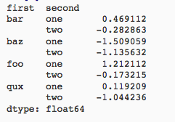
Hierarchical Indexes
Sometimes more intuitive organization of the data
Makes it easier to understand and analyze higher-dimensional data
e.g., instead of 3-D array, may only need a 2-D array

Slide 115
Today/Next Class
Tables
  Abstraction
  Operations
Pandas
Tidy Data
SQL and Relational Databases

Slide 116
Tidy Data
Variables
Labels
age | wgt_kg | hgt_cm
12.2 | 42.3 | 145.1
11.0 | 40.8 | 143.8
15.6 | 65.3 | 165.3
35.1 | 84.2 | 185.8
Observations
But also:
Names of files/DataFrames = description of one dataset
Enforce one data type per dataset (ish)

Slide 117
Example
Variable: measure or attribute:
age, weight, height, sex
Value: measurement of attribute:
12.2, 42.3kg, 145.1cm, M/F
Observation: all measurements for an object
A specific person is [12.2, 42.3, 145.1, F]

Slide 118
Tidying Data I
Name | Treatment A | Treatment B
John Smith | - | 2
Jane Doe | 16 | 11
Mary Johnson | 3 | 1
?????????????
Name | Treatment A | Treatment B | Treatment C | Treatment D
John Smith | - | 2 | - | -
Jane Doe | 16 | 11 | 4 | 1
Mary Johnson | 3 | 1 | - | 2
?????????????
Thanks to http://jeannicholashould.com/tidy-data-in-python.html
Notes:
What if we had treatmeants C, D, E, F

Slide 119
Tidying Data II
2/21
Name | Treatment | Result
John Smith | A | -
John Smith | B | 2
John Smith | C | -
John Smith | D | -
Jane Doe | A | 16
Jane Doe | B | 11
Jane Doe | C | 4
Jane Doe | D | 1
Mary Johnson | A | 3
Mary Johnson | B | 1
Mary Johnson | C | -
Mary Johnson | D | 2

Slide 120
Melting Data I
religion | <$10k | $10-20k | $20-30k | $30-40k | $40-50k | $50-75k
Agnostic | 27 | 34 | 60 | 81 | 76 | 137
Atheist | 12 | 27 | 37 | 52 | 35 | 70
Buddhist | 27 | 21 | 30 | 34 | 33 | 58
Catholic | 418 | 617 | 732 | 670 | 638 | 1116
Dont know/refused | 15 | 14 | 15 | 11 | 10 | 35
Evangelical Prot | 575 | 869 | 1064 | 982 | 881 | 1486
Hindu | 1 | 9 | 7 | 9 | 11 | 34
Historically Black Prot | 228 | 244 | 236 | 238 | 197 | 223
Jehovahs Witness | 20 | 27 | 24 | 24 | 21 | 30
Jewish | 19 | 19 | 25 | 25 | 30 | 95
?????????????

Slide 121
Melting Data II
f_df = pd.melt(df,
["religion"],
var_name="income",
value_name="freq")
f_df = f_df.sort_values(by=["religion"])
f_df.head(10)
religion | income | freq
Agnostic | <$10k | 27
Agnostic | $30-40k | 81
Agnostic | $40-50k | 76
Agnostic | $50-75k | 137
Agnostic | $10-20k | 34
Agnostic | $20-30k | 60
Atheist | $40-50k | 35
Atheist | $20-30k | 37
Atheist | $10-20k | 27
Atheist | $30-40k | 52

Slide 122
More complicated example
Billboard Top 100 data for songs, covering their position on the Top 100 for 75 weeks, with two “messy” bits:
Column headers for each of the 75 weeks
If a song didn’t last 75 weeks, those columns have are null
year | artist.inverted | track | time | genre | date.entered | date.peaked | x1st.week | x2nd.week | ...
2000 | Destiny's Child | Independent Women Part I | 3:38 | Rock | 2000-09-23 | 2000-11-18 | 78 | 63.0 | ...
2000 | Santana | Maria, Maria | 4:18 | Rock | 2000-02-12 | 2000-04-08 | 15 | 8.0 | ...
2000 | Savage Garden | I Knew I Loved You | 4:07 | Rock | 1999-10-23 | 2000-01-29 | 71 | 48.0 | ...
2000 | Madonna | Music | 3:45 | Rock | 2000-08-12 | 2000-09-16 | 41 | 23.0 | ...
2000 | Aguilera, Christina | Come On Over Baby | 3:38 | Rock | 2000-08-05 | 2000-10-14 | 57 | 47.0 | ...
2000 | Janet | Doesn't Really Matter | 4:17 | Rock | 2000-06-17 | 2000-08-26 | 59 | 52.0 | ...
Messy columns!
Thanks to http://jeannicholashould.com/tidy-data-in-python.html

Slide 123
More complicated example
# Keep identifier variables
id_vars = ["year",
"artist.inverted",
"track",
"time",
"genre",
"date.entered",
"date.peaked"]
# Melt the rest into week and rank columns
df = pd.melt(frame=df,
id_vars=id_vars,
var_name="week",
value_name="rank")
Creates one row per week, per record, with its rank

Slide 124
More complicated example
# Formatting
df["week"] = df['week'].str.extract('(\d+)’,
expand=False).astype(int)
df["rank"] = df["rank"].astype(int)
[…, “x2nd.week”, 63.0] → […, 2, 63]
# Cleaning out unnecessary rows
df = df.dropna()
# Create "date" columns
df['date'] = pd.to_datetime(
df['date.entered']) +
pd.to_timedelta(df['week'], unit='w') –
pd.DateOffset(weeks=1)

Slide 125
More complicated example
# Ignore now-redundant, messy columns
df = df[["year",
"artist.inverted",
"track",
"time",
"genre",
"week",
"rank",
"date"]]
df = df.sort_values(ascending=True,
by=["year","artist.inverted","track","week","rank"])
# Keep tidy dataset for future usage
billboard = df
df.head(10)

Slide 126
More complicated example
year | artist.inverted | track | time | genre | week | rank | date
2000 | 2 Pac | Baby Don't Cry (Keep Ya Head Up II) | 4:22 | Rap | 1 | 87 | 2000-02-26
2000 | 2 Pac | Baby Don't Cry (Keep Ya Head Up II) | 4:22 | Rap | 2 | 82 | 2000-03-04
2000 | 2 Pac | Baby Don't Cry (Keep Ya Head Up II) | 4:22 | Rap | 3 | 72 | 2000-03-11
2000 | 2 Pac | Baby Don't Cry (Keep Ya Head Up II) | 4:22 | Rap | 4 | 77 | 2000-03-18
2000 | 2 Pac | Baby Don't Cry (Keep Ya Head Up II) | 4:22 | Rap | 5 | 87 | 2000-03-25
2000 | 2 Pac | Baby Don't Cry (Keep Ya Head Up II) | 4:22 | Rap | 6 | 94 | 2000-04-01
2000 | 2 Pac | Baby Don't Cry (Keep Ya Head Up II) | 4:22 | Rap | 7 | 99 | 2000-04-08
2000 | 2Ge+her | The Hardest Part Of Breaking Up (Is Getting Ba... | 3:15 | R&B | 1 | 91 | 2000-09-02
2000 | 2Ge+her | The Hardest Part Of Breaking Up (Is Getting Ba... | 3:15 | R&B | 2 | 87 | 2000-09-09
2000 | 2Ge+her | The Hardest Part Of Breaking Up (Is Getting Ba... | 3:15 | R&B | 3 | 92 | 2000-09-16
?????????????

Slide 127
More to do?
Column headers are values, not variable names?
Good to go!
Multiple variables are stored in one column?
Maybe (depends on if genre text in raw data was multiple)
Variables are stored in both rows and columns?
Good to go!
Multiple types of observational units in the same table?
Good to go! One row per song’s week on the Top 100.
A single observational unit is stored in multiple tables?
Don’t do this!
Repetition of data?
Lots! Artist and song title’s text names. Which leads us to …

Slide 128
Today/Next Class
Tables
  Abstraction
  Operations
Pandas
Tidy Data
SQL and Relational Databases

Slide 129
Today’s Lecture
Relational data:
What is a relation, and how do they interact?
Querying databases:
SQL
SQLite
How does this relate to pandas?
Joins
Thanks to Zico Kolter for some structure for this lecture!

Slide 130
Relation
Simplest relation: a table aka tabular data full of unique tuples
Variables
(called attributes)
Labels
ID | age | wgt_kg | hgt_cm
1 | 12.2 | 42.3 | 145.1
2 | 11.0 | 40.8 | 143.8
3 | 15.6 | 65.3 | 165.3
4 | 35.1 | 84.2 | 185.8
Observations
(called tuples)

Slide 131
Primary keys
ID | age | wgt_kg | hgt_cm | nat_id
1 | 12.2 | 42.3 | 145.1 | 1
2 | 11.0 | 40.8 | 143.8 | 1
3 | 15.6 | 65.3 | 165.3 | 2
4 | 35.1 | 84.2 | 185.8 | 1
5 | 18.1 | 62.2 | 176.2 | 3
6 | 19.6 | 82.1 | 180.1 | 1
ID | Nationality
1 | USA
2 | Canada
3 | Mexico
The primary key is a unique identifier for every tuple in a relation
Each tuple has exactly one primary key

Slide 132
Foreign keys
ID | age | wgt_kg | hgt_cm | nat_id
1 | 12.2 | 42.3 | 145.1 | 1
2 | 11.0 | 40.8 | 143.8 | 1
3 | 15.6 | 65.3 | 165.3 | 2
4 | 35.1 | 84.2 | 185.8 | 1
5 | 18.1 | 62.2 | 176.2 | 3
6 | 19.6 | 82.1 | 180.1 | 1
ID | Nationality
1 | USA
2 | Canada
3 | Mexico
Foreign keys are attributes (columns) that point to a different table’s primary key
A table can have multiple foreign keys

Slide 133
Searching for elements
Find all people with nationality Canada (nat_id = 2):
???????????????
ID | age | wgt_kg | hgt_cm | nat_id
1 | 12.2 | 42.3 | 145.1 | 1
2 | 11.0 | 40.8 | 143.8 | 1
3 | 15.6 | 65.3 | 165.3 | 2
4 | 35.1 | 84.2 | 185.8 | 1
5 | 18.1 | 62.2 | 176.2 | 3
6 | 19.6 | 82.1 | 180.1 | 1
O(n)

Slide 134
Indexes
Like a hidden sorted map of references to a specific attribute (column) in a table; allows O(log n) lookup instead of O(n)
loc | ID | age | wgt_kg | hgt_cm | nat_id
0 | 1 | 12.2 | 42.3 | 145.1 | 1
128 | 2 | 11.0 | 40.8 | 143.8 | 2
256 | 3 | 15.6 | 65.3 | 165.3 | 2
384 | 4 | 35.1 | 84.2 | 185.8 | 1
512 | 5 | 18.1 | 62.2 | 176.2 | 3
640 | 6 | 19.6 | 82.1 | 180.1 | 1
nat_id | locs
1 | 0, 384, 640
2 | 128, 256
3 | 512

Slide 135
INdexes
Actually implemented with data structures like B-trees
(Take courses like CMSC424 or CMSC420)
But: indexes are not free
Takes memory to store
Takes time to build
Takes time to update (add/delete a row, update the column)
But, but: one index is (mostly) free
Index will be built automatically on the primary key
Think before you build/maintain an index on other attributes!

Slide 136
Relationships
Primary keys and foreign keys define interactions between different tables aka entities. Four types:
One-to-one
One-to-one-or-none
One-to-many and many-to-one
Many-to-many
Connects (one, many) of the rows in one table to (one, many) of the rows in another table

Slide 137
One-to-many & Many-to-one
One person can have one nationality in this example, but one nationality can include many people.
Person
Nationality
ID | age | wgt_kg | hgt_cm | nat_id
1 | 12.2 | 42.3 | 145.1 | 1
2 | 11.0 | 40.8 | 143.8 | 1
3 | 15.6 | 65.3 | 165.3 | 2
4 | 35.1 | 84.2 | 185.8 | 1
5 | 18.1 | 62.2 | 176.2 | 3
6 | 19.6 | 82.1 | 180.1 | 1
ID | Nationality
1 | USA
2 | Canada
3 | Mexico

Slide 138
One-to-One
Two tables have a one-to-one relationship if every tuple in the first tables corresponds to exactly one entry in the other
In general, you won’t be using these (why not just merge the rows into one table?) unless:
Split a big row between SSD and HDD or distributed
Restrict access to part of a row (some DBMSs allow column-level access control, but not all)
Caching, partitioning, & serious stuff: take CMSC424
Person
SSN

Slide 139
One-to-One-Or-None
Say we want to keep track of people’s cats:
People with IDs 2 and 3 do not own cats*, and are not in the table. Each person has at most one entry in the table.
Is this data tidy?
Person ID | Cat1 | Cat2
1 | Chairman Meow | Fuzz Aldrin
4 | Anderson Pooper | Meowly Cyrus
5 | Gigabyte | Megabyte
Person
Cat
*nor do they have hearts, apparently.

Slide 140
Many-to-Many
Say we want to keep track of people’s cats’ colorings:
One column per color, too many columns, too many nulls
Each cat can have many colors, and each color many cats
ID | Name
1 | Megabyte
2 | Meowly Cyrus
3 | Fuzz Aldrin
4 | Chairman Meow
5 | Anderson Pooper
6 | Gigabyte
Cat ID | Color ID | Amount
1 | 1 | 50
1 | 2 | 50
2 | 2 | 20
2 | 4 | 40
2 | 5 | 40
3 | 1 | 100
Cat
Color

Slide 141
Associative tables
Cats
Colors
Cat ID | Color ID | Amount
1 | 1 | 50
1 | 2 | 50
2 | 2 | 20
2 | 4 | 40
2 | 5 | 40
3 | 1 | 100
ID | Name
1 | Megabyte
2 | Meowly Cyrus
3 | Fuzz Aldrin
4 | Chairman Meow
5 | Anderson Pooper
6 | Gigabyte
ID | Name
1 | Black
2 | Brown
3 | White
4 | Orange
5 | Neon Green
6 | Invisible
Primary key ???????????
[Cat ID, Color ID] (+ [Color ID, Cat ID], case-dependent)
Foreign key(s) ???????????
Cat ID and Color ID

Slide 142
Aside: Pandas
So, this kinda feels like pandas …
And pandas kinda feels like a relational data system …
Pandas is not strictly a relational data system:
No notion of primary / foreign keys
It does have indexes (and multi-column indexes):
pandas.Index: ordered, sliceable set storing axis labels
pandas.MultiIndex: hierarchical index
Rule of thumb: do heavy, rough lifting at the relational DB level, then fine-grained slicing and dicing and viz with pandas

Slide 143
SQLite
On-disk relational database management system (RDMS)
Applications connect directly to a file
Most RDMSs have applications connect to a server:
Advantages include greater concurrency, less restrictive locking
Disadvantages include, for this class, setup time ☺
Installation:
conda install -c anaconda sqlite
(Should come preinstalled, I think?)
All interactions use Structured Query Language (SQL)

Slide 144
How a relational DB fits into your workflow
Persists!
Raw Input
Python
SQLite File
SQL
SQL
Structured output (trained classifiers, JSON for D3, visualizations)
SQLite CLI & GUI Frontend
Persists!

Slide 145
Crash Course in SQL (in python)
import sqlite3
# Create a database and connect to it
conn = sqlite3.connect(“cmsc320.db”)
cursor = conn.cursor()
# do cool stuff
conn.close()
Cursor: temporary work area in system memory for manipulating SQL statements and return values
If you do not close the connection (conn.close()), any outstanding transaction is rolled back
(More on this in a bit.)

Slide 146
Crash Course in SQL (in python)
# Make a table
cursor.execute(“””
CREATE TABLE cats (
id INTEGER PRIMARY KEY,
name TEXT
)”””)
?????????
id | name
cats
Capitalization doesn’t matter for SQL reserved words
SELECT = select = SeLeCt
Rule of thumb: capitalize keywords for readability

Slide 147
Crash Course in SQL (in python)
# Insert into the table
cursor.execute(“INSERT INTO cats VALUE (1, ’Megabyte’)”)
cursor.execute(“INSERT INTO cats VALUE (2, ‘Meowly Cyrus’)”)
cursor.execute(“INSERT INTO cats VALUE (3, ‘Fuzz Aldrin’)”)
conn.commit()
id | name
1 | Megabyte
2 | Meowly Cyrus
3 | Fuzz Aldrin
# Delete row(s) from the table
cursor.execute(“DELETE FROM cats WHERE id == 2”);
conn.commit()
id | name
1 | Megabyte
3 | Fuzz Aldrin

Slide 148
Crash Course in SQL (in python)
# Read all rows from a table
for row in cursor.execute(”SELECT * FROM cats”):
print(row)
# Read all rows into pandas DataFrame
pd.read_sql_query(“SELECT * FROM cats”, conn, index_col=”id”)
id | name
1 | Megabyte
3 | Fuzz Aldrin
index_col=“id”: treat column with label “id” as an index
index_col=1: treat column #1 (i.e., “name”) as an index
(Can also do multi-indexing.)

Slide 149
Joining data
A join operation merges two or more tables into a single relation. Different ways of doing this:
Inner
Left
Right
Full Outer
Join operations are done on columns that explicitly link the tables together

Slide 150
Inner Joins
id | name
1 | Megabyte
2 | Meowly Cyrus
3 | Fuzz Aldrin
4 | Chairman Meow
5 | Anderson Pooper
6 | Gigabyte
cat_id | last_visit
1 | 02-16-2017
2 | 02-14-2017
5 | 02-03-2017
visits
cats
Inner join returns merged rows that share the same value in the column they are being joined on (id and cat_id).
id | name | last_visit
1 | Megabyte | 02-16-2017
2 | Meowly Cyrus | 02-14-2017
5 | Anderson Pooper | 02-03-2017

Slide 151
Inner Joins
# Inner join in pandas
df_cats = pd.read_sql_query(“SELECT * from cats”, conn)
df_visits = pd.read_sql_query(“SELECT * from visits”, conn)
df_cats.merge(df_visits, how = “inner”,
left_on = “id”, right_on = ”cat_id”)
# Inner join in SQL / SQLite via Python
cursor.execute(“””
SELECT
*
FROM
cats, visits
WHERE
cats.id == visits.cat_id
”””)

Slide 152
Left Joins
Inner joins are the most common type of joins (get results that appear in both tables)
Left joins: all the results from the left table, only some matching results from the right table
Left join (cats, visits) on (id, cat_id) ???????????
id | name | last_visit
1 | Megabyte | 02-16-2017
2 | Meowly Cyrus | 02-14-2017
3 | Fuzz Aldrin | NULL
4 | Chairman Meow | NULL
5 | Anderson Pooper | 02-03-2017
6 | Gigabyte | NULL

Slide 153
Right Joins
id | name
1 | Megabyte
2 | Meowly Cyrus
3 | Fuzz Aldrin
4 | Chairman Meow
5 | Anderson Pooper
6 | Gigabyte
cat_id | last_visit
1 | 02-16-2017
2 | 02-14-2017
5 | 02-03-2017
7 | 02-19-2017
12 | 02-21-2017
Take a guess!
Right join
(cats, visits)
on
(id, cat_id)
???????????
visits
cats
id | name | last_visit
1 | Megabyte | 02-16-2017
2 | Meowly Cyrus | 02-14-2017
5 | Anderson Pooper | 02-03-2017
7 | NULL | 02-19-2017
12 | NULL | 02-21-2017

Slide 154
Left/Right Joins
# Left join in pandas
df_cats.merge(df_visits, how = “left”,
left_on = “id”, right_on = ”cat_id”)
# Left join in SQL / SQLite via Python
cursor.execute(“SELECT * FROM cats LEFT JOIN visits ON
cats.id == visits.cat_id”)
# Right join in pandas
df_cats.merge(df_visits, how = “right”,
left_on = “id”, right_on = ”cat_id”)
# Right join in SQL / SQLite via Python
☹

Slide 155
Full Outer Join
Combines the left and the right join ???????????
id | name | last_visit
1 | Megabyte | 02-16-2017
2 | Meowly Cyrus | 02-14-2017
3 | Fuzz Aldrin | NULL
4 | Chairman Meow | NULL
5 | Anderson Pooper | 02-03-2017
6 | Gigabyte | NULL
7 | NULL | 02-19-2017
12 | NULL | 02-21-2017
# Outer join in pandas
df_cats.merge(df_visits, how = “outer”,
left_on = “id”, right_on = ”cat_id”)

Slide 156
Google Image Search One Slide SQL Join Visual
Image credit: http://www.dofactory.com/sql/join

Slide 157
Raw SQL in Pandas
If you “think in SQL” already, you’ll be fine with pandas:
conda install -c anaconda pandasql
Info: http://pandas.pydata.org/pandas-docs/stable/comparison_with_sql.html
# Write the query text
q = ”””
SELECT
*
FROM
cats
LIMIT 10;”””
# Store in a DataFrame
df = sqldf(q, locals())

Slide 158
Next Class:
Exploratory Analysis

