Slide 1
Principles of
Data Science
John P Dickerson
Lecture #4 – 9/19/2018
CMSC641
Wednesdays
7pm – 9:30pm

Slide 2
Announcements
Project 1 is out!
Announced on ELMS and Piazza
https://github.com/JohnDickerson/cmsc641-fall2018/tree/master/project1
Due date is October 3rd
Reminder: Weekly quizzes, due
on Wednesdays at noon

Slide 3
“How does Import Work”
Python code is stored in module – simply put, a file full of Python code
A package is a directory (tree) full of modules that also contains a file called __init.py__
Packages let you structure Python’s module namespace
E.g., X.Y is a submodule Y in a package named X
For one module to gain access to code in another module, it must import it

Slide 4
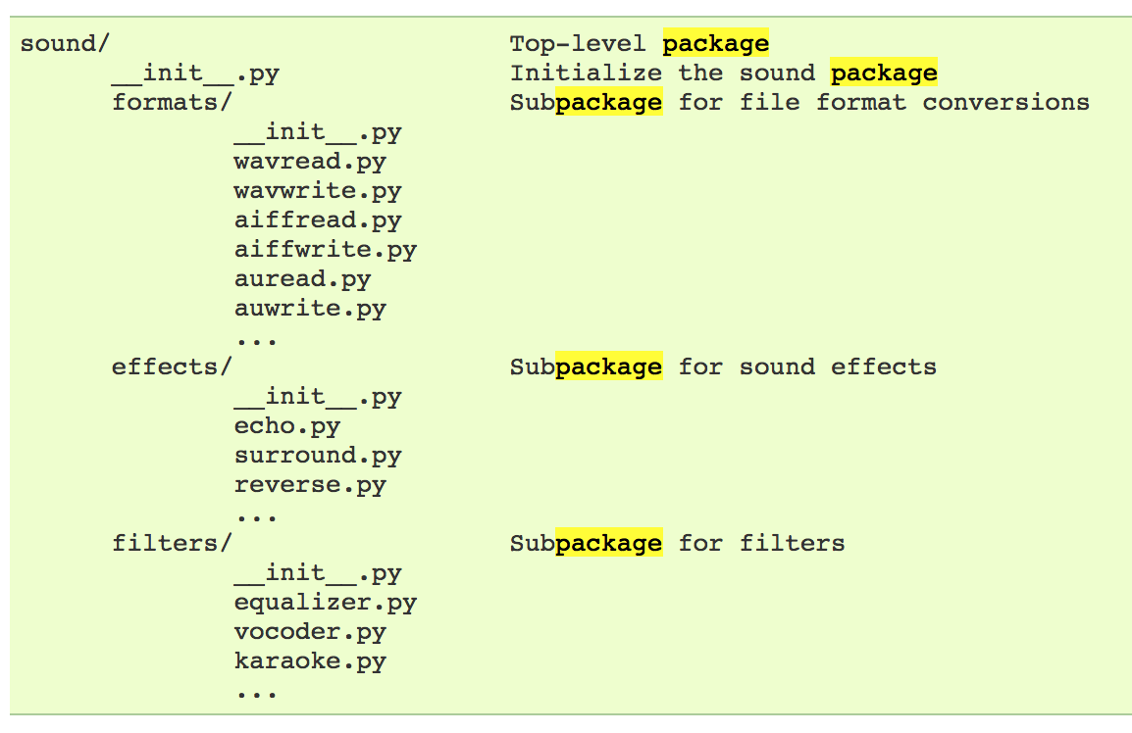
Example
# Load (sub)module sound.effects.echo
import sound.effects.echo
# Must use full name to reference echo functions
sound.effects.echo.echofilter(input, output, delay=0.7)
https://docs.python.org/2/tutorial/modules.html

Slide 5
Example
# Load (sub)module sound.effects.echo
import sound.effects.echo
# Must use full name to reference echo functions
sound.effects.echo.echofilter(input, output, delay=0.7)
# Load (sub)module sound.effects.echo
from sound.effects import echo
# No longer need the package prefix for functions in echo
echo.echofilter(input, output, delay=0.7)
# Load a specific function directly
from sound.effects.echo import echofilter
# Can now use that function with no prefix
echofilter(input, output, delay=0.7)
https://docs.python.org/2/tutorial/modules.html

Slide 6
The Data Lifecycle
Data collection
Data processing
Exploratory analysis
&
Data viz
Analysis, hypothesis testing, & ML
Insight & Policy Decision

Slide 7
The Data Lifecycle
Data collection
Data processing
Exploratory analysis
&
Data viz
Analysis, hypothesis testing, & ML
Insight & Policy Decision

Slide 8
Today/Next Class
Tables
  Abstraction
  Operations
Pandas
Tidy Data
SQL

Slide 9
Recap: Tables
Special Column, called “Index”, or “ID”, or “Key”
Usually, no duplicates Allowed
Variables
(also called Attributes, or Columns, or Labels)
ID | age | wgt_kg | hgt_cm
1 | 12.2 | 42.3 | 145.1
2 | 11.0 | 40.8 | 143.8
3 | 15.6 | 65.3 | 165.3
4 | 35.1 | 84.2 | 185.8
Observations,
Rows, or
Tuples

Slide 10
1. Select/slicing
Select only some of the rows, or some of the columns, or a combination
ID | age
1 | 12.2
2 | 11.0
3 | 15.6
4 | 35.1
ID | age | wgt_kg | hgt_cm
1 | 12.2 | 42.3 | 145.1
2 | 11.0 | 40.8 | 143.8
3 | 15.6 | 65.3 | 165.3
4 | 35.1 | 84.2 | 185.8
Only columns
ID and Age
Both
Only rows with wgt > 41
ID | age
1 | 12.2
3 | 15.6
4 | 35.1
ID | age | wgt_kg | hgt_cm
1 | 12.2 | 42.3 | 145.1
3 | 15.6 | 65.3 | 165.3
4 | 35.1 | 84.2 | 185.8

Slide 11
2. Aggregate/Reduce
Combine values across a column into a single value
73.9 | 232.6 | 640.0
ID | age | wgt_kg | hgt_cm
1 | 12.2 | 42.3 | 145.1
2 | 11.0 | 40.8 | 143.8
3 | 15.6 | 65.3 | 165.3
4 | 35.1 | 84.2 | 185.8
SUM
MAX
35.1 | 84.2 | 185.8
SUM(wgt_kg^2 - hgt_cm)
What about ID/Index column?
Usually not meaningful to aggregate across it
May need to explicitly add an ID column
14167.66

Slide 12
3. Map
Apply a function to every row, possibly creating more or fewer columns
ID | Address
1 | College Park, MD, 20742
2 | Washington, DC, 20001
3 | Silver Spring, MD 20901
ID | City | State | Zipcode
1 | College Park | MD | 20742
2 | Washington | DC | 20001
3 | Silver Spring | MD | 20901
Variations that allow one row to generate multiple rows in the output (sometimes called “flatmap”)

Slide 13
4. Group By
A = foo
Group tuples together by column/dimension
ID | B | C
1 | 3 | 6.6
3 | 4 | 3.1
4 | 3 | 8.0
7 | 4 | 2.3
8 | 3 | 8.0
ID | A | B | C
1 | foo | 3 | 6.6
2 | bar | 2 | 4.7
3 | foo | 4 | 3.1
4 | foo | 3 | 8.0
5 | bar | 1 | 1.2
6 | bar | 2 | 2.5
7 | foo | 4 | 2.3
8 | foo | 3 | 8.0
By ‘A’
A = bar
ID | B | C
2 | 2 | 4.7
5 | 1 | 1.2
6 | 2 | 2.5

Slide 14
4. Group By
B = 1
ID | A | C
5 | bar | 1.2
Group tuples together by column/dimension
B = 2
ID | A | C
2 | bar | 4.7
6 | bar | 2.5
ID | A | B | C
1 | foo | 3 | 6.6
2 | bar | 2 | 4.7
3 | foo | 4 | 3.1
4 | foo | 3 | 8.0
5 | bar | 1 | 1.2
6 | bar | 2 | 2.5
7 | foo | 4 | 2.3
8 | foo | 3 | 8.0
B = 3
By ‘B’
ID | A | C
1 | foo | 6.6
4 | foo | 8.0
8 | foo | 8.0
B = 4
ID | A | C
3 | foo | 3.1
7 | foo | 2.3

Slide 15
4. Group By
A = bar, B = 1
ID | C
5 | 1.2
Group tuples together by column/dimension
A = bar, B = 2
ID | C
2 | 4.7
6 | 2.5
ID | A | B | C
1 | foo | 3 | 6.6
2 | bar | 2 | 4.7
3 | foo | 4 | 3.1
4 | foo | 3 | 8.0
5 | bar | 1 | 1.2
6 | bar | 2 | 2.5
7 | foo | 4 | 2.3
8 | foo | 3 | 8.0
A = foo, B = 3
By ‘A’, ‘B’
ID | C
1 | 6.6
4 | 8.0
8 | 8.0
A = foo, B = 4
ID | C
3 | 3.1
7 | 2.3

Slide 16
5. Group By Aggregate
B = 1
B = 1
ID | A | C
5 | bar | 1.2
Sum (C)
1.2
B = 2
Compute one aggregate
Per group
ID | A | C
2 | bar | 4.7
6 | bar | 2.5
B = 2
Sum (C)
7.2
ID | A | B | C
1 | foo | 3 | 6.6
2 | bar | 2 | 4.7
3 | foo | 4 | 3.1
4 | foo | 3 | 8.0
5 | bar | 1 | 1.2
6 | bar | 2 | 2.5
7 | foo | 4 | 2.3
8 | foo | 3 | 8.0
B = 3
B = 3
ID | A | C
1 | foo | 6.6
4 | foo | 8.0
8 | foo | 8.0
Group by ‘B’
Sum on C
Sum (C)
22.6
B = 4
B = 4
Sum (C)
5.4
ID | A | C
3 | foo | 3.1
7 | foo | 2.3
16

Slide 17
5. Group By Aggregate
B = 1
Sum (C)
1.2
Final result usually seen
As a table
B = 2
Sum (C)
7.2
ID | A | B | C
1 | foo | 3 | 6.6
2 | bar | 2 | 4.7
3 | foo | 4 | 3.1
4 | foo | 3 | 8.0
5 | bar | 1 | 1.2
6 | bar | 2 | 2.5
7 | foo | 4 | 2.3
8 | foo | 3 | 8.0
B | SUM(C )
1 | 1.2
2 | 7.2
3 | 22.6
4 | 5.4
B = 3
Group by ‘B’
Sum on C
Sum (C)
22.6
B = 4
Sum (C)
5.4
17

Slide 18
6. Union/Intersection/Difference
Set operations – only if the two tables have identical attributes/columns
ID | A | B | C
1 | foo | 3 | 6.6
2 | bar | 2 | 4.7
3 | foo | 4 | 3.1
4 | foo | 3 | 8.0
5 | bar | 1 | 1.2
6 | bar | 2 | 2.5
7 | foo | 4 | 2.3
8 | foo | 3 | 8.0
ID | A | B | C
1 | foo | 3 | 6.6
2 | bar | 2 | 4.7
3 | foo | 4 | 3.1
4 | foo | 3 | 8.0
ID | A | B | C
5 | bar | 1 | 1.2
6 | bar | 2 | 2.5
7 | foo | 4 | 2.3
8 | foo | 3 | 8.0
U
Similarly Intersection and Set Difference manipulate tables as Sets
IDs may be treated in different ways, resulting in somewhat different behaviors
18

Slide 19
7. Merge or Join
Combine rows/tuples across two tables if they have the same key
ID | A | B
1 | foo | 3
2 | bar | 2
3 | foo | 4
4 | foo | 3
ID | C
1 | 1.2
2 | 2.5
3 | 2.3
5 | 8.0
ID | A | B | C
1 | foo | 3 | 1.2
2 | bar | 2 | 2.5
3 | foo | 4 | 2.3
⨝
What about IDs not present in both tables?
Often need to keep them around
Can “pad” with NaN
19

Slide 20
7. Merge or Join
Combine rows/tuples across two tables if they have the same key
Outer joins can be used to ”pad” IDs that don’t appear in both tables
Three variants: LEFT, RIGHT, FULL
SQL Terminology -- Pandas has these operations as well
ID | A | B
1 | foo | 3
2 | bar | 2
3 | foo | 4
4 | foo | 3
ID | C
1 | 1.2
2 | 2.5
3 | 2.3
5 | 8.0
ID | A | B | C
1 | foo | 3 | 1.2
2 | bar | 2 | 2.5
3 | foo | 4 | 2.3
4 | foo | 3 | NaN
5 | NaN | NaN | 8.0
⟗
20

Slide 21
Summary
Tables: A simple, common abstraction
  Subsumes a set of “strings” – a common input
Operations
  Select, Map, Aggregate, Reduce, Join/Merge, Union/Concat, Group By
In a given system/language, the operations may be named differently
  E.g., SQL uses “join”, whereas Pandas uses “merge”
Subtle variations in the definitions, especially for more complex operations

Slide 22
Today/Next Class
Tables
  Abstraction
  Operations
Pandas
Tidy Data
SQL and Relational Databases

Slide 23
Pandas: History
Written by: Wes McKinney
  Started in 2008 to get a high-performance, flexible tool to perform quantitative analysis on financial data
Highly optimized for performance, with critical code paths written in Cython or C
Key constructs:
  Series (like a NumPy Array)
  DataFrame (like a Table or Relation, or R data.frame)
Foundation for Data Wrangling and Analysis in Python

Slide 24
Pandas: series
Subclass of numpy.ndarray
Data: any type
Index labels need not be ordered
Duplicates possible but result in reduced functionality

Slide 25
Pandas: DataFrame
Each column can have a different type
Row and Column index
Mutable size: insert and delete columns
Note the use of word “index” for what we called “key”
  Relational databases use “index” to mean something else
Non-unique index values allowed
  May raise an exception for some operations

Slide 26
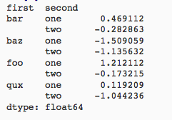
Hierarchical Indexes
Sometimes more intuitive organization of the data
Makes it easier to understand and analyze higher-dimensional data
e.g., instead of 3-D array, may only need a 2-D array

Slide 27
Essential Functionality
Reindexing to change the index associated with a DataFrame
  Common usage to interpolate, fill in missing values
From: Python for Data Analysis; Wes McKinney

Slide 28
Essential Functionality
“drop” to delete entire rows or columns
Indexing, Selection, Filtering: very similar to NumPy
Arithmetic Operations
  Result index union of the two input indexes
  Options to do “fill” while doing these operations

Slide 29
Function application and Mapping
From: Python for Data Analysis; Wes McKinney

Slide 30
Sorting and Ranking
From: Python for Data Analysis; Wes McKinney

Slide 31
Descriptive and Summary Statistics
From: Python for Data Analysis; Wes McKinney

Slide 32
Creating Dataframes
Directly from Dict or Series
From a Comma-Separated File – CSV file
  pandas.read_csv()
  Can infer headers/column names if present, otherwise may want to reindex
From an Excel File
  pandas.read_excel()
From a Database using SQL (see the reading for an example)
From Clipboard, URL, Google Analytics, …
…
From: Python for Data Analysis; Wes McKinney

Slide 33
More…
Unique values, Value counts
Correlation and Covariance
Functions for handling missing data – in a few classes
  dropna(), fillna()
Broadcasting
Pivoting
We will see some of these as we discuss data wrangling, cleaning, etc.

Slide 34
Today/Next Class
Tables
  Abstraction
  Operations
Pandas
Tidy Data
SQL and Relational Databases

Slide 35
Tidy Data
Variables
Labels
age | wgt_kg | hgt_cm
12.2 | 42.3 | 145.1
11.0 | 40.8 | 143.8
15.6 | 65.3 | 165.3
35.1 | 84.2 | 185.8
Observations
But also:
Names of files/DataFrames = description of one dataset
Enforce one data type per dataset (ish)

Slide 36
Example
Variable: measure or attribute:
age, weight, height, sex
Value: measurement of attribute:
12.2, 42.3kg, 145.1cm, M/F
Observation: all measurements for an object
A specific person is [12.2, 42.3, 145.1, F]

Slide 37
Tidying Data I
Name | Treatment A | Treatment B
John Smith | - | 2
Jane Doe | 16 | 11
Mary Johnson | 3 | 1
?????????????
Name | Treatment A | Treatment B | Treatment C | Treatment D
John Smith | - | 2 | - | -
Jane Doe | 16 | 11 | 4 | 1
Mary Johnson | 3 | 1 | - | 2
?????????????
Thanks to http://jeannicholashould.com/tidy-data-in-python.html
Notes:
What if we had treatmeants C, D, E, F

Slide 38
Tidying Data II
Next class
Name | Treatment | Result
John Smith | A | -
John Smith | B | 2
John Smith | C | -
John Smith | D | -
Jane Doe | A | 16
Jane Doe | B | 11
Jane Doe | C | 4
Jane Doe | D | 1
Mary Johnson | A | 3
Mary Johnson | B | 1
Mary Johnson | C | -
Mary Johnson | D | 2

Slide 39
Melting Data I
religion | <$10k | $10-20k | $20-30k | $30-40k | $40-50k | $50-75k
Agnostic | 27 | 34 | 60 | 81 | 76 | 137
Atheist | 12 | 27 | 37 | 52 | 35 | 70
Buddhist | 27 | 21 | 30 | 34 | 33 | 58
Catholic | 418 | 617 | 732 | 670 | 638 | 1116
Dont know/refused | 15 | 14 | 15 | 11 | 10 | 35
Evangelical Prot | 575 | 869 | 1064 | 982 | 881 | 1486
Hindu | 1 | 9 | 7 | 9 | 11 | 34
Historically Black Prot | 228 | 244 | 236 | 238 | 197 | 223
Jehovahs Witness | 20 | 27 | 24 | 24 | 21 | 30
Jewish | 19 | 19 | 25 | 25 | 30 | 95
?????????????

Slide 40
Melting Data II
f_df = pd.melt(df,
["religion"],
var_name="income",
value_name="freq")
f_df = f_df.sort_values(by=["religion"])
f_df.head(10)
religion | income | freq
Agnostic | <$10k | 27
Agnostic | $30-40k | 81
Agnostic | $40-50k | 76
Agnostic | $50-75k | 137
Agnostic | $10-20k | 34
Agnostic | $20-30k | 60
Atheist | $40-50k | 35
Atheist | $20-30k | 37
Atheist | $10-20k | 27
Atheist | $30-40k | 52

Slide 41
More complicated example
Billboard Top 100 data for songs, covering their position on the Top 100 for 75 weeks, with two “messy” bits:
Column headers for each of the 75 weeks
If a song didn’t last 75 weeks, those columns have are null
year | artist.inverted | track | time | genre | date.entered | date.peaked | x1st.week | x2nd.week | ...
2000 | Destiny's Child | Independent Women Part I | 3:38 | Rock | 2000-09-23 | 2000-11-18 | 78 | 63.0 | ...
2000 | Santana | Maria, Maria | 4:18 | Rock | 2000-02-12 | 2000-04-08 | 15 | 8.0 | ...
2000 | Savage Garden | I Knew I Loved You | 4:07 | Rock | 1999-10-23 | 2000-01-29 | 71 | 48.0 | ...
2000 | Madonna | Music | 3:45 | Rock | 2000-08-12 | 2000-09-16 | 41 | 23.0 | ...
2000 | Aguilera, Christina | Come On Over Baby | 3:38 | Rock | 2000-08-05 | 2000-10-14 | 57 | 47.0 | ...
2000 | Janet | Doesn't Really Matter | 4:17 | Rock | 2000-06-17 | 2000-08-26 | 59 | 52.0 | ...
Messy columns!
Thanks to http://jeannicholashould.com/tidy-data-in-python.html

Slide 42
More complicated example
# Keep identifier variables
id_vars = ["year",
"artist.inverted",
"track",
"time",
"genre",
"date.entered",
"date.peaked"]
# Melt the rest into week and rank columns
df = pd.melt(frame=df,
id_vars=id_vars,
var_name="week",
value_name="rank")
Creates one row per week, per record, with its rank

Slide 43
More complicated example
# Formatting
df["week"] = df['week'].str.extract('(\d+)’,
expand=False).astype(int)
df["rank"] = df["rank"].astype(int)
[…, “x2nd.week”, 63.0] → […, 2, 63]
# Cleaning out unnecessary rows
df = df.dropna()
# Create "date" columns
df['date'] = pd.to_datetime(
df['date.entered']) +
pd.to_timedelta(df['week'], unit='w') –
pd.DateOffset(weeks=1)

Slide 44
More complicated example
# Ignore now-redundant, messy columns
df = df[["year",
"artist.inverted",
"track",
"time",
"genre",
"week",
"rank",
"date"]]
df = df.sort_values(ascending=True,
by=["year","artist.inverted","track","week","rank"])
# Keep tidy dataset for future usage
billboard = df
df.head(10)

Slide 45
More complicated example
year | artist.inverted | track | time | genre | week | rank | date
2000 | 2 Pac | Baby Don't Cry (Keep Ya Head Up II) | 4:22 | Rap | 1 | 87 | 2000-02-26
2000 | 2 Pac | Baby Don't Cry (Keep Ya Head Up II) | 4:22 | Rap | 2 | 82 | 2000-03-04
2000 | 2 Pac | Baby Don't Cry (Keep Ya Head Up II) | 4:22 | Rap | 3 | 72 | 2000-03-11
2000 | 2 Pac | Baby Don't Cry (Keep Ya Head Up II) | 4:22 | Rap | 4 | 77 | 2000-03-18
2000 | 2 Pac | Baby Don't Cry (Keep Ya Head Up II) | 4:22 | Rap | 5 | 87 | 2000-03-25
2000 | 2 Pac | Baby Don't Cry (Keep Ya Head Up II) | 4:22 | Rap | 6 | 94 | 2000-04-01
2000 | 2 Pac | Baby Don't Cry (Keep Ya Head Up II) | 4:22 | Rap | 7 | 99 | 2000-04-08
2000 | 2Ge+her | The Hardest Part Of Breaking Up (Is Getting Ba... | 3:15 | R&B | 1 | 91 | 2000-09-02
2000 | 2Ge+her | The Hardest Part Of Breaking Up (Is Getting Ba... | 3:15 | R&B | 2 | 87 | 2000-09-09
2000 | 2Ge+her | The Hardest Part Of Breaking Up (Is Getting Ba... | 3:15 | R&B | 3 | 92 | 2000-09-16
?????????????

Slide 46
More to do?
Column headers are values, not variable names?
Good to go!
Multiple variables are stored in one column?
Maybe (depends on if genre text in raw data was multiple)
Variables are stored in both rows and columns?
Good to go!
Multiple types of observational units in the same table?
Good to go! One row per song’s week on the Top 100.
A single observational unit is stored in multiple tables?
Don’t do this!
Repetition of data?
Lots! Artist and song title’s text names. Which leads us to …

Slide 47
Today/Next Class
Tables
  Abstraction
  Operations
Pandas
Tidy Data
SQL and Relational Databases

Slide 48
Continuing today’s Lecture
Relational data:
What is a relation, and how do they interact?
Querying databases:
SQL
SQLite
How does this relate to pandas?
Joins
Thanks to Zico Kolter for some structure for this lecture!

Slide 49
Relation
Simplest relation: a table aka tabular data full of unique tuples
Variables
(called attributes)
Labels
ID | age | wgt_kg | hgt_cm
1 | 12.2 | 42.3 | 145.1
2 | 11.0 | 40.8 | 143.8
3 | 15.6 | 65.3 | 165.3
4 | 35.1 | 84.2 | 185.8
Observations
(called tuples)

Slide 50
Primary keys
ID | age | wgt_kg | hgt_cm | nat_id
1 | 12.2 | 42.3 | 145.1 | 1
2 | 11.0 | 40.8 | 143.8 | 1
3 | 15.6 | 65.3 | 165.3 | 2
4 | 35.1 | 84.2 | 185.8 | 1
5 | 18.1 | 62.2 | 176.2 | 3
6 | 19.6 | 82.1 | 180.1 | 1
ID | Nationality
1 | USA
2 | Canada
3 | Mexico
The primary key is a unique identifier for every tuple in a relation
Each tuple has exactly one primary key

Slide 51
Aren’t these called “indexes”?
Yes, in Pandas; but not in the database world
For most databases, an “index” is a data structure used to speed up retrieval of specific tuples
For example, to find all tuples with nat_id = 2:
  We can either scan the table – O(N)
  Or use an “index” (e.g., binary tree) – O(log N)

Slide 52
Foreign keys
ID | age | wgt_kg | hgt_cm | nat_id
1 | 12.2 | 42.3 | 145.1 | 1
2 | 11.0 | 40.8 | 143.8 | 1
3 | 15.6 | 65.3 | 165.3 | 2
4 | 35.1 | 84.2 | 185.8 | 1
5 | 18.1 | 62.2 | 176.2 | 3
6 | 19.6 | 82.1 | 180.1 | 1
ID | Nationality
1 | USA
2 | Canada
3 | Mexico
Foreign keys are attributes (columns) that point to a different table’s primary key
A table can have multiple foreign keys

Slide 53
Relation Schema
A list of all the attribute names, and their domains
create table department
(dept_name varchar(20),
building varchar(15),
budget numeric(12,2) check (budget > 0),
primary key (dept_name)
);
SQL Statements
To create Tables
create table instructor (
ID char(5),
name varchar(20) not null,
dept_name varchar(20),
salary numeric(8,2),
primary key (ID),
foreign key (dept_name) references department
)

Slide 54
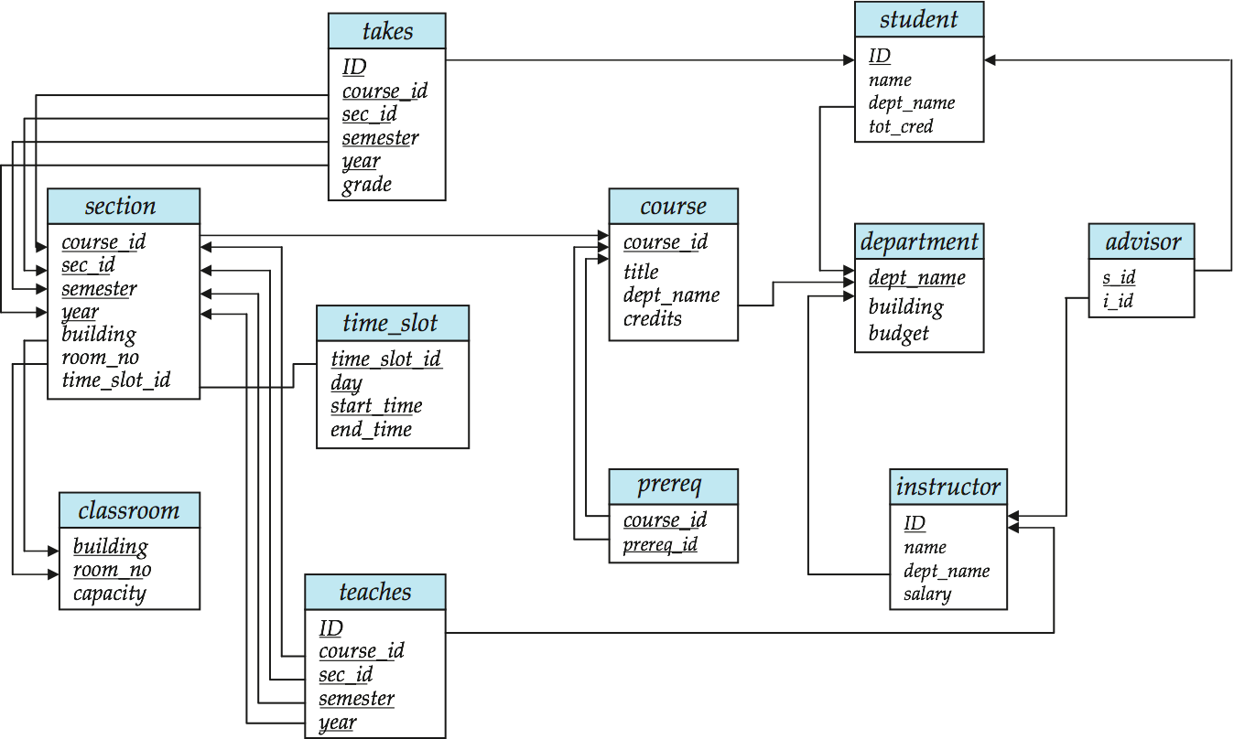
Schema Diagrams

Slide 55
Searching for elements
Find all people with nationality Canada (nat_id = 2):
???????????????
ID | age | wgt_kg | hgt_cm | nat_id
1 | 12.2 | 42.3 | 145.1 | 1
2 | 11.0 | 40.8 | 143.8 | 1
3 | 15.6 | 65.3 | 165.3 | 2
4 | 35.1 | 84.2 | 185.8 | 1
5 | 18.1 | 62.2 | 176.2 | 3
6 | 19.6 | 82.1 | 180.1 | 1
O(n)

Slide 56
(Database) Indexes
Like a hidden sorted map of references to a specific attribute (column) in a table; allows O(log n) lookup instead of O(n)
loc | ID | age | wgt_kg | hgt_cm | nat_id
0 | 1 | 12.2 | 42.3 | 145.1 | 1
128 | 2 | 11.0 | 40.8 | 143.8 | 2
256 | 3 | 15.6 | 65.3 | 165.3 | 2
384 | 4 | 35.1 | 84.2 | 185.8 | 1
512 | 5 | 18.1 | 62.2 | 176.2 | 3
640 | 6 | 19.6 | 82.1 | 180.1 | 1
nat_id | locs
1 | 0, 384, 640
2 | 128, 256
3 | 512

Slide 57
(DataBase) INdexes
Actually implemented with data structures like B-trees
(Take courses like CMSC642, or CMSC424)
But: indexes are not free
Takes memory to store
Takes time to build
Takes time to update (add/delete a row, update the column)
But, but: one index is (mostly) free
Index will be built automatically on the primary key
Think before you build/maintain an index on other attributes!

Slide 58
Relationships
Primary keys and foreign keys define interactions between different tables aka entities. Four types:
One-to-one
One-to-one-or-none
One-to-many and many-to-one
Many-to-many
Connects (one, many) of the rows in one table to (one, many) of the rows in another table

Slide 59
One-to-many & Many-to-one
One person can have one nationality in this example, but one nationality can include many people.
Person
Nationality
ID | age | wgt_kg | hgt_cm | nat_id
1 | 12.2 | 42.3 | 145.1 | 1
2 | 11.0 | 40.8 | 143.8 | 1
3 | 15.6 | 65.3 | 165.3 | 2
4 | 35.1 | 84.2 | 185.8 | 1
5 | 18.1 | 62.2 | 176.2 | 3
6 | 19.6 | 82.1 | 180.1 | 1
ID | Nationality
1 | USA
2 | Canada
3 | Mexico

Slide 60
One-to-One
Two tables have a one-to-one relationship if every tuple in the first tables corresponds to exactly one entry in the other
In general, you won’t be using these (why not just merge the rows into one table?) unless:
Split a big row between SSD and HDD or distributed
Restrict access to part of a row (some DBMSs allow column-level access control, but not all)
Caching, partitioning, & serious stuff: take CMSC642, or 424
Person
SSN

Slide 61
One-to-One-Or-None
Say we want to keep track of people’s cats:
People with IDs 2 and 3 do not own cats*, and are not in the table. Each person has at most one entry in the table.
Is this data tidy?
Person ID | Cat1 | Cat2
1 | Chairman Meow | Fuzz Aldrin
4 | Anderson Pooper | Meowly Cyrus
5 | Gigabyte | Megabyte
Person
Cat
*nor do they have hearts, apparently.

Slide 62
Many-to-Many
Say we want to keep track of people’s cats’ colorings:
One column per color, too many columns, too many nulls
Each cat can have many colors, and each color many cats
ID | Name
1 | Megabyte
2 | Meowly Cyrus
3 | Fuzz Aldrin
4 | Chairman Meow
5 | Anderson Pooper
6 | Gigabyte
Cat ID | Color ID | Amount
1 | 1 | 50
1 | 2 | 50
2 | 2 | 20
2 | 4 | 40
2 | 5 | 40
3 | 1 | 100
Cat
Color

Slide 63
Associative tables
Cats
Colors
Cat ID | Color ID | Amount
1 | 1 | 50
1 | 2 | 50
2 | 2 | 20
2 | 4 | 40
2 | 5 | 40
3 | 1 | 100
ID | Name
1 | Megabyte
2 | Meowly Cyrus
3 | Fuzz Aldrin
4 | Chairman Meow
5 | Anderson Pooper
6 | Gigabyte
ID | Name
1 | Black
2 | Brown
3 | White
4 | Orange
5 | Neon Green
6 | Invisible
Primary key ???????????
[Cat ID, Color ID] (+ [Color ID, Cat ID], case-dependent)
Foreign key(s) ???????????
Cat ID and Color ID

Slide 64
Aside: Pandas
So, this kinda feels like pandas …
And pandas kinda feels like a relational data system …
Pandas is not strictly a relational data system:
No notion of primary / foreign keys
It does have indexes (and multi-column indexes):
pandas.Index: ordered, sliceable set storing axis labels
pandas.MultiIndex: hierarchical index
Rule of thumb: do heavy, rough lifting at the relational DB level, then fine-grained slicing and dicing and viz with pandas

Slide 65
SQLite
On-disk relational database management system (RDMS)
Applications connect directly to a file
Most RDMSs have applications connect to a server:
Advantages include greater concurrency, less restrictive locking
Disadvantages include, for this class, setup time ☺
Installation:
conda install -c anaconda sqlite
(Should come preinstalled, I think?)
All interactions use Structured Query Language (SQL)

Slide 66
How a relational DB fits into your workflow
Persists!
Raw Input
Python
SQLite File
SQL
SQL
Structured output (trained classifiers, JSON for D3, visualizations)
SQLite CLI & GUI Frontend
Persists!

Slide 67
Crash Course in SQL (in python)
import sqlite3
# Create a database and connect to it
conn = sqlite3.connect(“cmsc641.db”)
cursor = conn.cursor()
# do cool stuff
conn.close()
Cursor: temporary work area in system memory for manipulating SQL statements and return values
If you do not close the connection (conn.close()), any outstanding transaction is rolled back
(More on this in a bit.)

Slide 68
Crash Course in SQL (in python)
# Make a table
cursor.execute(“””
CREATE TABLE cats (
id INTEGER PRIMARY KEY,
name TEXT
)”””)
?????????
id | name
cats
Capitalization doesn’t matter for SQL reserved words
SELECT = select = SeLeCt
Rule of thumb: capitalize keywords for readability

Slide 69
Crash Course in SQL (in python)
# Insert into the table
cursor.execute(“INSERT INTO cats VALUE (1, ’Megabyte’)”)
cursor.execute(“INSERT INTO cats VALUE (2, ‘Meowly Cyrus’)”)
cursor.execute(“INSERT INTO cats VALUE (3, ‘Fuzz Aldrin’)”)
conn.commit()
id | name
1 | Megabyte
2 | Meowly Cyrus
3 | Fuzz Aldrin
# Delete row(s) from the table
cursor.execute(“DELETE FROM cats WHERE id == 2”);
conn.commit()
id | name
1 | Megabyte
3 | Fuzz Aldrin

Slide 70
Crash Course in SQL (in python)
# Read all rows from a table
for row in cursor.execute(”SELECT * FROM cats”):
print(row)
# Read all rows into pandas DataFrame
pd.read_sql_query(“SELECT * FROM cats”, conn, index_col=”id”)
id | name
1 | Megabyte
3 | Fuzz Aldrin
index_col=“id”: treat column with label “id” as an index
index_col=1: treat column #1 (i.e., “name”) as an index
(Can also do multi-indexing.)

Slide 71
Joining data
A join operation merges two or more tables into a single relation. Different ways of doing this:
Inner
Left
Right
Full Outer
Join operations are done on columns that explicitly link the tables together

Slide 72
Inner Joins
id | name
1 | Megabyte
2 | Meowly Cyrus
3 | Fuzz Aldrin
4 | Chairman Meow
5 | Anderson Pooper
6 | Gigabyte
cat_id | last_visit
1 | 02-16-2017
2 | 02-14-2017
5 | 02-03-2017
visits
cats
Inner join returns merged rows that share the same value in the column they are being joined on (id and cat_id).
id | name | last_visit
1 | Megabyte | 02-16-2017
2 | Meowly Cyrus | 02-14-2017
5 | Anderson Pooper | 02-03-2017

Slide 73
Inner Joins
# Inner join in pandas
df_cats = pd.read_sql_query(“SELECT * from cats”, conn)
df_visits = pd.read_sql_query(“SELECT * from visits”, conn)
df_cats.merge(df_visits, how = “inner”,
left_on = “id”, right_on = ”cat_id”)
# Inner join in SQL / SQLite via Python
cursor.execute(“””
SELECT
*
FROM
cats, visits
WHERE
cats.id == visits.cat_id
”””)

Slide 74
Left Joins
Inner joins are the most common type of joins (get results that appear in both tables)
Left joins: all the results from the left table, only some matching results from the right table
Left join (cats, visits) on (id, cat_id) ???????????
id | name | last_visit
1 | Megabyte | 02-16-2017
2 | Meowly Cyrus | 02-14-2017
3 | Fuzz Aldrin | NULL
4 | Chairman Meow | NULL
5 | Anderson Pooper | 02-03-2017
6 | Gigabyte | NULL

Slide 75
Right Joins
id | name
1 | Megabyte
2 | Meowly Cyrus
3 | Fuzz Aldrin
4 | Chairman Meow
5 | Anderson Pooper
6 | Gigabyte
cat_id | last_visit
1 | 02-16-2017
2 | 02-14-2017
5 | 02-03-2017
7 | 02-19-2017
12 | 02-21-2017
Take a guess!
Right join
(cats, visits)
on
(id, cat_id)
???????????
visits
cats
id | name | last_visit
1 | Megabyte | 02-16-2017
2 | Meowly Cyrus | 02-14-2017
5 | Anderson Pooper | 02-03-2017
7 | NULL | 02-19-2017
12 | NULL | 02-21-2017

Slide 76
Left/Right Joins
# Left join in pandas
df_cats.merge(df_visits, how = “left”,
left_on = “id”, right_on = ”cat_id”)
# Left join in SQL / SQLite via Python
cursor.execute(“SELECT * FROM cats LEFT JOIN visits ON
cats.id == visits.cat_id”)
# Right join in pandas
df_cats.merge(df_visits, how = “right”,
left_on = “id”, right_on = ”cat_id”)
# Right join in SQL / SQLite via Python
☹

Slide 77
Full Outer Join
Combines the left and the right join ???????????
id | name | last_visit
1 | Megabyte | 02-16-2017
2 | Meowly Cyrus | 02-14-2017
3 | Fuzz Aldrin | NULL
4 | Chairman Meow | NULL
5 | Anderson Pooper | 02-03-2017
6 | Gigabyte | NULL
7 | NULL | 02-19-2017
12 | NULL | 02-21-2017
# Outer join in pandas
df_cats.merge(df_visits, how = “outer”,
left_on = “id”, right_on = ”cat_id”)

Slide 78
Google Image Search One Slide SQL Join Visual
Image credit: http://www.dofactory.com/sql/join

Slide 79
Group by Aggregates
SELECT nat_id, AVG(age) as average_age
FROM persons GROUP BY nat_id
ID | age | wgt_kg | hgt_cm | nat_id
1 | 12.2 | 42.3 | 145.1 | 1
2 | 11.0 | 40.8 | 143.8 | 1
3 | 15.6 | 65.3 | 165.3 | 2
4 | 35.1 | 84.2 | 185.8 | 1
5 | 18.1 | 62.2 | 176.2 | 3
6 | 19.6 | 82.1 | 180.1 | 1
nat_id | average_age
1 | 19.48
2 | 15.6
3 | 18.1

Slide 80
Raw SQL in Pandas
If you “think in SQL” already, you’ll be fine with pandas:
conda install -c anaconda pandasql
Info: http://pandas.pydata.org/pandas-docs/stable/comparison_with_sql.html
# Write the query text
q = ”””
SELECT
*
FROM
cats
LIMIT 10;”””
# Store in a DataFrame
df = sqldf(q, locals())

Slide 81
Next Class:
Exploratory Analysis

Slide 82
Today’s Lecture
Data collection
Data processing
Exploratory analysis
&
Data viz
Analysis, hypothesis testing, & ML
Insight & Policy Decision
Just a taste!

Slide 83
Today’s Lecture
Missing Data …
What is it?
Simple methods for imputation
… with a tiny taste of Stats/ML lecturers to come.
Thanks to John Atwood and Wenjiang Fu

Slide 84
Missing Data
Missing data is information that we want to know, but don’t
It can come in many forms, e.g.:
People not answering questions on surveys
Inaccurate recordings of the height of plants that need to be discarded
Canceled runs in a driving experiment due to rain
Could also consider missing columns (no collection at all) to be missing data …
[JA]

Slide 85
Key Question
Why is the data missing?
What mechanism is it that contributes to, or is associated with, the probability of a data point being absent?
Can it be explained by our observed data or not?
The answers drastically affect what we can ultimately do to compensate for the missing-ness
[JA]

Slide 86
Complete Case Analysis
Delete all tuples with any missing values at all, so you are left only with observations with all variables observed
Default behavior for libraries for analysis (e.g., regression)
We’ll talk about this much more during the Stats/ML lectures
This is the simplest way to handle missing data. In some cases, will work fine; in others, ?????????????:
Loss of sample will lead to variance larger than reflected by the size of your data
May bias your sample
# Clean out rows with nil values
df = df.dropna()
[JA]

Slide 87
Example
Dataset: Body fat percentage in men, and the circumference of various body parts [Penrose et al., 1985]
Question: Does the circumference of certain body parts predict body fat percentage?
Given complete data, how would you answer this ?????????
One way to answer is regression analysis:
One or more independent variables ("predictors”)
One dependent variables (“outcome”)
What is the relationship between the predictors and the outcome?
What is the conditional expectation of the dependent variable given fixed values for the dependent variables?

Slide 88
Linear regression
Assumption: relationship between variables is linear:
(We’ll relax linearity, study in more depth later.)
Population
Y-Intercept
Population Slope
Random Error
Y
=
β
+
β
X
+
ε
i
0
1
i
i
Dependent Variable
(e.g., ????????)
Independent Variable(s)
(e.g., ?????????)
[WF]

Slide 89
Population & Sample Regression Models
Population
☺
☺
☺
☺
☺
[WF]
Notes:
31

Slide 90
Population & Sample Regression Models
Population
Unknown Relationship
☺
☺
☺
☺
☺
[WF]
Notes:
32

Slide 91
Population & Sample Regression Models
Population
Random Sample
Unknown Relationship
☺
☺
☺
☺
☺
☺
☺
[WF]
Notes:
33

Slide 92
Population & Sample Regression Models
Population
Random Sample
Unknown Relationship
☺
☺
☺
☺
☺
☺
☺
[WF]
Notes:
34

Slide 93
Linear Regression
Observedvalue
ε_{i} = Random error
Observed value
[WF]
Notes:
35

Slide 94
Sample Linear Regression Model
ε_{i} = Random error
^
Unsampled observation
Observed value
[WF]
Notes:
36

Slide 95
Estimating Parameters:
Least Squares Method
?
Notes:
40

Slide 96
Scatter plot
Plot all (X_{i}, Y_{i}) pairs, and plot your learned model
If you squint, suggests how well the model fits the data
Y
60
40
20
0
X
0
20
40
60
[WF]

Slide 97
QUestion
How would you draw a line through the points?
How do you determine which line “fits the best” …?
?????????
Y
60
40
20
0
X
0
20
40
60
[WF]
Notes:
42

Slide 98
Question
How would you draw a line through the points?
How do you determine which line “fits the best” ?????????
Slope changed
Y
60
40
20
0
X
0
20
40
60
Intercept unchanged
[WF]
Notes:
43

Slide 99
Question
How would you draw a line through the points?
How do you determine which line “fits the best” ?????????
Slope unchanged
Y
60
40
20
0
X
0
20
40
60
Intercept changed
[WF]
Notes:
44

Slide 100
Question
How would you draw a line through the points?
How do you determine which line “fits the best” ?????????
Slope changed
Y
60
40
20
0
X
0
20
40
60
Intercept changed
[WF]
Notes:
45

Slide 101
Least Squares
Best fit: difference between the true Y-values and the estimated Y-values is minimized:
Positive errors offset negative errors …
… square the error!
Least squares minimizes the sum of the squared errors
Why squared? We’ll cover this in more depth in March.
Until then: http://www.benkuhn.net/squared
[WF]
Notes:
51

Slide 102
Least Squares, Graphically
[WF]
Notes:
52

Slide 103
Interpretation of Coefficients
^
Slope (β₁):
Estimated Y changes by β₁ for each unit increase in X
If β₁ = 2, then Y Is expected to increase by 2 for each 1 unit increase in X
Y-Intercept (β₀)
Average value of Y when X = 0
If β₀ = 4, then average Y is expected to be 4 when X Is 0
^
^
^
In-depth analysis of less naïve approaches to come!
[WF]

Slide 104
Now, Back to Missing Data …

Slide 105
Example
Question: Does the circumference of certain body parts predict BF%?
Assumption: BF% is a linear function of measurements of various body parts and other features …
Analysis: Results from a regression model with BF% …
Predictor | Estimate | S.E. | p-value
Age | 0.0626 | 0.0313 | 0.0463
Neck | -0.4728 | 0.2294 | 0.0403
Forearm | 0.45315 | 0.1979 | 0.0229
Wrist | -1.6181 | 0.5323 | 0.0026
(Interpretation ???????????)
[JA]
Notes:
Standard error – estimate of the standard deviation, will talk about this more later …
The p-value is the probability of obtaining a result equal to or "more extreme" than what was actually observed, when the null hyp is actually true – we’ll talk about this more …

Slide 106
What If data were missing?
In this case, the dataset is complete:
But what if 5 percent of the participants had missing values? 10 percent? 20 percent?
What if we performed complete case analysis and removed those who had missing values?
First let’s examine the effect if we do this if when the data is missing completely at random (MCAR)
Removed cases at random, reran analysis, stored the p-values
p-value: probability of getting at least as extreme a result as what we observed given that there is no relationship
Repeat 1000 times, plot p-values …
[JA]

Slide 107
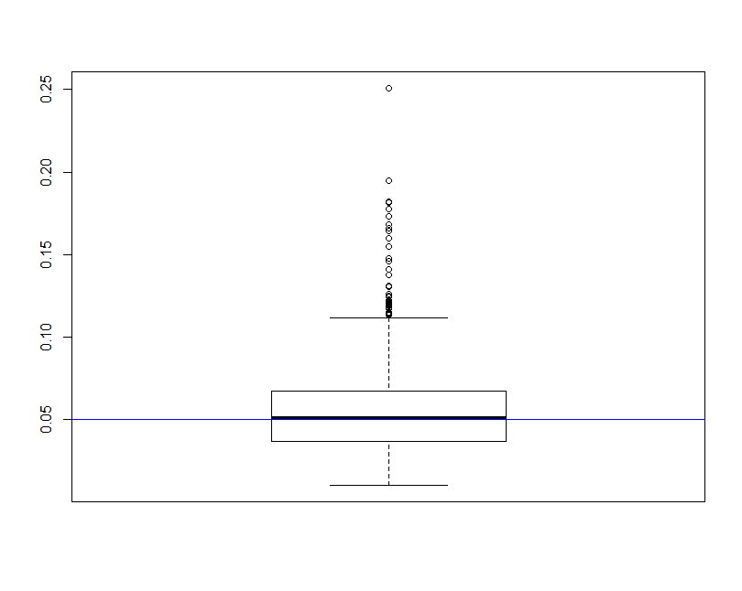
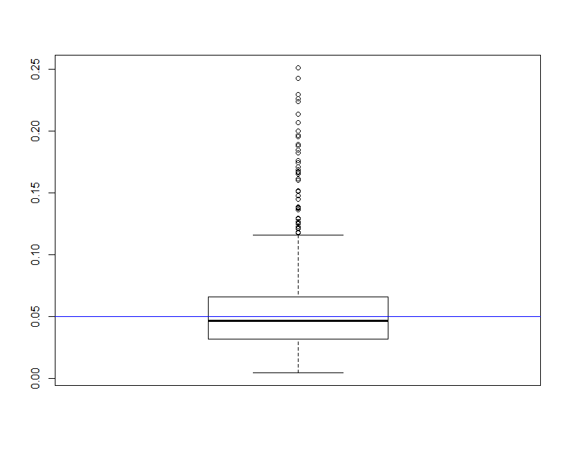
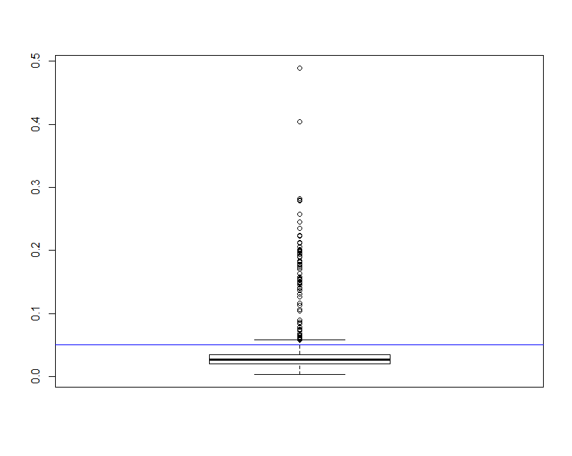
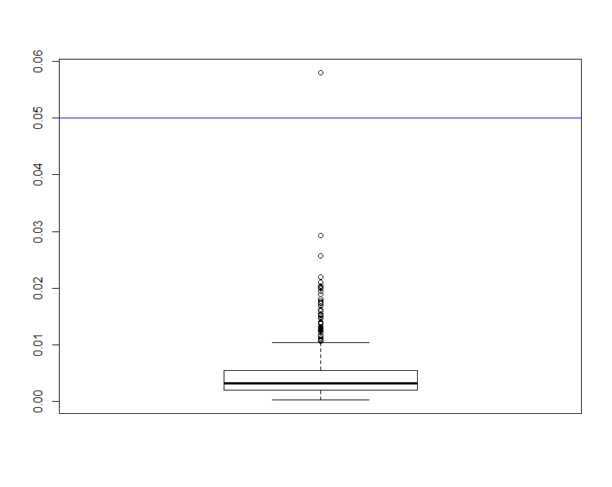
~5% Deleted (N=13)
p-value
Age
Neck
Forearm
Wrist
[JA]

Slide 108
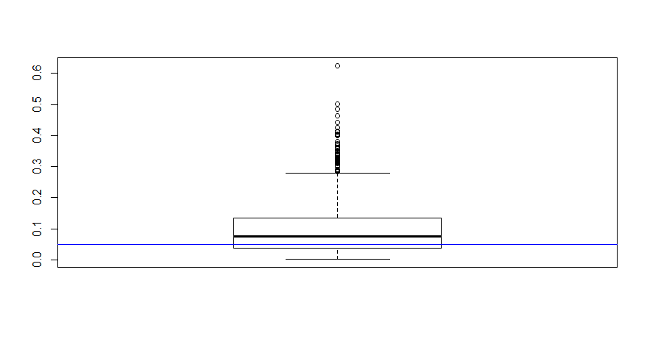
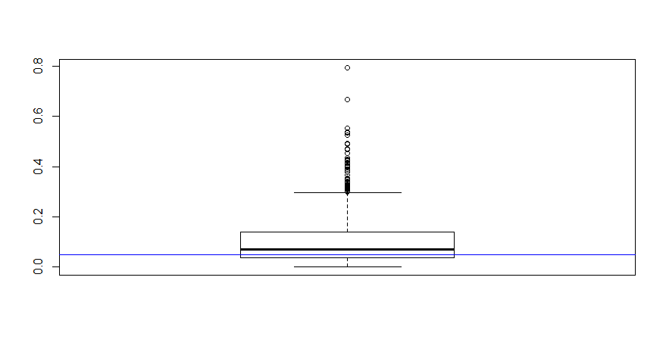
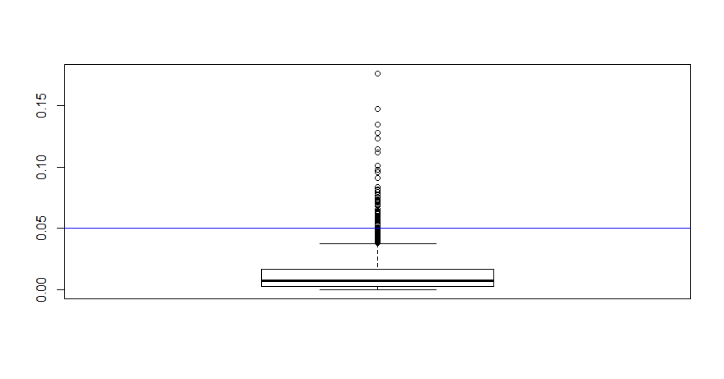
~20% Deleted (N=50)
p-value
Age
Forearm
Wrist
Neck
[JA]

Slide 109
Conclusions seem to change …
Age/Neck: fail to reject the null hypothesis usually?
vs
Age (5%)
Neck (5%)
Age (20%)
Neck (20%)
Still reject Forearm/Wrist most of the time
This is assuming the missing subjects’ distribtion does not differ from the non-missing. This would cause bias …
[JA]

Slide 110
Types Of Missing-ness
Missing Completely at Random (MCAR)
Missing at Random (MAR)
Missing Not at Random (MNAR)
[JA]

Slide 111
What Distinguishes Each Type of missing-ness?
Suppose you’re loitering outside of CSIC one day …
Students just received their mid-semester grades
You start asking passing undergrads their CMSC131 grades
You don’t force them to tell you or anything
You also write down their gender and hair color
[JA]

Slide 112
Your Sample
Hair Color | Gender | Grade
Red | M | A
Brown | F | A
Black | F | B
Black | M | A
Brown | M
Brown | M
Brown | F
Black | M | B
Black | M | B
Brown | F | A
Black | F
Brown | F | C
Red | M
Red | F | A
Brown | M | A
Black | M | A
Summary:
7 students received As
3 students received Bs
1 student received a C
Nobody is failing!
But 5 students did not reveal their grade …
[JA]

Slide 113
What influences a data point’s Presence?
Same dataset, but the values are replaced with a “0” if the data point is observed and “1” if it is not
Question: for any one of these data points, what is the probability that the point is equal to “1” …?
What type of missing-ness do the grades exhibit?
Hair Color | Gender | Grade
0 | 0 | 0
0 | 0 | 0
0 | 0 | 0
0 | 0 | 0
0 | 0 | 1
0 | 0 | 1
0 | 0 | 1
0 | 0 | 0
0 | 0 | 0
0 | 0 | 0
0 | 0 | 1
0 | 0 | 0
0 | 0 | 1
0 | 0 | 0
0 | 0 | 0
0 | 0 | 0
[JA]

Slide 114
MCAR: Missing Completely at Random
If this probability is not dependent on any of the data, observed or unobserved, then the data is Missing Completely at Random (MCAR)
Suppose that X is the observed data and Y is the unobserved data. Call our “missing matrix” R
Then, if the data are MCAR, P(R|X,Y) = ??????????
P(R|X,Y) = P(R)
Probability of those rows missing is independent of anything.
[JA]

Slide 115
Totally Realistic MCAR Example
You are running an experiment on plants grown in pots, when suddenly you have a nervous breakdown and smash some of the pots
You will probably not choose the plants to smash in a well-defined pattern, such as height age, etc.
Hence, the missing values generated from your act of madness will likely fall into the MCAR category
[JA]

Slide 116
Applicability of MCAR
A completely random mechanism for generating missing-ness in your data set just isn’t very realistic
Usually, missing data is missing for a reason:
Maybe older people are less likely to answer web-delivered questions on surveys
In longitudinal studies people may die before they have completed the entire study
Companies may be reluctant to reveal financial information

Slide 117
MAR: Missing at Random
Missing at Random (MAR): probability of missing data is dependent on the observed data but not the unobserved data
Suppose that X is the observed data and Y is the unobserved data. Call our “missing matrix” R
Then, if the data are MCAR, P(R|X,Y) = ??????????
P(R|X,Y) = P(R|X)
Not exactly random (in the vernacular sense).
There is a probabilistic mechanism that is associated with whether the data is missing
Mechanism takes the observed data as input

Slide 118
ExampleS?
?

Slide 119
MAR: Key Point
We can model that latent mechanism and compensate for it
Imputation: replacing missing data with substituted values
Models today will assume MAR
Example: if age is known, you can model missing-ness as a function of age
Whether or not missing data is MAR or the next type, Missing Not at Random (MNAR), is not* testable.
Requires you to “understand” your data
*unless you can get the missing data (e.g., post-study phone calls)

Slide 120
MNAR: Missing Not at Random
MNAR: missing-ness has something to do with the missing data itself
Examples: ??????????
Do you binge drink? Do you have a trust fund? Do you use illegal drugs? What is your sexuality? Are you depressed?
Said to be “non-ignorable”:
Missing data mechanism must be considered as you deal with the missing data
Must include model for why the data are missing, and best guesses as to what the data might be

Slide 121
Back to CSIC …
Is the the missing data:
MCAR;
MAR; or
MNAR?
???????????
Hair Color | Gender | Grade
Red | M | A
Brown | F | A
Black | F | B
Black | M | A
Brown | M
Brown | M
Brown | F
Black | M | B
Black | M | B
Brown | F | A
Black | F
Brown | F | C
Red | M
Red | F | A
Brown | M | A
Black | M | A

Slide 122
Add a variable
Bring in the GPA:
Does this change anything?
Hair Color | GPA | Gender | Grade
Red | 3.4 | M | A
Brown | 3.6 | F | A
Black | 3.7 | F | B
Black | 3.9 | M | A
Brown | 2.5 | M
Brown | 3.2 | M
Brown | 3.0 | F
Black | 2.9 | M | B
Black | 3.3 | M | B
Brown | 4.0 | F | A
Black | 3.65 | F
Brown | 3.4 | F | C
Red | 2.2 | M
Red | 3.8 | F | A
Brown | 3.8 | M | A
Black | 3.67 | M | A

Slide 123
Handling Missing Data …

Slide 124
Single Imputation
Mean imputation: imputing the average from observed cases for all missing values of a variable
Hot-deck imputation: imputing a value from another subject, or “donor,” that is most like the subject in terms of observed variables
Last observation carried forward (LOCF): order the dataset somehow and then fill in a missing value with its neighbor
Cold-deck imputation: bring in other datasets
Old and busted:
All fundamentally impose too much precision.
Have uncertainty over what unobserved values actually are
Developed before cheap computation

Slide 125
Multiple Imputation
Developed to deal with noise during imputation
Impute once → treats imputed value as observed
We have uncertainty over what the observed value would have been
Multiple imputation: generate several random values for each missing data point during imputation

Slide 126
Imputation Process
s₁
a₁
Incomplete data
s₂
a₂
Pooled results
s_{N}
a_{N}
Impute N times
Analysis performed on each imputed set

Slide 127
Tiny example
X | Y
32 | 2
43 | ?
56 | 6
25 | ?
84 | 5
Independent variable: X
Dependent variable: Y
We assume Y has a linear relationship with X

Slide 128
Let’s Impute Some Data!
Use a predictive distribution of the missing values:
Given the observed values, make random draws of the observed values and fill them in.
Do this N times and make N imputed datasets
X | Y
32 | 2
43 | 5.5
56 | 6
25 | 8
84 | 5
X | Y
32 | 2
43 | 7.2
56 | 6
25 | 1.1
84 | 5
For very large values of N=2 …

Slide 129
Inference with Multiple Imputation
Now that we have our imputed data sets, how do we make use of them? ???????????
Analyze each of the separately
X | Y
32 | 2
43 | 5.5
56 | 6
25 | 8
84 | 5
X | Y
32 | 2
43 | 7.2
56 | 6
25 | 1.1
84 | 5
Slope | -0.8245
Standard error | 6.1845
Slope | 4.932
Standard error | 4.287
Y
=
β
+
β
X
+
ε
Y
=
β
+
β
X
+
ε
i
0
1
i
i
i
0
1
i
i

Slide 130
Pooling analyses
Pooled slope estimate is the average of the N imputed estimates
Our example, β_{1p} = $\frac{β11+β12}{2}$ = (4.932-.8245) x 0.5 = 2.0538
The pooled slope variance is given by
$s= \frac{\sum{Zi}}{m}+(1+ \frac{1}{m}$) x $\frac{1}{m−1}∗\sum{(β1i }−$ β_{1p} )²
Where Z_{i} is the standard error of the imputed slopes
Our example: (4.287 + 6.1845)/2 + (3/2)*(16.569) = 30.08925
Standard error: take the square root, and we get 5.485
Notes:
For those following from home:
Variance: roughly how much a set of numbers are “spread around” their mean
Standard deviation: similar to variance (square root of variance) – same units as main data
Standard error (of the sample mean): how far the sample mean is from the population mean

Slide 131
Predicting the missing data given the observed data
Given events A, B; and P(A) > 0 …
Bayes’ Theorem:
$$P\left(B | A\right)=\frac{P(A|B)∗P(B)}{P(A)}$$
In our case:
$$P\left(H | E\right)=\frac{P(E|H)∗P(H)}{P(E)}$$
Probability of seeing evidence given the hypothesis
Prior probability of hypotheses
Posterior probability of the hypothesis given the evidence
Prior over the evidence

Slide 132
Bayesian Imputation
Establish a prior distribution:
Some distribution of parameters of interest θ before considering the data, P(θ)
We want to estimate θ
Given θ, can establish a distribution P(X_{obs}|θ)
Use Bayes Theorem to establish P(θ|X_{obs}) …
Make random draws for θ
Use these draws to make predictions of Y_{miss}

Slide 133
How big should N Be?
Number of imputations N depends on:
Size of dataset
Amount of missing data in the dataset
Some previous research indicated that a small N is sufficient for efficiency of the estimates, based on:
(1 + $\frac{λ}{N}$)-1
N is the number of imputations and λ is the fraction of missing information for the term being estimated [Schaffer 1999]
More recent research claims that a good N is actually higher in order to achieve higher power [Graham et al. 2007]

Slide 134
More advanced methods
Interested? Further reading:
Regression-based MI methods
Multiple Imputation Chained Equations (MICE) or Fully Conditional Specification (FCS)
  Readable summary from JHU School of Public Health: https://www.ncbi.nlm.nih.gov/pmc/articles/PMC3074241/
Markov Chain Monte Carlo (MCMC)
  We’ll cover this a bit, but also check out CMSC422!

Slide 135
Next Class:
Summary Statistics &Visualization

