Slide 1
Principles of
Data Science
John P Dickerson
Lecture #6 – 10/3/2018
CMSC641
Wednesdays
7:00pm – 9:30pm

Slide 2
Announcements
Mini-Project #1 was due today!
It is linked to from ELMS; also available at: https://github.com/umddb/cmsc641-fall2018/tree/master/project1
Deliverable is a .ipynb file submitted to ELMS
Mini-Project #2 is out!
It is linked to from ELMS; also available at: https://github.com/umddb/cmsc641-fall2018/tree/master/project2
Deliverable is a .ipynb file submitted to ELMS
Due Wednesday, October 24th

Slide 3
Rest of Today’s Lecture
Data collection
Data processing
Exploratory analysis
&
Data viz
Analysis, hypothesis testing, & ML
Insight & Policy Decision
Continue with the general topic of data wrangling and cleaning
Many slides from Amol Deshpande (UMD)

Slide 4
Overview
Goal: get data into a structured form suitable for analysis
  Variously called: data preparation, data munging, data curation
  Also often called ETL (Extract-Transform-Load) process
Often the step where majority of time (80-90%) is spent
Key steps:
  Scraping: extracting information from sources, e.g., webpages, spreadsheets
  Data transformation: to get it into the right structure
  Data integration: combine information from multiple sources
  Information extraction: extracting structured information from unstructured/text sources
  Data cleaning: remove inconsistencies/errors

Slide 5
Overview
Goal: get data into a structured form suitable for analysis
  Variously called: data preparation, data munging, data curation
  Also often called ETL (Extract-Transform-Load) process
Often the step where majority of time (80-90%) is spent
Key steps:
  Scraping: extracting information from sources, e.g., webpages, spreadsheets
  Data transformation: to get it into the right structure
  Information extraction: extracting structured information from unstructured/text sources
  Data integration: combine information from multiple sources
  Data cleaning: remove inconsistencies/errors
Already covered
In a few
classes

Slide 6
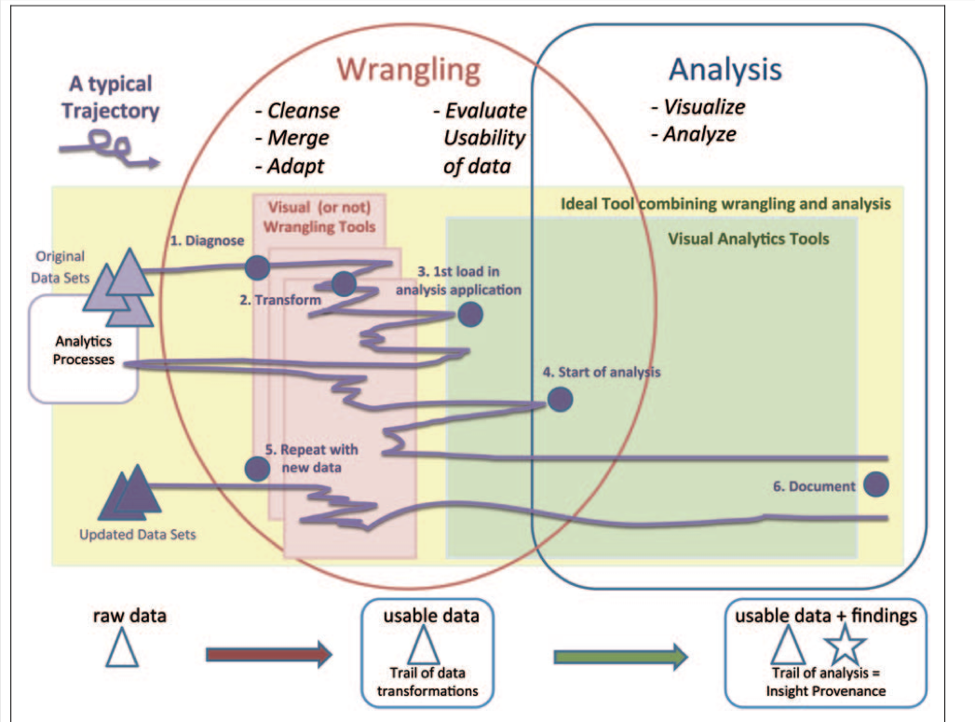
Overview

Slide 7
Overview
Many of the problems are not easy to formalize, and have seen little work
  E.g., Cleaning
  Others aspects of integration, e.g., schema mapping, have been studied in depth
A mish-mash of tools typically used
  Visual (e.g., Trifacta), or not (UNIX grep/sed/awk, Pandas)
  Ad hoc programs for cleaning data, depending on the exact type of errors
  Different types of transformation tools
  Visualization and exploratory data analysis to understand and remove outliers/noise
  Several tools for setting up the actual pipelines, assuming the individual steps are setup (e.g., Talend, AWS Glue)

Slide 8
Outline
Data Integration
Data Quality Issues
Data Cleaning
Entity Resolution

Slide 9
Outline
Data Integration
Data Quality Issues
Data Cleaning
Entity Resolution

Slide 10
Data Integration
Linkage
Queries
Querying integrated information sources (e.g. queries to views, execution of web-based queries, …)
Data mining & analyzing integrated information (e.g., collaborative filtering/classification learning using extracted data, …)
Discovering information sources (e.g. deep web modeling, schema learning, …)
Gathering data (e.g., wrapper learning & information extraction, federated search, …)
Cleaning data (e.g., de-duping and linking records) to form a single [virtual] database

Slide 11
Data Integration
Goal: Combine data residing in different sources and provide users with a unified view of these data for querying or analysis
  Each data source has its own schema called local schemas (much work assumes relational schemas, but some work on XML as well)
  The unified schema is often called mediated schema or global schema
Two different setups:
Bring the data together into a single repository (often called data warehousing)
Keep the data where it is, and send queries back and forth

Slide 12
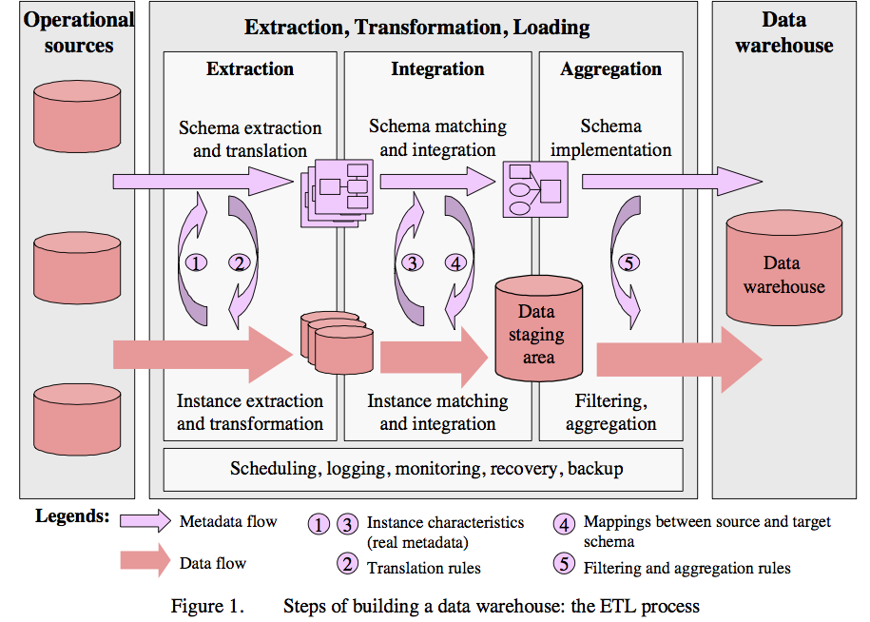
1. Data Warehousing
  From Data Cleaning: Problems and Current Approaches
Many of the problems are not easy to formalize, and have seen little work
  E.g., Cleaning
  Others aspects of integration, e.g., schema mapping, have been studied in depth
Typical workflow
  From Data Cleaning: Problems and Current Approaches
  Somewhat old: data is mostly coming from structured sources
  For a data scientist, the data scraping is equally important

Slide 13
2. In-place integration
Query Q
Mediated Schema
Q’
Q’
Q’
Q’
Q’
Source
Source
Source
Source
Source

Slide 14
Data Integration
Two different setups:
Bring the data together into a single repository (often called data warehousing)
  Relatively easier problem - only need one-way-mappings
  Query performance predictable and under your control
Keep the data where it is, and send queries back and forth
  Need two-way mappings -- a query on the mediated schema needs to be translated into queries over data source schemas
  Not as efficient and clean as data warehousing, but a better fit for dynamic data
  Or when data warehousing is not feasible

Slide 15
Data Integration: Key Challenges
Data extraction, reconciliation, and cleaning
  Get the data from each source in a structured form
  Often need to use wrappers to extract data from web sources
  May need to define a schema
Schema alignment and mapping
  Decide on the best mediated schema
  Figure out mappings and matchings between the local schemas and the global schema
Answer queries over the global schema
  In the second scenario, need to figure out how to map a query on global schema onto queries over local schemas
  Also need to decide which sources contain relevant data
Limitations in mechanisms for accessing sources
  Many sources have limits on how you can access them
  Limits on the number of queries you can issues (say 100 per min)
  Limits on the types of queries (e.g., must enter a zipcode to get information from a web source)

Slide 16
Schema Matching or Alignment
Flashbacks to Project 1 …
Goal: Identify corresponding elements in two schemas
  As a first step toward constructing a global schema
  Schema heterogeneity is a key roadblock
    Different data sources speak their own schema
Hotel, Restaurant,
AdventureSports, HistoricalSites
Data Source
Consumer
Hotel, Gaststätte
Brauerei, Kathedrale
Data Source
Mediator
Data Source
Lodges, Restaurants
Beaches, Volcanoes

Slide 17
Schema Matching or Alignment
Books
Title
ISBN
Price
DiscountPrice
Edition
Authors
ISBN
FirstName
LastName
BooksAndMusic
Title
Author
Publisher
ItemID
ItemType
SuggestedPrice
Categories
Keywords
BookCategories
ISBN
Category
CDCategories
ASIN
Category
CDs
Album
ASIN
Price
DiscountPrice
Studio
Inventory
Database A
Artists
ASIN
ArtistName
GroupName
Inventory Database B

Slide 18
summary
Data integration continues to be a very active area in research and increasingly industry
Solutions still somewhat ad hoc and manual, although tools beginning to emerge
Need to minimize the time needed to integrate a new data source
  Crucial opportunities may be lost otherwise
  Can take weeks to do it properly
Dealing with changes to the data sources a major headache
  Especially for data sources not under your control

Slide 19
Outline
Data Integration
Data Quality Issues
Data Cleaning
Entity Resolution

Slide 20
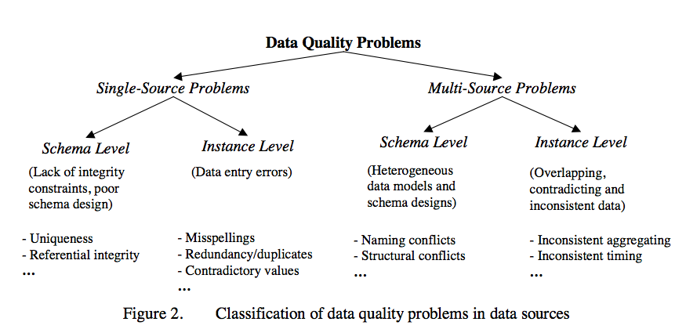
Data quality Problems
Different sources are developed separately, and maintained by different people
Issue 1: Mapping information across sources (schema mapping/transformation)
  Naming conflicts: same name used for different objects
  Structural conflicts: different representations across sources
  We will cover this later
Issue 2: Entity Resolution: Matching entities across sources
Issue 3: Data quality issues
  Contradicting information, Mismatched information, etc.
  From Data Cleaning: Problems and Current Approaches

Slide 21
Single-source problems
Depends largely on the source
Databases can enforce constraints, whereas data extracted from files or spreadsheets, or scraped from webpages is much more messy
Types of problems:
  Ill-formatted data, especially from webpages or files or spreadsheets
  Missing or illegal values, Misspellings, Use of wrong fields, Extraction issues (not easy to separate out different fields)
  Duplicated records, Contradicting Information, Referential Integrity Violations
  Unclear default values (e.g., data entry software needs something)
  Evolving schemas or classification schemes (for categorical attributes)
  Outliers

Slide 22
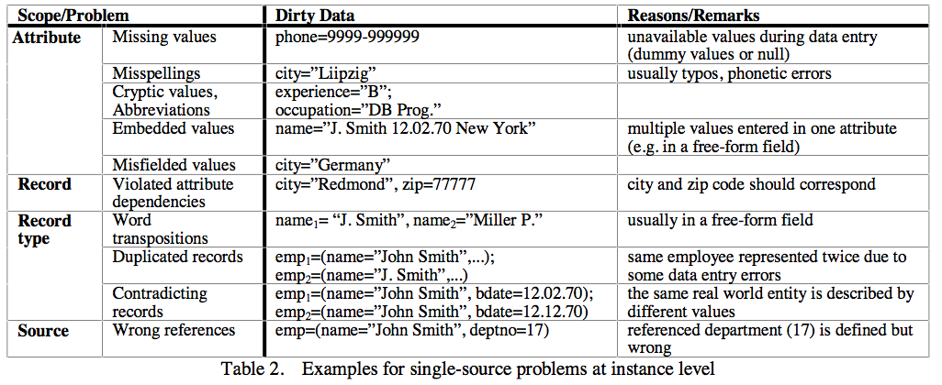
Data quality Problems

Slide 23
Multi-source problems
Different sources are developed separately, and maintained by different people
Issue 1: Mapping information across sources (schema mapping/transformation)
  Naming conflicts: same name used for different objects
  Structural conflicts: different representations across sources
  We will cover this later
Issue 2: Entity Resolution: Matching entities across sources
Issue 3: Data quality issues
  Contradicting information, Mismatched information, etc.

Slide 24
Outline
Data Integration
Data Quality Issues
Data Cleaning
  Outlier Detection
  Constraint-based Cleaning
  Entity Resolution

Slide 25
Univariate outliers
A set of values can be characterized by metrics such as center (e.g., mean), dispersion (e.g., standard deviation), and skew
Can be used to identify outliers
  Must watch out for "masking": one extreme outlier may alter the metrics sufficiently to mask other outliers
  Should use robust statistics: considers effect of corrupted data values on distributions – we will talk about this in depth later
  Robust center metrics: median, k% trimmed mean (discard lowest and highest k% values)
  Robust dispersion:
    Median Absolute Deviation (MAD): median distance of all the values from the median value
A reasonable approach to find outliers: any data points 1.4826x MAD away from median
  The above assumes that data follows a normal distribution
  May need to eyeball the data (e.g., plot a histogram) to decide if this is true

Slide 26
Univariate outliers
Wikipedia Article on Outliers lists several other normality-based tests for outliers
If data appears to be not normally distributed:
  Distance-based methods: look for data points that do not have many neighbors
  Density-based methods:
    Define density to be average distance to k nearest neighbors
    Relative density = density of node/average density of its neighbors
    Use relative density to decide if a node is an outlier
Most of these techniques start breaking down as the dimensionality of the data increases
  Curse of dimensionality
  Can project data into lower-dimensional space and look for outliers there
    Not as straightforward

Slide 27
Multivariate outliers
Analogous to above, one set of techniques based on assuming data follows a multi-variate normal distribution
  Defined by a mean, μ, and a covariance matrix, Σ
  Mahalanobis Depth of a point: Square root of (x - μ)'Σ⁻¹(x - μ)
  Measures how far the point x is from the multivariate normal distribution
    Look for points that are too far away
Mean/Covariance are not robust -- they are sensitive to outliers
  Iterative approach: remove points with high Mahalanobis distance, recompute the mean and covariance
  Several other general approaches discussed in the reference above (by Hellerstein)
  No clear guidelines here -- need to try different techniques based on the data

Slide 28
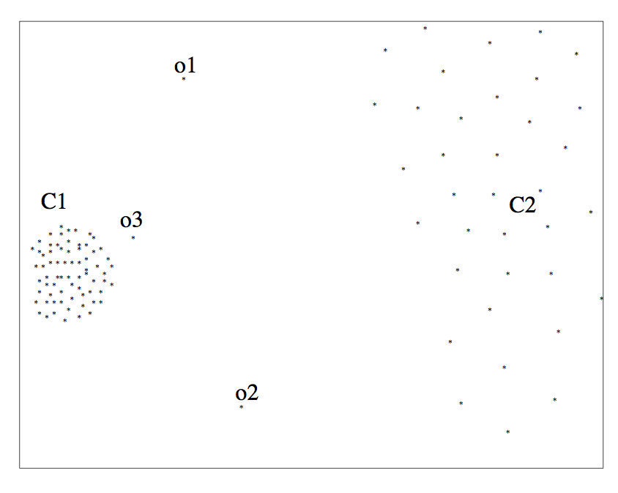
outliers

Slide 29
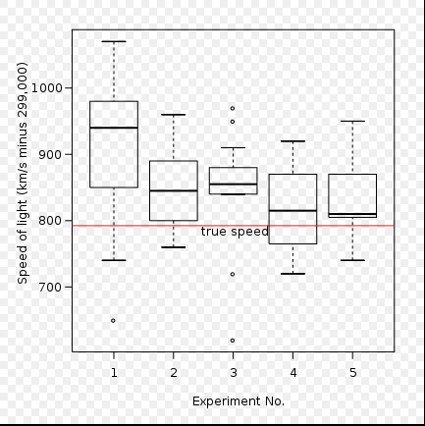
outliers

Slide 30
Other outliers
Timeseries outliers
  Often the data is in the form of a timeseries
  Can use the historical values/patterns in the data to flag outliers
  Rich literature on forecasting in timeseries data
Frequency-based outliers
  An item is considered a "heavy hitter" if it is much more frequent than other items
  In relational tables, can be found using a simple groupby-count
  Often the volume of data may be too much (e.g., internet routers)
    Approximation techniques often used
    To be discussed sometime later in the class
Things generally not as straightforward with other types of data
  Outlier detection continues to be a major research area

Slide 31
Wrap-up
Data wrangling/cleaning are a key component of data science pipeline
Still largely ad hoc although much tooling in recent years
Specifically, we covered:
Schema mapping and matching
Outliers
Next up:
Constraint-based Cleaning
Entity Resolution/Record Linkage/Data Matching

Slide 32
Data Cleaning: Outlier Resolution
From: Entity Resolution Tutorial
Identify different manifestations of the same real world object
  Also called: identity reconciliation, record linkage, deduplication, fuzzy matching, Object consolidation, Coreference resolution, and several others
Motivating examples: ?????????????
  Postal addresses
  Entity recognition in NLP/Information Extraction
  Identifying companies in financial records
  Comparison shopping
  Author disambiguation in citation data
  Connecting up accounts on online networks
  Crime/Fraud Detection
  Census
  ...

Slide 33
Data Cleaning: Outlier Resolution
Important to correctly identify references
  Often actions taken based on extracted data
  Cleaning up data by entity resolution can show structure that may not be apparent before
Challenges
  Such data is naturally ambiguous (e.g., names, postal addresses)
  Abbreviations/data truncation
  Data entry errors, Missing values, Data formatting issues complicate the problem
  Heterogeneous data from many diverse sources
No magic bullet here !!
  Approaches fairly domain-specific
  Be prepared to do a fair amount of manual work

Slide 34
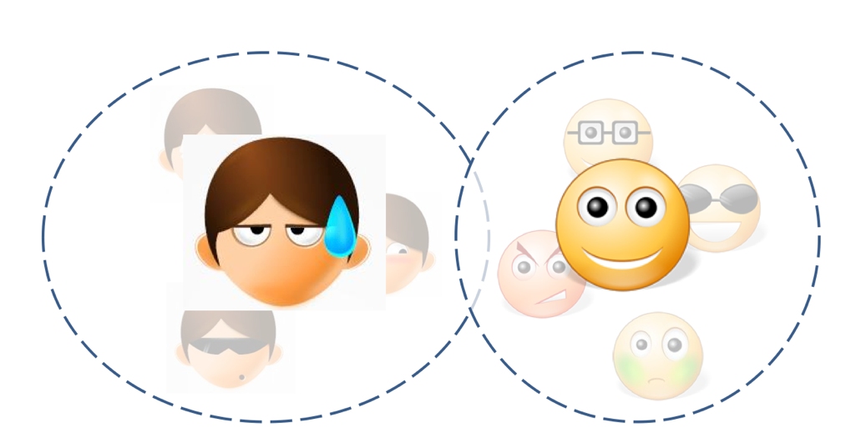
Entity Resolution: Three Slightly Different Problems
Setup:
  Real world: there are entities (people, addresses, businesses)
  We have a large collection of noisy, ambiguous "references" to those entities (also called "mentions")
  Somewhat different techniques, but a lot of similarities
Deduplication
  Cluster records/mentions that correspond to the same entity
  Choose/construct a cluster representative
    This is in itself a non-trivial task (e.g., averaging may work for numerical attributes, but what about string attributes?)

Slide 35
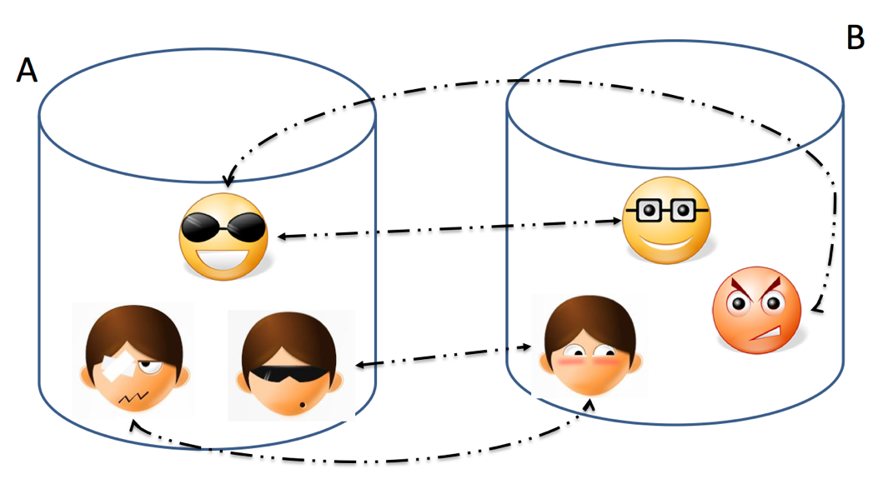
Entity Resolution: Three Slightly Different Problems
Setup:
  Real world: there are entities (people, addresses, businesses)
  We have a large collection of noisy, ambiguous "references" to those entities (also called "mentions")
  Somewhat different techniques, but a lot of similarities
Record Linkage
  Match records across two different databases (e.g., two social networks, or financial records w/ campaign donations)
  Typically assume that the two databases are fairly clean

Slide 36
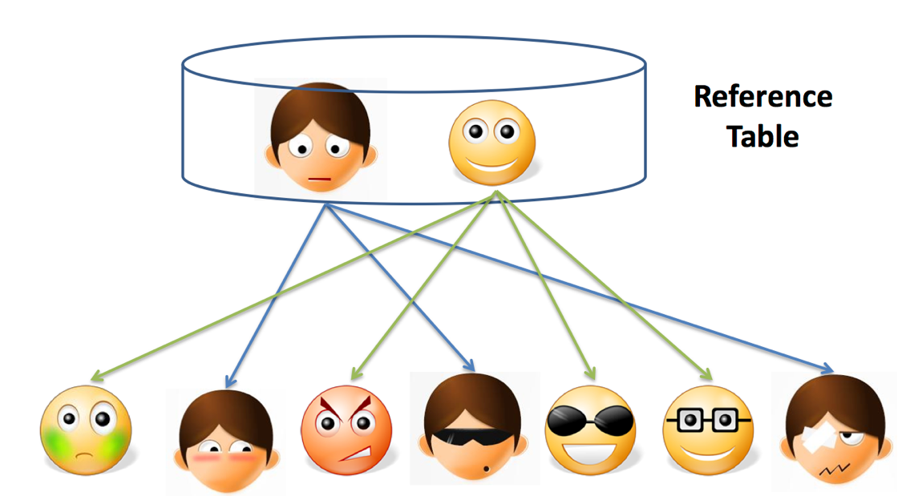
Entity Resolution: Three Slightly Different Problems
Setup:
  Real world: there are entities (people, addresses, businesses)
  We have a large collection of noisy, ambiguous "references" to those entities (also called "mentions")
  Somewhat different techniques, but a lot of similarities
Reference Matching
  Match "references" to clean records in a reference table
  Commonly comes up in "entity recognition" (e.g., matching newspaper article mentions to names of people)

Slide 37
Entity Resolution: Data Matching
Comprehensive treatment: Data Matching; P. Christen; 2012 (Springer Books -- not available for free)
One of the key issues is finding similarities between two references
  What similarity function to use?
Edit Distance Functions
  Levenstein: min number of changes to go from one reference to another
    A change is defined to be: a single character insertion or deletion or substitution
    May add transposition
  Many adjustments to the basic idea proposed (e.g., higher weights to changes at the start)
  Not cheap to compute, especially for millions of pairs
Set Similarity
  Some function of intersection size and union size
  E.g., Jaccard distance = size of intersection/size of union
  Much faster to compute
Vector Similarity
  Cosine similarity – we’ll talk about this much more in NLP lectures

Slide 38
Entity Resolution: Data Matching
Q-Grams
  Find all length-q substrings in each string
  Use set/vector similarity on the resulting set
Several approaches that combine the above (especially q-grams and edit distance, e.g., Jaro-Winkler)
Soundex: Phonetic Similarity Metric
  Homophones should be encoded to the same representation so spelling errors can be handled
  Robert and Rupert get assigned the same code (R163), but Rubin yields R150
May need to use Translation Tables
  To handle abbreviations, nicknames, other synonyms
Different types of data requires more domain-specific functions
  E.g., geographical locations, postal addresses
  Also much work on computing distances between XML documents etc.

Slide 39
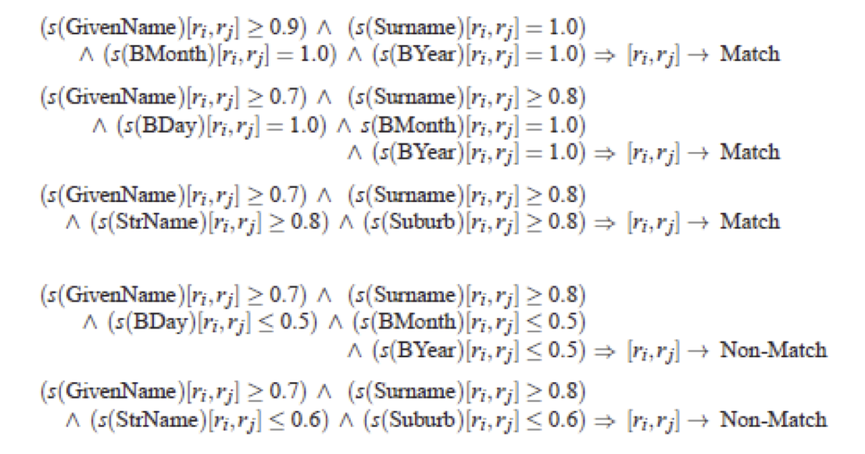
Entity Resolution: Algorithms
Simple threshold method
  If the distance below some number, the two references are assumed to be equal
  May review borderline matches manually
Can be generalized to rule-based:
  Example from Christen, 2012

Slide 40
Entity Resolution: Algorithms
May want to give more weight to matches involving rarer words
  More naturally applicable to record linkage problem
  If two records match on a rare name like "Machanavajjhala", they are likely to be a match
  Can formalize this as "probabilistic record linkage”
Constraints: May need to be satisfied, but can also be used to find matches
  Often have constraints on the matching possibilities
  Transitivity: M1 and M2 match, and M2 and M3 match, and M1 and M3 must match
  Exclusivity: M1 and M2 match --> M3 cannot match with M2
  Other types of constraints:
    E.g., if two papers match, their venues must match

Slide 41
Entity Resolution: Algorithms
Clustering-based ER Techniques:
  Deduplication is basically a clustering problem
  Can use clustering algorithms for this purpose
  But most clusters are very small (in fact of size = 1)
  Some clustering algorithms are better suited for this, especially Agglomerative Clustering
    Unlikely K-Means would work here

Slide 42
Entity Resolution: Algorithms
Crowdsourcing
  Humans are often better at this task
  Can use one of the crowdsourcing mechanisms (e.g., Mechanical Turk) for getting human input on the difficult pairs
  Quite heavily used commercially (e.g., to disambiguate products, restaurants, etc.)

Slide 43
Entity Resolution: Scaling to Big Data
One immediate problem
  There are O(N²) possible matches
  Must reduce the search space
Use some easy-to-evaluate criterion to restrict the pairs considered further
  May lead to false negative (i.e., missed matches) depending on how noisy the data is
Much work on this problem as well, but domain-specific knowledge likely to be more useful in practice
One useful technique to know: min-hash signatures
  Can quickly find potentially overlapping sets
  Turns up to be very useful in many domains (beyond ER)

Slide 44
Next Up:
Summary Statistics &Visualization

Slide 45
Today’s Lecture
Data collection
Data processing
Exploratory analysis
&
Data viz
Analysis, hypothesis testing, & ML
Insight & Policy Decision

Slide 46
Exploratory Data Analysis
Seen so far:
Manipulations that prepare datasets into tidy form
Join tables and compute summaries
Form relationships between different entities
EDA is the last step before Big Time Statistics and ML™:
Want to quickly “get a feel” for the data through summary statistics, visualization, et cetera
Spot nuances like skew, how distributed the data is, trends, how pairs of variables interact, problems
Suggests which Stats/ML assumptions to make and approaches to take

Slide 47
Last Week’s lesson
Having a really big sample does not assure you of an accurate result.
It may assure you of a really solid, really bad (inaccurate) result.
Not all randomness is create equal when it comes to random sampling of a population:
Ask why data are missing! MCAR, MAR, MNAR.
Ask how the data were collected.

Slide 48
Today’s lesson: Summary Statistics
Part of descriptive statistics, used to summarize data:
Convey lots of information with extreme simplicity
Descriptive statistics for a variable:
Measures of location: mean, median, mode
Measure of dispersion: variance, standard deviation
Measuring correlation of two variables:
Understanding correlation
Measuring correlation
Scatter plots and regression
Thanks to William Green (NYU Stern IOMS) and Hector Corrada Bravo (UMD)

Slide 49
Measures of Location
These are 30 hours of average defect data on sets of circuit boards. Roughly what is the typical value?
1.45 1.65 1.50 2.25 1.65 1.60 2.30 2.20 2.70 1.70
2.35 1.70 1.90 1.45 1.40 2.60 2.05 1.70 1.05 2.35
1.90 1.55 1.95 1.60 2.05 2.05 1.70 2.30 1.30 2.35
Location and central tendency
There exists a distribution of values
We are interested in the “center” of the distribution
Two measures are the sample mean and the sample median
They look similar, and measure the same thing
They differ systematically (and predictably) when the data are not symmetric
[WG]

Slide 50
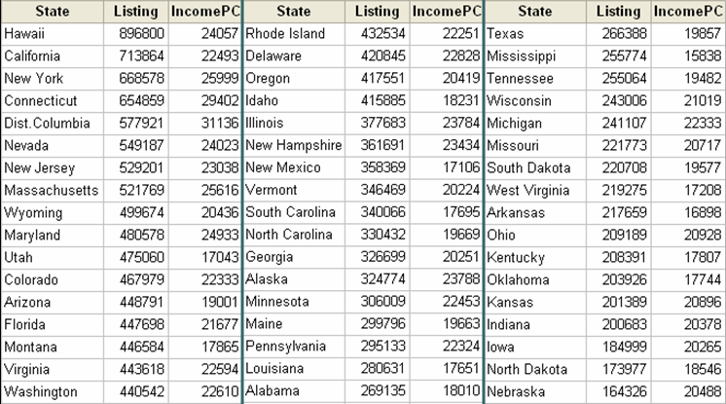
The mean Of aggregate data
Average list price:
1/51 ($898,800 + $713,864 + … + $164,326) = $369,687
[WG]

Slide 51
Averaging Averages?
Hawaii’s average listing = $896,800
Hawaii’s population = 1,275,194
Illinois’ average listing = $377,683
Illinois’ population = 12,763,371
Illinois and Hawaii each get an equal weight of 1/51 = .019607 when the mean is computed.
Looks like Hawaii is getting too much influence …
[WG]

Slide 52
Weighted Average
New average is $409,234 compared to $369,687 without weights, an error of 11%
Sometimes an unequal weighting of the observations is necessary
State population data: http://www.factmonster.com/ipka/A0004986.html

Slide 53
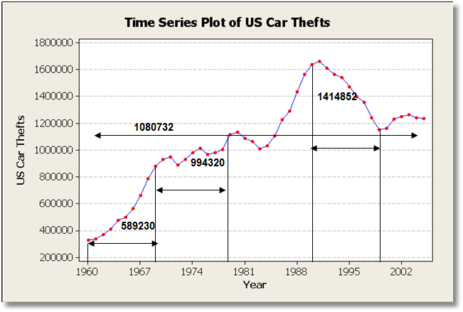
Averages & Time Series
Averaging trending time series is usually not helpful
Mean changes completely depending on time interval
What about periodic time series data ??????????
Ask yourself:
Does the mean over the entire observation period mean anything?
Does it estimate anything meaningful?

Slide 54
The Sample Median
Median:
Sort the data
Take the middle point*
Odd number:
Central observation: Med[1,2,4,6,8,9,17]
Even number:
Midpoint between the two central observations Med[1,2,4,6,8,9,14,17] = (6+8)/2=7
* There are faster ways, e.g., to find the median in linear time!

Slide 55
What is the center?
The mean and median measure the central tendency of data
Generally, the center of of a dataset is a point in its range that is close to the data.
Close? Need a distance metric between two points x and x₂
We’ve talked about some already!
Absolute deviation: | x₁ – x₂ |
Squared deviation: (x₁ – x₂)²
We’ll define the center based on these metrics

Slide 56
Dataset for this part
53,940 measurements of diamonds
More info: https://en.wikipedia.org/wiki/Diamond_(gemstone)#Gemological_characteristics

Slide 57
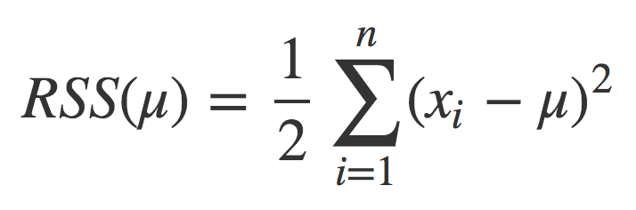
The Mean Revisited
Define a center point μ based on some function of the distance from each data point to that center point
Residual sum of squares (RSS) for a point μ:
So what should our estimate of the “center” of this dataset be, based on the RSS metric?
?????????????

Slide 58
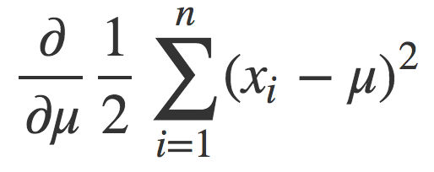
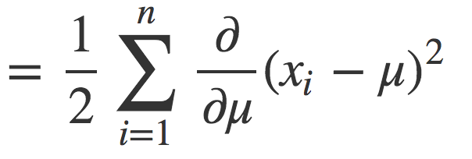
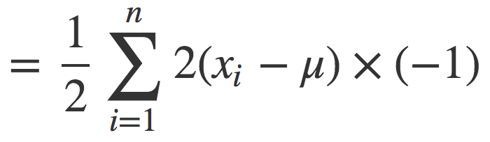
The mean Revisited
Want the point μ that minimizes the RSS ??????????
Find the derivative of RSS and set it to zero, solve for μ!

Slide 59
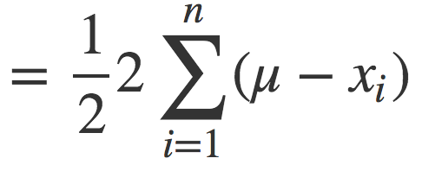
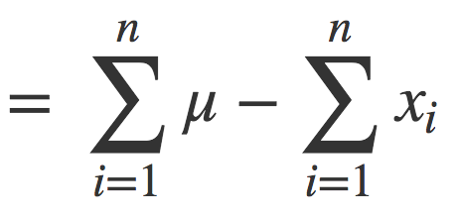
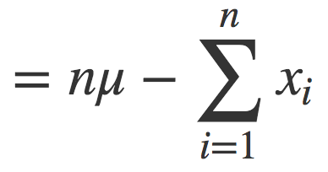
The mean revisited

Slide 60
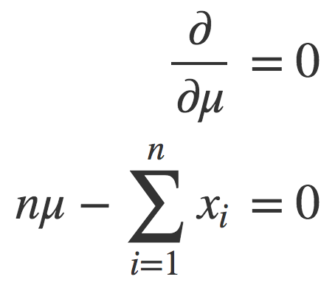
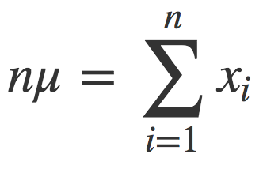
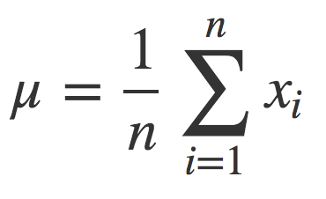
The mean revisited
Set the derivative to zero and solve for μ:
The mean is the point μ that minimizes the RSS for a dataset.

Slide 61
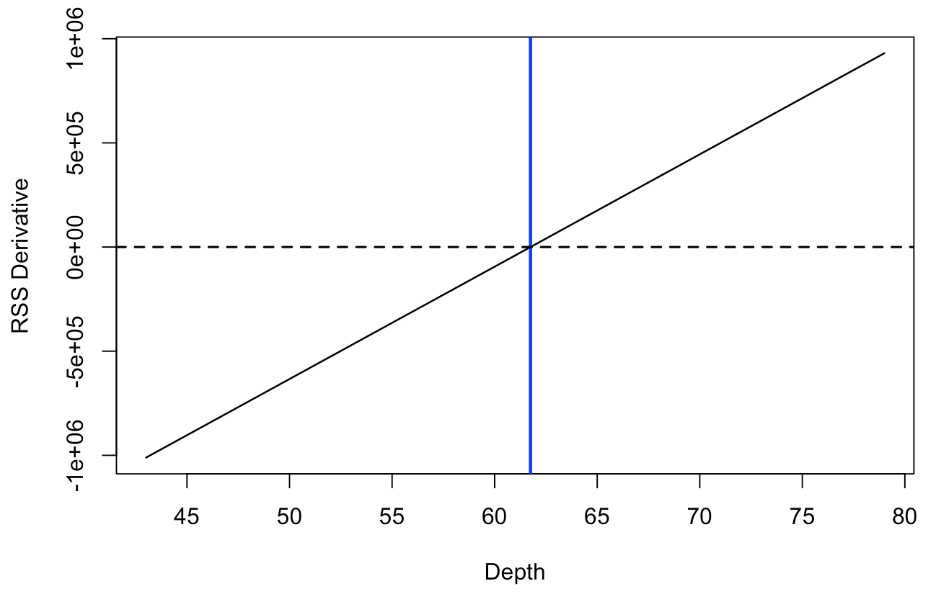
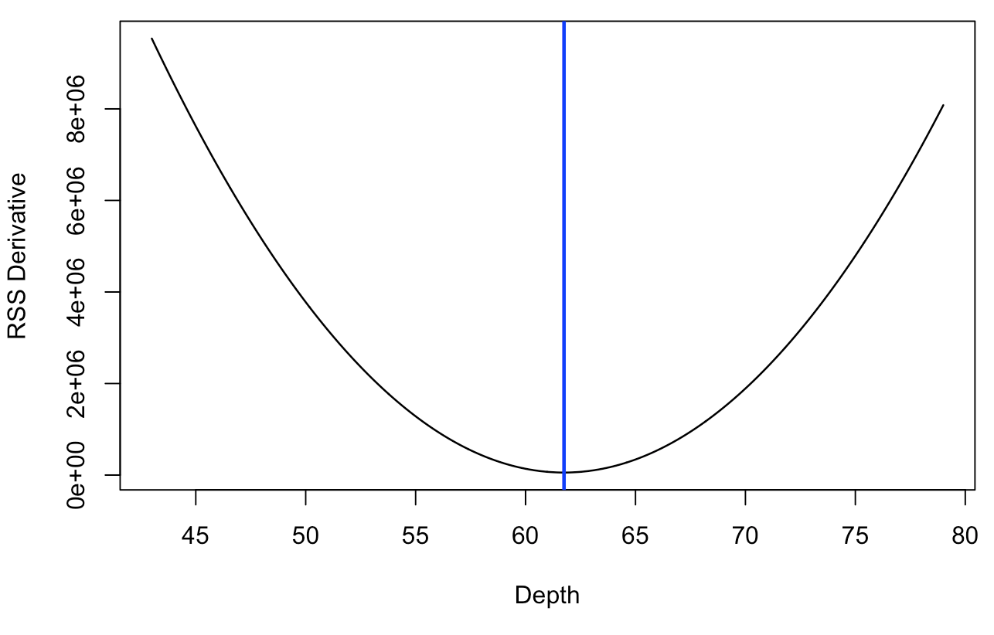
The mean revisited
What about a weighted average ???????
The mean is the point μ that minimizes the RSS for a dataset.

Slide 62
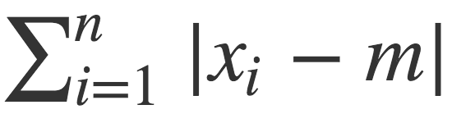
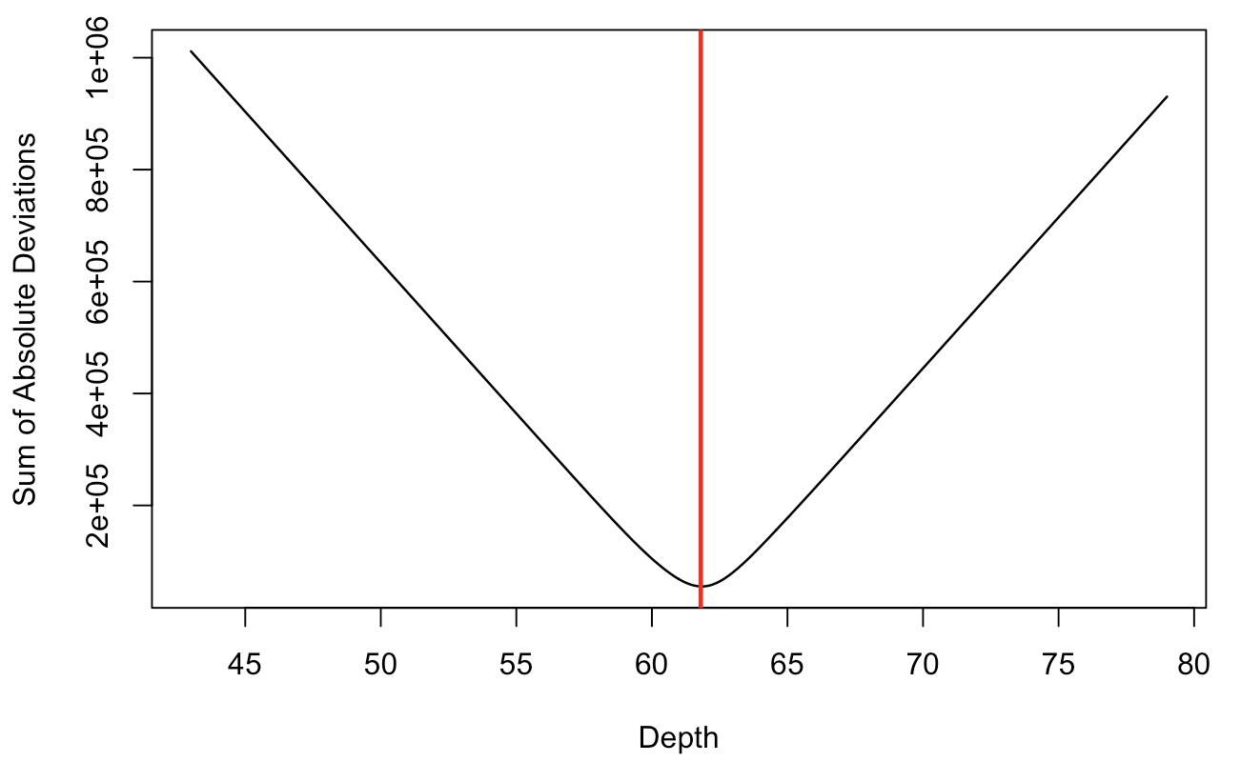
The median revisited
Define a center point m based on some function of the distance from each data point to that center point
The median m minimizes the sum of absolute differences:

Slide 63
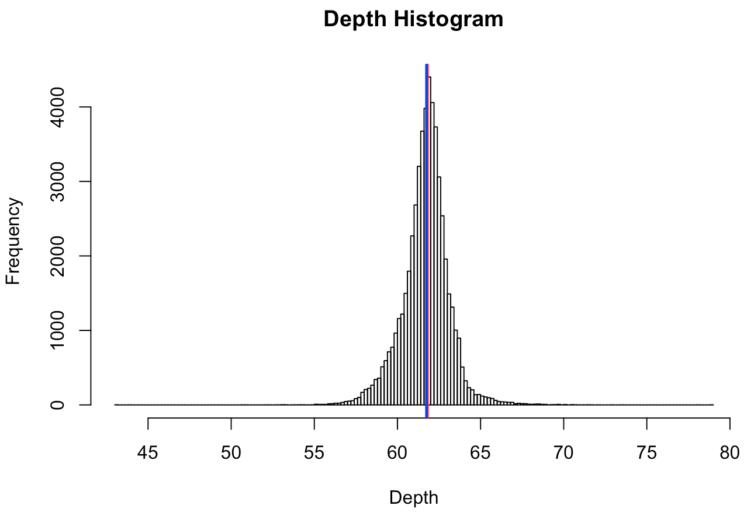
Mean != Median

Slide 64
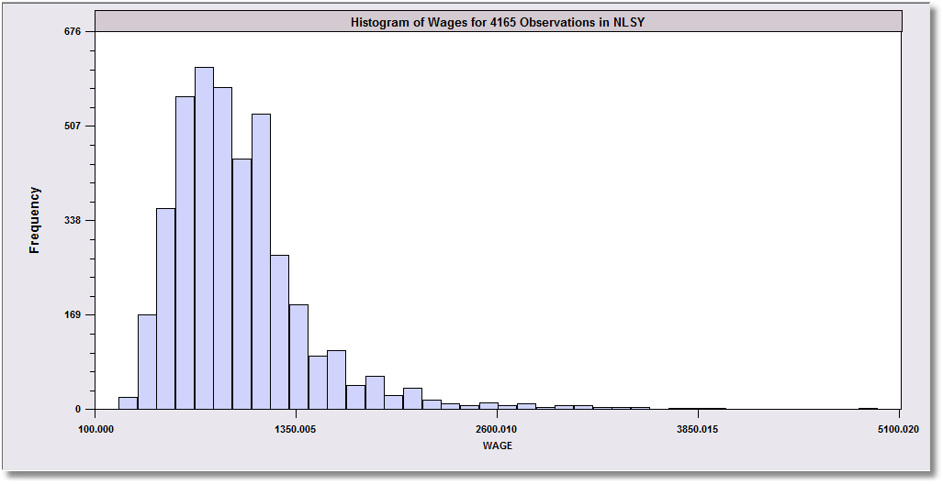
Skewed Data
Monthly Earnings
N = 595,
Median = 800
Mean = 883
These data are skewed to the right.
Median
Mean
The mean will exceed the median when the distribution is skewed to the right.
Skewness is in the direction of the long tail

Slide 65
SKewness
Extreme observations distort means but not medians.
Outlying observations distort the mean:
Med [1,2,4,6,8,9,17] = 6
Mean[1,2,4,6,8,9,17] = 6.714
Med [1,2,4,6,8,9,17000] = 6 (still)
Mean[1,2,4,6,8,9,17000] = 2432.8 (!)
Typically occurs when there are some outlying observations, such as in cross sections of income or wealth and/or when the sample is not very large.

Slide 66

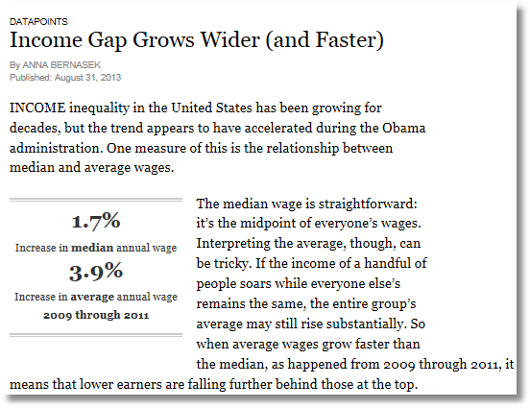
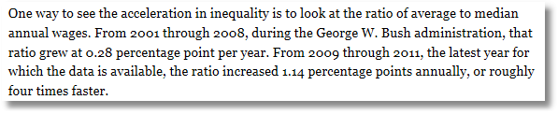

Slide 67
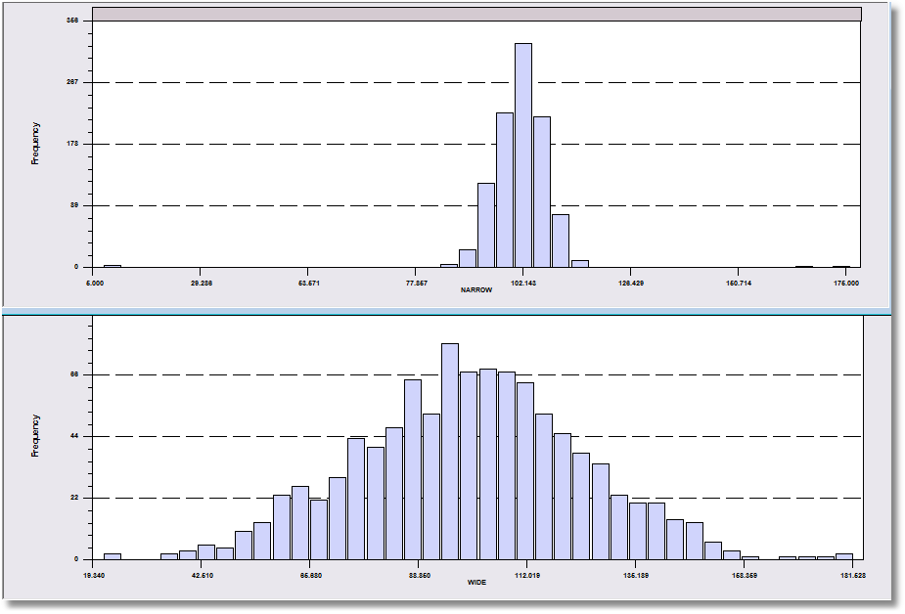
More Information Needed!
Both data sets have a mean of about 100.

Slide 68
Dispersion of the Observations
30 hours of average defect data on sets of circuit boards.
1.45 1.65 1.50 2.25 1.65 1.60 2.30 2.20 2.70 1.70
2.35 1.70 1.90 1.45 1.40 2.60 2.05 1.70 1.05 2.35
1.90 1.55 1.95 1.60 2.05 2.05 1.70 2.30 1.30 2.35
We quantify the variation of the values around the mean.
Note the range is from 1.05 to 2.70. This gives an idea where the data lie.
The mean plus a measure of the variation do the same job.

Slide 69
Range as a Measure of Dispersion
Problems
????????
These two data sets both have 1,000 observations
that range from about 10 to about 180.

Slide 70
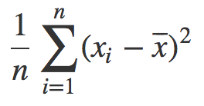
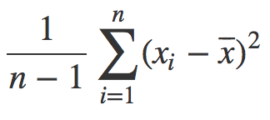
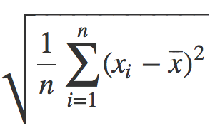
Variance & STDEV:
Measures of dispersion
Variance = s_{X}² =
Standard deviation = s_{X} =
The variance is commonly used statistic for spread
What are the units of the variance ??????????
Standard deviation “fixes this,” can be used as an interpretable unit of measurement
or
Why n-1? http://nebula.deanza.edu/~bloom/math10/m10divideby_nminus1.pdf

Slide 71
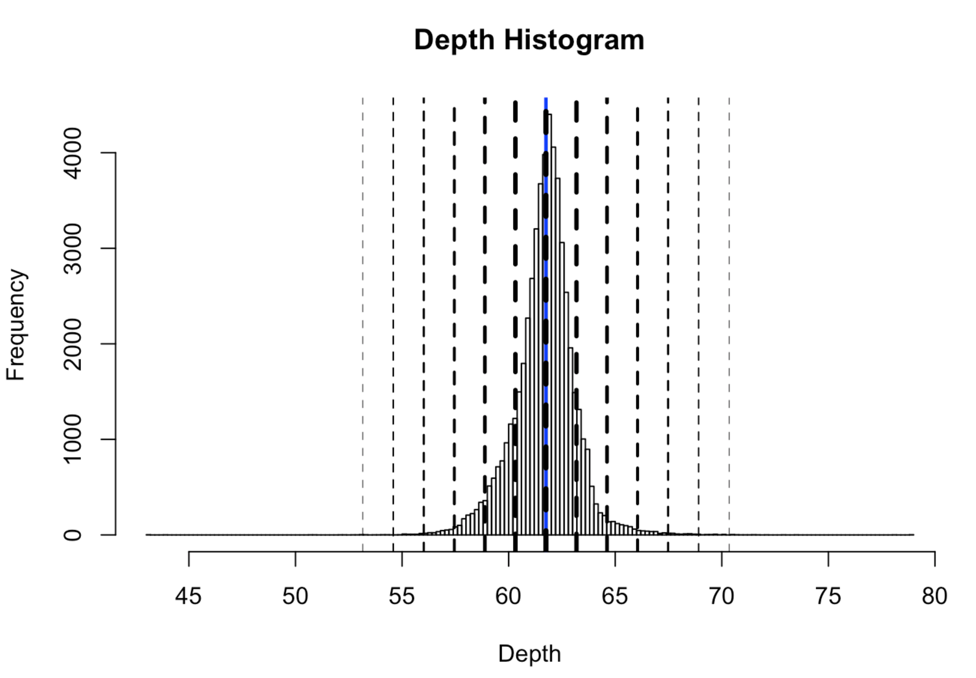

Slide 72
Using “standard deviations from the mean” as a unit
SDs | Proportion | Interpretation
1 | 0.68 | 68% of the data is within ± 1 sds
2 | 0.95 | 95% of the data is within ± 2 sds
3 | 0.9973 | 99.73% of the data is within ± 3 sds
4 | 0.999937 | 99.9937% of the data is within ± 4 sds
5 | 0.9999994 | 99.999943% of the data is within ± 5 sds
6 | 1 | 99.9999998% of the data is within ± 6 sds

Slide 73
Pairs of data Points?

Slide 74
Correlation
Variables Y and X vary together
Causality vs. correlation: Does movement in X “cause” movement in Y in some metaphysical sense?
Correlation
Simultaneous movement through a statistical relationship
Simultaneous variation “induced” by the variation of a common third effect

Slide 75
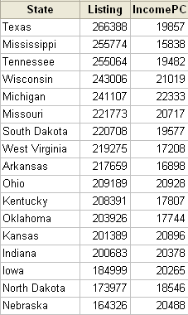
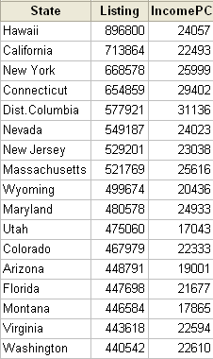
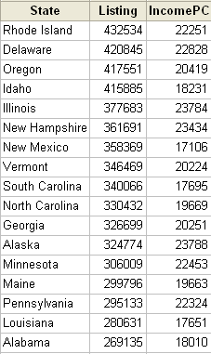
House Prices & Per Capita Income

Slide 76
Scatter Plot Suggests Positive Correlation

Slide 77
Linear Regression Measures Correlation
Regression Line: Listing = a + b IncomePC

Slide 78
Correlation Is Not Causation
Price and income seem to be positively correlated.
Does a rise in income cause a rise in gas prices ??????????????
US gasoline prices, 1953-2004, plotted against per-capita US income

Slide 79
A Hidden Relationship
Not positively “related” to each other; both positively related to “time.”

Slide 80
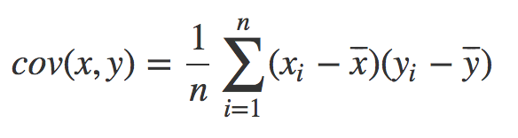
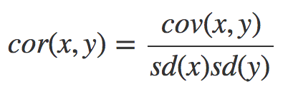
“Related” ...?
Want to capture: some variable X varies in the same direction and at the same scale as some other variable Y
What happens if:
X varies in the opposite direction as Y ????????
X varies in the same direction as Y ????????
What are the units of the covariance ????????
Pearson’s correlation coefficient is unitless in [-1,+1]:

Slide 81
Correlation
r_{Income,Listing} = +0.591

Slide 82
Correlations
r = 0.0
r = +1.0
r = +0.5

Slide 83
Correlation is not causation!!!
 | 2000 | 2001 | 2002 | 2003 | 2004 | 2005 | 2006 | 2007 | 2008 | 2009
Divorce rate in Maine Divorces per 1000 people (US Census) | 5 | 4.7 | 4.6 | 4.4 | 4.3 | 4.1 | 4.2 | 4.2 | 4.2 | 4.1
Per capita consumption of margarine (US) Pounds (USDA) | 8.2 | 7 | 6.5 | 5.3 | 5.2 | 4 | 4.6 | 4.5 | 4.2 | 3.7
r=0.993
?????????
http://tylervigen.com/spurious-correlations

Slide 84
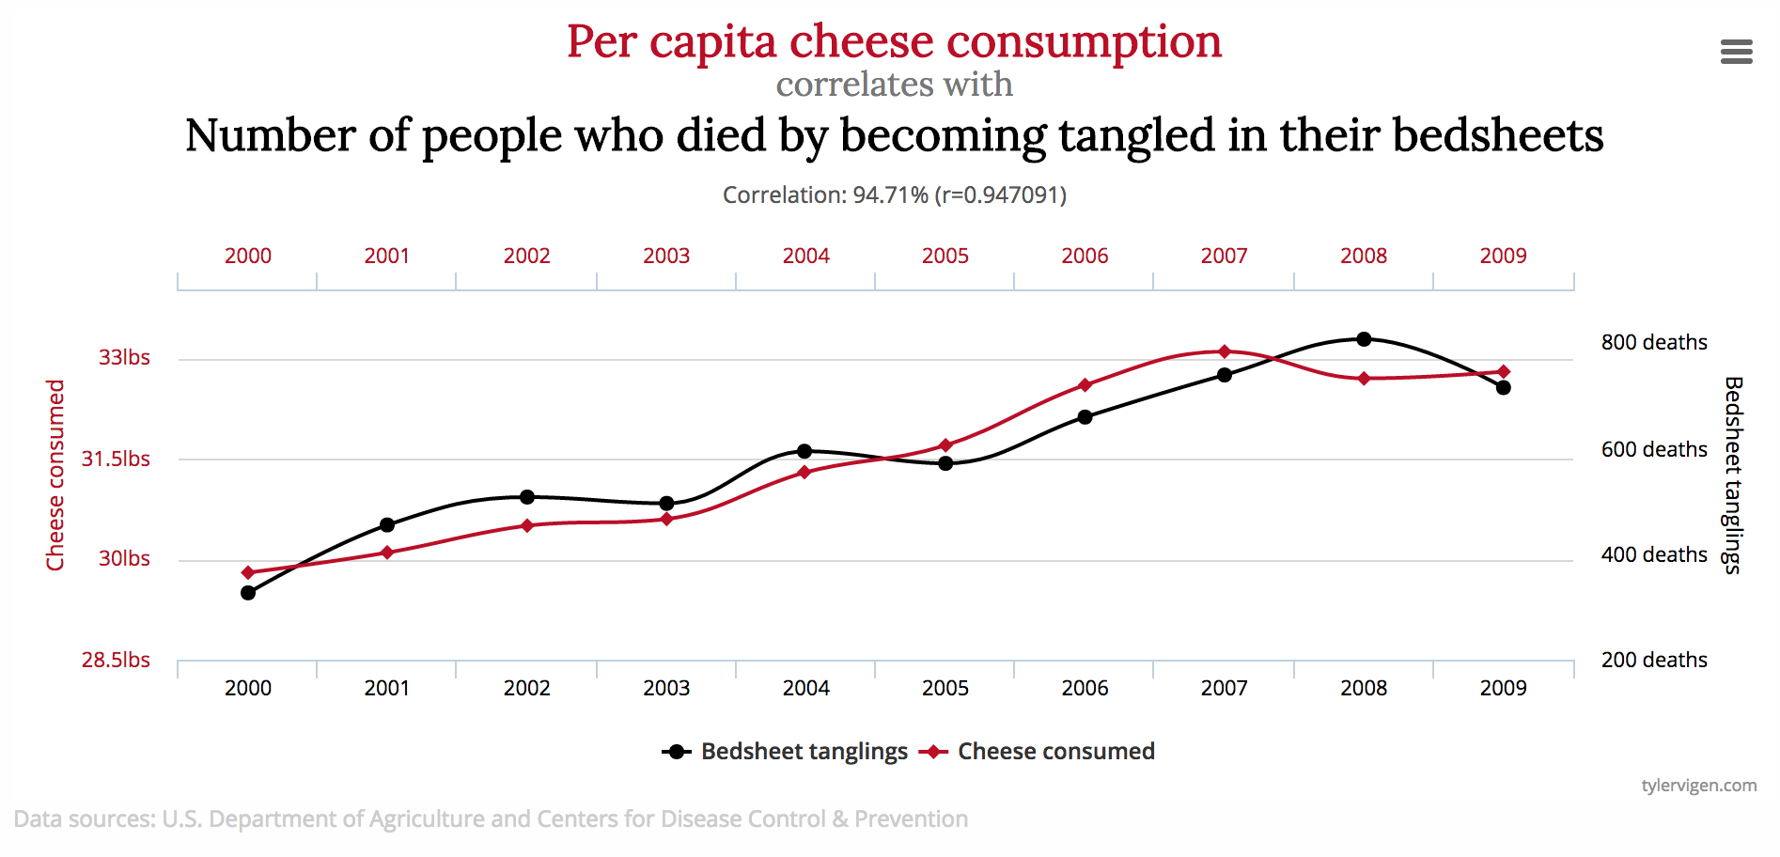
Just to drive the point home …

Slide 85
Transformations

Slide 86
Transformations
So, you’ve figured out that your data are:
Skewed
Have vastly different ranges across datasets and/or different units
What do you do?
Transform the variables to:
ease the validity and interpretation of data analyses
change or ease the type of Stat/ML models you can use

Slide 87
Standardization
Transforming the variable to a comparable metric
  known unit
  known mean
  known standard deviation
  known range
Three ways of standardizing:
  P-standardization (percentile scores)
  Z-standardization (z-scores)
  D-standardization (dichotomize a variable)
Slides adapted from Maarten Buis

Slide 88
When you should always standardize
When averaging multiple variables, e.g. when creating a socioeconomic status variable out of income and education.
When comparing the effects of variables with unequal units, e.g. does age or education have a larger effect on income?
Slides adapted from Maarten Buis

Slide 89
P-Standardization
Every observation is assigned a number between 0 and 100, indicating the percentage of observation beneath it.
Can be read from the cumulative distribution
In case of knots: assign midpoints
The median, quartiles, quintiles, and deciles are special cases of P-scores.
Slides adapted from Maarten Buis

Slide 90
Slides adapted from Maarten Buis

Slide 91
P-standardization
Turns the variable into a ranking, i.e. it turns the variable into a ordinal variable.
It is a non-linear transformation: relative distances change
Results in a fixed mean, range, and standard deviation; M=50, SD=28.6, This can change slightly due to knots
A histogram of a P-standardized variable approximates a uniform distribution
Slides adapted from Maarten Buis

Slide 92
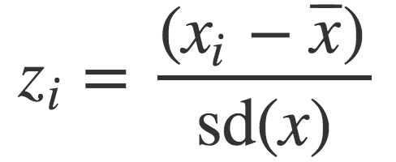
Centering And Scaling
Transform your data into a unitless scale
Put data into “standard deviations from the mean” units
This is called standardizing a variable, into standard units
Given data points x = x₁, x₂, ..., x_{n}:
Translates x into a scaled and centered variable z
What is the mean of z ??????????
What is the standard deviation of z ??????????
Notes:
Mean of z = 0
Stdev of z = 1

Slide 93
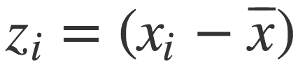
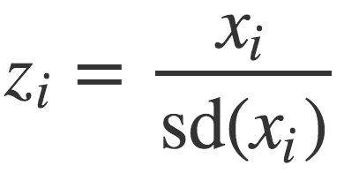
Centering or Scaling
Maybe you just want to center the data:
What is the mean of z ??????????
What is the standard deviation of z ??????????
Maybe you just want to scale the data:
What is the mean of z ??????????
What is the standard deviation of z ??????????

Slide 94
Discrete to continuous variables
Some models only work on continuous numeric data
Convert a binary variable to a number ???????????
health_insurance = {“yes”, “no”} → {1, 0}
Why not {-1, +1} or {-10, +14}?
0/1 encoding lets us say things like “if a person has healthcare then their income increases by $X.”
Might need {-1,+1} for certain ML algorithms (e.g., SVM)

Slide 95
Discrete to continuous variables
What about non-binary variables?
My main transportation is a {BMW, Bicycle, Hovercraft}
One option: { BMW → 1, Bicycle → 2, Hovercraft → 3 }
Problems ??????????
One-hot encoding: convert a categorical variable with N values into a N-bit vector:
BMW → [1, 0, 0]; Bicycle → [0, 1, 0]; Hovercraft → [0, 0, 1]
# Converts dtype=category to one-hot-encoded cols
cols = [‘my_transportation’]
df = df.get_dummies( columns = cols )

Slide 96
Continuous to discrete variables
Do doctors prescribe a certain medication to older kids more often? Is there a difference in wage based on age?
Pick a discrete set of bins, then put values into the bins
Equal-length bins:
Bins have an equal-length range and skewed membership
Good/Bad ????????
Equal-sized bins:
Bins have variable-length ranges but equal membership
Good/Bad ????????

Slide 97
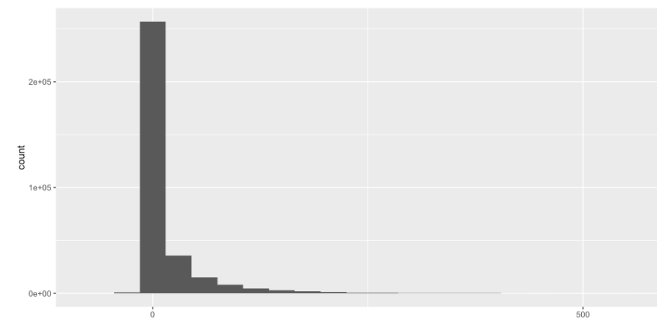
Skewed Data
Skewed data often arises in multiplicative processes:
Some points float around 1, but one unlucky draw → 0
Logarithmic transforms reduce skew:
If values are all positive, apply log₂ transform
If some values are negative:
  Shift all values so they are positive, apply log₂
  Signed log: sign(x) * log₂( |x| + 1)

Slide 98
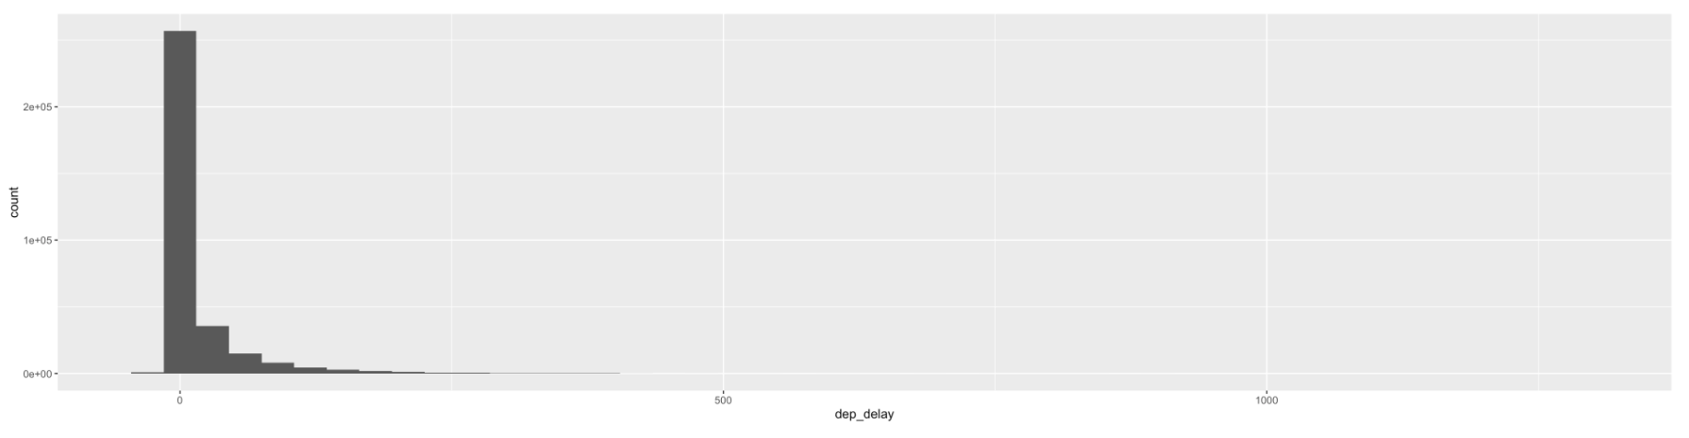
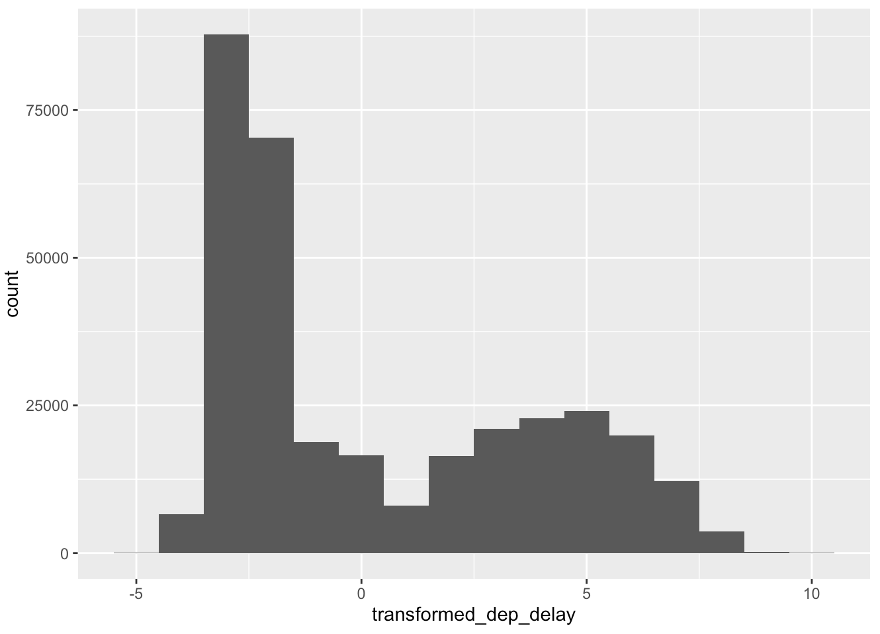
Skewed Data
log₂ transform on airline takeoff delays

Slide 99
Next Class:
Visualization, Graphs, & Networks

